Slide 1

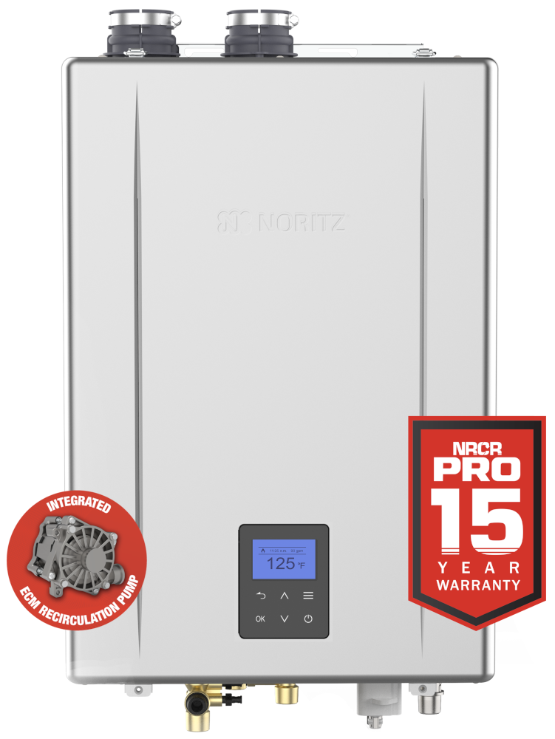
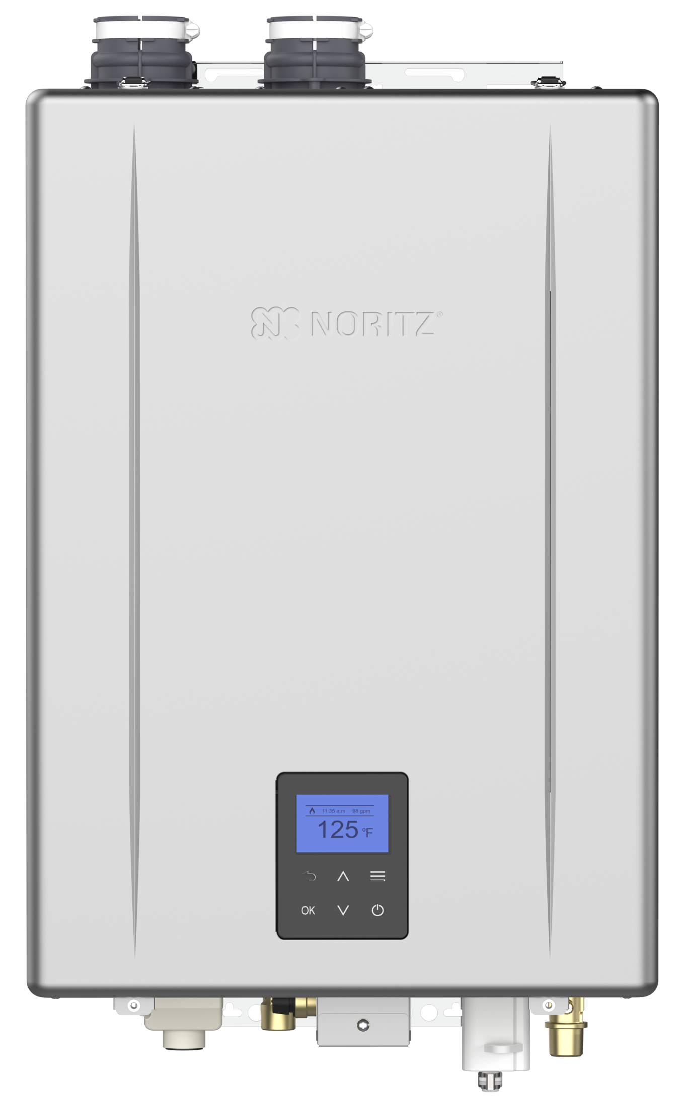
Models, Overview, Features and Changes

Slide 2

OUTLINE
Pro Series Lineup
  EZ Series Pro
  NRCR Pro
  NCC199CDV Pro
What’s New
  EZ Start Plus Bluetooth App
  Field Gas Conversion
  Built-in Operation Panel
  Front Cover Latches
Installation
  Venting
  Gas
  Condensate
  Unit Settings
  Basic Maintenance
Commercial Racks

Slide 3
PRO SERIES LINEUP

Slide 4
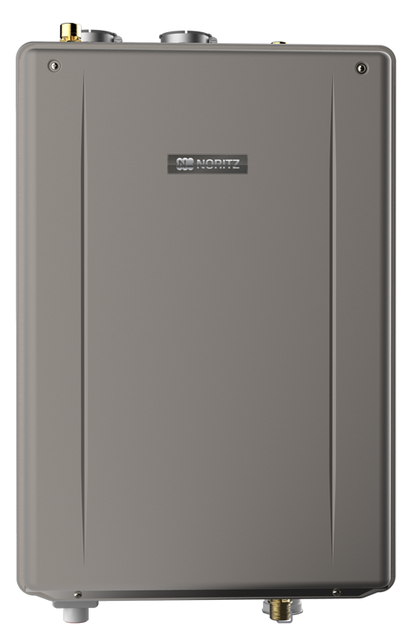
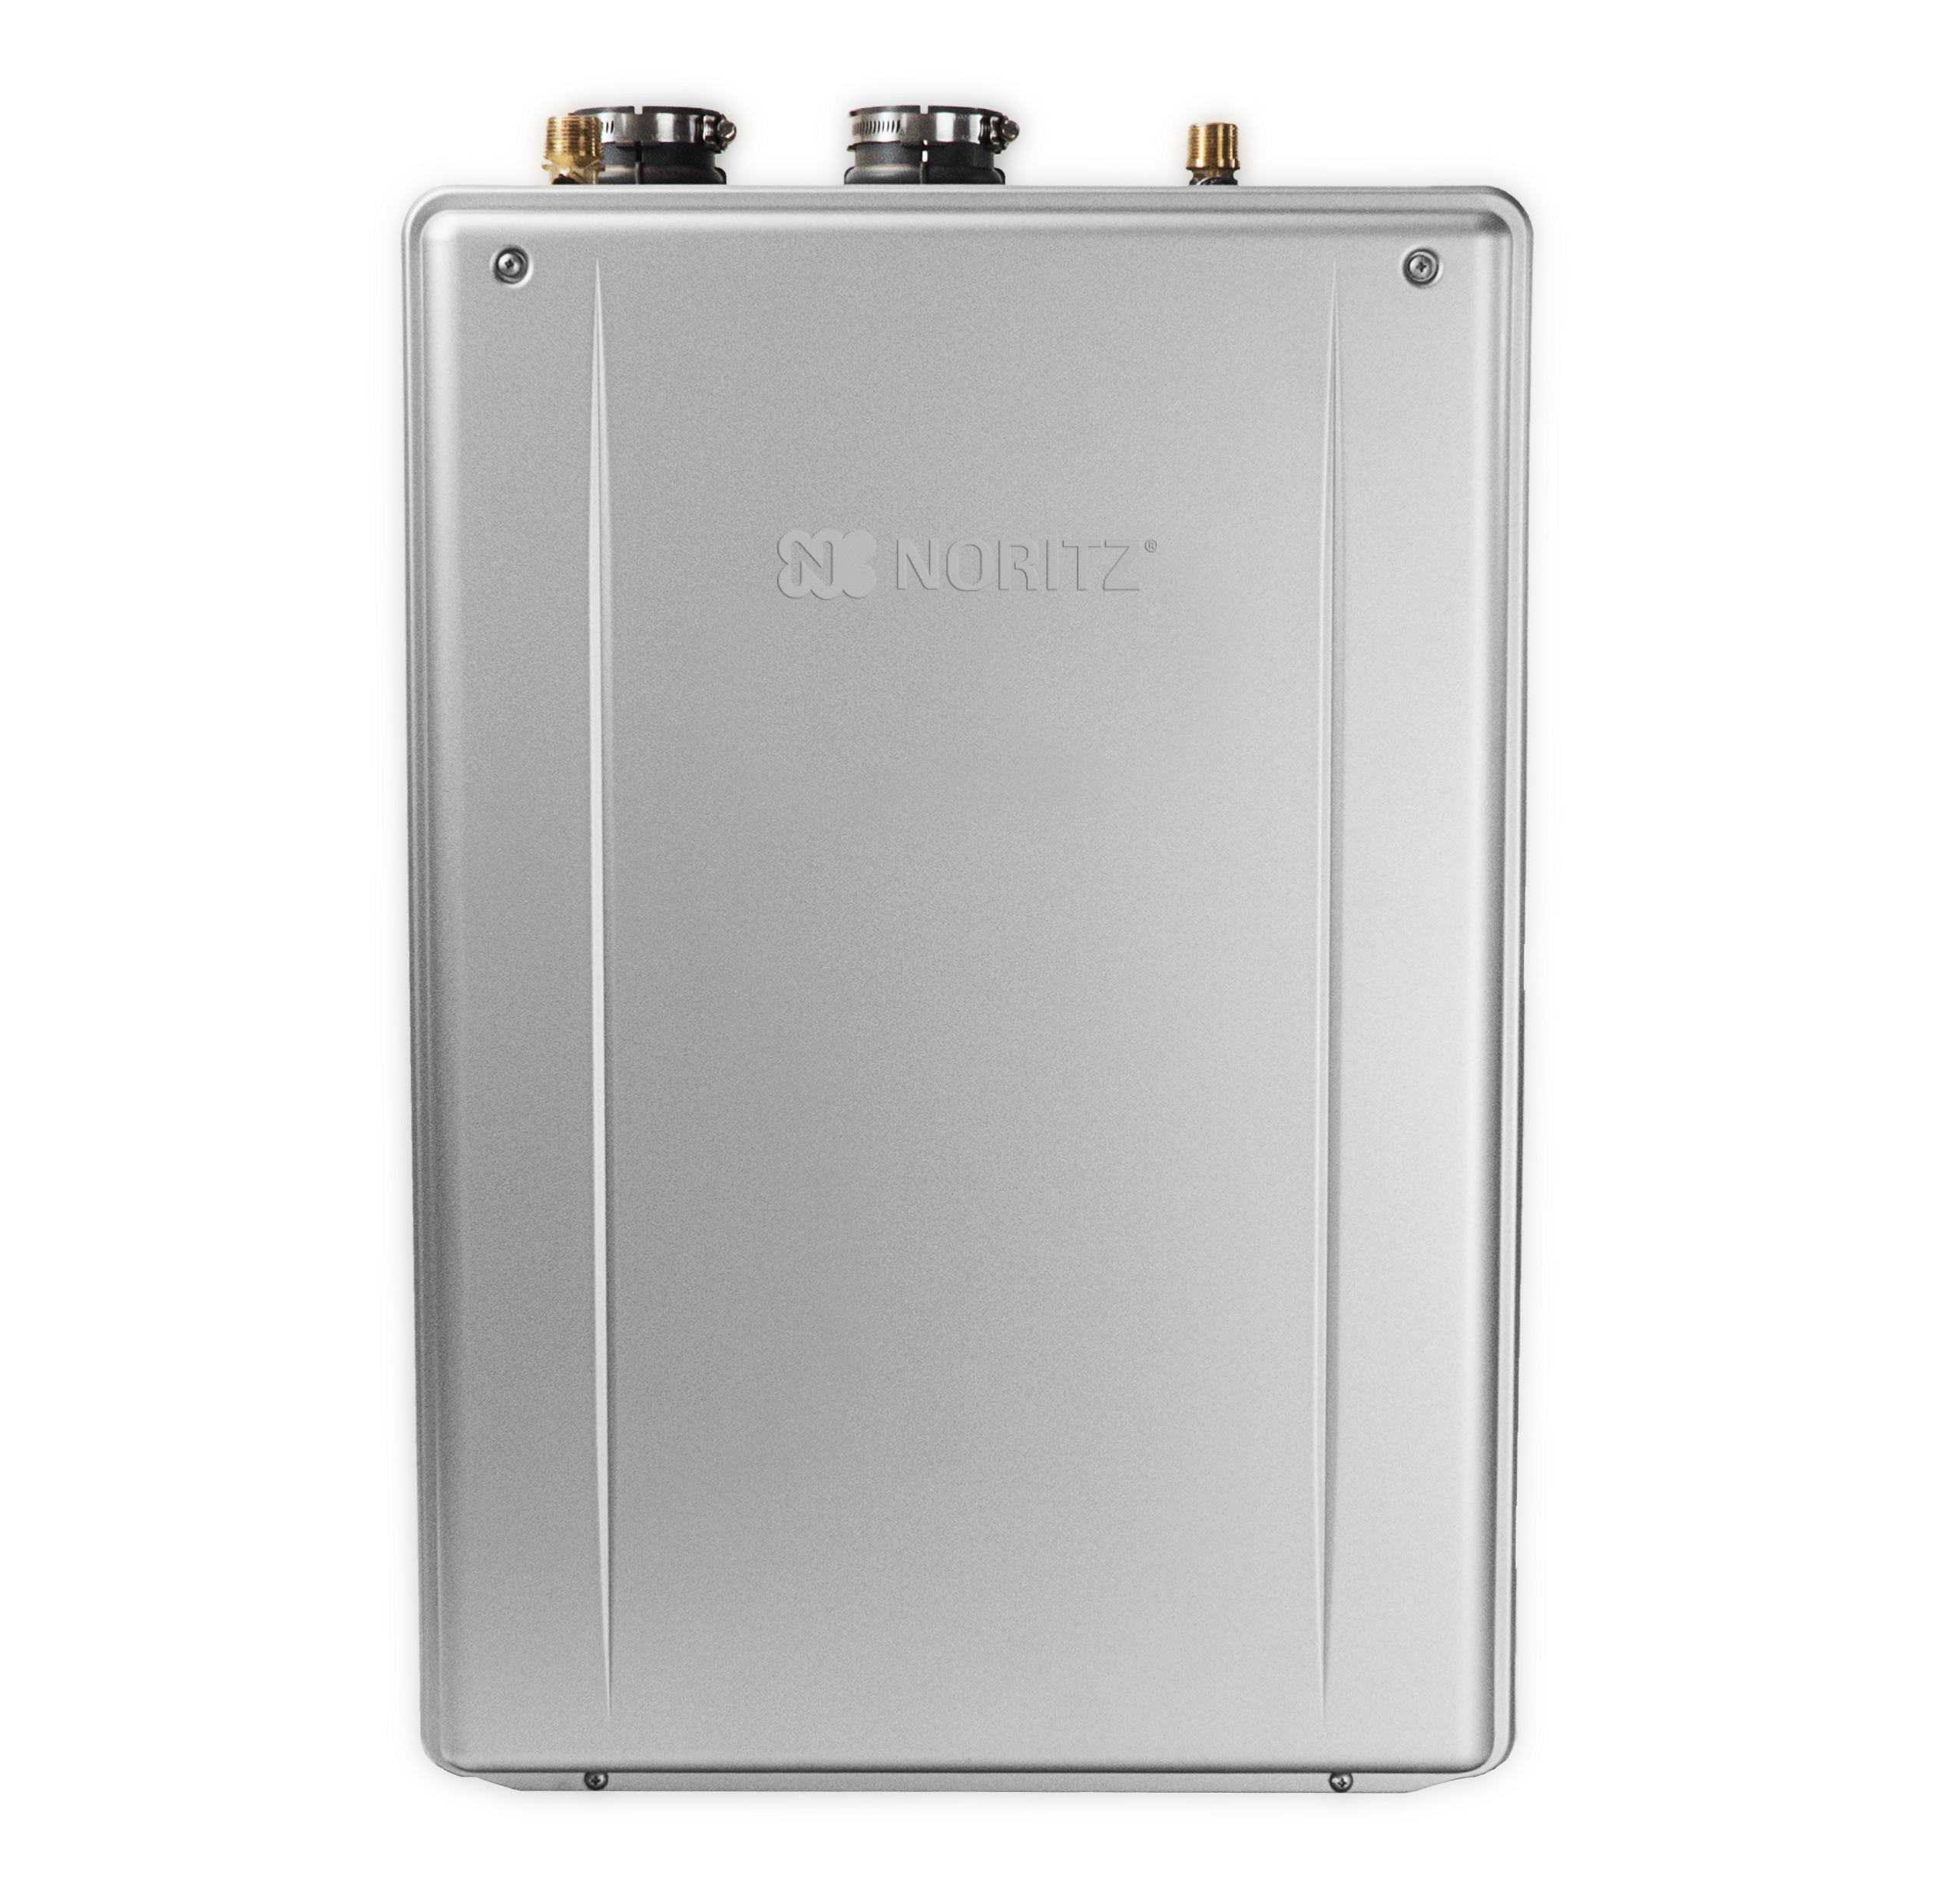
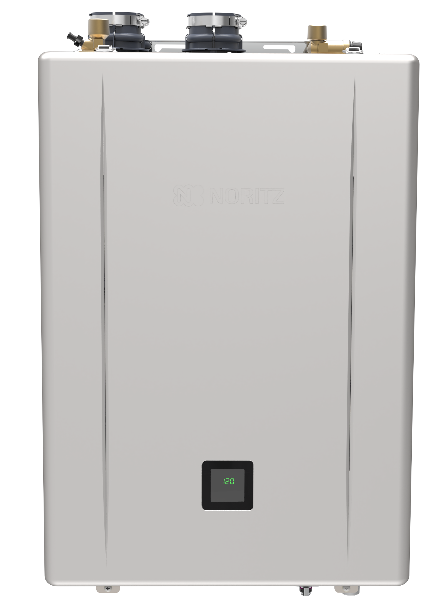
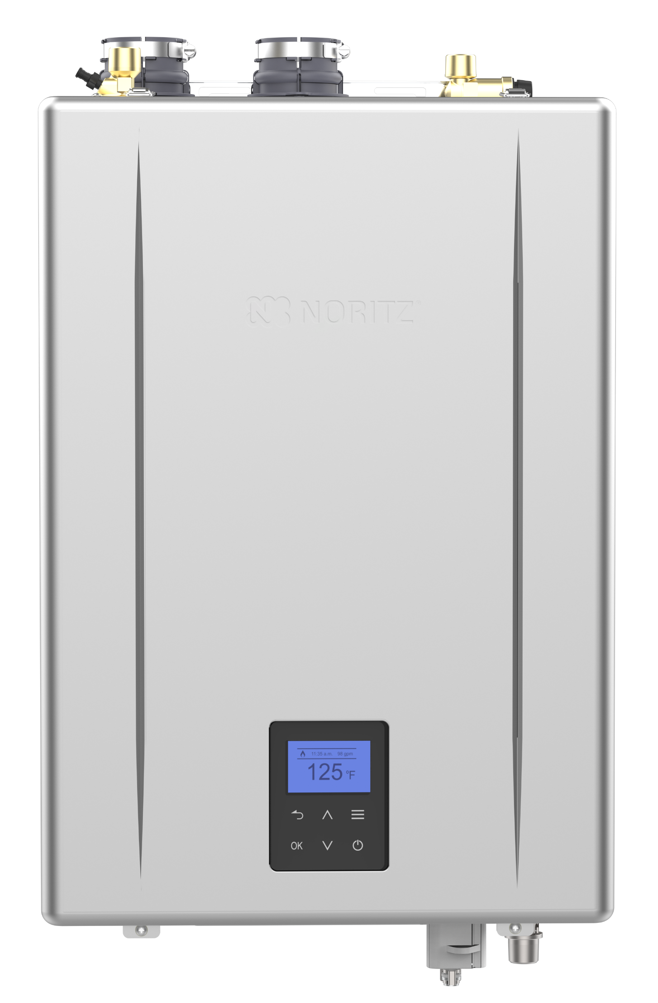
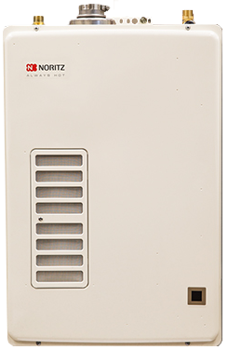
10+ YEARS OF EZTR INNOVATION
It all started in 2014 with the EZTR40 package, offering installers a time saving and EZ way to replace a tank with a tankless utilizing top mounted water connections. In 2017 the Pre-Mix EZ and EZTR models were introduced offering higher efficiency and capacities. In 2020 the EZ/EZTR Pre-Mix lineup was expanded to include the NRCR along with new features like Steady BTU. Now, the latest Pro Series models offer even higher efficiency and more features including a new EZ71 model!
2014
2017
2020
2024
2026
Pro Series units were updated in 2026 with the operation panel, making unit settings even easier!

Slide 5
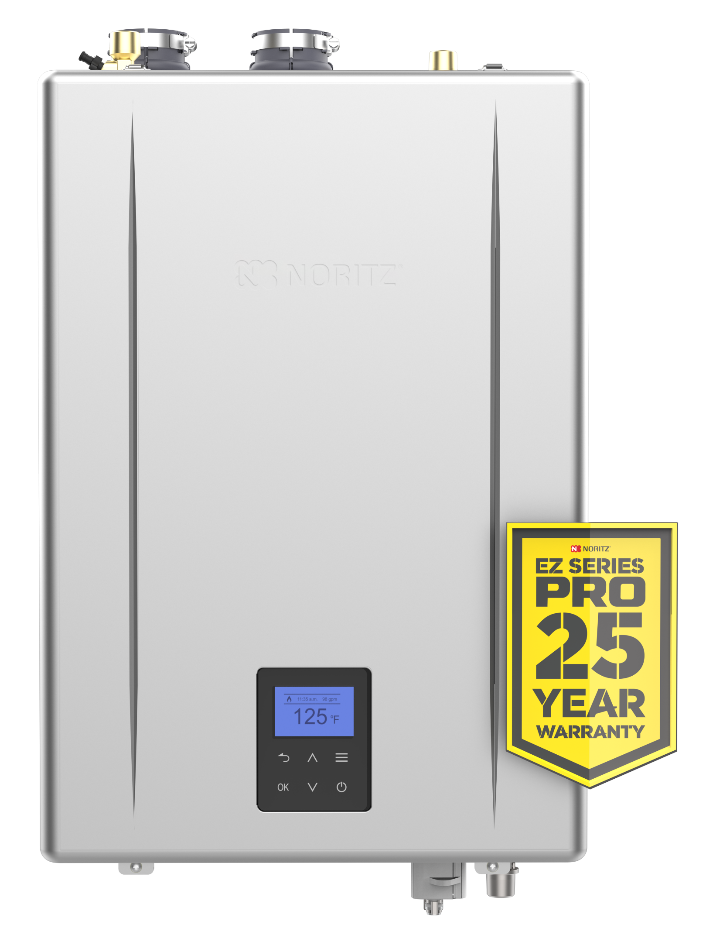
EZ SERIES PRO
The EZ Series Pro is the most versatile unit in our lineup. Designed to make any installation EZ, whether replacing a tank using the flex vent kit or installing the unit outdoors with the simple vent cap.
3 sizes available to meet the needs of any project. Need more flow? Install 2 identical models and double the flow. Last but not least, a 25 year warranty on the heat exchanger, the best in the industry!

Slide 6
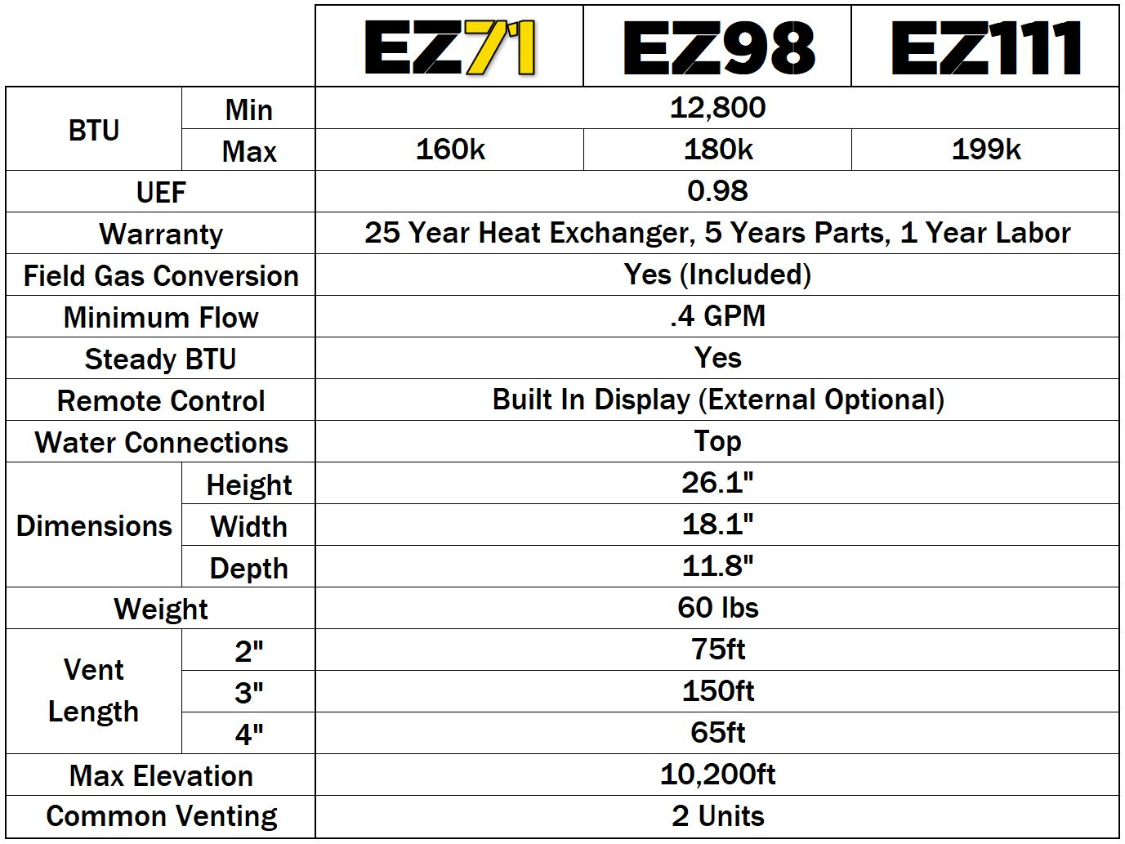
EZ SERIES PRO SPECIFICATIONS
NEW

Slide 7
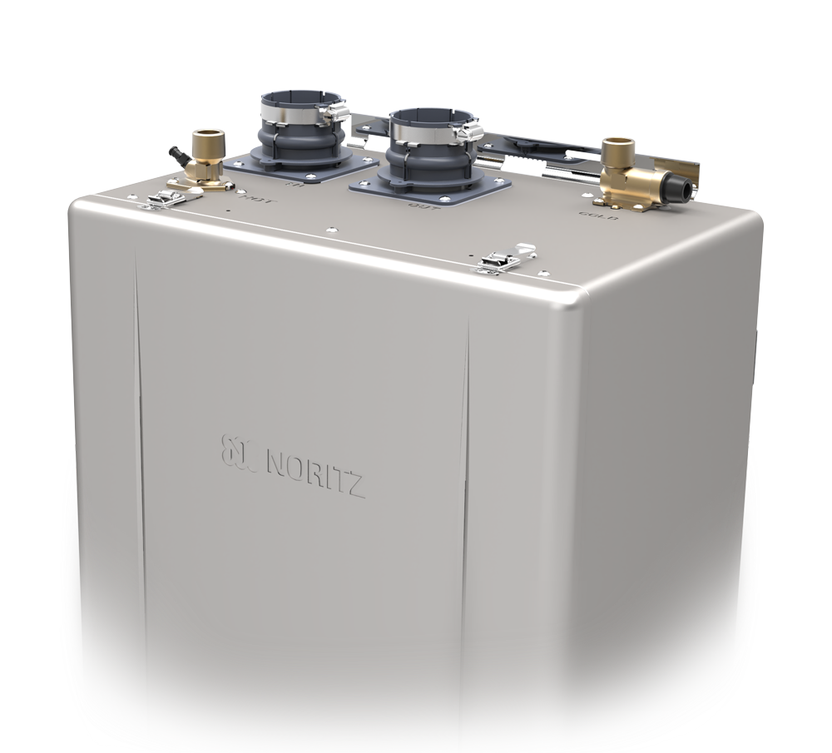
NEW EZ71 MODEL
With the addition of the EZ71, there is now an EZ unit for those smaller applications where a larger unit doesn’t make much sense.
The EZ71 will be available as an individual unit and not part of an EZTR package, however you may still use the flex vent conversion and flex vent kit like any other EZ unit.

Slide 8


EZTR BUNDLES
EZTR75 Bundle:
EZ111DV Pro Unit
199k btu Max
11.1 gpm Max
Make your own EZTR bundle:
Choose Unit:
EZ71, EZ98 or EZ111
Add Flex Conversion Kit:
EZ2-CK-1 Flex Conversion
Choose 25 or 35 Foot Vent:
EZ2-FVK-1 25 Foot Vent
OR
EZ2FVK-2-1 35 Foot Vent
Add Isolation Valve Kit
EZTR50 Bundle:
EZ98DV Pro Unit
180k btu Max
9.8 gpm Max

Slide 9
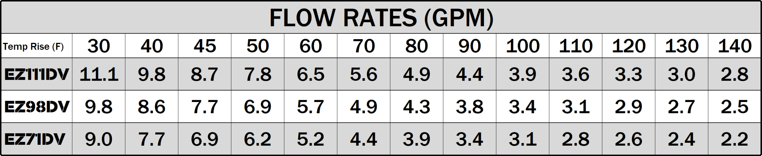
EZ PERFORMANCE
Need more flow? Quick Connect two identical EZ Pro units and double the flow!

Slide 10


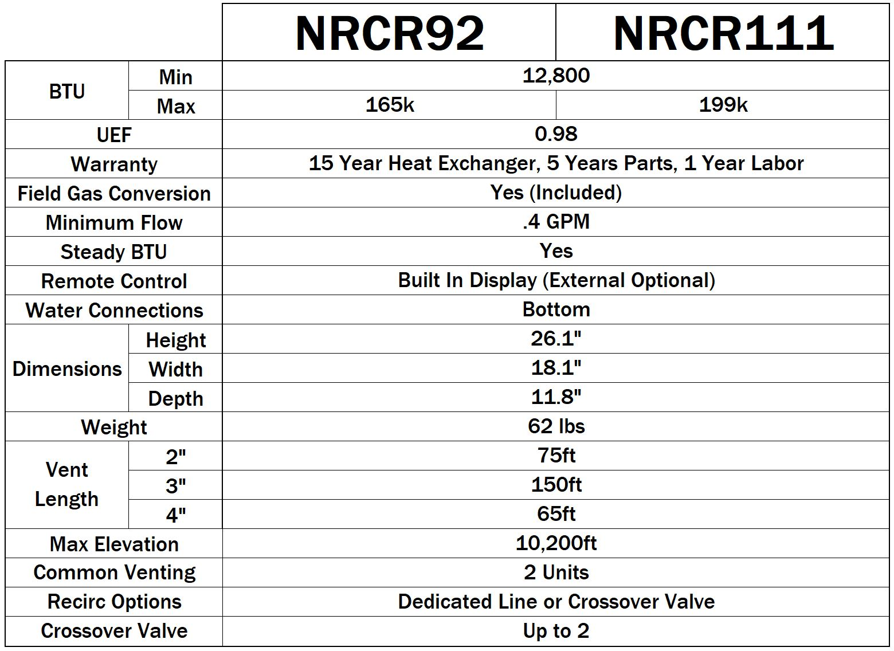
SPECIFICATIONS

Slide 11
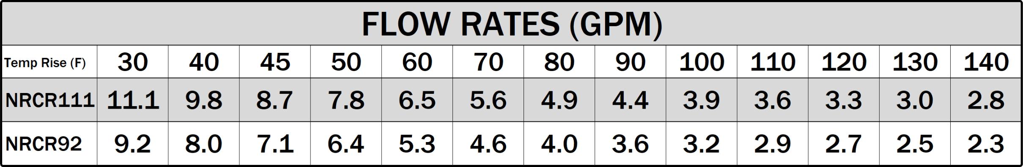
PERFORMANCE
Need more flow? Quick Connect two identical NRCR units and double the flow!

Slide 12
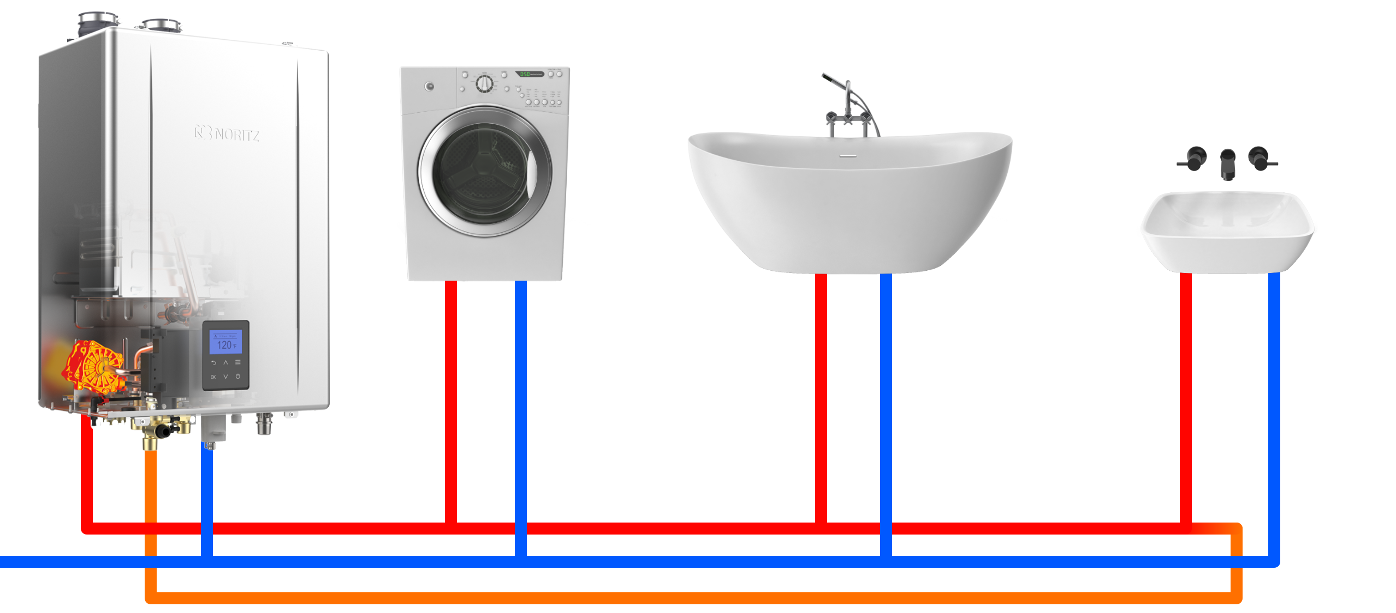
DEDICATED
Return Line should have a shut off valve, hose bibb and expansion tank

Slide 13
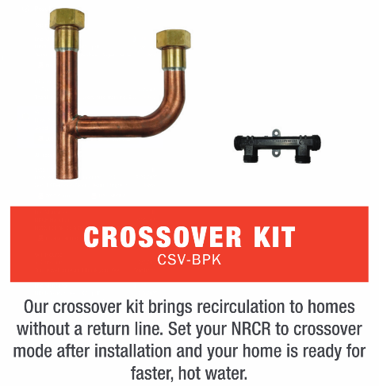
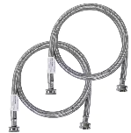
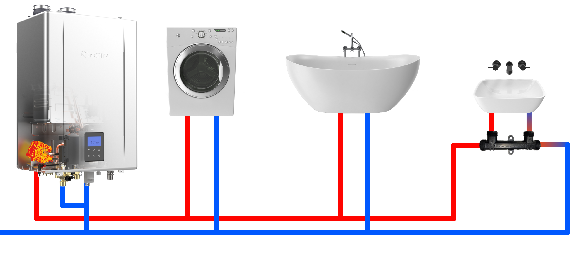
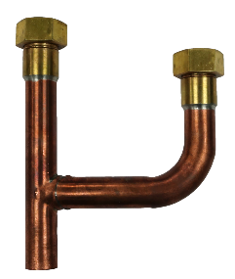
CROSSOVER
When using a crossover valve, the minimum set temperature is 120 F

Slide 14
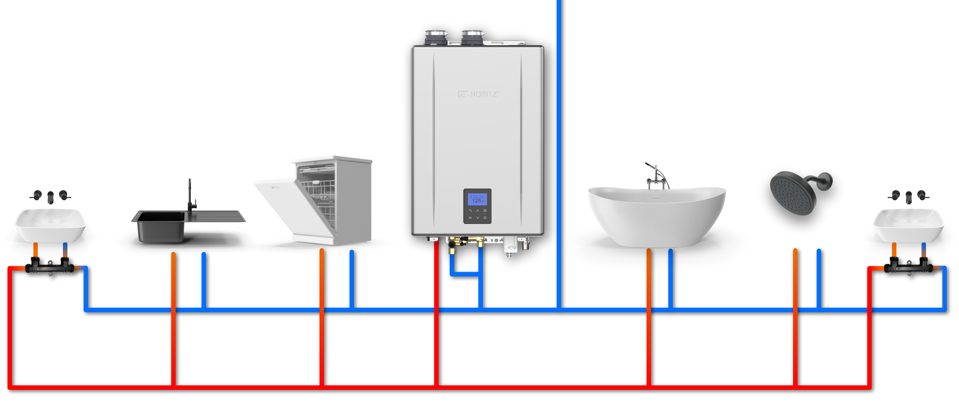
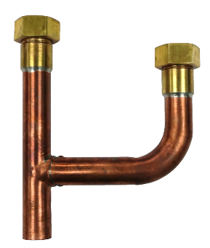
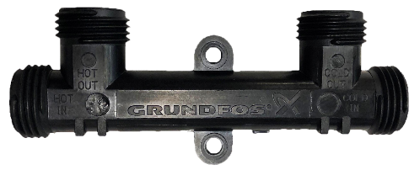
2 CROSSOVER
Crossover Valve: cCS-V
Crossover Kit: CSV-BPK
Return Water
Cold Water
Cold Water
Return Water
Hot Water
Hot Water

Slide 15
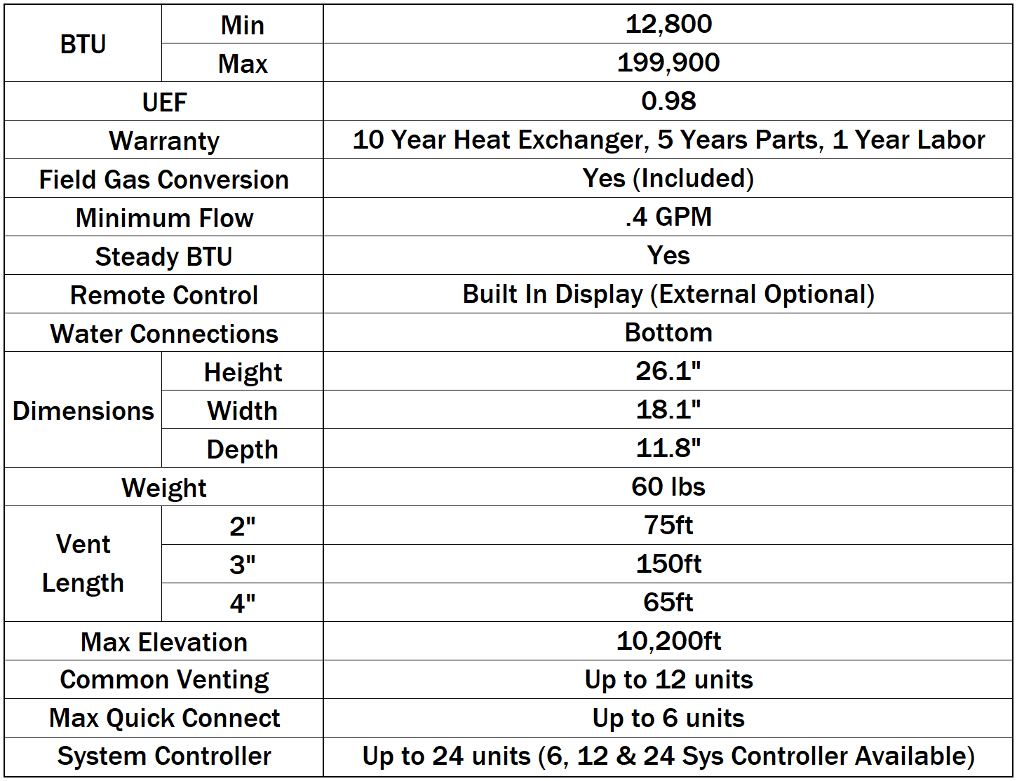
NCC199CDV PRO SPECIFICATIONS
NCC199CDV PRO SPECIFICATIONS
Up to 8 units

Slide 16
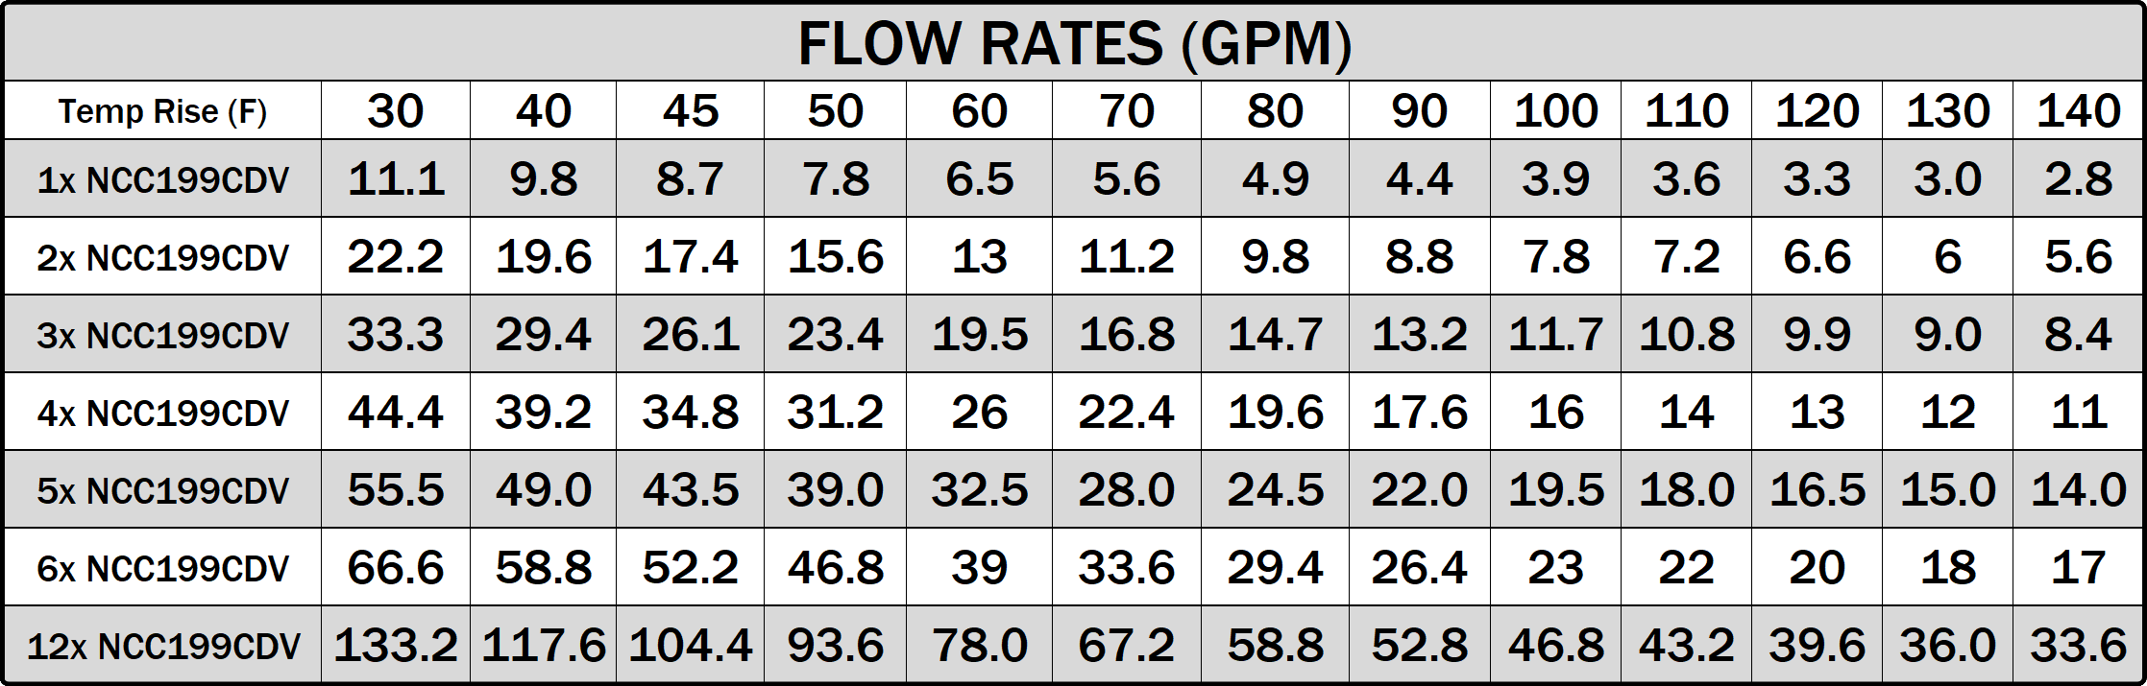
NCC199CDV PRO PERFORMANCE

Slide 17
NCC199CDV PRO QUICK CONNECT
Leader
Follower
Follower
Follower
Follower
Follower
Optional
RC-9018M
Qcc-1
Qcc-2
Qcc-1
Qcc-2
Qcc-1
Qcc-2
Qcc-1
Qcc-2
Qcc-1
Qcc-2
Qcc-1
UNUSED
Qcc-2
UNUSED
Units must be connected in series using QC cords (QC-2)
QC cords are not included in box (purchased separately)
For all sub units, the QC cord runs from Qcc-1 (white) to Qcc-2 (red) on the subsequent units
※Qcc-1 OPEN
“Last Follower”
Image of QC connectors

Slide 18
QUICK CONNECT PRO ERROR HANDLING
System 1
System 2
Leader
Follower
Follower
Follower
Leader
Follower
Optional
RC-9018M
Power Outage
or EC F76
Qcc-1
Qcc-2
Qcc-1
Qcc-2
Qcc-1
Qcc-2
Qcc-1
Qcc-2
Qcc-1
Qcc-2
Qcc-1
UNUSED
Qcc-2
UNUSED
Disconnection
QC PRO: Unit with a Power Outage, the system will divide into 2 systems and continue to operate (separate systems) until power is restored.
If an error code appears, the system will skip the coded unit but still operate as one system, except in F76 situations (multi-system communication error).

Slide 19
NCC199CDV PRO QC W/ OLDER GEN
When replacing one previous gen CDV with a CDV Pro at a site where 2 previous gen CDVs are quick-connected
Setting change of CDV Pro:
When connecting the CDV Pro to a previous gen or former model, the CDV Pro's quick connection setting must be set to “quick connect” instead of “quick connect pro”
Change the unit to which remote control is connected:
When previous gen and CDV Pro are installed in same system, CDV Pro must be the main unit with remote
Connect remote control to the new CDV Pro
CDV
CDV
CDV
PRO
(Replaced)
(New Unit)
(QC-2 Cord)
(QC-2 Cord)
Qcc-2 Empty

Slide 20
REPLACING EXISTING QC SYSTEM
When both units are replaced and now all products are CDV Pro
Setting change of the CDV Pro
CDV Pro's quick connection setting must be set to “quick connect pro” instead of “quick connect”
Once both units are CDV Pro, remote is optional and can be removed if desired
CDV
PRO
PRO
PRO
(Replaced)
(New Unit)
Qcc-1 Empty
Qcc-2 Empty
(QC-2 Cord)
Qcc-2 Empty
(QC-2 Cord)

Slide 21
WHAT’S NEW?

Slide 22
WHAT’S NEW
.98 UEF for all models
  Highest UEF for complete BTU range in the industry
EZ Start Plus Bluetooth App
  Physical dipswitches are gone! Unit setup is done entirely through Bluetooth app.
Field Gas Conversion
  Default setup for NG, conversion included to change to LP without the need to order a gas conversion kit.
Built in Operation Panel
  Remote control is optional. Maintenance Monitors, Unit Settings and more can be accessed through the Operation Panel.

Slide 23
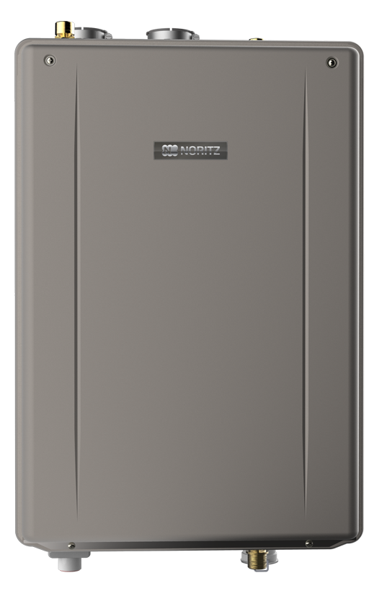
NEW LEVEL OF EFFICIENCY
The new Pro Series lineup all achieve a .98 UEF making them among the most efficient tankless models on the market. In 2026 the Operation Panel was added. Same great efficiency, now even easier to install!
.87 UEF
.96 UEF
.96 UEF
.98 UEF
.98 UEF
2014
2020
2024
2026
2017

Slide 24
EZ START PLUS APP
Initial unit setup, temperature adjustment and maintenance can all be handled through the new EZ Start Plus Bluetooth App!
The App will walk you through setting up the unit upon completing installation and provides an easy way to register the unit for your customers.
Error Code History can be accessed and will link you directly to help articles related to any error codes stored.

Slide 25
FIELD GAS CONVERSION
All Pro Series models are ready to be used with NG. If the jobsite has LP, a simple field gas conversion can be performed without the need to purchase any additional parts. Conversion is EZ and can be done in about 5 minutes.
Conversion Kit taped to top of unit
Contents of LP Conversion Kit

Slide 26
FIELD GAS CONVERSION
Step 1
Step 2
Step 3
Step 4
Remove screw
Remove the c-clip
Carefully remove gas fitting
Remove 2 screws securing venturi fitting

Slide 27
FIELD GAS CONVERSION
Step 5
Step 6
Step 7
Step 8
GASKET
O-RING
Remove NG orifice
Insert LP orifice
(make sure o-ring and gasket aren’t lost or damaged)
Secure venturi fitting
Insert gas fitting, secure c-clip and screw

Slide 28

FIELD GAS CONVERSION
Step 9
Step 10: Changing gas type to LP with EZ Start Plus App
Plug in LP conversion connector
*Operation Panel can also be used to convert gas type, see gas conversion directions included with unit
Open EZ Start Plus App and select Contractor
Make sure Bluetooth is ON
Select Unit then tap OK
Enter Passcode and tap “NEXT”

Slide 29
FIELD GAS CONVERSION
Step 10 (continued): Changing gas type to LP with EZ Start Plus App
Register Warranty or skip
Tap “Unit Setting”
Tap “Convert Gas Type”
Tap Change Setting, Tap LP then tap “DONE”
After a few seconds it should show complete

Slide 30
FIELD GAS CONVERSION
MAKE SURE TO FILL OUT AND ATTATCH GAS CONVERSION STICKER TO UNIT

Slide 31
BUILT IN OPERATION PANEL
Displays temperature setting, service reminders and error codes. Also allows you to view maintenance monitors, error code history and change installation settings. The new operation panel makes the remote control a truly optional item.

Slide 32
NEW LATCHED FRONT COVER
Easier access when performing preventative maintenance, service or operating the built in display window. Remove 2 screws at the bottom of the front cover and the latches hold the cover in place until you’re ready to remove it.

Slide 33
INSTALLATION

Slide 34
PRE-INSTALLATION CHECKS
Verify the following before installation and read the manual:
Check the gas:
EZ71 Max btu is 160k.
NRCR92 Max btu is 165k.
EZ98 Max btu is 180k.
EZ111/NRCR111/NCC199CDV Max btu is 199k.
Ensure the existing gas system can support that demand + other existing gas demands.
Check the power:
Pro Series and all Noritz units operate on 120 VAC at 60Hz.
Check the vent:
Pro Series uses plastic venting (PVC, CPVC and PP).
Existing venting will likely have to be replaced unless you are replacing a similar type unit.
Exhaust leaks into the home may lead to injury or death. Do not take shortcuts here.

Slide 35
PRO SERIES UNIT MOUNTING
Mount bracket, hang heater and shift side to side for precise alignment, secure heater.

Slide 36
PRO SERIES VENTING OPTIONS
As with previous models, you have the ability to install the unit indoors or outdoors with a variety of venting options.
Indoor DV
Indoor SV
Indoor NRK
Indoor FSV
Outdoor
Max Vent Lengths DV or SV:
2”: 75 Feet, 3”: 150 Feet, 4”: 65 Feet

Slide 37
NO ROOF KIT
Have a straight run of b-vent? The No Roof Kit makes it even EZ’er to replace a tank!
Features:
Faster Installation without roof access
Up to 8.5’ venting available
Available for 3” and 4” round b-vent
Less material waste
The No Roof Kit comes with all accessories needed for installation*:
Polypropylene Kit
SV Conversion Kit
Diffuser Kit
Item #: NRK-1
*PVC Parts must be field supplied

Slide 38
EZ 2 INCH FLEX VENT
Use existing 3” or 4” round b-vent.
2 additional parts numbers required*:
⚫ EZ2-CK-1: Conversion kit to adapt unit to accept flex vent.
⚫ EZ2FVK-1 (25 ft.) or EZ2FVK-2-1 (35 ft.): Select either 25 ft. or 35 ft. depending on length of existing b-vent.
NOTE: Flexible vent can be shortened but you cannot join 2 pieces of flexible vent to extend the length.
*NOT Required if an EZTR package is purchased.

Slide 39
INSTALLATION CLEARANCES
Verify the following before installation and read the manual
Select a proper installation location:
Maintain minimum required clearances and if possible, recommended clearances.
Required
Recommended
Cooking Equipment

Slide 40
INSTALLATION CLEARANCES
Verify the following before installation and read the manual
Select a proper installation location:
Maintain minimum required clearances and if possible, recommended clearances.
Recommended clearances are not only there to provide enough space for inspection, maintenance and repair but also to make sure the homeowner has quick and unimpeded access to gas and water shut offs in the unlikely event of an emergency.
Required
Recommended
Cooking Equipment

Slide 41
½” GAS LINE CONDITIONS
½” Gas line is still an option with the new Pro Series assuming an 8” WC or higher initial starting pressure. As always, make sure to follow the gas sizing tables in the installation manual.

Slide 42
GAS LINE CONDITIONS
General gas guidelines.
Test inlet pressure after installation:
Low demand (1 or 2 fixtures)
Moderate demand (3 or 4 fixtures)
High demand (5+ fixtures)
Worst case scenario, 5+ fixtures + all other gas appliances.

Slide 43
GAS LINE CONDITIONS
An improperly sized gas line generally results in one or more of the following issues:
Ignition Failure (Error Code 11)
Flame Loss (Error Code 12)
Abnormal Combustion (Error Code 10 or 90)
Fluctuating water temperatures
Abnormal noises
Other items in the gas supply system that could cause problems:
Meter size
Water/debris in gas line
Earthquake safety shutoff valve (California specific)

Slide 44
PRO SERIES VENTING GUIDELINES
Wide variety of venting options for an EZ install.
Direct Vent Horizontal

Slide 45
PRO SERIES VENTING GUIDELINES
Wide variety of venting options for an EZ install.
Direct Vent Horizontal

Slide 46
PRO SERIES VENTING GUIDELINES
Wide variety of venting options for an EZ install.
Direct Vent Horizontal
(Option 1)

Slide 47
PRO SERIES VENTING GUIDELINES
Wide variety of venting options for an EZ install.
Direct Vent Horizontal
(Option 2)

Slide 48
PRO SERIES VENTING GUIDELINES
Wide variety of venting options for an EZ install.
Direct Vent Horizontal
(Option 3)

Slide 49
PRO SERIES VENTING GUIDELINES
Wide variety of venting options for an EZ install.
Direct Vent Horizontal
(Concentric)

Slide 50
PRO SERIES VENTING GUIDELINES
Wide variety of venting options for an EZ install.
Direct Vent Vertical

Slide 51
PRO SERIES VENTING GUIDELINES
Wide variety of venting options for an EZ install.
Direct Vent Vertical
(Concentric)

Slide 52
PRO SERIES VENTING GUIDELINES
Wide variety of venting options for an EZ install.
Single Vent
Horizontal
Vertical

Slide 53
PRO SERIES VENTING GUIDELINES
Wide variety of venting options for an EZ install.
Outdoor
Flexible Vent

Slide 54
PRO SERIES COMMON VENTING
*The Btu/h input of the unit will be reduced by up to 9%.

Slide 55
PRO SERIES COMMON VENTING
See the complete common vent manual on support.noritz.com

Slide 56
CONDENSATE DRAIN LINE
Guidelines for routing the condensate drain line.

Slide 57
PROGRAMMING THE UNIT
Pro Series units no longer have physical dipswitches on the circuit board. All programming of the unit is done with the new EZ Start Plus App or the built in operation panel.
Directions can be found in the manual

Slide 58
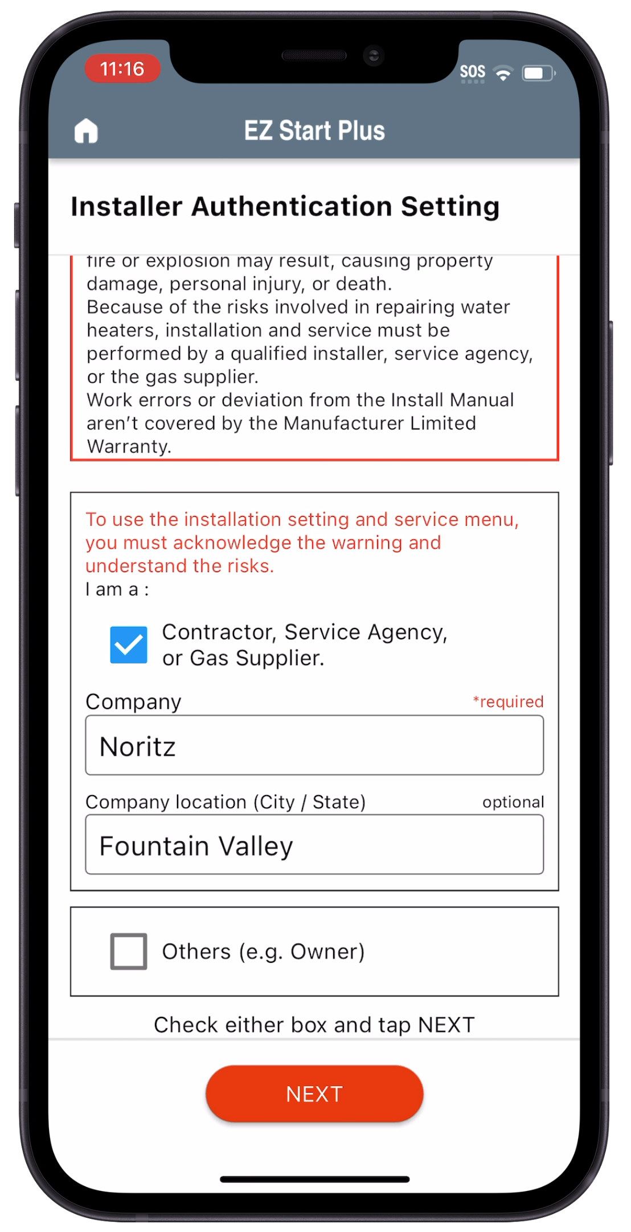
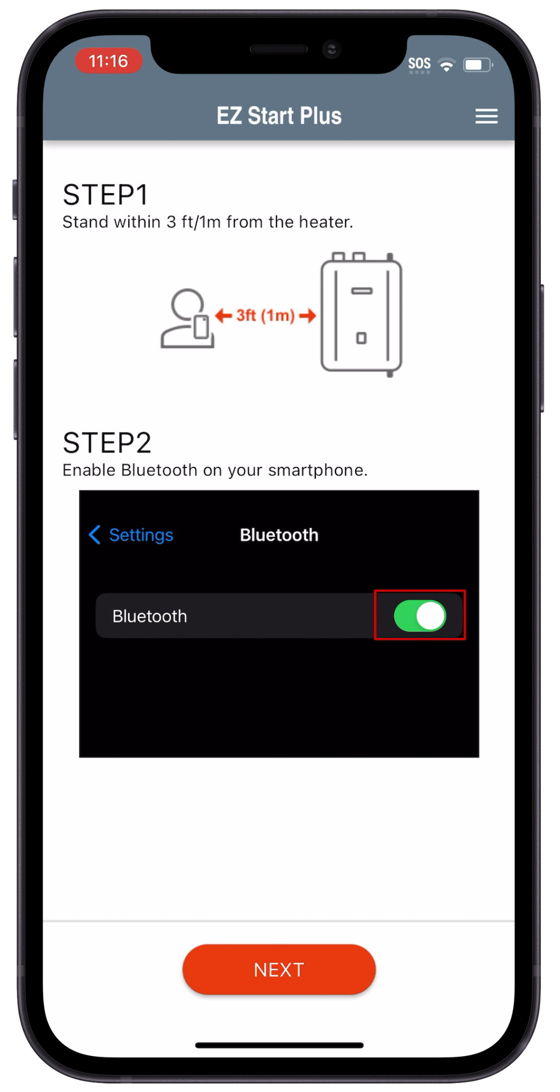
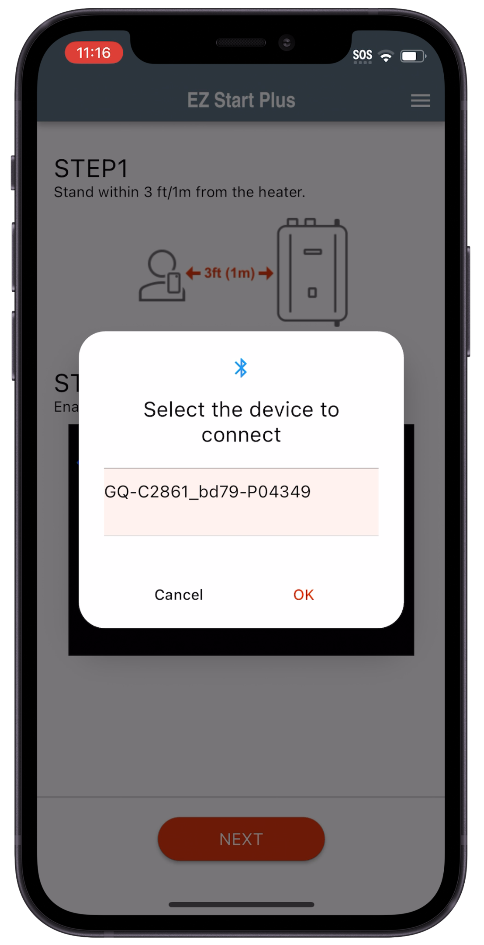
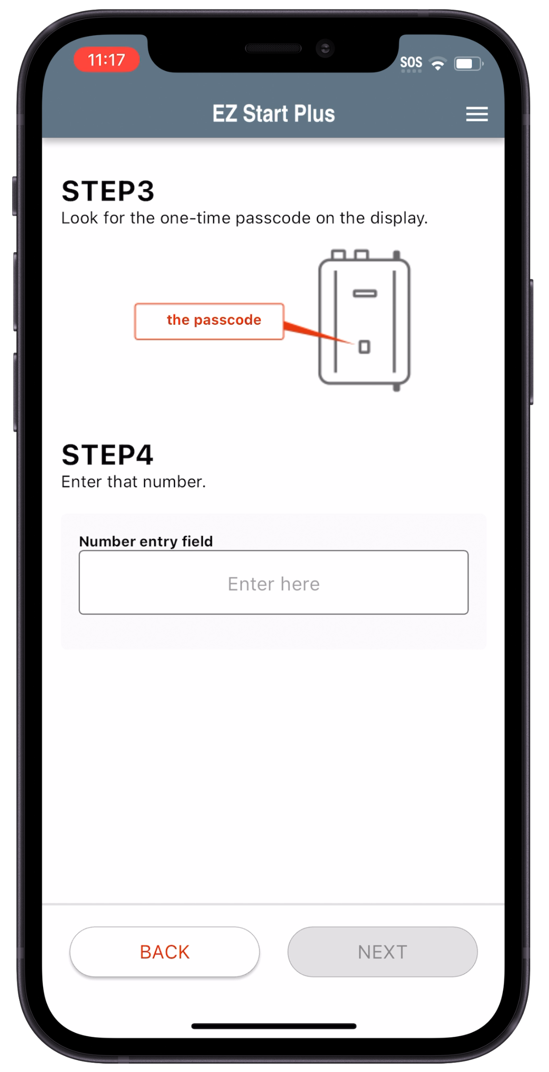
EZ START PLUS APP
Open EZ Start Plus App and select Contractor
Make sure Bluetooth is ON
Select Unit then tap OK
Enter Passcode and tap “NEXT”

Slide 59
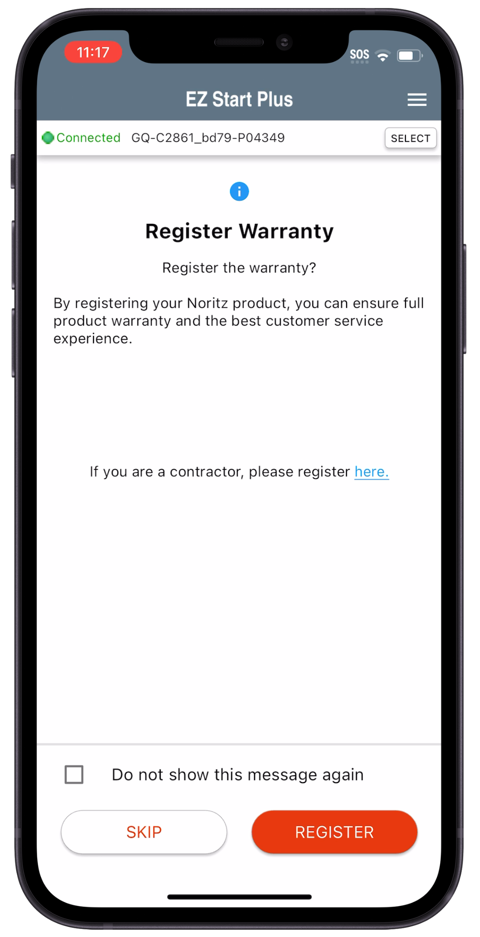
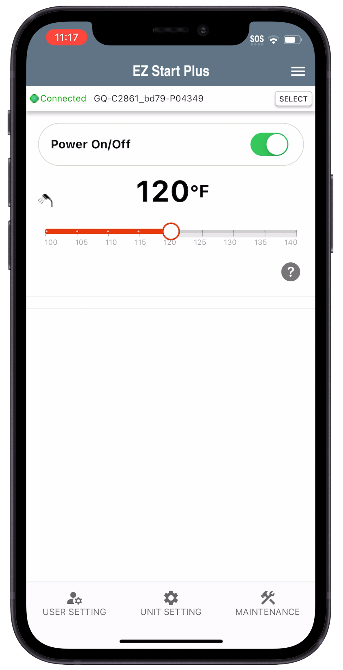
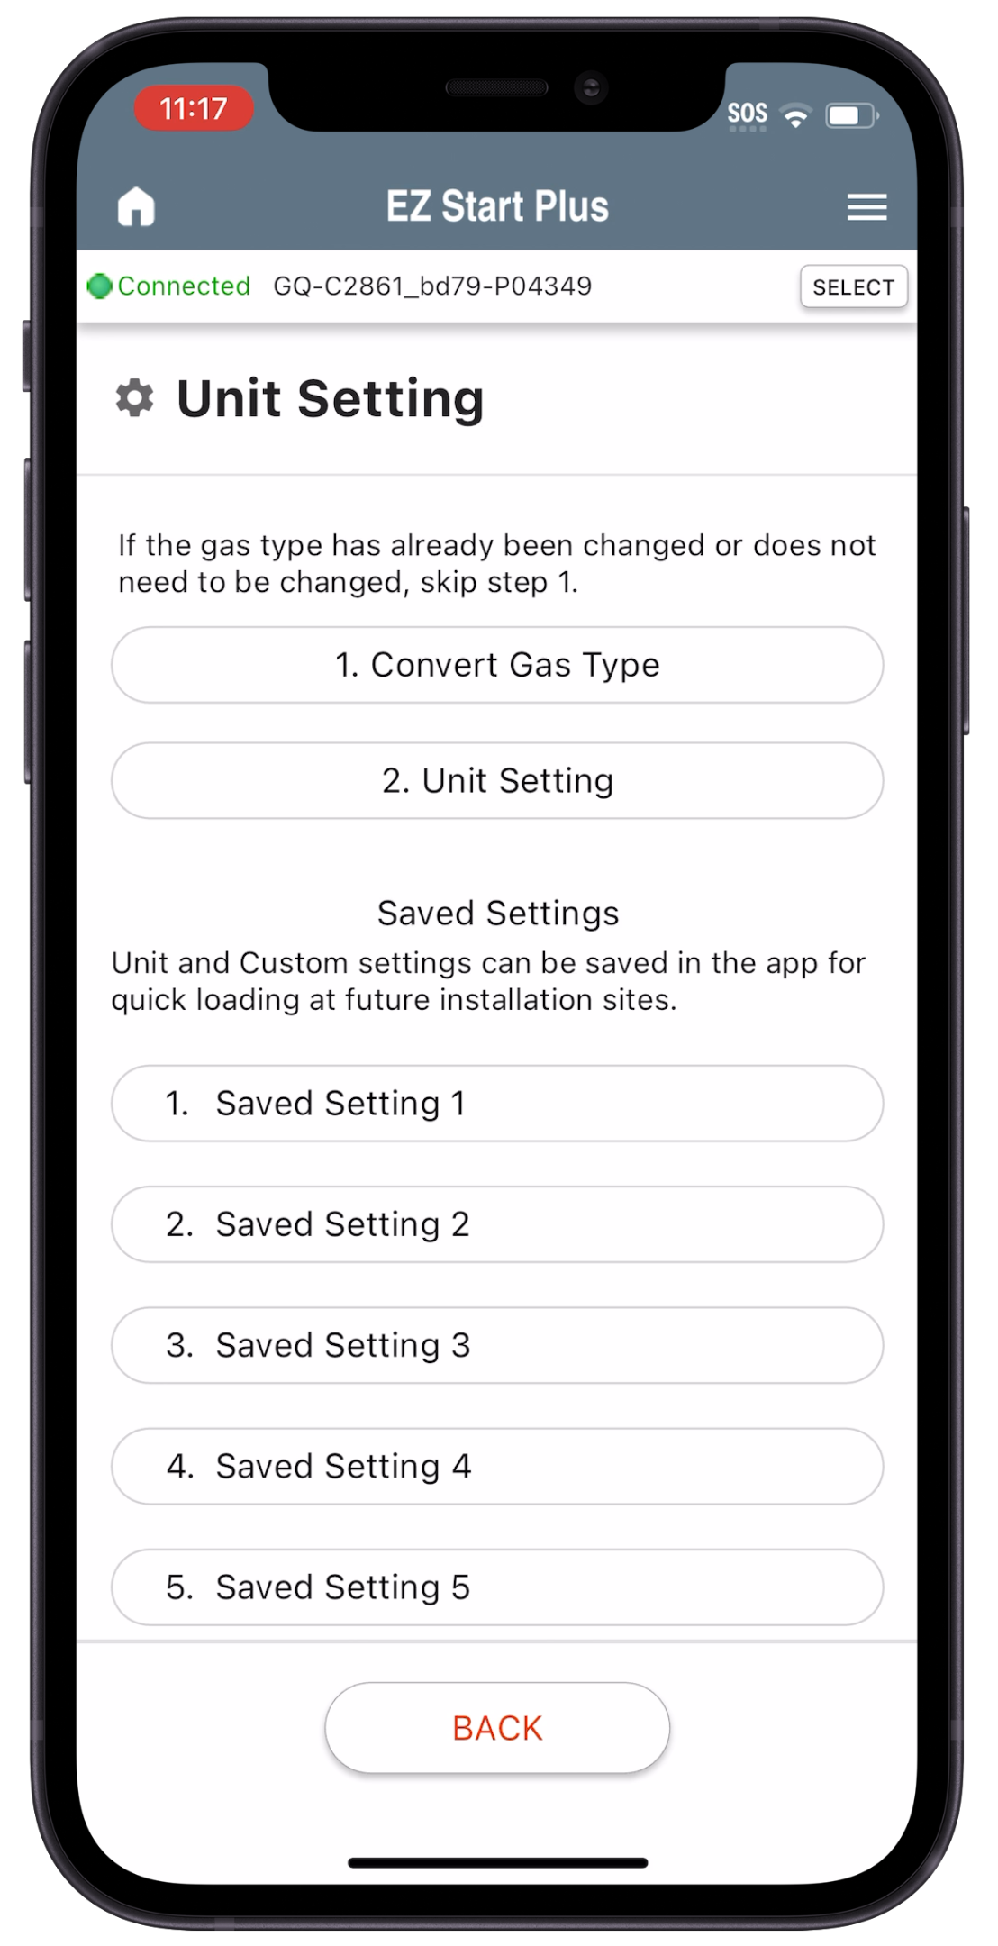
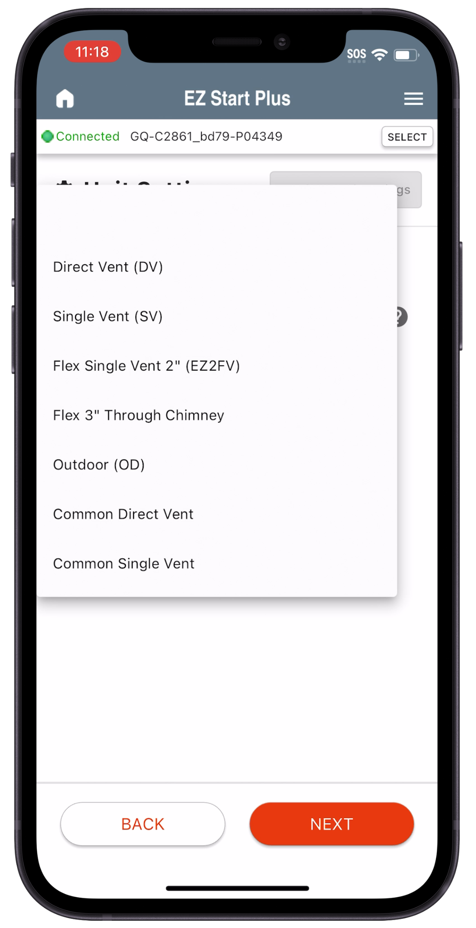
EZ START PLUS APP
Register Warranty or skip
Tap “Unit Setting”
Tap “Unit Setting”
Select Options Based on Installation then tap NEXT

Slide 60
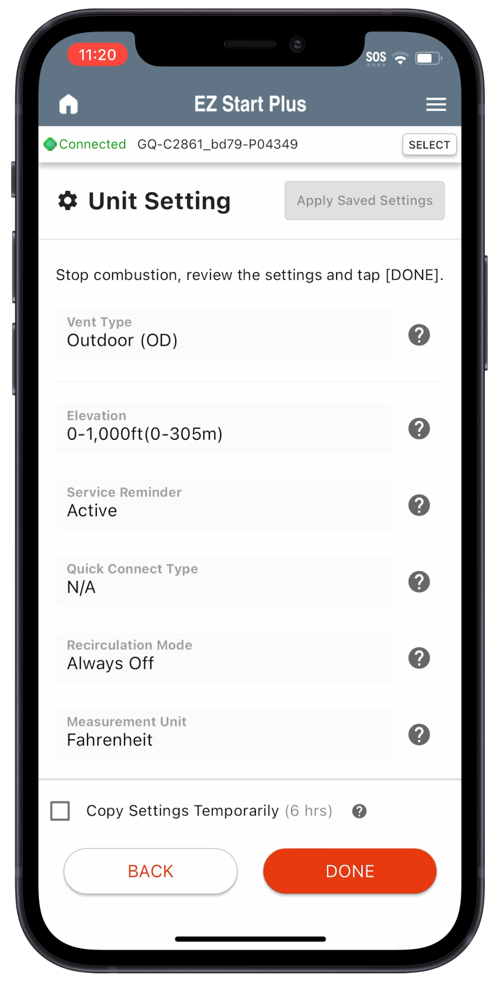
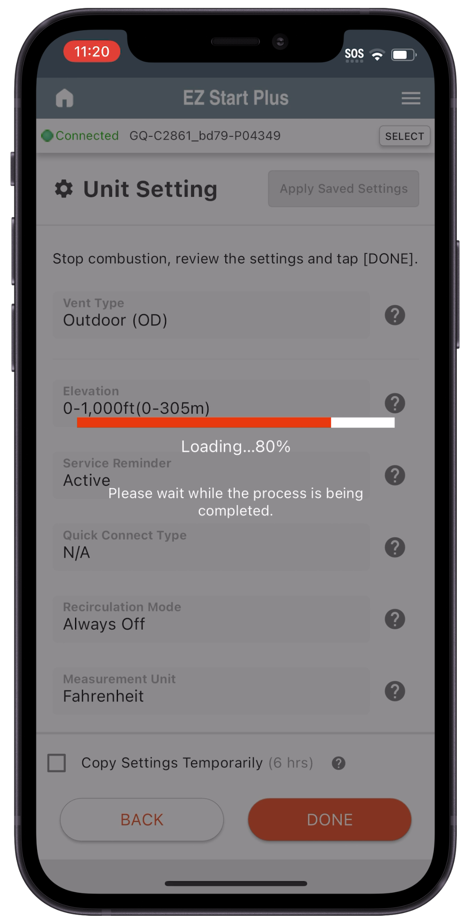
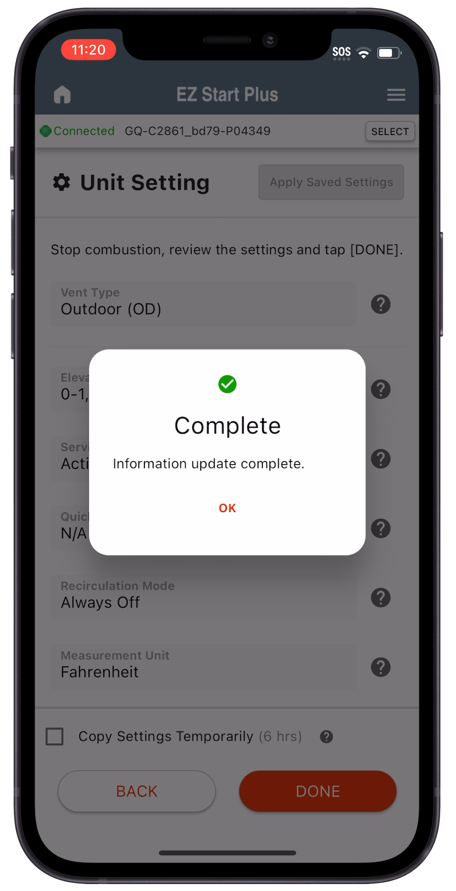
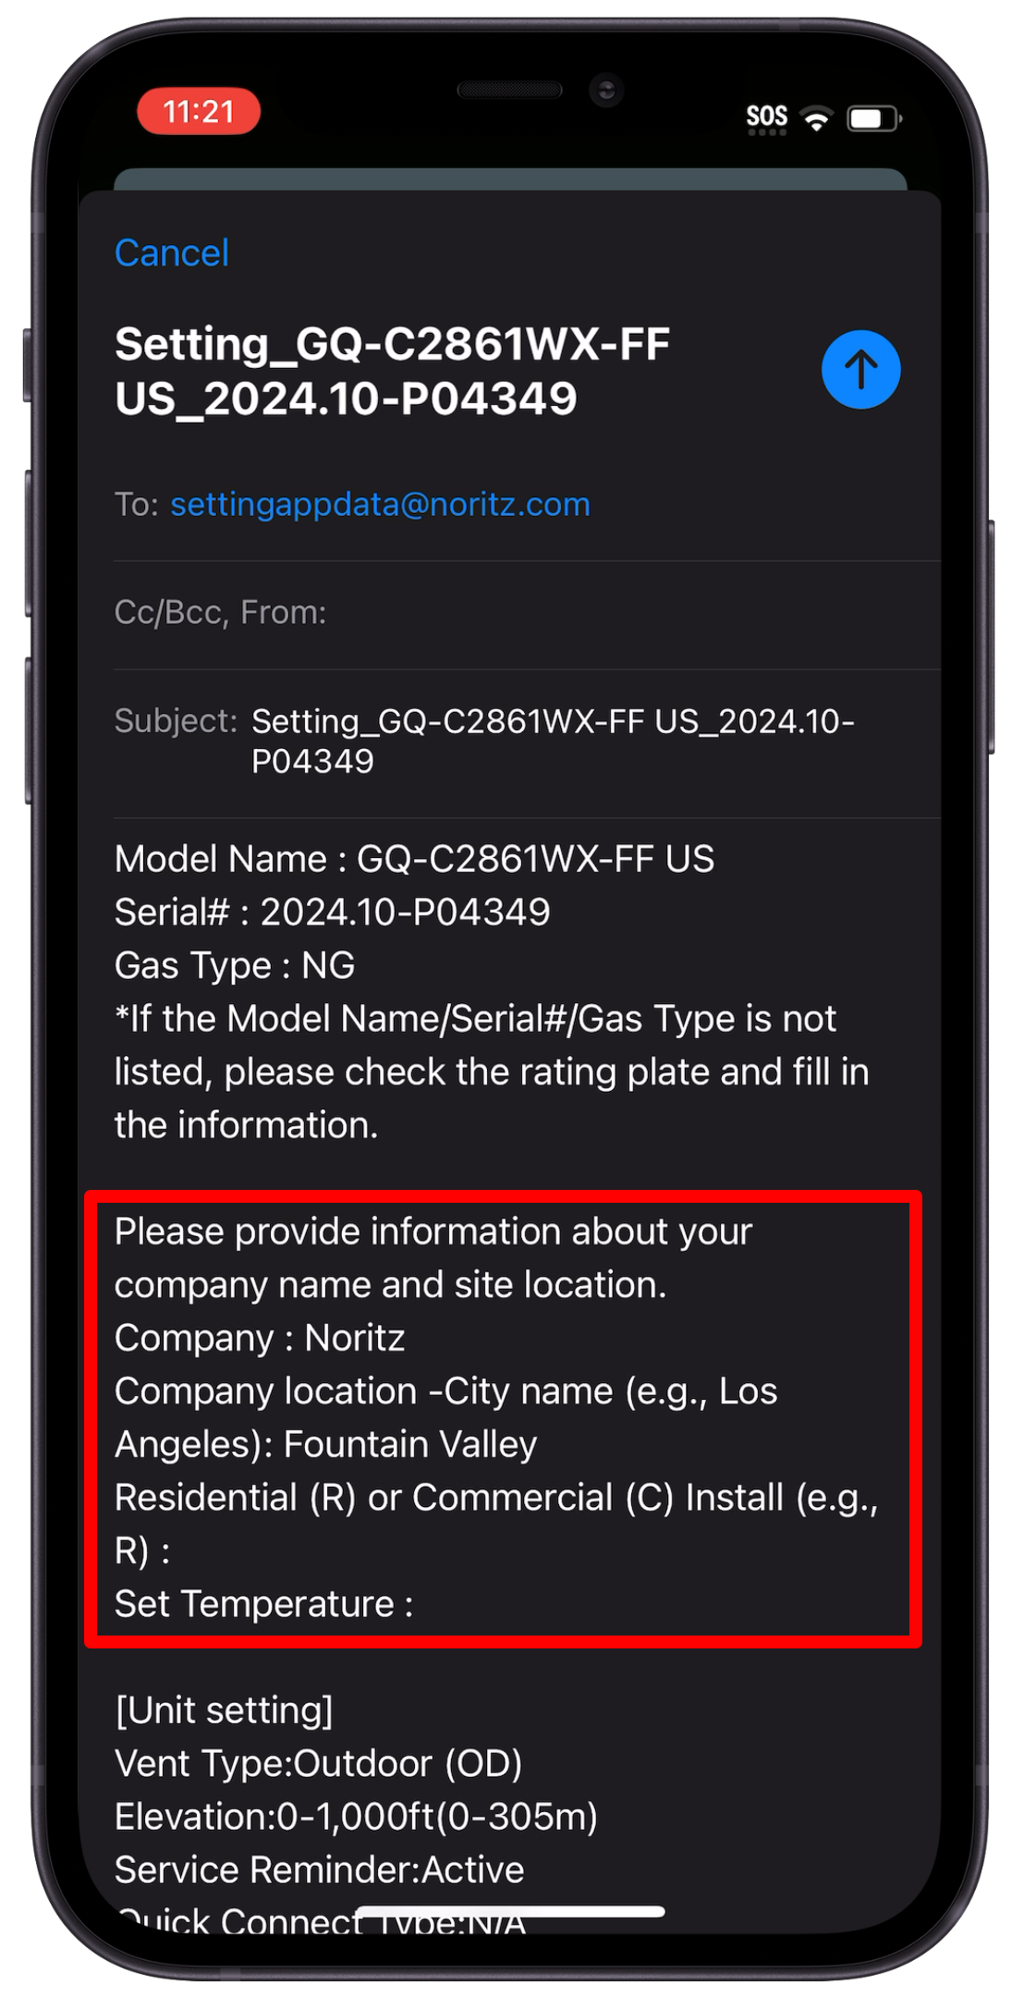
EZ START PLUS APP
Upon completion, email app will open to allow emailing the installation settings to Noritz. This is not required, but very helpful for Customer Care.
Review your selections then tap DONE
App programs unit
Tap OK when complete
Please fill out these items if you opt in to send.

Slide 61
BASIC MAINTENANCE
Keep the unit performing to its potential

Slide 62
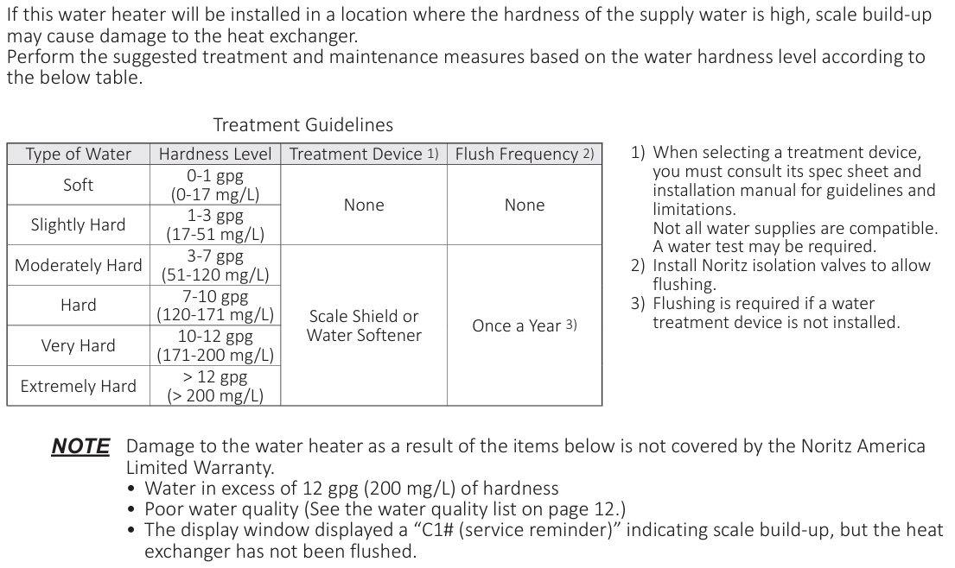
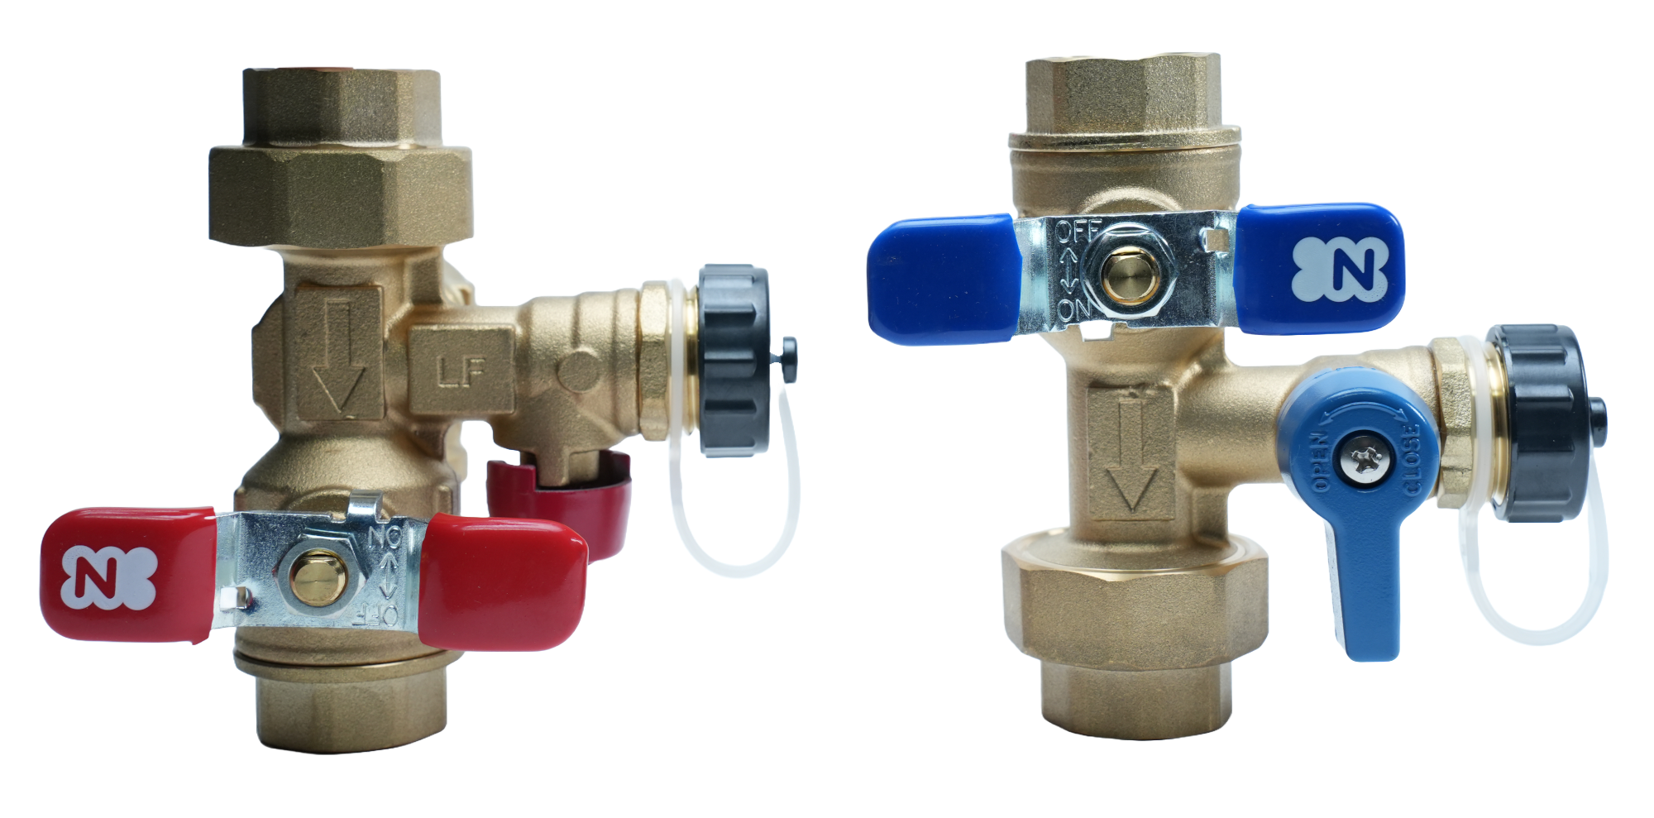
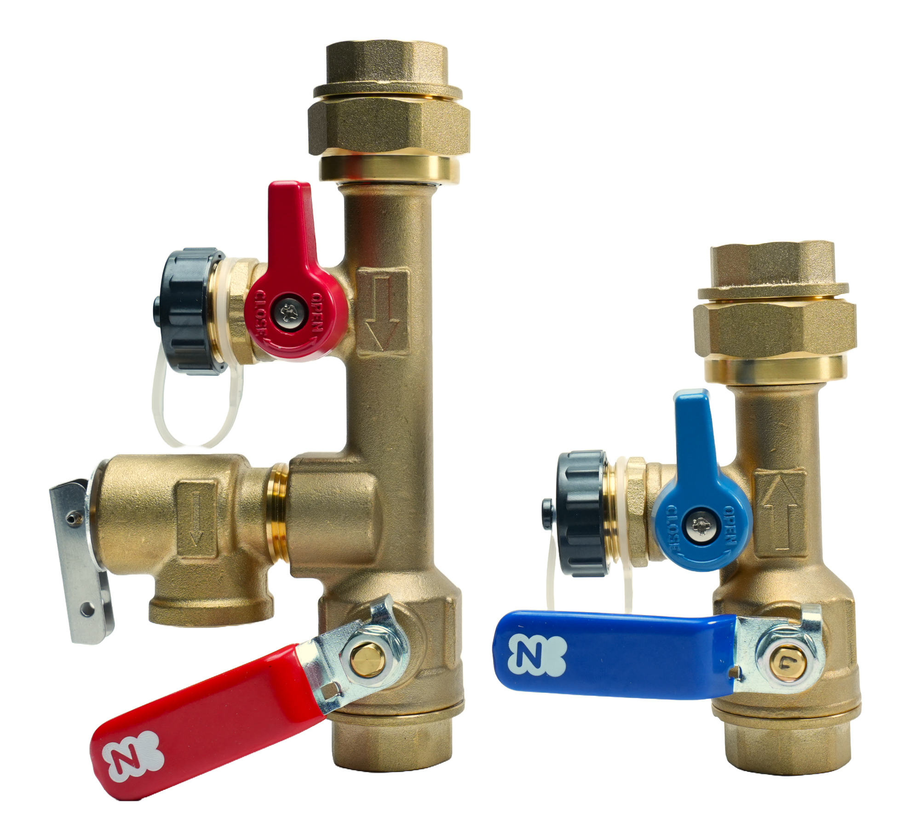
WATER QUALITY
Water Quality Guidelines in the Installation Manual should always be followed.

Slide 63
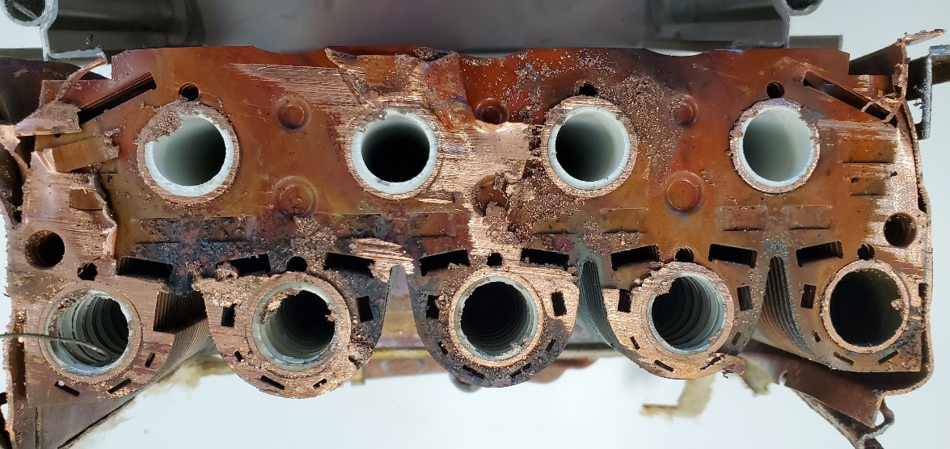
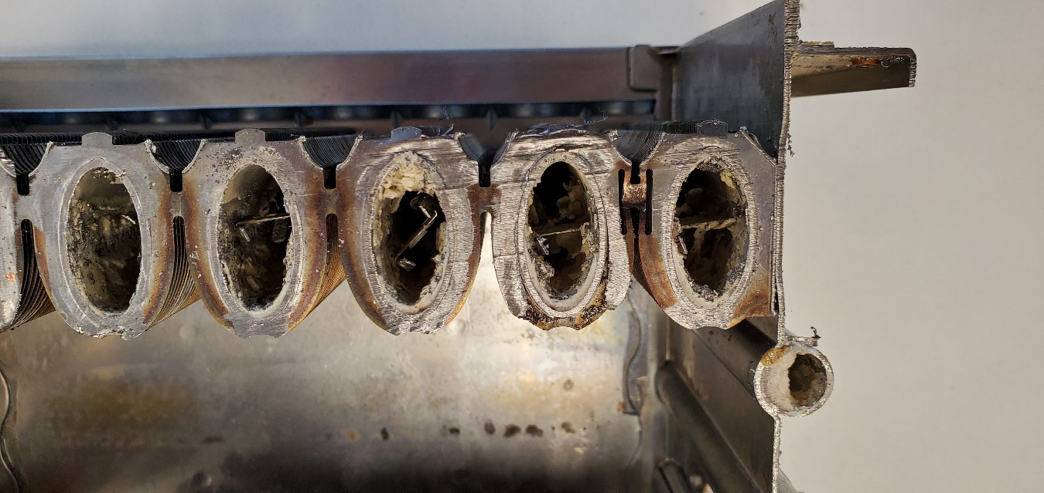
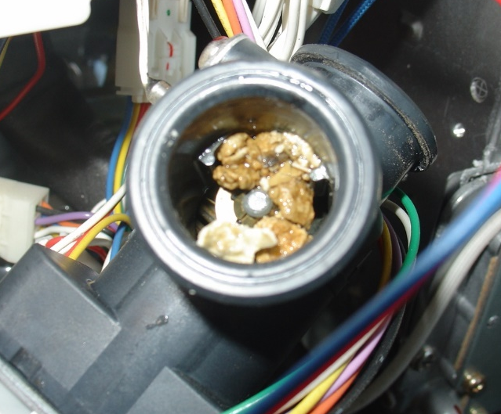
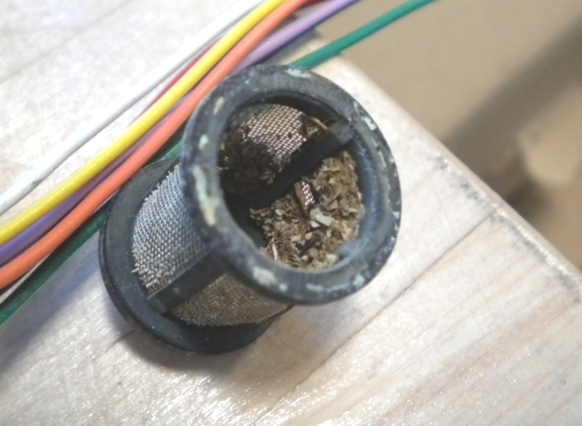
POOR WATER QUALITY ISSUES
Here are some issues related to Hard Water or Poor Water Quality:
Scale Buildup
Unstable Water Temperature
Error Codes: 14, 16, 20, 65
Clogged Inlet/Recirc Filter Screen

Slide 64
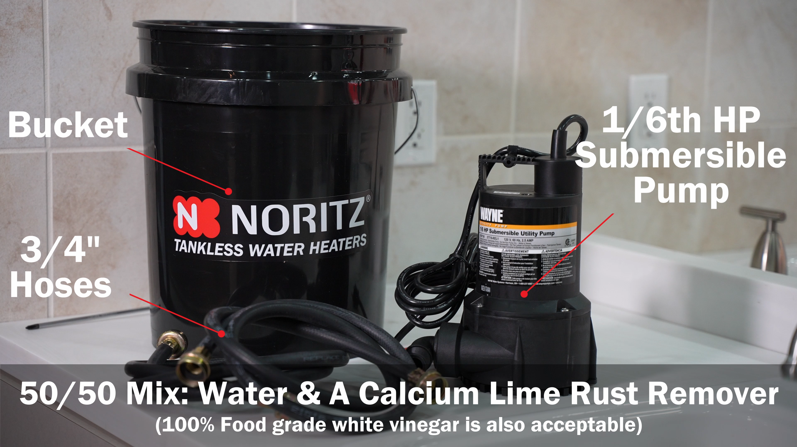
DESCALING/FLUSHING
So, what do you need to perform a proper descale?

Slide 65
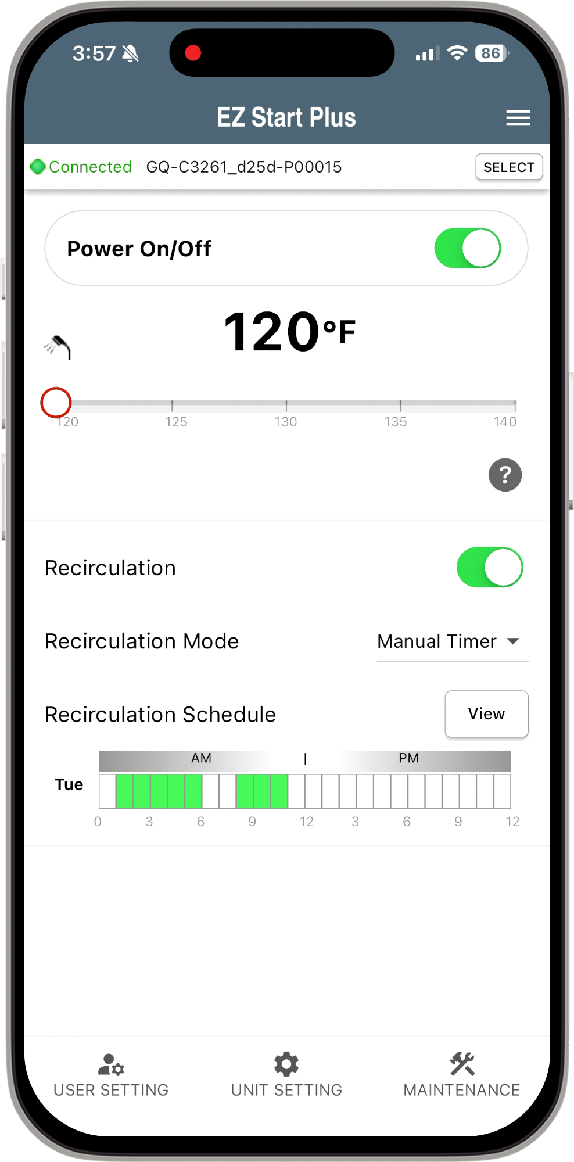
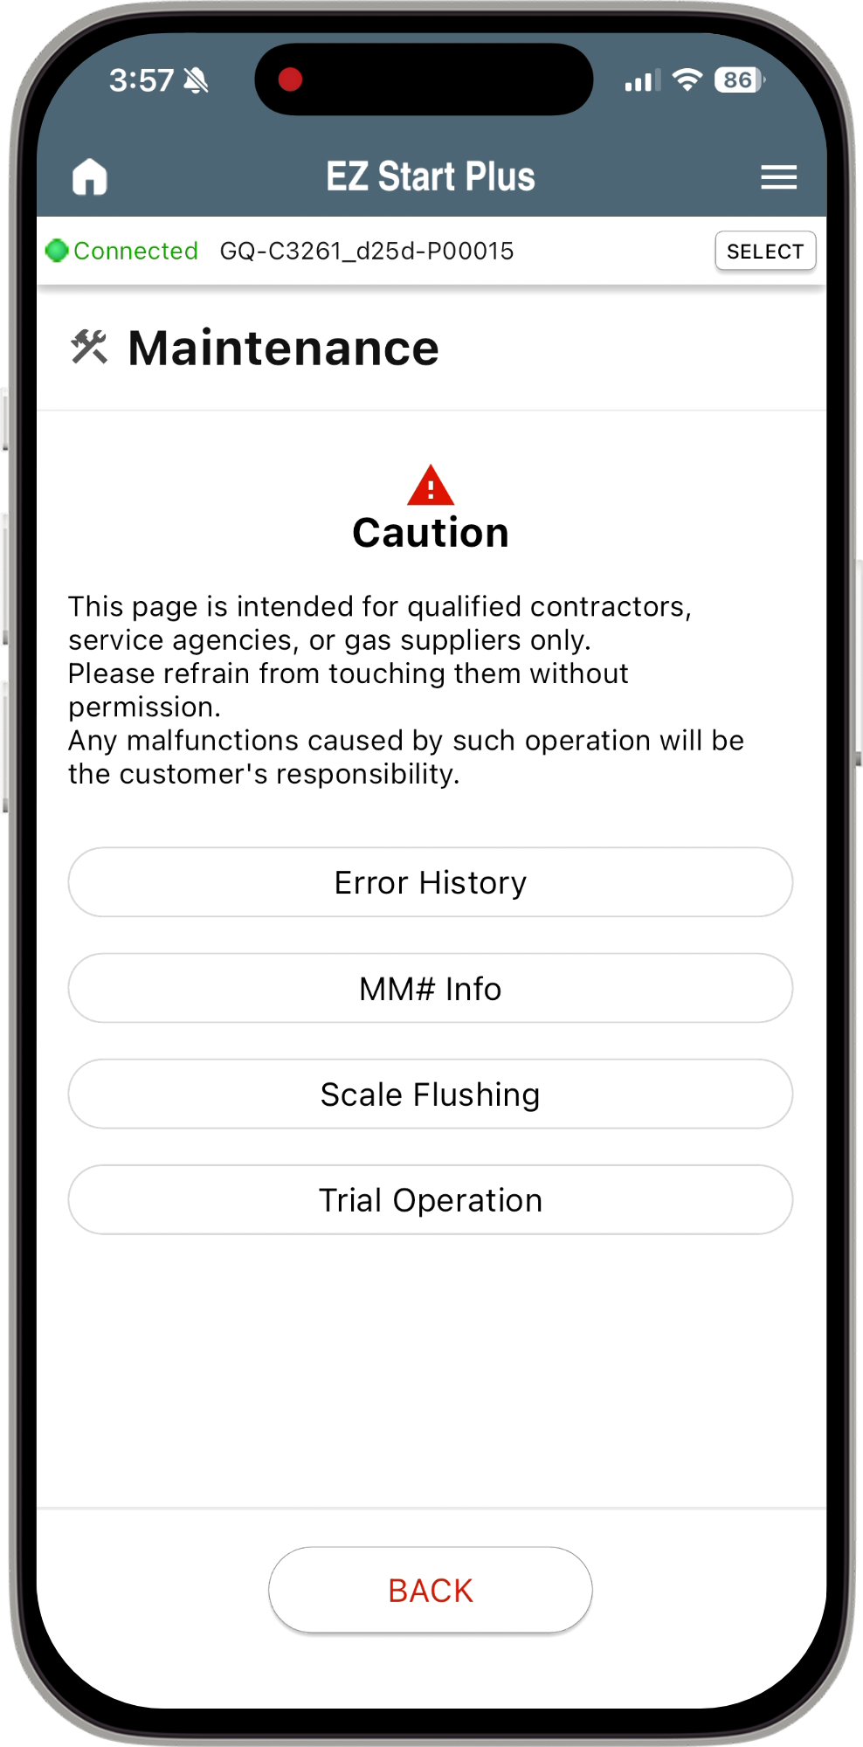

DESCALING/FLUSHING
The flush connector is gone and descale mode is started with the EZ Start Plus App or the operation panel.
Directions can be found in the manual

Slide 66
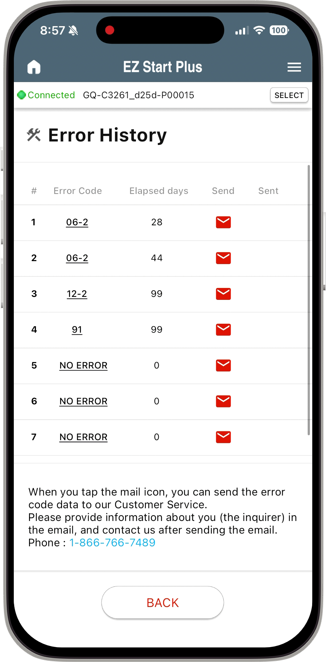
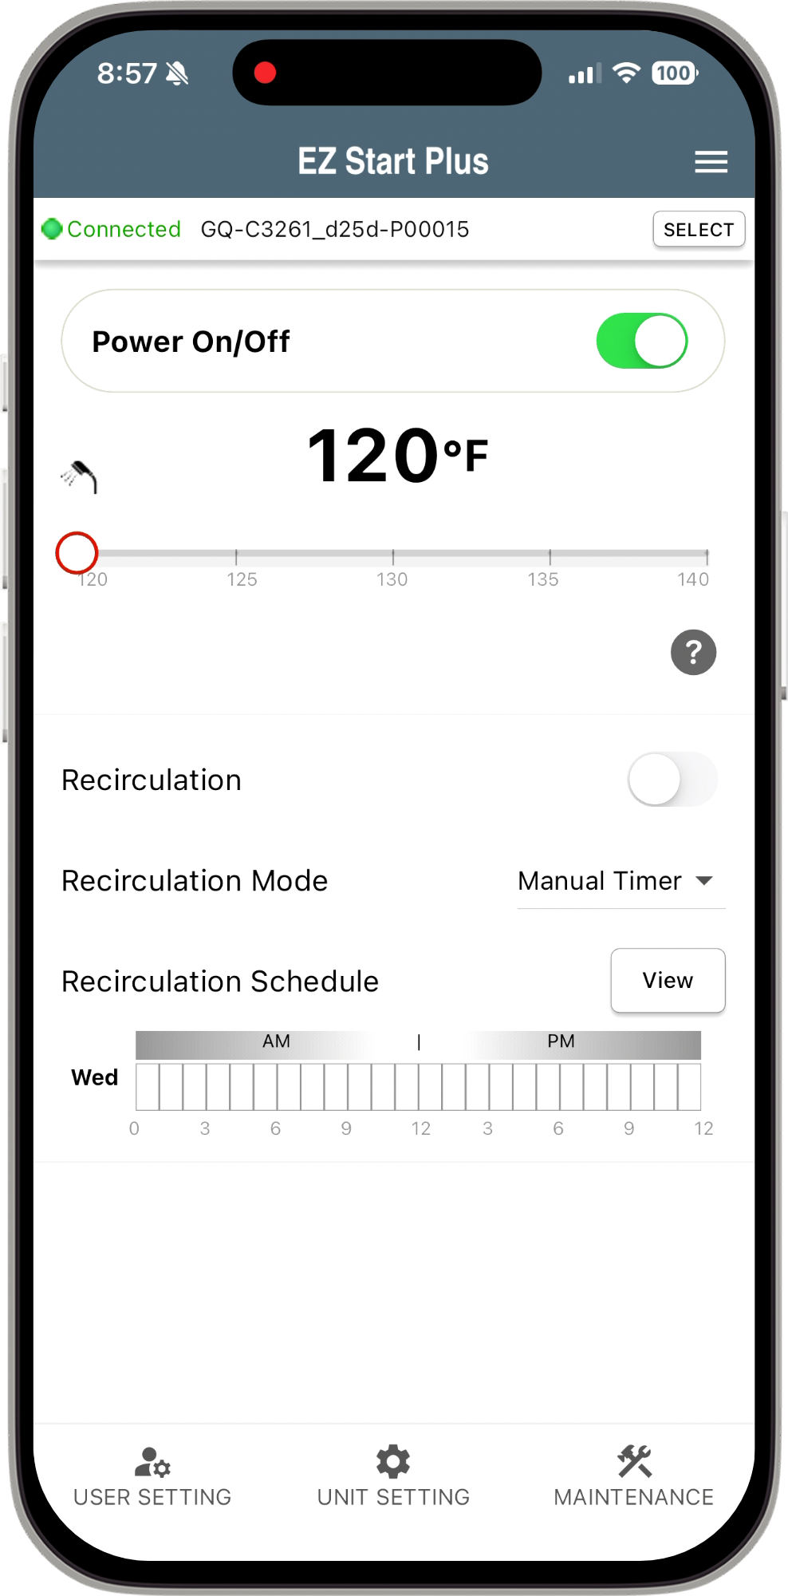

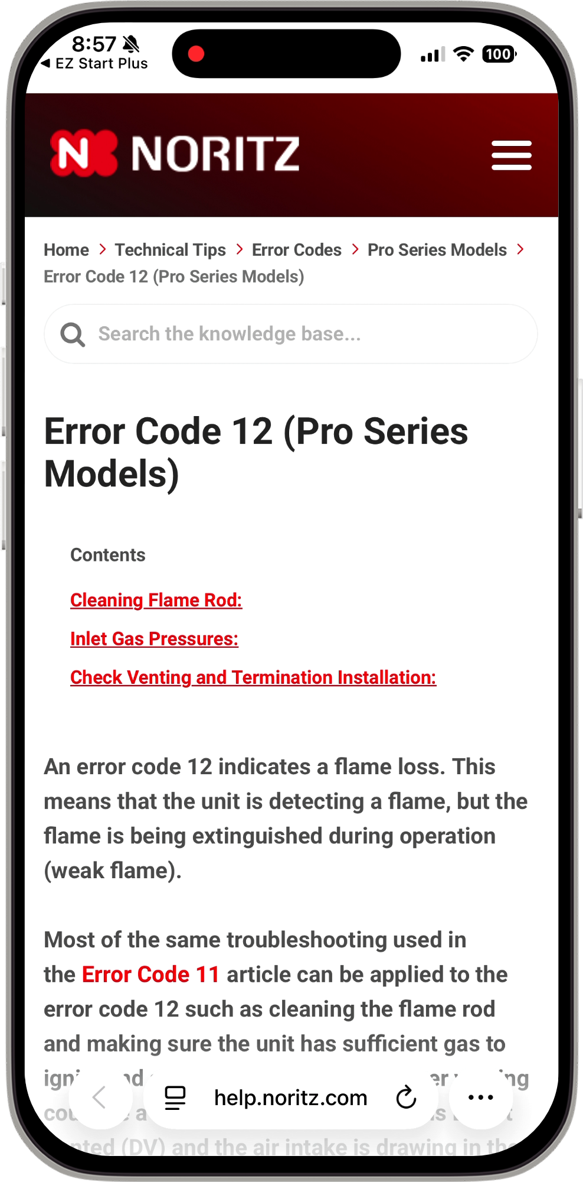
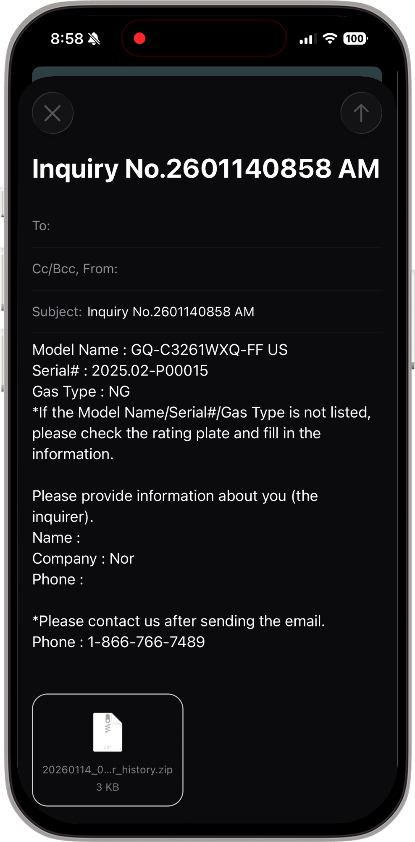
EZ START PLUS ERROR HISTORY
Shows the number of days elapsed since the error was reported.
Error history can be displayed, and content can be emailed to Noritz Customer Care.
Tap on the error code to link to the Noritz web site. Detailed error code info displayed.
Tap the email icon to launch the email app to send data to Noritz Customer Care.
📨
To
Customer Care
Tap the phone # to launch the phone app and call Noritz.
Tap Maintenance Button
Tap Error History Button

Slide 67



EZ START PLUS MAINT MONITOR
You can check and record up to 2 minutes of Maintenance Monitor data
and send to Noritz Customer Care.
Tap Maintenance Button
Tap MM# Info Button
Tap REC Button
Tap STOP Button or 2 minutes passed
Auto launches email after recording ended

Slide 68


TRIAL OPERATION
Depending on the unit you can do a trial operation on:
Fan Motor, Igniter, Water Servo, Pump (NRCR only), or Bypass Servo (CDV only)
Tap Maintenance Button
Tap Trial Operation Button
Select Part for Trial Operation
Tap Toggle Button to turn ON
Tap Toggle Button to turn OFF

Slide 69
COMMERCIAL RACKS

Slide 70

CMK and CRK Systems
Features & Benefits
Easy to Transport
Sturdy Aluminum Frame
Install in Less Than 2 Hours
True Commercial Manifold
Best Value in the Industry
Retrofit Easy Button
CRK-BASE + CMK-BB4 Shown, NCC199CDV Pro Units Sold Separately.

Slide 71

CRK-BASE
Features & Benefits
Assembly uses only 12 Bolts vs 60 Bolts of Competitor Racks!
Single CRK-BASE allows for 1-4 units, competitor requires Base + Extension to install more than 2 units.
Lighter weight corrosion resistant Aluminum frame vs. Heavier Coated Steel frame of competitor.
CRK-BASE Shown expanded to allow up to 4 units in a back to back configuration.
CRK-BASE Shown expanded to allow up to 4 units in a back to back configuration.

Slide 72



CMK (Commercial Manifold Kit)
Design Your System
Step 1
Select Desired Number of NCC199CDV Tankless Needed for System
Designed for Use With Our Award-Winning NCC199CDV Tankless

Slide 73


CMK (Commercial Manifold Kit)
Design Your System
Step 2
Choose Between Wall Hanging or Floor Standing System
CMK-SS
Wall Hanging Bundle Kits
CMK-SS2
CMK-SS3
CMK-SS4
CMK-BB
Floor Standing Bundle Kits
CMK-BB2
CMK-BB4

Slide 74



CMK (Commercial Manifold Kit)
Design Your System
Wall
Hanging Configurations
Floor
Standing Configurations
Step 3
Select Your
CMK or CRK Configuration
CMK-SS2
CMK-SS3
CMK-SS4
CMK-BB2
CMK-BB4

Slide 75


CMK (Commercial Manifold Kit)
Design Your System
Step 4
Choose the Floor-Standing Base
(For CRK Only)
The CRK-BASE commercial rack kit allows for custom floor standing installations of 1 to 4 tankless units.
Step 5
Select Optional Extension
(For CRK Only)
The CRK-ADDON commercial kit lets you expand your existing system to more than 4 units.

Slide 76

CMK (Commercial Manifold Kit)
Additional Notes
One CRK-ADDON may be used per CRK-BASE. Attempting to use multiple CRK-ADDON may result in misaligned water and gas manifolds.
Up to 24 NCC199CDV heaters can be connected using multiples of the CRK-BASE and CRK-ADDON kits. A 6, 12 or 24 unit system controller (sold separately) will be needed to ensure system balancing and load management.
NCC199CDV units may be common vented, refer to the common vent manual for full details.
Manifold sizing is designed for a maximum of eight (8) water heaters. In order to connect units in greater number than eight, a common header of a larger diameter may be necessary. Refer to local plumbing and/or building code for minimum pipe sizing requirements.
Common Header Diameter Recommendation

Slide 77


PRO COMMERCIAL SOLUTIONS
The entirety of the commercial product offering will be refreshed with the new model of NCC199CDV PRO
CRK/CMK Compatible (no SKU change)
Hybrid Hot
CR60
TTS

Slide 78
HELPFUL LINKS
SUPPORT.NORITZ.COM
NORITZ.COM/TECHTIPS
HELP.NORITZ.COM
TRAINING.NORITZ.COM
YOUTUBE.COM/NORITZAMERICA
Customer Care: 866-766-7489

Slide 79

THANK YOU

