Slide 1
SALES TRAINING

Slide 2
ONE COMPANY
Combining Noritz “Best-in-Class” TRUE Commercial Tankless Water Heating Technology with Facilities Resource Group “Most Trusted” Commercial Water Heating Solutions Organization

Slide 3

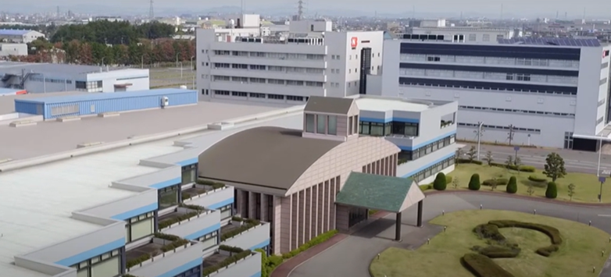
NORITZ
Over 75 Years of Innovation
Established in 1951, Noritz is Globally Headquartered in Kobe, Japan.
Noritz America out of Fountain Valley, CA has been present since 2002 covering US & CANADA.
Over 1 Million
Units of gas water heaters manufactured in Japan per year. Our factory in Japan quickly delivers water heating products to match the specific needs of local customers around the world.
Operation in 17 Countries
Over 3,600 Employees in Japan, over 2,700 Outside Japan for a total of OVER 6,300 employees Worldwide.

Slide 4
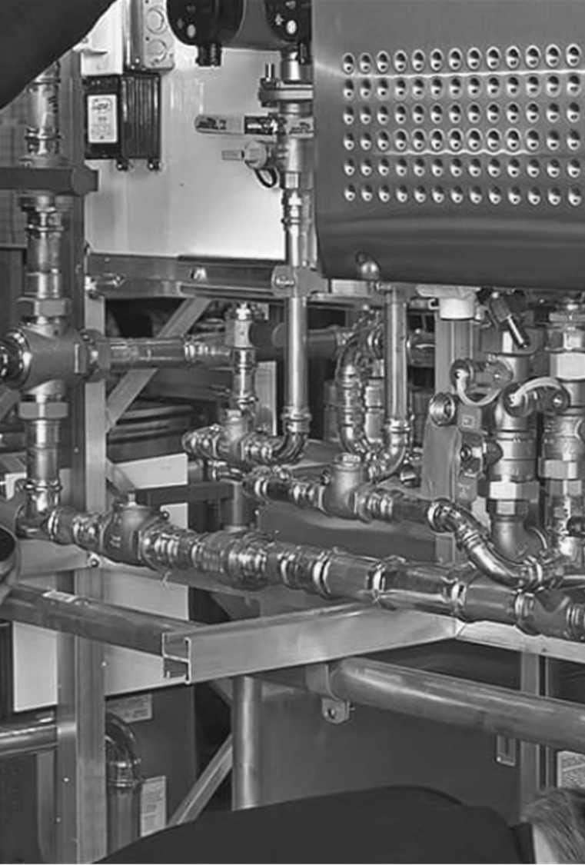
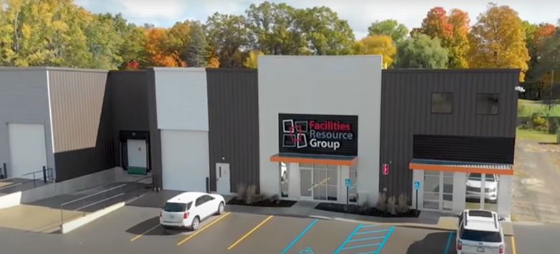
FRG
Over 25 Years of Customer Excellence
Established in 2001, Facilities Resource Group, out of Comstock Park, MI, has been building our business through our attention to detail, dedication to our customers, and exceptional service.
ZERO Stores Closures
Our 24 / 7 / 365 Technical Support keeps our customer’s doors open while producing dependable, reliable water heating systems.
Unmatched Solutions
FRG provides the highest quality commercial water heating solutions in the industry with professionally-trained installation network and premium planned maintenance programs.

Slide 5

TRAINING AGENDA
Commercial Water Heating Essentials
Technology, Performance, and System Design
Customer Engagement and Value Identification
Competitive Positioning and Sales Strategy
Application Demand & Sizing Requirements

Slide 6

COMMERCIAL WATER HEATING ESSENTIALS
Introduction to Commercial Water Heating
What Is a Commercial Gas Tankless System?
Commercial Tankless Use Cases

Slide 7


COMMERCIAL WATER HEATING ESSENTIALS
Introduction to Commercial Water Heating
Critical Role in Industries
Commercial water heating supports essential operations across hospitality, healthcare, education, and food service industries.
Other Industries
Food Manufacturing
Laundromats

Slide 8
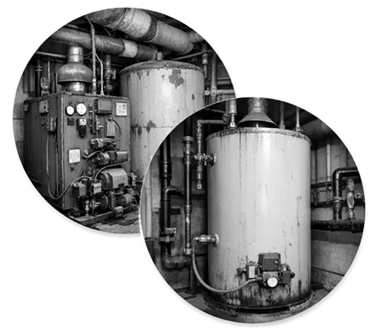
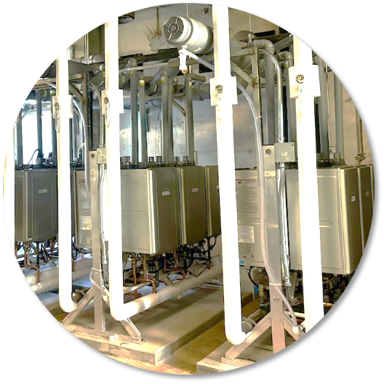
COMMERCIAL WATER HEATING ESSENTIALS
Introduction to Commercial Water Heating
Shift from Tank & Boiler to Tankless
The market is transitioning from traditional commercial tank heaters & commercial boilers to efficient, scalable tankless water heating solutions.

Slide 9


COMMERCIAL WATER HEATING ESSENTIALS
Introduction to Commercial Water Heating
Energy Efficiency and Sustainability
New regulations drive demand for high-efficiency, low-emission water heaters with better energy control.
State and Federal rebates reduce upfront installation costs, making high‑efficiency systems more affordable while accelerating long‑term energy and operational savings.

Slide 10
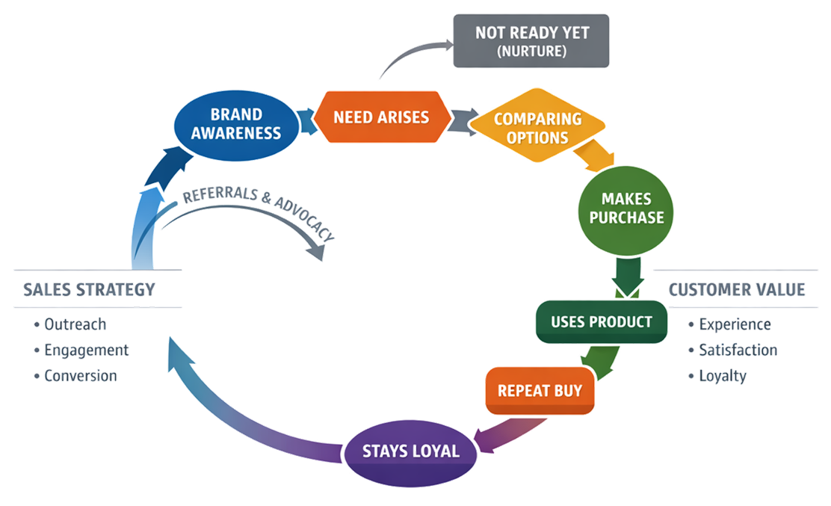
COMMERCIAL WATER HEATING ESSENTIALS
Introduction to Commercial Water Heating
Sales Strategy and Customer Value
Sales professionals focus on lifecycle value, reliability, and scalability to meet customers' operational goals.

Slide 11
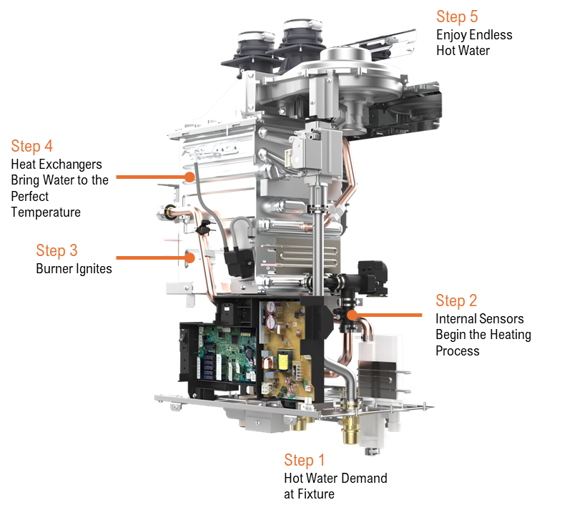
COMMERCIAL WATER HEATING ESSENTIALS
What Is a Commercial Gas Tankless System?
On-Demand Hot Water Heating
Tankless systems heat water instantly as it flows, eliminating the need for preheated storage tanks and reducing energy waste.

Slide 12
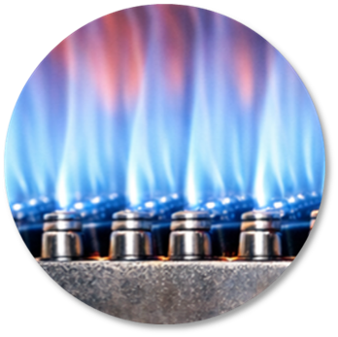
COMMERCIAL WATER HEATING ESSENTIALS
What Is a Commercial Gas Tankless System?
High-Efficiency Performance
Maximum output while lowering operational costs
Stability and Control
Precise temperature control for consistent hot water delivery, featuring high-elevation adjustments and safety lock-outs
Environmental Impact
Advanced combustion minimizes carbon footprint through lower emissions
Safety Features
Built-in mechanisms include flame sensors, lightning protection, and freeze protection
Advanced Combustion Control
Sophisticated combustion management modulates burner output to optimize energy use and ensure precise temperature delivery.

Slide 13
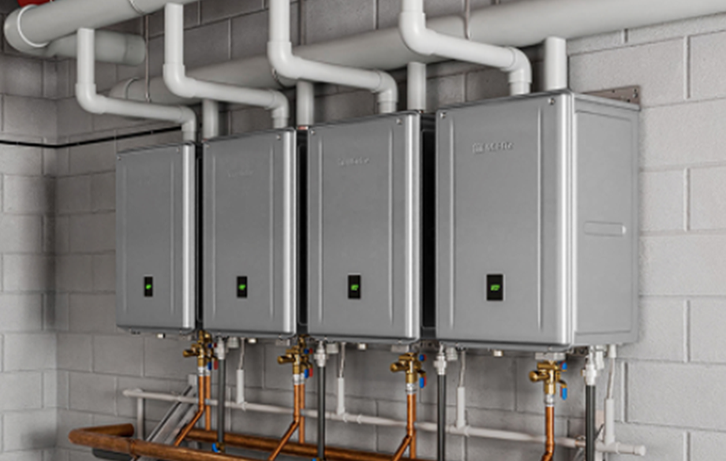
COMMERCIAL WATER HEATING ESSENTIALS
What Is a Commercial Gas Tankless System?
From 2 to up to 24 Units in 1 System
Modular Scalability and Redundancy
Multi-unit cascades allow scaling output and ensure continuous operation even during maintenance, minimizing downtime.

Slide 14
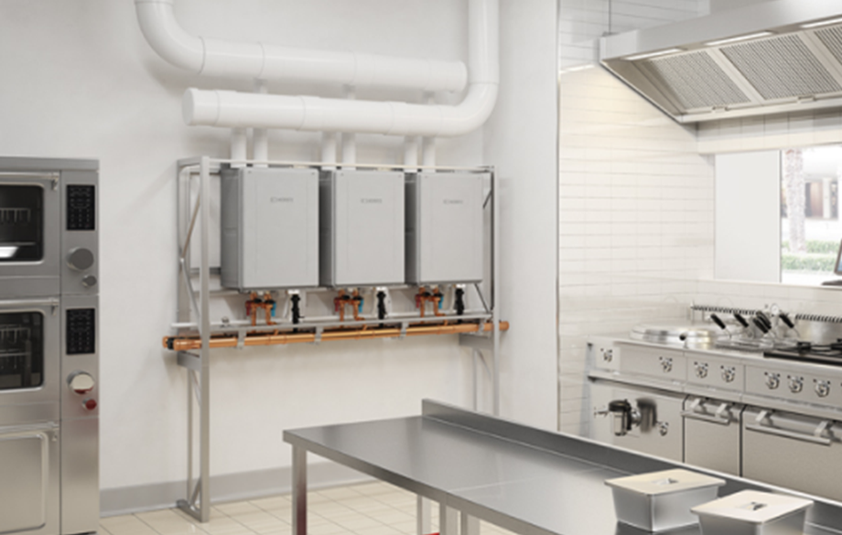
COMMERCIAL WATER HEATING ESSENTIALS
What Is a Commercial Gas Tankless System?
Compact Design and Reliability
Compact footprint, venting flexibility, and longer service life distinguish tankless systems from traditional water heaters.

Slide 15
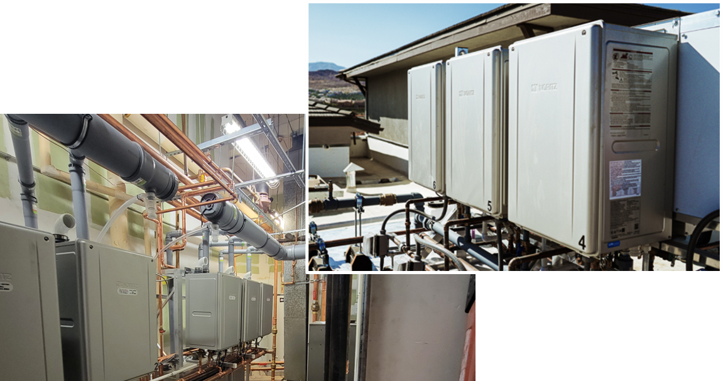
COMMERCIAL WATER HEATING ESSENTIALS
Commercial Tankless Use Cases
Hotels, Hospitality, & Multi-Family
Provides endless hot water for guest rooms, laundries, and kitchens, supporting high occupancy and comfort.

Slide 16
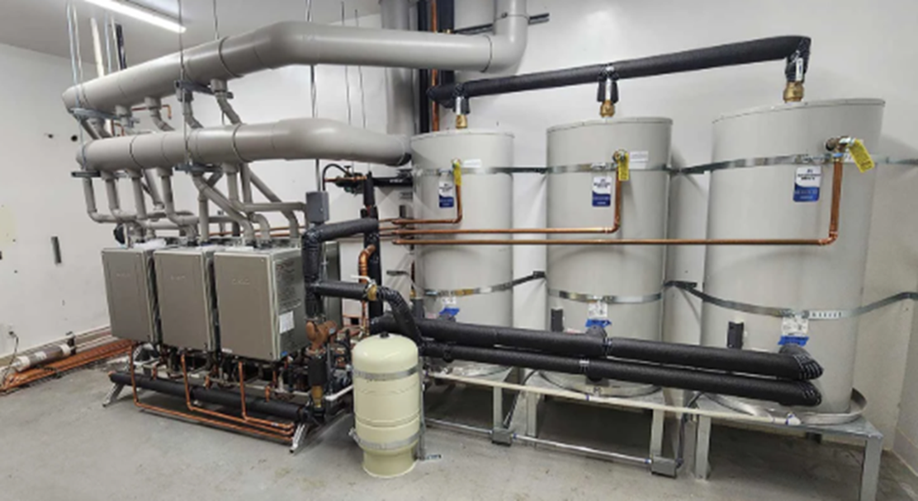
COMMERCIAL WATER HEATING ESSENTIALS
Commercial Tankless Use Cases
Healthcare Facilities
Delivers precise, reliable hot water for sanitation, handwashing, and patient care with essential temperature control.

Slide 17
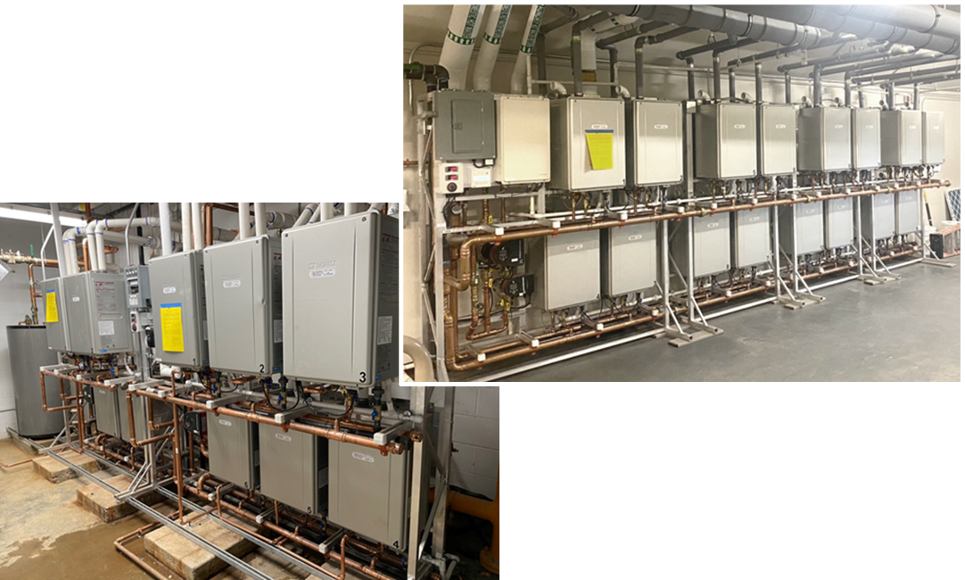
COMMERCIAL WATER HEATING ESSENTIALS
Commercial Tankless Use Cases
Educational Institutions & Dormitories
Reduce energy costs, support sustainability goals, ensure reliable hot water for high-demand environments, and lower long-term maintenance expenses.

Slide 18
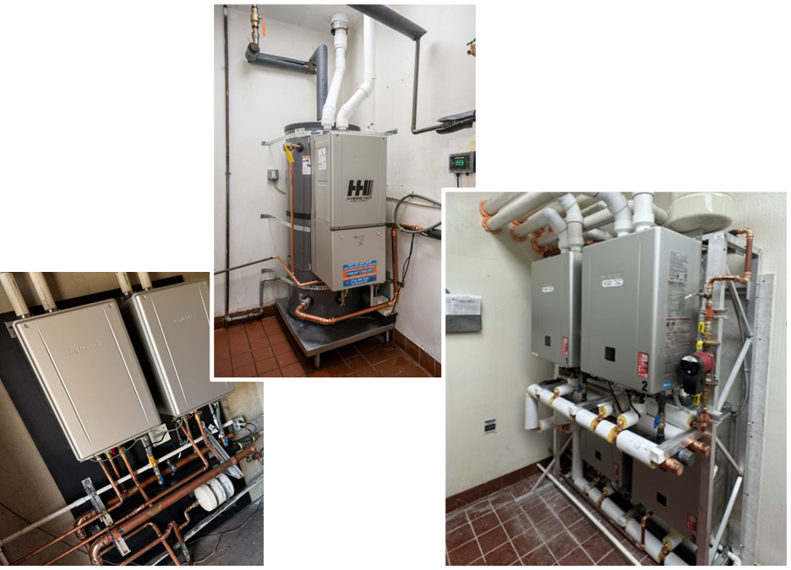
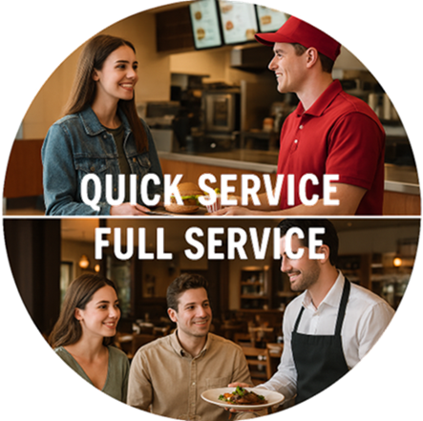
COMMERCIAL WATER HEATING ESSENTIALS
Commercial Tankless Use Cases
Restaurants and Food Service
Tankless systems ensure reliable hot water recovery for dishwashing and sanitation, reducing downtime during busy hours.

Slide 19

TECHNOLOGY, PERFORMANCE, AND SYSTEM DESIGN
Key Product Features
Solutions Lineup

Slide 20
TECHNOLOGY, PERFORMANCE, AND SYSTEM DESIGN
Key Product Features
Higher Efficiency Products
Lower Operating Cost
High Thermal Efficiency
Many models exceed 90% thermal efficiency, reducing energy waste and lowering operational costs significantly.

Slide 21
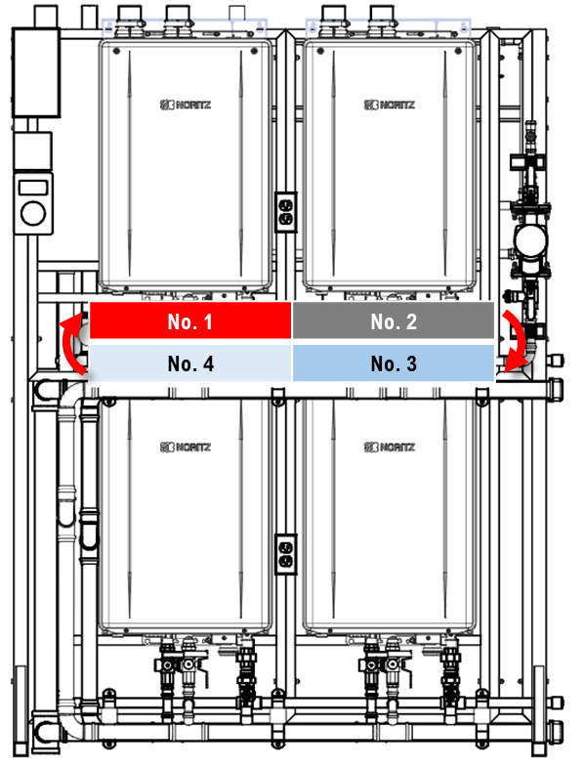
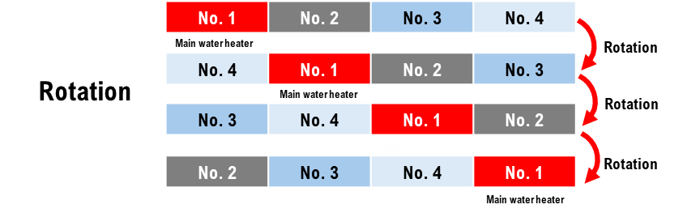
TECHNOLOGY, PERFORMANCE, AND SYSTEM DESIGN
Wide Modulation Range
Burners adjust dynamically to hot water demand, ensuring consistent temperature and enhanced efficiency during all load periods.
Industry-leading, non-primary cascading system control strategy to ensure 100% balanced run time across connected heaters.
Key Product Features

Slide 22
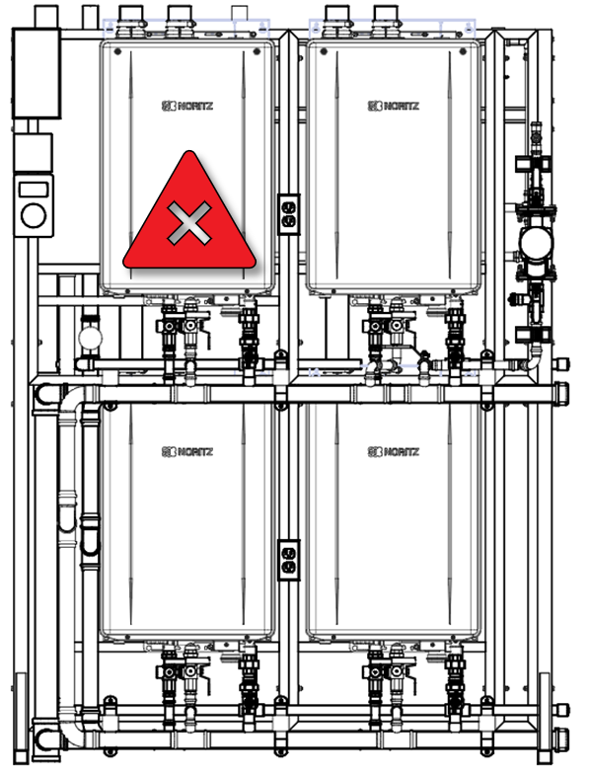
TECHNOLOGY, PERFORMANCE, AND SYSTEM DESIGN
Key Product Features
Built-in Redundancy
Cascaded units provide uninterrupted hot water supply, allowing servicing without system downtime.

Slide 23
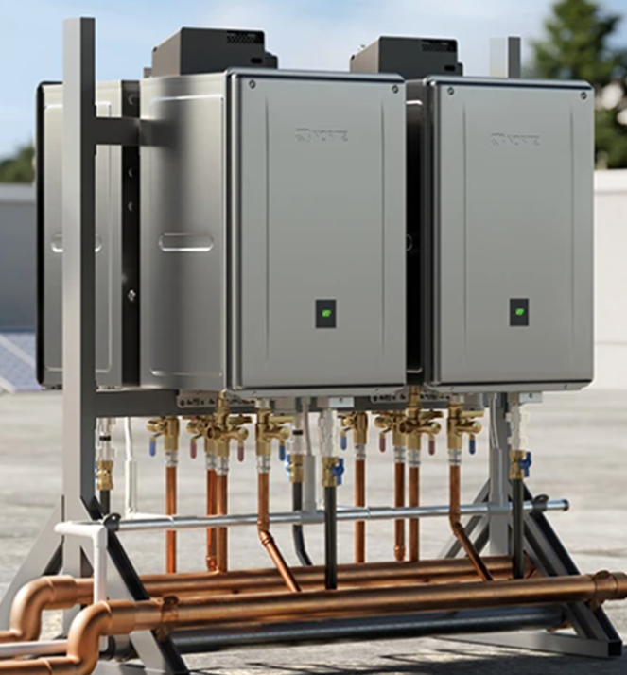
TECHNOLOGY, PERFORMANCE, AND SYSTEM DESIGN
Key Product Features
Venting and Durability Features
Supports flexible venting options and includes corrosion-resistant heat exchangers, advanced controls, and freeze protection.

Slide 24
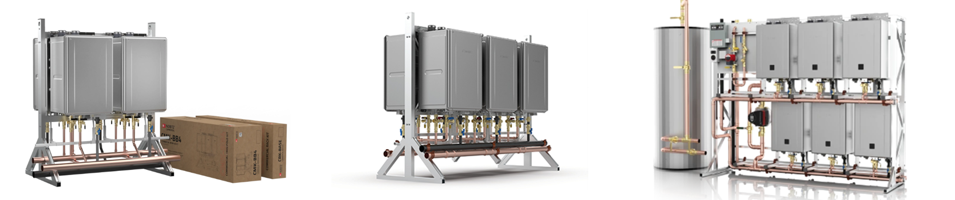
TECHNOLOGY, PERFORMANCE, AND SYSTEM DESIGN
Solutions Lineup
Our Commercial Gas Tankless Solutions Lineup
MODULAR
CONFIGURED
ENGINEERED

Slide 25
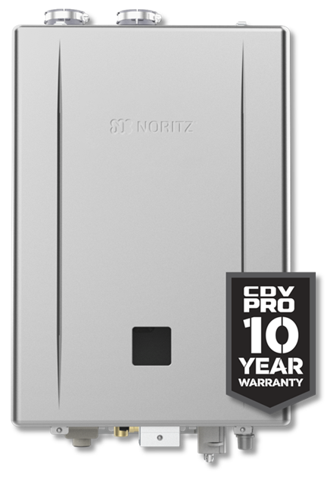
TECHNOLOGY, PERFORMANCE, AND SYSTEM DESIGN
Solutions Lineup
THE ENGINES – NCC199CDV
BEST Commercial Heat Exchanger Warranty in the Industry (10 years)
BEST Commercial Efficiency Rating (0.98)
Common Vent up to 12 Units
System Control Capable up to 24 Units
System btuh Range: 199K to 4.8Mil

Slide 26
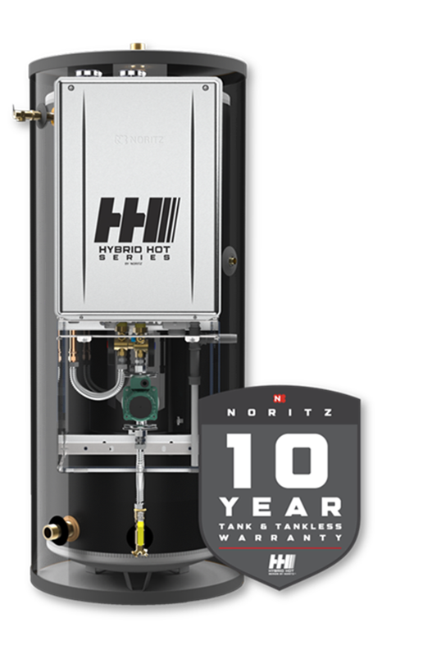
TECHNOLOGY, PERFORMANCE, AND SYSTEM DESIGN
Solutions Lineup
THE ENGINES – Hybrid Hot
Combing the BEST Commercial Tankless with a 119 Gallon Storage Tank with Hydrastone Lining
Faster hot water recovery and larger first hour rating because of larger pump and bypass
Multi unit capability up to 6 units
Direct replacement of Commercial Tank Water Heaters in most small commercial applications

Slide 27
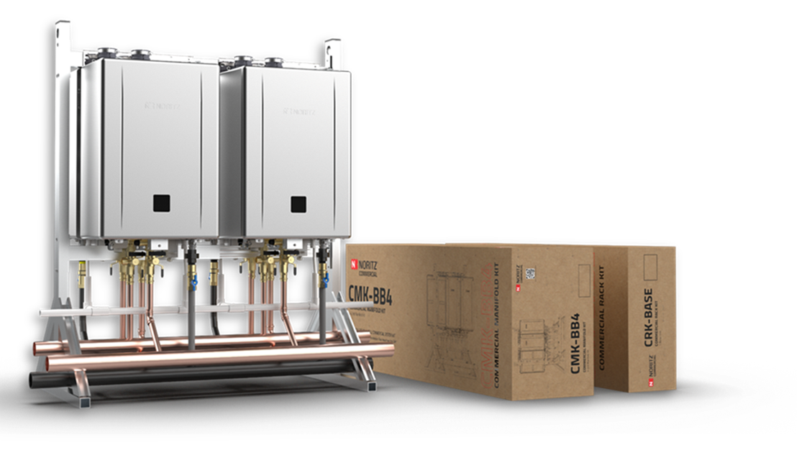
TECHNOLOGY, PERFORMANCE, AND SYSTEM DESIGN
Solutions Lineup
MODULAR SERIES: CMK – CRK Systems (Features & Benefits)
Easy to Transport
Sturdy Aluminum Frame
Install in Less Than 2 Hours
True Commercial Manifold
Best Value in the Industry
Retrofit Easy Button
(CMK = Commercial Manifold Kit / CRK = Commercial Rack Kit)
CRK-BASE + CMK-BB4 Shown, NCC199CDV Pro Units Sold Separately.

Slide 28
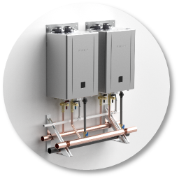
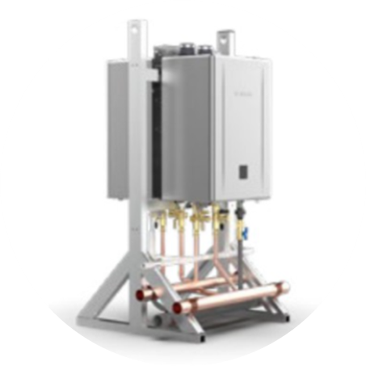
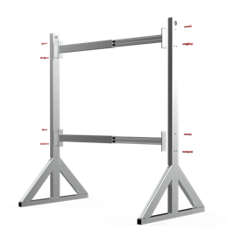
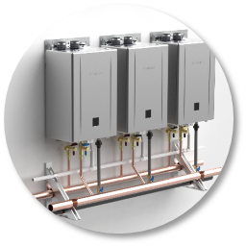
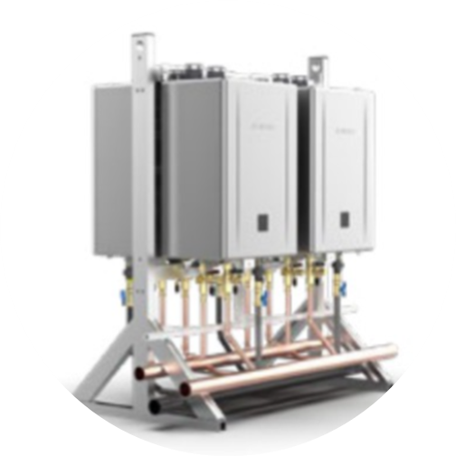
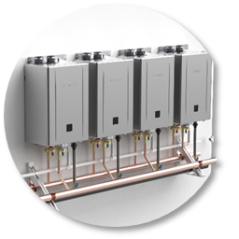
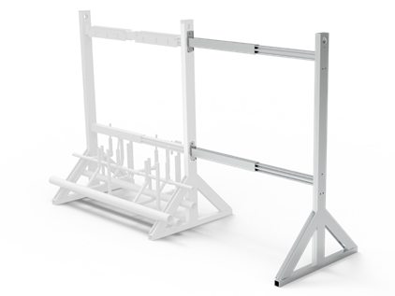
TECHNOLOGY, PERFORMANCE, AND SYSTEM DESIGN
Solutions Lineup
MODULAR SERIES: CMK – CRK Systems (Options)
3 Wall Hanging Bundle Kit – Options (Can be Parallel Connected)
CMK-SS2 (2 Units)
2 Floor Standing Bundle Kit – Options (Can Also be Parallel Connected)
CMK-BB2 (1 to 2 Units)
CRK-BASE (Rack for 1 – 4 Units)
CMK-SS3 (3 Units)
CMK-BB4 (2 to 4 Units)
CRK-ADDON (For Expansion)
CMK-SS4 (4 Units)
NCC199CDV Pro Units Sold Separately

Slide 29
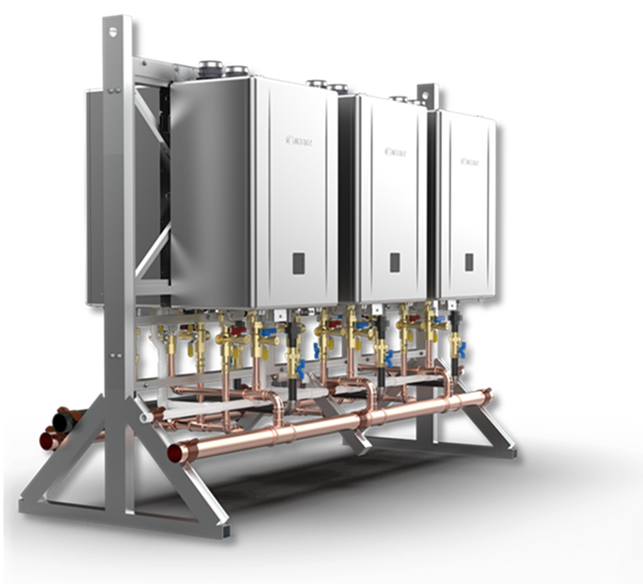
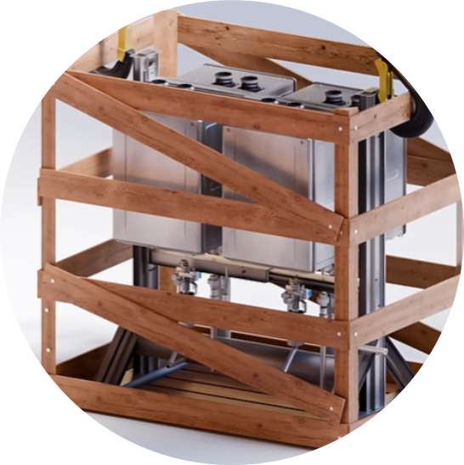
TECHNOLOGY, PERFORMANCE, AND SYSTEM DESIGN
Solutions Lineup
CONFIGURED SERIES: CR Systems (Features & Benefits)
Pre-fabricated and assembled racking system (with heaters) for use in flat rooftop or mechanical room applications
Floor standing models have a lower center of gravity (shorter than TTS) for increased stability and easier transportation
Pre-piped manifolds and condensate lines with pre-wired multi-system to reduce installation time
Professionally crated for direct site shipment
CR61-FS6 Shown, NCC199CDV Pro Units Included.
(CR = Commercial Rack)

Slide 30
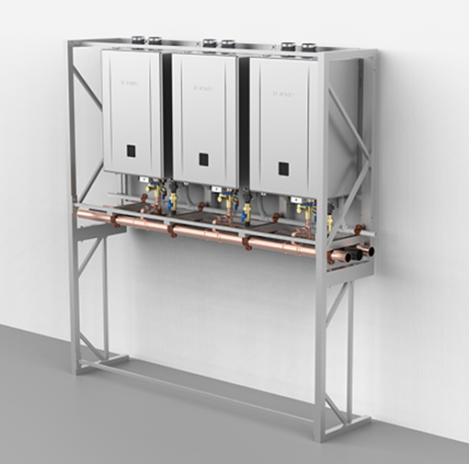
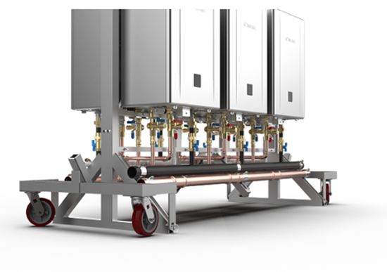
TECHNOLOGY, PERFORMANCE, AND SYSTEM DESIGN
Solutions Lineup
CONFIGURED SERIES: CR Systems (Options)
Wall Hanging
CR61-WH2 (2 Units)
CR61-WH3 (3 Units)
Floor Standing
CR61-FS3 (3 Units)
CR61-FS4 (4 Units)
CR61-FS5 (5 Units)
CR61-FS6 (6 Units)
CR61 Wheel Kit is designed to simplify logistics of moving Noritz Commercial Racks from the crate to the installation site.
CR61-WH3 Shown, NCC199CDV Pro Units Included.

Slide 31

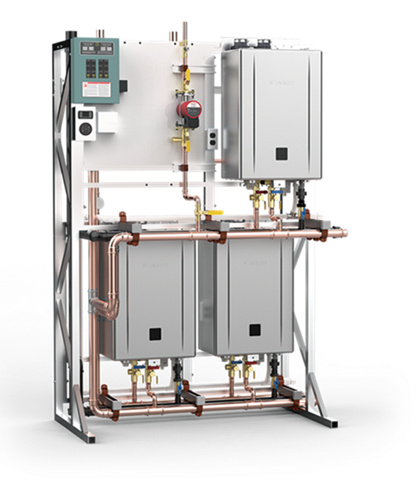
TECHNOLOGY, PERFORMANCE, AND SYSTEM DESIGN
Solutions Lineup
ENGINEERED SERIES: TTS Systems (Features & Benefits)
(TTS = Total Tankless Solution)
Most UNMATCHED Complete Water Heater Solution in the Industry
OPC (One Point of Connection)
Water, Power, Gas, Condensate, Recirculation, Storage
Resulting in a significant reduction in labor hours, contributing to improved operational efficiency, resource optimization, and reduction in business closure hours
Professionally engineered solutions with customized options through FIOPs (Factory Installed Options). All FIOPs are engineered and highly-modular.
TTS-S3 Shown, NCC199CDV Pro Units Included.

Slide 32
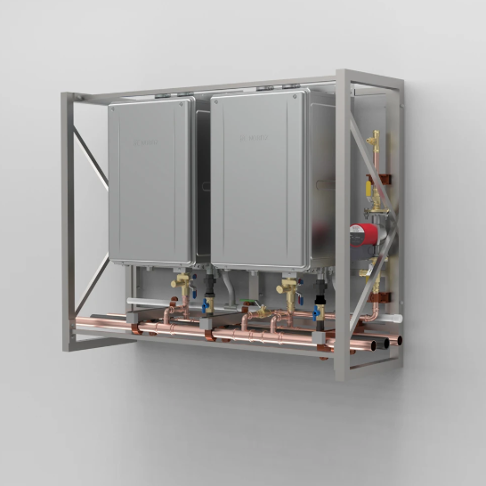
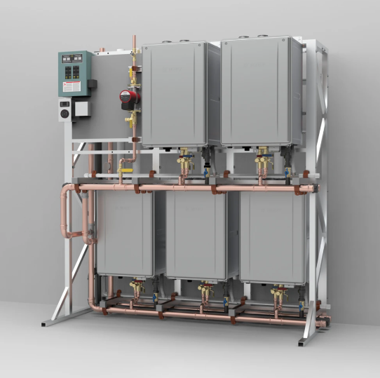
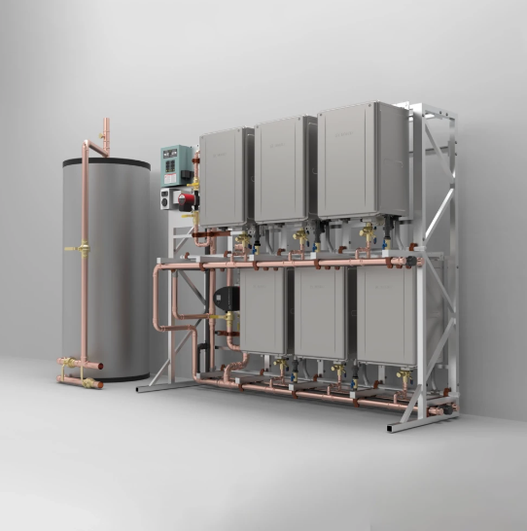
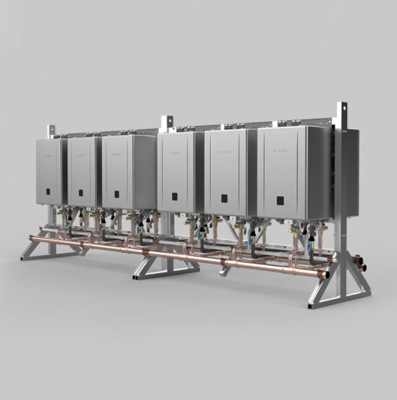
TECHNOLOGY, PERFORMANCE, AND SYSTEM DESIGN
Solutions Lineup
ENGINEERED SERIES: TTS Systems (Options)
SWH Series
All the features from other TTS Systems while utilizing a wall hung configuration
S Series
Floor standing configuration and boasts all features found on our TTS Systems
TWST Series
All the features found on our TTS Systems while also utilizing a storage tank
FIOP
Custom offerings that are tailored to the needs and demands of a business
Range from 399,800 to 799,600 BTU
S & TWST Series: Range from 399,800 to 1,199,400 BTU
Range from 399,800 to 4.8 Mil BTU

Slide 33

CUSTOMER ENGAGEMENT AND VALUE IDENTIFICATION
Customer Pain Points
Future View

Slide 34

CUSTOMER ENGAGEMENT AND VALUE IDENTIFICATION
Customer Pain Points
High Energy Costs
Inefficient tank water heaters lead to high utility bills by consuming energy even during idle periods.

Slide 35
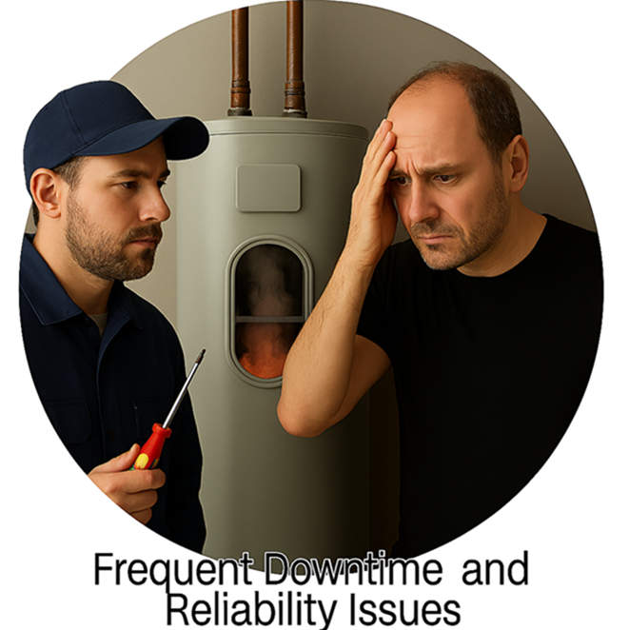
CUSTOMER ENGAGEMENT AND VALUE IDENTIFICATION
Customer Pain Points
Frequent Downtime and Reliability Issues
Tank failures and insufficient hot water cause operational disruptions and impact customer satisfaction.
Frequent parts failures and high-cost repairs.

Slide 36
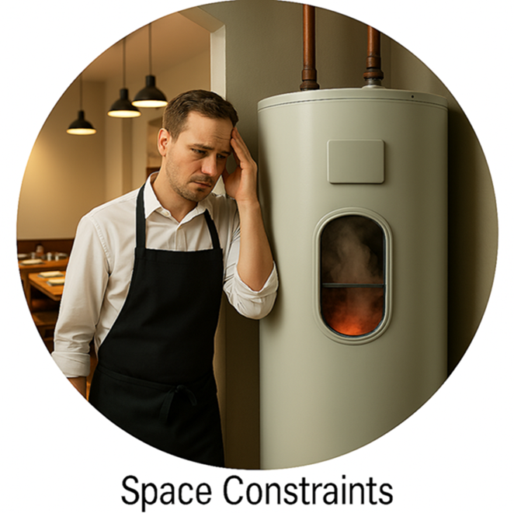
CUSTOMER ENGAGEMENT AND VALUE IDENTIFICATION
Customer Pain Points
Space Constraints
Bulky tank systems occupy valuable floor space, limiting room in restaurants, hotels, and multifamily properties.

Slide 37
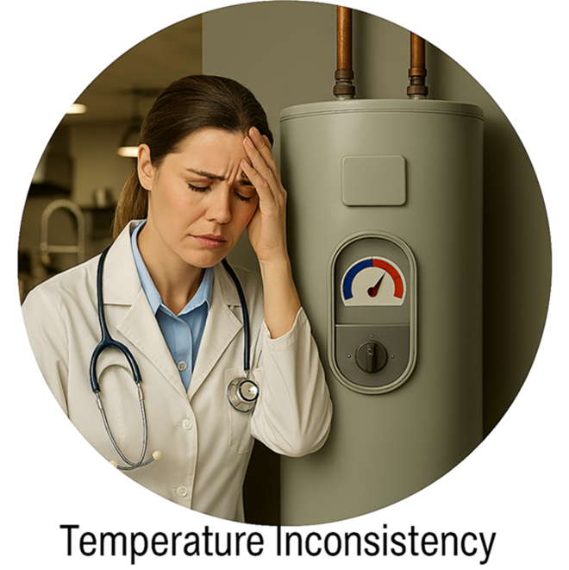
CUSTOMER ENGAGEMENT AND VALUE IDENTIFICATION
Customer Pain Points
Temperature Inconsistency
Fluctuating hot water temperatures cause frustration, especially in healthcare and food service settings.

Slide 38

CUSTOMER ENGAGEMENT AND VALUE IDENTIFICATION
Future View
Future Proofing and Scalability
Commercial customers evolve
Tankless platforms allow staged expansion and easier retrofits compared to traditional systems
Designing with growth in mind builds TRUST and often wins long term accounts

Slide 39

COMPETITIVE POSITIONING AND SALES STRATEGY
Tank & Boiler vs. Tankless Comparison
Application‑Based Selling Strategy

Slide 40
COMPETITIVE POSITIONING AND SALES STRATEGY
Tank & Boiler vs. Tankless Comparison
Energy Efficiency
Tankless systems heat water on demand, eliminating standby heat loss and lowering energy bills compared to traditional tanks.
Tankless systems have a higher turndown ratio due to modulating gas valves and on‑demand burners designed to adjust output precisely to real‑time flow.
Tanks & Boilers, by contrast, are built to heat and maintain large volumes of stored water, so their burners generally have less modulation range, leading to lower turndown capability and less efficiency at low-demand conditions.
Commercial Boiler
Noritz Solution

Slide 41
COMPETITIVE POSITIONING AND SALES STRATEGY
Tank & Boiler vs. Tankless Comparison
Thermal Cycling & Heat Stress
The high burner temperatures of commercial tank water heaters, combined with repeated thermal stress on the steel tank and insulating scale buildup that forces longer firing cycles, significantly shorten tank life, an effect that increases as hotter outlet water temperatures are required.

Slide 42
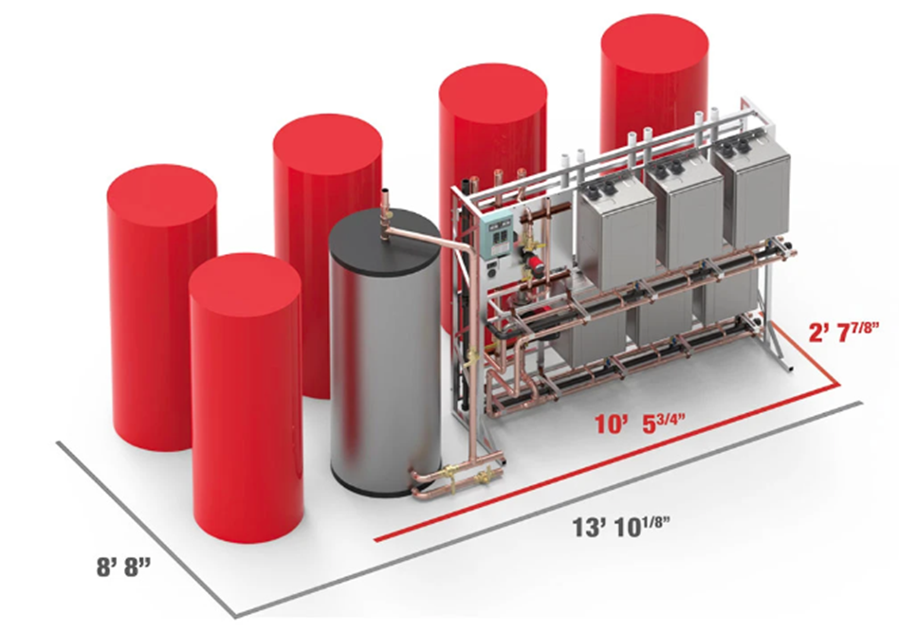
COMPETITIVE POSITIONING AND SALES STRATEGY
Tank & Boiler vs. Tankless Comparison
Space and Installation
Tank systems require large mechanical spaces, while tankless units offer compact designs that save floor space.

Slide 43
COMPETITIVE POSITIONING AND SALES STRATEGY
Tank & Boiler vs. Tankless Comparison
Operating Costs and Reliability
Tankless systems have lower lifetime costs due to higher efficiency, modular serviceability, and reduced risk of tank failure.
Increased Reliability
Lower Operating Cost
Help customers think beyond install price.
Reframe the conversation around TOTAL COST OF OWNERSHIP, not upfront equipment cost.

Slide 44
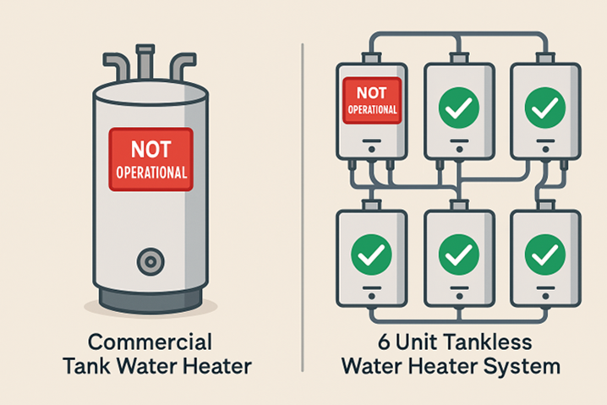
COMPETITIVE POSITIONING AND SALES STRATEGY
Tank & Boiler vs. Tankless Comparison
Business CLOSED
Business OPEN
System Redundancy and Safety
Multiple tankless units provide built-in redundancy, reducing shutdown risks and enhancing safety over traditional tanks.
This is a massive ADVANTAGE in ALL commercial environments where downtime equals lost revenue, unhappy tenants, or stoppage of production.

Slide 45
COMPETITIVE POSITIONING AND SALES STRATEGY
Application‑Based Selling Strategy
Start With DISCOVERY — Understand the Customer’s Goals Ask better questions before offering solutions:
Are they expanding?
Renovating?
Adding equipment?
Planning multi-year growth?
Designing with future demand in mind positions us as EXPERT ADVISORS and prevents undersized systems that limit future scalability.

Slide 46
COMPETITIVE POSITIONING AND SALES STRATEGY
Application‑Based Selling Strategy
Avoid Like for Like Thinking — ENGINEER the Best Solution
Existing systems are often incorrectly sized
Replacement should NOT equal replication
Slow down, EVALUATE the entire hot water ecosystem, begin collecting key information to begin the sizing process to deliver a true solution instead of solving a short-term symptom.

Slide 47
COMPETITIVE POSITIONING AND SALES STRATEGY
Application‑Based Selling Strategy
Design Around REAL Usage, Not Just Theoretical Load
Understand how the building normally uses hot water.
Many commercial sites have short, intense peaks rather than constant demand.
In some cases, a smaller rack paired with storage may outperform a larger tankless only solution.
Build for REAL WORLD usage patterns.

Slide 48
COMPETITIVE POSITIONING AND SALES STRATEGY
Application‑Based Selling Strategy
Water Quality Awareness
Never assume water conditions.
Test and verify, hardness, chloramines, as municipal treatment changes can dramatically impact system longevity.
If water pressure is an issue, booster pumps may be considered.
Educating the customer here positions us as professionals and PROTECTS both equipment life and brand reputation.

Slide 49
COMPETITIVE POSITIONING AND SALES STRATEGY
Application‑Based Selling Strategy
Recirculation Strategy Matters
Understand if recirculation is controlled.
Uncontrolled recirc loops can burn through lifecycle hours and erode warranty expectations.
Position SMART controls, proper pump strategies, and design considerations that protect long term system health.

Slide 50
COMPETITIVE POSITIONING AND SALES STRATEGY
Application‑Based Selling Strategy
Maintenance Expectations (Critical in Commercial)
Set expectations early: commercial tankless systems require maintenance, often twice per year.
Position this as a STRENGTH, not a weakness.
Proactive maintenance ensures efficiency, longevity, warranty protection, and predictable operation.
Customers appreciate transparency when it’s framed around RELIABILITY and lifecycle cost.

Slide 51
COMPETITIVE POSITIONING AND SALES STRATEGY
Application‑Based Selling Strategy
Serviceability and Accessibility
Rack systems designed for serviceability reduce labor costs and future downtime.
Highlight ease of maintenance, component access, and standardized layouts.
Engineers and facility managers APPRECIATE deeply about this once they understand it.

Slide 52
COMPETITIVE POSITIONING AND SALES STRATEGY
Application‑Based Selling Strategy
Commercial Professional Positioning
Always aim to educate, not just sell
Test assumptions, validate water quality, verify demand, and explain tradeoffs
The goal is to be seen as the expert GUIDING THE DECISION, not the vendor pushing equipment.

Slide 53
SIZING REQUIREMENTS & APPLICATION RECOMMENDATION
Sizing Inputs & Their Value
Recommended Solution Offering

Slide 54

SIZING REQUIREMENTS & APPLICATION RECOMMENDATION
Sizing Inputs & Their Value
Number of Floors
What It Is
Why It Matters
Value
How many levels the hot water system must supply
- Vertical height creates static head pressure loss.
- More floors often require longer pipe runs, increasing heat loss and impacting recirculation design.
- High rise buildings may require multiple zones or split systems.
Ensures the system maintains consistent pressure, temperature, and response time across all levels, avoiding hot water delays or insufficient flow.

Slide 55

SIZING REQUIREMENTS & APPLICATION RECOMMENDATION
Sizing Inputs & Their Value
Number of Shower Heads
What It Is
Why It Matters
Value
Total showers used by guests, employees, residents, or gym patrons.
- Showers represent one of the highest GPM demands in commercial applications.
Correctly modeling shower demand prevents peak hour shortages, ensuring systems deliver continuous hot water even during heavy usage.
- Peak-use periods (morning rush, gym turnover, shift changes) heavily influence peak flow sizing.

Slide 56

SIZING REQUIREMENTS & APPLICATION RECOMMENDATION
Sizing Inputs & Their Value
Number of Sinks
What It Is
Why It Matters
Value
Includes handwashing stations in restrooms, kitchens, break rooms, classrooms, etc..
- Individually low flow, but collectively significant in high traffic environments.
Accurate sink counts prevent undersizing by accounting for the “always-on” background demand that supports hygiene and operation.
- Predictable, frequent use contributes to baseline (continuous) demand.

Slide 57

SIZING REQUIREMENTS & APPLICATION RECOMMENDATION
Sizing Inputs & Their Value
Number of Dishwashers
What It Is
Why It Matters
Value
Commercial warewashing equipment in restaurants, cafeterias, hospitality, etc.
- Dishwashers require high-temperature, high-volume bursts.
Properly sized tankless systems ensure sanitation compliance, reduce recovery delays, and prevent equipment downtime in food service settings.
- Booster heaters depend on consistent inlet temperature — tankless must sustain this.
- Cycle-based operation creates intermittent but intense GPM and BTU loads.

Slide 58

SIZING REQUIREMENTS & APPLICATION RECOMMENDATION
Sizing Inputs & Their Value
Number of Washing Machines
What It Is
Why It Matters
Value
Laundry equipment in hotels, multifamily, spas, gyms, and hospitals.
- Washers draw large volumes of hot water during fill cycles.
Ensures stable operation during heavy laundry turnover, prevents slow recovery, and reduces energy waste by matching tankless output to real usage.
- Multiple machines running simultaneously can create peak stacking.
- Hot cycles significantly increase total daily consumption.

Slide 59

SIZING REQUIREMENTS & APPLICATION RECOMMENDATION
Sizing Inputs & Their Value
Number of Public Lavatories
What It Is
Why It Matters
Value
Restrooms open to the public in lobbies, event spaces, retail, dining, etc.
- High variability and peak traffic spikes (events, lunch hours).
Ensures fast delivery of hot water for guests and compliance with sanitation expectations, improving the customer experience.
- Multi sink stations create cumulative demand that influences recirculation design.

Slide 60

SIZING REQUIREMENTS & APPLICATION RECOMMENDATION
Sizing Inputs & Their Value
Number of Water Fixtures (Overall Fixture Count)
What It Is
Why It Matters
Value
A total count of all hot-water-consuming outlets in the building.
- Fixture count is a fundamental basis for total building load, per industry sizing standards.
Allows precise system right sizing - not too small (risk of shortages), not too large (wasted capital and operational cost).
- Helps calculate simultaneous usage probability, which informs the true GPM capacity required.
- Critical for cascading and system redundancy planning.

Slide 61
SIZING REQUIREMENTS & APPLICATION RECOMMENDATION
Sizing Inputs & Their Value
How These Inputs Work Together
Each individual sizing need contributes to a bigger picture:
Fixtures determine total peak GPM
Building layout impacts temperature maintenance & recirculation needs
Equipment loads (dishwashers, washers) dictate BTU demand
Simultaneous usage drives cascading system design
Environmental and operational needs dictate redundancy
Collectively, these inputs allow you to design a high-performance, energy-efficient, precise commercial tankless solution tailored to the building’s actual behavior — not guesswork.

Slide 62
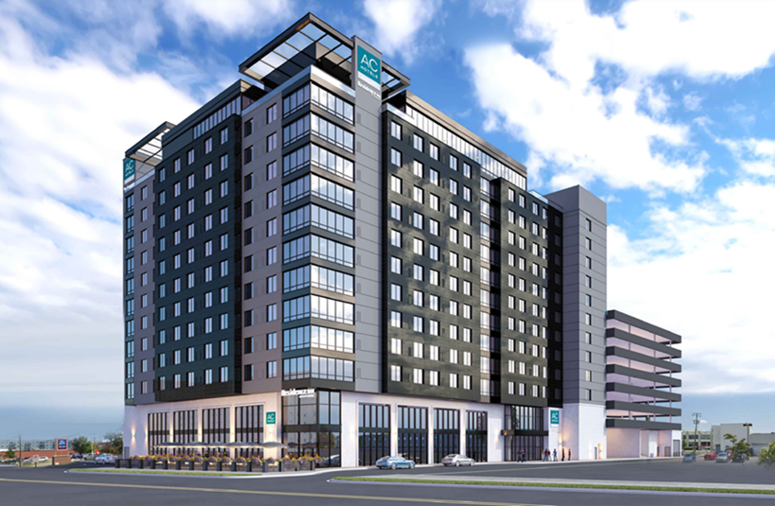
SIZING REQUIREMENTS & APPLICATION RECOMMENDATION
Sizing Inputs & Their Value
Scenario Snapshot: 12‑Story Business Hotel with Gym + Banquet
Building Type:
Full‑service hotel
Floors:
12 (guest floors 2–12; lobby + kitchen + banquet on 1)
Occupancy:
220 rooms
Amenities:
Lobby restrooms, fitness center, banquet kitchen, laundry
Target delivery temperature (mixed at point of use): 120 °F
Incoming water temperature (winter design):
50 °F - ΔT for sizing: 90 °F (140 – 50)
Recirculation:
Yes, multi‑zone risers
Notes:
Feedback

Slide 63
SIZING REQUIREMENTS & APPLICATION RECOMMENDATION
Sizing Inputs & Their Value
Scenario Snapshot: 12‑Story Business Hotel with Gym + Banquet
Number of Building Floors
Input: 12 floors
Why it matters (applied):
The vertical rise (~120–140 ft from plant to top fixtures) imposes static head and requires boosted recirculation for top‑floor response times.
Design impact:
Split the system into two primary riser zones with dedicated balancing valves and recirc pumps sized for each loop. This also enables staged heating plant operation.
Value realized:
Consistent temperature and response across floors, reduced “cold first‑minute” complaints, and better pump energy control.
Notes:
Feedback

Slide 64
SIZING REQUIREMENTS & APPLICATION RECOMMENDATION
Sizing Inputs & Their Value
Scenario Snapshot: 12‑Story Business Hotel with Gym + Banquet
2) Number of Shower Heads
Input: 260 shower heads (approx. 1.2 per key across singles/doubles + 4 for gym + 6 for staff locker rooms)
Peak modeling assumptions:
Fixture flow rate: 1.8 GPM per shower head (modern commercial low‑flow)
250 Private Showers & 10 Public Showers (Probability of simultaneous use higher with Public Showers)
Design impact:
Shower demand dominates peak flow; system must support this load concurrently with baseline fixtures and intermittent spikes from high occupancy.
Value realized:
Prevents peak‑hour shortages, protects guest experience.
Notes:
Feedback

Slide 65
SIZING REQUIREMENTS & APPLICATION RECOMMENDATION
Sizing Inputs & Their Value
Scenario Snapshot: 12‑Story Business Hotel with Gym + Banquet
3) Number of Sinks
Input:
Guestroom lavatories: 220 / Public lavatories (lobby, banquet foyer, fitness): 34
Kitchen hand sinks + prep: 10 : Total sinks: 264
Peak modeling assumptions:
Public Lav & Private Lav - Flow Rate: 0.5 GPM (Probability of simultaneous use higher with Public Lav’s)
Kitchen Hand Sinks, Prep Sinks (Flow Rate: 2.0 GPM - 5.0 GPM)
Important to list out every type of fixture in commercial kitchen as GPM varies per fixtures type.
Design impact:
Sinks contribute to baseline, predictable demand; must be layered into peak modeling to avoid undersizing.
Value realized:
Right‑sizing avoids “mystery” shortages caused by background draws.
Notes:
Feedback

Slide 66
SIZING REQUIREMENTS & APPLICATION RECOMMENDATION
Sizing Inputs & Their Value
Scenario Snapshot: 12‑Story Business Hotel with Gym + Banquet
4) Number of Dishwashers
Input:
1 high‑temp flight‑type dishwasher (banquet/BOH) / 2 undercounter units (bar & pantry)
Why it Matters:
Flight‑type: 2.5–7.5GPM during operation 140–160 °F inlet target; cycles continuously during events.
Undercounter: 0.6–3.0 GPM intermittent cycles of 60–120 sec with recovery.
Dishwasher model numbers crucial to accurately determine peak flowrate and necessary temperature requirements.
Design impact:
Dish machines are temperature‑sensitive and need a certain flowrate to operate properly.
Value realized:
Sanitation compliance and consistent service throughput.
Notes:
Feedback

Slide 67
SIZING REQUIREMENTS & APPLICATION RECOMMENDATION
Sizing Inputs & Their Value
Scenario Snapshot: 12‑Story Business Hotel with Gym + Banquet
5) Number of Washing Machines
Input:
8 (hotel OPL: 4 × 60 lbs., 4 × 40 lbs.)
Why It Matters:
Draw per active machine: 2.0–3.0 GPM during fill spikes
Crucial to record model numbers or washer capacity in lbs. to ensure proper demand is satisfied.
Design impact:
Laundry creates short, intense bursts that overlap with showers (morning strip) and dish (breakfast/banquet).
Value realized:
Avoids slow recovery, keeps housekeeping schedules intact.
Notes:
Feedback

Slide 68
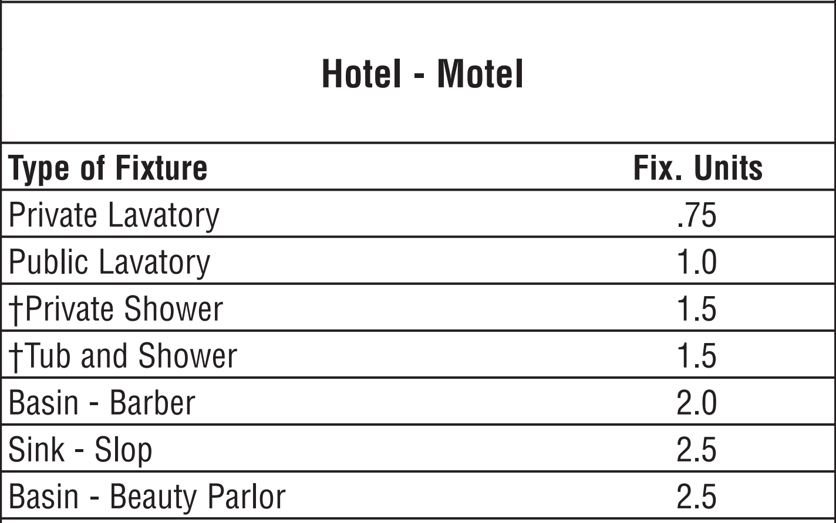
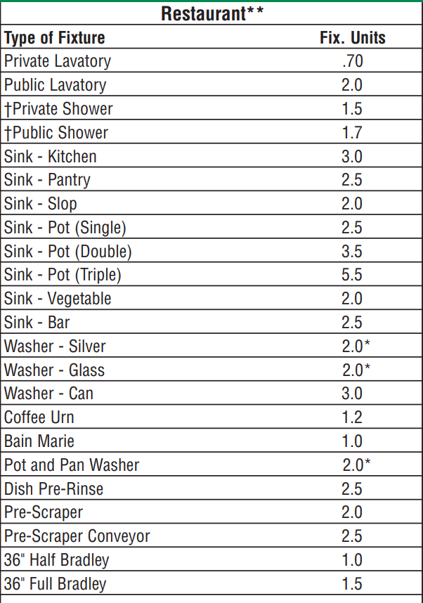
SIZING REQUIREMENTS & APPLICATION RECOMMENDATION
Sizing Inputs & Their Value
Scenario Snapshot: 12‑Story Business Hotel with Gym + Banquet
7) Number of Water Fixtures (Overall Fixture Count)
Input:
Showers: 260
Lavatories (guest + public + staff): 264
Kitchen/Prep/Dish: 13 total fixtures
Laundry: 8 machines
Fitness/Locker: already included above (showers/sinks)
Total fixtures for probability modeling: 662
Why it matters:
Overall count supports simultaneity probability and cascaded system planning.
Used to confirm Peak GPM modeling, ensure redundancy, and handle maintenance without service disruption.
ASHRAE Modified Hunter Curve - Fixture Units
Notes:
Feedback

Slide 69
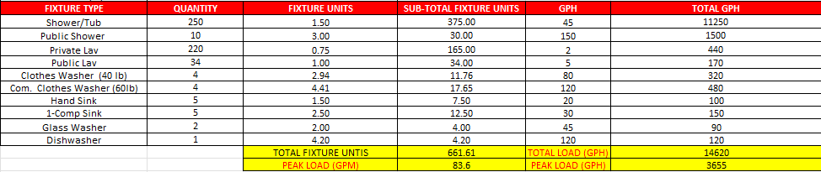
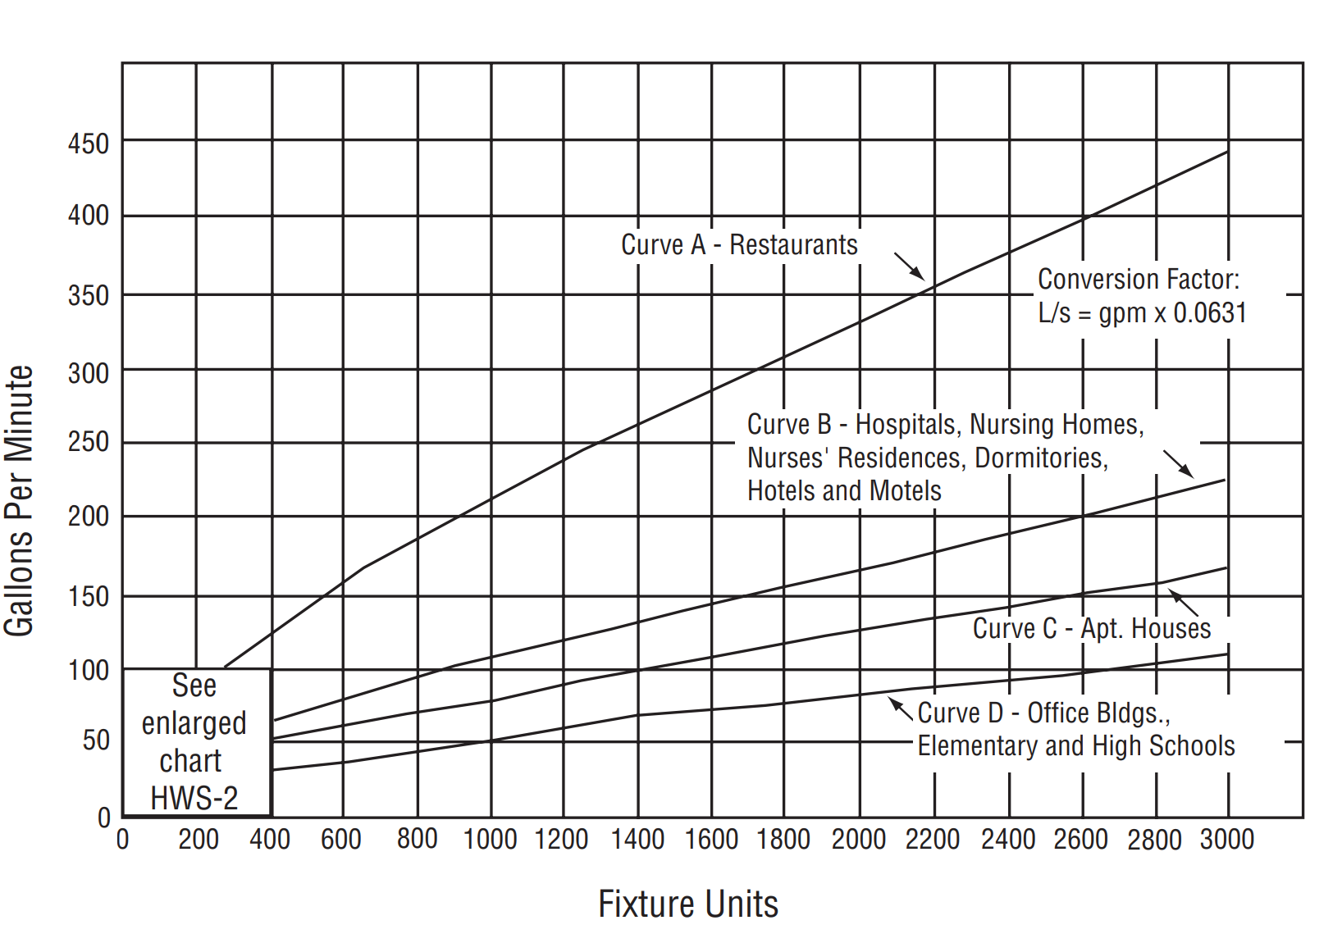
SIZING REQUIREMENTS & APPLICATION RECOMMENDATION
Scenario Snapshot: 12‑Story Business Hotel with Gym + Banquet
Sizing Inputs & Their Value
Pulling It Together — Peak GPM, GPH & BTU/h Load
TANKLESS AND STORAGE
Demand Factor x Total GPH = Peak Demand | 0.25 x 14,620 = 3,655 GPH
Btu/H (HEAT LOAD) T & S = GPH x p x Cp x DeltaT/ eff
3655 x 8.31 x 1 x (140-50) / .98 = 2,789,362 Btu/H
TANKLESS ONLY
Btu/H ( HEAT LOAD) TANKLESS =GPM x 60(min/ hr.) x p x Cp x Delta T/ eff
83.6 x 60 x 8.31 x 1 x (140 - 50) / .98 = 3,828,026 Btu/H
p = density of water ( 8.31 LBm / gal)
Cp = Specific Heat [1 Btu/ (LBm x deg F)]
Delta T = Temp Rise ( Tout - Tin)
Notes:
Feedback

Slide 70
SIZING REQUIREMENTS & APPLICATION RECOMMENDATION
Scenario Snapshot: 12‑Story Business Hotel with Gym + Banquet
Sizing Inputs & Their Value
Pulling It Together — Total Units
Choice of equipment design does take retrofit into account; however, application alone is the main deciding factor. Add +1 or +2 to system design for redundancy, and serviceability.
Recommendations are typically made on a case‑by‑case basis, with the specific application being one of the most critical factors.
By understanding the types of fixtures commonly used in different applications, one can more accurately anticipate the appropriate system design direction.
Options | Model | Qty of Racks | Qty of Heaters | Qty of Storage Tanks (175 gal.) | Max Input (btu/hr.) | Max Total Flowrate (GPM) | Total Recovery (GPH) | 1st Hour Delivery (gal.)
1 – Tankless Only | TTS-S20 | 4 | 20 | - | 3,998,000 | 87.1 | 5,226 | -
2 – Tankless with Storage | TTS-TWST16 | 4 | 16 | 2 | 3,198,400 | 69.7 | 4,179 | 4,424
Notes:
Feedback

Slide 71
SIZING REQUIREMENTS & APPLICATION RECOMMENDATION
Scenario Snapshot: 12‑Story Business Hotel with Gym + Banquet
Sizing Inputs & Their Value
What Each Input Enabled (Value Recap)
Floors:
Informed zoning and recirculation strategy → consistent top‑floor performance.
Shower heads:
Defined the dominant peak GPM load.
Sinks:
Captured baseline/background demand → avoided hidden undersizing.
Dishwashers:
Ensured temperature stability for sanitation during cycles.
Washing machines:
Accounted for stacked bursts during hotel turnover.
Public lavatories:
Drove fast‑delivery recirc near event spaces.
Total fixture count:
Supported probability modeling, cascade sizing, and N+1 redundancy.
Notes:
Feedback

Slide 72
SIZING REQUIREMENTS & APPLICATION RECOMMENDATION
Recommended Solution Offering
Commercial Application Recommendation Scope Based on Sizing Inputs & System Type
Each series - Modular, Configured, and Engineered - fits different levels of complexity, installation constraints, and operational demands.
The sizing inputs (floors, fixtures, equipment loads, etc.) determine when each solution provides the best outcome.
MODULAR
CONFIGURED
ENGINEERED

Slide 73
SIZING REQUIREMENTS & APPLICATION RECOMMENDATION
Recommended Solution Offering
MODULAR SERIES (CMK / CRK Systems)
Best for SIMPLE to MID‑RANGE Projects
Ideal When the Sizing Inputs Show:
Ideal for emergency installs
Low to moderate fixture count
Light-to-normal peak demand
Retrofit where existing tanks or small quantity of tankless banks are being replaced
Limited mechanical room or rooftop access
Why This Series Works:
The Modular Series is designed for fast deployment, easy transport, and simple scalability.

Slide 74
SIZING REQUIREMENTS & APPLICATION RECOMMENDATION
Recommended Solution Offering
MODULAR SERIES (CMK / CRK Systems)
Best for SIMPLE to MID‑RANGE Projects
Sizing Input Insight | Why Modular Works
Retrofit situations | “Retrofit Easy Button” + fast install under 2 hours
Limited site access (hallways, elevators) | Lightweight aluminum frame & modular components
Budget-sensitive customers | “Best Value in the Industry”
Recommended For:
Small hotels / motels
Quick-service restaurants
Light commercial retail
Small gyms
Single-story schools or offices

Slide 75
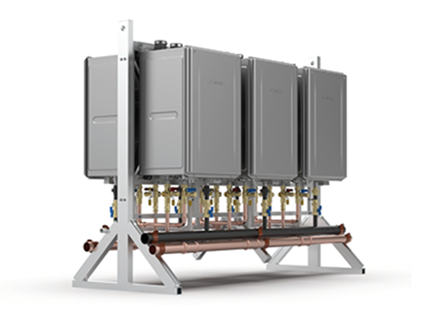
SIZING REQUIREMENTS & APPLICATION RECOMMENDATION
Recommended Solution Offering
2. CONFIGURED SERIES (CR Systems)
Best for MID‑RANGE to HIGHER DEMAND Projects
Ideal When the Sizing Inputs Show:
Moderate to high fixture counts
Multiple showers, laundry stations, or restaurant dishwashers2–6 floors
Need for rooftop installation or tight mechanical rooms
Predictable or heavy peak usage (hospitality, multifamily, gyms)
Why This Series Works:
Configured Systems provide factory-assembled, pre-piped, pre-wired racking that significantly reduces install time while supporting stronger water heating demand.

Slide 76
SIZING REQUIREMENTS & APPLICATION RECOMMENDATION
Recommended Solution Offering
2. CONFIGURED SERIES (CR Systems)
Best for MID‑RANGE to HIGHER DEMAND Projects
Sizing Input Insight | Why Configured Works
Rooftop or mechanical room constraints | Low center of gravity → easier and safer placement
Busy facilities needing fast changeover | Pre-wired multi-systems reduce install time
Requires direct site shipment | Systems arrive professionally crated
Recommended For:
Mid-size hotels
Multifamily properties
Full-service restaurants
Fitness centers
Schools / dormitories

Slide 77

SIZING REQUIREMENTS & APPLICATION RECOMMENDATION
Recommended Solution Offering
3. ENGINEERED SERIES (TTS Systems)
Best for Complex, High-demand, or Customized projects
Ideal When the Sizing Inputs Show:
High-rise buildings
Large fixture counts (continuous use expectations)
Multiple dishwashers + large laundry operations
Complex recirculation loops & storage needs
Long pipe runs with high-temperature maintenance requirements
Need for full turnkey design
Critical operations (downtime not acceptable)
Why This Series Works:
The Engineered Series is essentially a fully designed commercial plant room on a skid, delivering unmatched ease, capacity, and customization.

Slide 78
SIZING REQUIREMENTS & APPLICATION RECOMMENDATION
Recommended Solution Offering
3. ENGINEERED SERIES (TTS Systems)
Best for Complex, High-demand, or Customized projects
Sizing Input Insight | Why Configured Works
High critical load (big GPM + high BTU) | OPC (One Point of Connection) simplifies massive systems
Many floors / long runs | Included recirculation & storage options solve temperature maintenance
Complex equipment loads | Custom FIOPs allow electrical, gas, storage, and control tailoring
Need for lowest downtime | Turnkey design reduces install hours & operational disruption
Hospitals, hotels, stadiums | Full engineering ensures compliance and peak performance
Recommended For:
Hospitals & medical centers
Large hotels & resorts
Large multifamily high-rises
Universities
Industrial facilities
Stadiums, airports, convention centers

Slide 79

SIZING REQUIREMENTS & APPLICATION RECOMMENDATION
Recommended Solution Offering
Putting It All Together: Recommendation Framework
Step 1 — Use Sizing Inputs to Gauge Complexity
Step 2 — Assess Building Structure
Step 3 — Evaluate Operational Needs
Step 4 — Match to Customer Environment
MODULAR
Few fixtures
CONFIGURED
Moderate fixtures
ENGINEERED
Many fixtures + equipment
MODULAR
Limited space , Emergency Replacement
CONFIGURED
Planned Replacement or when a quick professional install is needed
ENGINEERED
Spec’d or planned replacement. Custom solution for mechanical room
MODULAR
Budget-focused
CONFIGURED
Time-sensitive installs
ENGINEERED
Zero downtime & engineered requirements
MODULAR
Light commercial
CONFIGURED
Mid-market commercial
ENGINEERED
Large / mission critical

Slide 80
KEY TAKEAWAYS
Commercial Water Heating Essentials
Technology, Performance, and System Design
Customer Engagement and Value Identification
Competitive Positioning and Sales Strategy
Application Demand & Sizing Requirements

Slide 81
KEY TAKEWAYS
Introduction to Commercial Water Heating
What Is a Commercial Gas Tankless System?
Commercial Tankless Use Cases
Critical Role in Industries
Shift from Tank & Boiler to Tankless
Energy Efficiency and Sustainability
Sales Strategy and Customer Value
On-Demand Hot Water Heating
Advanced Combustion Control
Modular Scalability and Redundancy
Compact Design and Reliability
Restaurants and Food Service
Hotels, Hospitality, & Multi-Family
Healthcare Facilities
Educational Institutions & Dormitories
Commercial Water Heating Essentials

Slide 82
KEY TAKEWAYS
Key Product Features
Solutions Lineup
High Thermal Efficiency
Wide Modulation Range
Built-in Redundancy
Venting and Durability Features
Engines
Hybrid Hot
NCC199CDV
Series
Modular – CMK / CRK
Configured - CR
Engineered - TTS
Technology, Performance, and System Design

Slide 83
KEY TAKEWAYS
Customer Pain Points
Future View
High Energy Costs
Frequent Downtime and Reliability Issues
Temperature Inconsistency
Future Proofing and Scalability
Customer Engagement and Value Identification

Slide 84
KEY TAKEWAYS
Tank & Boiler vs. Tankless Comparison
Application‑Based Selling Strategy
Energy Efficiency
Thermal Cycling & Heat Stress
Space and Installation
Operating Costs and Reliability
System Redundancy and Safety
Start With DISCOVERY — Understand the Customer’s Goals
Avoid Like for Like Thinking — ENGINEER the Best Solution
Design Around REAL Usage, Not Just Theoretical Load
Water Quality Awareness
Recirculation Strategy Matters
Maintenance Expectations (Critical in Commercial)
Serviceability and Accessibility
Commercial Professional Positioning
Competitive Positioning and Sales Strategy

Slide 85
KEY TAKEWAYS
Sizing Inputs & Their Value
What It Is
Number of Shower Heads
Number of Sinks
Number of Dishwashers
Number of Washing Machines
Number of Public Lavatories
Number of Water Fixtures (Overall Fixture Count)
Why It Matters
Value
Number of Floors
Scenario Snapshot:
12‑Story Business Hotel with Gym + Banquet
Application Demand & Sizing Requirements

Slide 86
KEY TAKEWAYS
Recommended Solution Offering
Commercial Application Recommendation Scope Based on Sizing Inputs & System Type
1. MODULAR SERIES (CMK / CRK Systems)
2. CONFIGURED SERIES (CR Systems)
3. ENGINEERED SERIES (TTS Systems)
Putting It All Together: Recommendation Framework
Application Demand & Sizing Requirements

Slide 87
QUESTIONS?
SALES TRAINING

