Slide 2





TRAINING AGENDA
Combi Boiler
Essentials
Technology, Performance, and System Design
Customer Engagement and Value Identification
Competitive Positioning and Sales Strategy
Application Demand & Sizing Requirements

Slide 3
COMBI BOILER ESSENTIALS
What Is a Combi Boiler?
How It Works
Market Context
System Comparisons

Slide 4
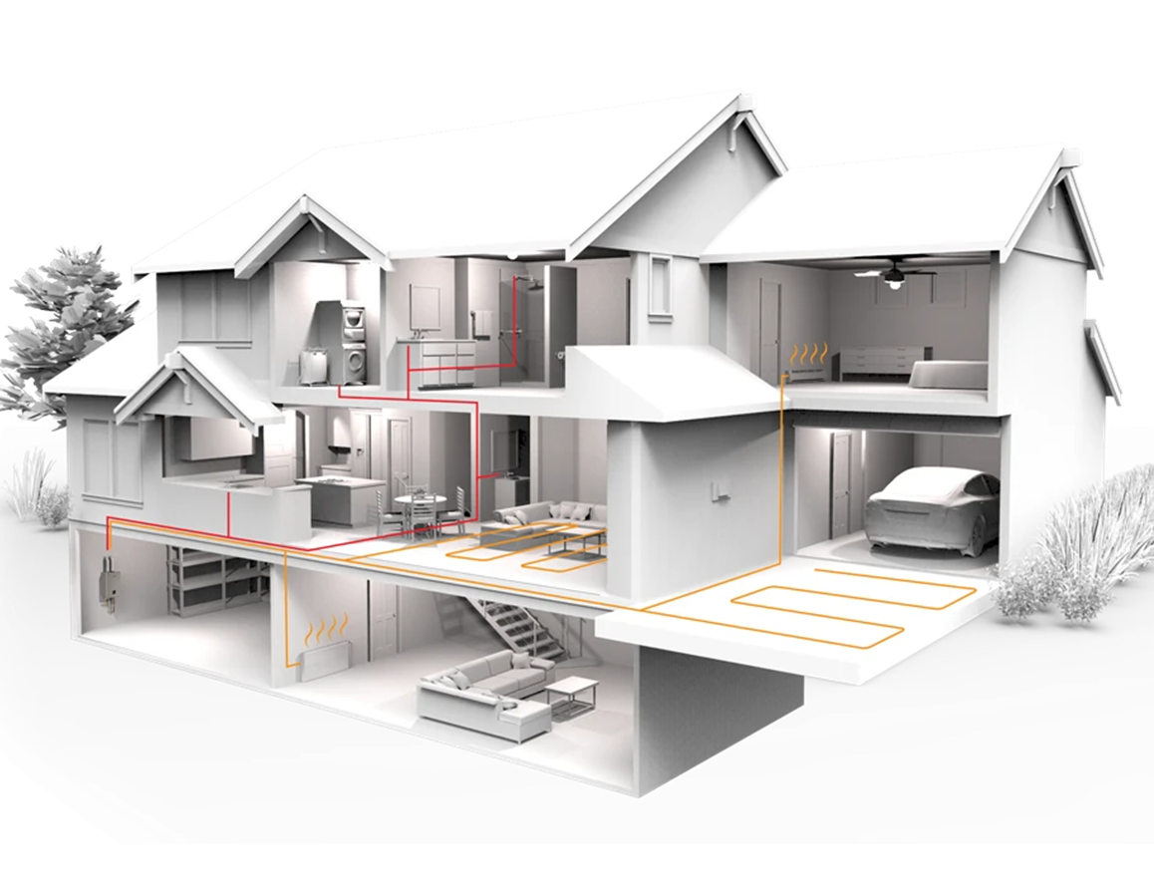
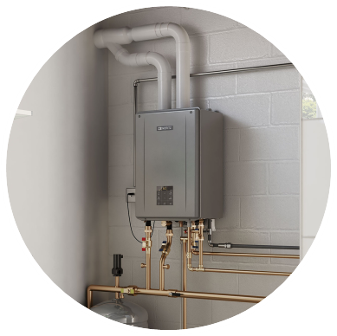
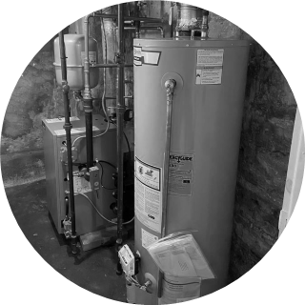
COMBI BOILER ESSENTIALS
What Is a Combi Boiler?
A combi (combination) boiler provides:
  Space heating (radiant floors, baseboard, fan coils)
  Domestic hot water (DHW) for faucets, showers, appliances
Combines heating boiler + water heater into one compact unit
No storage tank required
Immediate value: space savings + efficiency

Slide 5
COMBI BOILER ESSENTIALS
How Noritz Combi Boiler Works
Heating Only
Closed loop system
Hot water heated by primary & secondary heat exchangers
Recirculated hot water to provide space heating comfort
3-Way Valve: Variable Distribution Control
Hot Water
DHW
Heating

Slide 6
COMBI BOILER ESSENTIALS
How Noritz Combi Boiler Works
Domestic Hot Water Only
Hot water to fixture demand
Heated by flat plate heat exchanger
Hot water for heating heats flat plate heat exchanger
3-Way Valve: Variable Distribution Control
Hot Water
DHW
Heating

Slide 7

COMBI BOILER ESSENTIALS
How Noritz Combi Boiler Works
Simultaneous Heating & DHW
Our ADVANCED technology provides BOTH Heating and Domestic Hot Water simultaneously
Homeowners can use showers or faucets without shutting off or noticeably reducing home heating, ensuring consistent comfort
3-Way Valve: Variable Distribution Control
Hot Water
DHW
Heating

Slide 8
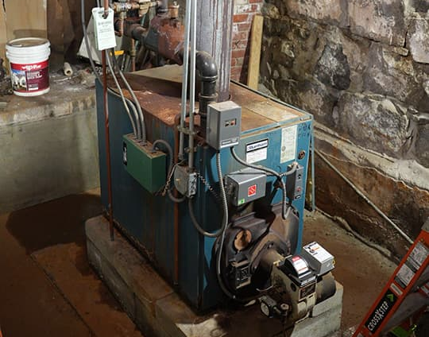
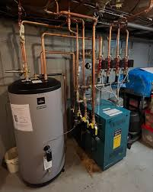
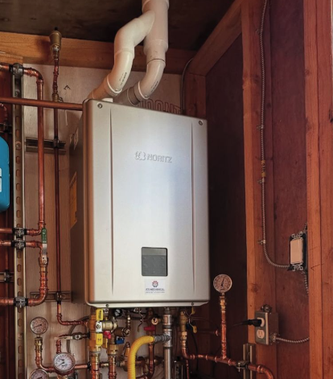
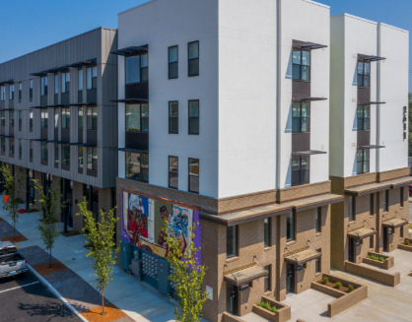
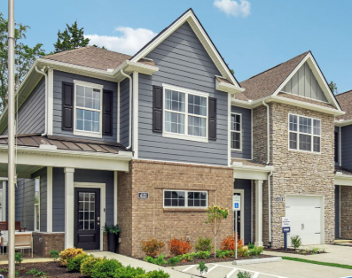
COMBI BOILER ESSENTIALS
Market Context
Market Shift
Strong Demand
Retrofits
  Replacing aging boilers and storage tanks
Urban Housing
  Condos, townhomes, accessory dwelling units (ADUs)
New Construction
  Energy codes
  Smaller footprint
  Reduction in termination for furnace
Large Storage & Low-Efficient Atmospheric Systems
High-Efficient,
Compact Solution
Combi boilers win where space, efficiency, simplicity, & high utility rebates are primary drivers

Slide 9
COMBI BOILER ESSENTIALS
System Comparisons
Noritz Combi Boiler VS
Tank Water Heater
System Boiler & Indirect Tank
Most Combi Boilers
Endless Hot Water, Higher Efficiency, No Standby Loss
Lower Upfront Cost, Smaller Footprint, Fewer Components
Best overall comfort control with simultaneous performance, most combi boilers will do heating OR domestic hot water

Slide 10

TECHNOLOGY, PERFORMANCE, AND SYSTEM DESIGN
Core Technologies
Performance Metrics
System Design Fundamentals
Venting Options
Wiring Options
Plumbing Diagrams
Heating Applications

Slide 11
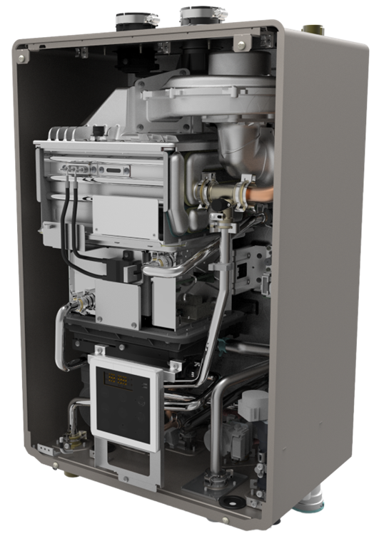
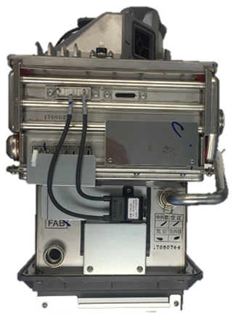

TECHNOLOGY, PERFORMANCE, AND SYSTEM DESIGN
Core Technologies
Premix Burner
Single stage, Ceramic fiber
Significantly reduces harmful flue gases
Primary Heat Exchanger
ASME H Stamp
316L Austenite Stainless Steel, most Corrosion Resistance Material
Secondary Heat Exchanger
316L Austenite Stainless Steel
Pre-heats water with exhaust gases
Bruner & Heat Exchangers

Slide 12
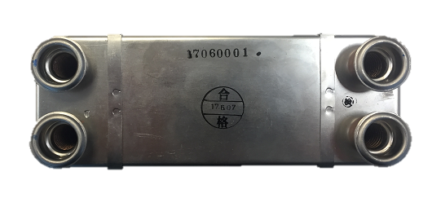
TECHNOLOGY, PERFORMANCE, AND SYSTEM DESIGN
Core Technologies
SCR (Stress Corrosion Resistant) Austenite Stainless Steel
Indirectly heats the DHW side of the system, less scale build up on the DHW side due to the lower heating temperatures
Flat Plate Heat Exchanger
Heat Exchanger

Slide 13
TECHNOLOGY, PERFORMANCE, AND SYSTEM DESIGN
Performance Metrics
Models (2) | NRCB180DV | NRCB199DV
Standard Gas Input (BTUH) | Min: 18,000 Max: 180,000 | Min: 18,000 Max: 199,900
Heating Gas Input (BTUH) | Min: 18,000 Max: 100,000 | Min: 18,000 Max: 120,000
DHW Flow Range (GPM) | 0.4 – 9.8 | 0.4 – 11.1
AFUE | 95%
DHW Burner Off Flow (GPM) | 0.29
Heating Temp Range | 100F – 180F (As low as 80F with setting)
DHW Temp Range | 90F – 140F
Simultaneous Heating & DHW | YES
Max Elevation | 10,000 feet
Connection Sizes | ¾” DHW & Gas, 1” Heating, ½” Auto Feeder & Condensate
Quick Connect Capable | YES (With same BTU EZ or CDV Unit)
Outdoor Temp Sensor | INCLUDED
Warranty | 10 Year Heat Exchanger, 5 Year Parts, 1 Year Labor
Key Specifications

Slide 14
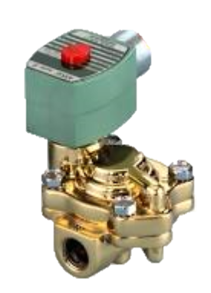
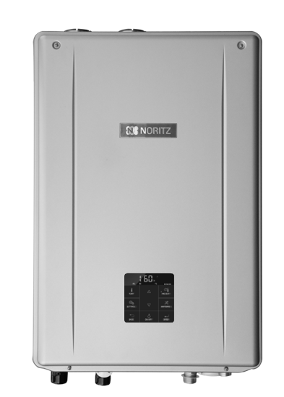

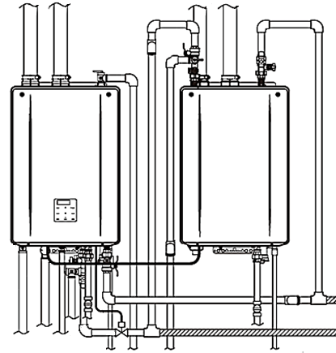
TECHNOLOGY, PERFORMANCE, AND SYSTEM DESIGN
Performance Metrics
IMPORTANT NOTE
Solenoid Valve is needed when using a QC System with any EZ Unit
The Solenoid Valve must be Normal Closed Valve and Slow Closing to avoid water hammer
For more Domestic Hot Water demand, ADD 1 EZ Model at the same Max BTUH as the Combi
Solenoid Valve must be
¾” 120V AC - 1.5 Amp Max
Connect with QC-2,
Quick-Connect Cord.
Mount units 3”-18” apart
Expansion

Slide 15
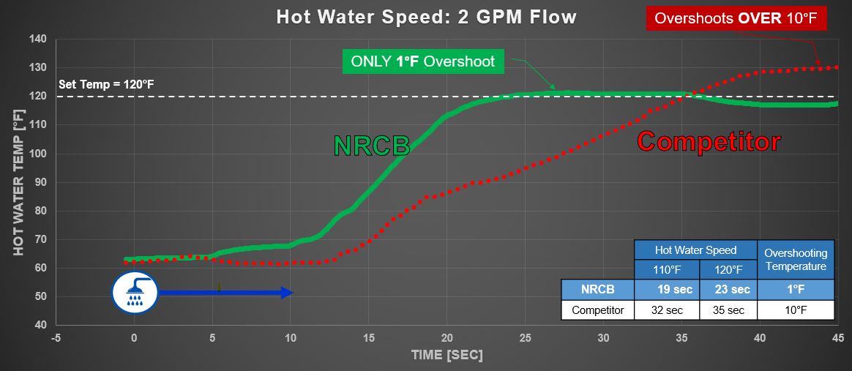
TECHNOLOGY, PERFORMANCE, AND SYSTEM DESIGN
System Design Fundamentals
Quick Temperature Control & Stability

Slide 16
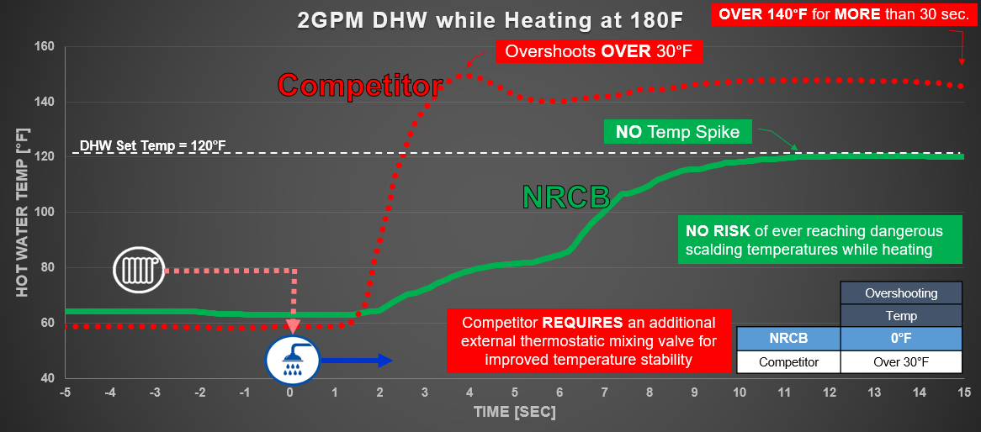
TECHNOLOGY, PERFORMANCE, AND SYSTEM DESIGN
System Design Fundamentals
Quick Temperature Control & Stability

Slide 17
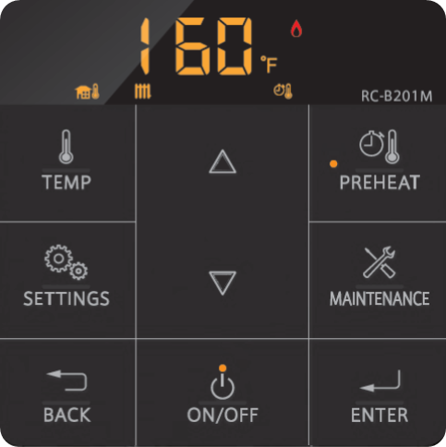
TECHNOLOGY, PERFORMANCE, AND SYSTEM DESIGN
System Design Fundamentals
Heating Control Settings
User Mode – 5 Options
1. Standard (Manual Heating Settings) most common
2. Outdoor Reset Control
3. External Control (0-10 V) not common
Installer Mode – 19 Options
Maintenance Mode
Diagnostic Mode – 3 Options
Pre-Heat Timer Setting
Control Panel

Slide 18
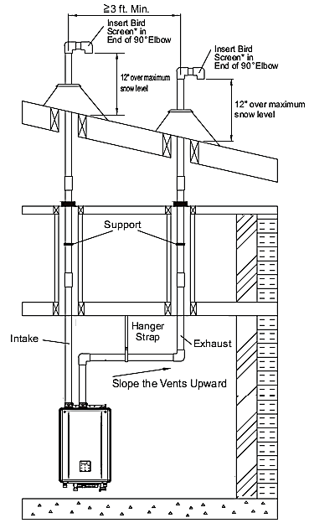
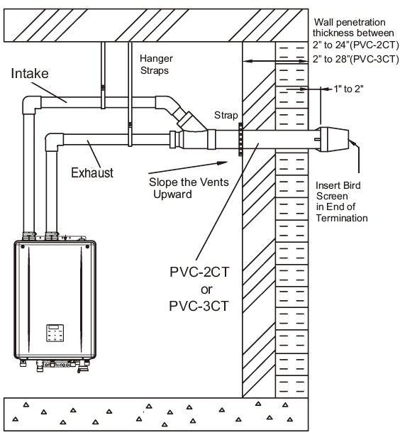
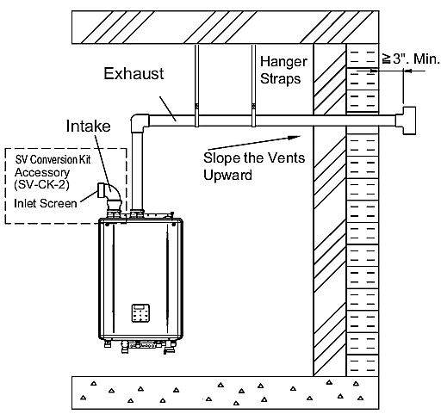
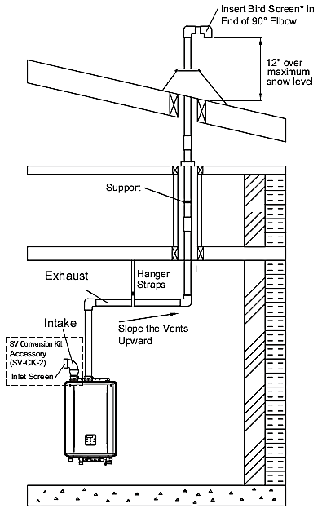
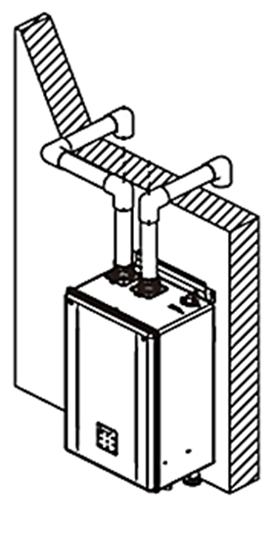
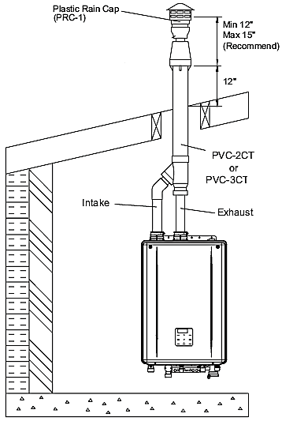
TECHNOLOGY, PERFORMANCE, AND SYSTEM DESIGN
Venting Options
2” or 3” Diameters: PVC, CPVC, or PP Material (Horizontal / Vertical Termination Options)
Direct Vent (2 Pipes: Exhausting Outdoor and Pulling Intake Outdoor Clean Air) – 2 Terminations
Concentric Vent (Pipe in a Pipe: Exhausting Outdoor and Pulling Intake Outdoor Clean Air) – 1 Termination
Single Vent (Exhausting Outdoor and Pulling Intake from Indoor Combustion Air – 1 Termination
For Single Vent:
Minimum make up air is required. More information in Installation Manual.

Slide 19
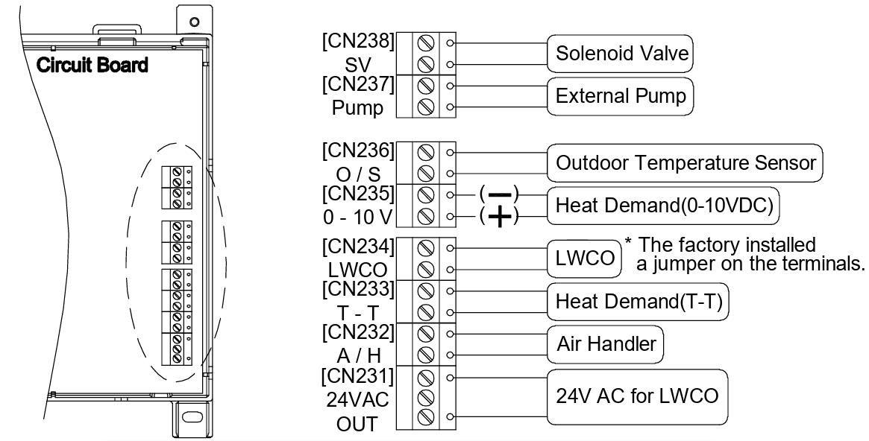
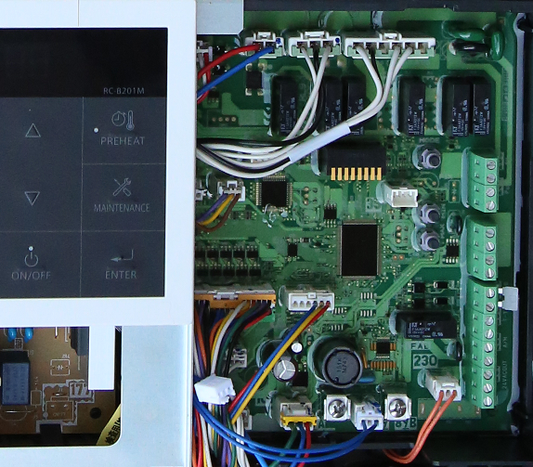
TECHNOLOGY, PERFORMANCE, AND SYSTEM DESIGN
Wiring Options
For accessories, controls, sensors, other equipment to compliment Combi Boiler system
Circuit Board

Slide 20
TECHNOLOGY, PERFORMANCE, AND SYSTEM DESIGN
Plumbing Diagrams
Combi Boiler as a Water Heater Only (Space Heating to be installed in the future)
Primary/Secondary Piping with Zone Valves
Primary/Secondary Piping with Zone Pumps
Air Handler Piping
Recirculation System on DHW side
Key applications for most system needs

Slide 21
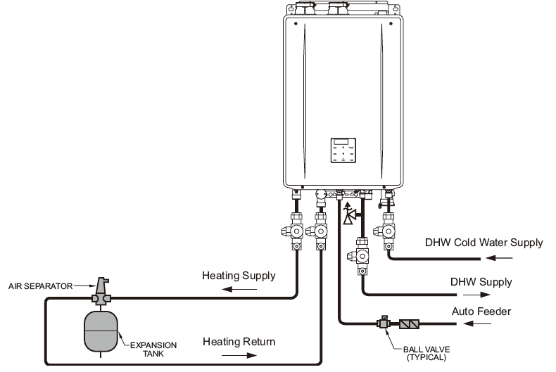
TECHNOLOGY, PERFORMANCE, AND SYSTEM DESIGN
Plumbing Diagrams
Combi Boiler as a Water Heater Only (Space Heating to be installed in the future)

Slide 22
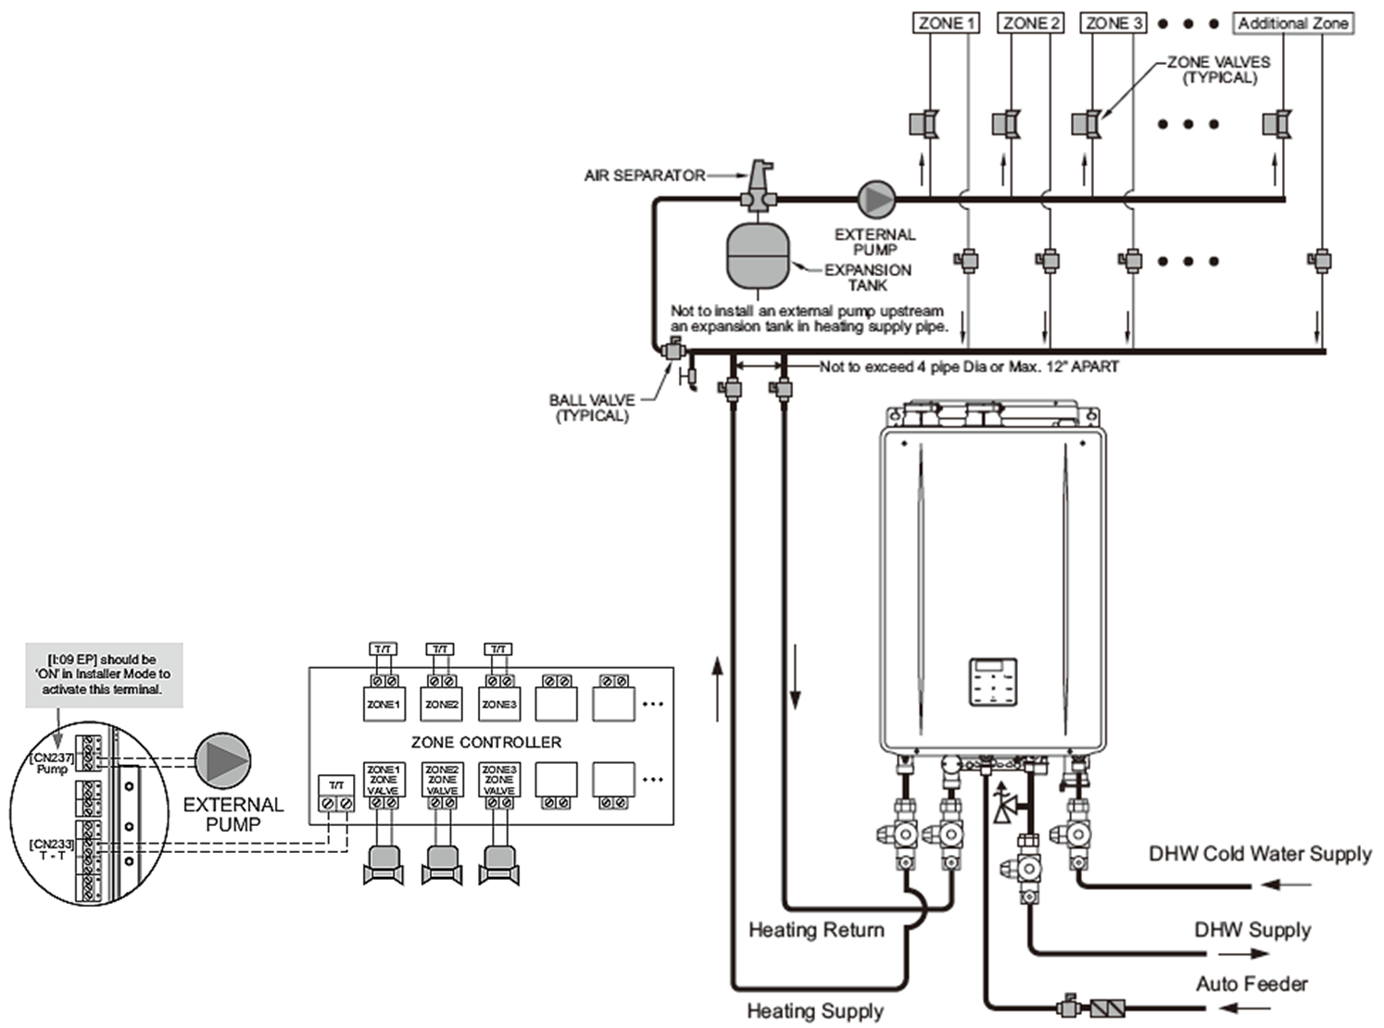
TECHNOLOGY, PERFORMANCE, AND SYSTEM DESIGN
Plumbing Diagrams
Primary/Secondary Piping with Zone Valves

Slide 23
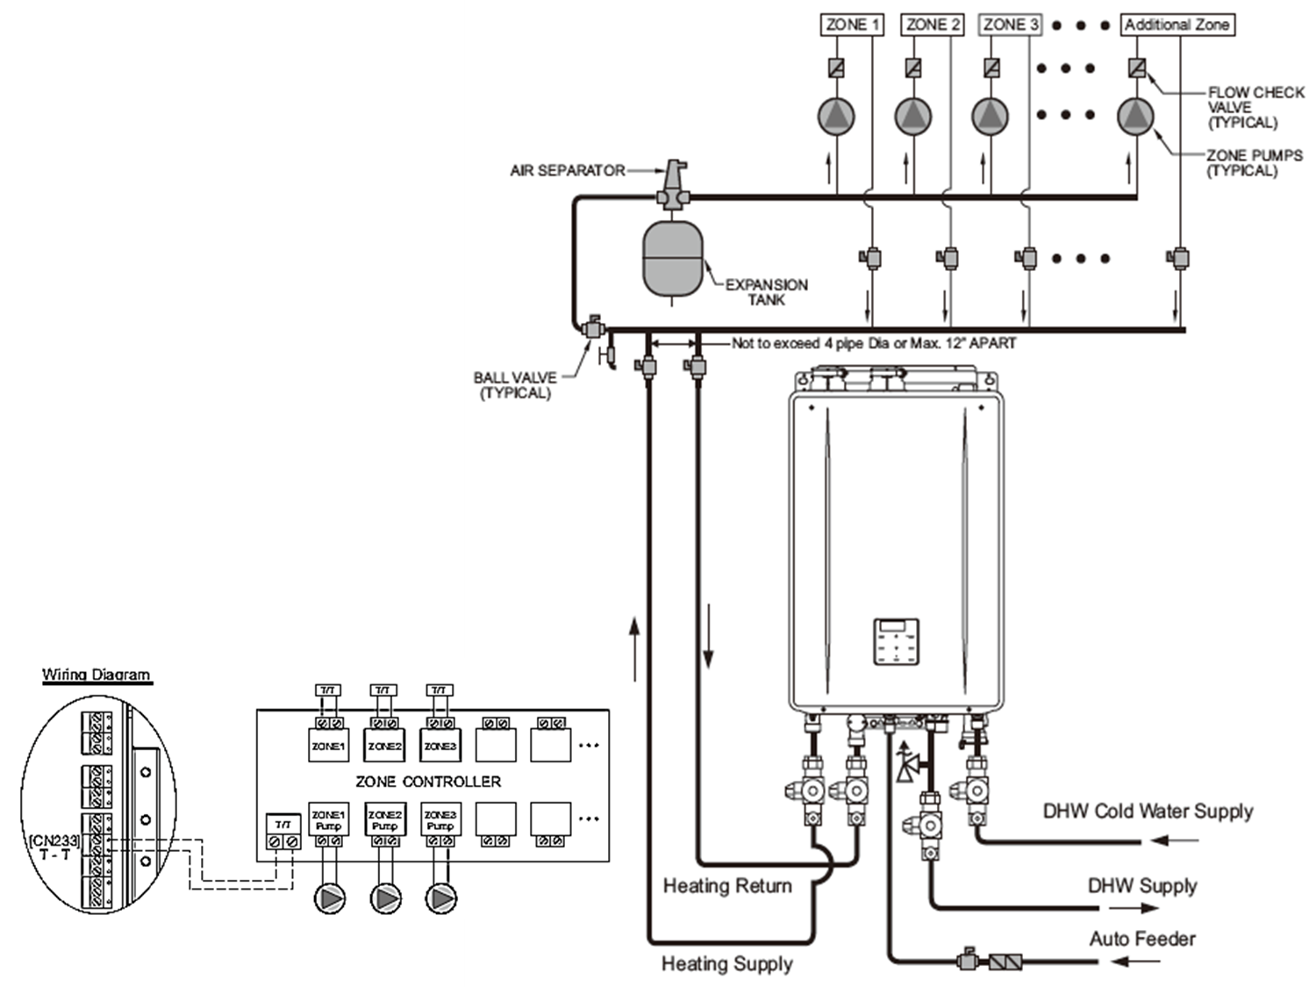
TECHNOLOGY, PERFORMANCE, AND SYSTEM DESIGN
Plumbing Diagrams
Primary/Secondary Piping with Zone Pumps

Slide 24
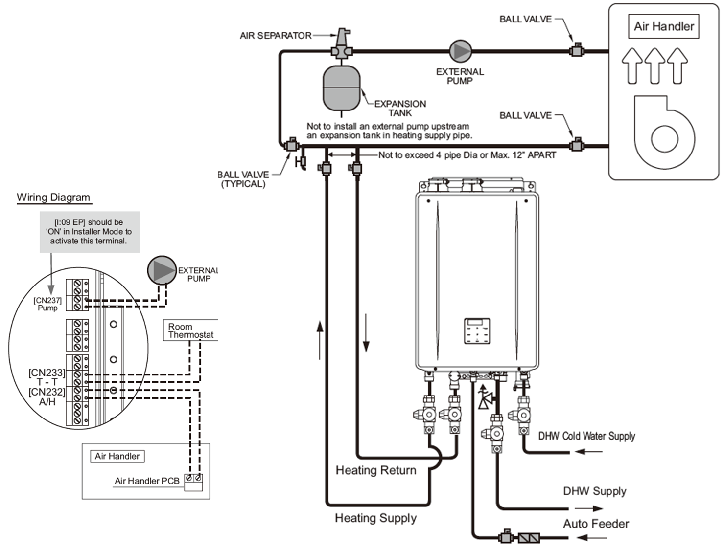
TECHNOLOGY, PERFORMANCE, AND SYSTEM DESIGN
Plumbing Diagrams
Air Handler Piping

Slide 25
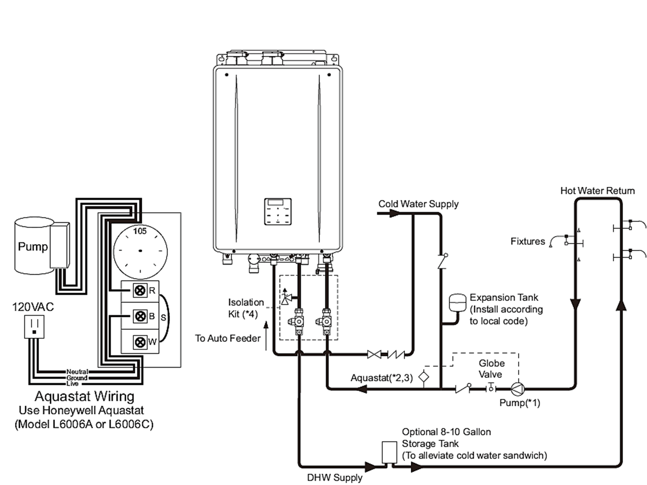
TECHNOLOGY, PERFORMANCE, AND SYSTEM DESIGN
Plumbing Diagrams
Recirculation System on DHW side
The heating might not operate in some conditions during recirculation
Insulate the DHW Supply and Return pipe completely
Aquastat and timer are required to control recirc loop.
REQUIRED
This should only be installed when Heat loop is set minimum 20 F higher than the domestic side. If not possible then Quick Connect system with recirculation would be recommended.
Flow on recirculation pump should be from 1 to 1.5 gpm.
(If higher, simultaneously heating and DHW may not work)

Slide 26
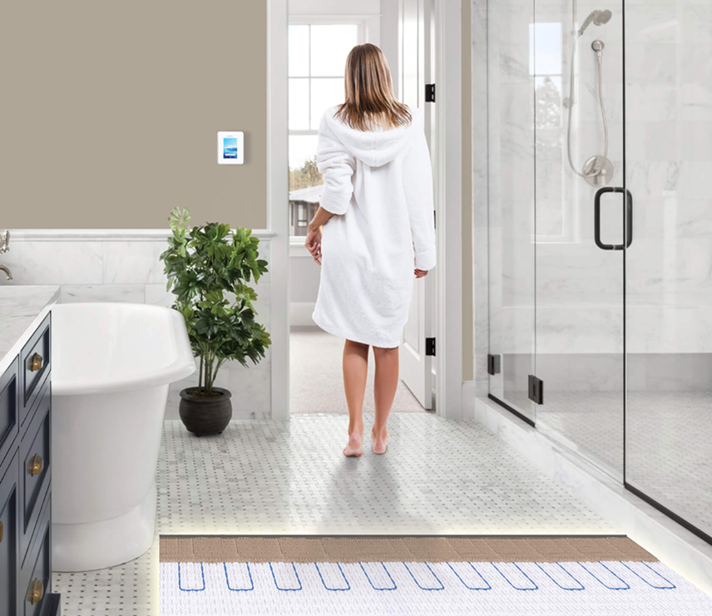
HEATING APPLICATIONS
Hydronic Systems
Radiant Floor Heating
Warm water circulates through tubing embedded in floors.
  Best for:
    New construction
    High-efficiency homes
    Comfort-focused customers
  Key advantage
    Low-temp operation = high efficiency

Slide 27
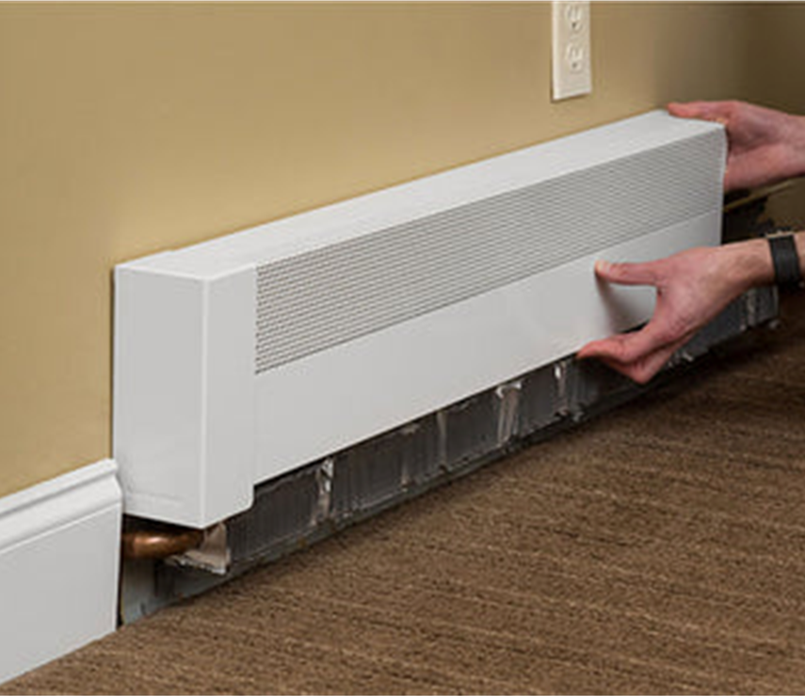
HEATING APPLICATIONS
Hydronic Systems
Baseboard Radiators (Fin-Tube)
Baseboard Units along walls
  Best for:
    Retrofits
    Traditional homes
  Key advantage
    Simple, proven

Slide 28
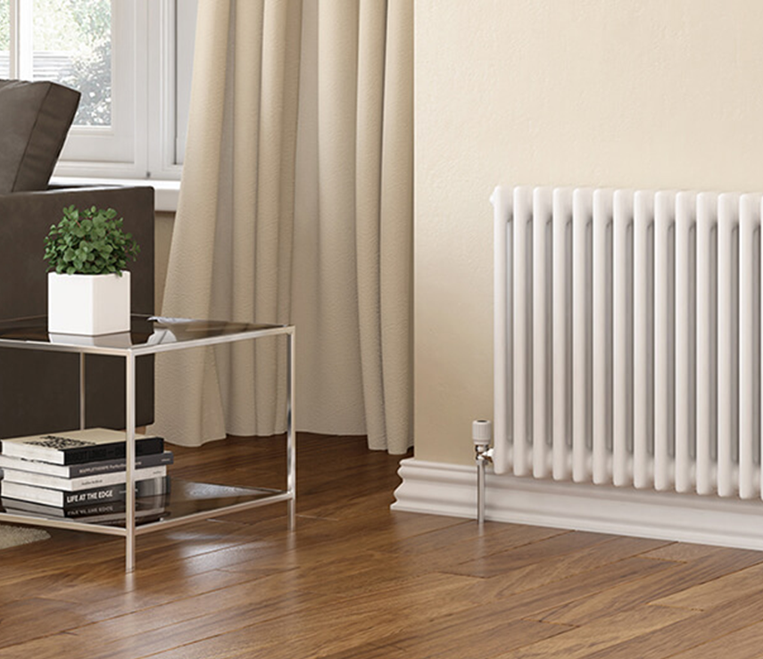
HEATING APPLICATIONS
Hydronic Systems
Panel Radiators
Integrated into limited wall spaces
  Best for:
    Modern hydronic retrofits
    Zoned comfort
  Key advantage
    Faster response than radiant

Slide 29
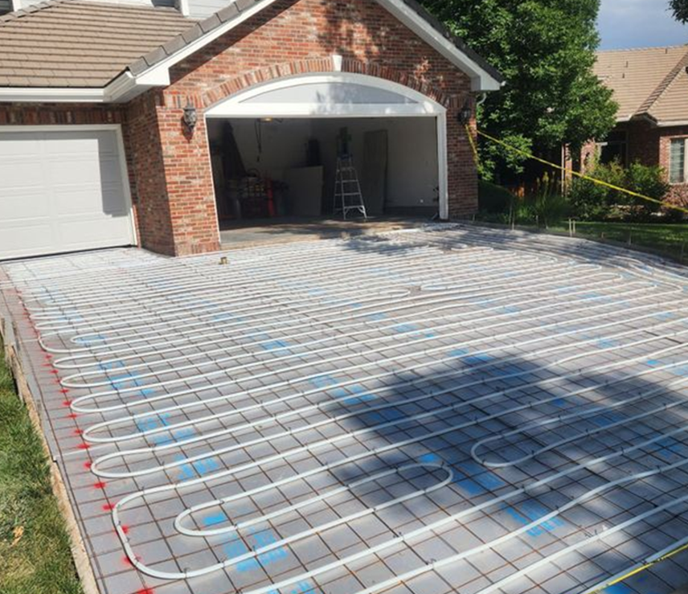
HEATING APPLICATIONS
Hydronic Systems
Snow Melt
Integrated into limited wall spaces
  Best for:
    Driveways, walkways
  Key advantage
    Activating the heating only when needed, reducing labor and time spent snow removal.
NOTE
A flat-plate heat exchanger may need to be installed due to the limit of 35% glycol limit of the NRCB

Slide 30
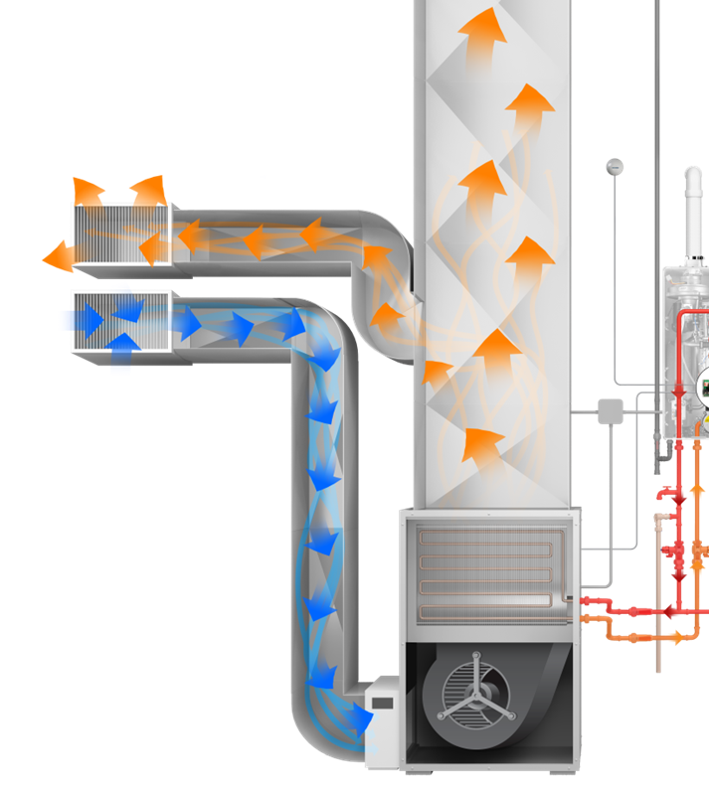
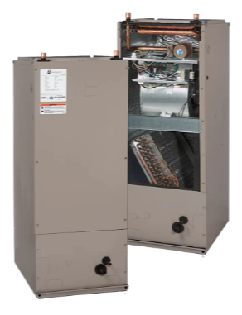
HEATING APPLICATIONS
Hydronic Systems
Air Handler
Equipment designed to regulate and circulate air within a building using hot water
  Best for:
    Gas furnace replacement
    In conjunction with cooling source
  Key advantage
    Complete system

Slide 31
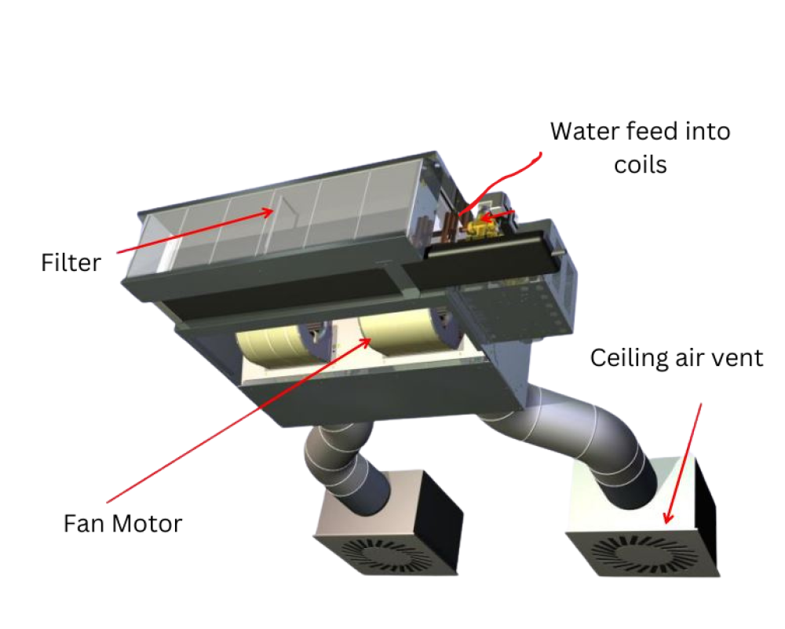
HEATING APPLICATIONS
Hydronic Systems
Fan Coil Unit
Utilizes hot water to move heated air
  Best for:
    Ceiling application
    Localized rooms
  Key advantage
    Smaller, self-contained device

Slide 32

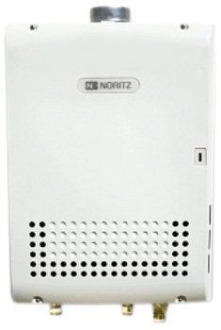
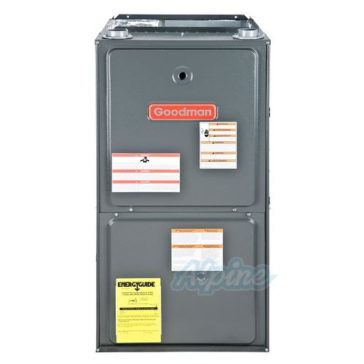
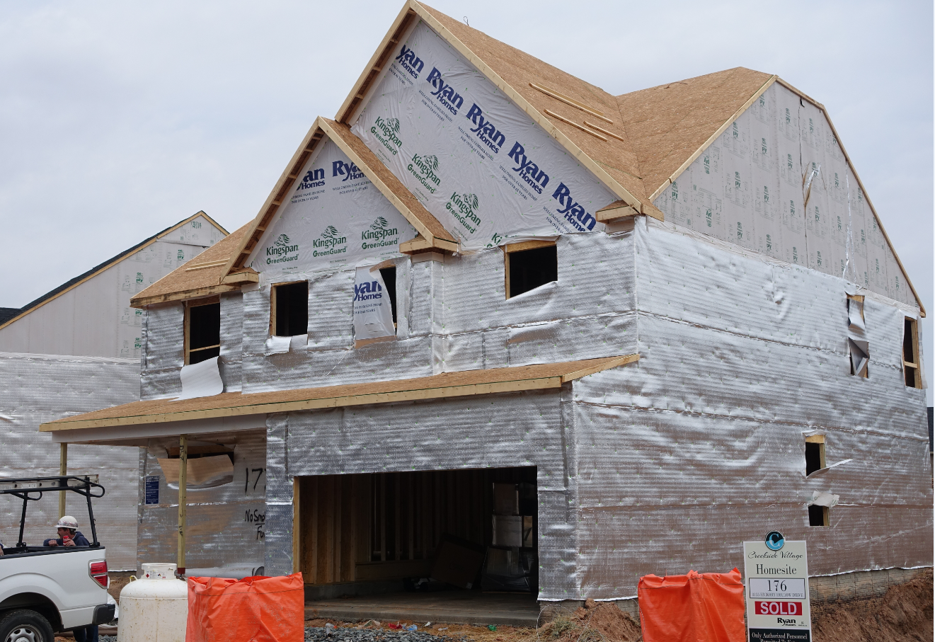
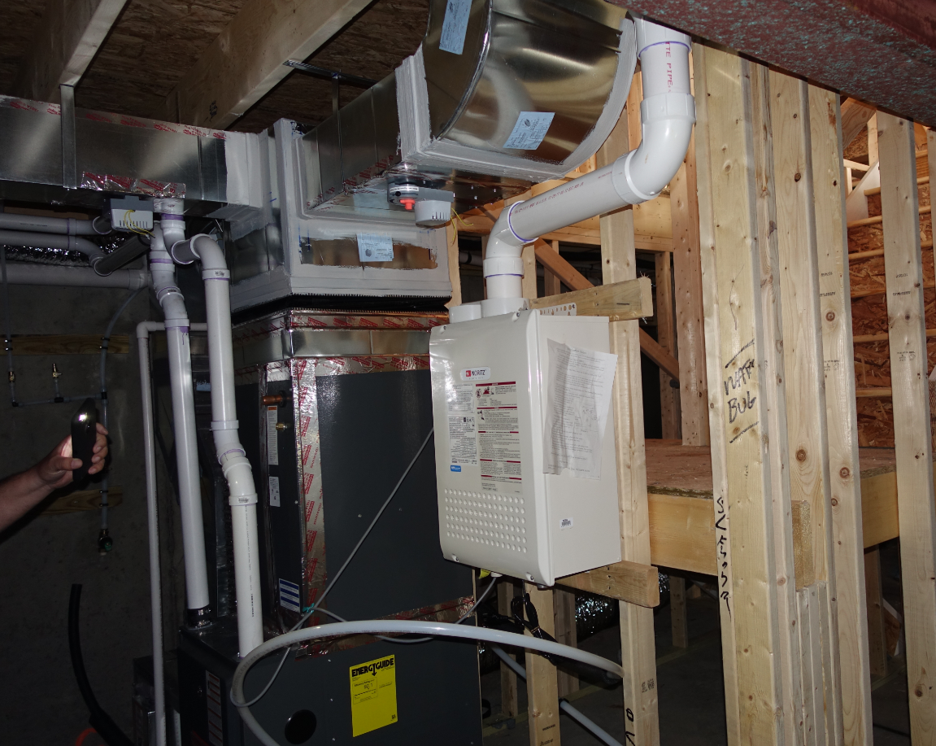
HEATING APPLICATIONS
Hydronic Systems
Use Case
New Construction – Builder Advantage
  Baltimore, MD
    Single-Family Home (Tankless with Gas Furnace)
3" PVC
3" PVC
4 Terminations
Termination Direction
Insulation
Insulation

Slide 33
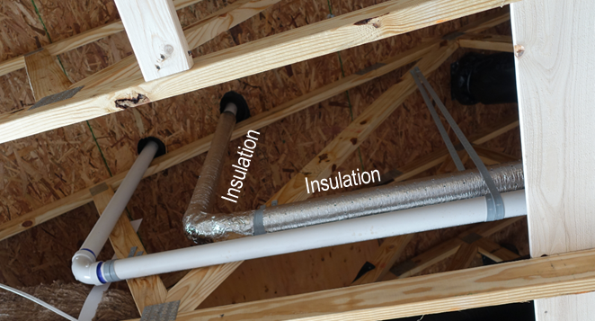
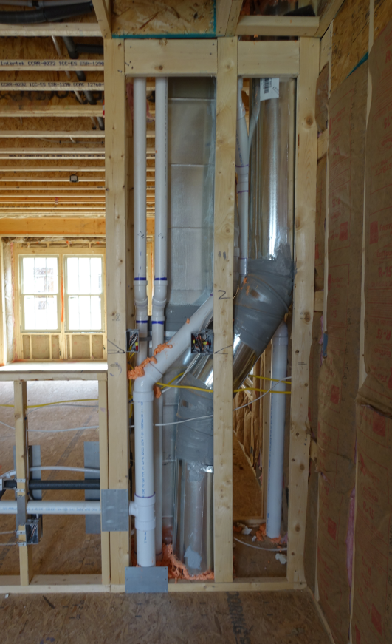

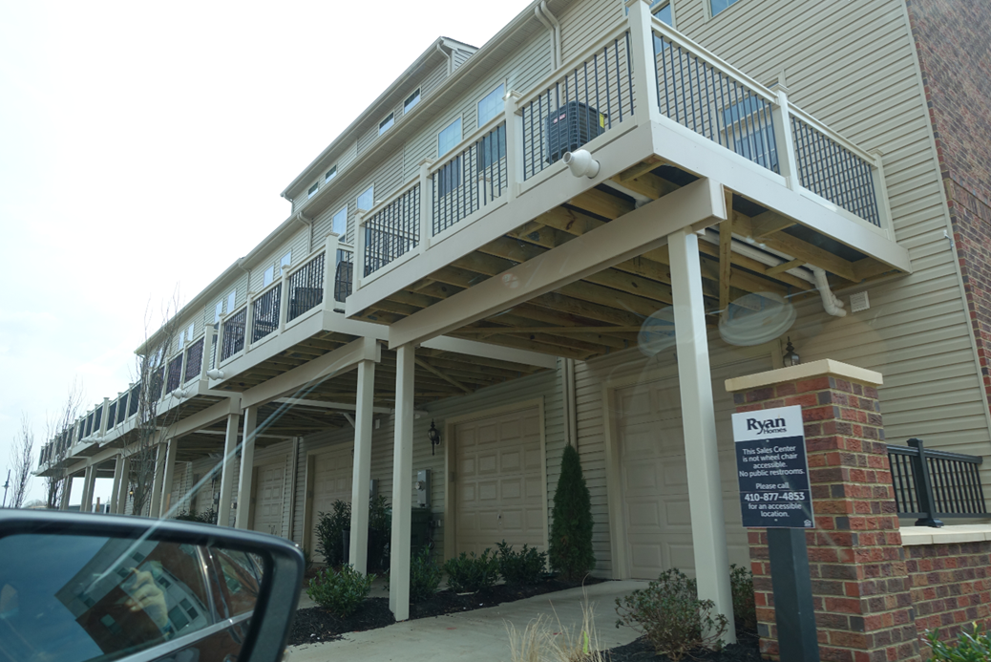
HEATING APPLICATIONS
Hydronic Systems
Use Case
New Construction – Builder Advantage
  Baltimore, MD
    Townhome (Tankless with Gas Furnace)
2" PVC
5" PVC
Concentric
Insulation
Insulation
3 Terminations
1 – Side
2 - Roof

Slide 34
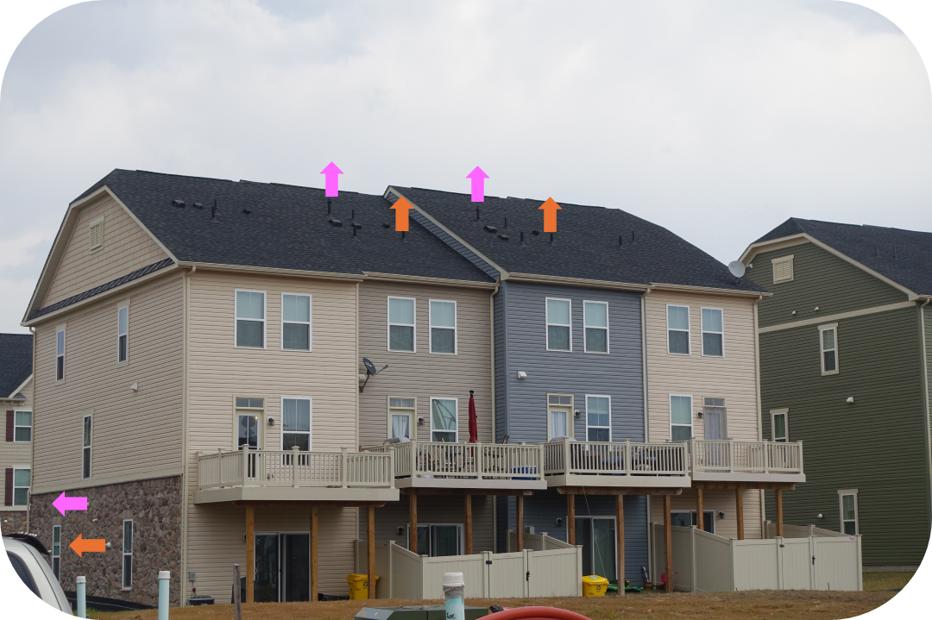
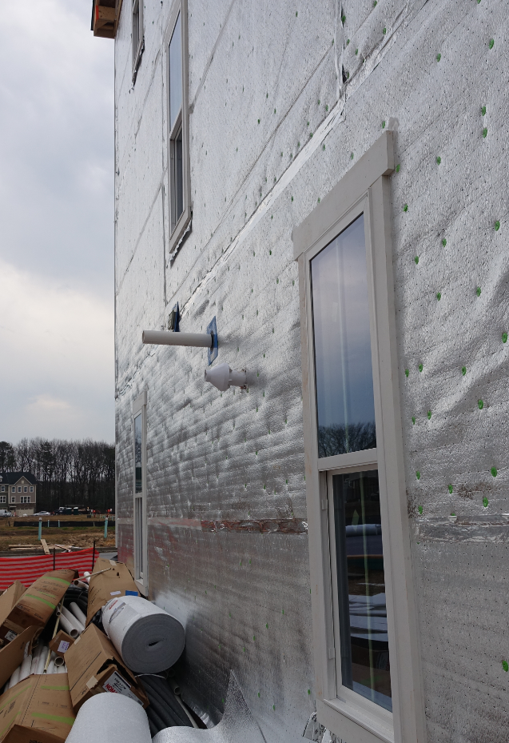
HEATING APPLICATIONS
Hydronic Systems
Use Case
5" PVC
Concentric
New Construction – Builder Advantage
  Baltimore, MD
    Multi-Family (Tankless with Gas Furnace)
3" PVC
5" PVC
Concentric
3" PVC
4 Terminations – 2 Dwellings
2 – Side
2 - Roof

Slide 35
HEATING APPLICATIONS
Hydronic Systems
Use Case - Challenges
New Construction – Builder Advantage
  Installers are struggling with venting water heater and gas furnace
  Not ideal in attic and mechanical rooms

Slide 36
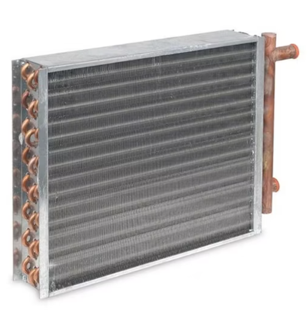
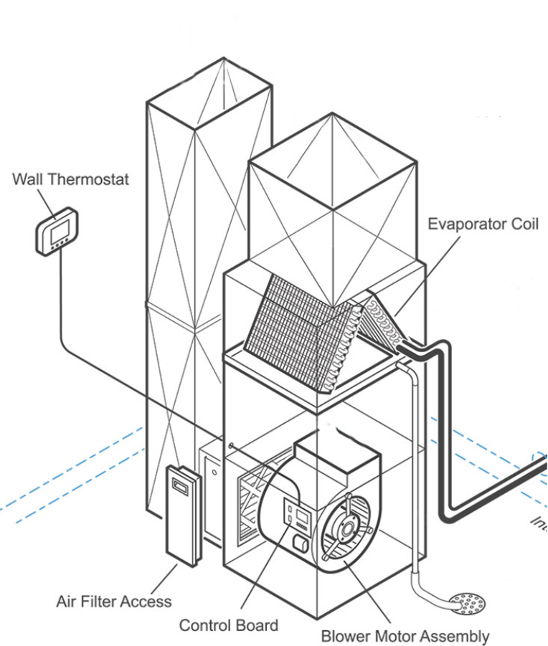
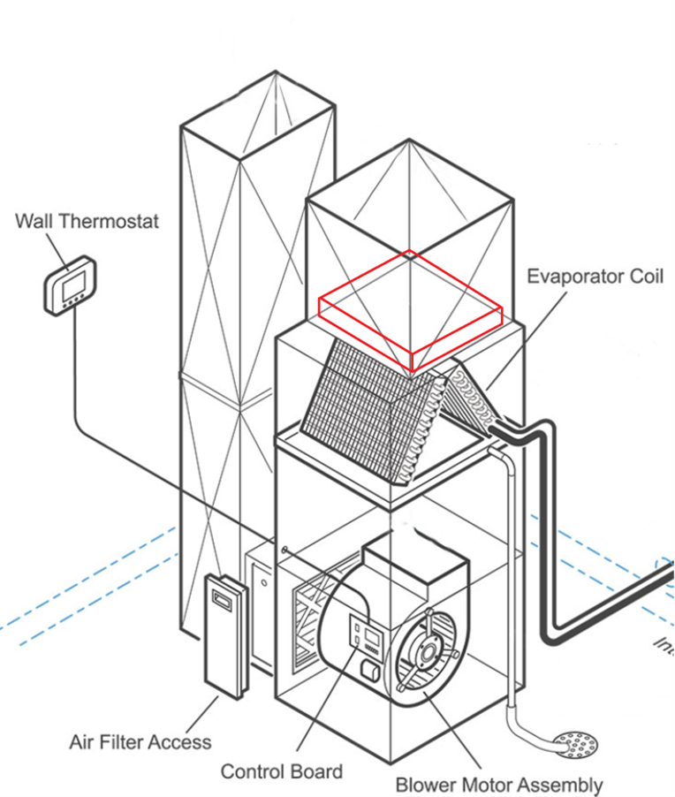
HEATING APPLICATIONS
Hydronic Systems
Heating Coil - Solution
This option ELIMINATES
Gas Heat Exchanger as well as
Terminations for intake & exhaust
Heating Coil placed on top of evaporator coil
New Construction – Builder Advantage
  Use Case: Cost Reduction
Cooling Application
Heating Application
Warm Air
Return
Cold Air
Supply
Heating Coil Not Operating
Cold Air
Return
Warm Air
Supply
Heating Coil Operating
Evaporating Coil Operating
Evaporating Coil Not Operating

Slide 37
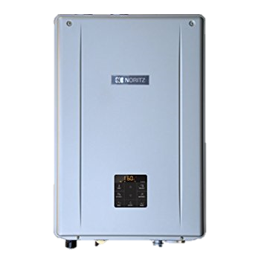
HEATING APPLICATIONS
Hydronic Systems
Heating Coil - Solution
Single-Family Home
3" PVC
3" PVC
2" PVC
4 Terminations
2 Terminations
Tankless with Gas Furnace
Combi with Heating Coil

Slide 38
HEATING APPLICATIONS
Hydronic Systems
Heating Coil - Solution
Townhome
2" PVC
5" PVC
Concentric
5" PVC
Concentric
Tankless with Gas Furnace
Combi with Heating Coil

Slide 39
HEATING APPLICATIONS
Hydronic Systems
Heating Coil - Solution
Multi-Family
5" PVC
Concentric
3" PVC
5" PVC
Concentric
5" PVC
Concentric
5" PVC
Concentric
3" PVC
Tankless with Gas Furnace
Combi with Heating Coil

Slide 40
HEATING APPLICATIONS
Hydronic Systems
Heating Coil
New Construction – Builder Advantage – Other Features
  40/60/80/100 KBTU heating coils available
  Direct connection between combi boiler and heating coil.
    Primary/secondary system and external/additional pump are not required.
  No electrical wiring is required to the heating coil.
    Heating is controlled by the combi boiler (and room thermostat)
  Heating coil can be put anywhere on the duct system.
    Simultaneous DHW/Heating technology.
  Less water quality issue (scale/corrosion) than regular tankless water heaters

Slide 41

CUSTOMER ENGAGEMENT AND VALUE IDENTIFICATION
Target Customer Segments
Customer Pain Points
Translating Features → Benefits
Value Drivers by Persona

Slide 42
TARGET CUSTOMER SEGMENTS
Homeowners
Contractors
Builders / Developers
Retrofit: replacing old boiler + tank
New build: efficiency + space
Ease of install
Callbacks and service friendliness
Cost per unit
Mechanical room footprint

Slide 43

CUSTOMER PAIN POINTS
Rethinking Home Comfort: Heating & Hot Water, Simplified
Today’s systems are outdated, inefficient, and frustrating. There’s a better way.
Most homes are still running two separate systems.
A boiler/furnace + a tank water heater.

Slide 44

CUSTOMER PAIN POINTS
1
Running Out of Hot Water
2
Inconsistent Temperature
3
Rising Energy Costs
4
Space Constraints
5
System Complexity
Everyone has experienced it—back-to-back showers and suddenly… cold water.
Impact:
Household frustration
Peak demand failures

Slide 45

CUSTOMER PAIN POINTS
1
Running Out of Hot Water
2
Inconsistent Temperature
3
Rising Energy Costs
4
Space Constraints
5
System Complexity
Temperature swings during showers or
fixtures running simultaneously.
Impact:
Poor user experience
Perception of unreliable system

Slide 46

CUSTOMER PAIN POINTS
1
Running Out of Hot Water
2
Inconsistent Temperature
3
Rising Energy Costs
4
Space Constraints
5
System Complexity
Traditional systems waste energy
just keeping water hot.
Impact:
Higher monthly bills
Inefficient standby losses

Slide 47

CUSTOMER PAIN POINTS
1
Running Out of Hot Water
2
Inconsistent Temperature
3
Rising Energy Costs
4
Space Constraints
5
System Complexity
Mechanical rooms, garages, & basements
are crowded - especially in modern homes.
Impact:
Lost usable space
Installation limitations

Slide 48

CUSTOMER PAIN POINTS
1
Running Out of Hot Water
2
Inconsistent Temperature
3
Rising Energy Costs
4
Space Constraints
5
System Complexity
Two appliances = more parts,
more failure points, more confusion.
Impact:
Harder to service
More things that can break

Slide 49

CUSTOMER PAIN POINTS
The Turning Point: There Has to Be a Better Way
Bridge from frustration to solution
Homeowners don’t want more equipment
they want a smarter solutions

Slide 50
TRANSLATING FEATURES → BENEFITS
The Turning Point: There Has to Be a Better Way
High AFUE
Lower monthly bills
Compact design
More usable space
Superior Stainless Steel heat exchangers
Longevity & reliability
Simultaneous Performance
Uninterrupted Comfort

Slide 51
VALUE DRIVERS BY PERSONA
Homeowner
Contractor
Builder
comfort, savings, peace of mind
simple install, fewer callbacks
cost‑effective, compact, code‑friendly

Slide 52

COMPETITIVE POSITIONING AND SALES STRATEGY
Objection Handling
Pricing & ROI Story
Sales Process Framework

Slide 53
OBJECTION HANDLING
Not enough hot water
Too expensive
Complicated install
Maintenance concerns
Confirm sizing
Explain realistic capacity
Add an EZ Model
Compare total installed cost
Highlight energy savings & rebates
Pre‑assembled components
Contractor‑focused design
Simple annual service
Long‑term reliability story

Slide 54
PRICING & ROI STORY
Lower operating cost vs traditional systems
Reduced venting, equipment, and footprint costs
Rebates and efficiency incentives
Payback over system lifespan, not just day one

Slide 55
SALES PROCESS FRAMEWORK
Discovery – Understand Before You Sell
Product Match – Engineer the Right Solution
Qualification – Is This a Real Opportunity?
Value Presentation – Sell Outcomes, Not Equipment
Confident Close – Guide the Decision
Identify the application
Understand current system pain points
Document system details
Identify potential barriers
Establish timeline
Evaluate application fit for a combi solution
Match features to needs
Address installation considerations
Position differentiation
Tie features directly to their pain points
Quantify benefits where possible
Pre-handle objections
Summarize alignment
Create urgency (when appropriate)
Define next steps
Each step should clearly connect to the next - no gaps, no assumptions

Slide 56

APPLICATION DEMAND & SIZING REQUIREMENTS
Sizing Methodology
Additional Accessories

Slide 57

SIZING METHODOLOGY
Calculate peak Domestic Hot Water demand (GPM)
Calculate heating load (BTUs)
Select unit that meets both requirements
Verify gas and venting feasibility

Slide 58



ADDITIONAL ACCESSORIES
Part # MK-NRCB-1
Premade to align with the heating supply and return ports. Shut off valves and ports to flush the HEX along with a drain port to bleed out air in the system
½” pressure reducing valve is needed on the auto feeder connection line to reduce the inlet water pressure to below 30 psi
Air Separator is required at the highest point of the heating system

Slide 59
HOW THE 5 SECTIONS CONNECT
Combi Boiler
Essentials
Technology, Performance, and System Design
Customer Engagement and Value Identification
Competitive Positioning and Sales Strategy
Application Demand & Sizing Requirements
What
it is
How it works
How to
sell it
How to
win
How to get it right

Slide 60
QUESTIONS?

