Slide 1
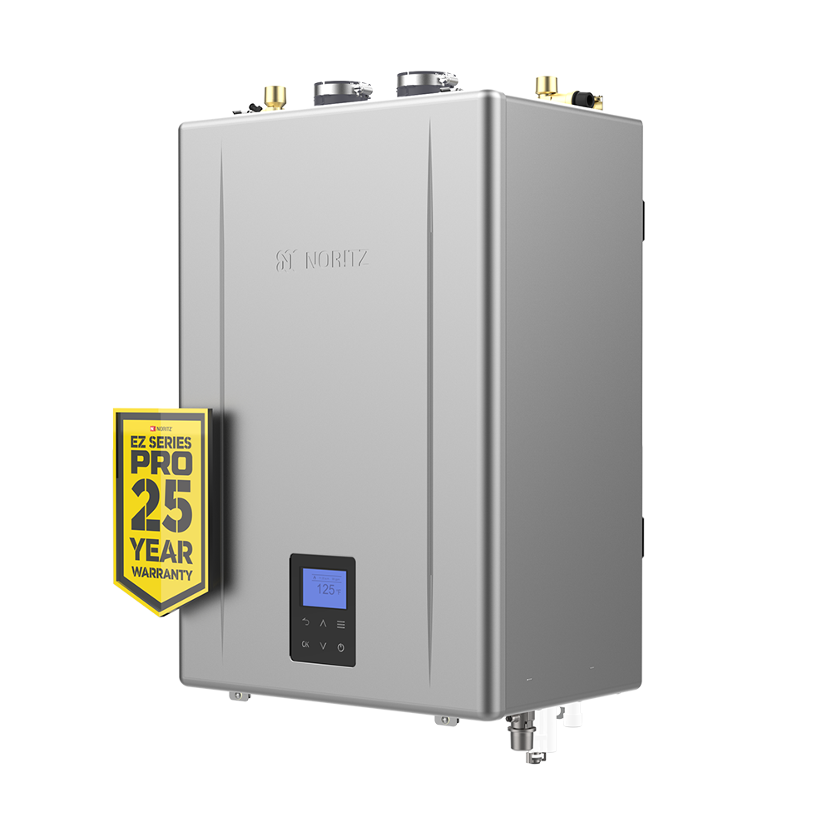

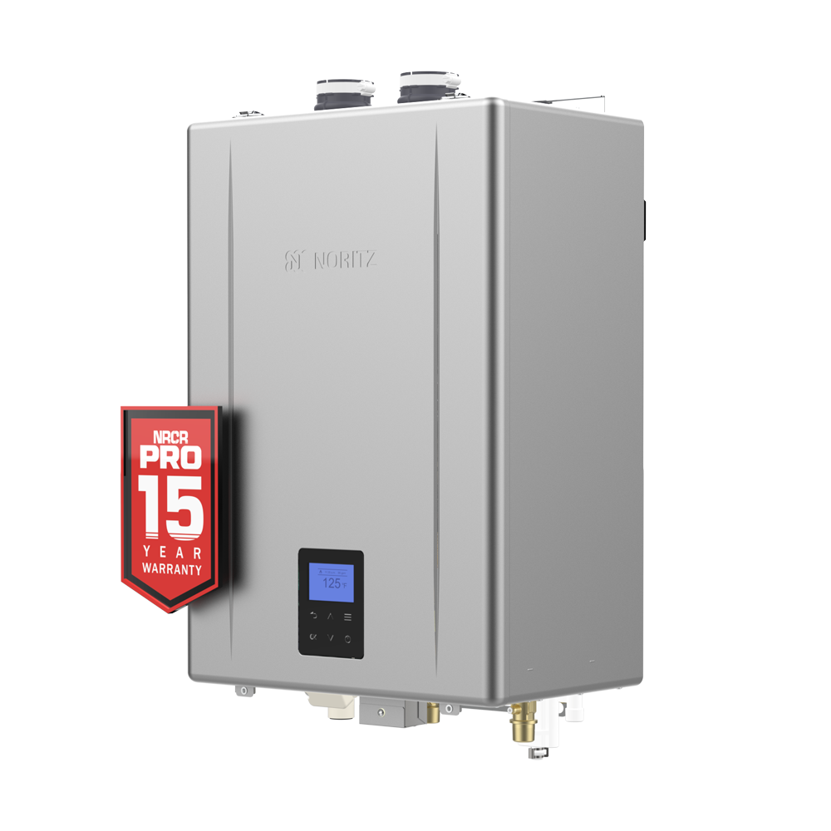

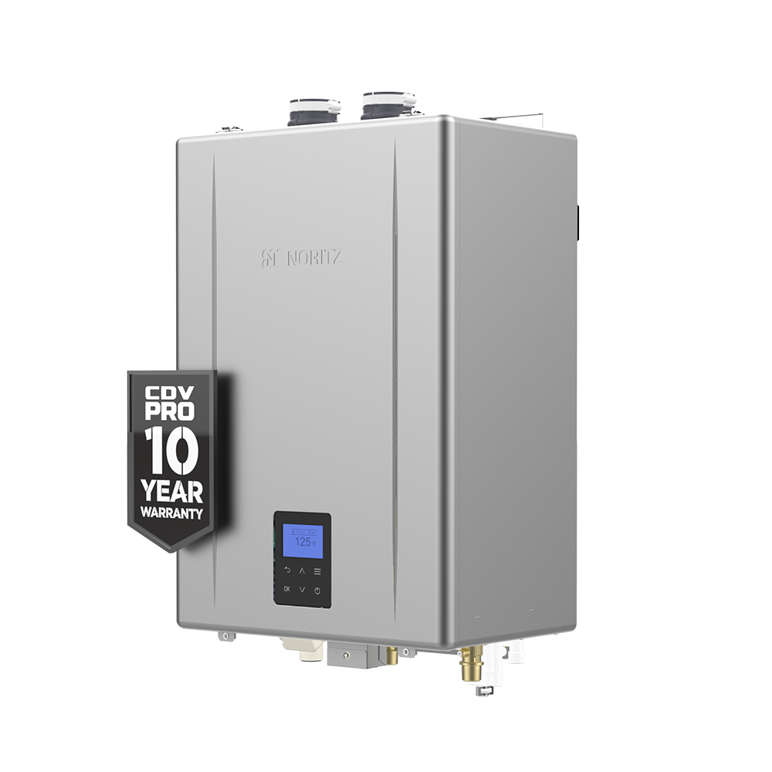
Upgraded PRO Series

Slide 2
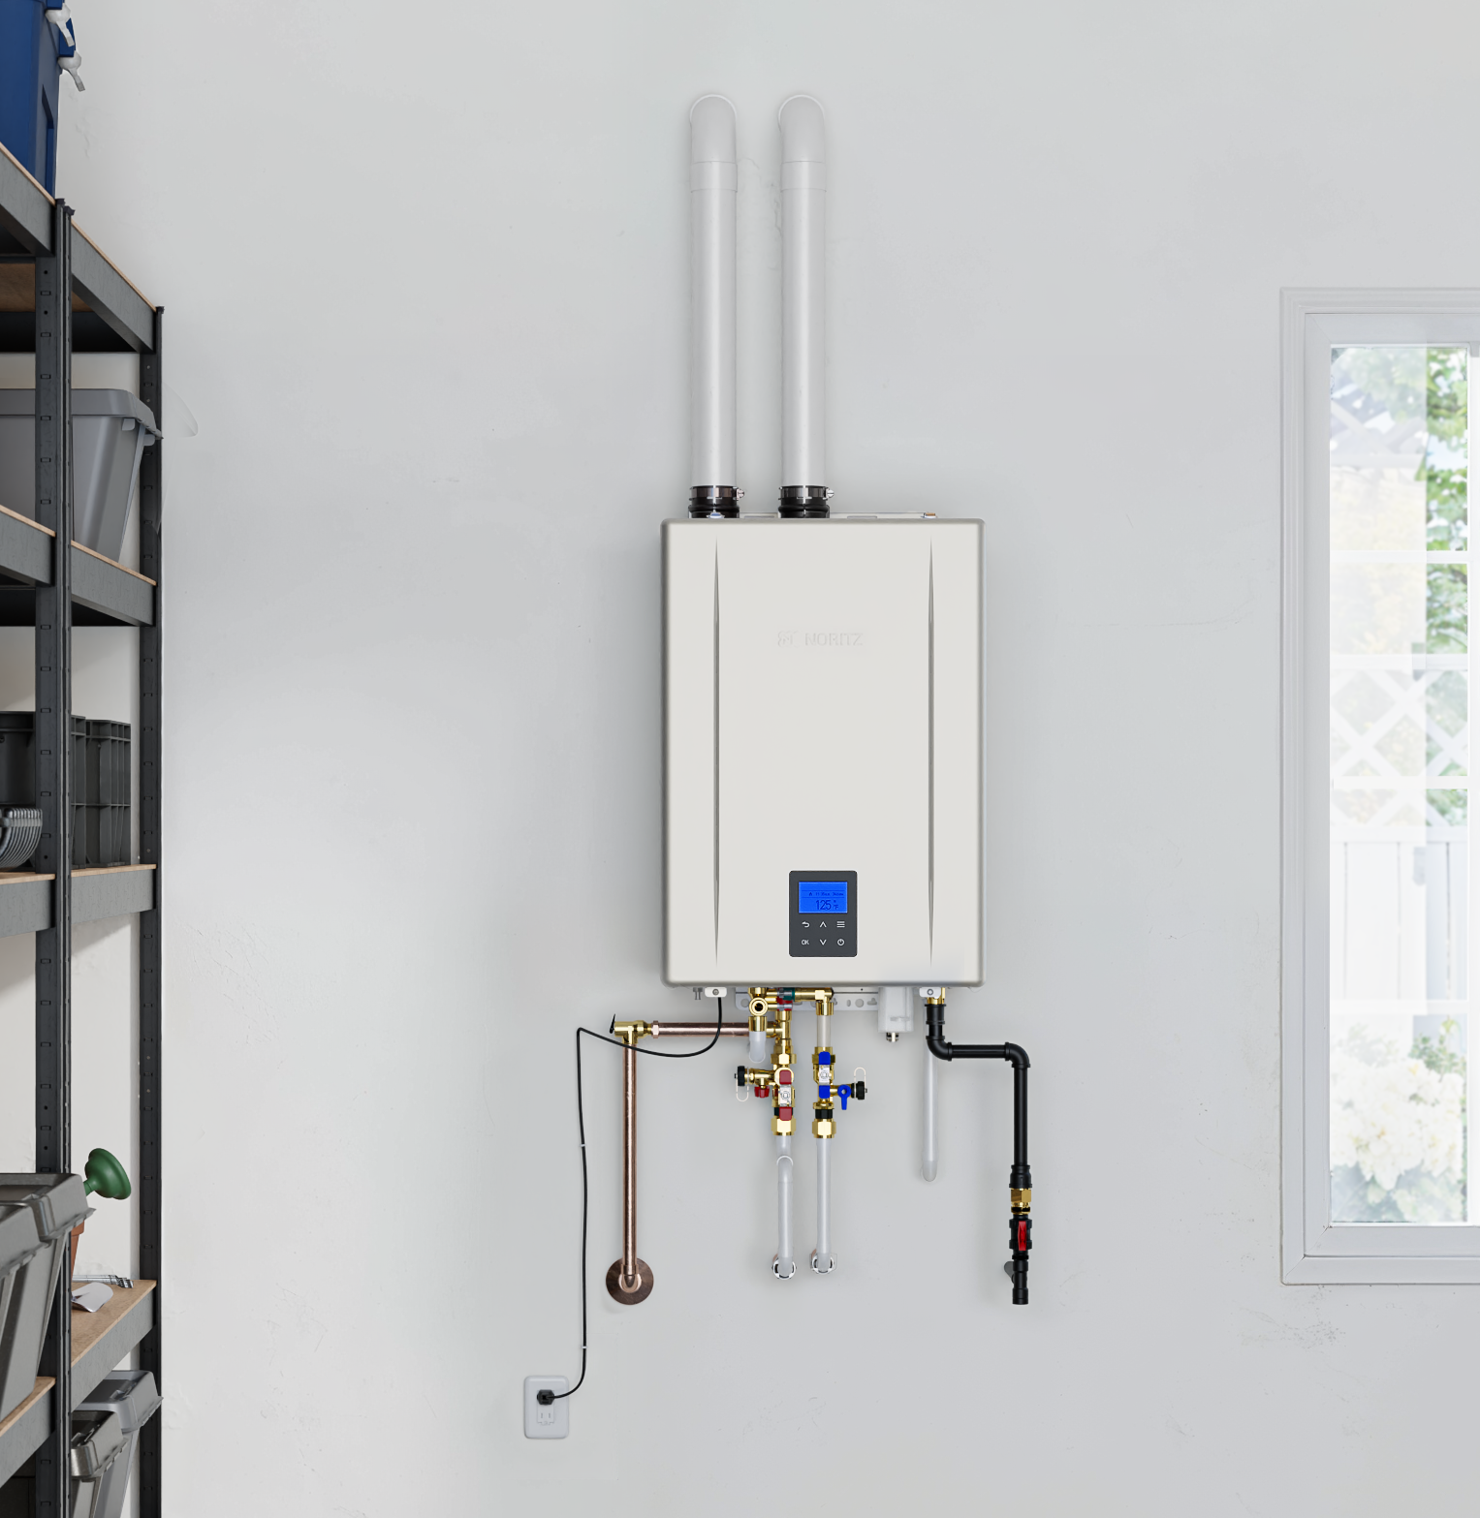
OUTLINE
New Upgraded PRO Series Units
Model Numbers
Industry Leading Features
New Features
Operation Panel
Main Menu
Settings Menu
Service Menu
Bluetooth App Updates

Slide 3
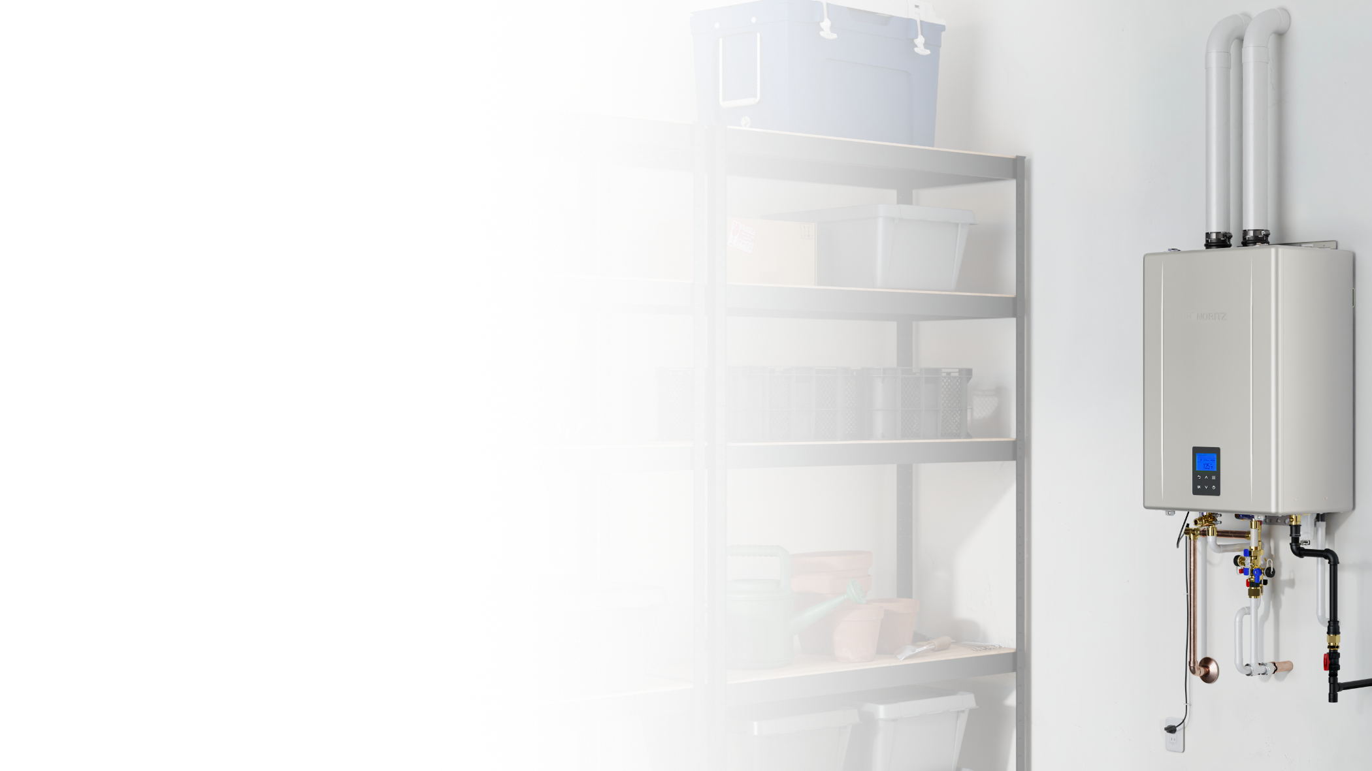
MODEL NUMBERS
Model Number
Trade Name Old New
EZ111DV GQ-C3261WX-FF US GQ-C3261WX-FF-1 US
EZ98DV GQ-C2861WX-FF US GQ-C2861WX-FF-1 US
EZ71DV GQ-C2661WX-FF US GQ-C2661WX-FF-1 US
NRCR111DV GQ-C3261WXQ-FF US GQ-C3261WXQ-FF-1 US
NRCR92DV GQ-C2661WXQ-FF US GQ-C2661WXQ-FF-1 US
NCC199CDV GQ-C3261WZ-FF US GQ-C3261WZ-FF-1 US
*Hybrid Hot and Pre-Made Rack Systems are TBD on release of new version

Slide 4





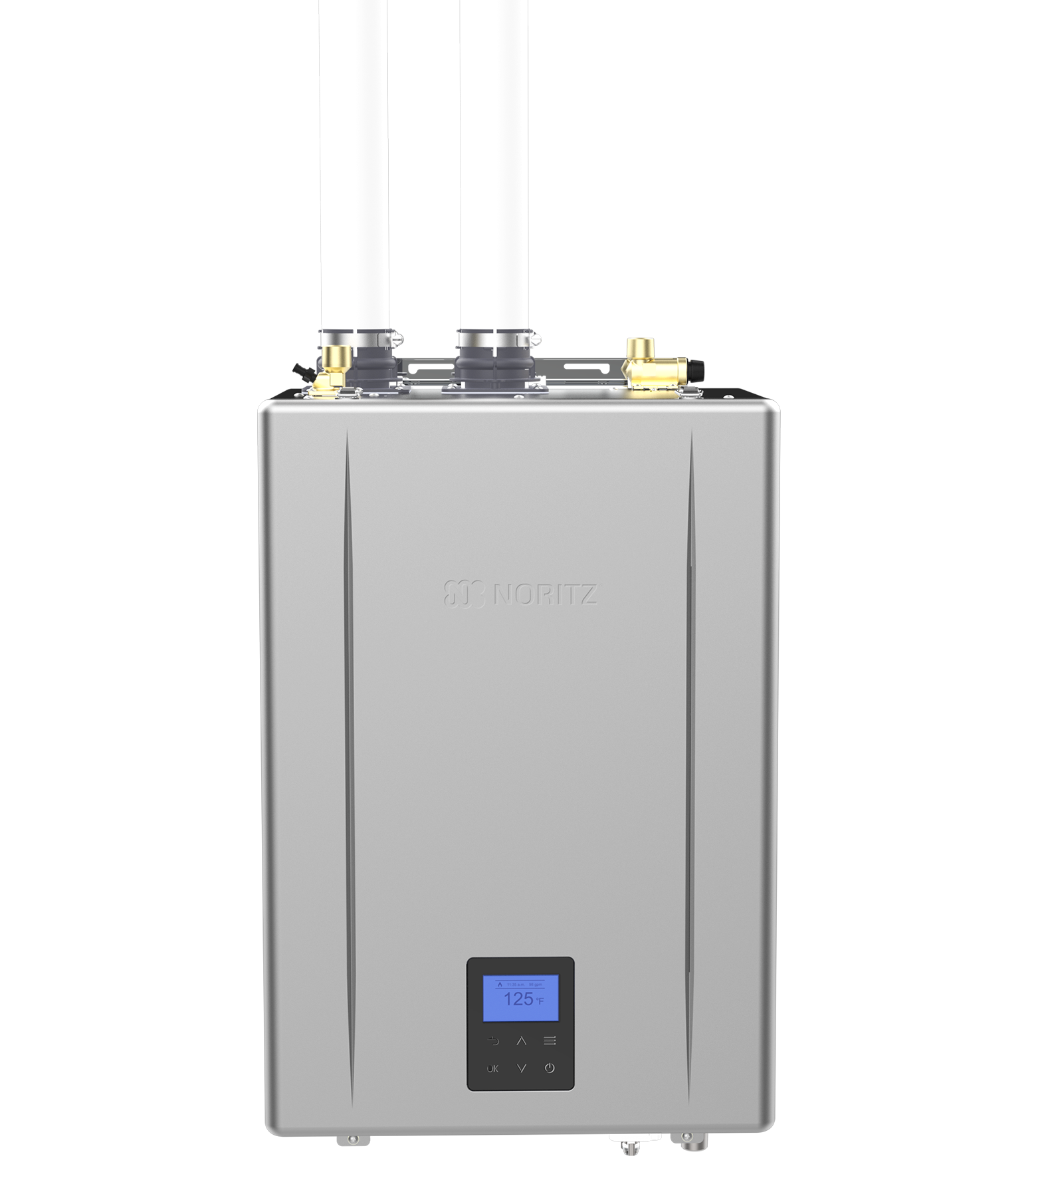
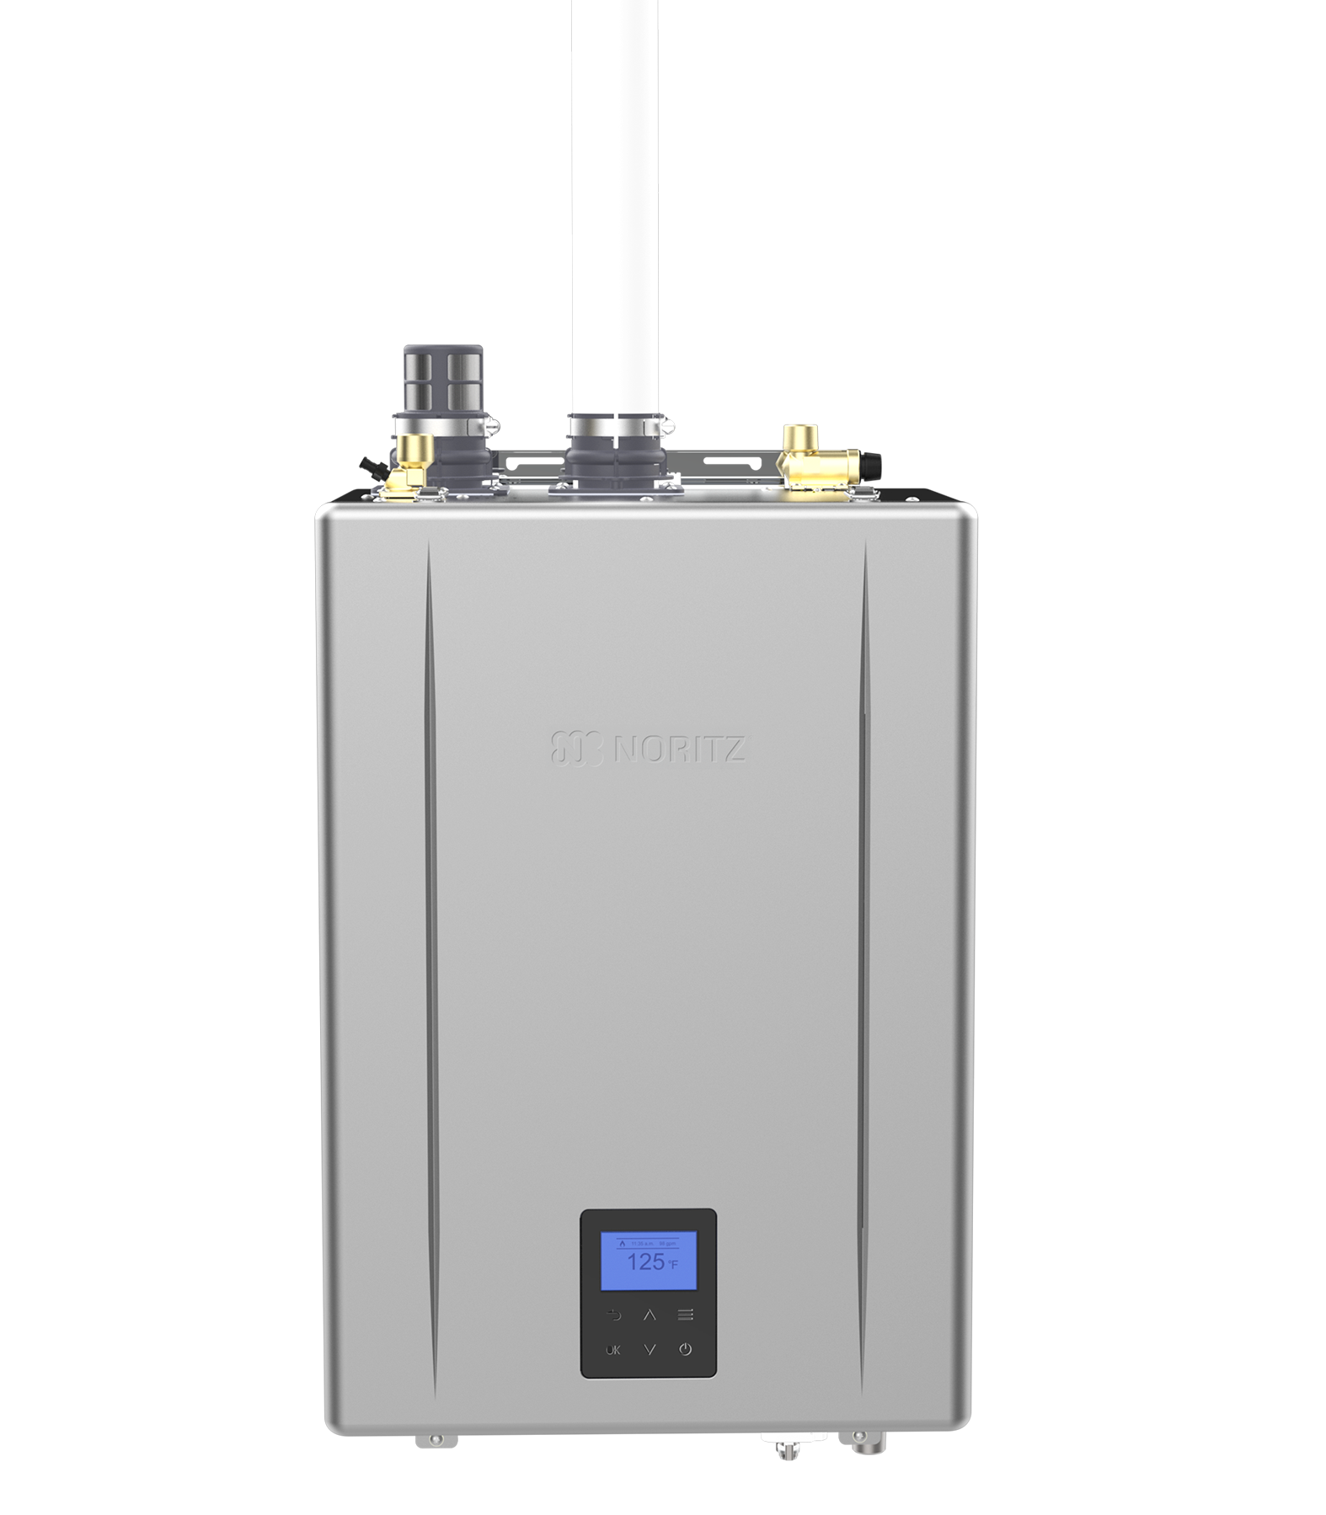
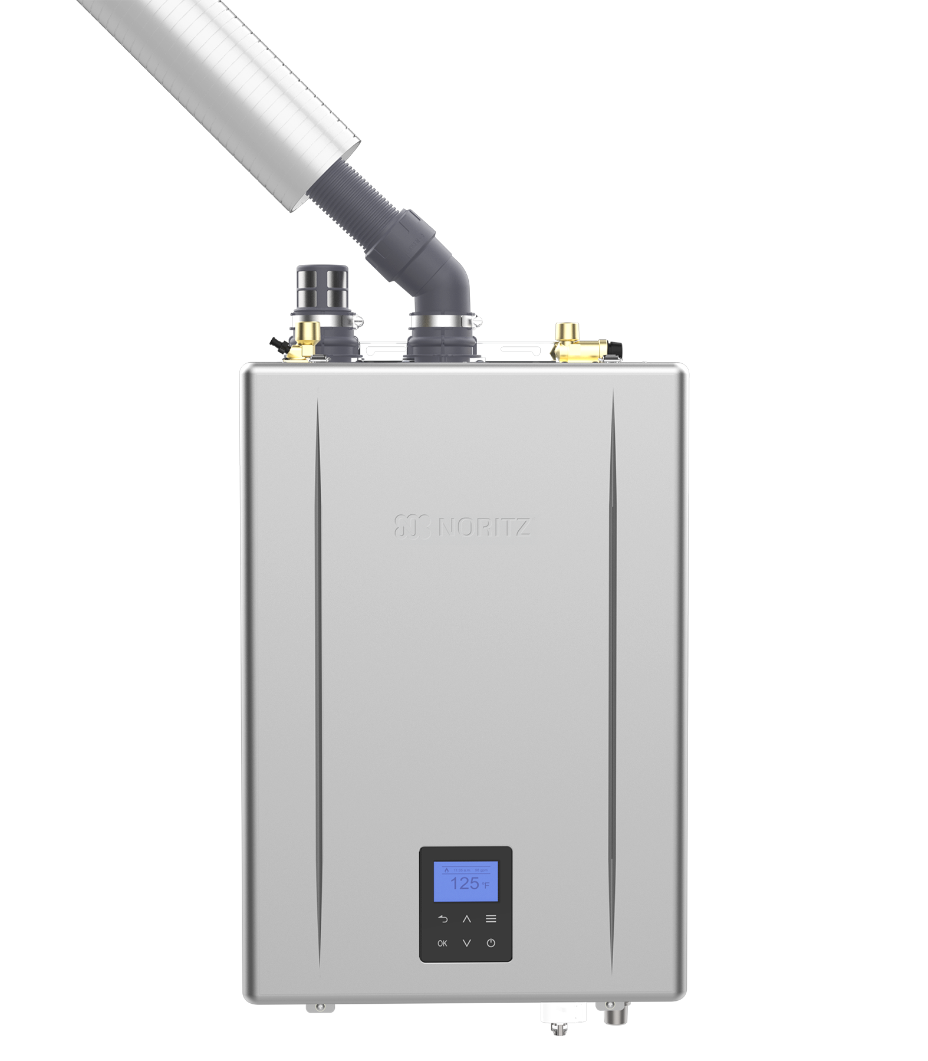
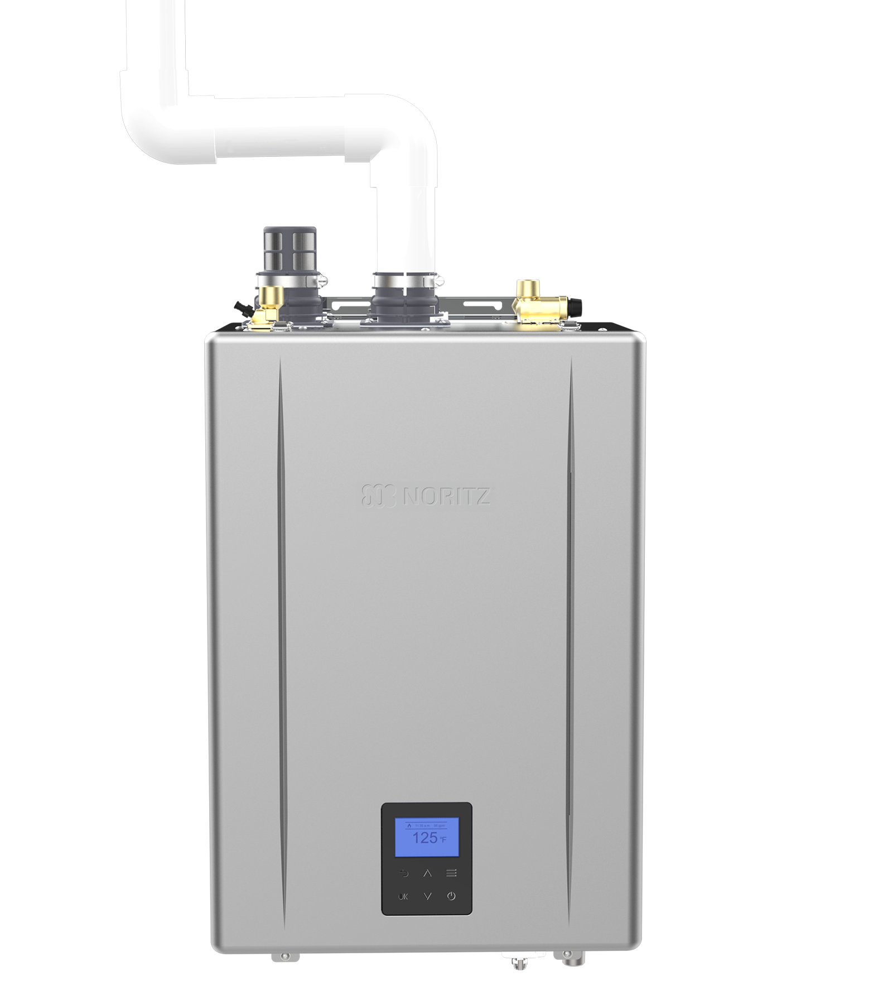
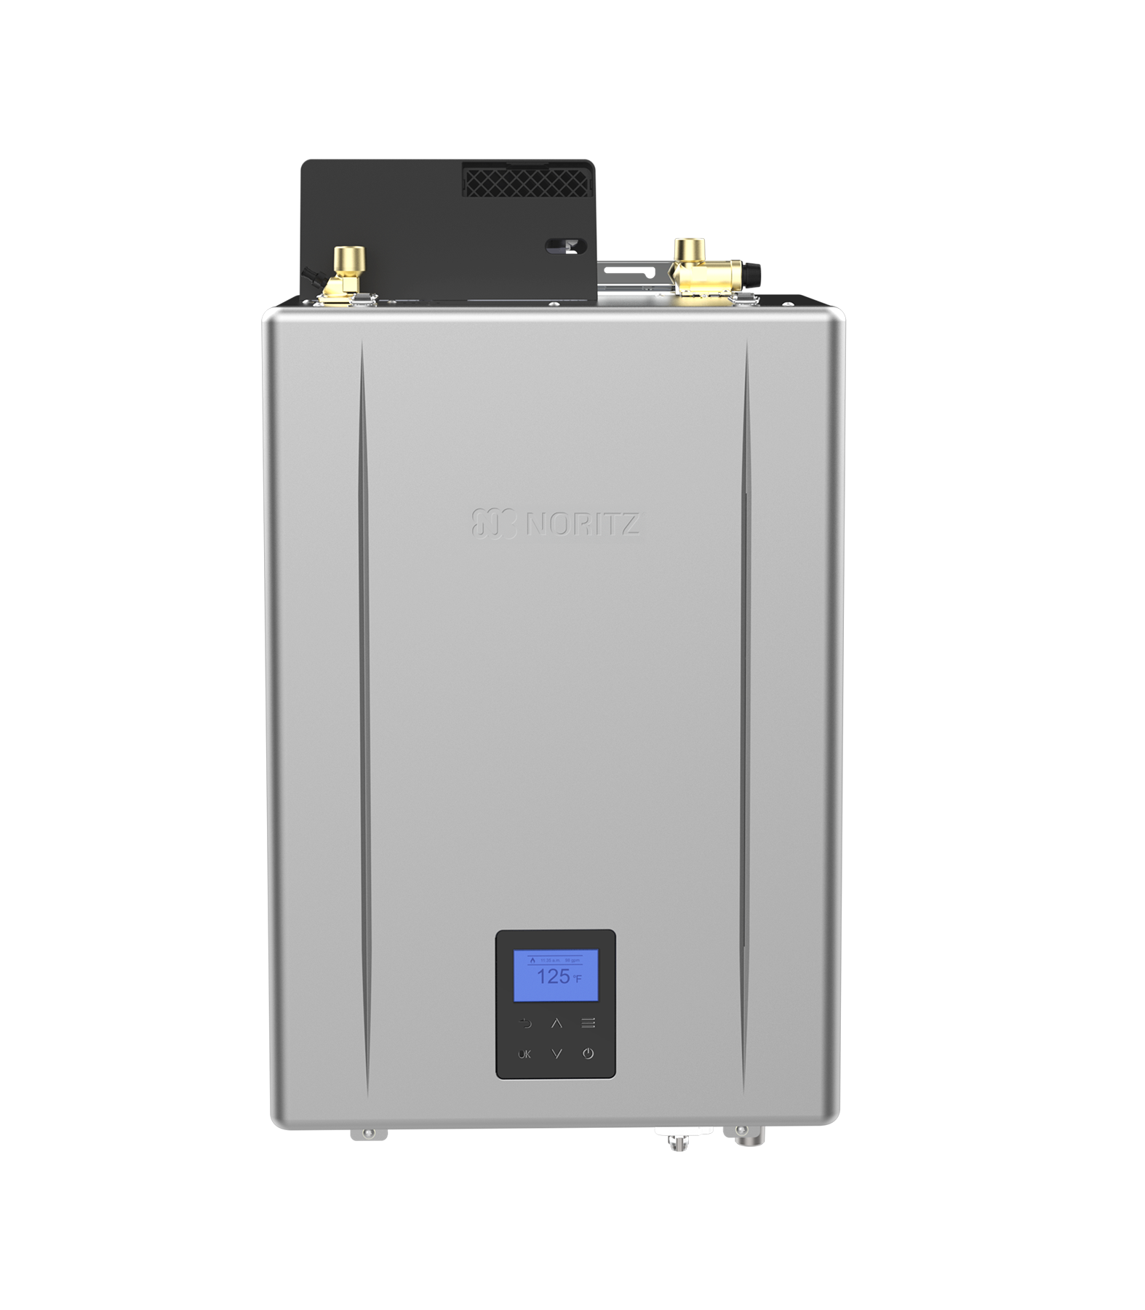
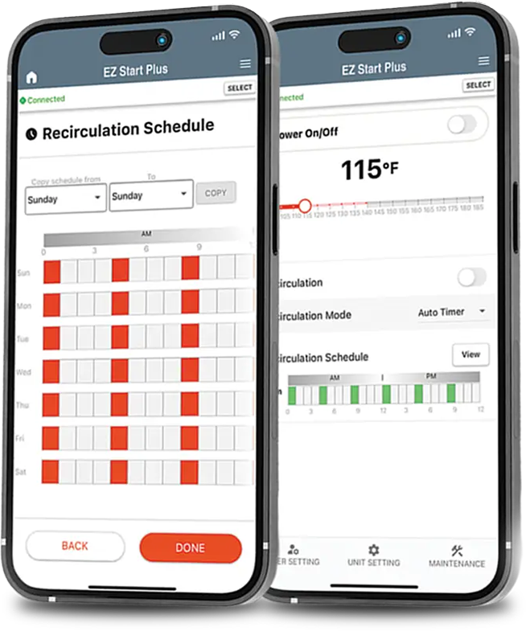

INDUSTRY LEADING FEATURES
PRO Series units have Industry Leading Features that apply to all units
Warranty
EZ PRO Series – 25 years on the heat exchanger
NRCR PRO Series – 15 years on the heat exchanger
CDV PRO Unit – 10 years on the heat exchanger
Hybrid Hot PRO System – 10 years on the heat exchanger & tank
Energy Efficiency – 0.98 UEF on all units
Bluetooth App
Versatile Venting
Direct Vent
Single Vent
Outdoor
Flex Vent (EZ & NRCR only)
No Roof Kit

Slide 5

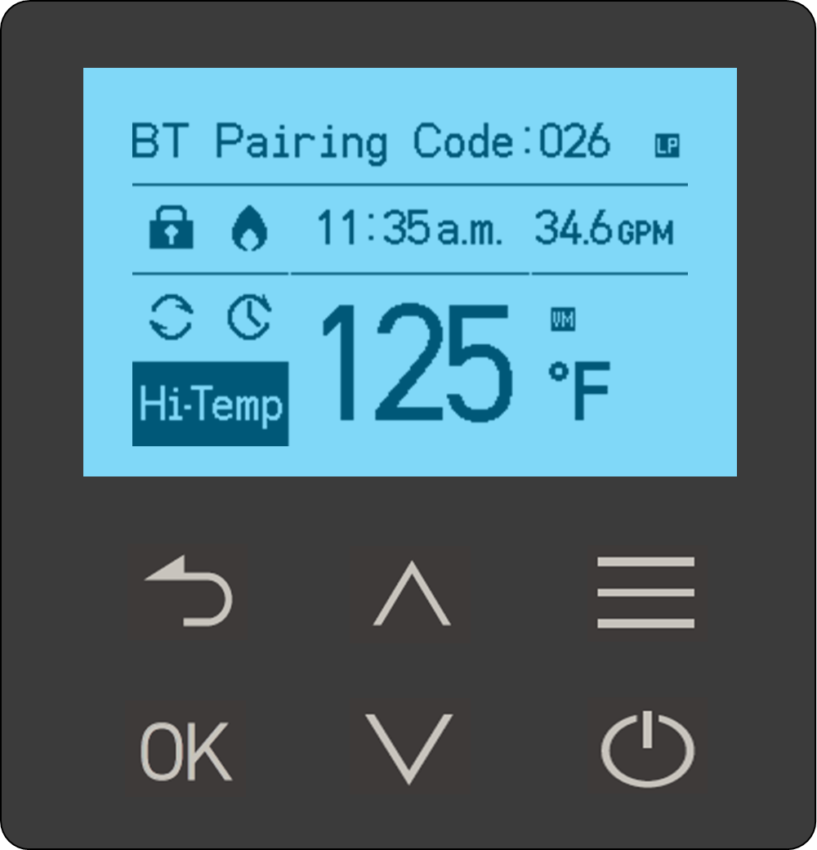
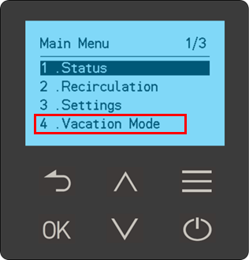

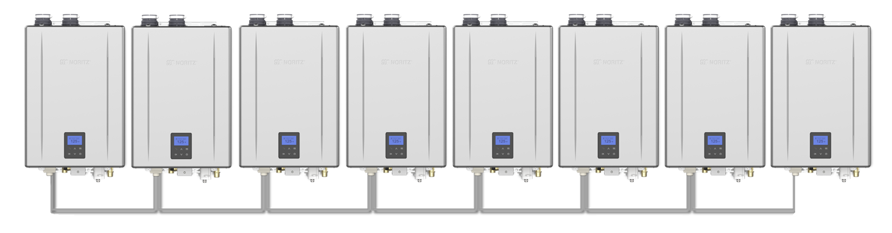
NEW UPGRADED FEATURES
Same Industry Leading Product with additional features
Built-in Operation Panel
Vacation Mode
Change Pump Speed on NRCR
Quick Connect Pro:
Up to 8 NCC199CDV PRO and you can monitor all 8 at the same time

Slide 6
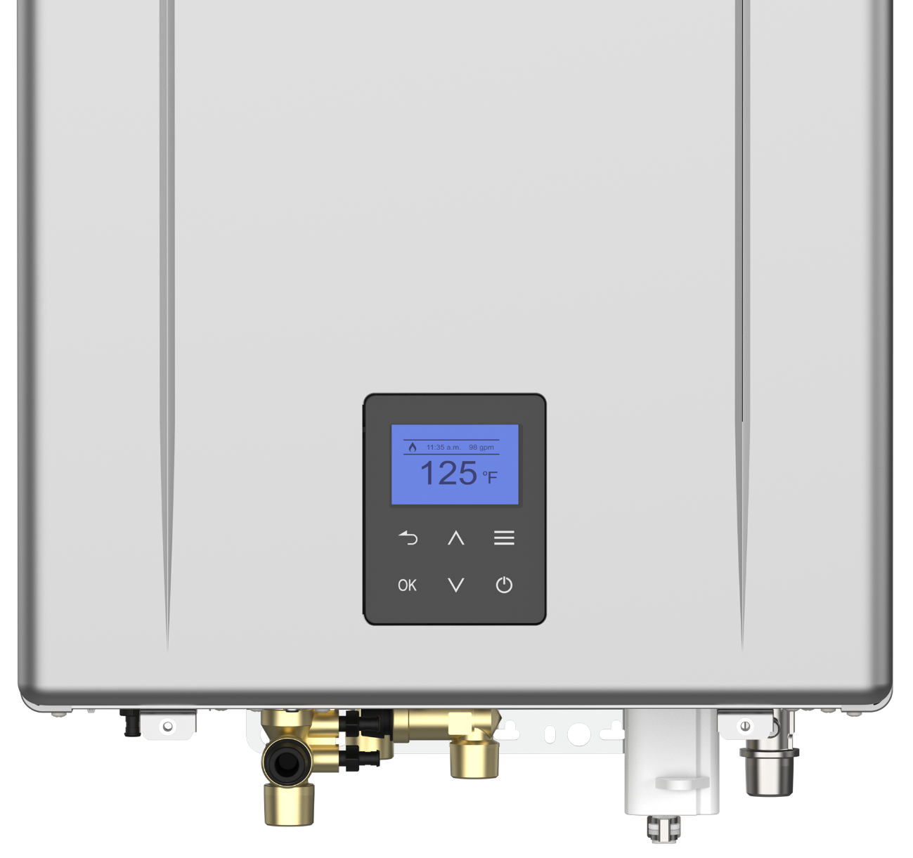
OPERATION PANEL
Operation Panel has replaced the built-in display
Waterproof keypad
All unit setting and MM information available at your fingertips

Slide 7
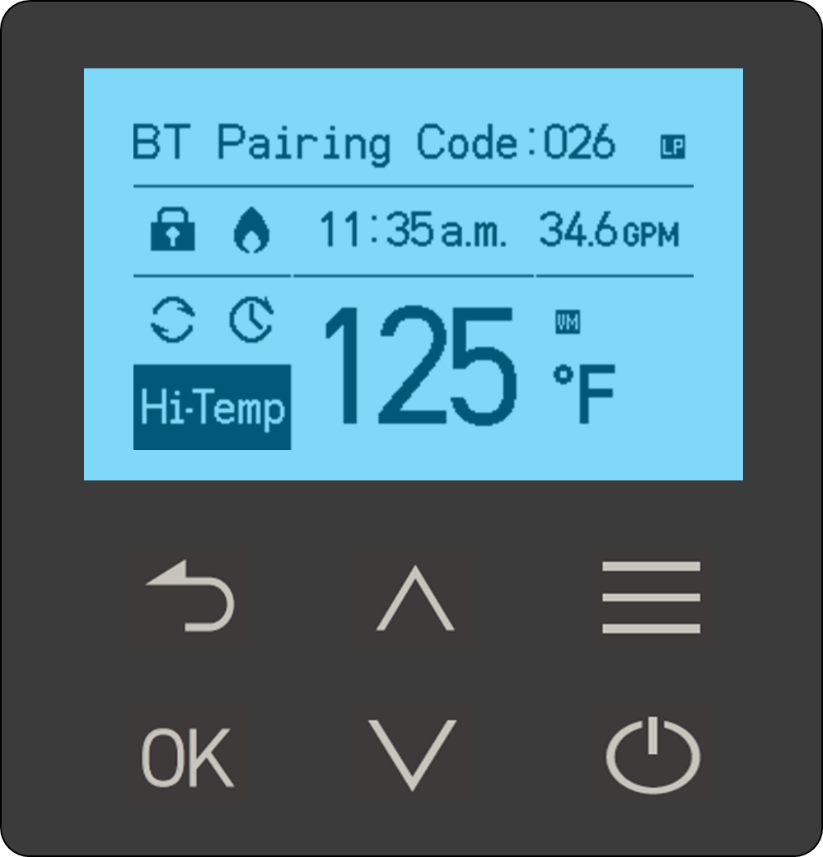
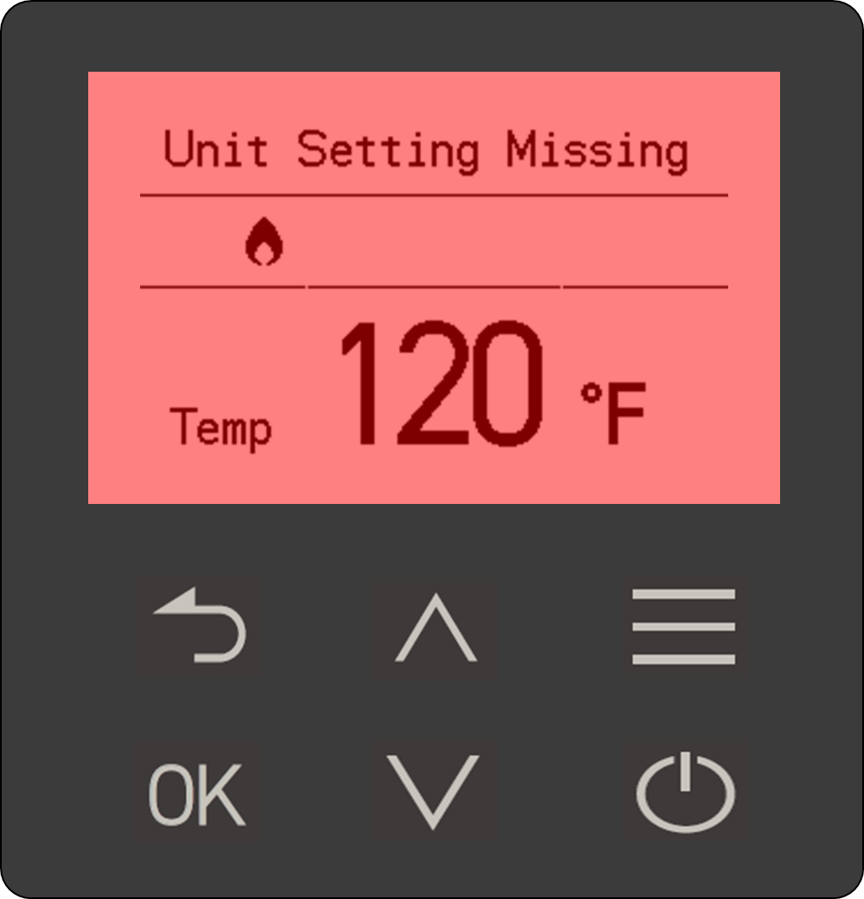
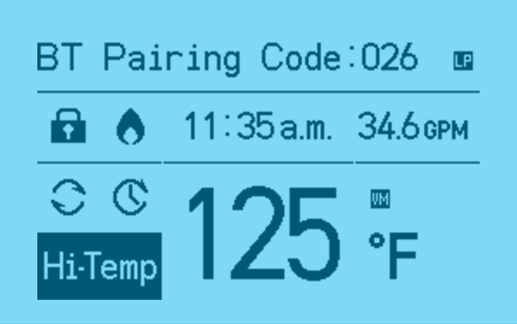
OPERATION PANEL
Operation Panel has 6 buttons:
Back Button
OK Button
Up and Down Buttons
Menu Button
Power Button
Main Display shows:
Bluetooth Pairing Code
LP Gas Icon
Screen Lock Icon
Burner On Icon
Time
Flow Rate of System
Recirculation Icons
Set Temperature (over 120 F – Hi-Temp is displayed)
Vacation Mode Icon
Screen is illuminated Blue, but when there is a warning or error code, it illuminates Red

Slide 8
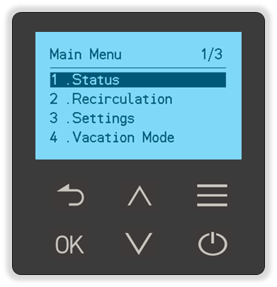
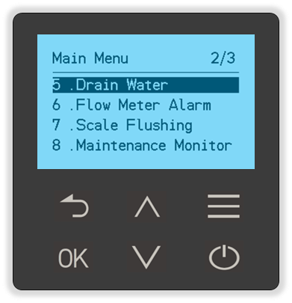
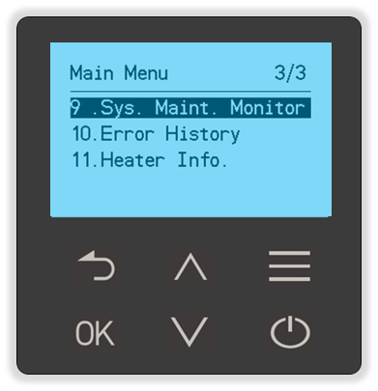

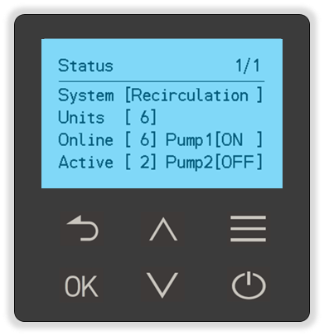
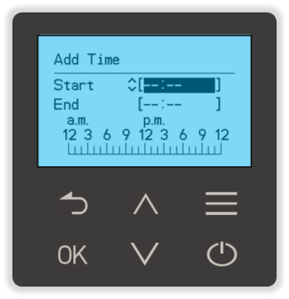
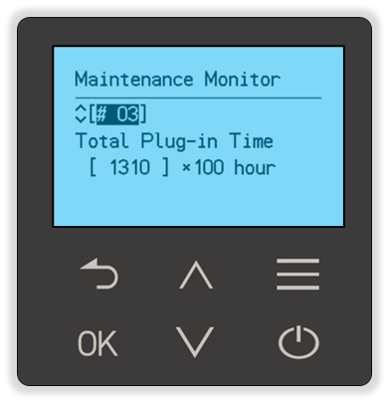
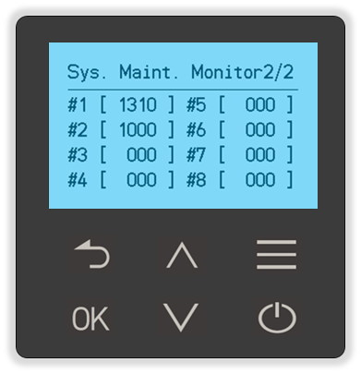
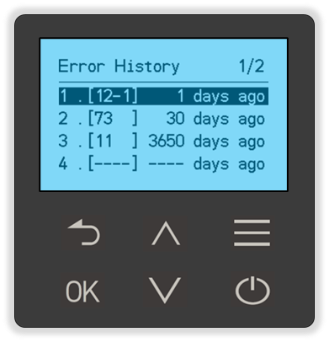
MAIN MENU
Enter the Main Menu by pushing the button
Main Menu 1/3
Main Menu 2/3
Main Menu 3/3
1. Status
2. Recirculation
8. Maintenance Monitor
9. System Maintenance Monitor
10. Error History

Slide 9
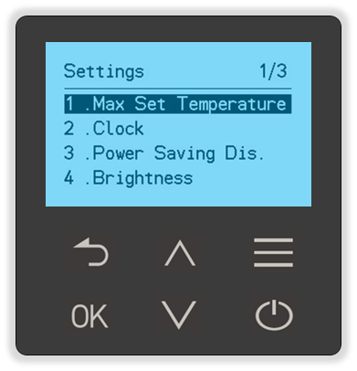
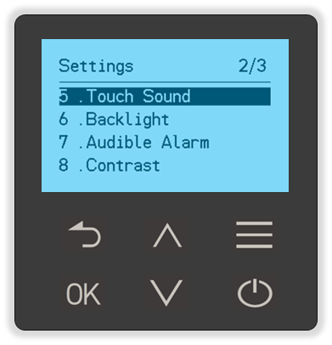
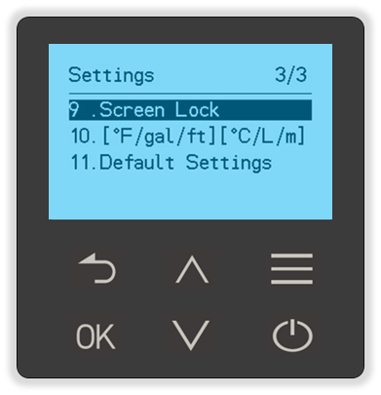
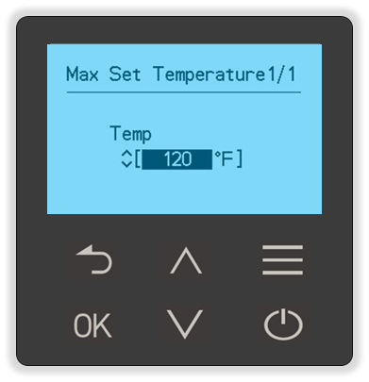
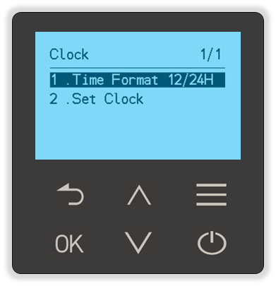
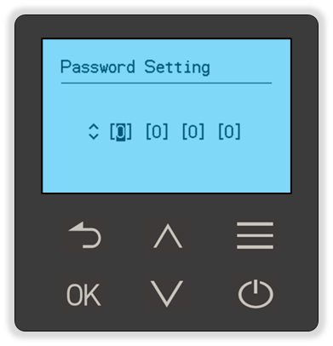
SETTINGS MENU
Settings Menu is for adjusting the Operation Panel Display along with setting maximum hot water temp and clock
1. Max Set Temperature
2. Clock
9. Screen Lock

Slide 10
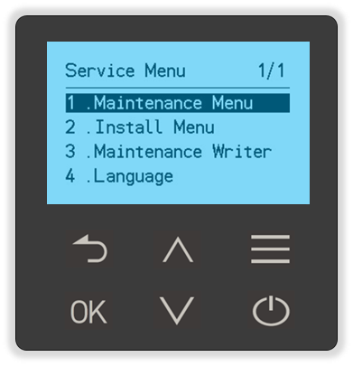
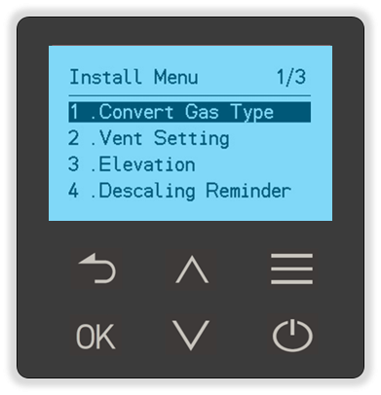
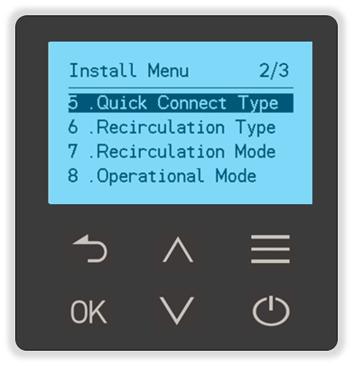
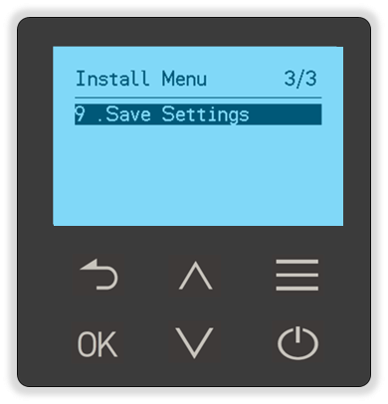
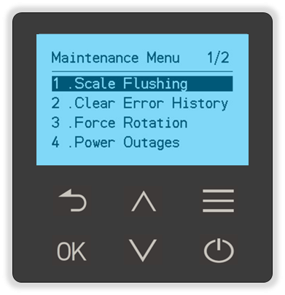
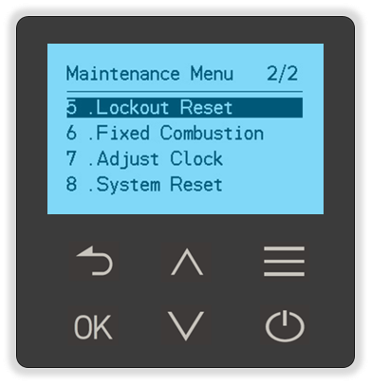
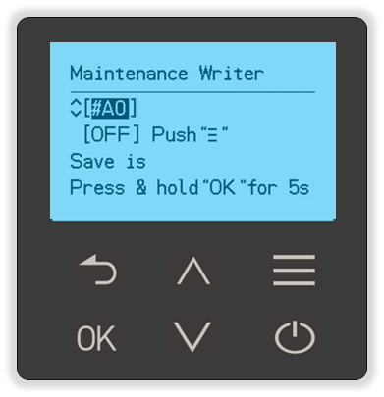
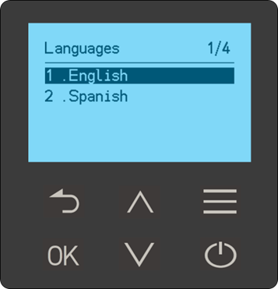
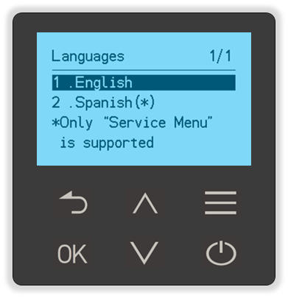
SERVICE MENU
To enter the Service Menu, Push and Hold both Arrow Keys
1. Installer Menu 1/3
1. Installer Menu 2/3
1. Installer Menu 3/3
1. Maintenance Menu 1/2
1. Maintenance Menu 2/2
3. Maintenance Writer
4. Language
Only Service Menu can be changed to Spanish

Slide 11
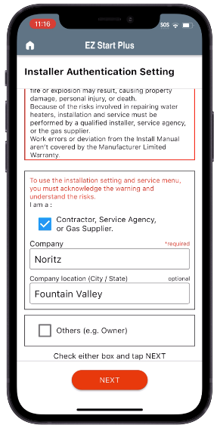
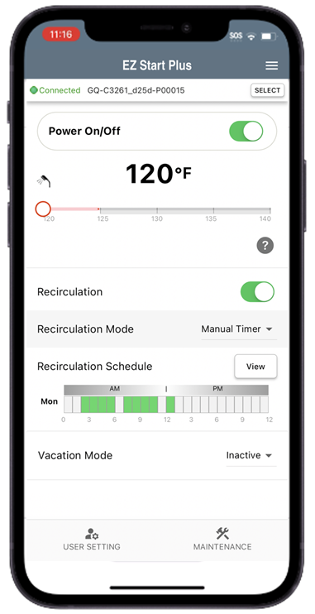
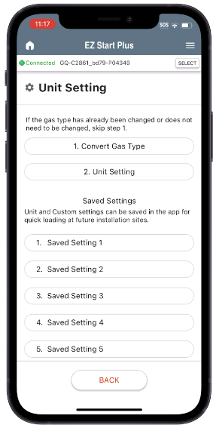
BLUETOOTH APP UPDATES
EZ Start PLUS App has been updated
Installer Authentication Setting Screen
Users don’t have access to Unit Settings or Trial Operation
Vacation Mode
10 saved slots within Unit Setting Menu

Slide 12
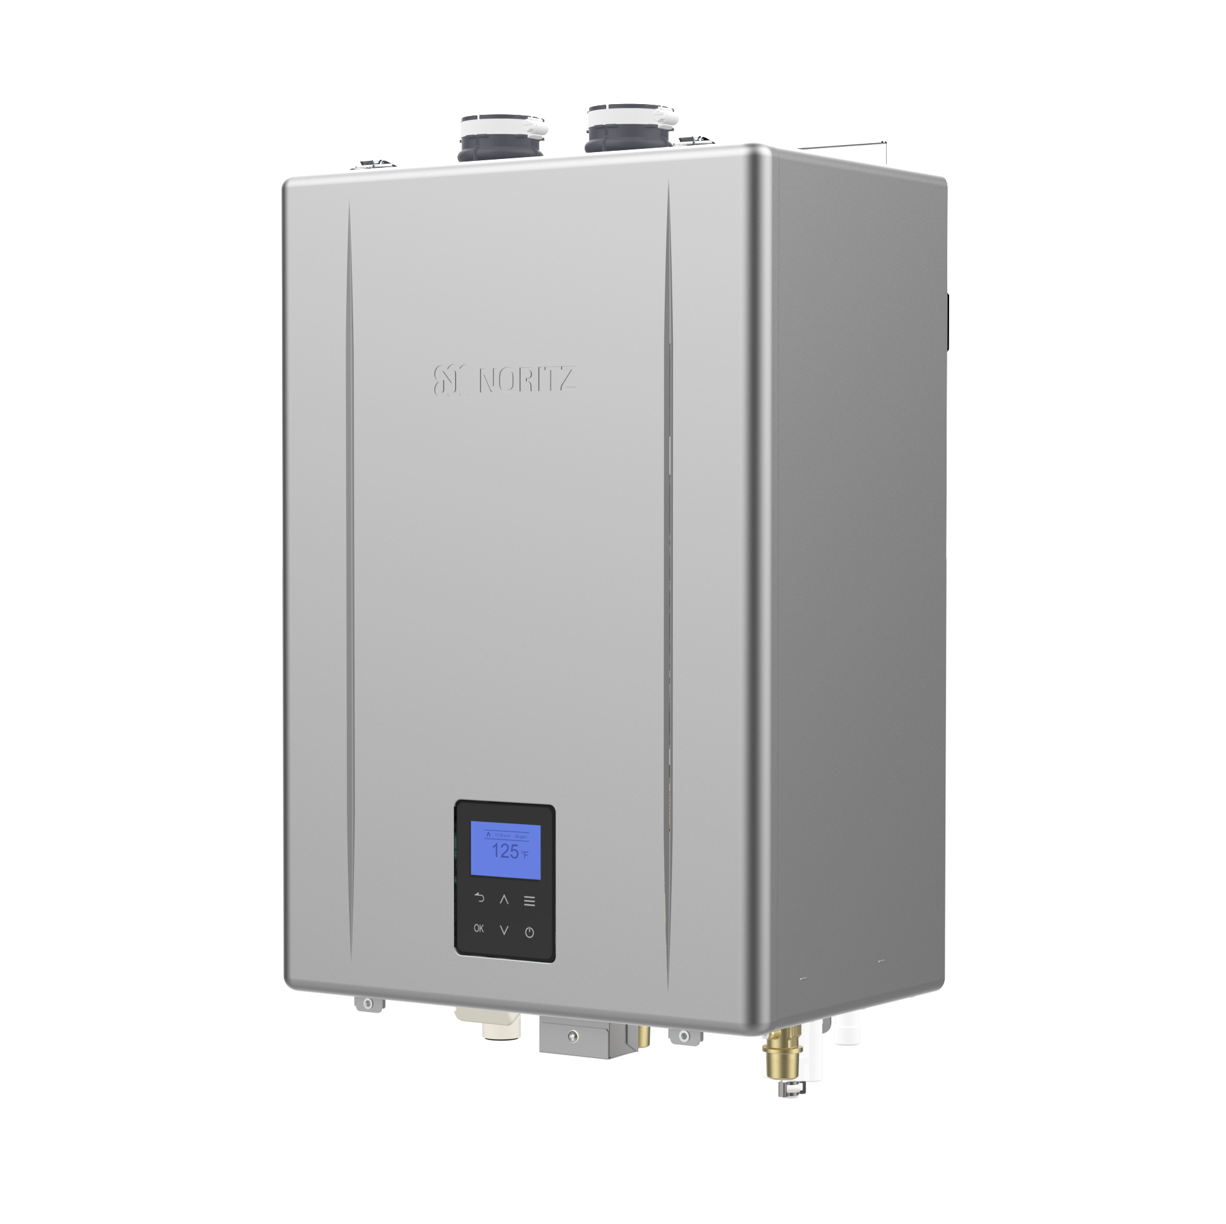

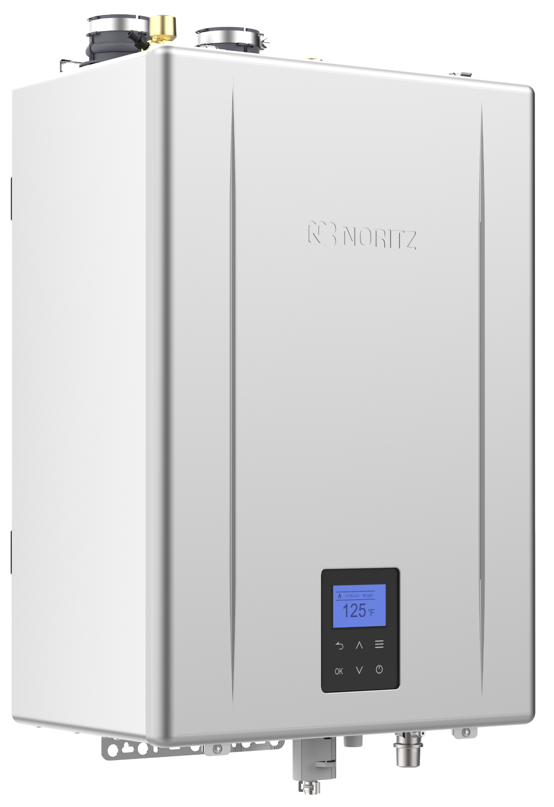
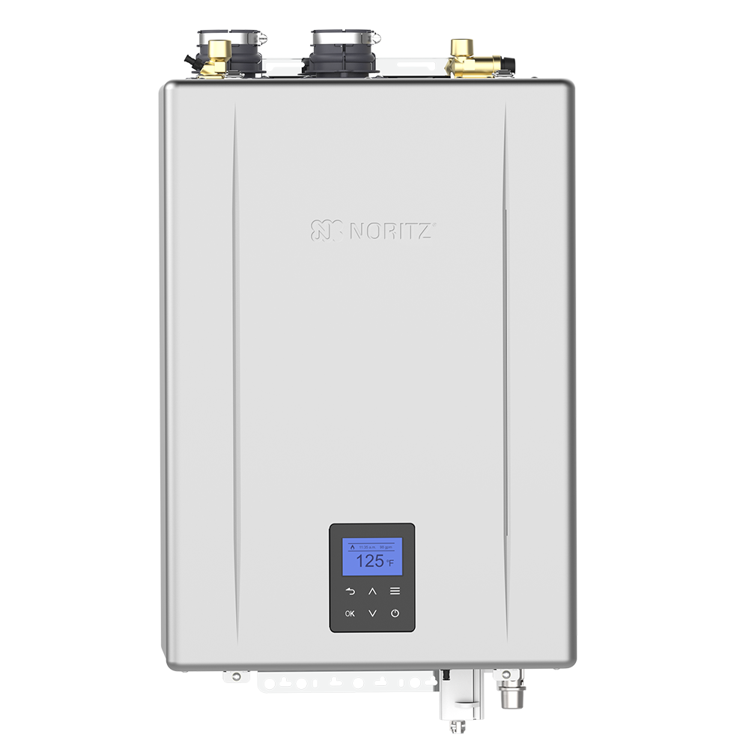

0.98 UEF
Best Efficiency
Best Warranty
Best Heater
Best Support
Now Easiest to Install

Slide 13
HELPFUL LINKS
SUPPORT.NORITZ.COM
NORITZ.COM/TECHTIPS
HELP.NORITZ.COM
TRAINING.NORITZ.COM
YOUTUBE.COM/NORITZAMERICA
Customer Care: 866-766-7489

Slide 14

THANK YOU

