Slide 1
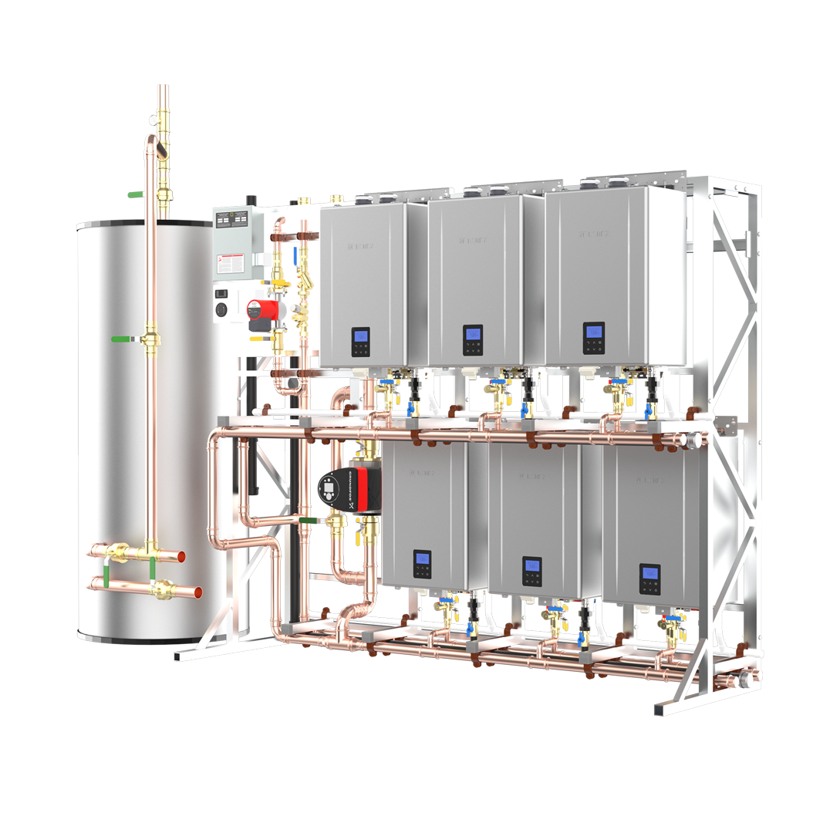

The Original Tankless Water Heater Manufacturer and World Leader in Tankless Technology since 1951

Slide 2
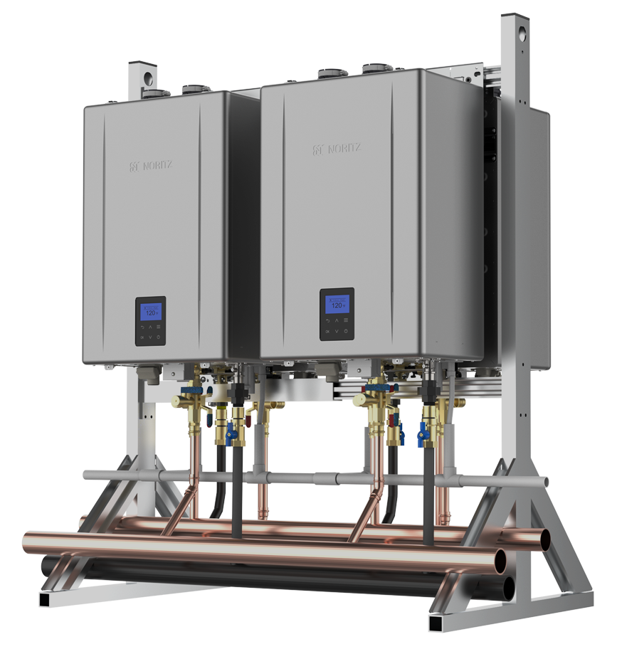
INTRODUCTION
NCC300OD & NCC300DV
NC380-SV-ASME
NCC199CDV
Hybrid Hot System
CMK & CRK Manifold Systems
CR61 Systems
TTS – S and SWH Series
TTS – TWST Series
Sizing and FIOP (Factory Installed Options)

Slide 3
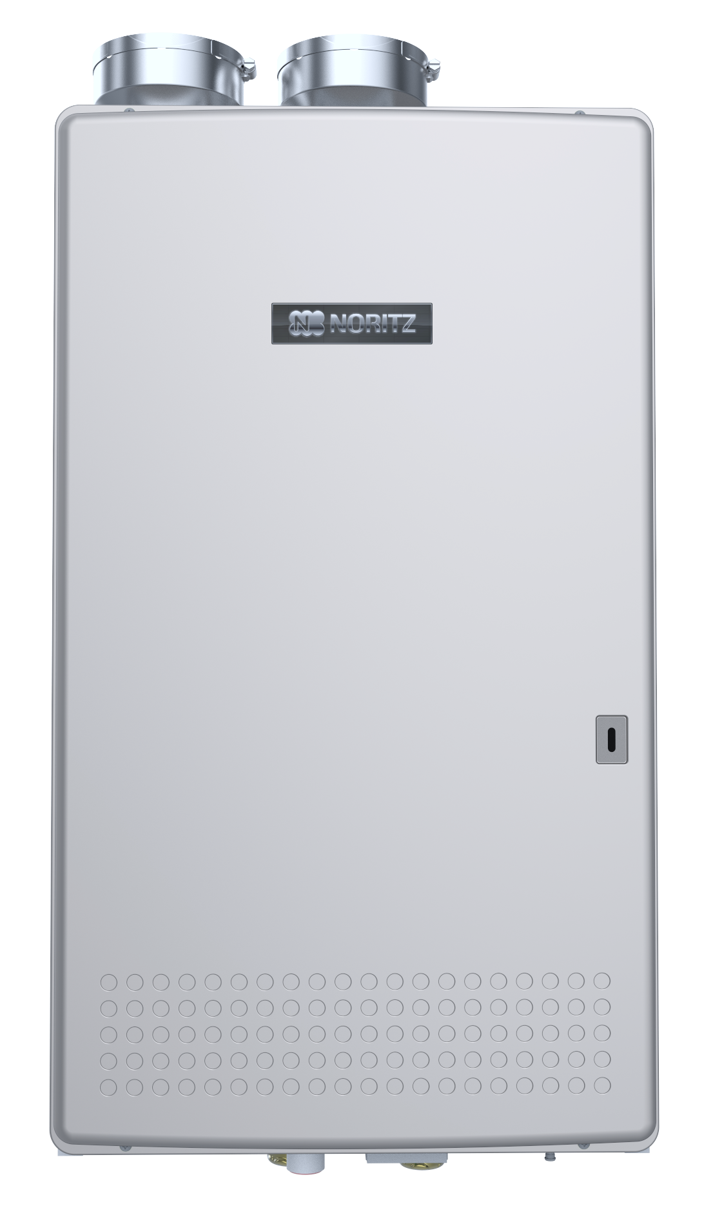
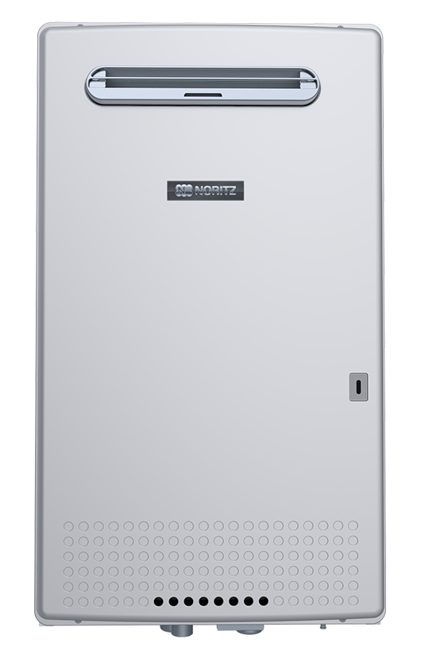
NCC300 SERIES
Indoor Model: NCC300DV (4” PVC, CPVC, PP and 5” SS w/ adapters)
Outdoor Model: NCC300OD (no vent cap required)
BTU Range: 15,000 – 300,000 BTUh
Flow Range: 0.5 – 13.2 gpm
Temperature Range: 100 F – 185 F
Thermal Efficiency: 97%
Turndown Ratio: 20:1
Multi System: up to 24 units (up to 7.2 million BTUh)
Warranty: 5 yr HEX, 5 yr parts, 1 yr labor
HEX: K type copper (primary) SS (secondary)
Sales only in CA, MN & WI

Slide 4

NCC300 SERIES
Flow Rates and Pressure Loss

Slide 5
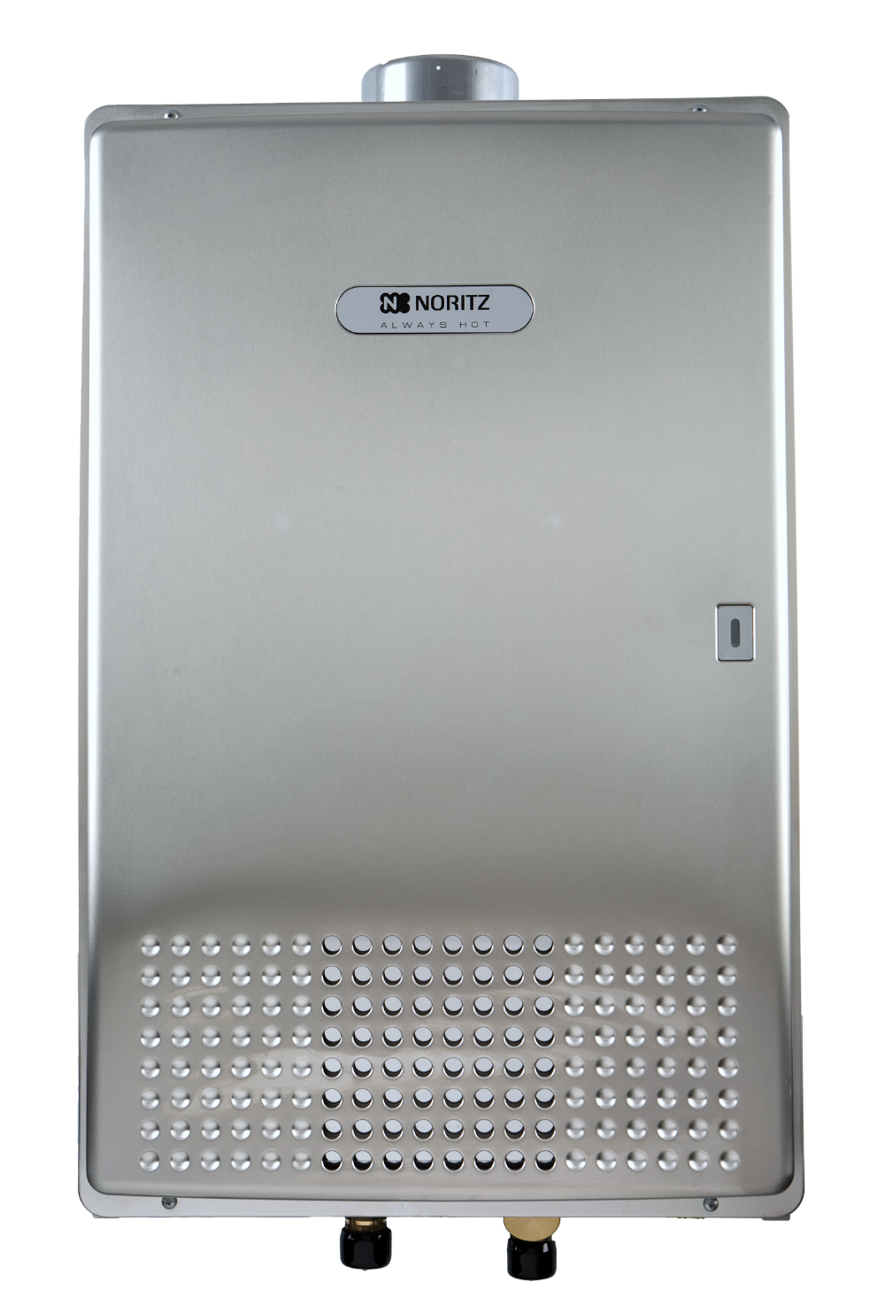
NC380-SV-ASME
Non-Condensing - Indoor/Outdoor Installations
Indoor – 5” Cat III Stainless Steel Venting
Outdoor – Vent Cap Required (VC-132)
BTU Range: 22,500 – 380,000 BTUh
Flow Range: 0.7 – 13.2 gpm
Temperature Range: 100 F – 180 F
Thermal Efficiency: 80%
Multi System: up to 24 units (up to 9.1 million BTUh)
Warranty: 5 yr HEX, 5 yr parts, 1 yr labor
HEX: K type copper

Slide 6

NC380-SV-ASME
Flow Rates and Pressure Loss

Slide 7
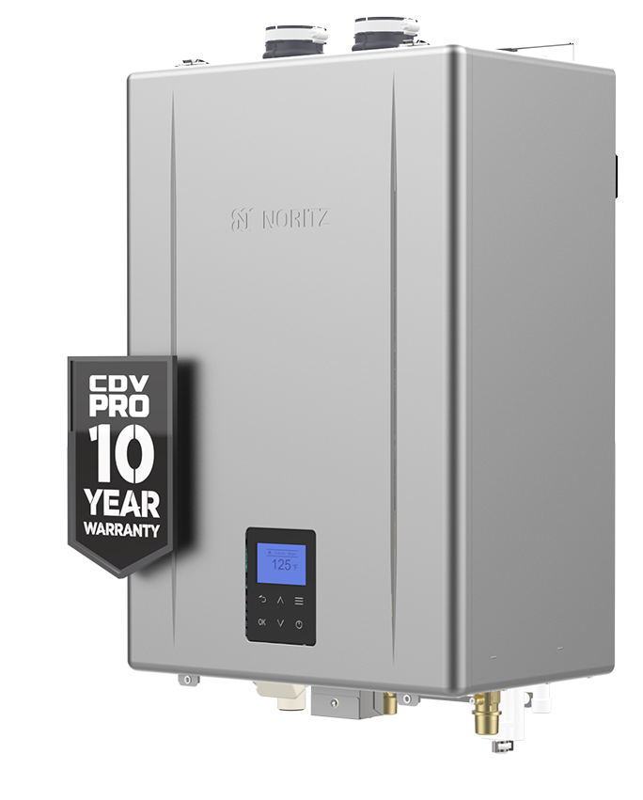
NCC199CDV PRO SERIES
Indoor/Outdoor Model (Versatile Venting)
Indoor: 2”- 75’, 3”- 150’ or 4”- 65’ PVC/CPVC/PP
Outdoor: Vent Cap required (VC-6-1)
BTU Range: 12,800 – 199,900 BTUh
Flow Range: 0.4 – 11.1 gpm
Temperature Range: 100 F – 185 F
Thermal Efficiency: 98% (UEF 0.98)
Turndown Ratio: 16:1
Multi System: up to 24 units (up to 4.8 million BTUh)
Warranty: 10 yr HEX, 5 yr parts, 1 yr labor
HEX: Stainless Steel for both Primary and Secondary

Slide 8
NCC199CDV PRO ADD’L FEATURES
Bluetooth Connectivity: EZ Start Plus App
Wi-Fi Capable
Operation Panel
Service Reminder
Field Convertible: LP parts included in box
Built in non-return valve
Common Vent up to 12 units
High Altitude Approved up to 10,200 ft
Scale Detection
Pre-Mix Burner w/ Negative Pressure Gas Valve
Quick Connect Capable up to 8 units

Slide 9

NCC199CDV PRO SERIES
Flow Rates and Pressure Loss

Slide 10
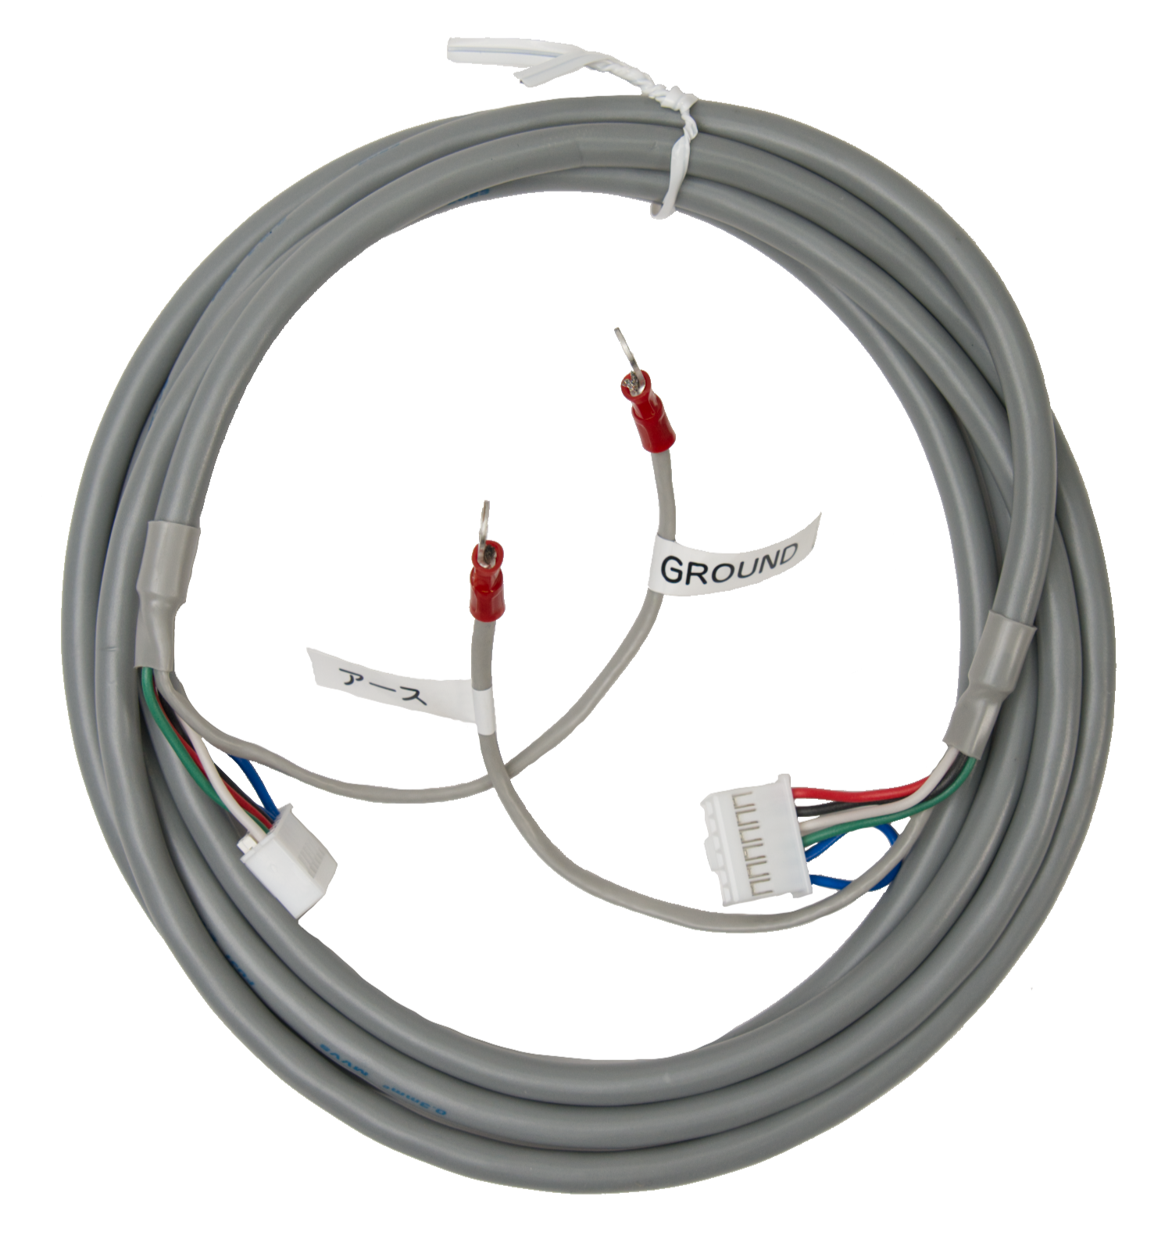
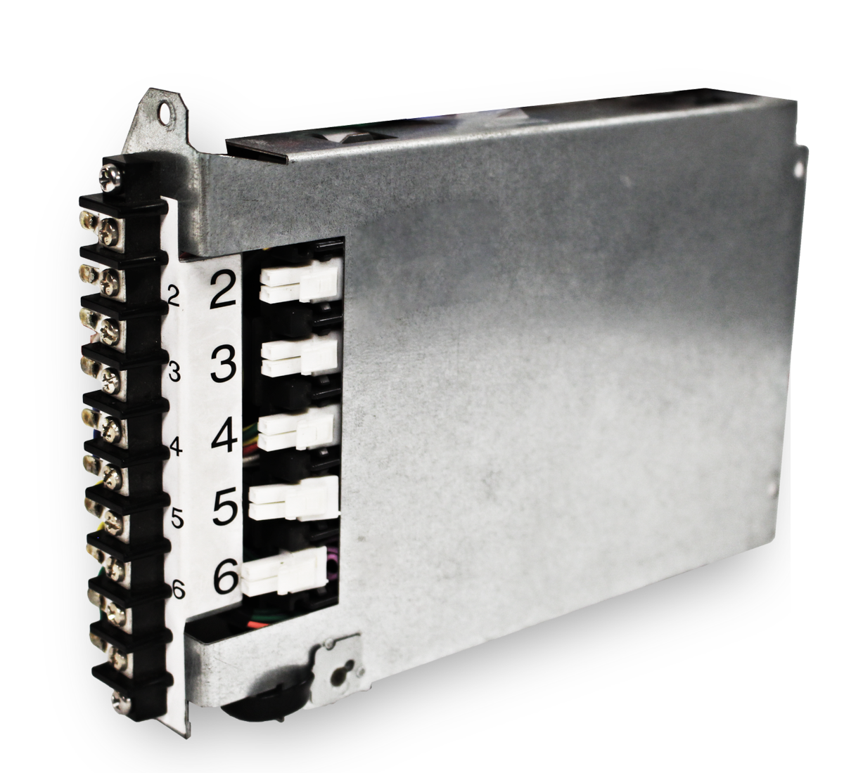
NCC199CDV PRO MULTI UNIT SYSTEMS
Superior commercial unit linking made easy
Quick Connect Cord (QC-2)
System Controller (SC(U)-##M)
Up to 8 units
Stages, rotates, load balances
Up to 24 units (6, 12 & 24)
Stages, rotates, load balances
Settings types:
Standard, Recirculation, Storage
Aquastat & Timer
Fan Control (External)

Slide 11
NCC199CDV PRO MULTI UNIT SYSTEMS
If using QC Cords: purchase one less than the number of units
  Example: 6 units you will need qty 5 of the QC-2
If using 6-unit system controller, need to purchase:
1x SC-401-6M System Controller
1x of the RC-9018M Remote
Qty equal to the number of units of the RC-CORD10 or RC-CORD26 (10 ft or 26 ft Remote Cords)
Example 4 units: you will need 1 System Controller, 1 Remote, 4 Remote Cords
If using 12 or 24 unit system controller, need to purchase:
1x SCU-401-12M (or -24M) System Controller
1x RC-9018M (Remote)
Qty +1 the number of units of the RC-CORD10 or RC-CORD26 Remote Cords
  Example 10 units: you will need 1 System Controller, 1 Remote, 11 Remote Cords

Slide 12
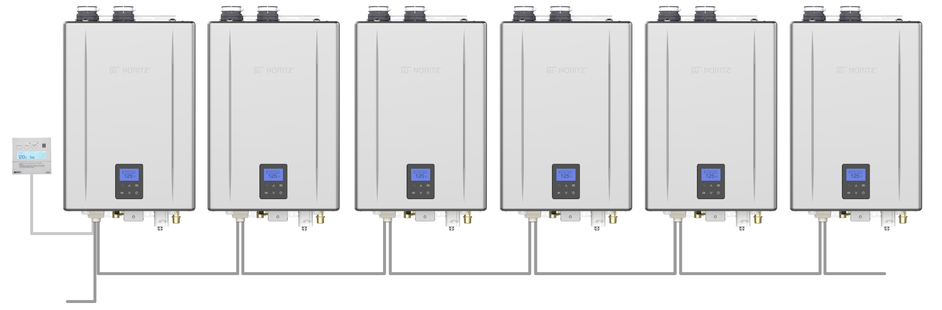
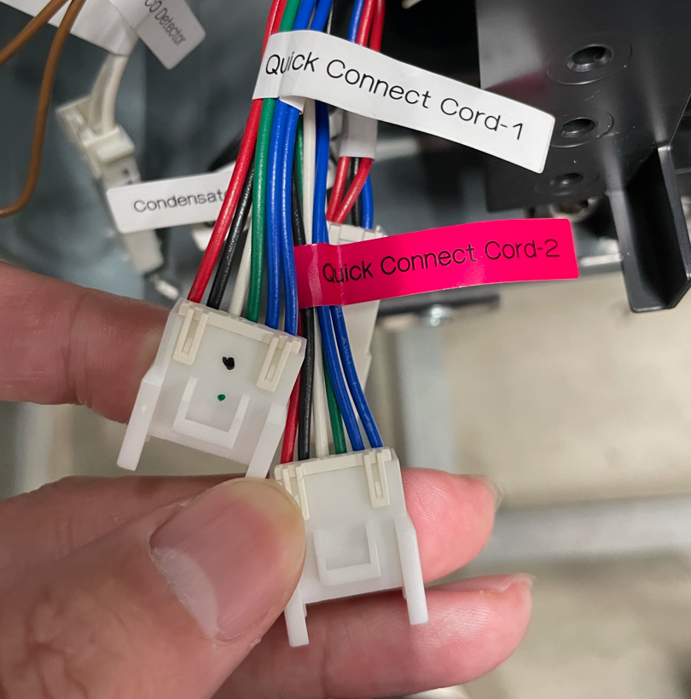
NCC199CDV PRO QUICK CONNECT
Leader
Follower
Follower
Follower
Follower
Follower
Optional
RC-9018M
Qcc-1
Qcc-2
Qcc-1
Qcc-2
Qcc-1
Qcc-2
Qcc-1
Qcc-2
Qcc-1
Qcc-2
Qcc-1
UNUSED
Qcc-2
UNUSED
Units must be connected in series using QC cords (QC-2)
QC cords are not included in box (purchased separately)
For all sub units, the QC cord runs from Qcc-1 (white) to Qcc-2 (red) on the subsequent units
※Qcc-1 OPEN
“Last Follower”
Image of QC connectors

Slide 13
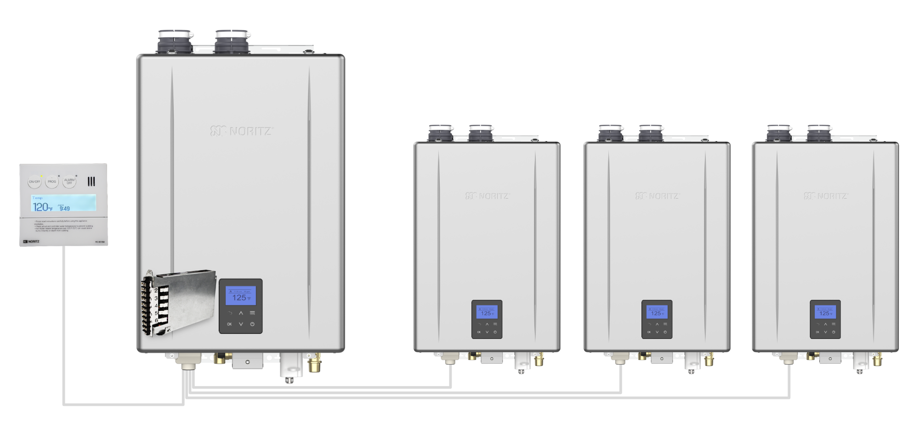
NCC199CDV PRO MULTI UNIT SYSTEMS
Remote Cords: Total qty of units
RC-CORD10 (10ft Cord)
RC-CORD26 (26ft Cord)
Example: 4 Units = 4 Remote Cords, 1 System Controller and 1 Commercial Remote.
1x RC-9018M
Commercial Remote
1x SC-401-6M
System Controller

Slide 14
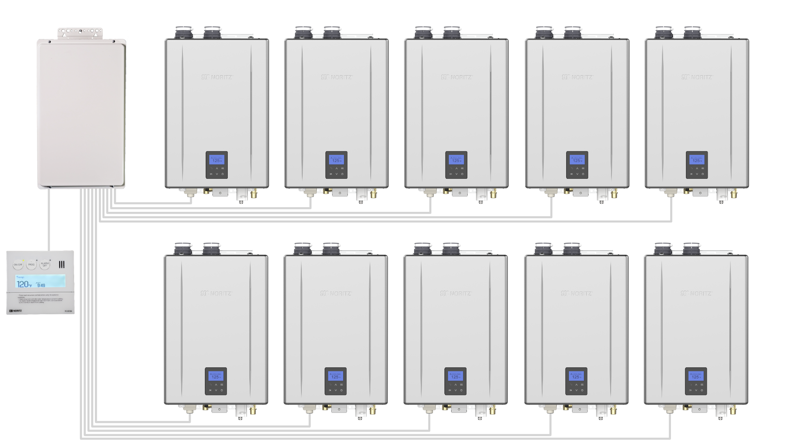
NCC199CDV PRO MULTI UNIT SYSTEMS
1x SCU-401-12M (or 24M) System Controller
1x RC-9018M
Commercial Remote
Remote Cords:
Total qty of units +1
RC-CORD10 (10ft Cord)
RC-CORD26 (26ft Cord)
Example: 10 Units = 11 Remote Cords, 1 System Controller and 1 Commercial Remote.

Slide 15


VENT MATERIALS
Fill the condensate container by pouring approx. 10
oz. (280 mL) of water into the exhaust flue on the
top of the water heater as illustrated below.
This is a Category IV appliance.
Only vent materials approved for use with Category IV appliances may be used.
Under normal conditions, this water heater will not produce an exhaust flue Temperature greater than 149°F (65°C) and schedule 40 PVC pipe may be used as the vent material. If the water heater set temperature is 160°F (70°C) or higher and there is a return line to the water heater from either a recirculation pump or a combination space heating system, schedule 40/80 CPVC, polypropylene or stainless steel must be used.
If the vent pipe has already been installed:
After installing the condensate drain pipe, make
sure that the area around the water heater is well
ventilated. Open a window or a door if necessary.
Then operate the water heater and check that
condensate comes out of the condensate drain
pipe.
(During normal use of the water heater, condensate
will usually begin to discharge from the condensate
drain pipe within 15 minutes of use, but it may take
longer depending on the season and/or installation
site conditions.)

Slide 16
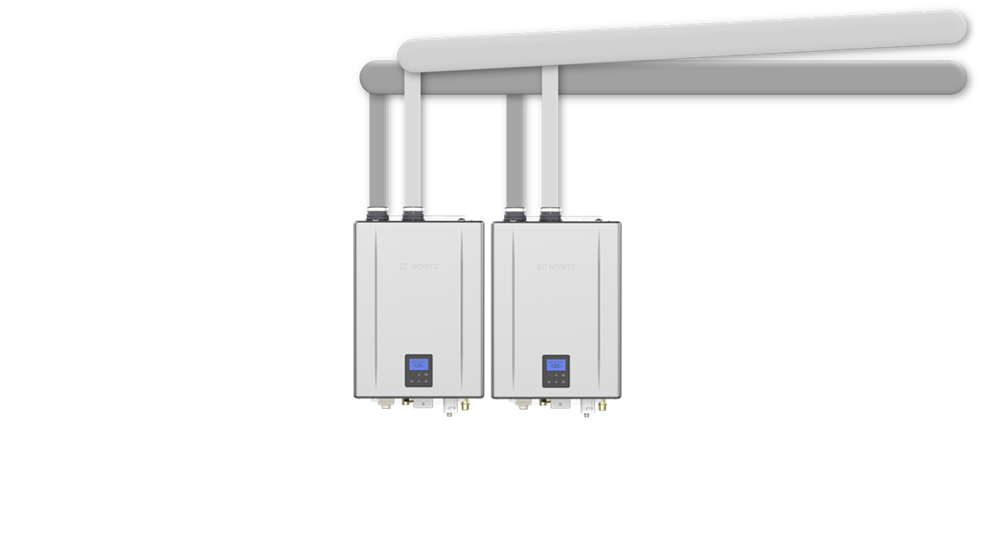
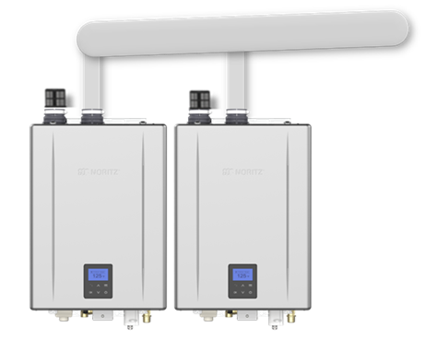
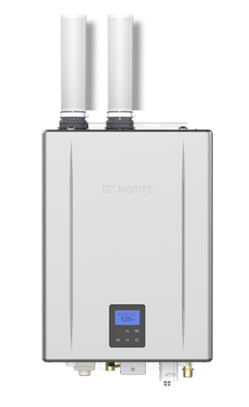
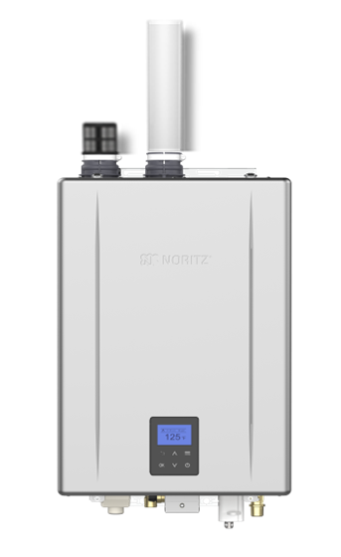
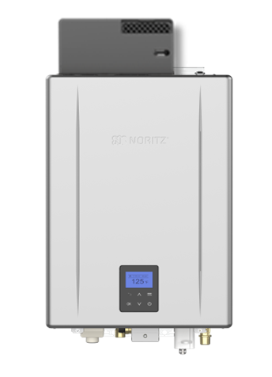
NCC199CDV PRO VENT VERSATILITY
Direct Vent
Single Vent
Outdoor
Common Direct Vent
Common Single Vent

Slide 17
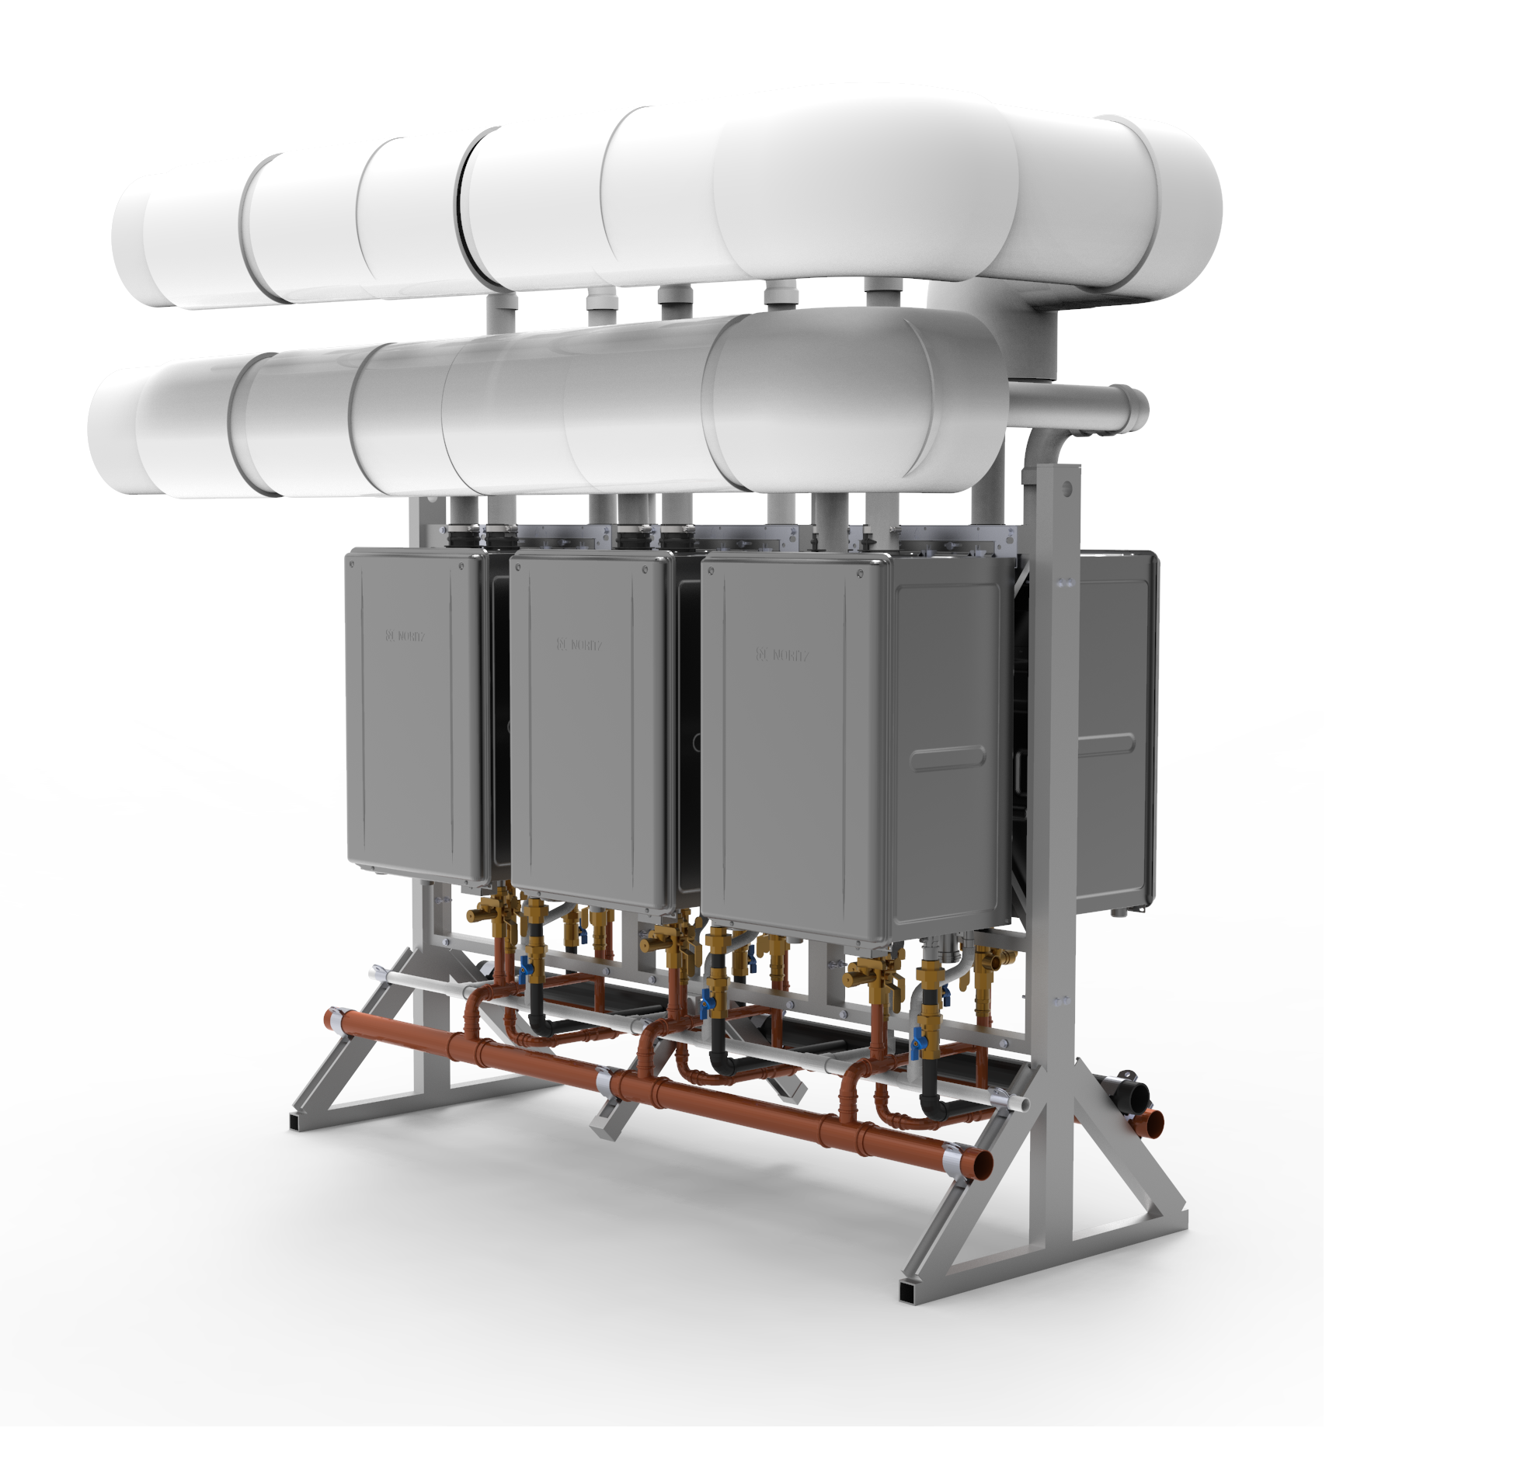
COMMON VENTING
Up to 12 Noritz Water Heaters can share the same venting system. This means significantly reduced penetrations through the wall or roof resulting in less labor and a cleaner finished look. The use of a larger vent diameter system allows for longer vent runs for larger and taller building – up to 200 ft. of equivalent length.
OFFERS A CLEAN, LABOR SAVING INSTALL WHILE ENSURING THE UTMOST IN SAFETY AND PERFORMANCE
  Tested with safety in mind – each water heater has a built-in non-return valve to prevent flue gas from entering idle units.
  Reduces wall or ceiling penetrations.
  Utilizes either ULCS-636 approved Polypropylene (PP) venting (capable of handling temperatures up to 230° F) or Schedule 40/80 PVC.

Slide 18
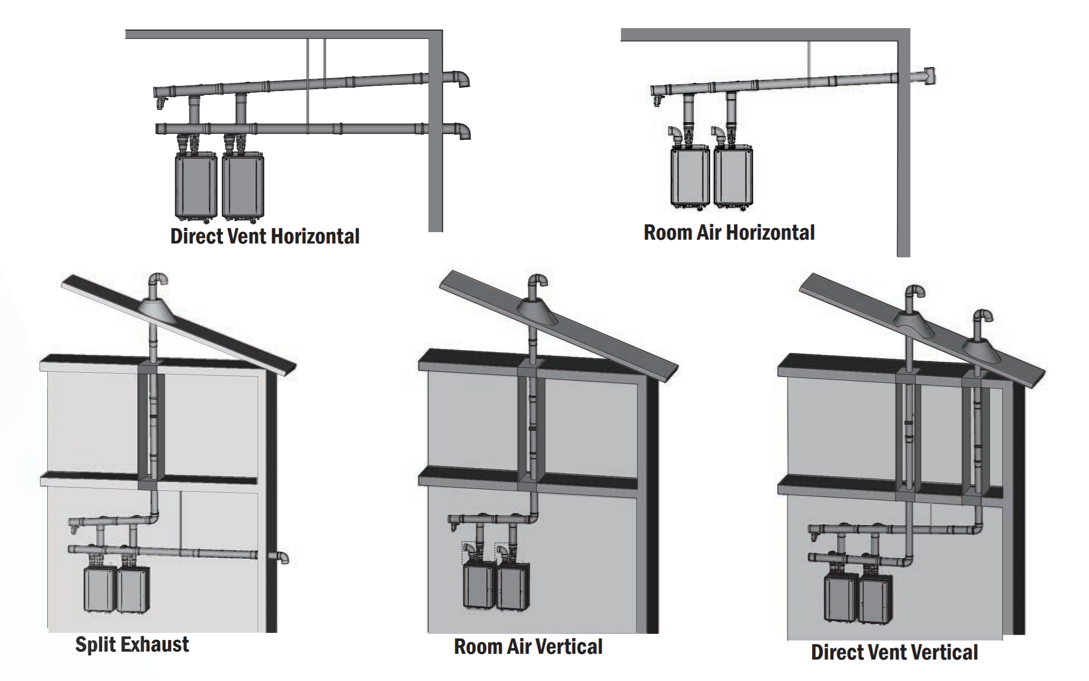
COMMON VENT OPTIONS
Ultimate Flexibility
Figuring out where to safely and efficiently route the exhaust system is one of the biggest hurdles for any HVAC system designer.
Noritz Common Venting offers designers the most flexibility to decide how to safely and efficiently route the vent. For room air installations, the combustion air can be drawn from the room environment, further reducing the installation complexity, by requiring only a single penetration for the exhaust.

Slide 19
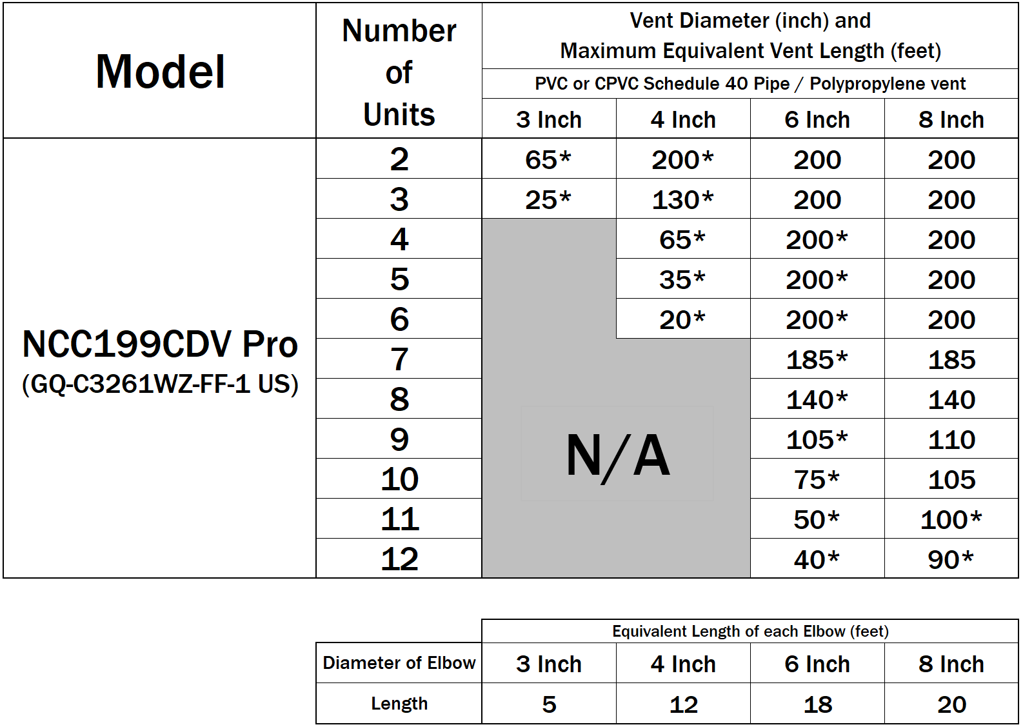
COMMON VENT LENGTHS
NOTE: The sizing method shown in this table is provided for the convenience of the installer. Maximum acceptable vent system static pressure drop is 0.6” WC.
* The Btu/h input of the unit will be reduced by up to 9%
When counting the number of elbows, DO NOT include the termination, see next slide

Slide 20


COMMON VENT LENGTHS
Total Equivalent Length
= 60 ft + 4 x 12 ft (4” Elbow) = 108 ft > 65 ft (Refer to table)
4” Vent System is NOT Suitable
= 60 ft + 4 x 18 ft (6” Elbow) = 132 ft < 200 ft (Refer to table)
6” Vent System is Suitable
Total Equivalent Length
= 35 ft + 2 x 5 ft (3” Elbow)
= 45 ft < 65 ft (Refer to table)
3” Vent System is Suitable

Slide 21
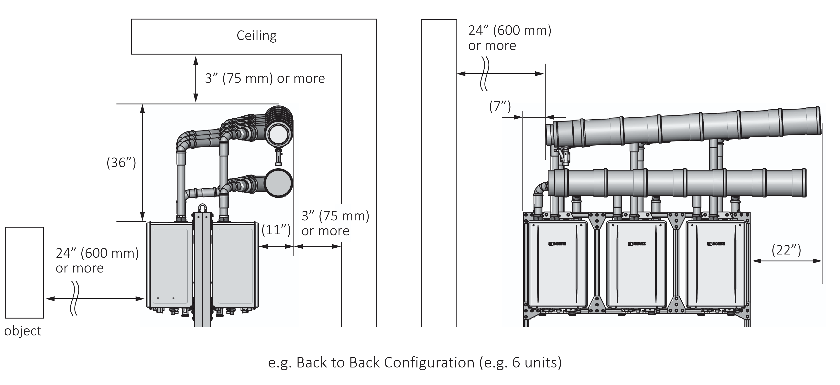
COMMON VENT EXAMPLES

Slide 22
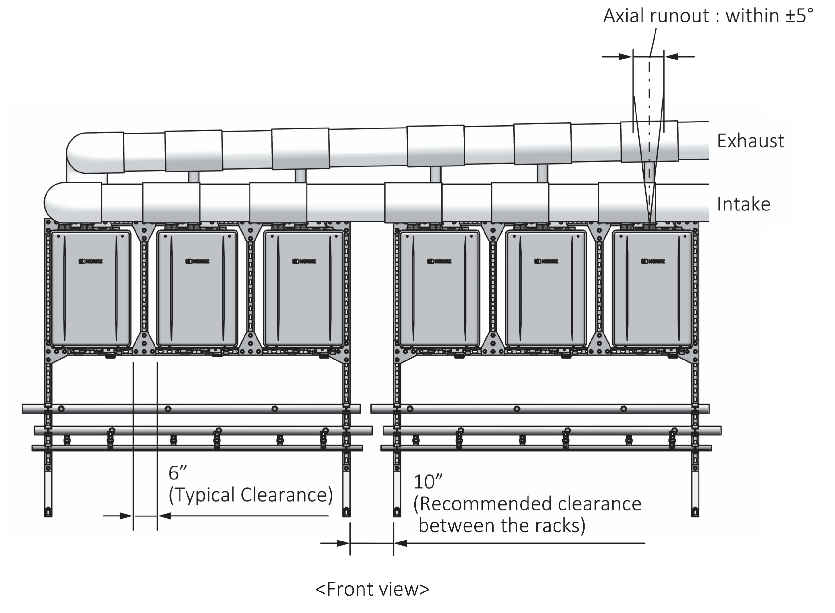
COMMON VENT EXAMPLES
6 Units in-line PVC DV

Slide 23
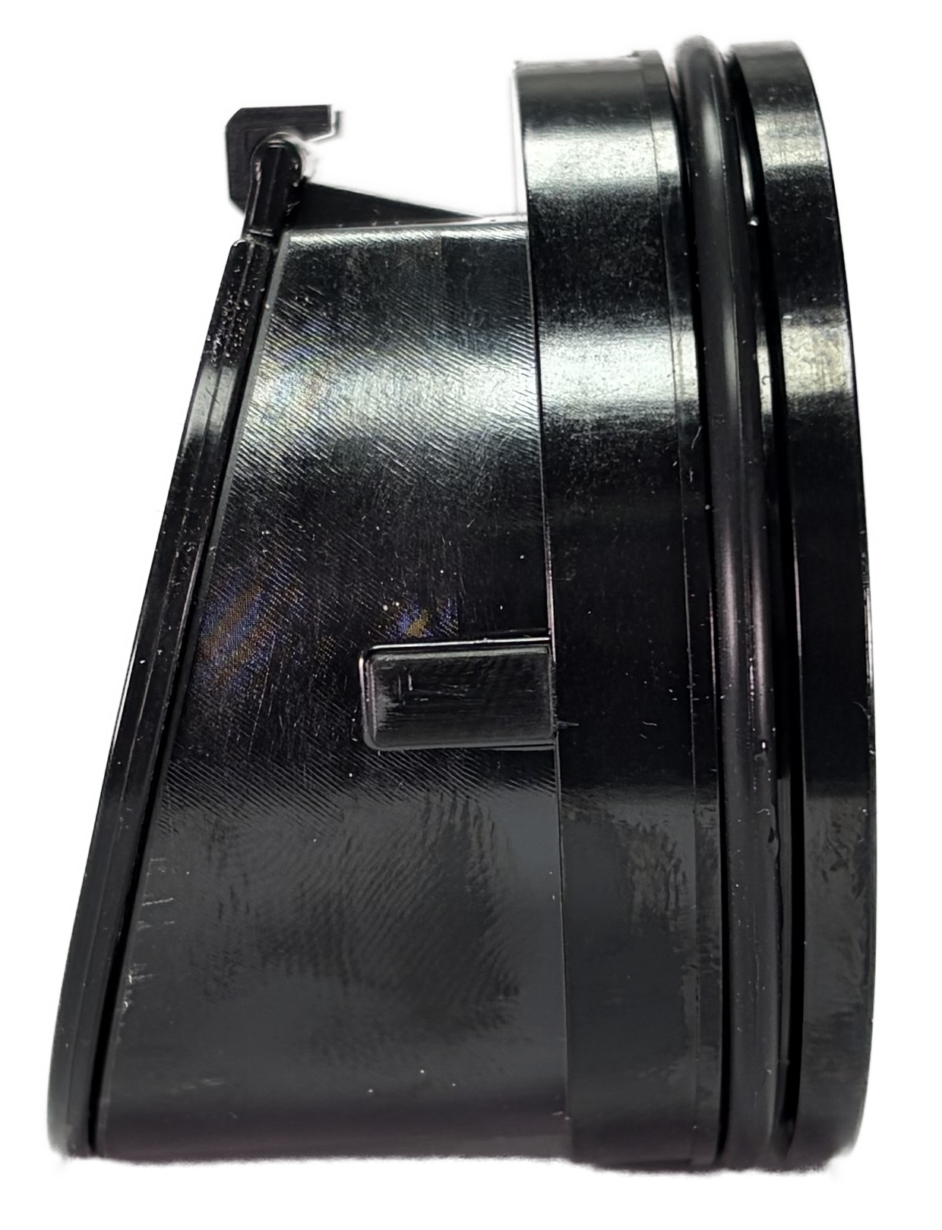
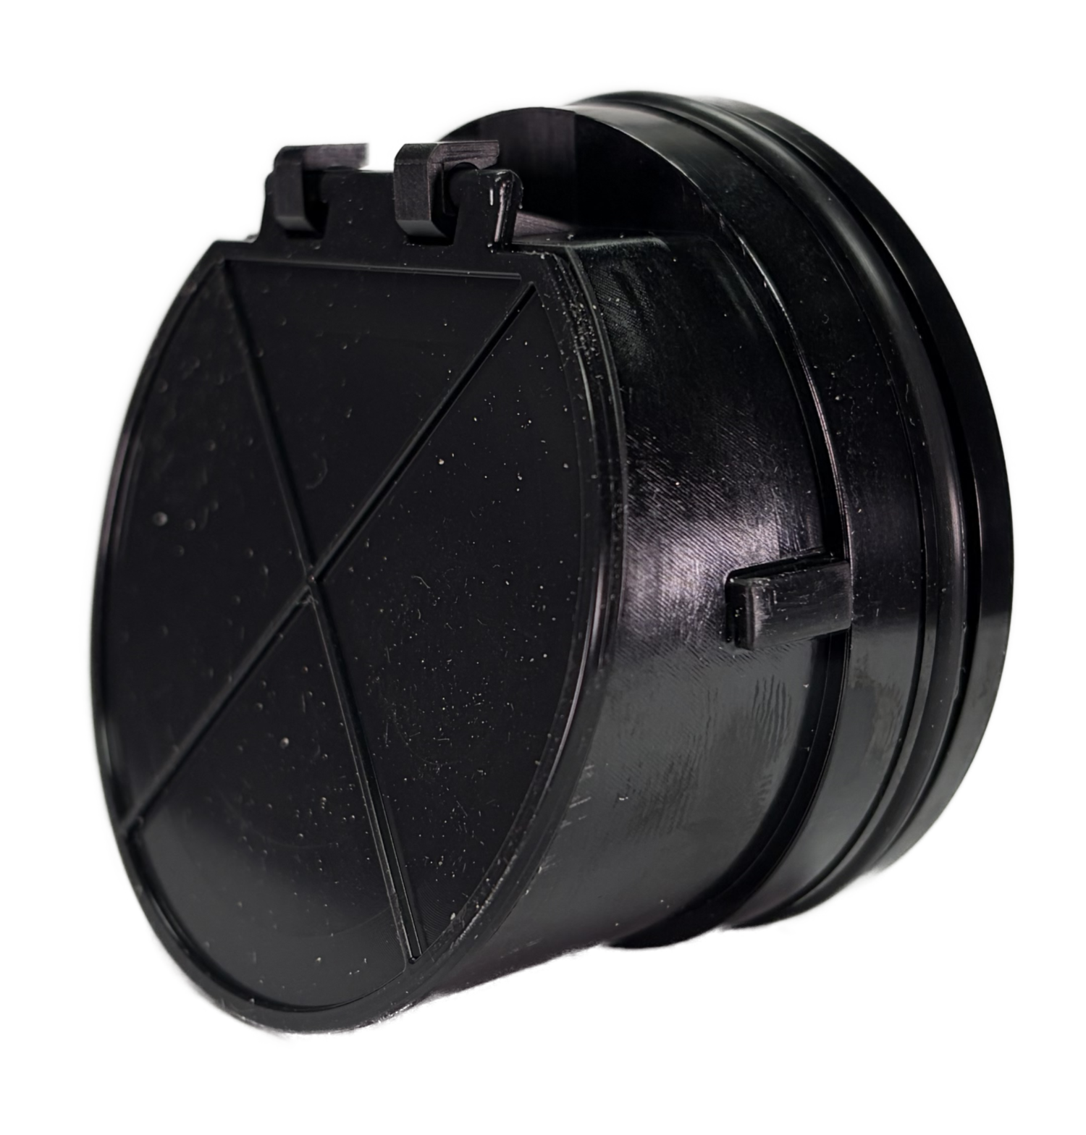
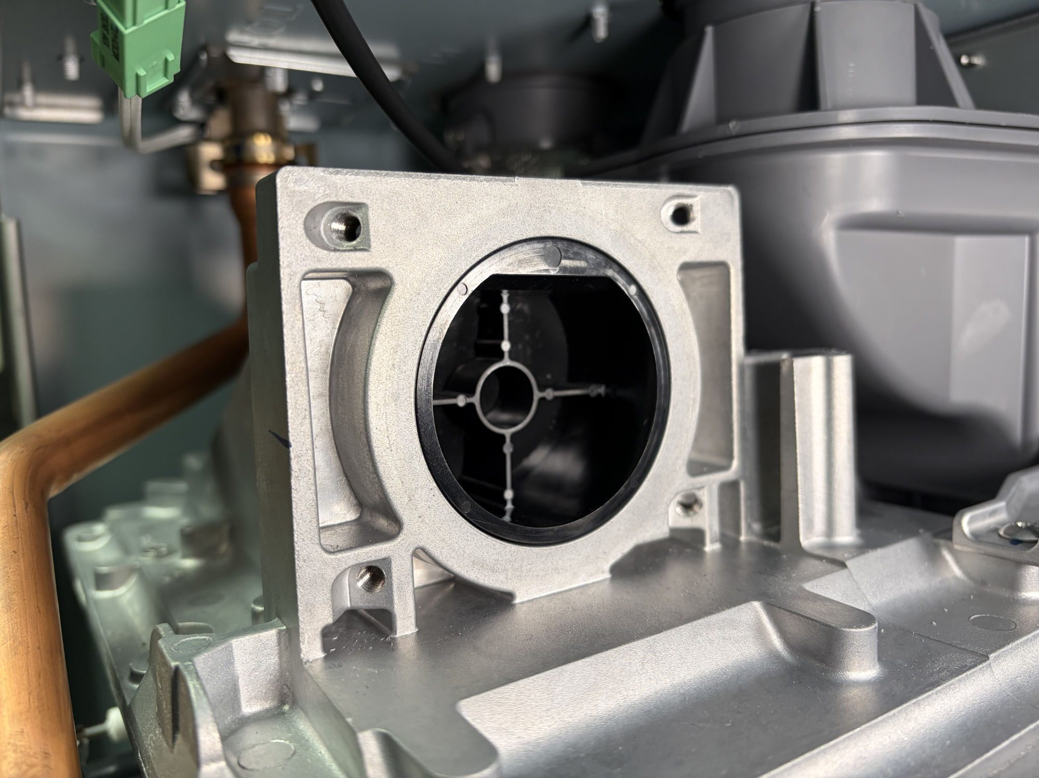

BUILT-IN BACK FLOW PREVENTER
Does not need an external Non-Return Valve. Built in one is CSA certified and satisfies their requirements (less cost to common vent).
External Non-Return Valve Not Required because
of integrated Internal Back Flow Damper for Common Venting.
This System w/o NRV is certified and satisfies CSA safety guideline.
Notes:
No longer requires an external Non-Return Valve which could add an additional $300 premium per heater to common vent. The Non-Return Valve is now integrated into the unit between the fan motor assembly and combustion box satisfying CSA safety guidelines.

Slide 24
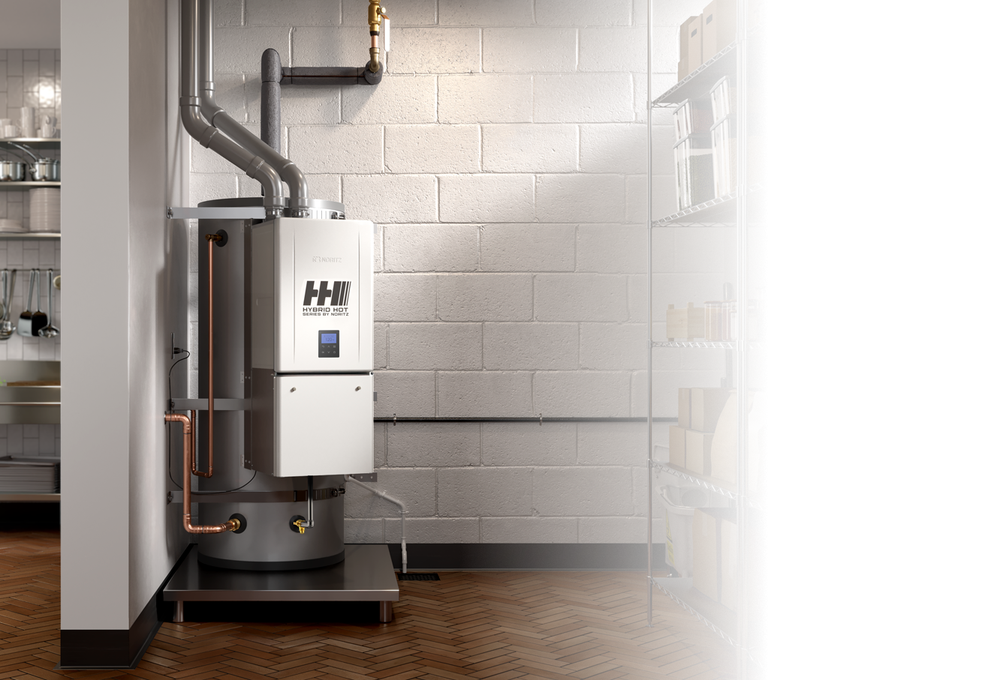


Slide 25

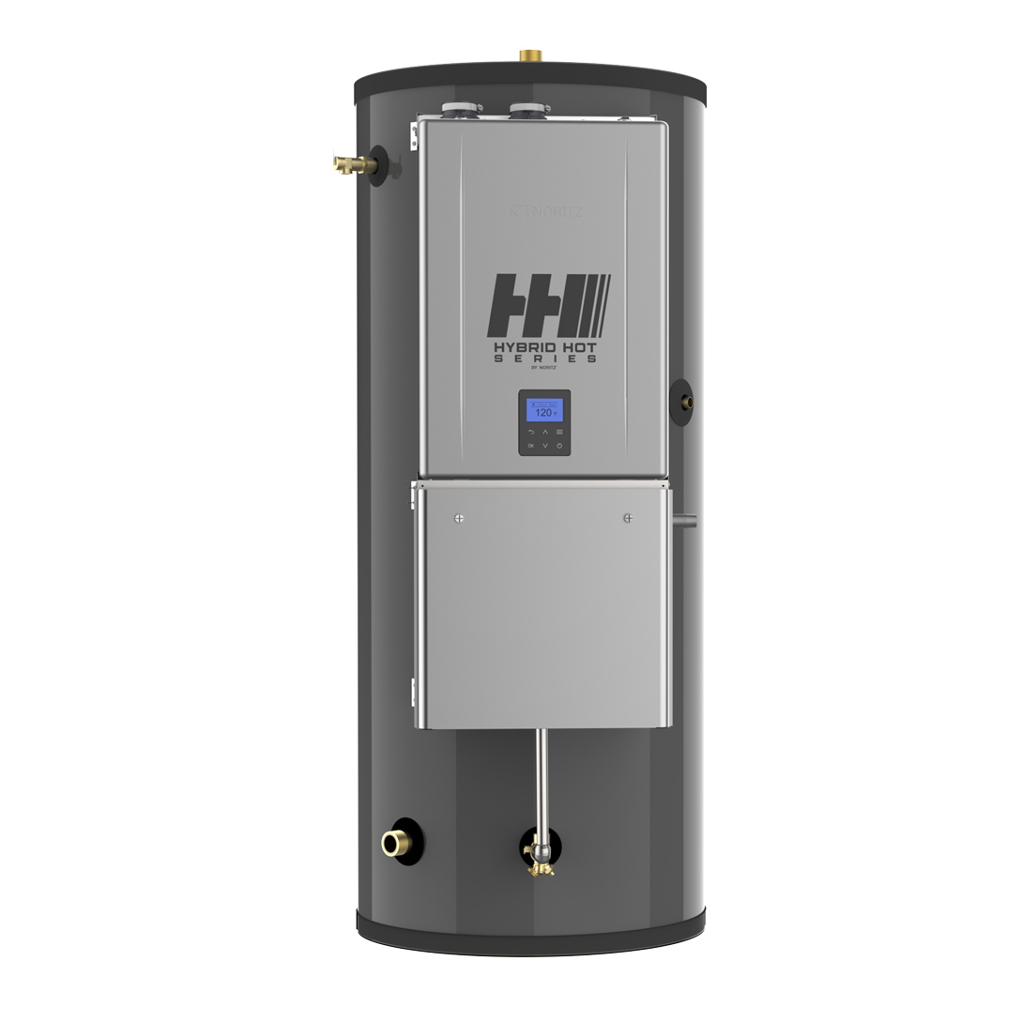






The Hybrid Hot Series by Noritz brings together the storage of a standard tank and the power and efficiency of a tankless to take on any commercial hot water demand.
Combined to meet the hot water requirements of businesses, the Hybrid Hot Series by Noritz utilizes the latest in tankless and tank storage technologies to create a powerful and reliable solution for businessowners. The Hybrid Hot also offers common venting for multiple units to ensure endless hot water is always available.
FASTER HOT WATER RECOVERY
The Hybrid Hot offers the best BTU possible at the quickest rate, providing businesses with energy savings and more.
THE BEST OF TANK AND TANKLESS
With an endless supply of hot water, lower pressure drop, and no limitation of hot water flow rate, the Hybrid Hot Series by Noritz combines features of both technologies to provide the most reliable hot water delivery system to date for commercial applications.
CONTINUOUS HOT WATER DELIVERY
If your tank suddenly runs out of hot water, no need to worry. The Hybrid Hot Series by Noritz can continue to provide hot water using the paired NCC199CDV tankless even after your stored supply is depleted*. (*Hot water capabilities are limited)
CEMENT LINING
With no anode rod and a greater warranty than other tanks on the market, our tank also features cement lining for superior corrosion resistance.
NHH199100
Assembled in the USA

Slide 26
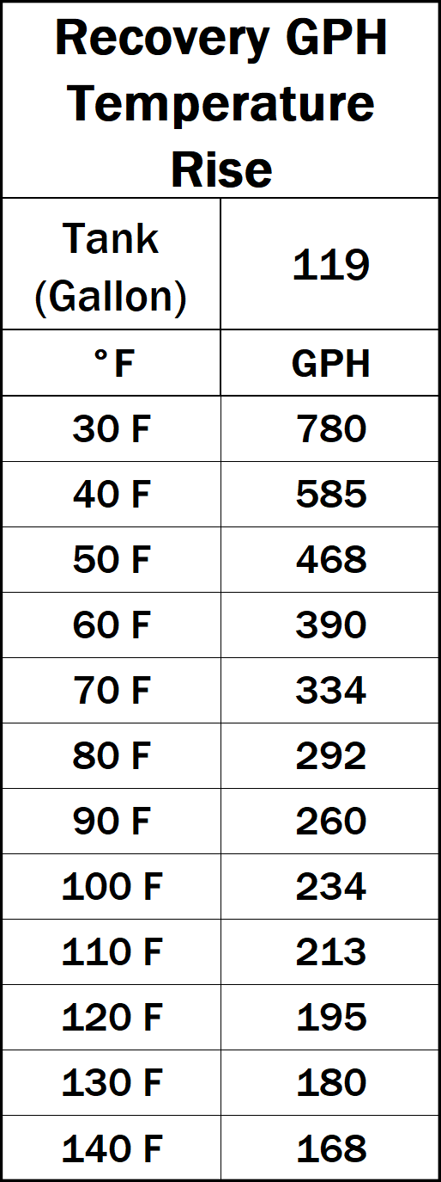
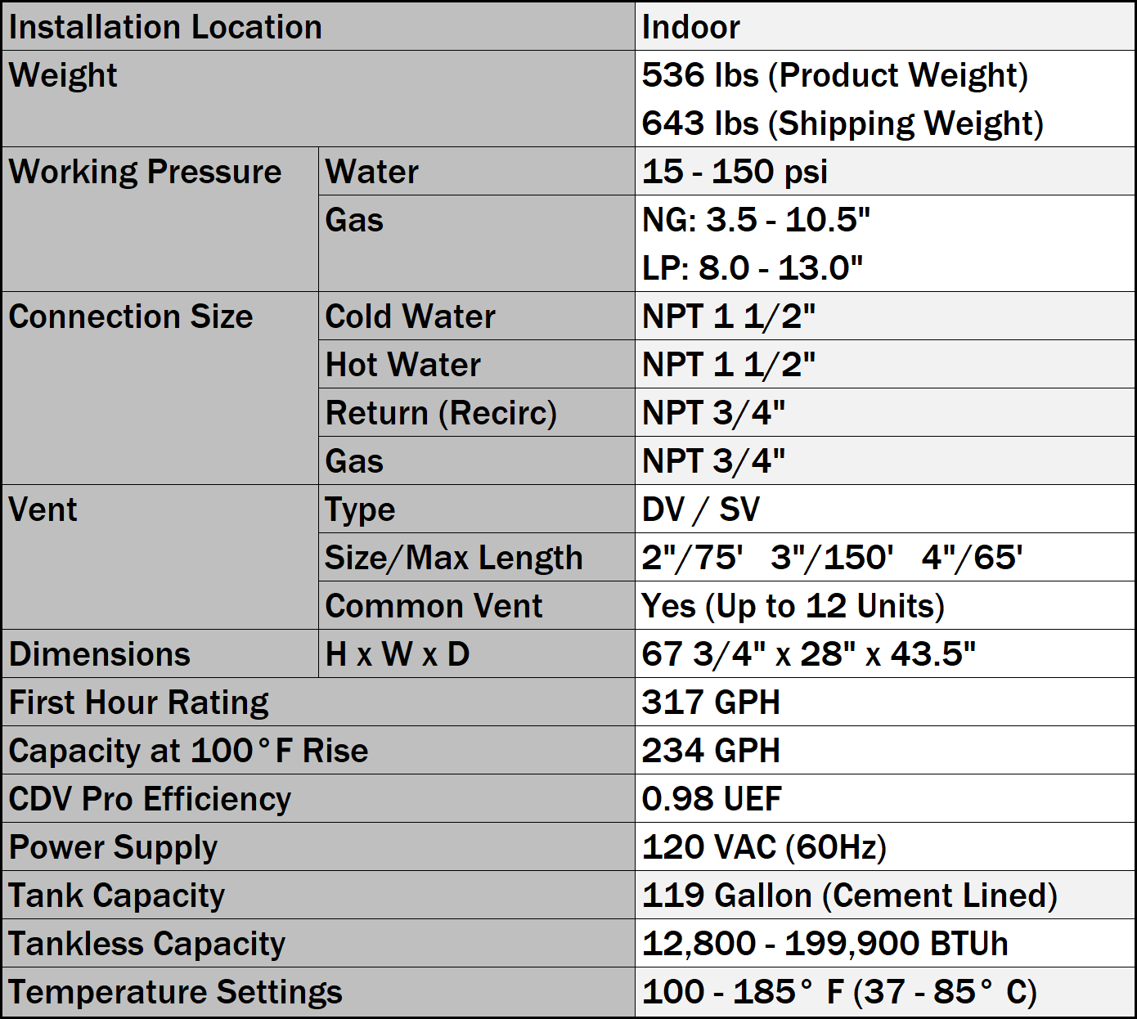
NHH199100

Slide 27
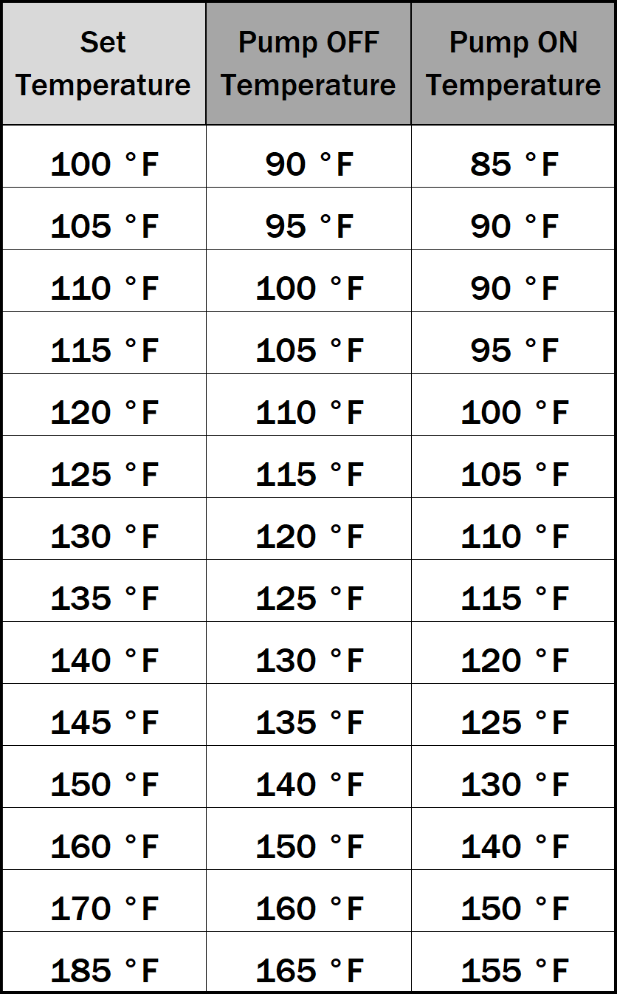
The NCC199CDV on the Hybrid Hot Unit comes programmed from the factory to function like a tankless and storage system without the system controller.
NHH199100

Slide 28
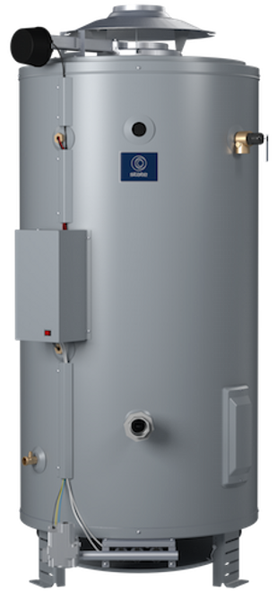
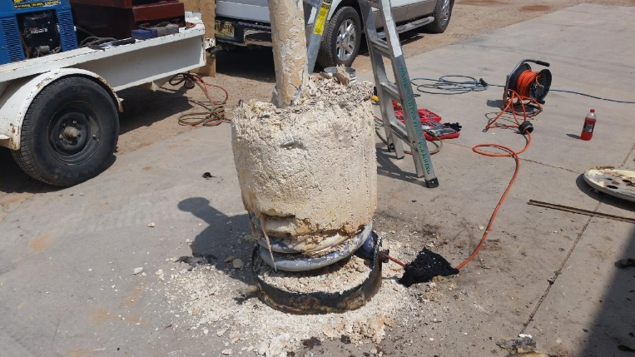
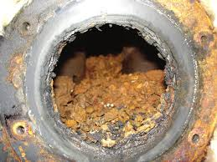
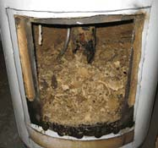
THERMAL CYCLING & HEAT STRESS
A Standard Efficiency Commercial Gas water Heater can reach temperatures over 500ºF at the burner chamber. The constant expansion and contraction of the steel tank and heat related stresses to the tank can, over time shorten its life (Stress Crack Corrosion).
Add in the accumulation of scale build up in the bottom of the tank (covering the burner) acting as an insulated layer. Causing the heater to fire longer each time the tank needs to be regenerated.
These main two factors add to shorter tank life. The hotter the outlet water needs to be, the more effect it will have on the tank.
AO Smith Cyclone

Slide 29
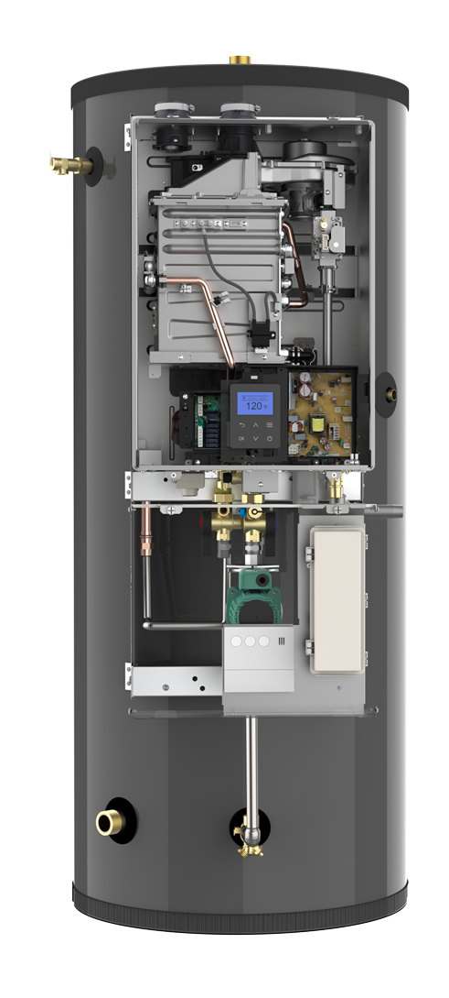
THERMAL CYCLING & HEAT STRESS
Our Hybrid Hot by Noritz reduces the amount of heat stress and thermal wear to the tank by up to 2/3 of commercial tank heaters. The Hybrid Hot storage tank will never see temperatures above 185ºF.
Also, with no burner under the tank, expansion and contraction of the tank will be held to a minimum.
Our concrete lined tank adds another layer of protection.

Slide 30
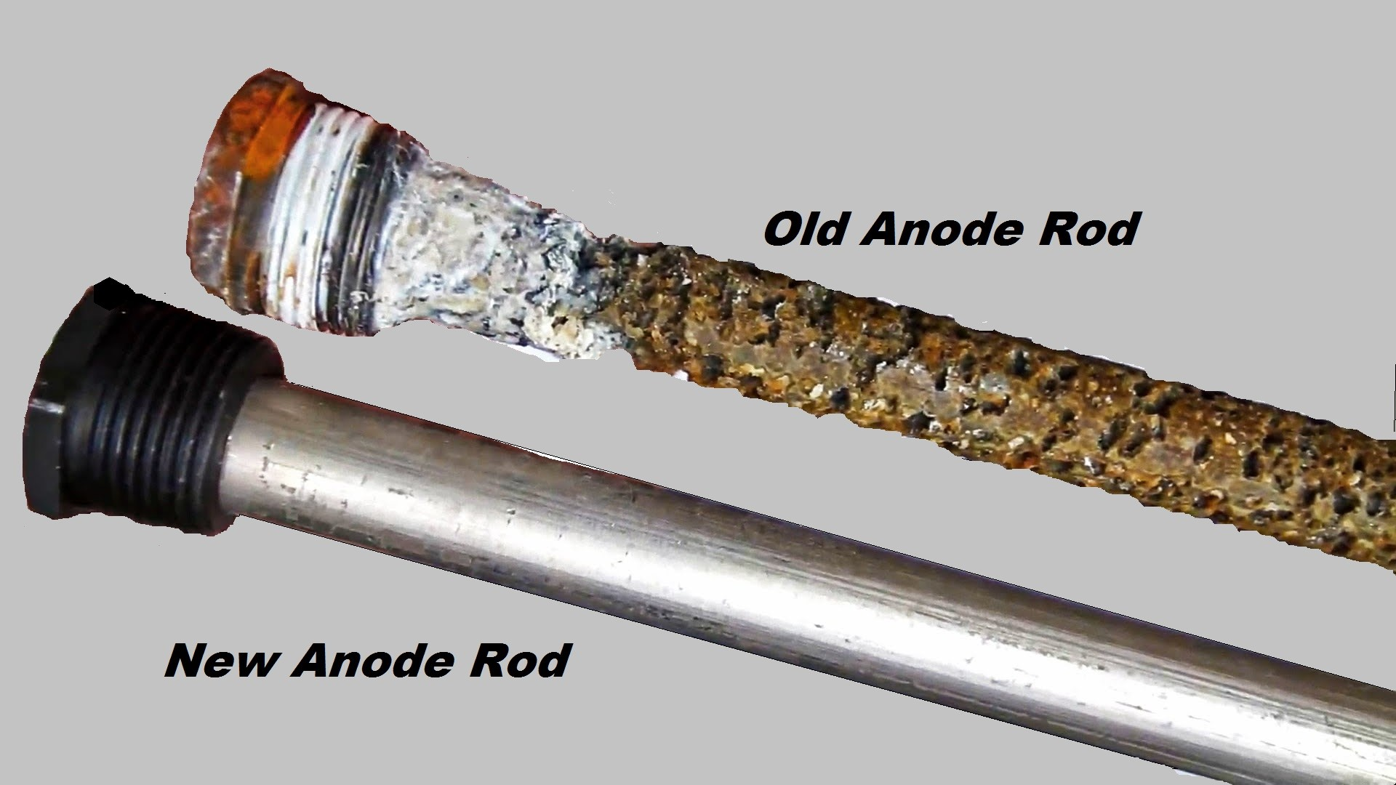
CEMENT LINED VS. GLASS LINED
Hydrastone Lining
A seamless ½” thick lining is impervious to adverse water conditions and is proven to be the most effective method of preventing tank failure due to corrosion. Hydrastone lining absorbs and traps water, which then loses its oxygen and becomes inert, thus preventing tank corrosion.
Premium Insulation
2” thick polyurethane foam combined with heat-retaining Hydrastone lining allows less than 0.3ºF heat loss per hour.
0.005” Glass lined storage tanks require an anode rod to attract the corrosive minerals that attack the water heater

Slide 31
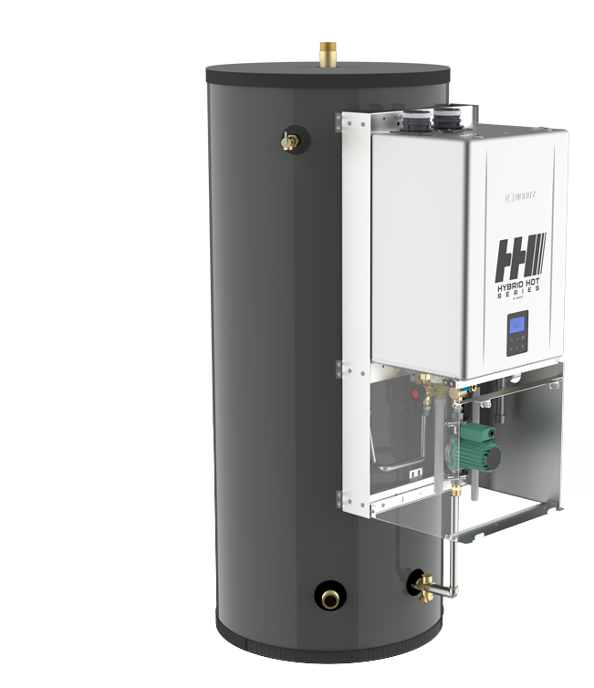
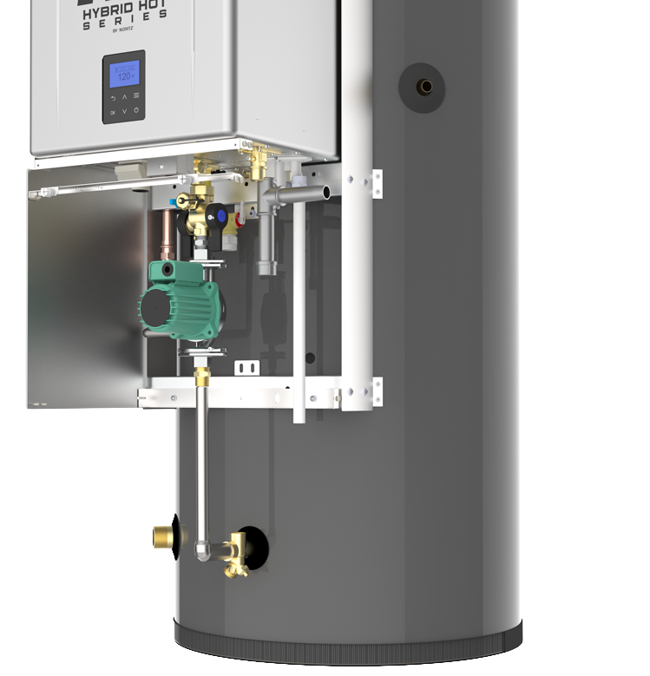

Tank Outlet Port
T&P Relief Valve
Hot Water Line
Pump
Cold Water Line
Tank Inlet Port
Recirc Port
Gas Port
Condensate Drain
Thermistor
(on tank surface)
Drain Port &
Wye Strainer

Slide 32

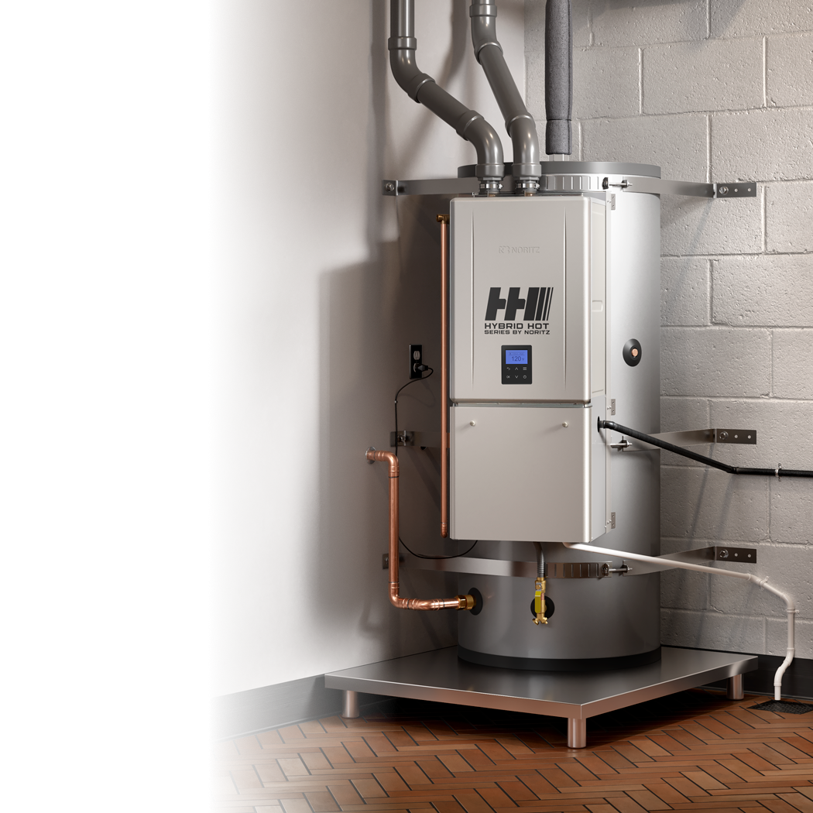
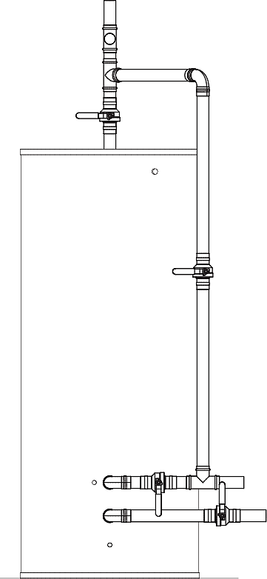


1 ½” NPT Hot Outlet
Hot out to System
¾” FNPT Recirc Return
Hot out to storage
Recirc Pump
System Pump
Check Valve
1 ½” NPT Cold Supply
Inlet Cold to the tank
¾” Gas
Return Loop
Blend water to Tankless
¾” Combo Drain and Cold Inlet to Tankless

Slide 33
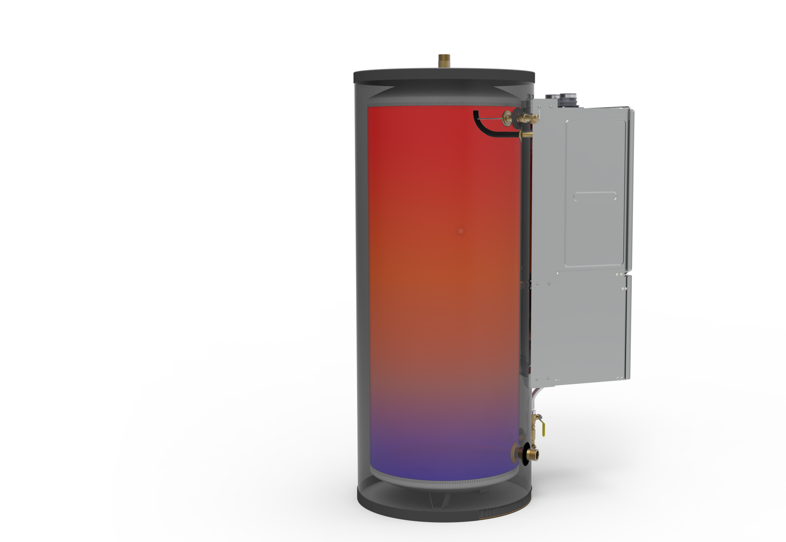
BASIC OPERATION
Water connection locations help to stratify the water temperatures in the tank keeping the upper tank full of the hottest water. Provides the best energy efficient supply of hot water.
This extends the 70% rule associated with tank heaters

Slide 34
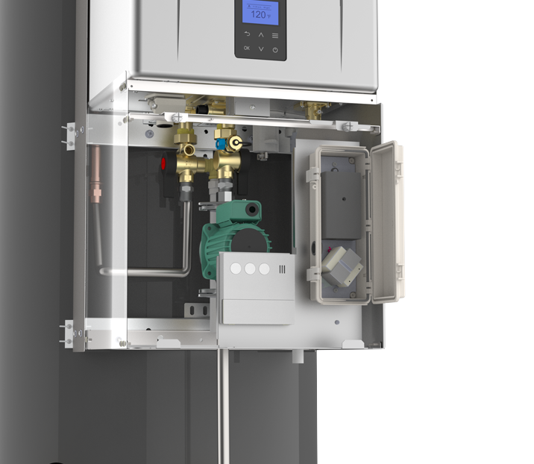
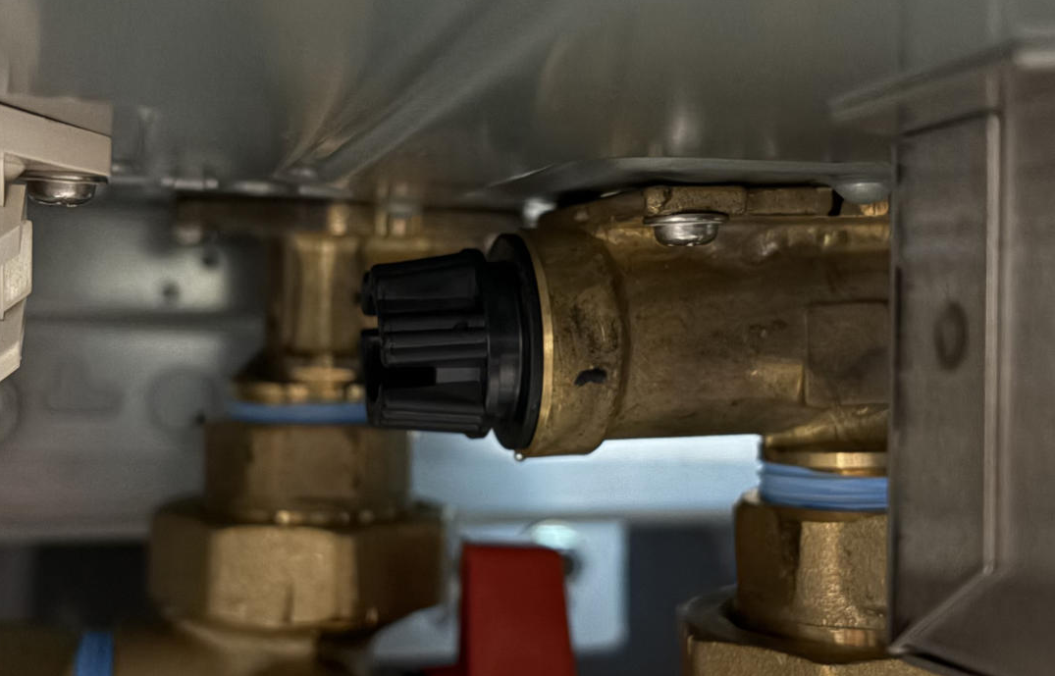
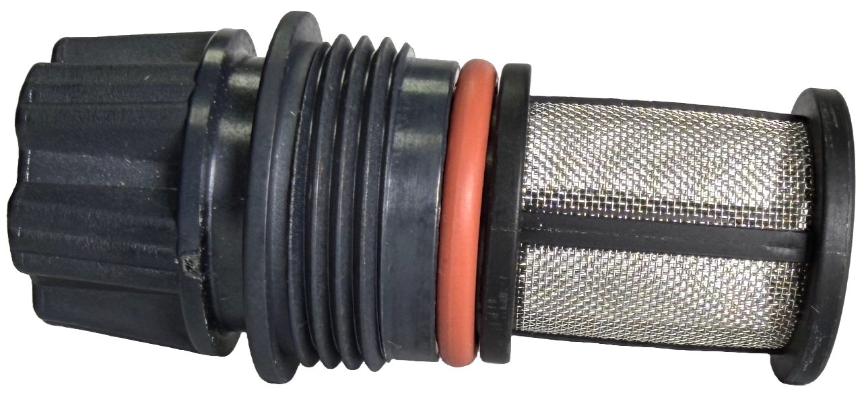
UNDER THE HOOD
Inlet Filter
Error Indicator Light
Pump Controller
Transformer
Remote Control
TACO 009FS5 SYSTEM PUMP
(4 – 5 GPM)
All internal controls for operation are pre-plumbed and install ready

Slide 35
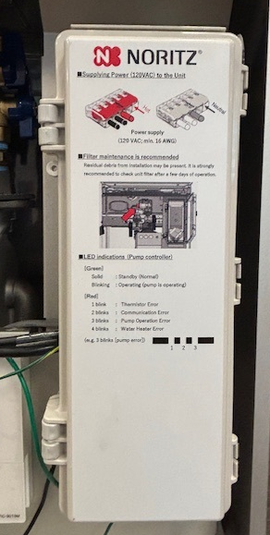
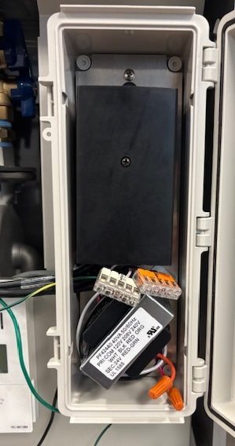
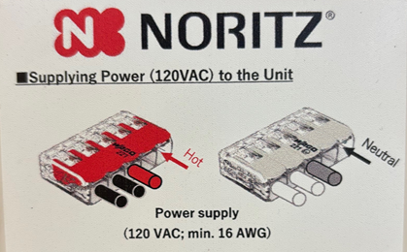
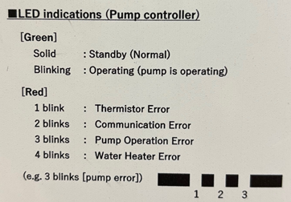
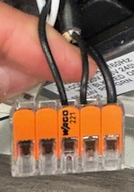
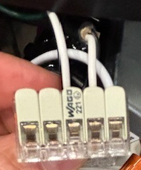
ELECTRICAL WIRING
The Hybrid Hot doesn’t come with a power cord. The contractor will need to purchase and wire
Hot
Neutral

Slide 36


MULTIPLE PIPING
Water Piping Diagram. Piping can be either first in, last out or in parallel
Hot Water Return
Pump
Gas Supply
Expansion Tank (Install according to local code)

Slide 37
COMMON VENTING
When common venting Hybrid Hot Water heaters, a system controller (SC-401-6M or 12M) must be installed (purchased separately).
Multi unit systems require pressure balancing of the piping system (Piping in Parallel or first in last out).
System bypass controls are set to stay open to 160ºF

Slide 38


Hybrid Hot install at the State of Washington Facilities complex, Whidbay Island, Washington
One of two Hybrid Hot installs at Farmer Boys Burgers, So. Cal

Slide 39

CMK and CRK Commercial Systems
Introducing the new Noritz Complete Commercial System Bundles

Slide 40

CMK and CRK Systems
Features & Benefits
Easy to Transport
Sturdy Aluminum Frame
Assembly uses only 12 Bolts vs 60 Bolts of Competitor Racks!
Install in Less Than 2 Hours
True Commercial Manifold
Best Value in the Industry
Retrofit Easy Button
CRK-BASE + CMK-BB4 Shown, NCC199CDV Pro Units Sold Separately.

Slide 41


CMK (Commercial Manifold Kit)
System Configurations
Side by Side
CMK-SS2
Wall Hanging Side by Side Commercial Manifold Kit featuring 2 NCC199CDV Tankless Water Heaters (sold separately)
Max BTU/h: 399,800
CMK-SS3
Wall Hanging Side by Side Commercial Manifold Kit featuring 3 NCC199CDV Tankless Water Heaters (sold separately)
Max BTU/h: 599,700
CMK-SS4
Wall Hanging Side by Side Commercial Manifold Kit featuring 4 NCC199CDV Tankless Water Heaters (sold separately)
Max BTU/h: 799,600

Slide 42


CMK (Commercial Manifold Kit)
System Configurations
Back to Back
CMK-BB2
Commercial Manifold Kit connecting 2 Back to Back NCC199CDV Tankless Water Heaters (sold separately) installed on CRK Base – Floor standing rack (sold separately)
Max BTU/h: 399,800
CMK-BB4
Commercial Manifold Kit connecting 4 Back to Back NCC199CDV Tankless Water Heaters (sold separately) installed on CRK Base – Floor standing rack (sold separately)
Max BTU/h: 799,600

Slide 43


CRK (Commercial Rack Kit)
System Configurations
CRK-BASE
The CRK-BASE commercial rack kit allows for custom floor standing installations of 1 to 4 tankless units.
CRK-ADDON
The CRK-ADDON commercial kit lets you expand your existing system to more than 4 units.

Slide 44

CMK (Commercial Manifold Kit)
Additional Notes
One CRK-ADDON may be used per CRK-BASE. Attempting to use multiple CRK-ADDON may result in misaligned water and gas manifolds.
Up to 24 NCC199CDV Pro heaters can be connected using multiples of the CRK-BASE and CRK-ADDON kits. Quick Connect Pro up to 8 units or use a 6, 12 or 24 unit system controller (sold separately) to ensure system balancing and load management.
NCC199CDV Pro units may be common vented, refer to the common vent manual for full details.
Manifold sizing is designed for a maximum of eight (8) water heaters. In order to connect units in greater number than eight, a common header of a larger diameter may be necessary. Refer to local plumbing and/or building code for minimum pipe sizing requirements.
Common Header Diameter Recommendation

Slide 45


Slide 46


MULTI SYSTEM TANKLESS SOLUTIONS
Pre-Engineered & Pre-Fabricated
Tankless
Tankless with Storage

Slide 47

FEATURES | CR61 | TTS-S | TTS-TWST
Pre-Engineered | X | X | X
Pre-Wired System Controller | X | X | X
Water Pre-Plumbed | X | X | X
Gas Pre-Plumbed | X | X | X
Shut Off Valves / Service Valves | X | X | X
Condensate Pre-Plumbed | X | X | X
Fits Through 3’0 x 7’0 Door | X | X | X
Power OPC |  | X | X
Breaker Box with Included Circuit Breakers |  | X | X
Surge Protector |  | X | X
Building Recirculation |  | X | X
Pump Control & Timer |  | X | X
Most Compact Footprint |  | X | X
Expansion Tank |  | X | X
ECM Circulator for Storage Tank |  |  | X
System Pump Bypass |  |  | X
Storage Tank Manifolds |  |  | X
115 Gallon Storage Tank |  |  | X
Storage Tank and Building Check Valves |  |  | X
Y Strainer |  |  | X
Pre-Configured Control Wiring |  |  | X
Building Supply and Return Well Immersed Temperature Gauges |  |  | X
COMPARISON
CR61 Commercial Rack System
VS.
TTS-S & TTS-TWST
Synergy Series

Slide 48

COMMERCIAL RACK SERIES (CR)
HOT WATER SUPPLY CAPACITY
INCLUDES:
NCC199CDV PRO w/ industry leading 0.98 UEF (GQ-C3261WZ-FF-1 US)
System Controller (SC-401-6M)
Remote Control Cord (RC-CORD-10)
2” Copper Manifold for Hot & Cold
2” Black Iron Manifold for Gas
3/4” PVC Manifold Condensate Drain
Aluminum Frames
Isolation Valves w/ PRV for Water
Gas Shut Offs
Serial Number Barcode tags
Individual Heater Number Label

Slide 49


Kenny Deel Stadium – Melissa Texas ISD
4 Separate Racks – 9 total units – Main Stadium

Slide 50
What is TTS?
The TOTAL TANKLESS SOLUTION
Why SYNERGY?
We’re Synergizing Multiple Technologies & Resources for the Best Commercial Water Heater System Available

Slide 51





Commercial Market Segments / Verticals to Target:
Education: K – 12 University Dorms
Restaurants
Assisted Living Senior Care
Multi Family
Most Unmatched Complete Water Heater Solution in the Industry
Best Warranty
In Industry
High Efficiency
98% TE 0.98 UEF
TDR 16:1 Each Tankless Engine
24 units = TDR 384:1
One Point of Connection
Water
Power
Gas
Condensate
Recirculation
Storage
Ability to combine
multiple heaters in
the smallest footprint
as well as the ability
to fit through any
3’-0” x 7’-0”
commercial door
Professionally
integrated
accessories within
the aluminum frame
Providing optional
storage water heater
integration
REDUCTION IN LABOR HOURS | FULL SOLUTION FOR CUSTOMER | WORRY-FREE INSTALLATION

Slide 52

S Series
The S Series comes with all the necessary equipment needed for a 2 to 6 tankless commercial system.
Features
One Point of Connection
Aluminum Frame
2 to 6 – Noritz NCC199CDV (GQ61) Tankless Water Heaters with
System Controller
1 ½” Water & Gas Manifolds
¾” Condensate Drain Manifold
Expansion Tank Included
Neutralizer Included
Breaker Box w/ Included Circuit Breakers
Pump Controller with Timer
Surge Protector
ECM Building Recirculation Pump
Shutoff Valves
Well Immersed Thermistors for Easy Monitoring of Building Hot Water
Performance

Slide 53

SWH Series
The SWH Series provides the most complete commercial water heater solution in the market. This tankless water heating system provides up to 799,600BTU/hr. in a wall mounted platform for maximizing unutilized space, with built in redundancy and equalization of heating performance
Features
One Point of Connection
Aluminum Frame
2 to 4 – Noritz NCC199CDV (GQ61) Tankless Water Heaters with System
Controller
1 ½” Water & Gas Manifolds
¾” Condensate Drain Manifold
Expansion Tank Included
Neutralizer Included
Breaker Box w/ Included Circuit Breakers
ECM Pump Controller with Timer
Surge Protector
Building Recirculation Pump
Shutoff Valves
Well Immersed Thermistors for Easy Monitoring of Building Hot Water
Performance

Slide 54



S Series
PUMPS & CONTROLS
Breaker Box
Surge Protector
3/4” Building Return Line Connection
Power supplies each outlet
Temperature Probe
Flange Valve
Dixell Control for Pump
Pump Timer w/ 90 hr Battery Back Up
Junction Box
Flange Valve w/ Service Port
5 GPM ECM Building Recirculation Pump

Slide 55

S Series
HOT WATER THERMOMETER
Hot Water Outlet Thermometer

Slide 56

S Series
PLUMBING
Check Valve
Isolation valve

Slide 57

S Series
SYSTEM CONTROLLER
Labeled (System Controller) Installed
#1 Unit is the Main unit and where the commercial remote wires to communicate with the system controller

Slide 58

S Series
WATER/GAS CONNECTIONS
Hot Water Isolation Valve w/ PRV
Cold Water Isolation Valve
Gas Valve w/ Union

Slide 59

S Series
MANIFOLDS
¾” Condensate Drain, Open
1 ½” Hot Water Manifold, End
1 ½” Cold Water Manifold, End
1 ½” Gas Manifold, End

Slide 60


S Series
EXPANSION TANK CONNECTION
Expansion Tank Thread Connection
Expansion Tank Isolation Valve
Hose, Drain Port
Valve w/ Turn Wheel

Slide 61

S Series
BOTTOM UNITS PRE-VENTED
2” PVC air intake venting
2” PVC exhaust venting

Slide 62

S Series
WATER/GAS CONNECTIONS
1-1/2” Hot Water Outlet Connection
1-1/2” Cold Water Inlet Connection
2” Gas Stand-Pipe Inlet Connection
Behind rack

Slide 63



S Series
INCLUDED ACCESSORIES
4.4 Gallon
Expansion Tank
Literature Rack w/ Manuals & Commercial Remotes
Condensate Neutralizer

Slide 64
• One Point of Connection
• Aluminum Frame
• 2 to 6 – Noritz NCC199CDV Tankless Water Heaters with System
Controller
• 115 Gallon Storage Tank Included
• 1 ½” Water & Gas Manifolds
• 2” Gas Inlet Connection
• ¾” Condensate Drain Manifold
• Expansion Tank Included
• Breaker Box w/ Included Circuit Breakers
• Pump Controller with Timer
• Surge Protector
• ECM Building Recirculation Pump
• ECM Storage Tank Recovery Circulator
• Shutoff Valves
• Well Immersed Thermistors for Easy Monitoring of Building Hot Water
Performance
• 2” Hot Water Supply to Storage Tank
• 2” Cold Make Up Water
• 2” Supply through Pump to Tankless
• 2” Pump Bypass
• Integrated 2” Check Valves
TWST Series
(Tankless w/ Storage)

Slide 65


BUILDING PUMP & RETURN LINE
TWST Series
(Tankless w/ Storage)
1” Building Return Line Connection
Differences between S Series

Slide 66

CONTROLS
TWST Series
(Tankless w/ Storage)
Additional Dixell Control for System Pump
Differences between S Series

Slide 67

SYSTEM PUMP
TWST Series
(Tankless w/ Storage)
ECM System Pump
Differences between S Series

Slide 68

SYSTEM PUMP PIPING
TWST Series
(Tankless w/ Storage)
2” Isolation Valve for Pump
2” Bypass Piping
2” Isolation Valve for Bypass
2” Isolation Valve for Pump
Differences between S Series

Slide 69

EXPANTION TANK & RETURN CONNECTION
TWST Series
(Tankless w/ Storage)
1” Building Return
Behind rack
1” Expansion Tank Connection
Differences between S Series

Slide 70

WATER/GAS CONNECTIONS
TWST Series
(Tankless w/ Storage)
2” Gas Inlet Connection
2” Hot Water Outlet to Storage Tank includes Building Flow check
2” Return from Storage Tank Connection
Behind rack
2” Cold Inlet Connection Includes building Back Check
Differences between S Series

Slide 71

INCLUDED ACCESSORIES
TWST Series
(Tankless w/ Storage)
20 Gallon Expansion Tank
Literature Rack w/ Manuals & Commercial Remotes
Condensate Neutralizer

Slide 72

Hot Water Outlet
Cold Water Inlet
S Series
Sequence of
Operations

Slide 73
Building Return Inlet
S Series
Sequence of
Operations

Slide 74
INTELLIGENT SYSTEM
S Series
In a multi-system setup, the Noritz commercial units will communicate with one another and work in unison to even out the load on each individual unit, maximizing output and system life.
With the ability to modulate between multiple units with the use of a system controller makes Noritz commercial water heaters the most efficient water heating system on the market today.
50%
1 heater will work solely until the demand grows greater than 50%

Slide 75
INTELLIGENT SYSTEM
S Series
50%
50%
The load will equalize among more heaters to meet high volume demand.
50%
50%

Slide 76
MODULAR OPERATION
S Series
The Noritz modular system is based on a single self-contained, interchangeable unit that can combine and communicate with like units to meet any hot water demand.
No. 1 | No. 2
No. 4 | No. 3
No. 1 | No. 2 | No. 3 | No. 4
Main water heater
Rotation
No. 4 | No. 1 | No. 2 | No. 3
Rotation
Main water heater
Rotation
No. 3 | No. 4 | No. 1 | No. 2
Main water heater
Rotation
No. 2 | No. 3 | No. 4 | No. 1
Main water heater

Slide 77
MODULAR OPERATION
S Series
If 1 unit is inoperable due to maintenance or issues, the other units can pick up the demand.
Ensuring the property NEVER loses hot water.

Slide 78


Cold Water Inlet
Hot Water Outlet
TWST Series
Sequence of Operation

Slide 79
Cold Water Inlet
Hot Water Outlet
TWST Series
Sequence of Operation
Storage Tank Return
System Pump Increases to Ramp Up Tankless Units to Bring Storage Tank Back to Temperature Set Point

Slide 80
Cold Water Inlet
Hot Water Outlet
Building Return Inlet
TWST Series
Sequence of Operation
Building Recirculated Water being mixed with Inlet

Slide 81
Hot Water Outlet
Cold Water Inlet
Building Return Inlet
TWST Series
Sequence of Operation
Dixel Temperature Controller & Sensor (Set Point at 145 °F with a 3 ° F Dif)
Tank Temperature Settings controlled by Pump Control & System Pump
145 °F
160 °F
160 °F
160 °F
Thermistor
160 °F
160 °F
160 °F
145 °F
155 °F

Slide 82
Hot Water Outlet
Cold Water Inlet
Building Return Inlet
TWST Series
Sequence of Operation
Dixel Temperature Controller & Sensor (Set Point at 145 °F with a 3 ° F Dif)
Tank Temperature Settings controlled by Pump Control & System Pump
145 °F
160 °F
160 °F
160 °F
High Demand
DUMP LOAD
Thermistor
160 °F
160 °F
160 °F
142 °F
155 °F
System Pump Increases to Ramp Up Tankless Units to Bring Storage Tank Back to Temperature Set Point
145 °F

Slide 83
Hot Water Outlet
Cold Water Inlet
Building Return Inlet
TWST Series
Sequence of Operation
Bypass – When Servicing System Pump
System Pump is Inoperative

Slide 84
Hot Water Outlet
Cold Water Inlet
Building Return Inlet
TWST Series
Sequence of Operation
Bypass – When Servicing System Pump
Water Heating Completely Dependent on Tankless
Same Bypass Option if Storage Tank needs to be Replaced

Slide 85

SHIPPING CRATE
Professionally crated and available through National Distribution

Slide 86



JOHNS HOPKINS UNIVERSITY
Baltimore, MD
Before
After

Slide 87


COTTON MILL APARTMENTS
New Orleans, LA
TTS-TWST10
Replaced 3Mbtuh input mid efficiency boiler w/ 1.9 Mbtuh 98% condensing commercial tankless technology
2 x 175G ASME Tank
ASME Expansion tank
Neutralizer
ECM System pump and controls
Building recirculation pump and controls
110:1 turn down ratio
10 year HEX warranty
5 year parts warranty
1 year reasonable labor

Slide 88




ALLEN INDEPENDENT SCHOOL DISTRICT
Allen, TX

Slide 89


FOOTPRINT DIMENSIONS
A
B

Slide 90




NORITZ ONLINE SIZING
www.noritz.com/commercial-sizing-calculator/

Slide 91

TTS ONLY SIZING – FRG WEBSITE
What Is A FIOP?
Factory Installed Options
If a standard offering doesn't fit the needs
Allows for the most complete solution from the factory

Slide 92

WHERE TO FIND FIOP SIZING?
www.webfrg.com/tts
Get a TTS FIOP Quote

Slide 93

USING FIOP FORM
Choose your application
By choosing you application you will see the options for the most common fixtures used in that application

Slide 94


USING FIOP FORM
All Red Asterisk* Fields must be filled in. Enter “O” if not applicable
Multi-Family Example
Correctional Facility Example

Slide 95

WHY FILL OUT A FIOP FORM?
Ensures the client is getting what they need
All while maintaining our TTS Features
Professionally Crafted – Expertly installed

Slide 96

EQUIPMENT SIZING – TANKLESS ONLY

Slide 97


COMMERCIAL CONSULTATION
Have a question on specs, sizing or how you can build Noritz into your next project? Talk to our commercial experts directly.
commercial@noritz.com
Case Studies, Resources, Technical Documents, Sizing Calculator:
www.noritz.com/commercial
Juan Rivera
Commercial Application Engineer
Jrivera@noritz.com

Slide 98





SUPERIOR WARRANTIES

Slide 99

THANK YOU

