Slide 1

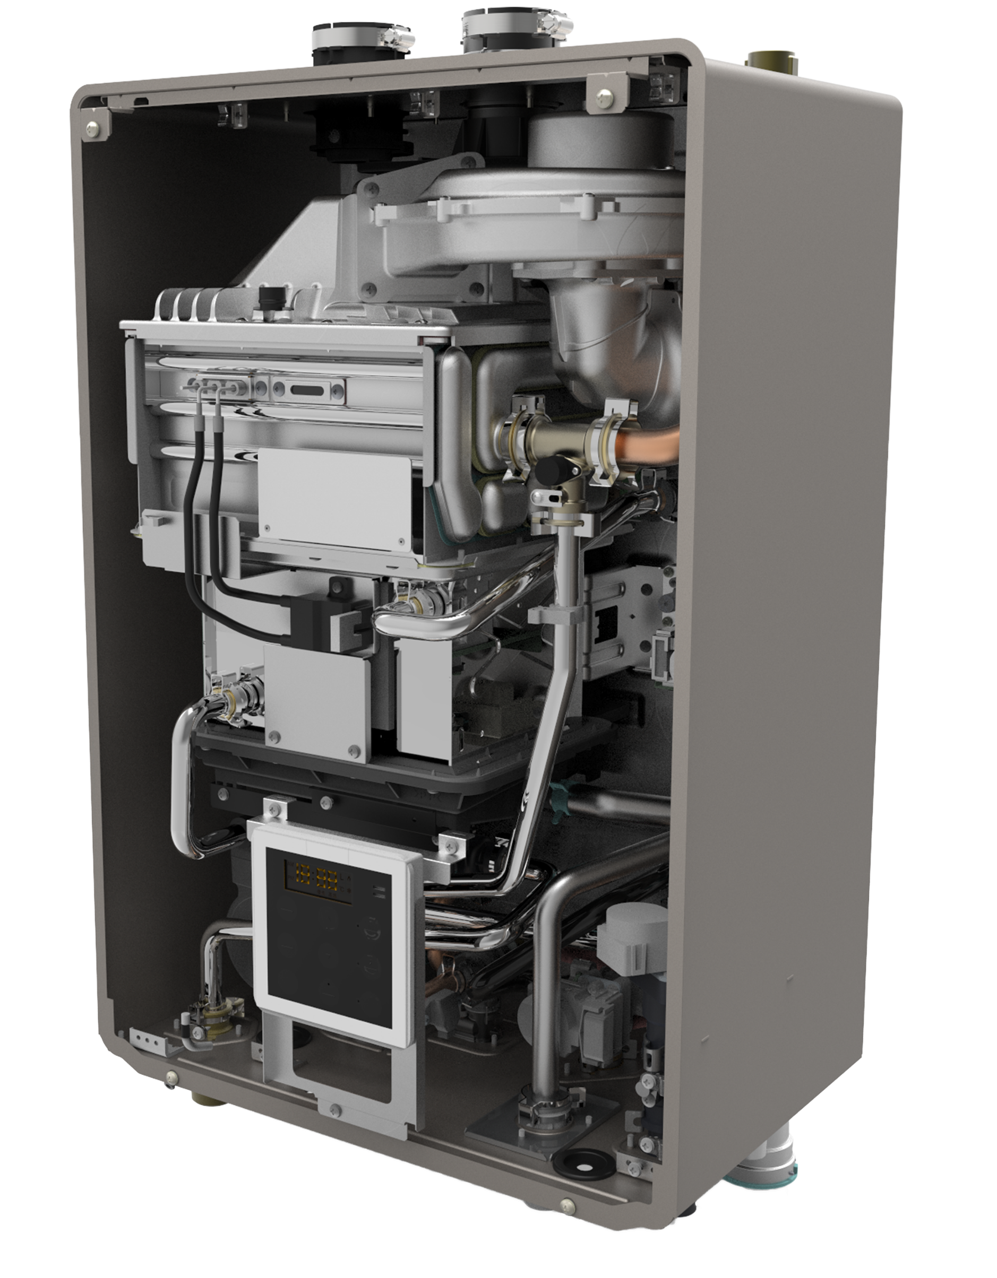

NRCB OVERVIEW
Introduction to the NRCB

Slide 2
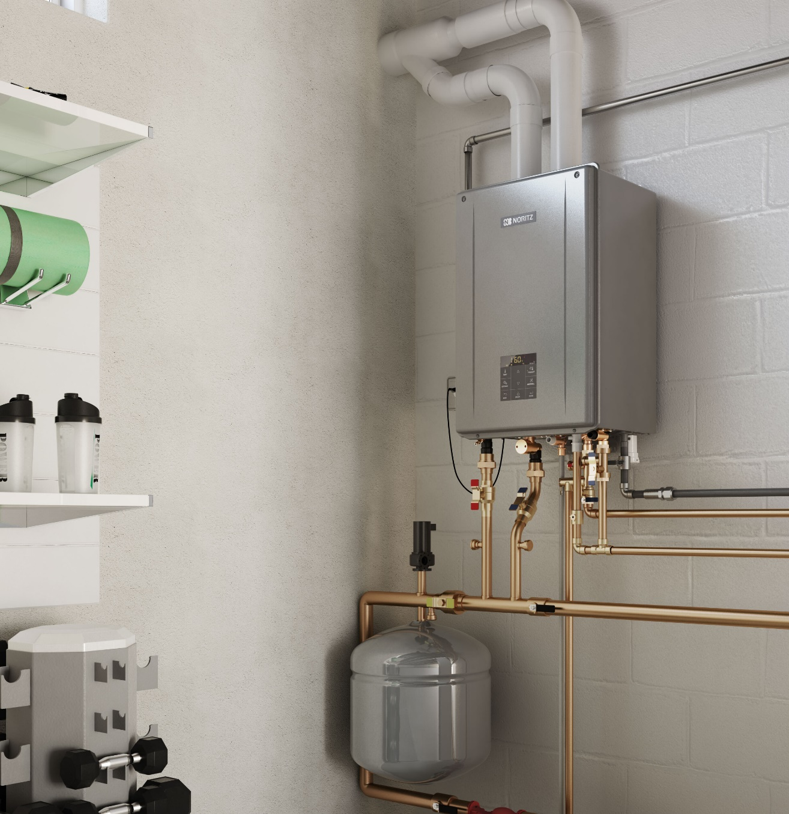
INTRODUCTION
Specifications
Key Features
Installation
Venting
Water Connections
Dip Switch Settings
Control Panel
Heating Control Settings
Electrical Wiring
Additional Accessories
Water Treatment
Maintenance Monitors

Slide 3
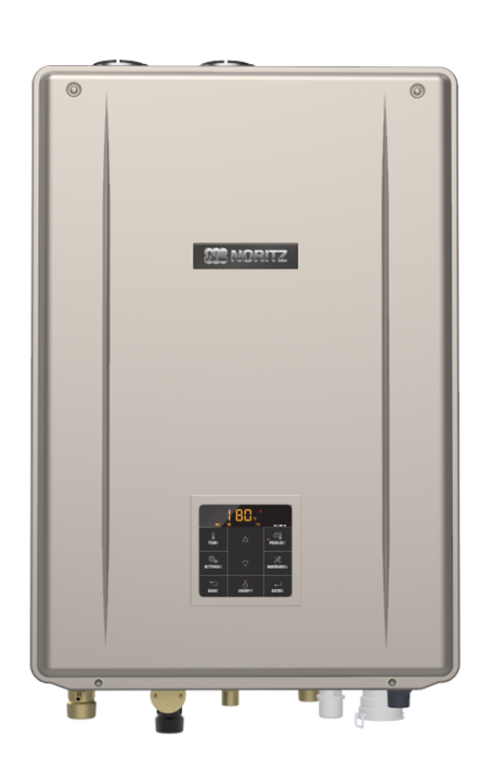
SPECIFICATIONS
Models | NRCB180DV / NRCB199DV
Standard Gas Input | Min: 18k Max: 180k / Min: 18k Max: 199k
Heating Gas Input | Min: 18k Max: 100k / Min: 18k Max: 120k
DHW Flow Range | 0.4 – 9.8 GPM / 0.4 – 11.1 GPM
AFUE | 95%
DHW Burner Off Flow | 0.29 GPM
Heating Temp Range | 100F – 180F (As low as 80F with setting)
DHW Temp Range | 90F – 140F
Simultaneous Heating & DHW | YES
Max Elevation | 10,000 feet
Connection Sizes | ¾” DHW & Gas, 1” Heating, ½” Auto Feeder & Condensate
Quick Connect Capable | YES (With same BTU EZ or CDV Unit)
Outdoor Temp Sensor | INCLUDED
Warranty | 10 Year HEX, 5 Year Parts, 1 Year Labor

Slide 4



KEY FEATURES
Simultaneous Operation of DHW & Heating
Quick Temperature Control and Stability
High DHW Flow Rates

Slide 5
SIMULTANEOUS OPERATION
Most Competitor’s 3-Way Valve:
Either Heating or DHW.
Hot Water
Hot Water
Heating
DHW
Heating Position
DHW Position

Slide 6
SIMULTANEOUS OPERATION
NRCB 3-Way Valve:
BOTH Heating and DHW!
Hot Water
Hot Water
Hot Water
Heating
Heating
DHW
DHW
Heating
DHW
Heating
DHW
Heating Position
Simultaneous Position
DHW Position

Slide 7
QUICK TEMP CONTROL & STABILITY
Overshoots OVER 10°F
ONLY 1°F Overshoot
 | Hot Water Speed |  | Overshooting Temperature
 | 110°F | 120°F
NRCB | 19 sec | 23 sec | 1°F
Competitor | 32 sec | 35 sec | 10°F

Slide 8
QUICK TEMP CONTROL & STABILITY
OVER 140°F for MORE than 30 sec.
Overshoots OVER 30°F
NO Temp Spike
NO RISK of ever reaching dangerous scalding temperatures while heating
 | Overshooting
 | Temp
NRCB | 0°F
Competitor | Over 30°F
Competitor REQUIRES an additional external thermostatic mixing valve for improved temperature stability

Slide 9
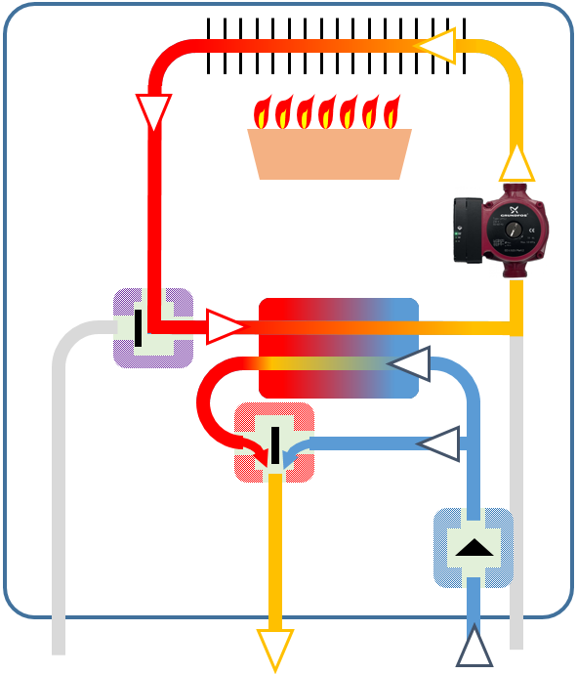
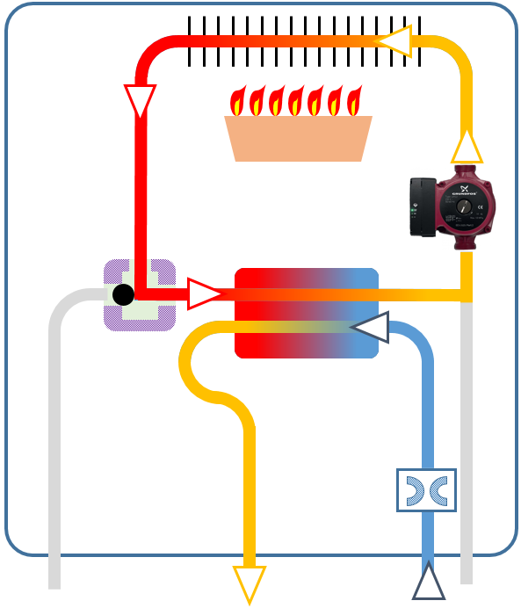
HIGH DHW FLOW RATES
 | NRCB | Competitor
Water Pathway
Flow Control | Variable | Fixed
Max GPM (199k btu Model) | 11.1 GPM | 5.6 GPM
Min Activation | 0.4 GPM | 0.5 GPM
Min Operation | 0.29 GPM | Not Mentioned
Bypass Control
Valve
Flow Control
(Variable)
Flow Restriction
(Fixed)
HOT
COLD
HOT
COLD

Slide 10
INSTALLATION

Slide 11
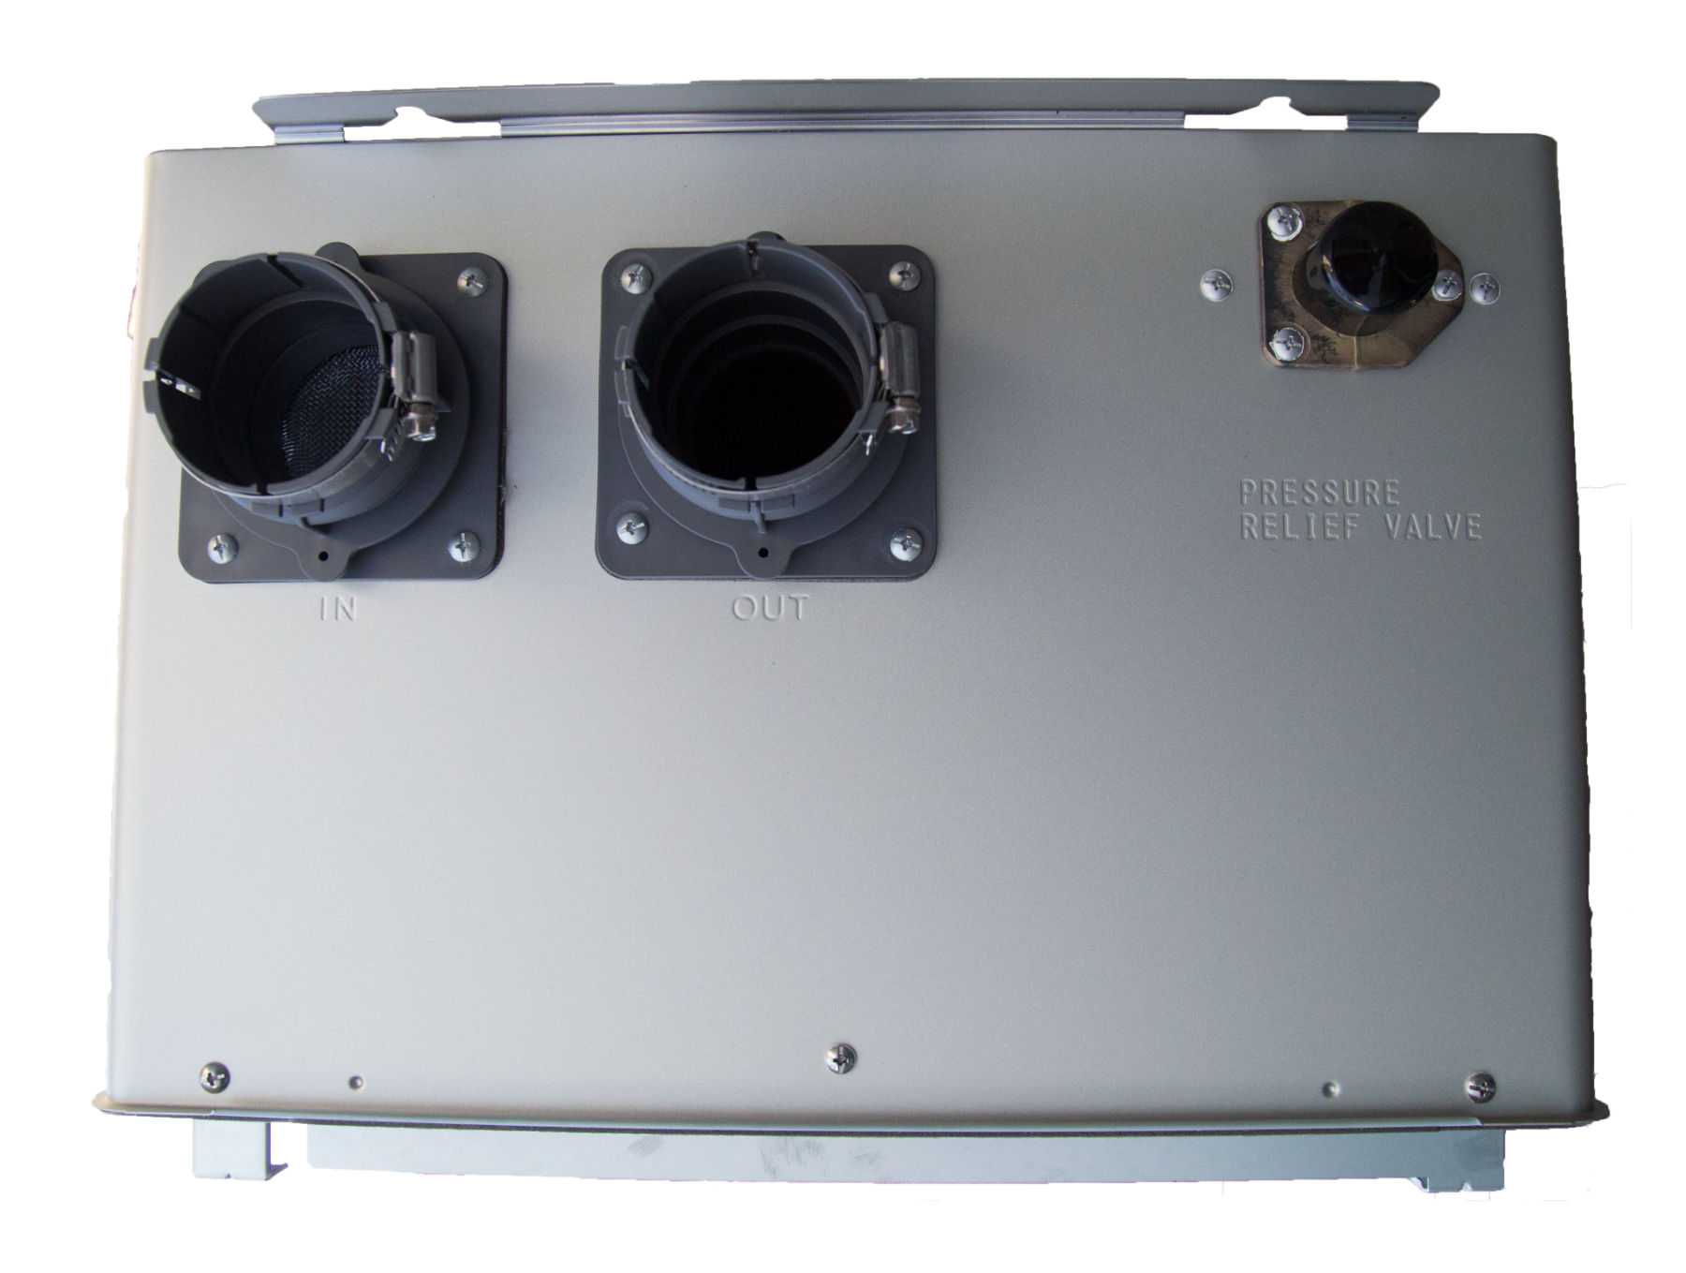
VENTING & TOP OF UNIT
DV and SV Venting
OD Capable w/ VCK-NRCB
2” or 3” PVC/CPVC or PP
60ft w/ 2”
100ft w/ 3”
Intake
Exhaust
Heating Pressure Relief Valve

Slide 12
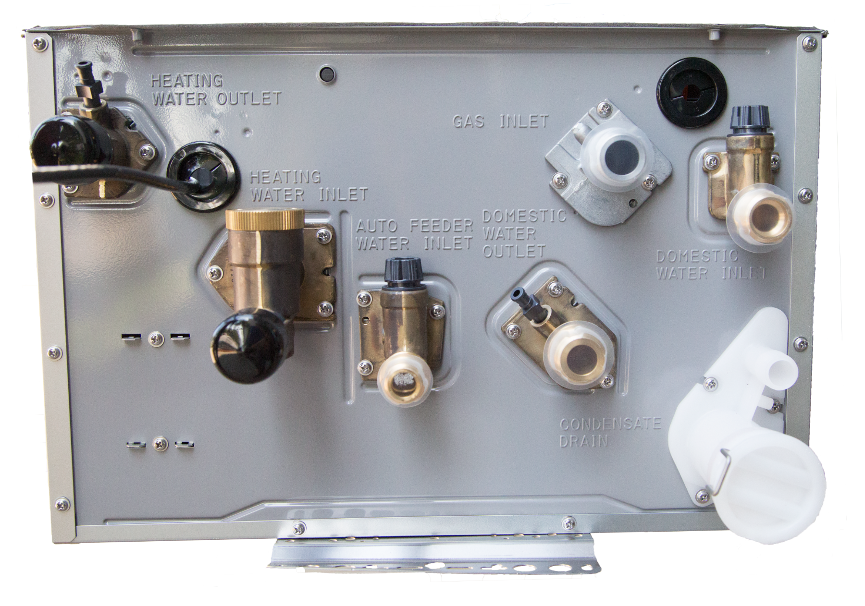
BOTTOM CONNECTIONS
Auto Feeder Water Inlet
Hot Water Outlet
(DHW)
Gas Inlet
Heating Water Outlet (Supply)
Cold Water Inlet
(DHW)
Condensate Drain
Heating Water Inlet (Return)

Slide 13


PRESSURE RELIEF VALVES
Heating Side ¾” 30 psi
(Included)
Domestic Side ¾” 150 psi
(Purchased Separately)

Slide 14
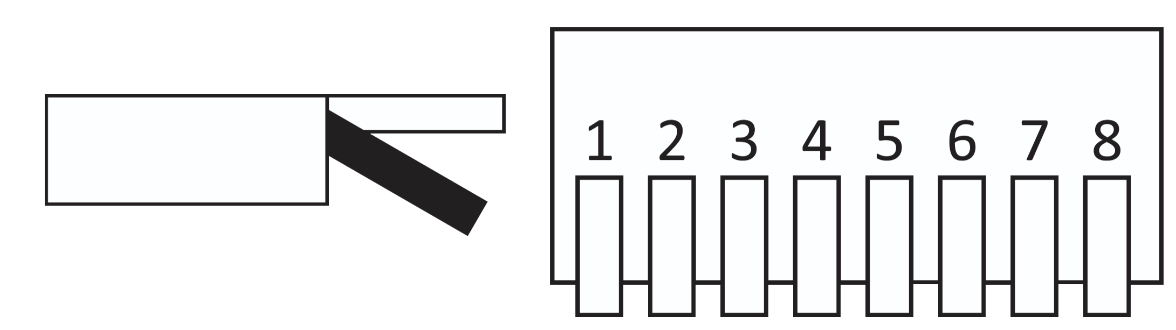




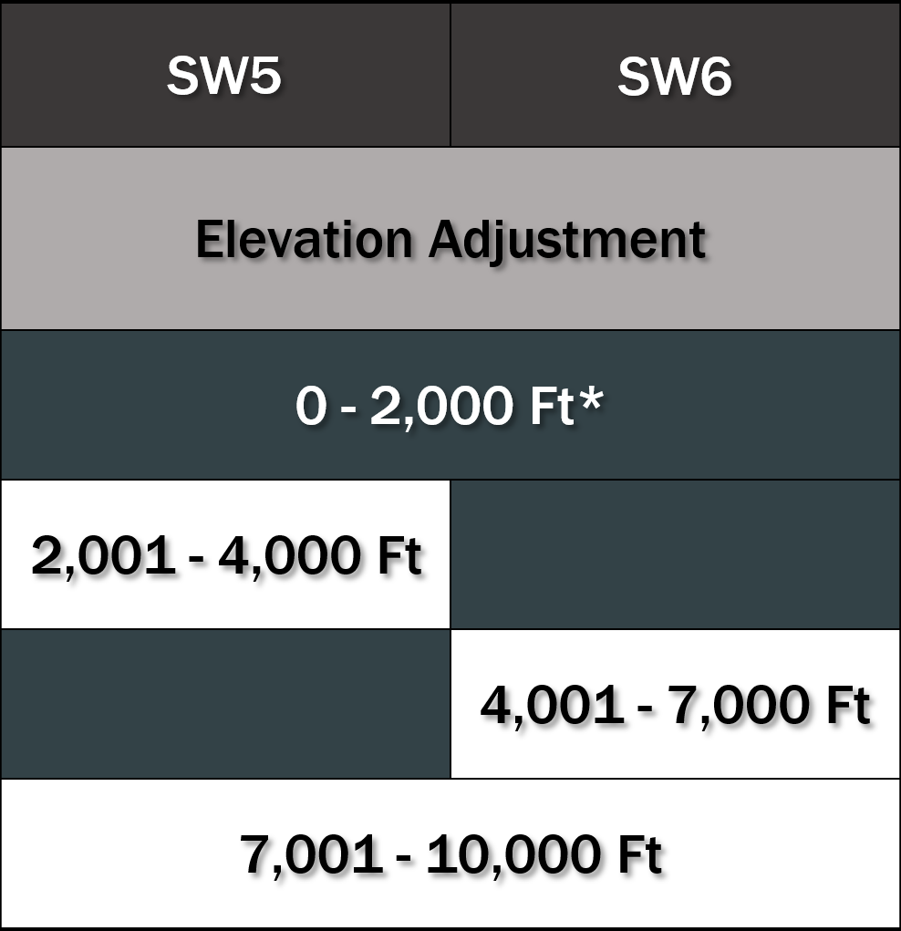
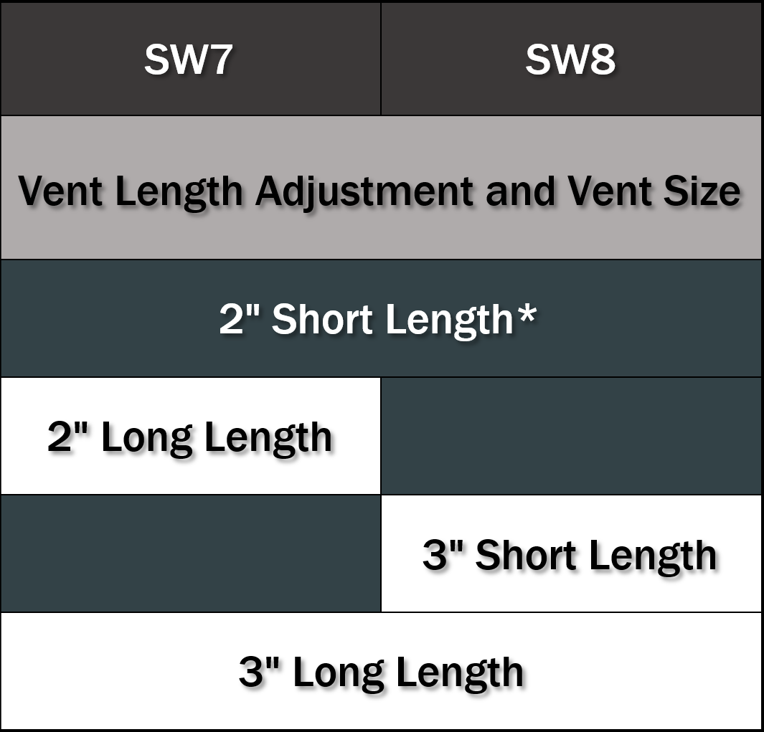
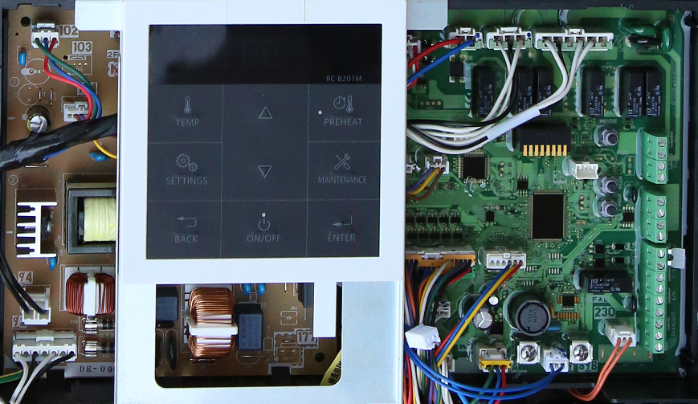
DIPSWITCH SETTINGS
OFF
Set up the unit for expanding simultaneous, vent type, elevation, vent length and size.
ON
*Default Setting

Slide 15
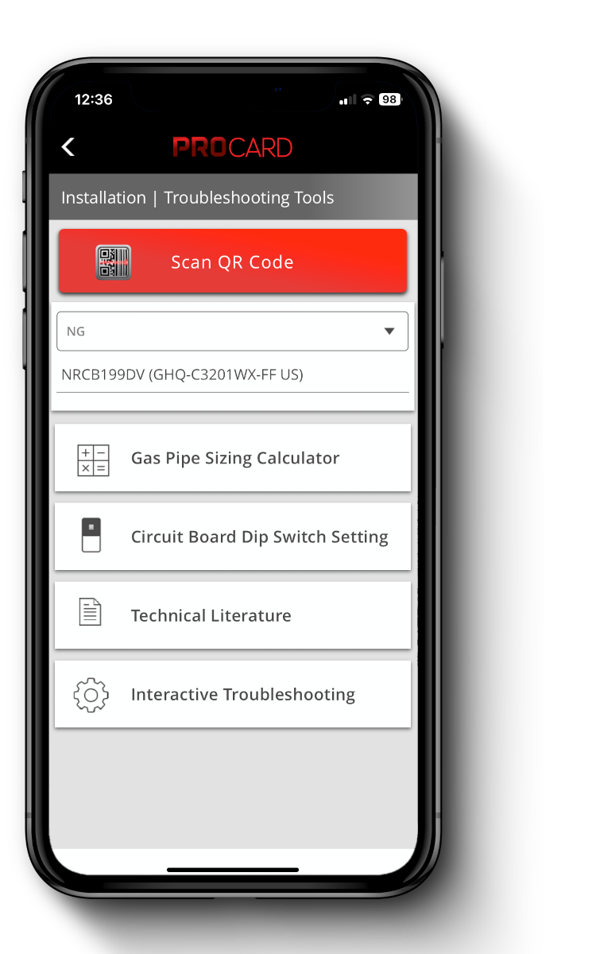
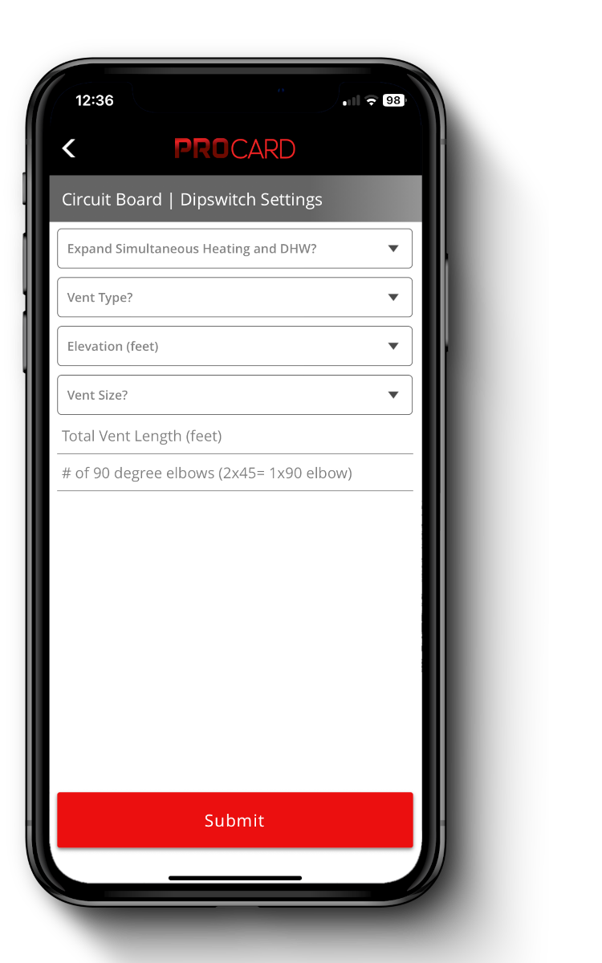

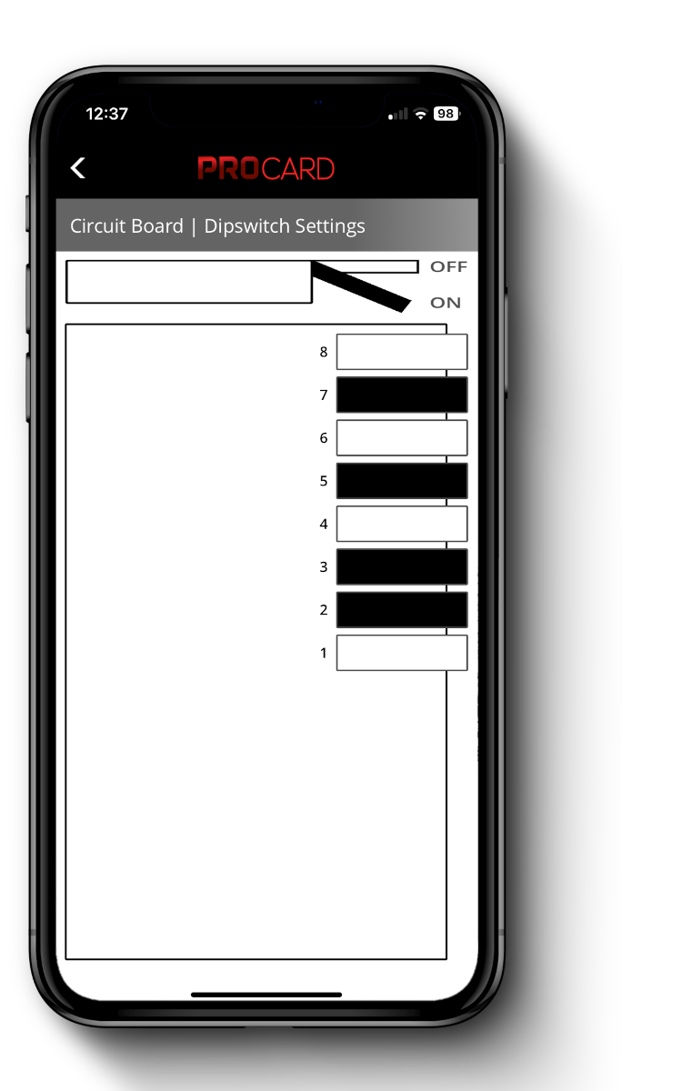

DIPSWITCH SETTINGS W/ PROCARD
Made simple using the PROCard APP!

Slide 16
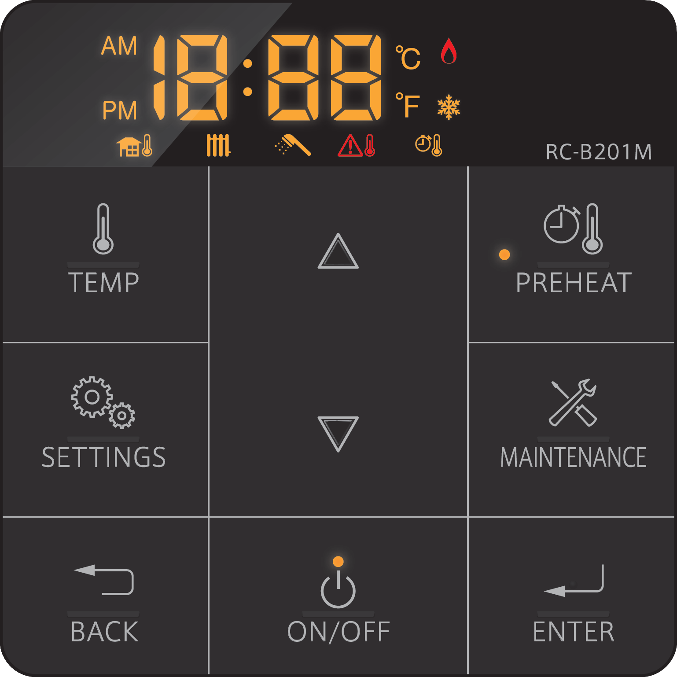
CONTROL PANEL

Slide 17
DISPLAY SCREEN
Clock / Error Code / Temperature Display
Unit Display Type
Burner ON Icon
Freeze Prevention Icon
DHW Preheat Icon
Outdoor Reset Icon
Heating Icon
DHW Icon
DHW High Temperature Icon
If set to °F, Display will read Fahrenheit and Gallons per minute
If set to °C, Display will read Celsius and Liters per minute

Slide 18
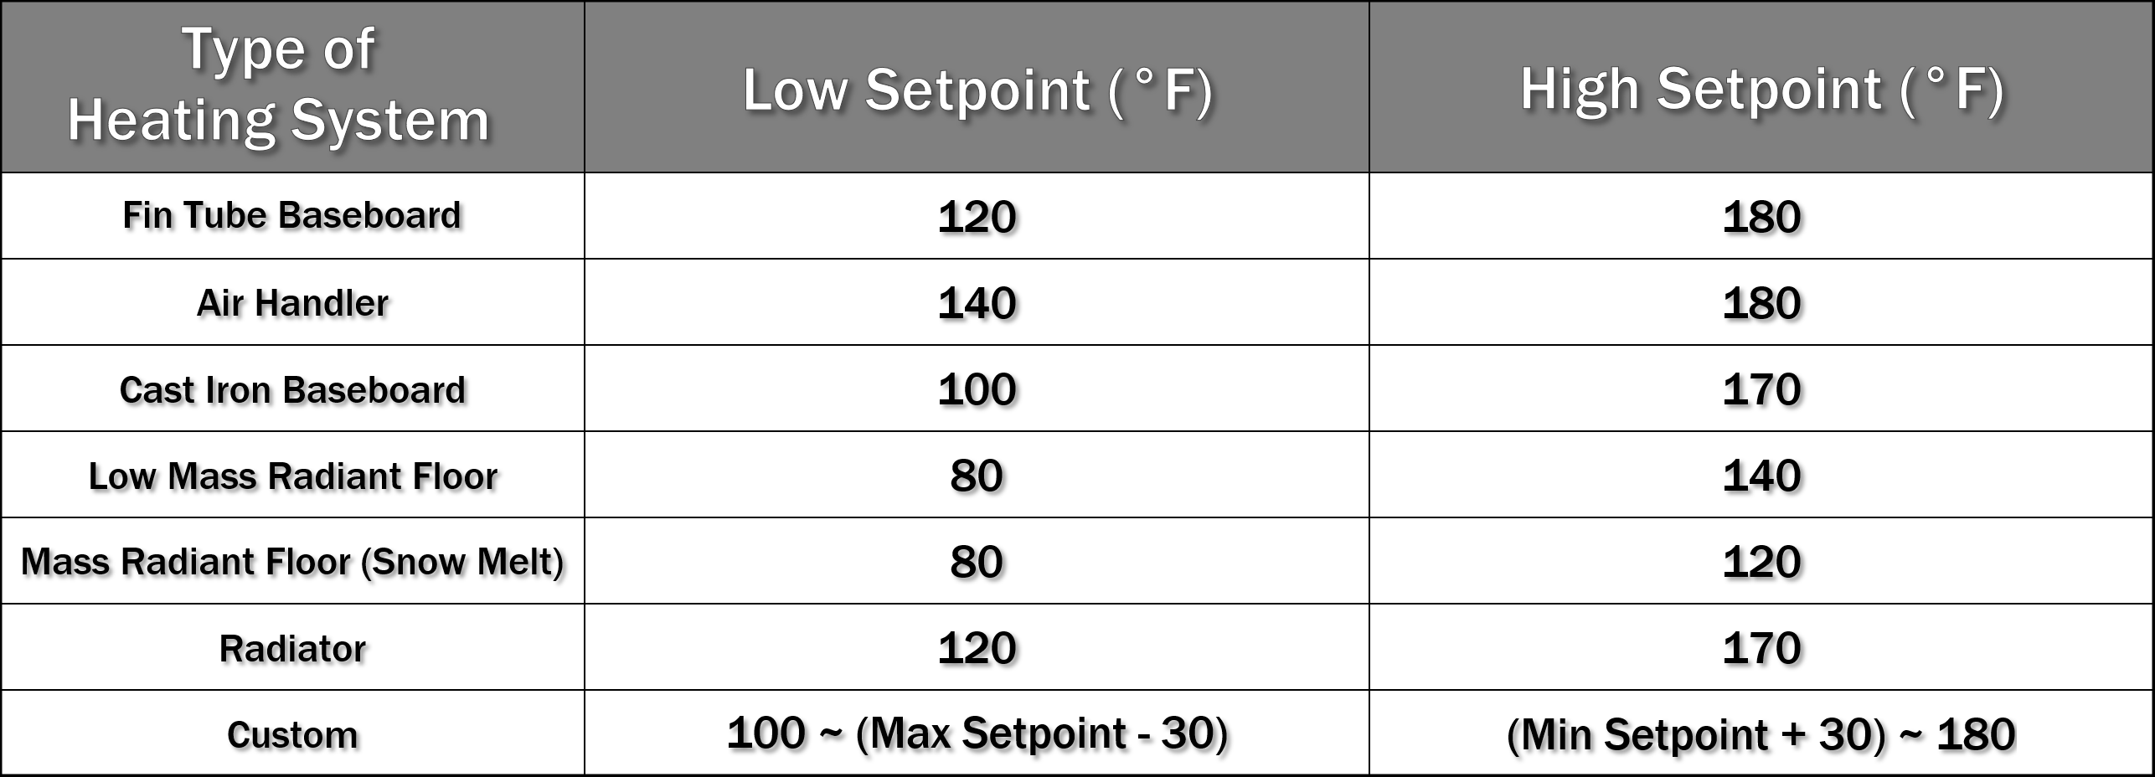
HEATING CONTROL SETTINGS
There are 3 main ways to control the NRCB
Standard (Manual Heating Settings) most common
Outdoor Reset Control
External Control (0-10 V) not common
When using Outdoor Reset there are 6 preprogrammed heating types and 1 custom type

Slide 19
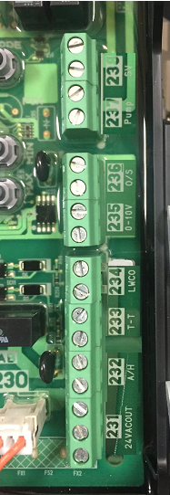

ELECTRICAL WIRING

Slide 20
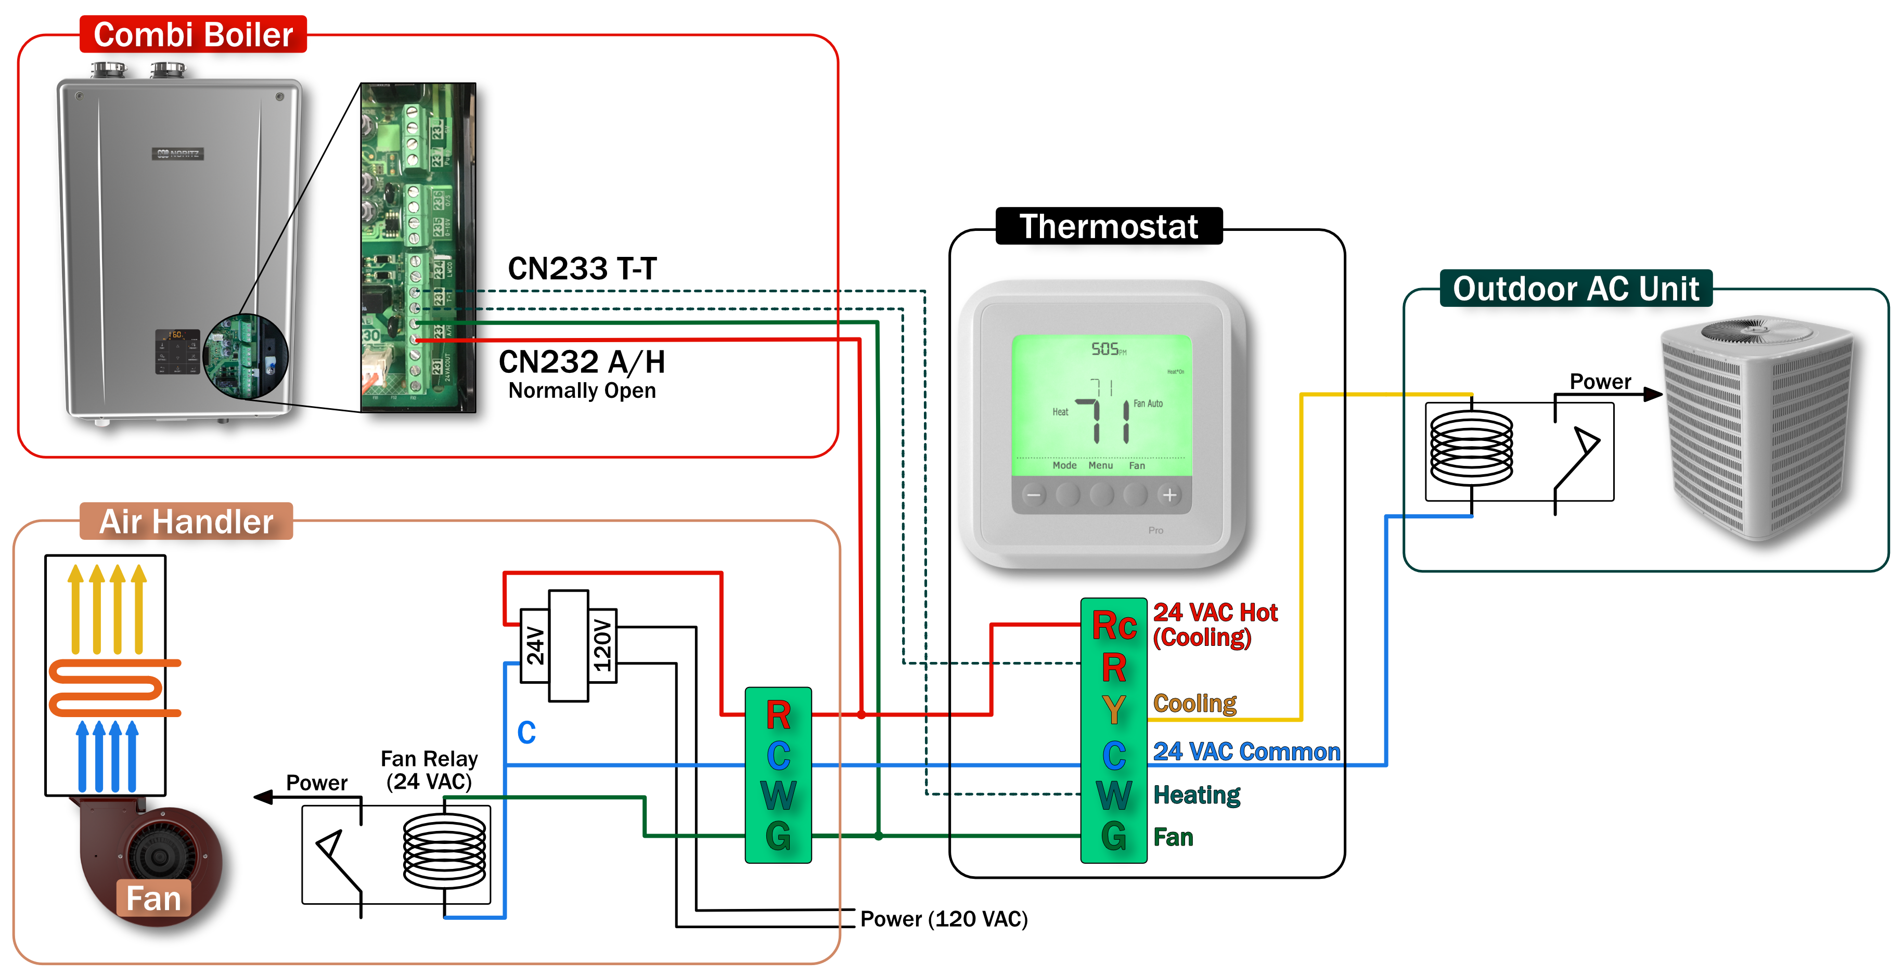
THERMOSTAT & AIR HANDLER WIRING
 | Rc-Y (Cooling) | Rc-G (Fan) | R-W (Heating)
Cool | Close | Close | Open
Heat | Open | Close | Close

Slide 21

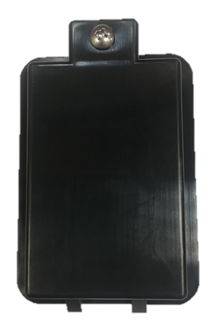

OUTDOOR RESET SENSOR WIRING
Outdoor Reset Sensor is included in the box with the Combi.
No additional charge!!!
It should be hardwired to the Combi’s Circuit Board Terminal CN 236 (O/S) to control the heating set temperature per the outside temperature. Energy Savings!!!
Outdoor Reset Sensor
Installing the Outdoor Reset provides more options for different heating applications
Additional programming is needed to set up see installation manual
Avoid Areas with direct sunlight or near a heat source which may not be representative of true outdoor temperature
Best location is on a N or NE facing wall, beneath the eaves, where the sensor is shielded from direct sunlight and moisture

Slide 22


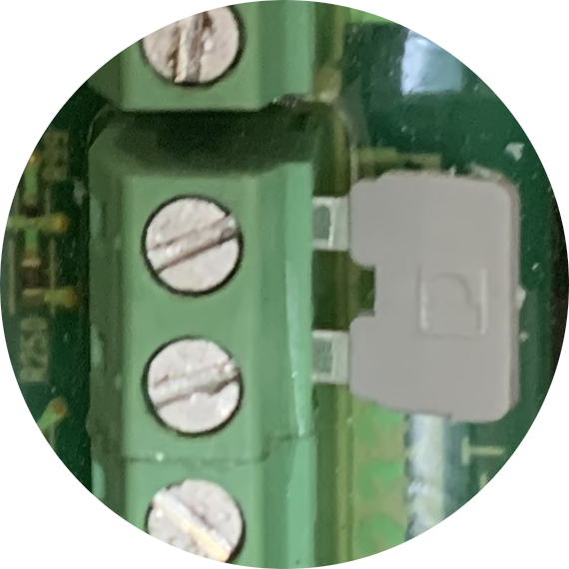
OPTIONAL EXTERNAL LWCO
LWCO needs to be above unit’s case
Factory Installed Jumper
LWCO Line
Install LWCO above unit’s case
Disconnect Factory Installed Jumper Wire from CN 234 on Circuit Board
Wire LWCO Line to CN 234
Wire 24 VAC (max 0.5 Amps) to CN 231
24 VAC

Slide 23
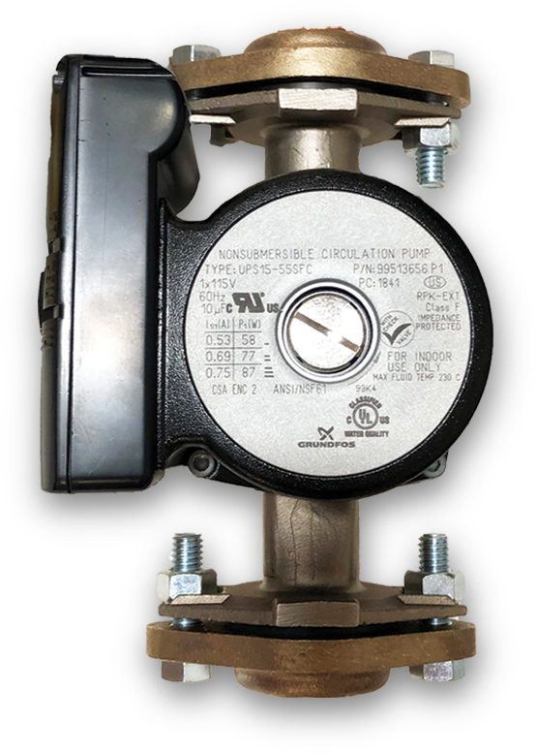
OPTIONAL EXTERNAL PUMP WIRING
The Combi can control an External Pump
Pump must be 120V AC and 2 Amp Max
The pump should be used for the Secondary Loop in a Primary/Secondary Loop Application (Internal Pump in the Combi is the Primary Pump)
Additional programming is needed to set up an External Pump (see installation manual)
120 VAC for Pump Controls

Slide 24
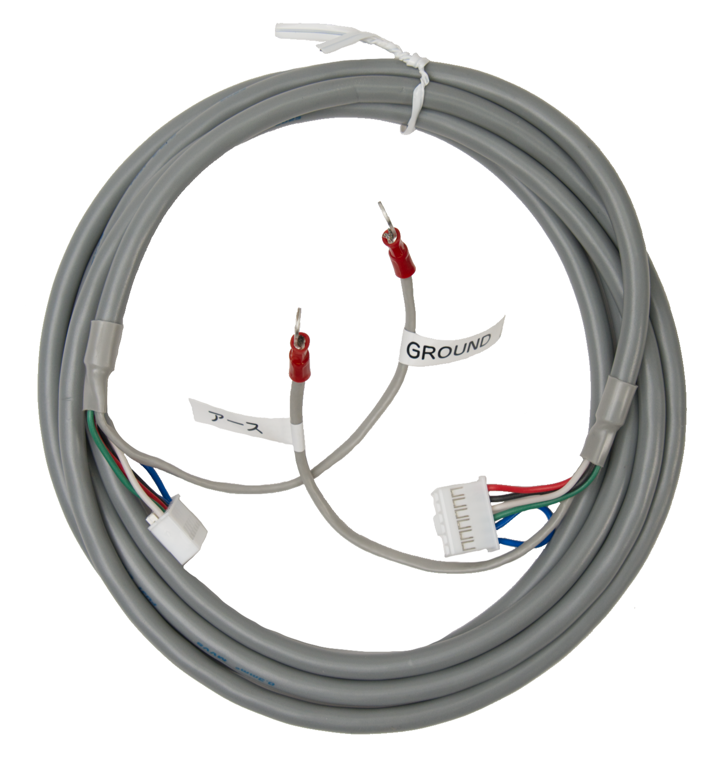
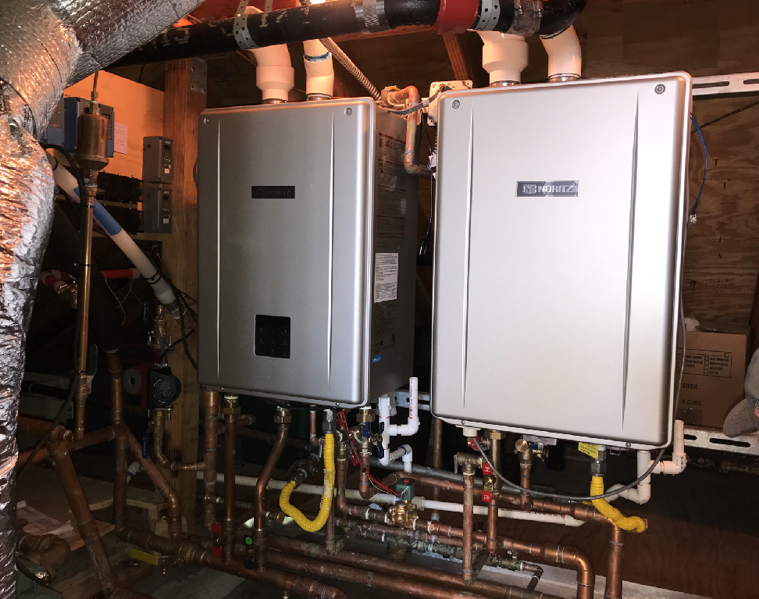
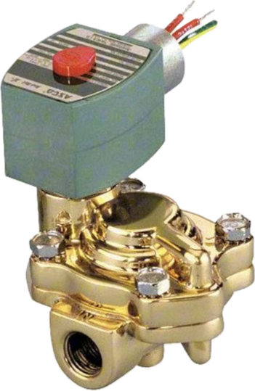
NEED MORE DHW?
Add a PRO Series Unit with a QC-2 Quick Connect Cord
Use the remote on the boiler
Slow closing solenoid valve is required between the NRCB and Tankless
The units will not rotate, and a recirculation system can be used.

Slide 25

SOLENOID WIRING FOR QC SYSTEMS
Solenoid Valve must be
¾” 120V AC - 1.5 Amp Max
Solenoid Valve is needed when using a QC System with any PRO Unit
The Solenoid Valve must be Normal Closed Valve and Slow Closing to avoid water hammer

Slide 26
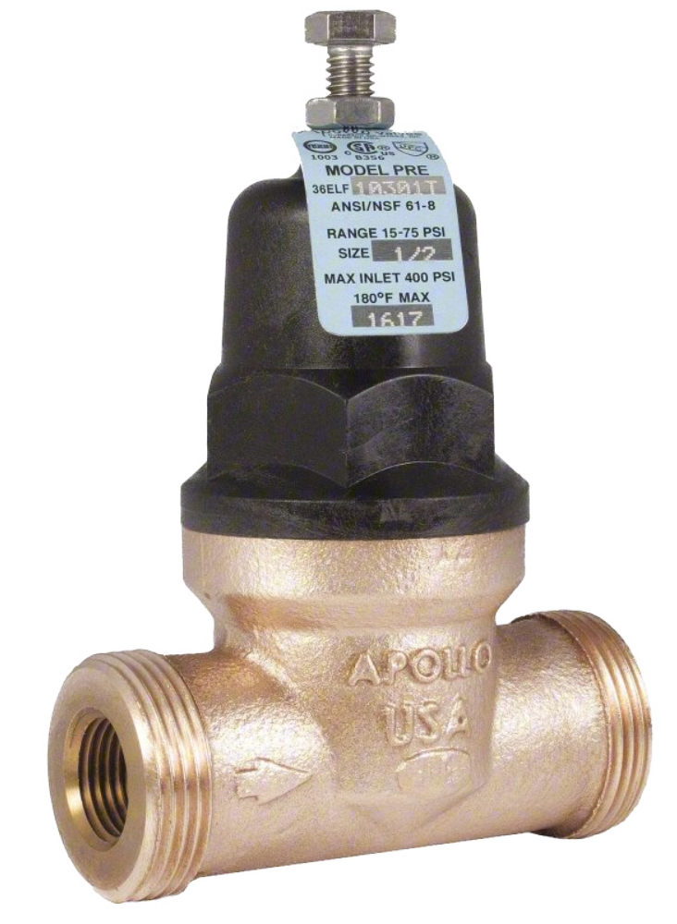
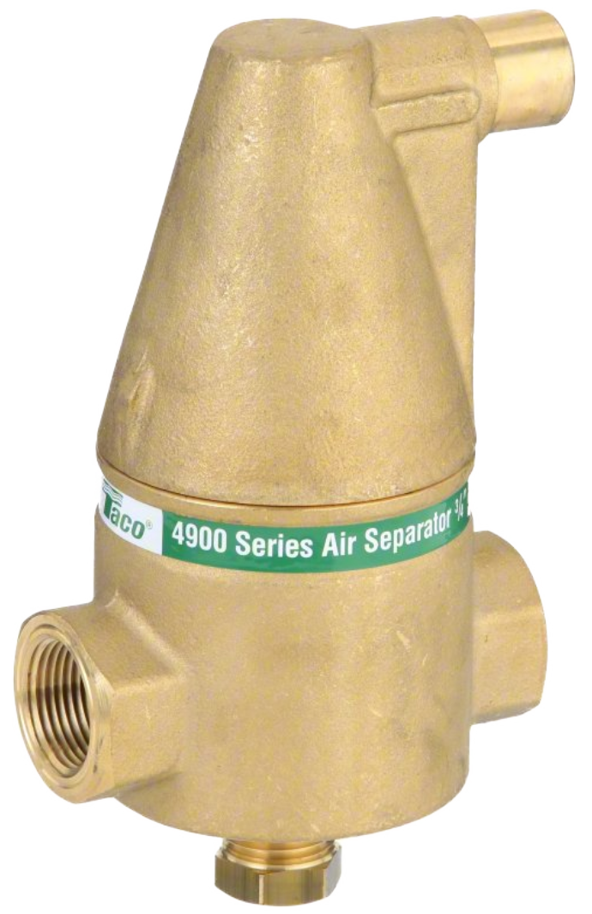
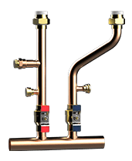
ADDITIONAL ACCESSORIES
Air Separator
Required at the highest point of the heating system
½” Pressure Reducing Valve Needed on the auto feeder connection line to reduce the inlet water pressure to below 30 psi
Manifold Kit MK-NRCB-1
Premade to align with the heating supply and return ports. Shut off valves and ports to flush the HEX along with a drain port to bleed out air in the system

Slide 27
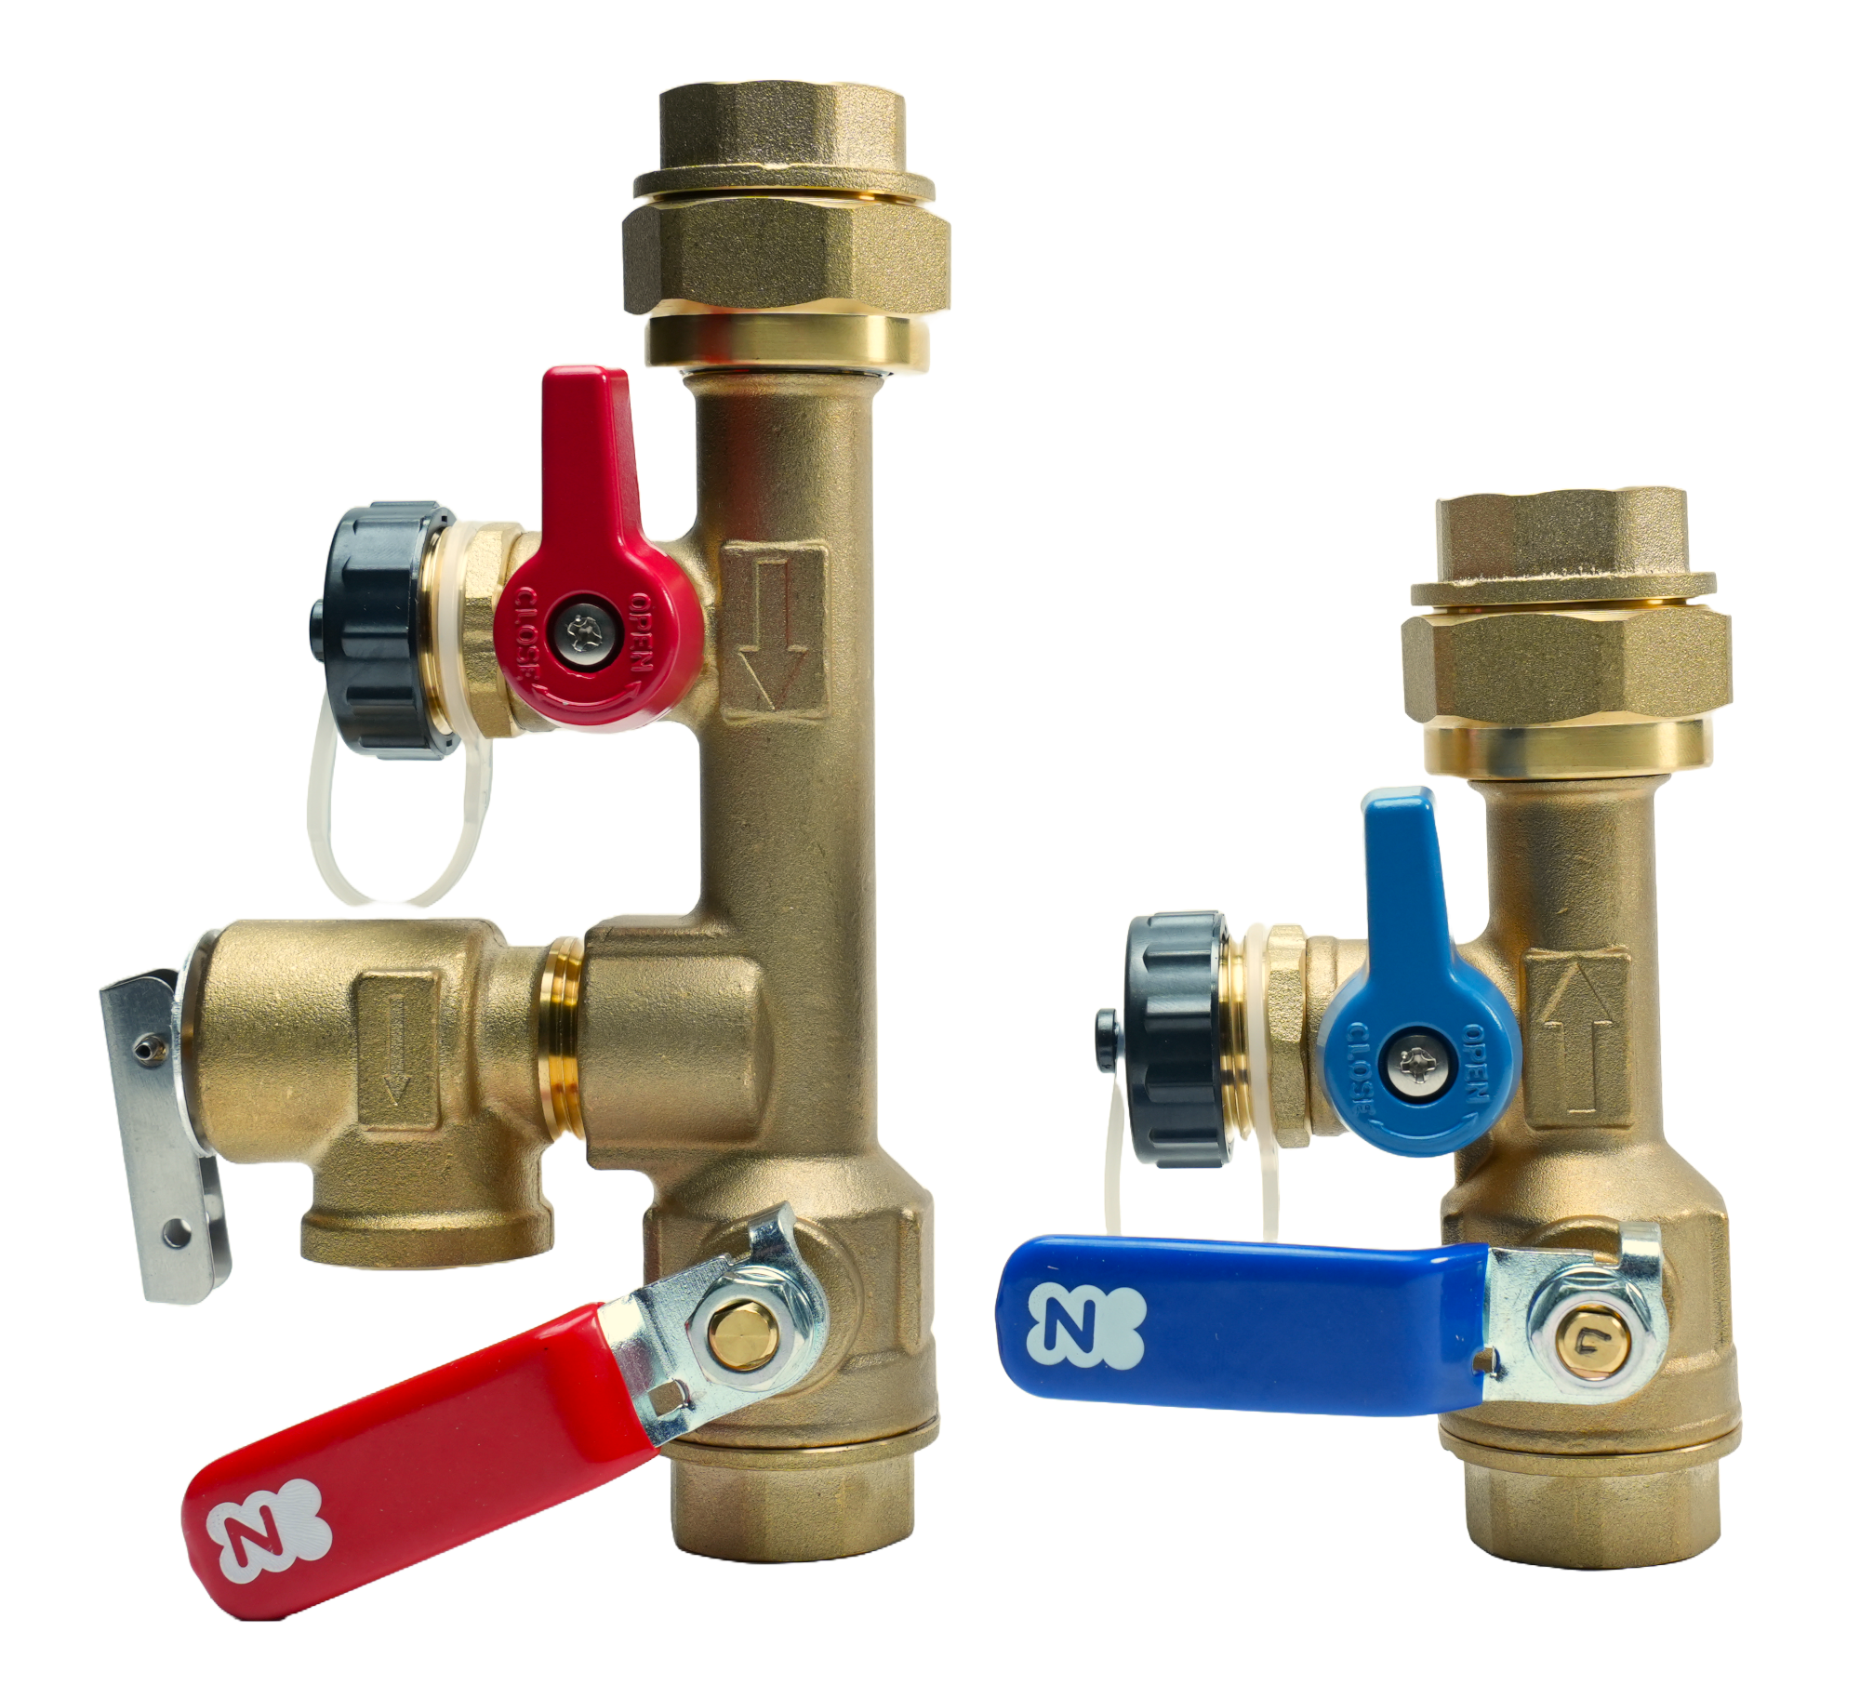


WATER TREATMENT
Water Quality Guidelines in the Installation Manual should always be followed.

Slide 28
MAINTENANCE MONITORS
General Combustion Information for Warranty Purposes
Data No. | Item Name | Multiplier | Units
01 | Total Heating Combustion Time | X 10 | Hours
02 |  | X 10,000 | Hours
03 | Total Plug In Time | X 100 | Hours
04 | Total DHW Combustion Time | X 1 | Hours
05 |  | X 1,000 | Hours
06 | Total Simultaneous Use of DHW & Heating | X 1 | Hours
07 | Number of DHW Ignition Times | X 100 | Time
08 |  | X 100,000 | Time
11 | Number of Heating Ignition Times | X 100 | Time
12 |  | X 100,000 | Time
78 | Total Circulation Pump Run Time | X 10 | Hours
79 |  | X 10,000 | Hours
Full list of Maintenance Monitors are located on the Technical Data Sheet inside the front cover of unit

Slide 29
MAINTENANCE MONITORS
Flow, Temperature, Pressure and Error Code Information
Data No. | Item Name | Multiplier | Units*
14 | Total DHW Flow Rate | X 0.1 | gal/min
30 | DHW Inlet Temperature | X 1 | °F
31 | DHW Outlet Temperature | X 1 | °F
32 | DHW Heat Exchanger Temperature | X 1 | °F
34 | Heating Return Temperature | X 1 | °F
35 | Heating Supply Temperature | X 1 | °F
36 | Exhaust Temperature | X 1 | °F
38 | Outdoor Temperature Sensor Temp | X 1 | °F
67 | Heating Water Pressure | X 0.1 | psi
91-98 | Error Code History (91 is most recent) If 3 digit error code the first 2 digits will show and then flip to subdivision number, this will flip every 2 seconds
* If [I:00_FC] is set to C (Celsius) then units will be in lit/min and °C

Slide 30
THANK YOU

