Slide 1
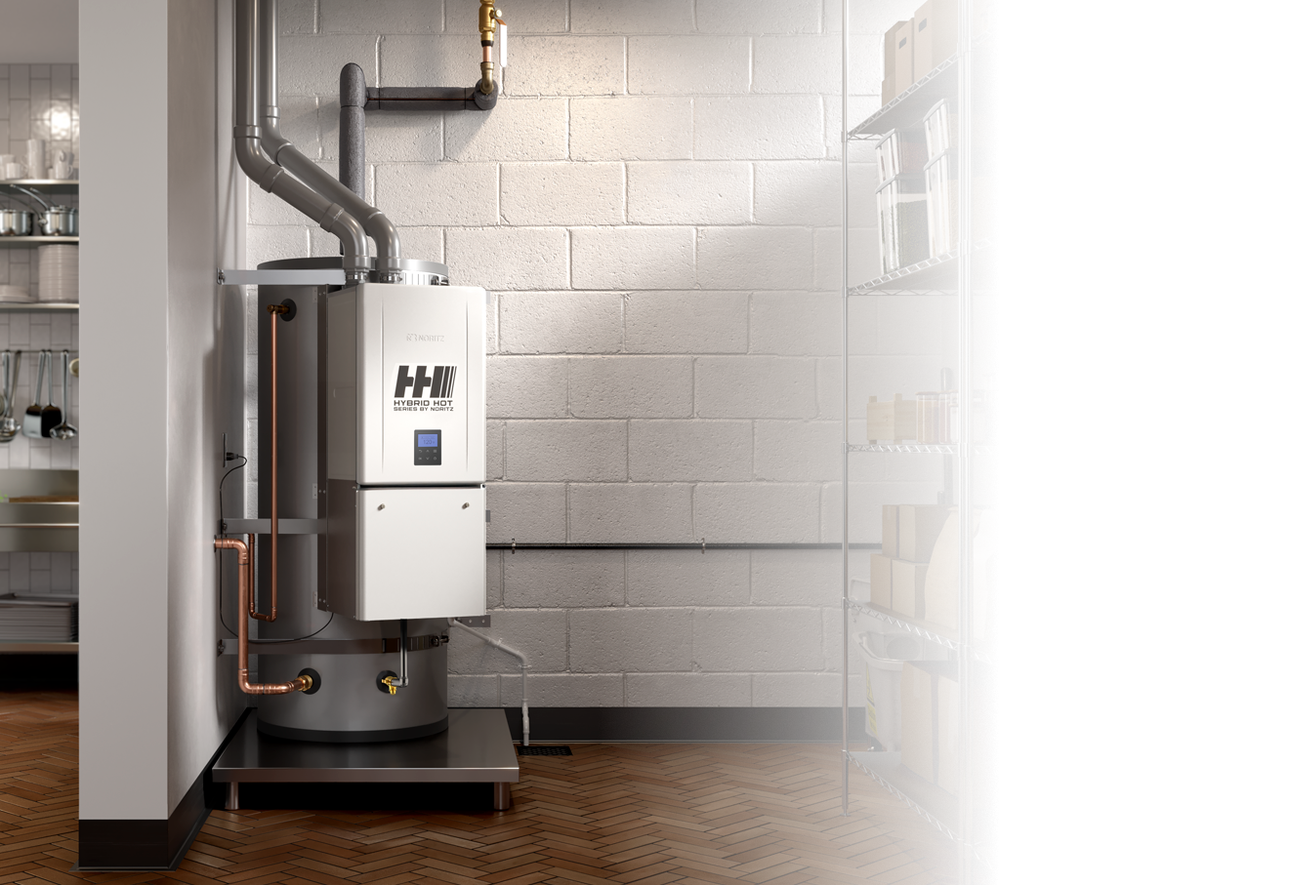

Introduction and Overview

Slide 2
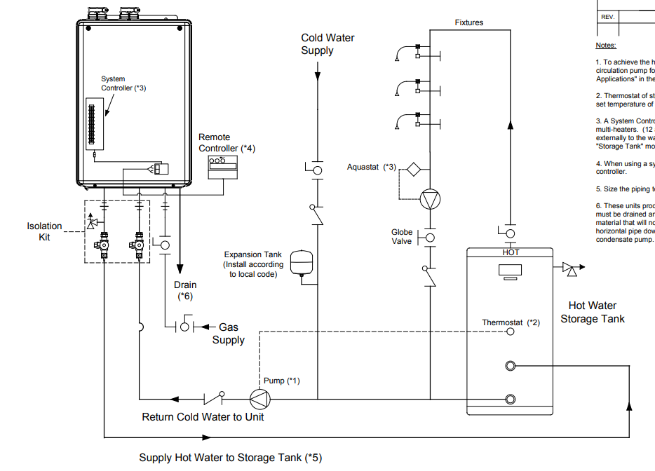

WHY HYBRID HOT?
Noritz has offered plumbing diagrams showing the use of a storage tank and tankless for many years. Now we offer the complete package ready to install.

Slide 3

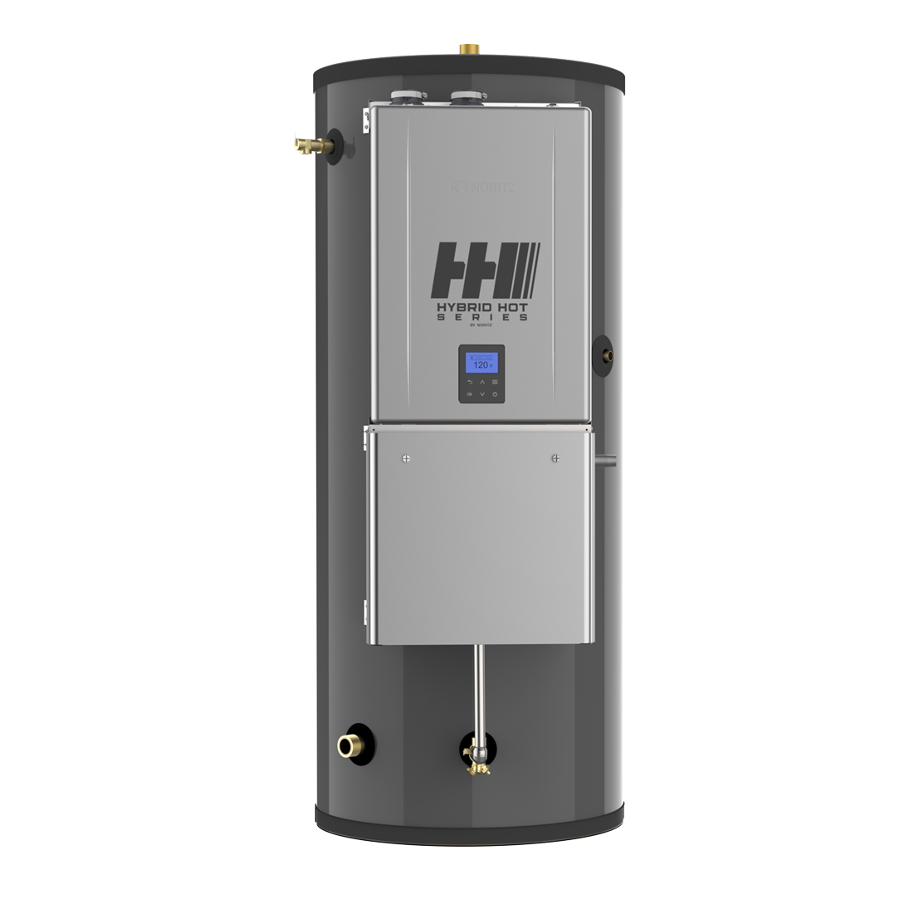






The Hybrid Hot Series by Noritz brings together the storage of a standard tank and the power and efficiency of a tankless to take on any commercial hot water demand.
Combined to meet the hot water requirements of businesses, the Hybrid Hot Series by Noritz utilizes the latest in tankless and tank storage technologies to create a powerful and reliable solution for businessowners. The Hybrid Hot also offers common venting for multiple units to ensure endless hot water is always available.
FASTER HOT WATER RECOVERY
The Hybrid Hot offers the best BTU possible at the quickest rate, providing businesses with energy savings and more.
THE BEST OF TANK AND TANKLESS
With an endless supply of hot water, lower pressure drop, and no limitation of hot water flow rate, the Hybrid Hot Series by Noritz combines features of both technologies to provide the most reliable hot water delivery system to date for commercial applications.
CONTINUOUS HOT WATER DELIVERY
If your tank suddenly runs out of hot water, no need to worry. The Hybrid Hot Series by Noritz can continue to provide hot water using the paired NCC199CDV tankless even after your stored supply is depleted*. (*Hot water capabilities are limited)
CEMENT LINING
With no anode rod and a greater warranty than other tanks on the market, our tank also features cement lining for superior corrosion resistance.
NHH199100
Assembled in the USA

Slide 4
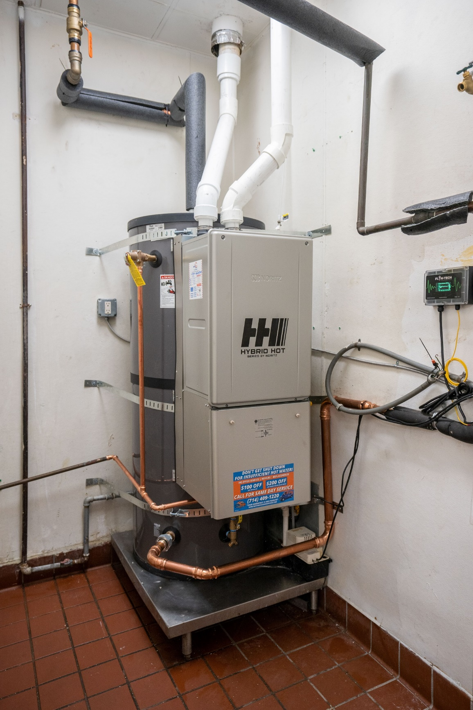
APPLICATIONS
Best used in short periods of high demand applications but applicable in any kind of commercial application.
  Commercial dish machines
  Laundromats
Case studies being conducted in Santa Paula Middle School and Rowland Heights Boiling Crab
Rowland Heights Boiling Crab

Slide 5
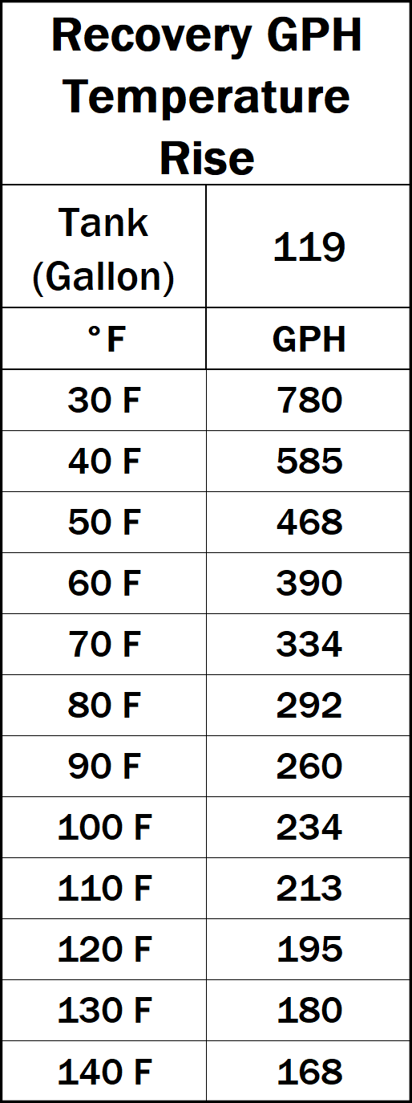
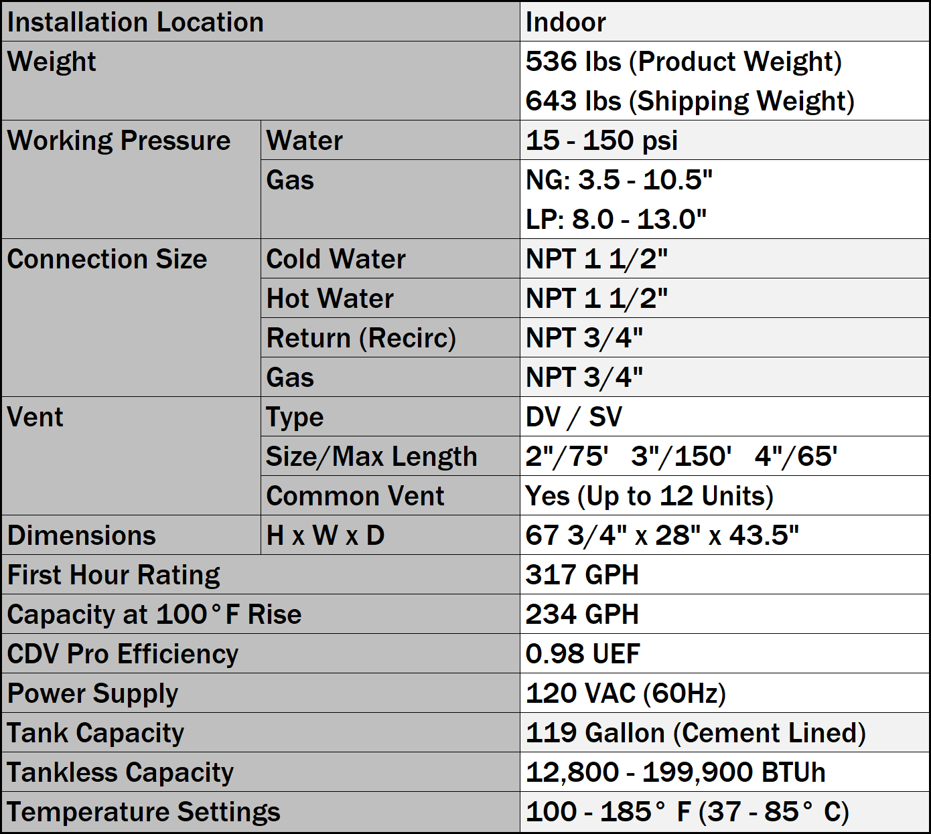
RECOVERY & SPECS

Slide 6
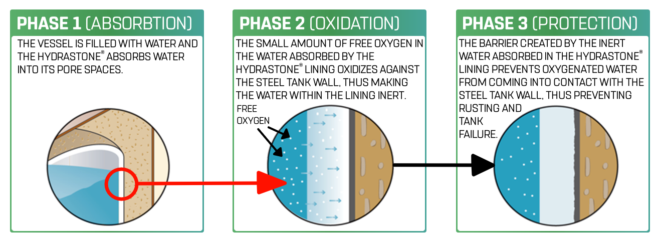
HYDRASTONE® LINING

Slide 7
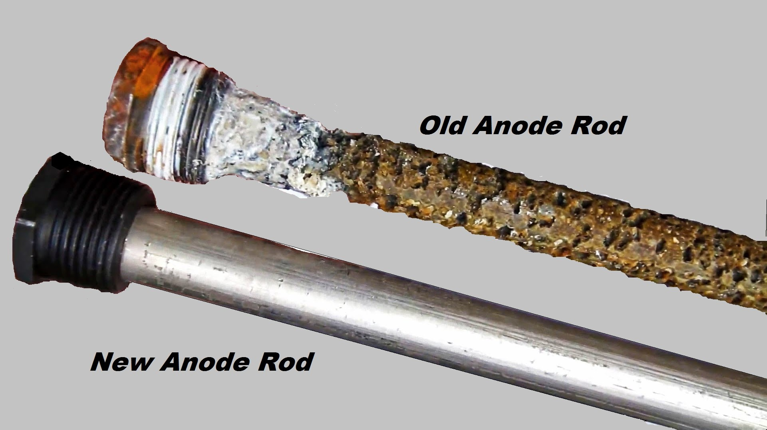
CEMENT LINED VS. GLASS LINED
Hydrastone Lining
A seamless ½” thick lining is impervious to adverse water conditions and is proven to be the most effective method of preventing tank failure due to corrosion. Hydrastone lining absorbs and traps water, which then loses its oxygen and becomes inert, thus preventing tank corrosion.
Premium Insulation
2” thick polyurethane foam combined with heat-retaining Hydrastone lining allows less than 0.3ºF heat loss per hour.
0.005” Glass lined storage tanks require an anode rod to attract the corrosive minerals that attack the water heater

Slide 8
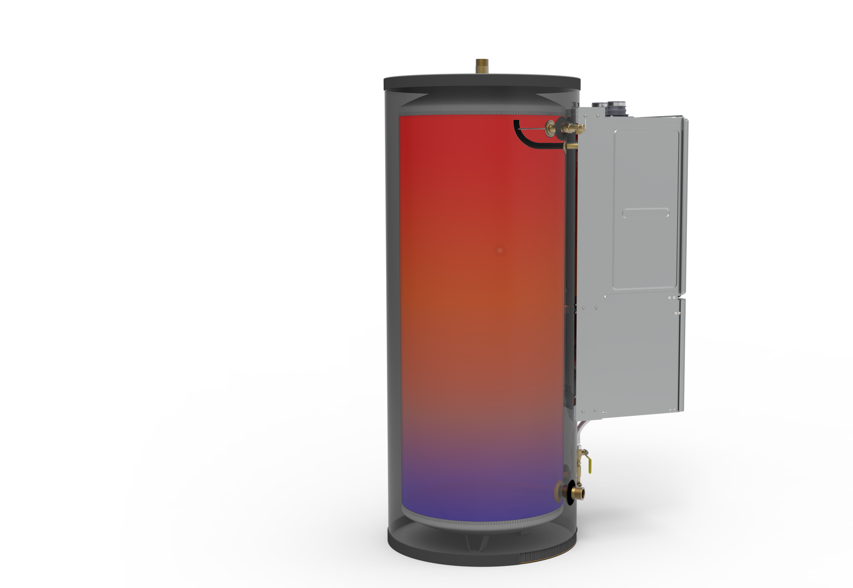
BASIC OPERATION
Water connection locations help to stratify the water temperatures in the tank keeping the upper tank full of the hottest water. Provides the best energy efficient supply of hot water.
This extends the 70% rule associated with tank heaters

Slide 9
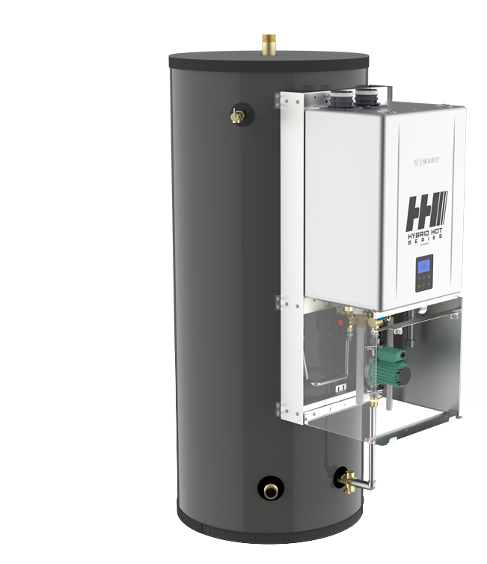
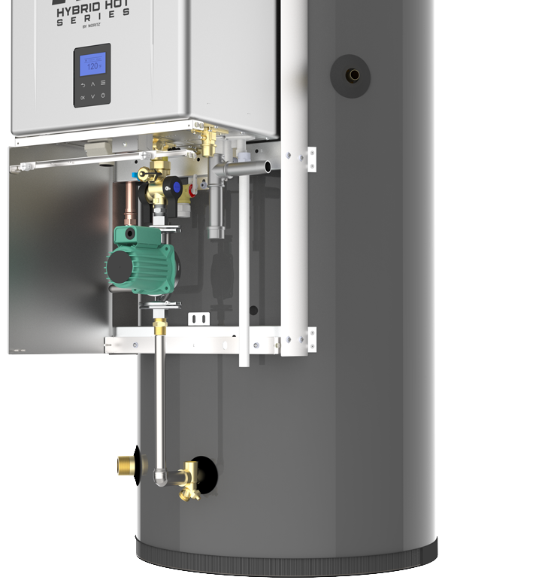

Tank Outlet Port
T&P Relief Valve
Hot Water Line
Pump
Cold Water Line
Tank Inlet Port
Recirc Port
Gas Port
Condensate Drain
Thermistor
(on tank surface)
Drain Port &
Wye Strainer

Slide 10
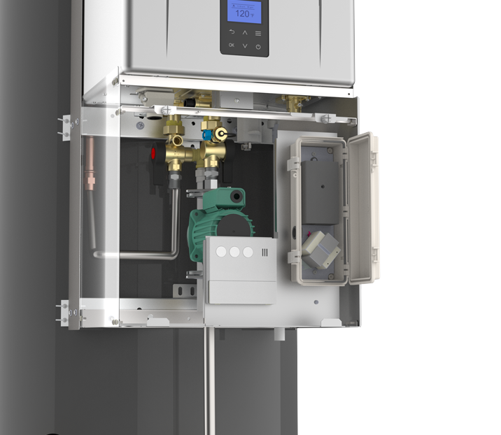
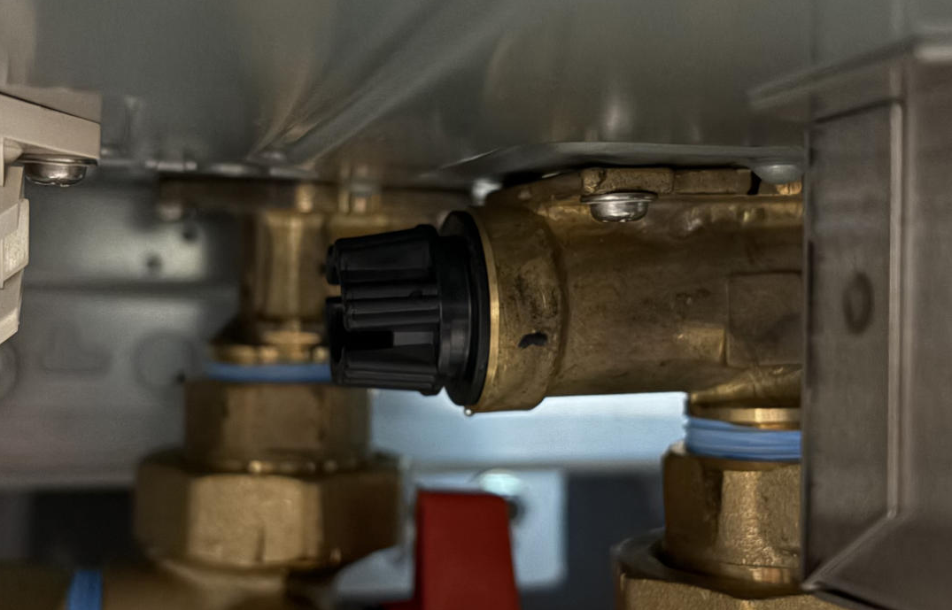
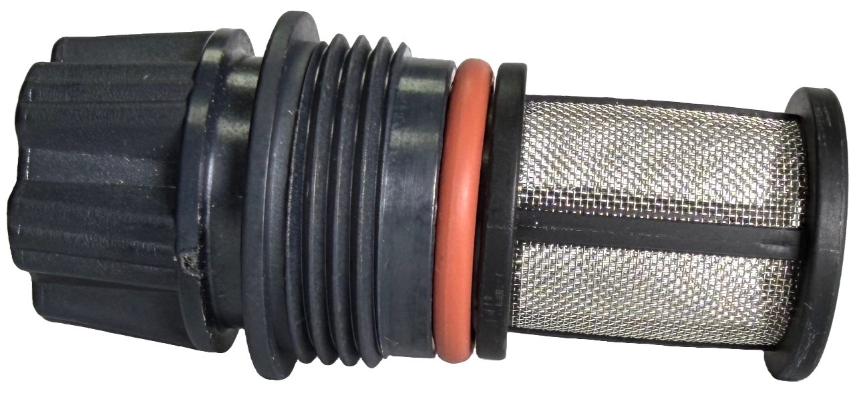
UNDER THE HOOD
Inlet Filter
Error Indicator Light
Pump Controller
Transformer
Remote Control
TACO 009FS5 SYSTEM PUMP
(4 – 5 GPM)
All internal controls for operation are pre-plumbed and install ready

Slide 11
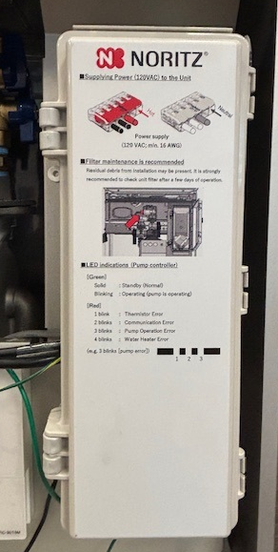
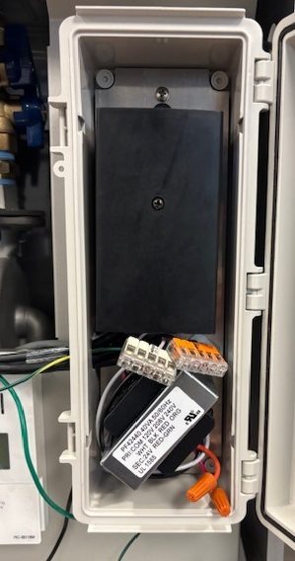
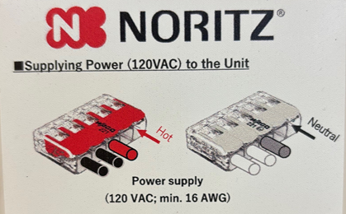
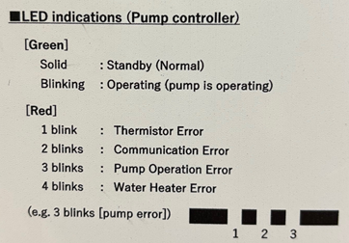
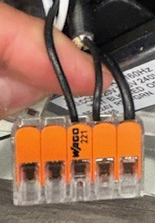
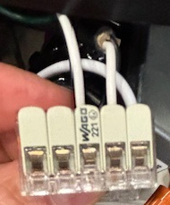
ELECTRICAL WIRING
The Hybrid Hot doesn’t come with a power cord. The contractor will need to purchase and wire
Hot
Neutral

Slide 12

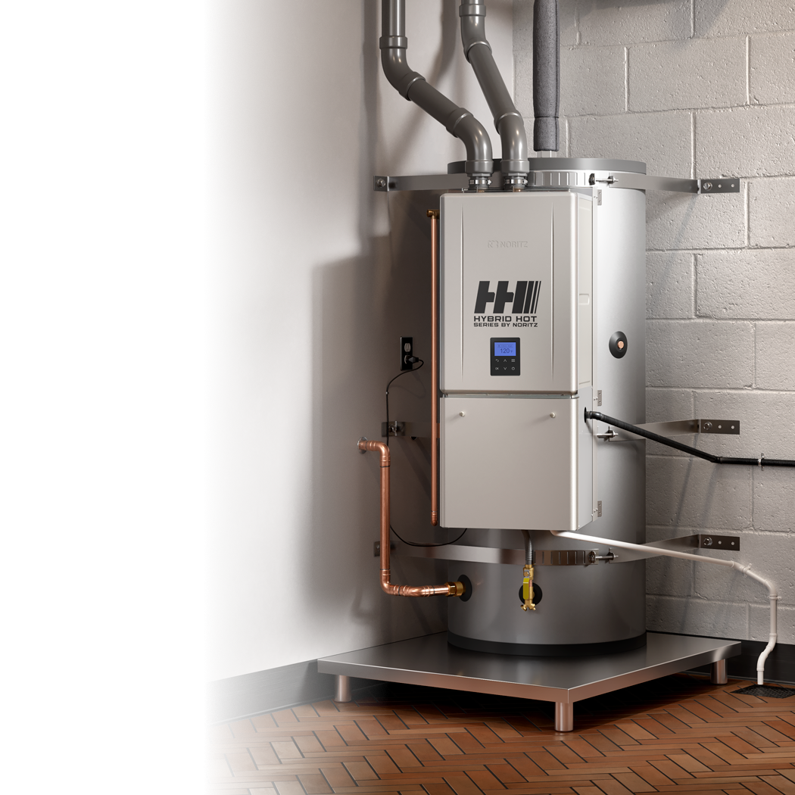
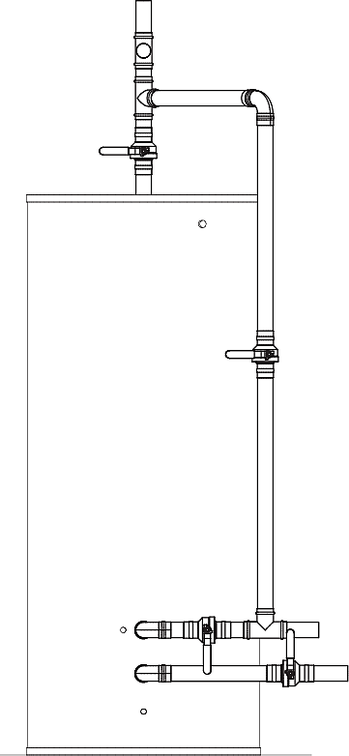


1 ½” NPT Hot Outlet
Hot out to System
¾” FNPT Recirc Return
Hot out to storage
Recirc Pump
System Pump
Check Valve
1 ½” NPT Cold Supply
Inlet Cold to the tank
¾” Gas
Return Loop
Blend water to Tankless
¾” Combo Drain and Cold Inlet to Tankless

Slide 13
COMMON VENTING
When common venting Hybrid Hot Water heaters, a system controller (SC-401-6M or 12M) must be installed (purchased separately).
Multi unit systems require pressure balancing of the piping system (Piping in Parallel or first in last out).
System bypass controls are set to stay open to 160ºF

Slide 14
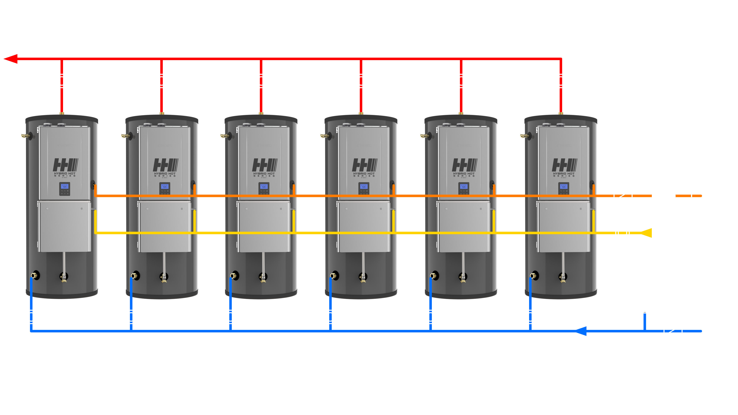
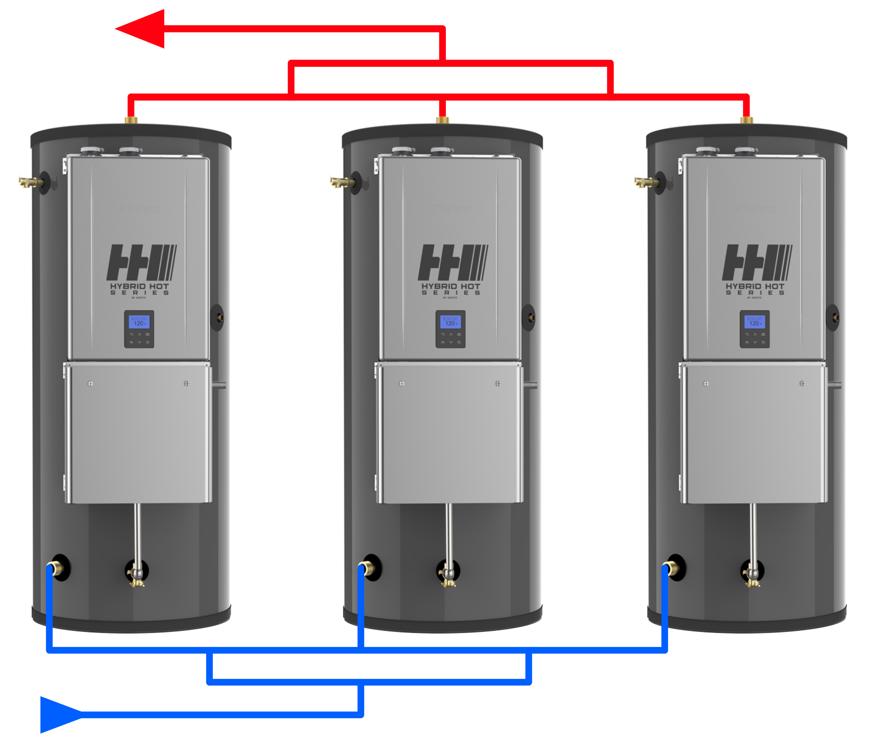
MULTIPLE PIPING
Water Piping Diagram. Piping can be either first in, last out or in parallel
Hot Water Return
Pump
Gas Supply
Expansion Tank (Install according to local code)

Slide 15

WARRANTY REGISTRATION
Tankless serial number is used for registration
Warranty is registered via PROCard App or Noritz website
Our system recognizes that the NCC199CDV used is part of a Hybrid Hot

Slide 16
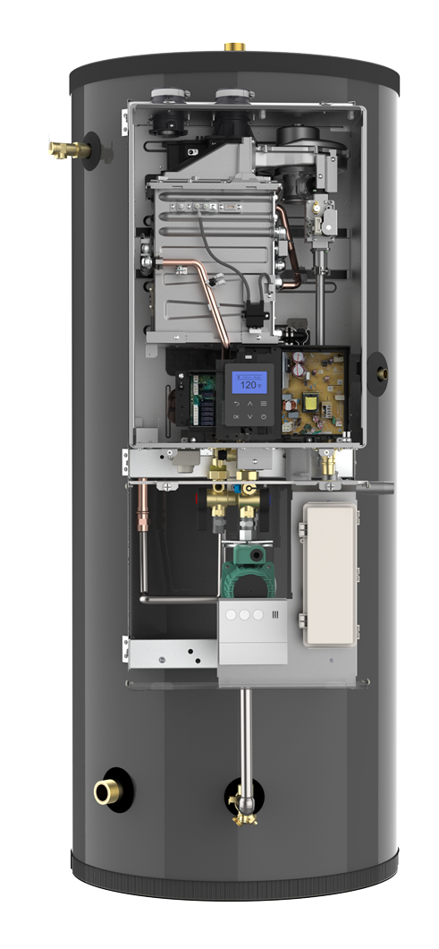
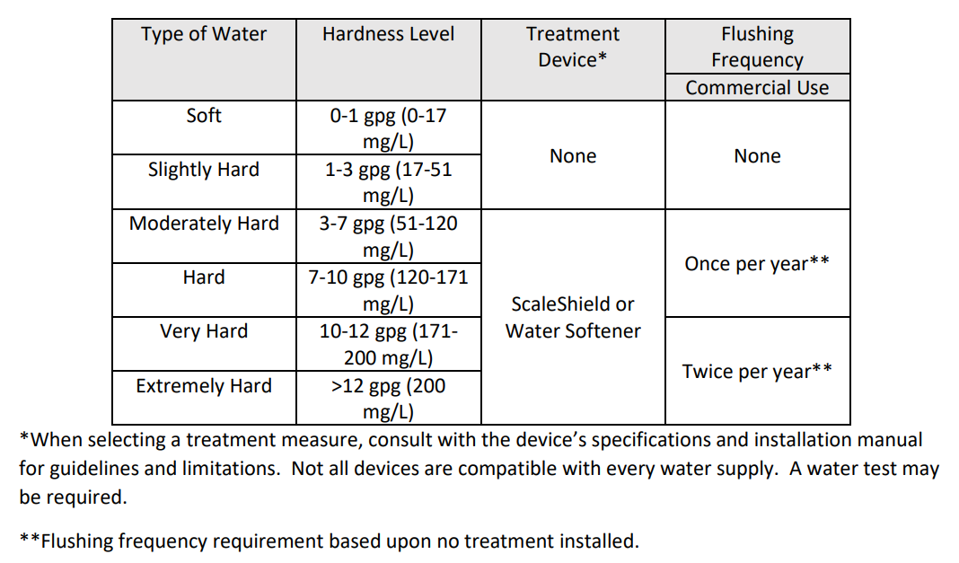
SERVICE & MAINTENANCE
Tankless only cares about refilling the storage tank, that's its primary operation
Tankless can be isolated from the tank to provide hot water while the tankless is serviced
Tankless is taking water from the bottom of the tank so hard water sediment can accumulate at the inlet filter
Tank should be flushed of hard water buildup periodically
Hard water should be treated per guidelines in the manual
Parts Available:
  All NCC199CDV Parts
  Pump
  Controls
  Isolation Valves
  Gaskets

Slide 17
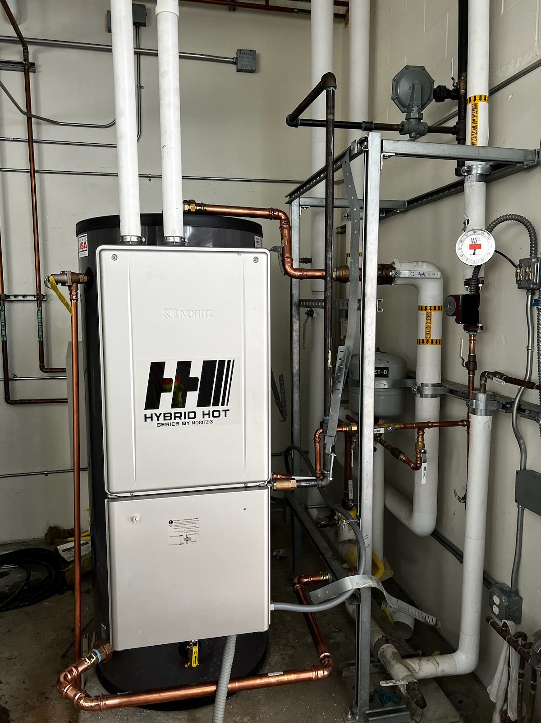
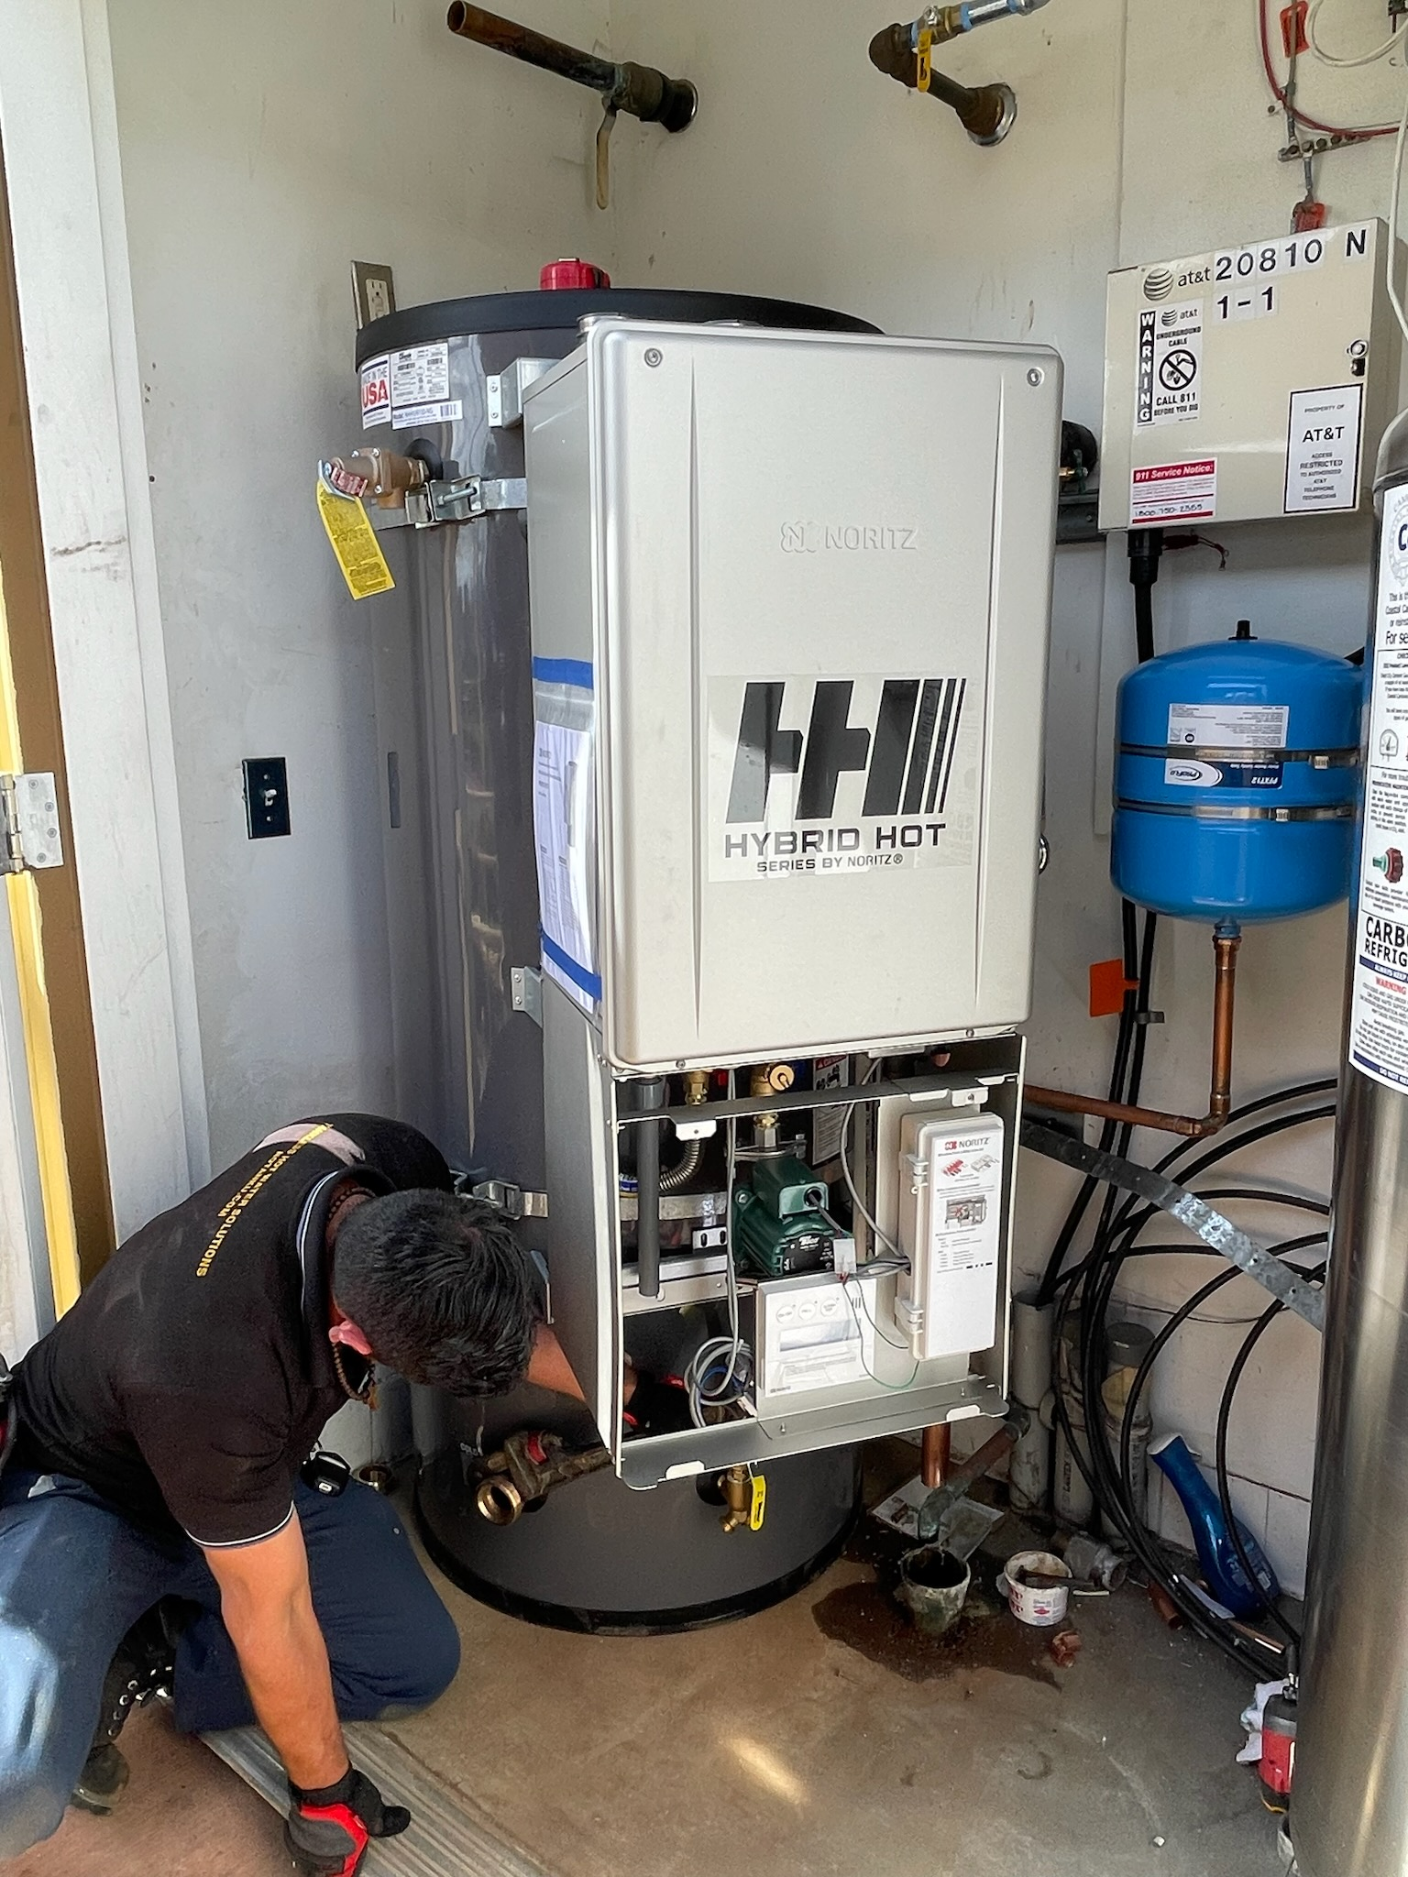
Hybrid Hot install at the State of Washington Facilities complex, Whidbay Island, Washington
One of two Hybrid Hot installs at Farmer Boys Burgers, So. Cal

Slide 18

THANK YOU

