Slide 1

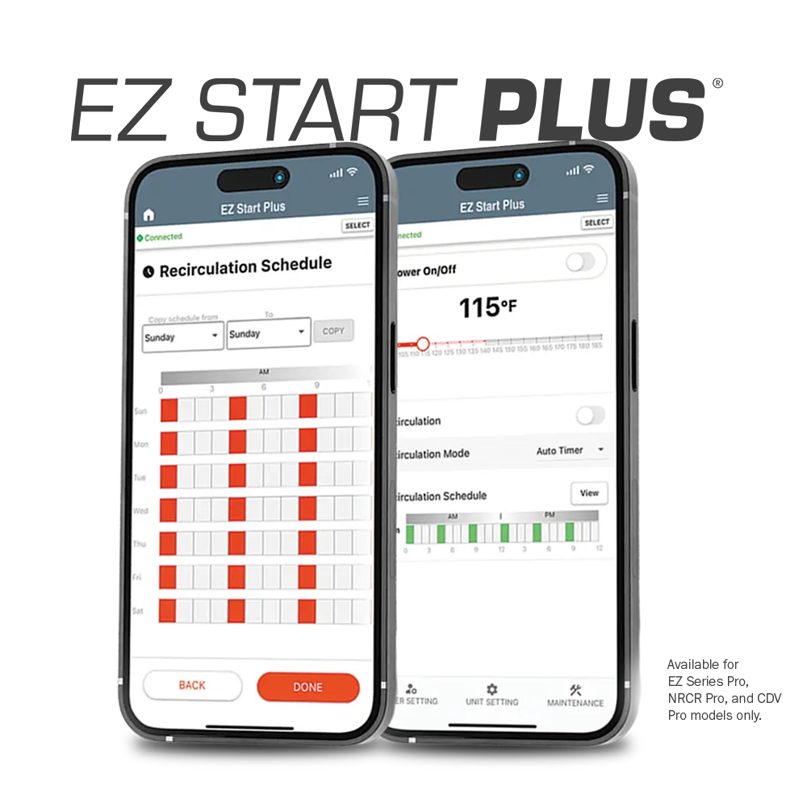

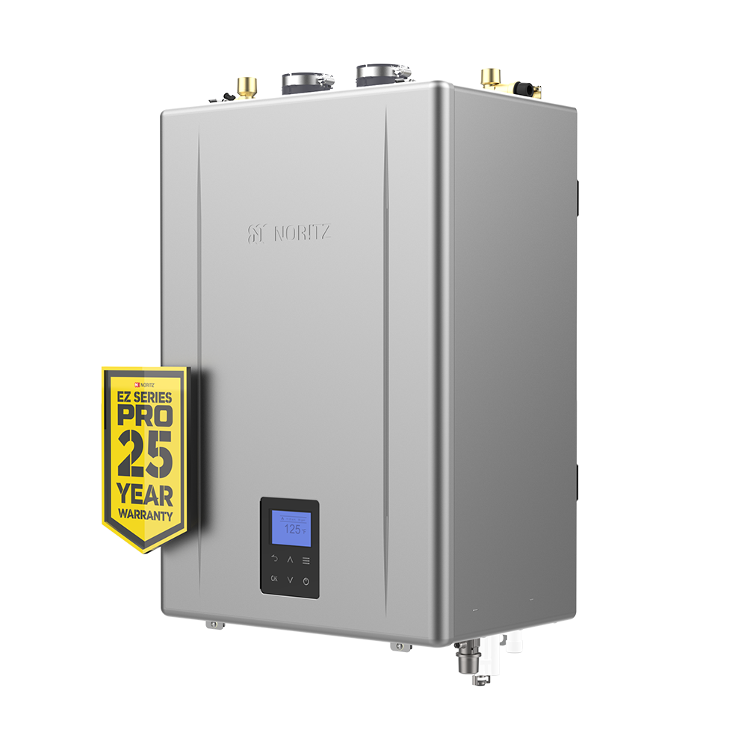
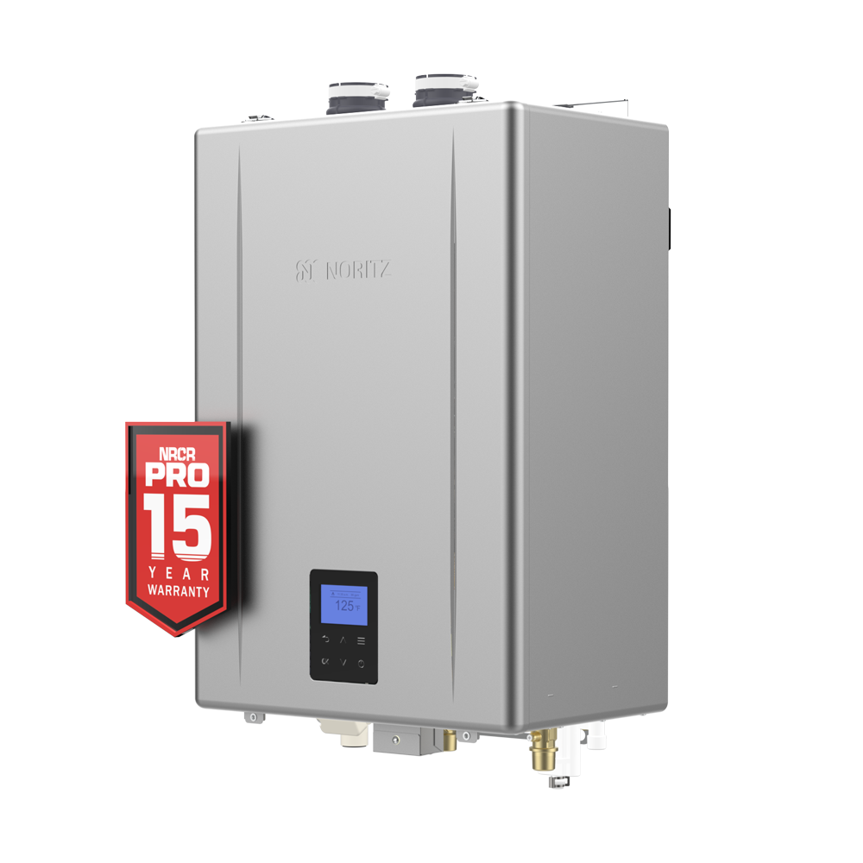
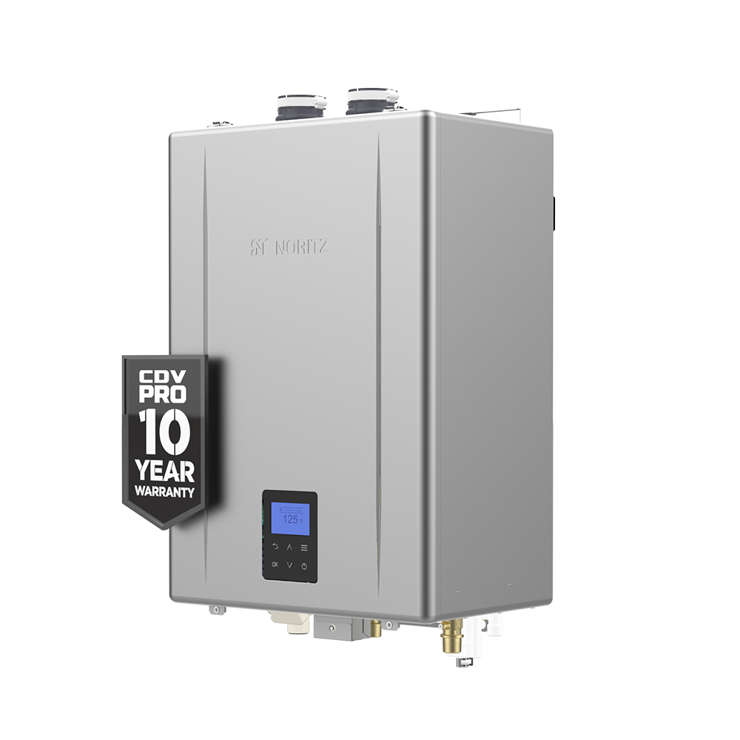
EZ Start Plus App Screens

Slide 2
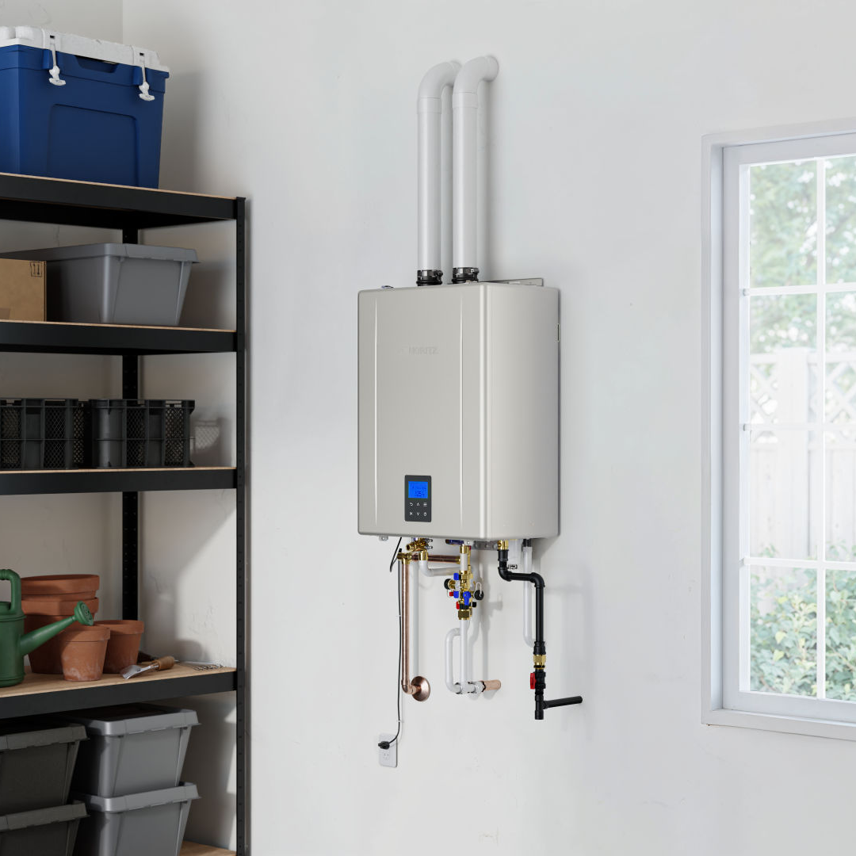

OUTLINE
EZ Start Plus App
Programming the Unit
Built In Display
Initial Set Up of the App
Field Gas Conversions
Unit Settings
Saved Settings
User Settings
Recirc Timer Settings
Error Code History
Maintenance Monitors
Trial Operation

Slide 3
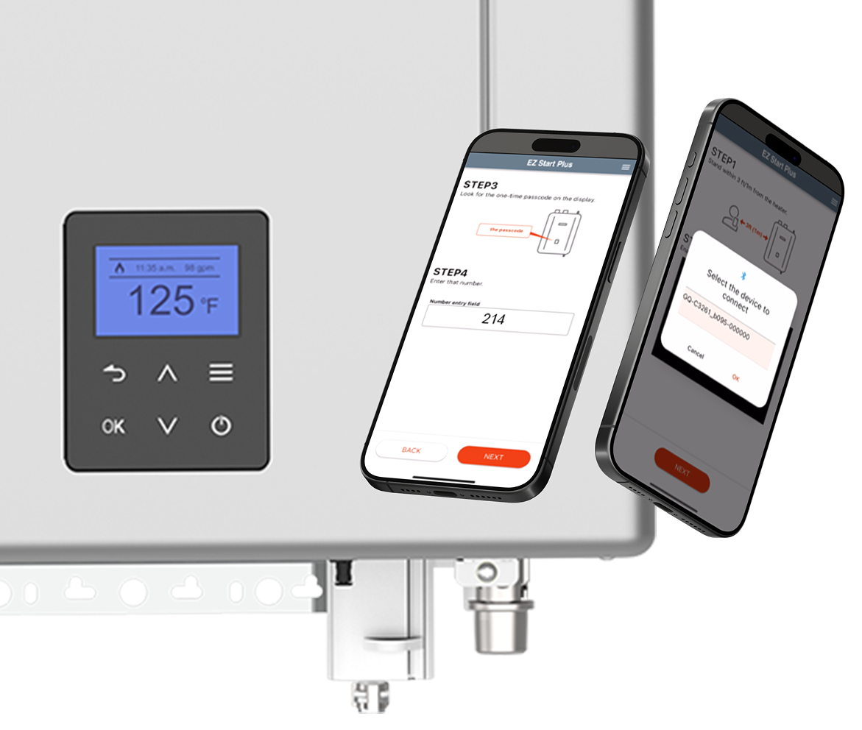
EZ START PLUS APP
Initial unit setup, temperature adjustment and maintenance can all be handled through the new EZ Start Plus Bluetooth App!
The App will walk you through setting up the unit upon completing installation and provides an easy way to register the unit for your customers.
Error Code History can be accessed and will link you directly to help articles related to any error codes stored.

Slide 4
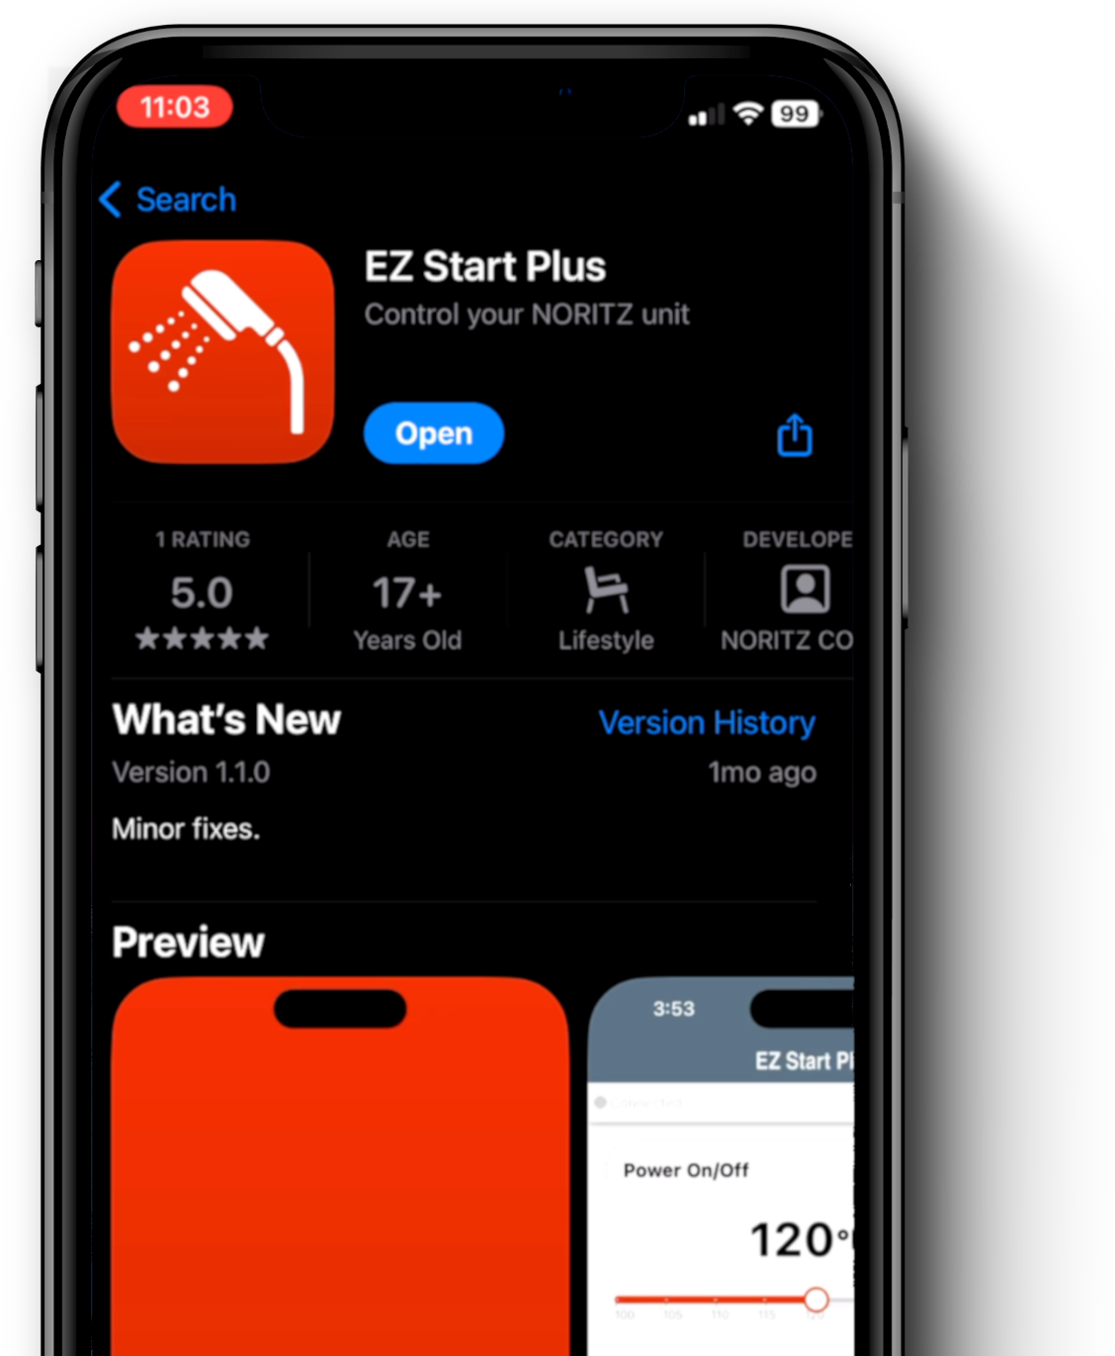
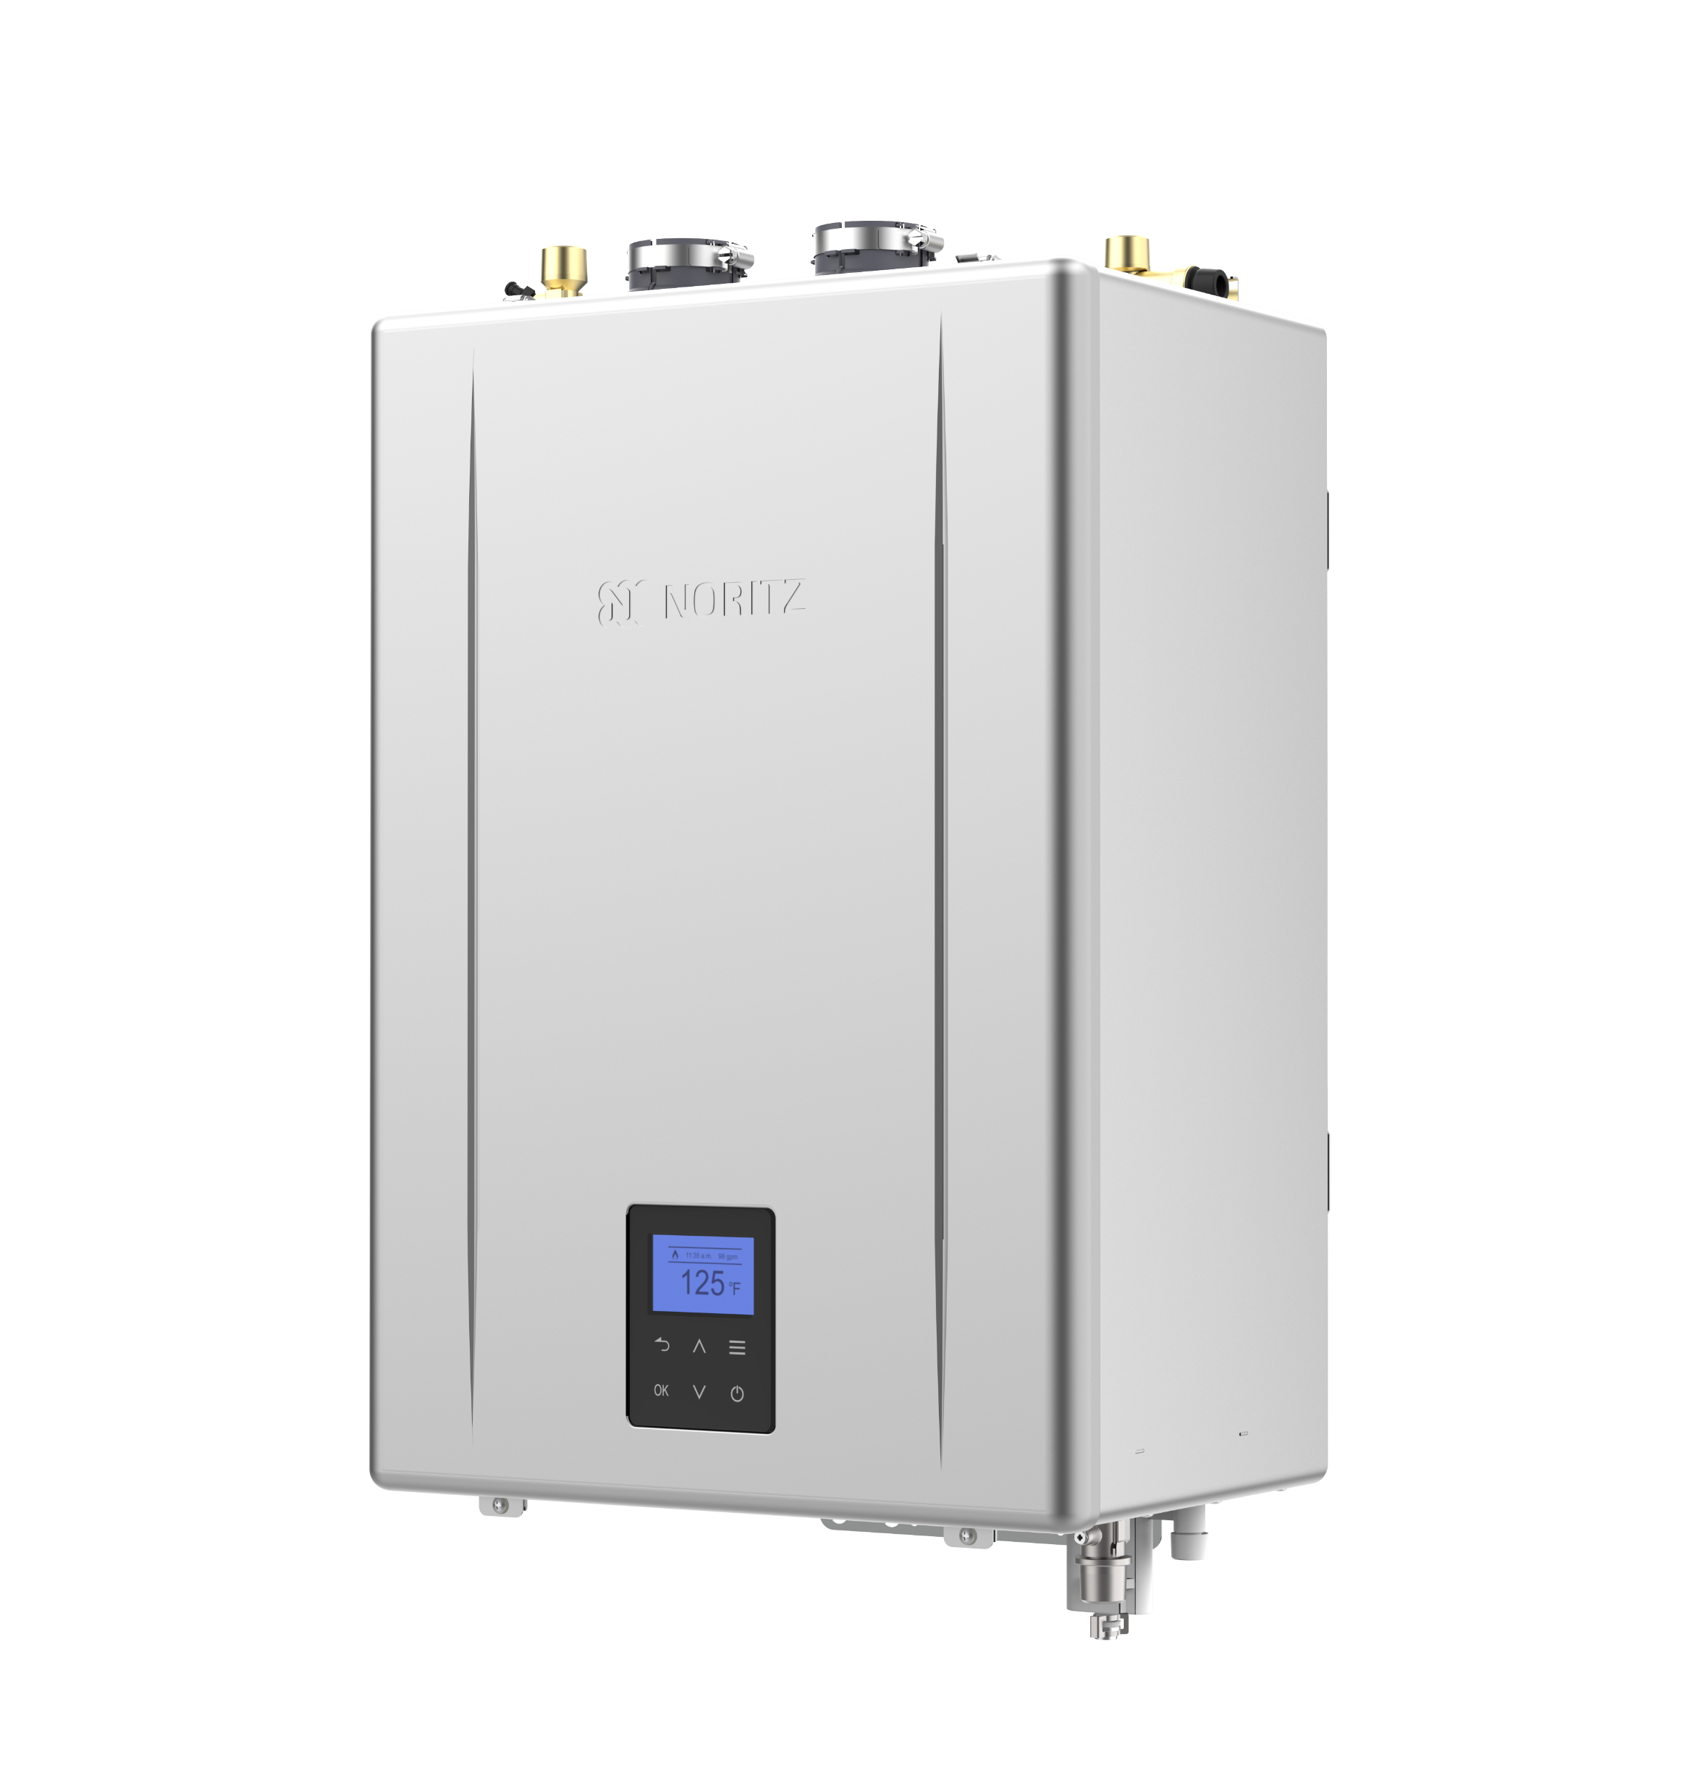
PROGRAMMING THE UNIT
Pro Series units no longer have physical dipswitches on the circuit board. All programming of the unit is done with the new EZ Start Plus App or the built-in operation panel.
Directions can be found in the manual

Slide 5
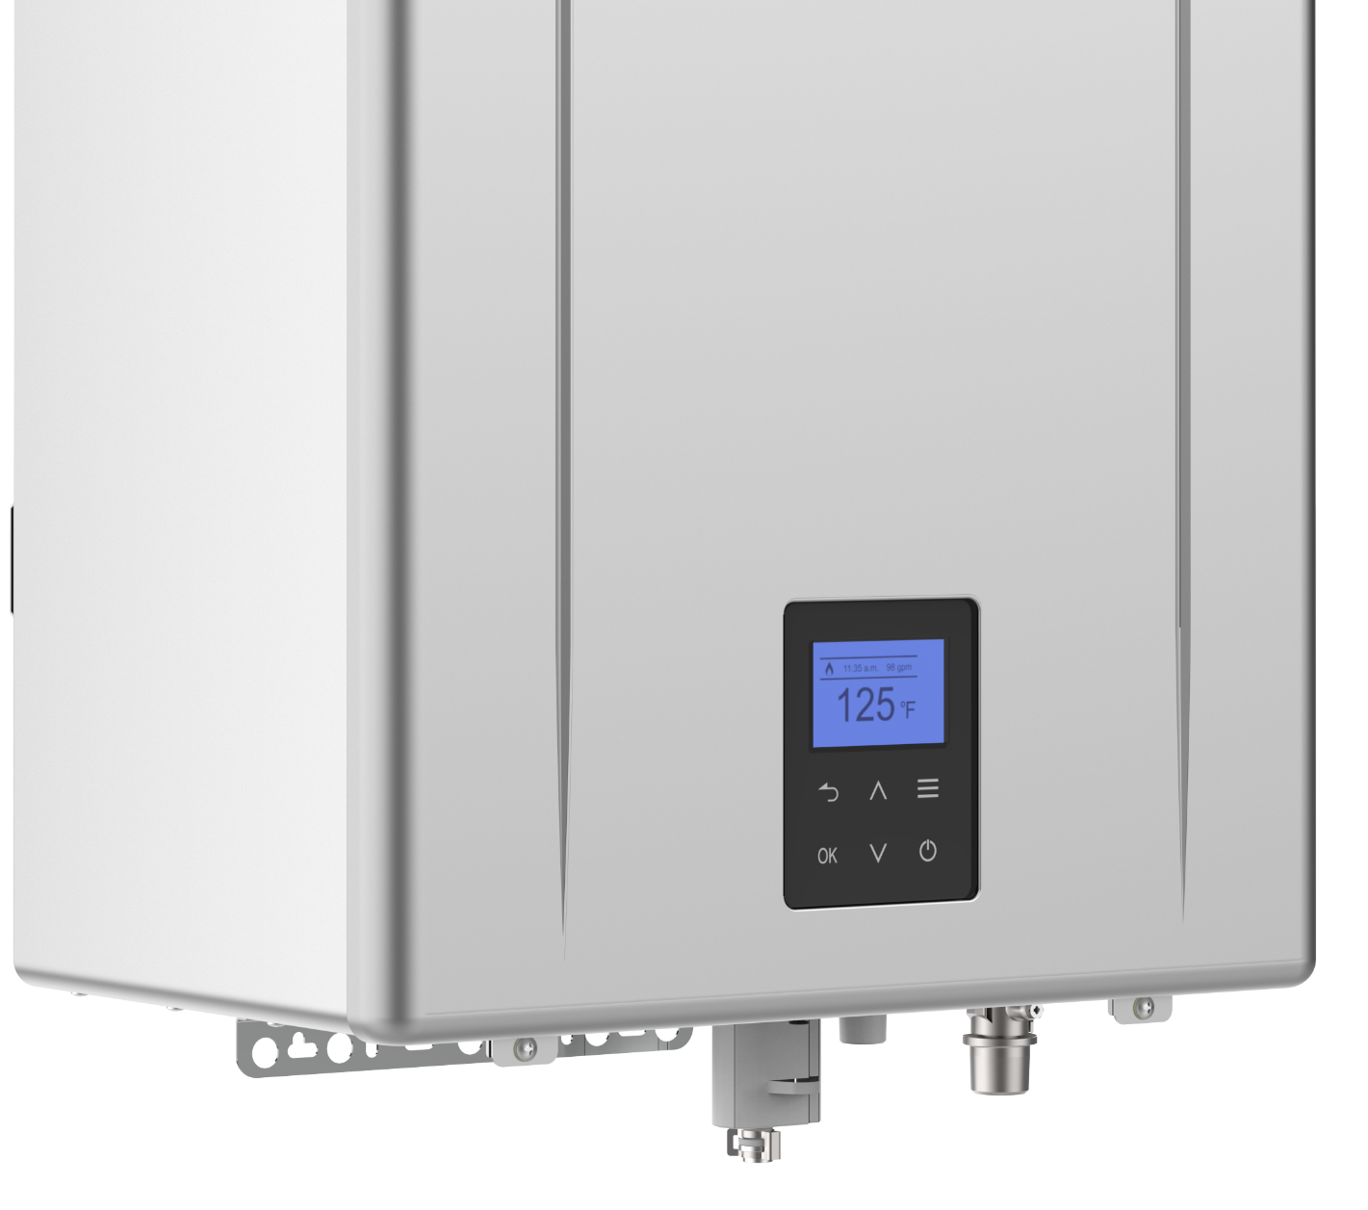
BUILT IN OPERATION PANEL
Displays temperature setting, service reminders and error codes. Also allows you to view maintenance monitors, error code history and change installation settings. The new operation panel makes the remote control a truly optional item.

Slide 6
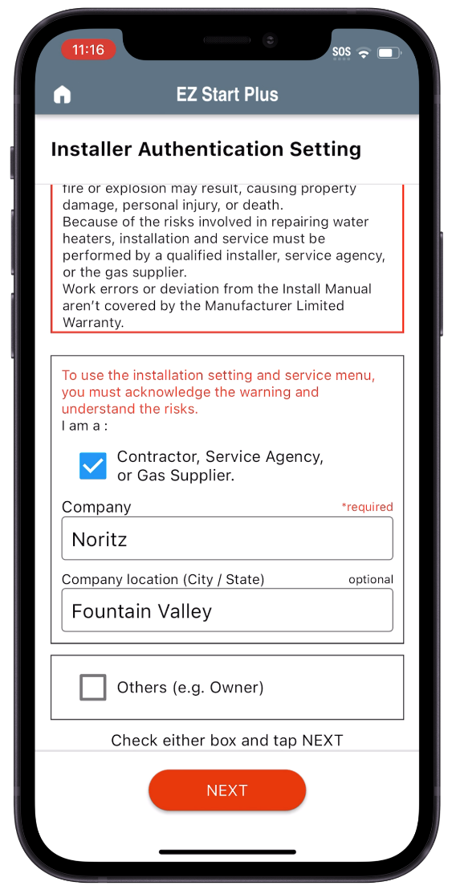
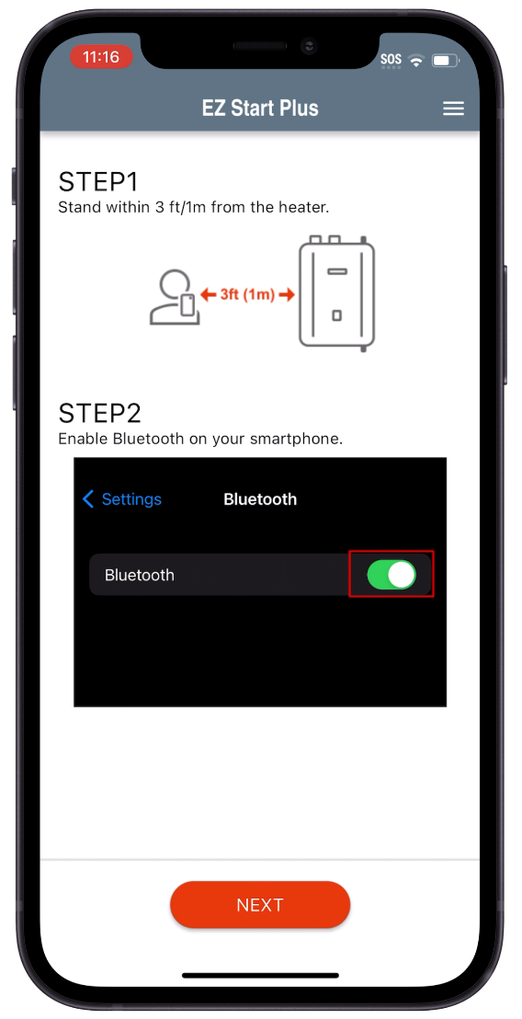
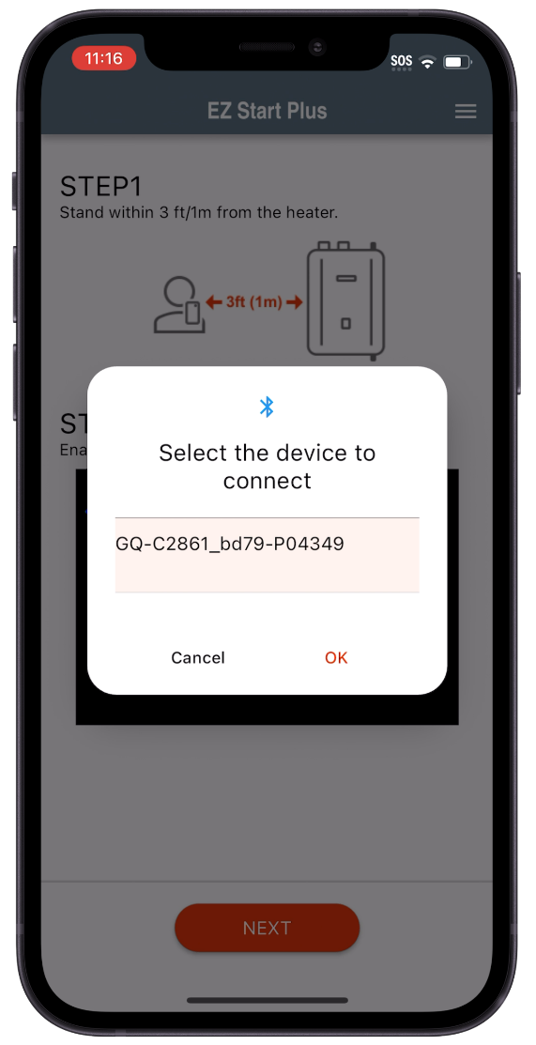
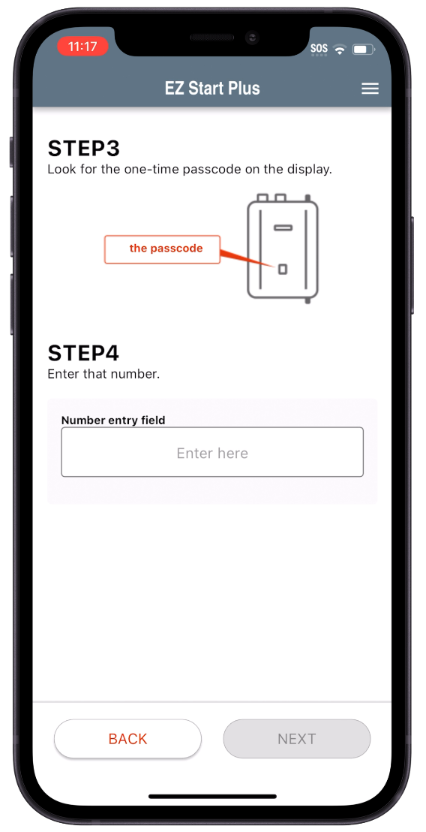
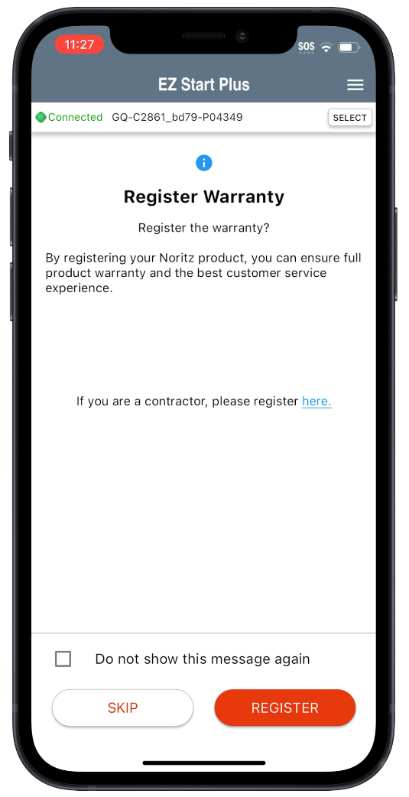

INITIAL SETUP
Open EZ Start Plus App and select Contractor
Make sure Bluetooth is ON
Select Unit then tap OK
Enter Passcode and tap “NEXT”
Register Warranty or skip
If you select Other (e.g. Owner) the Unit Settings and Trial Operation Functions are disabled

Slide 7
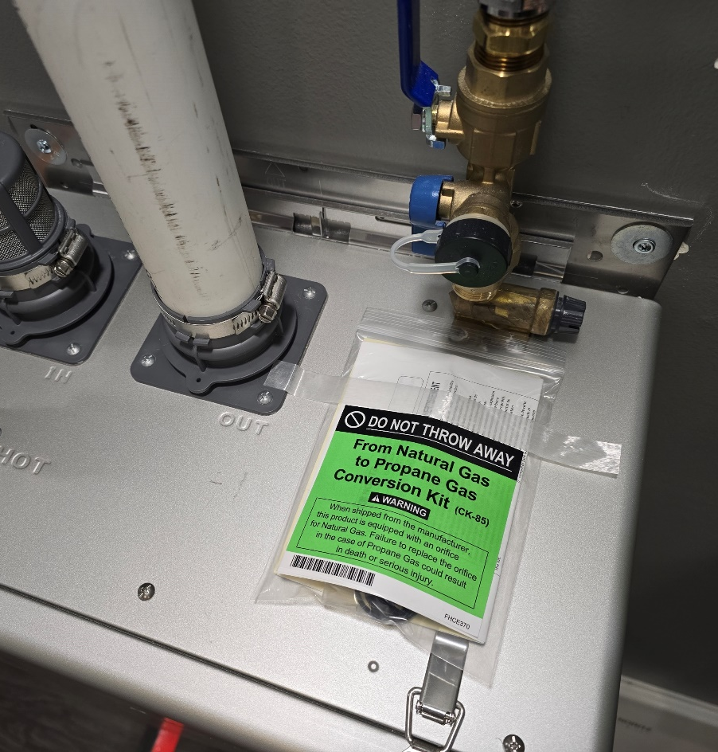
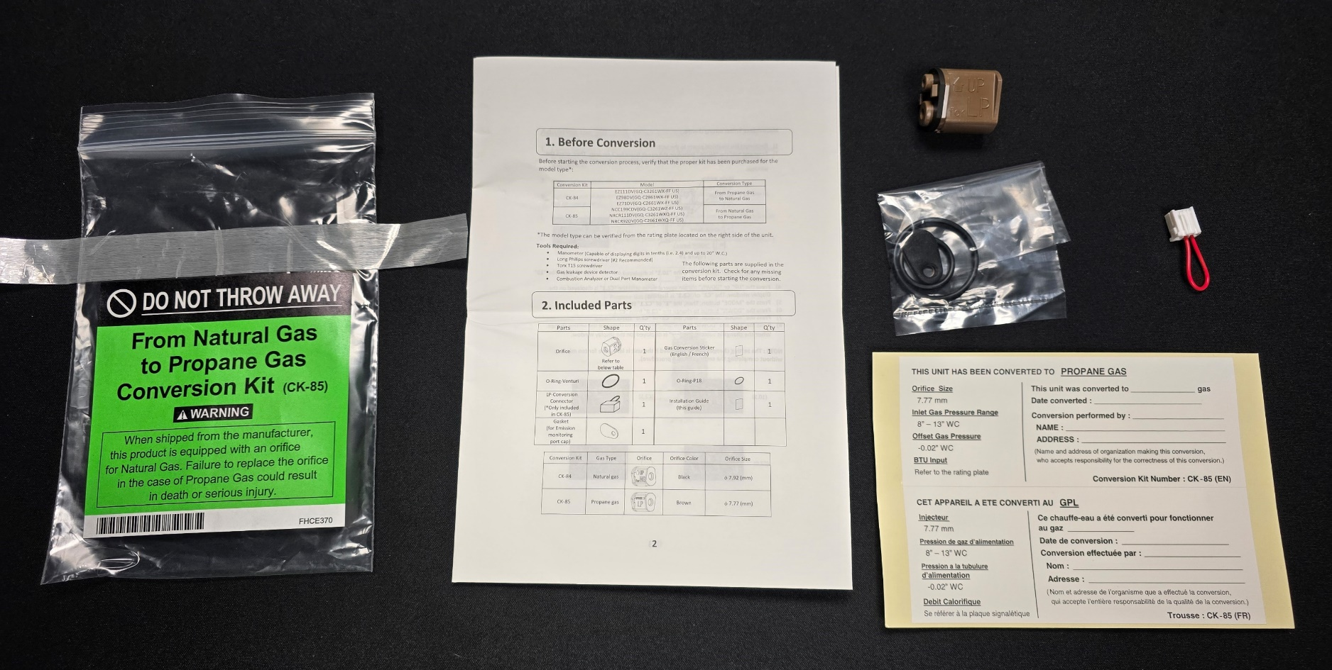
FIELD GAS CONVERSION
All Pro Series models are ready to be used with NG. If the jobsite has LP, a simple field gas conversion can be performed without the need to purchase any additional parts. Conversion is EZ and can be done in about 5 minutes.
Conversion Kit taped to top of unit
Contents of LP Conversion Kit

Slide 8
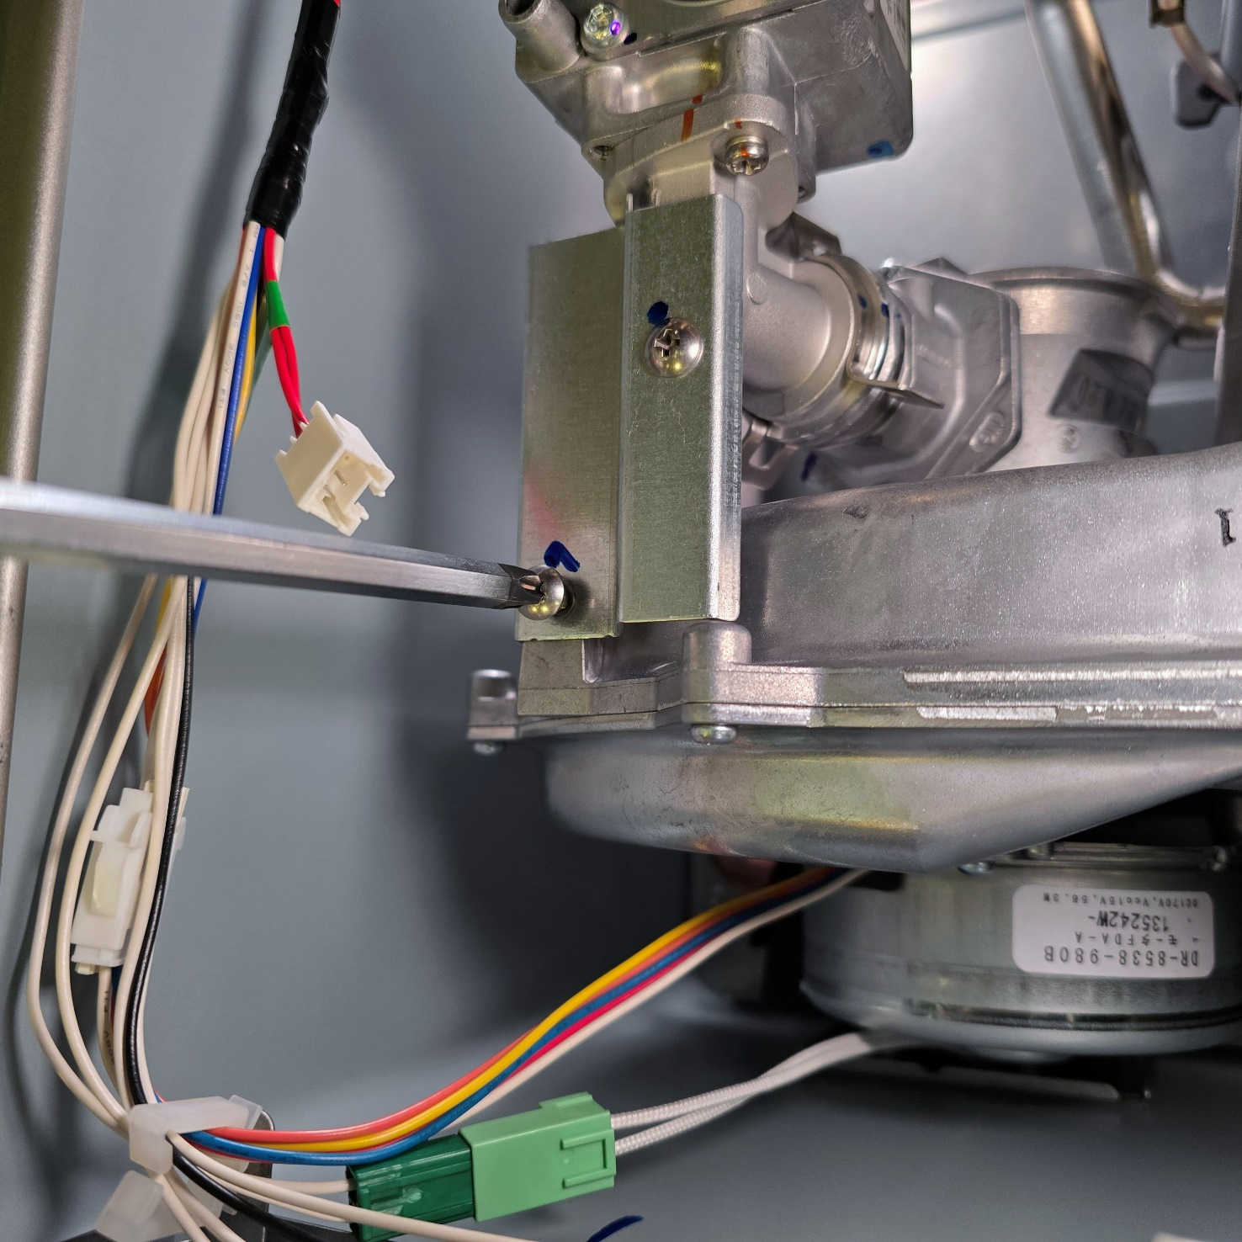
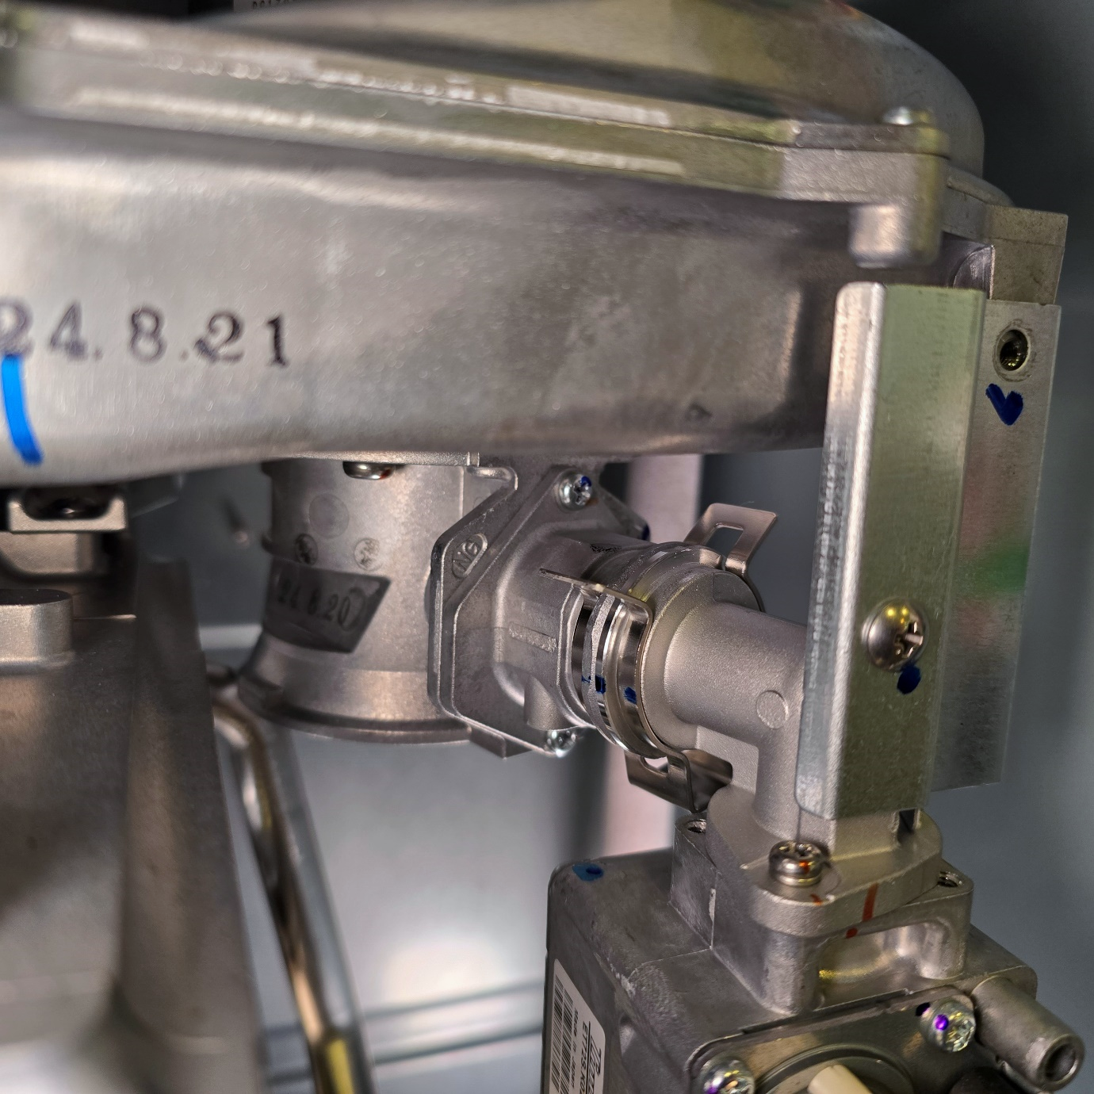
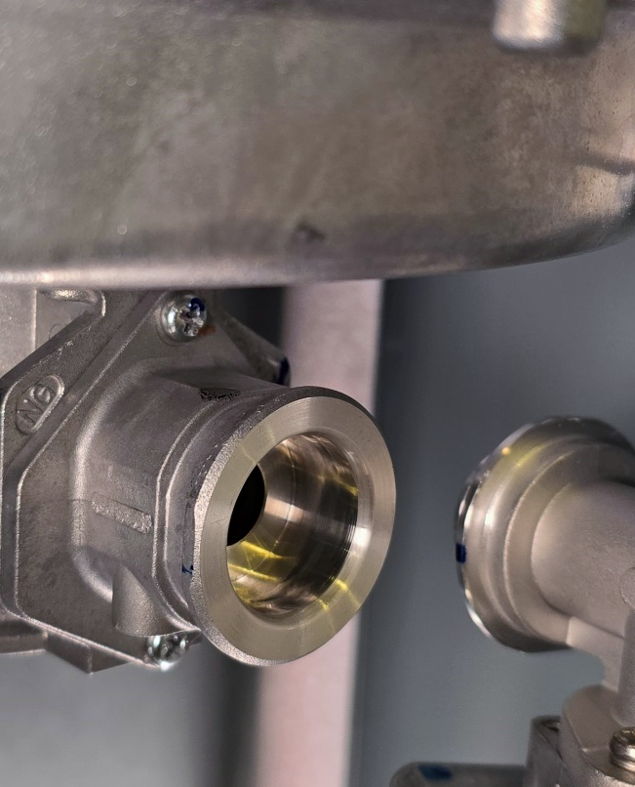
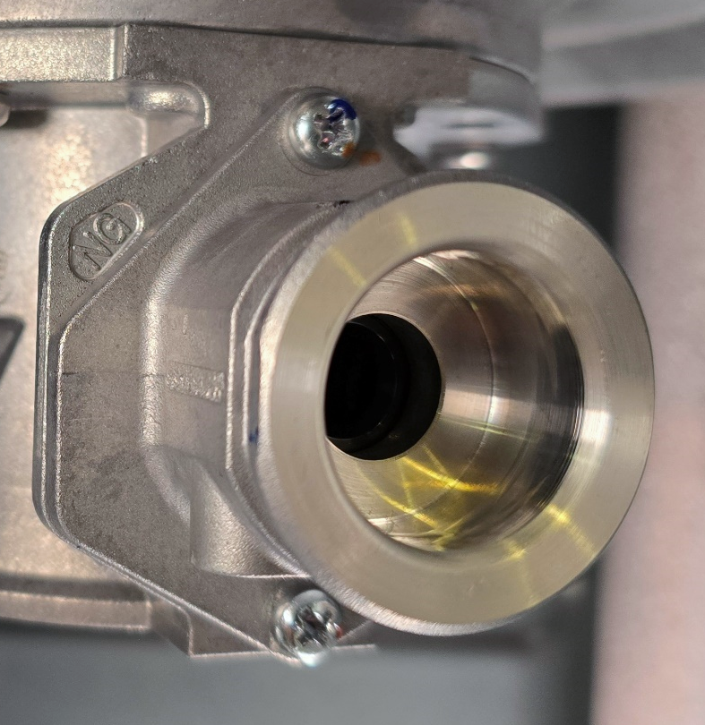
FIELD GAS CONVERSION
Step 1
Step 2
Step 3
Step 4
Remove screw
Remove the c-clip
Carefully remove gas fitting
Remove 2 screws securing venturi fitting

Slide 9
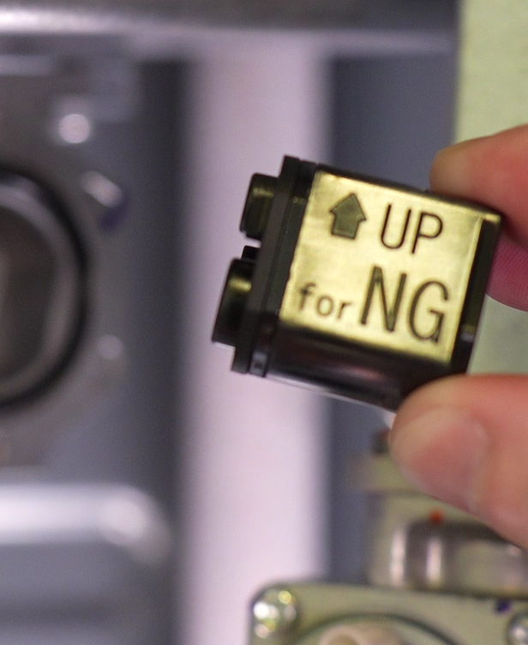
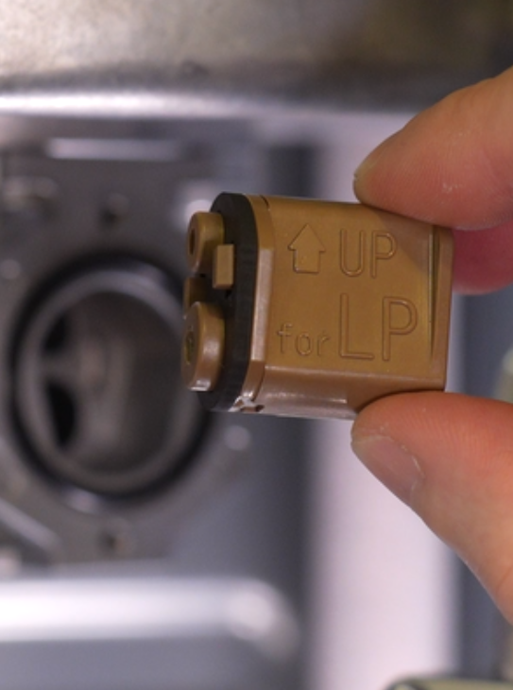
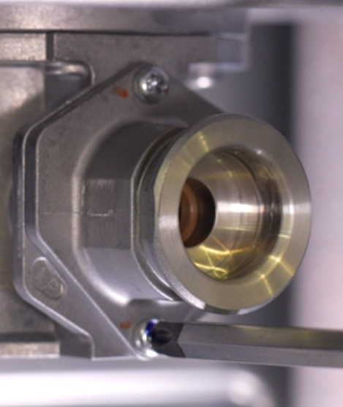
FIELD GAS CONVERSION
Step 5
Step 6
Step 7
Step 8
GASKET
O-RING
Remove NG orifice
Insert LP orifice
(make sure o-ring and gasket aren’t lost or damaged)
Secure venturi fitting
Insert gas fitting, secure c-clip and screw

Slide 10
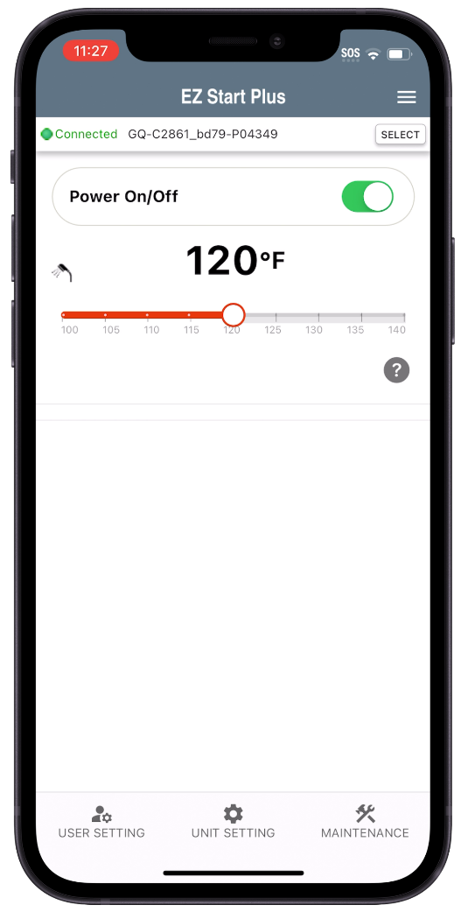
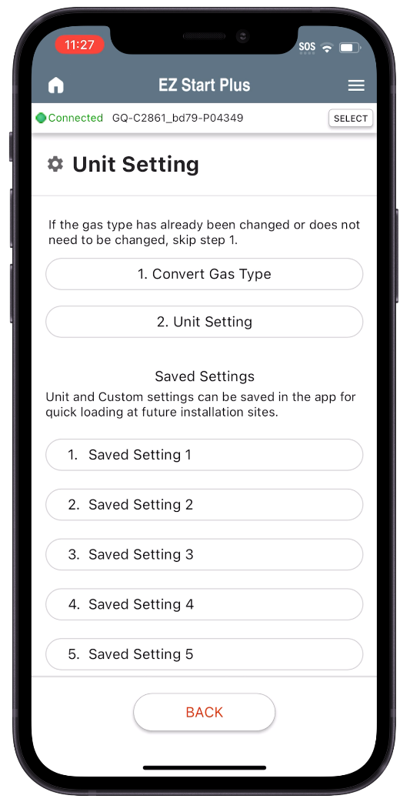
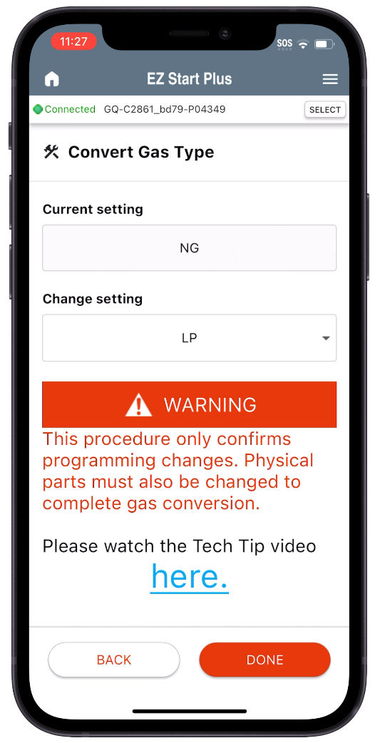
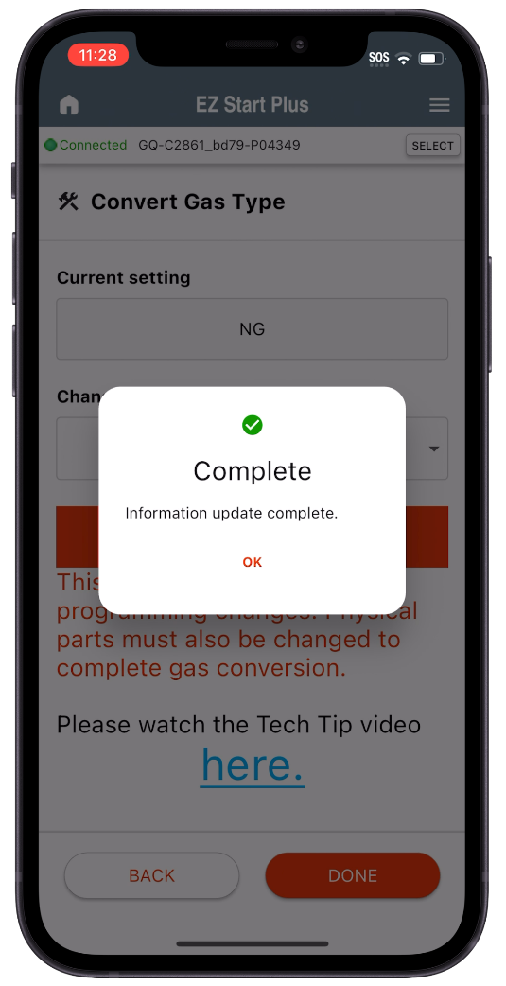
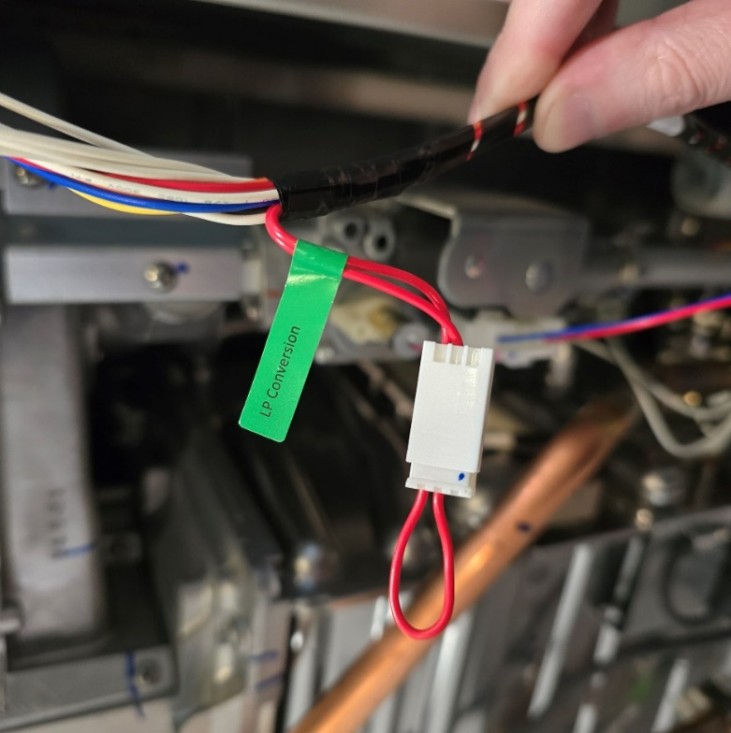
FIELD GAS CONVERSION
Step 9
Step 10 (continued): Changing gas type to LP with EZ Start Plus App
Plug in LP conversion connector
*Operation Panel can also be used to convert gas type, see gas conversion directions included with unit
Tap “Unit Setting”
Tap “Convert Gas Type”
Tap Change Setting, Tap LP then tap “DONE”
After a few seconds it should show complete

Slide 11
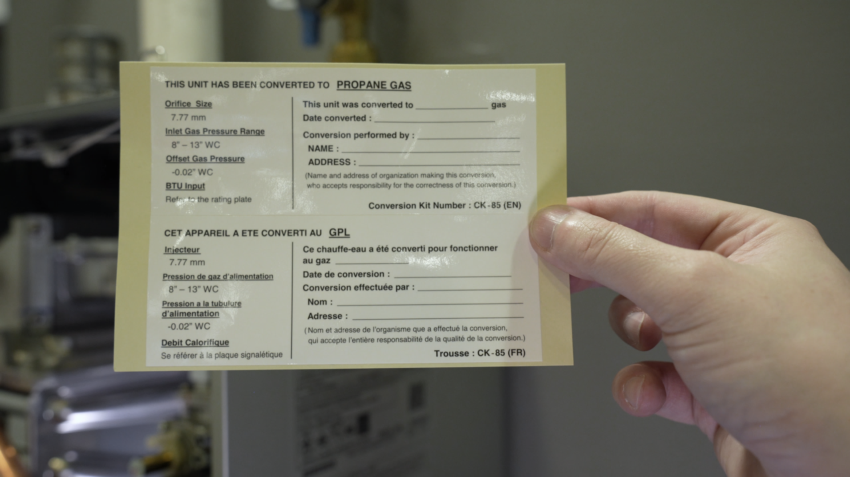
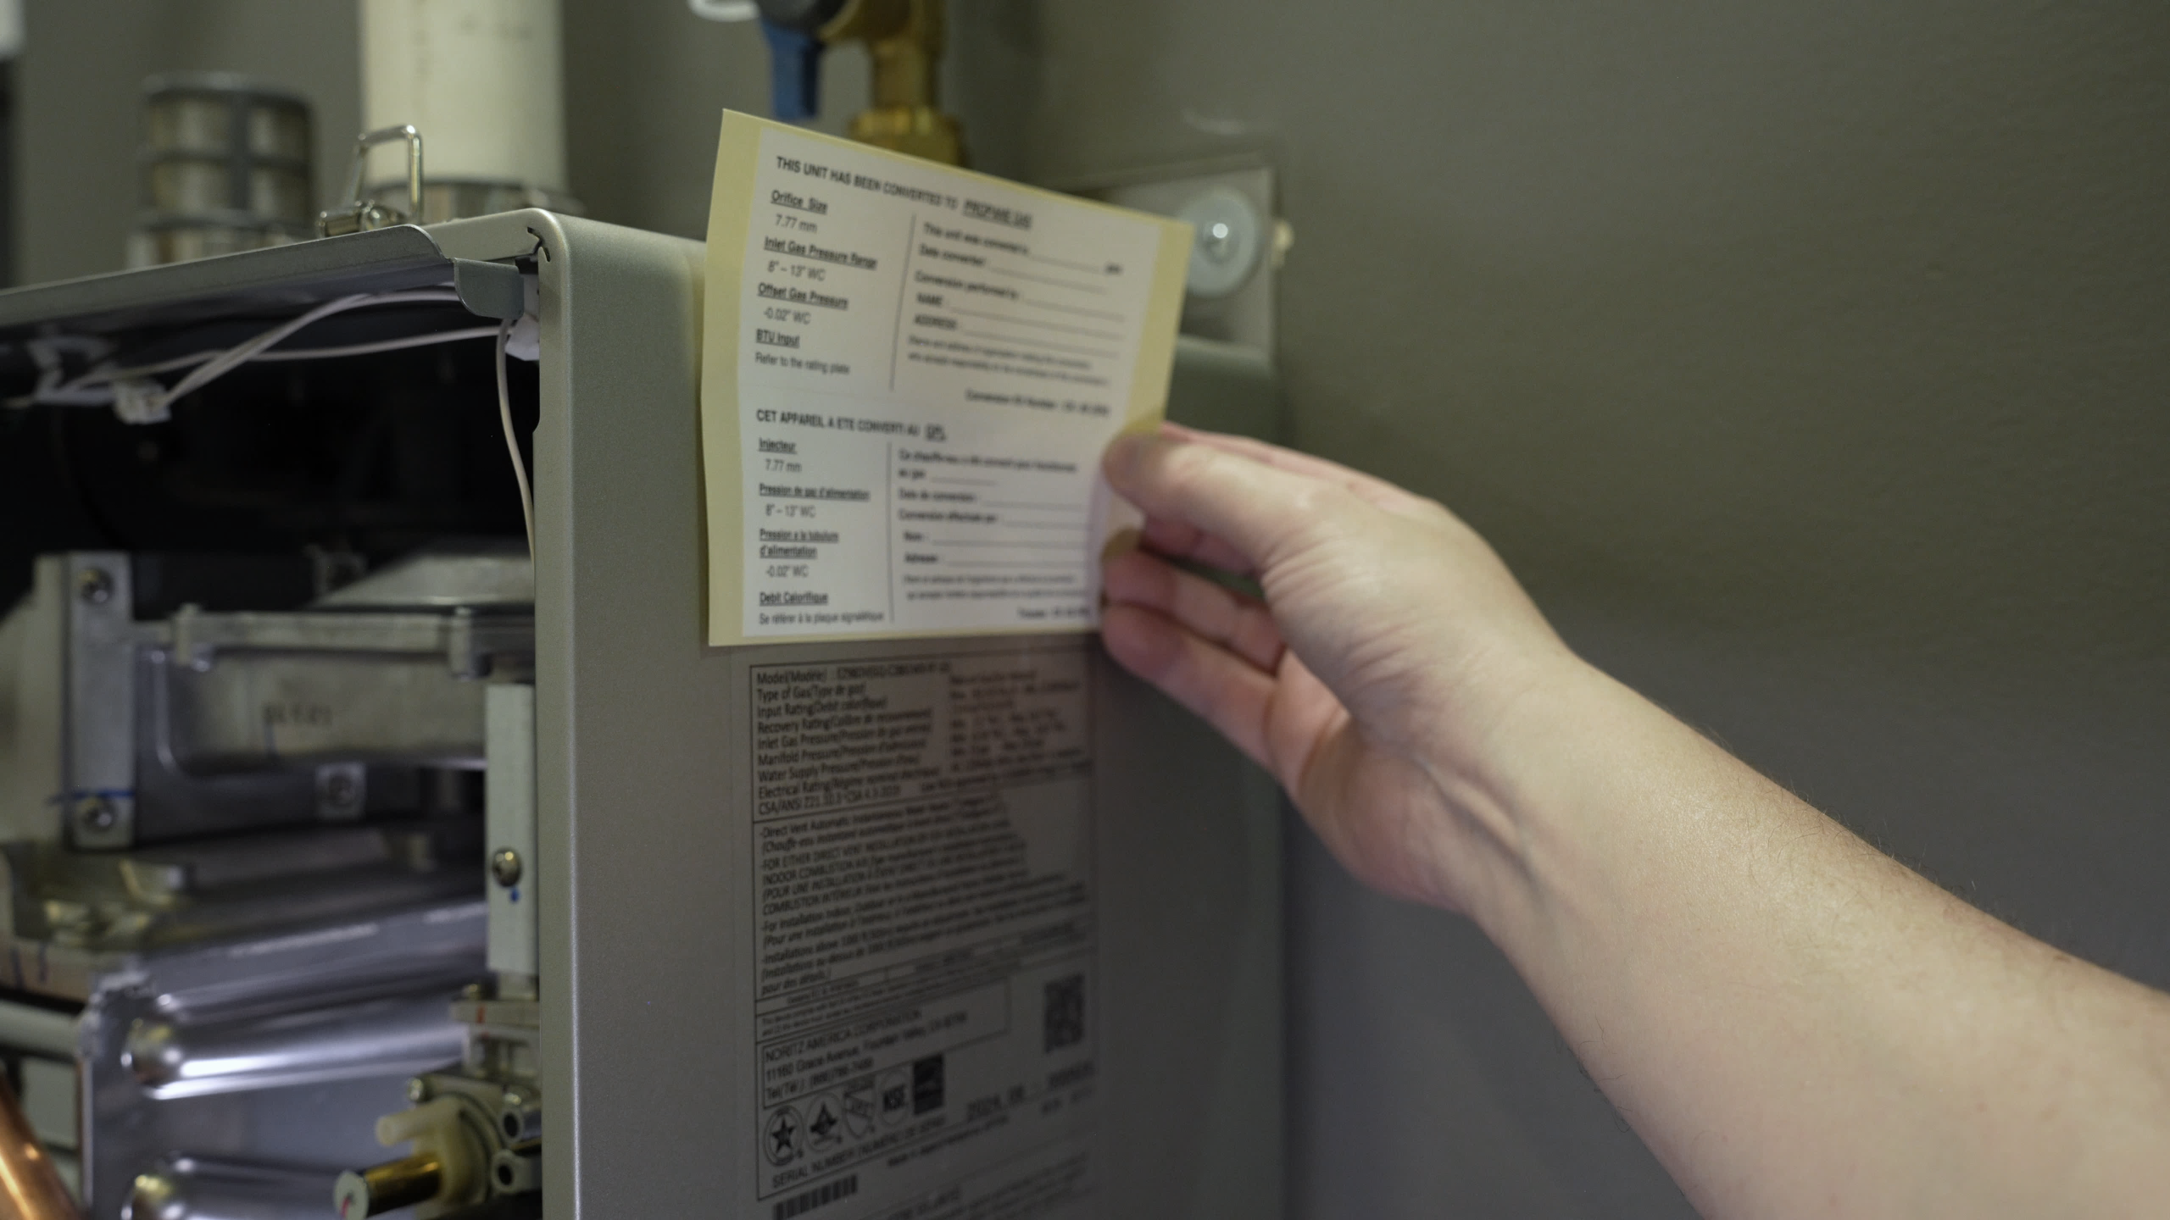
FIELD GAS CONVERSION
MAKE SURE TO FILL OUT AND ATTATCH GAS CONVERSION STICKER TO UNIT

Slide 12
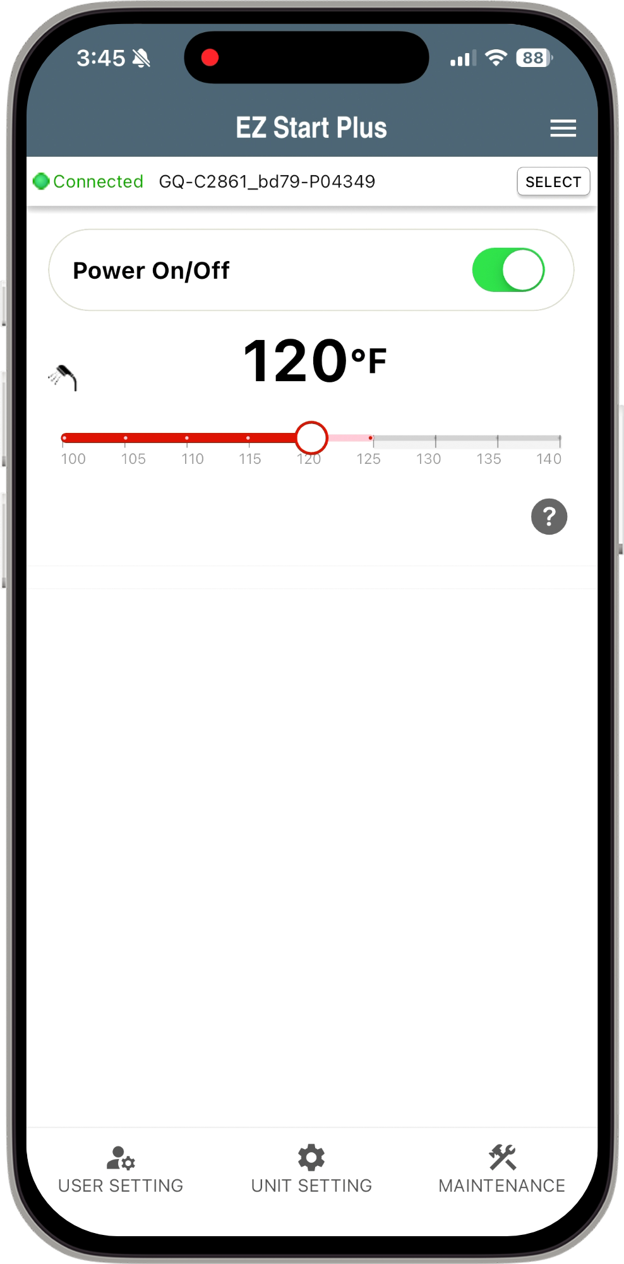
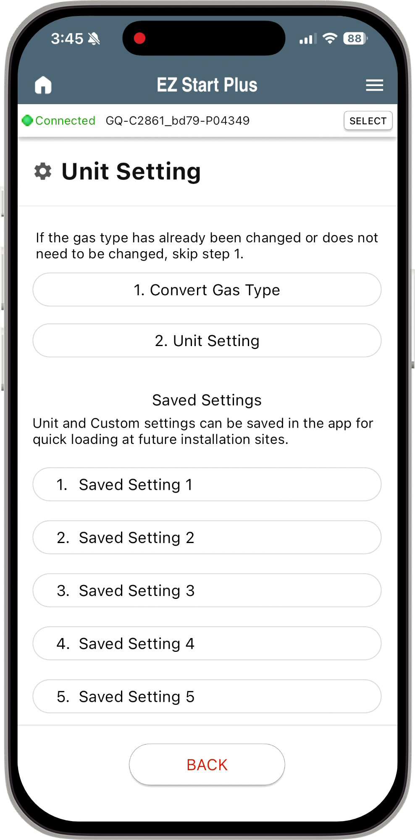
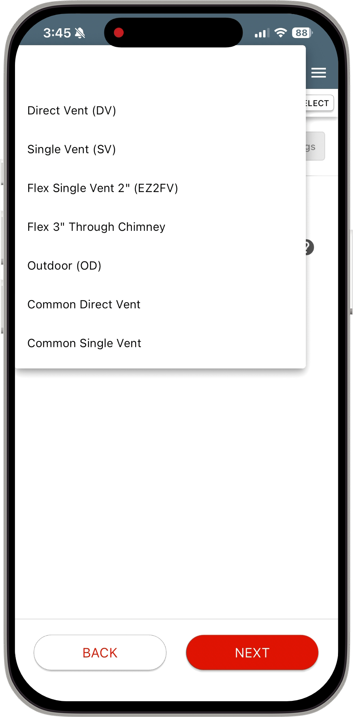
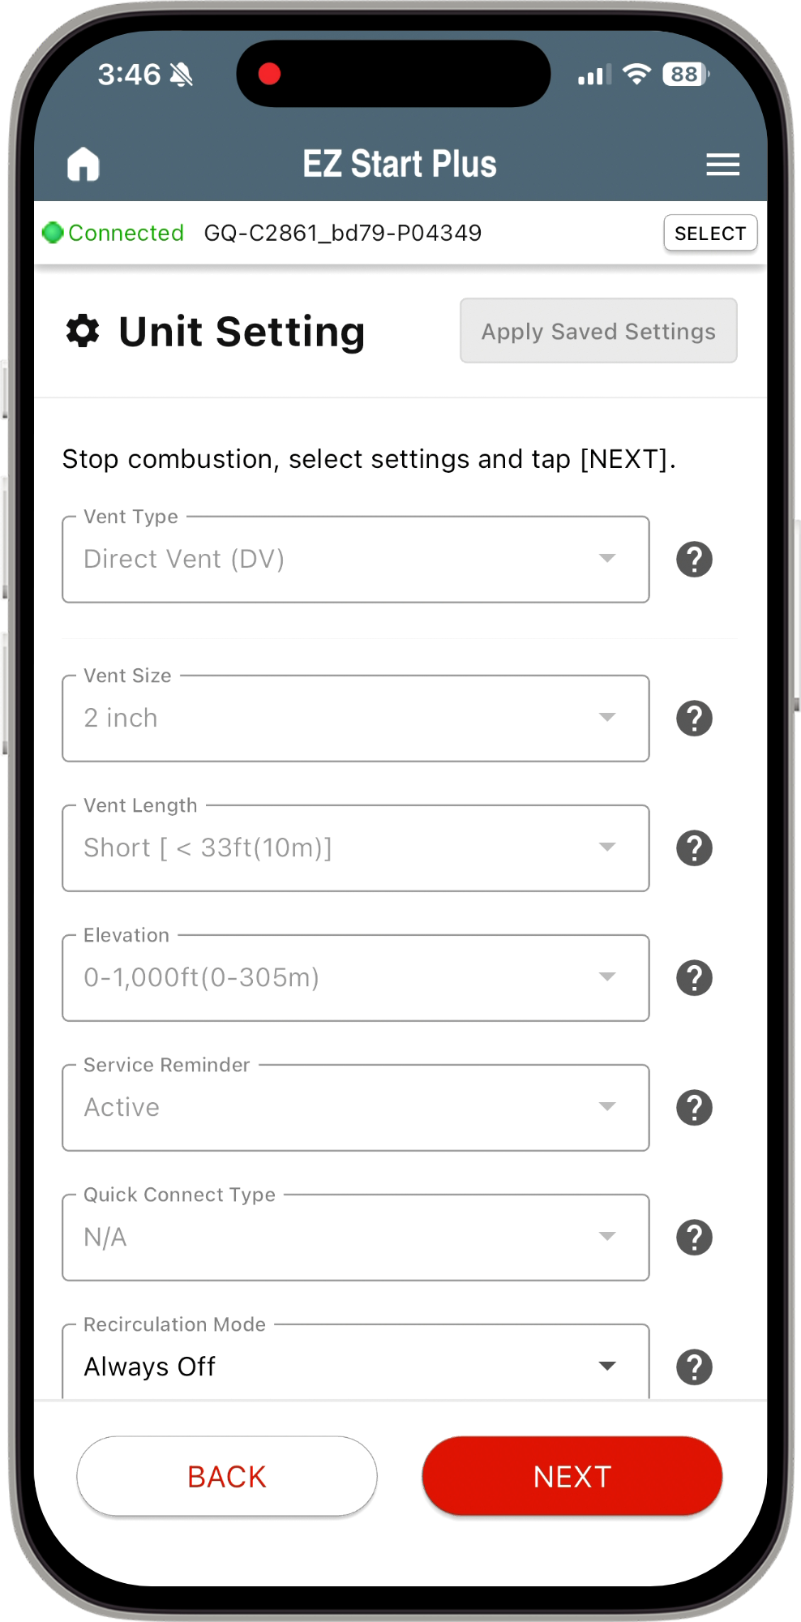
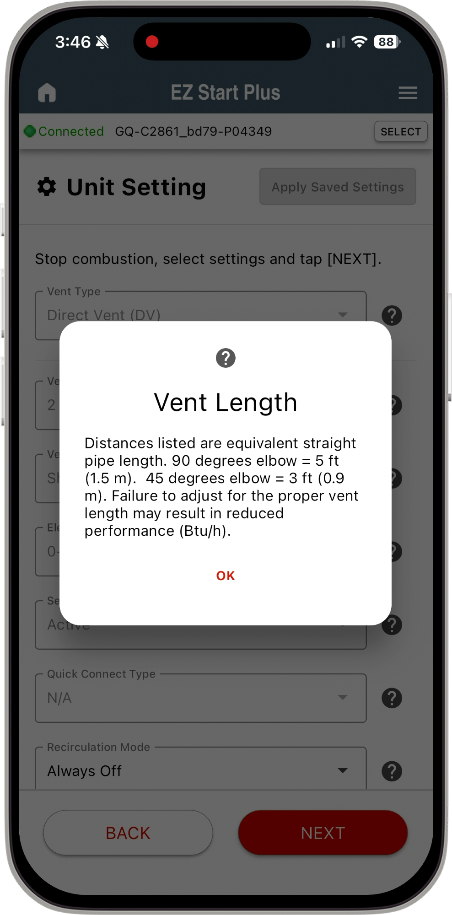
UNIT SETTINGS
Tap “Unit Setting”
Tap “2. Unit Setting”
Select Options Based on Installation then tap NEXT
Tap “?” To get additional information on setting
Tap OK to Close

Slide 13
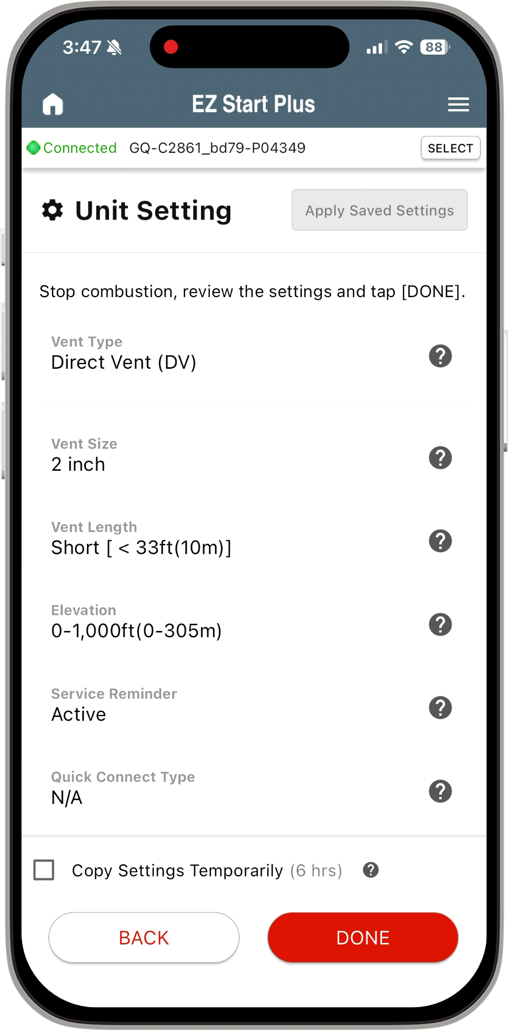
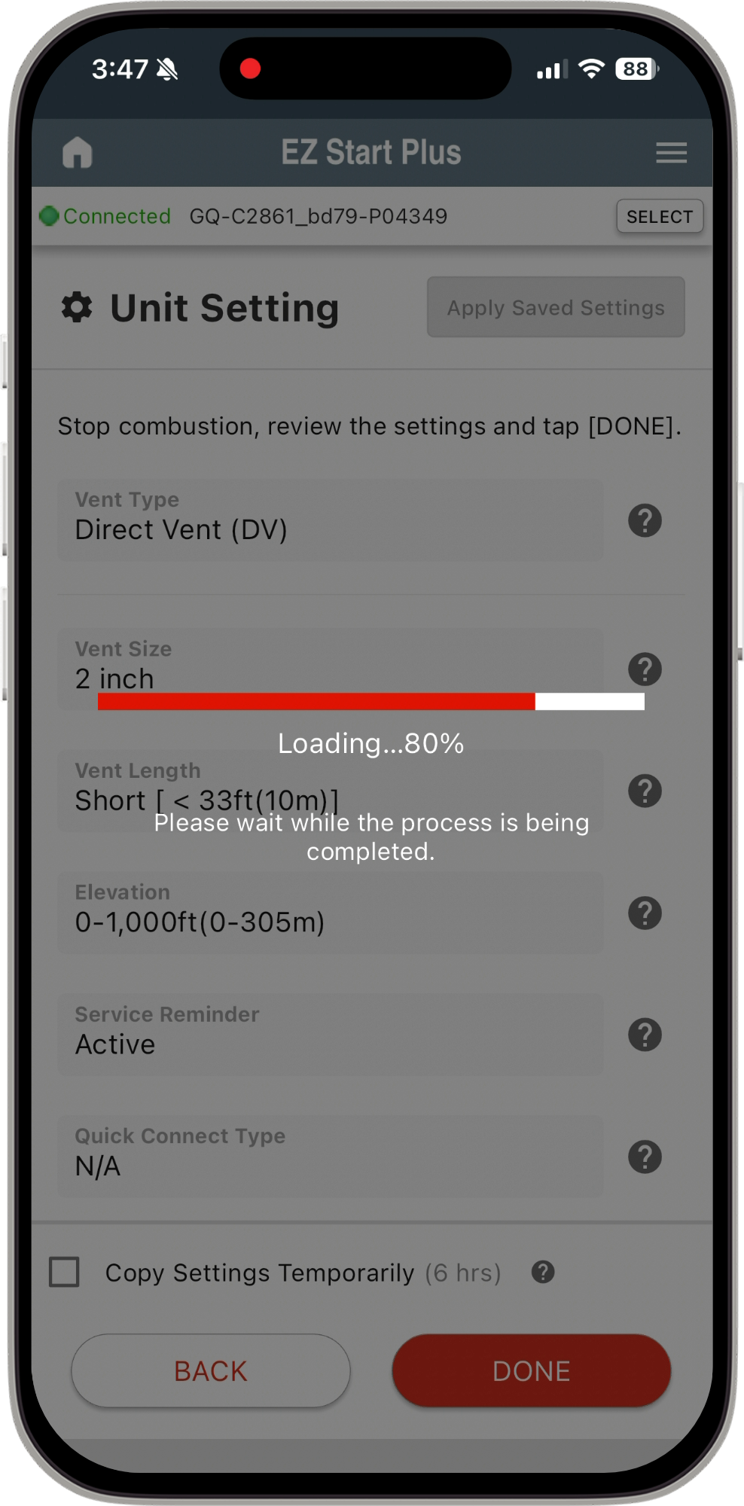
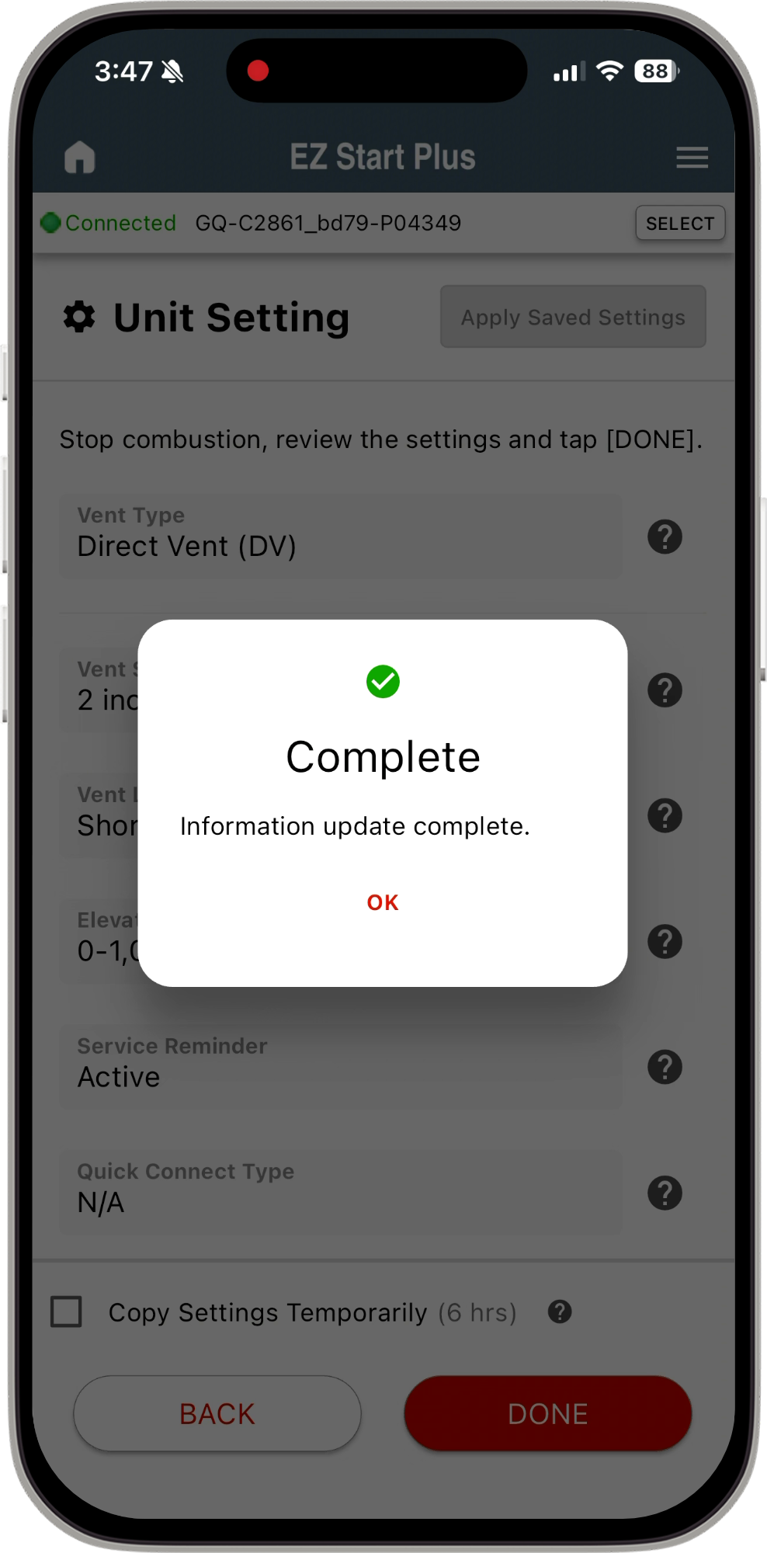
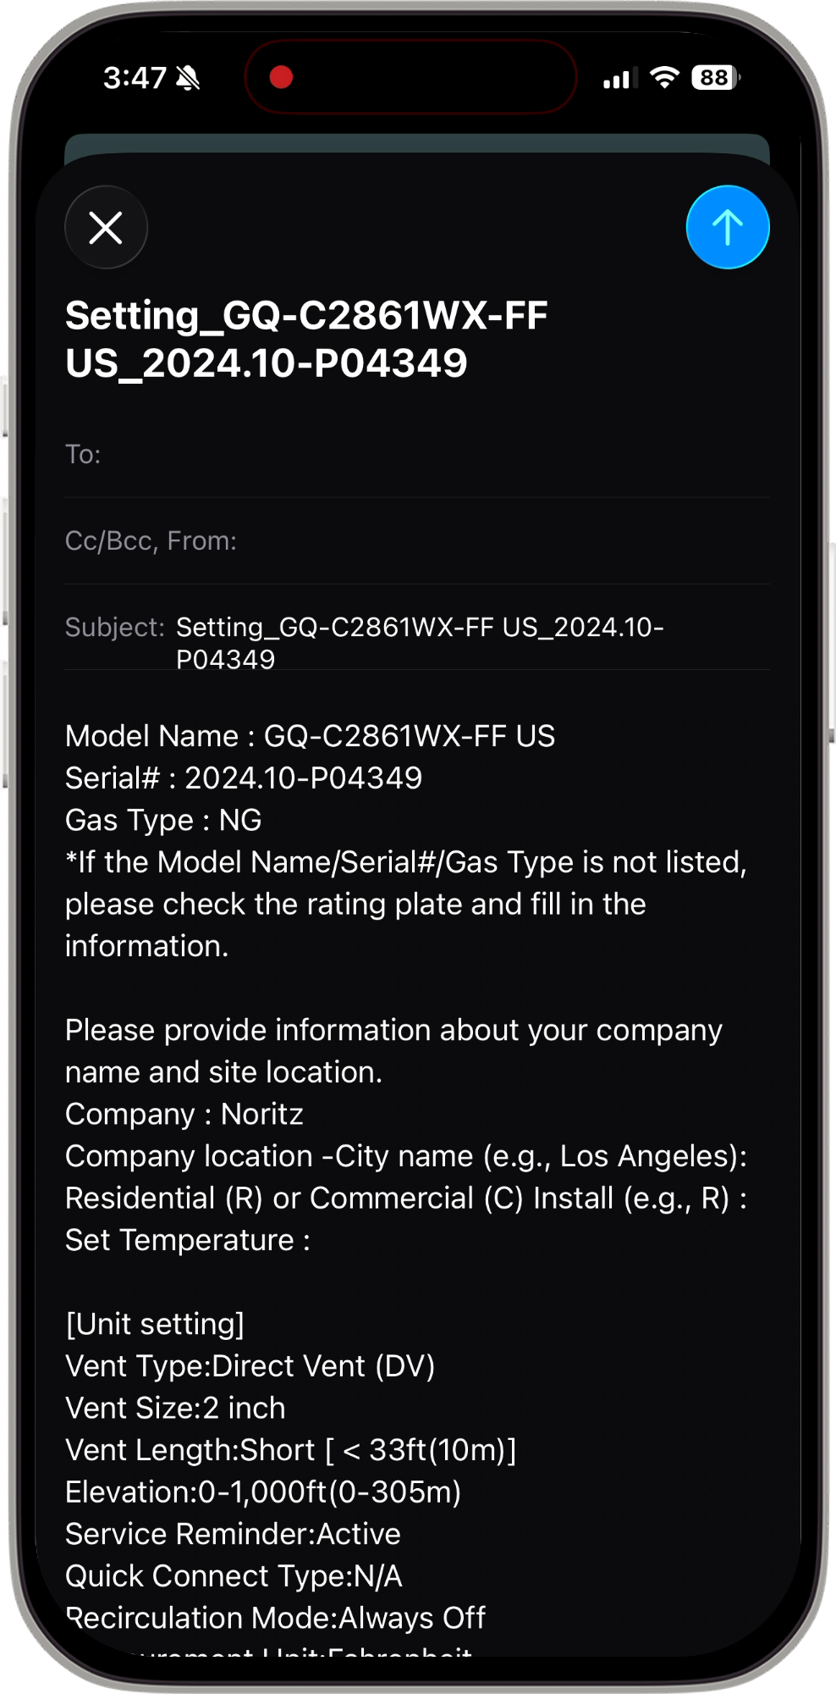
UNIT SETTINGS
Upon completion, email app will open to allow emailing the installation settings to Noritz. This is not required, but very helpful for Customer Care.
Review your selections then tap DONE
Please fill out these items if you opt in to send
App programs unit
Tap OK when complete
If you check the Copy Settings Temporarily, you can use the Apply Saved Settings for 6 hours.

Slide 14

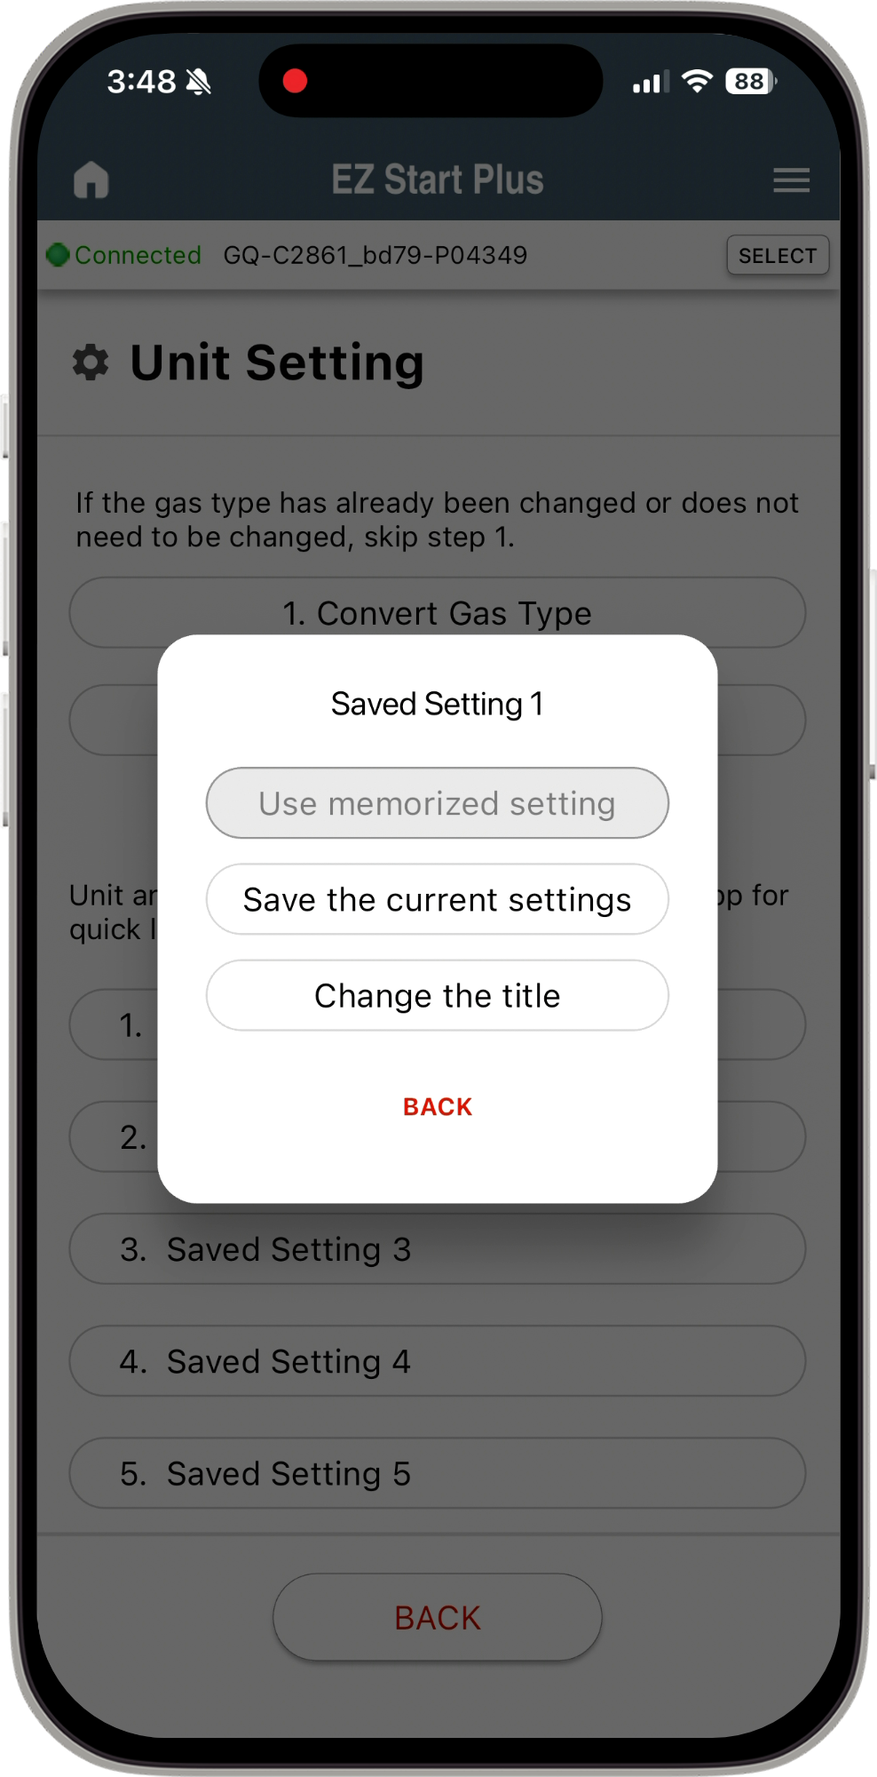
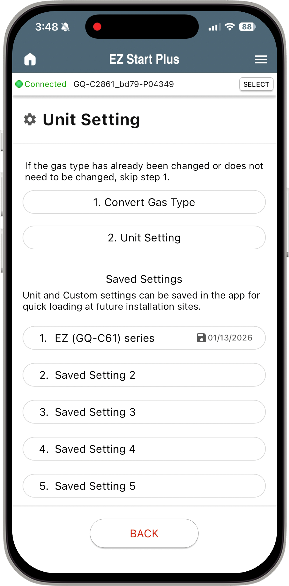
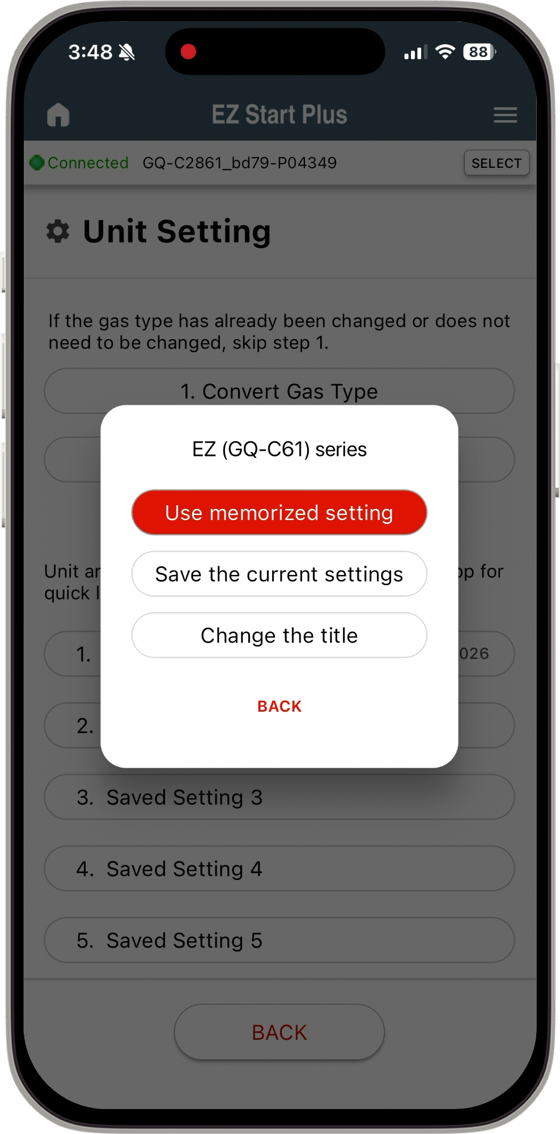
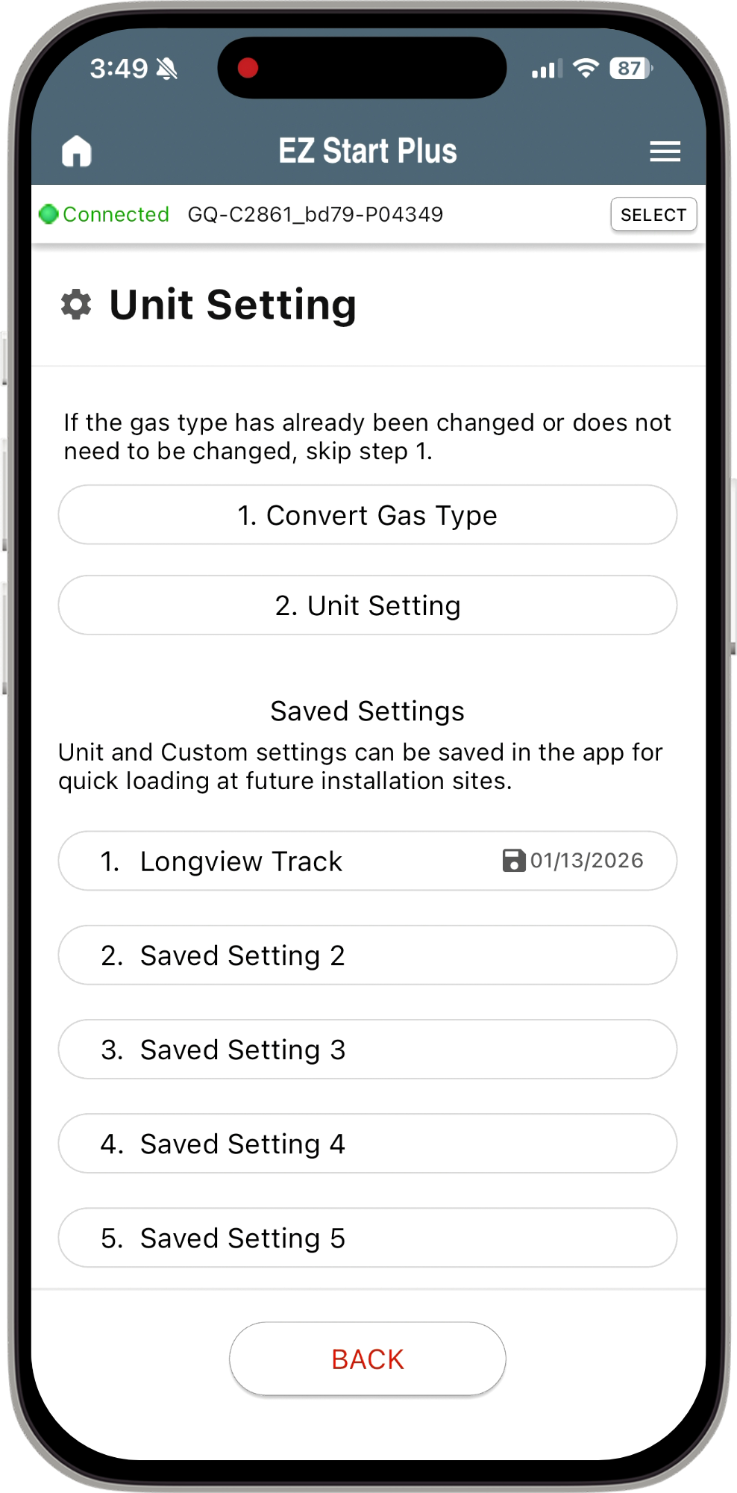
SAVED SETTINGS
Tap “Saved Setting 1”
Tap “Save the current settings”
The App will save model name and date in title
To rename title Tap “Change the title”
Type in name you want to reference the settings

Slide 15
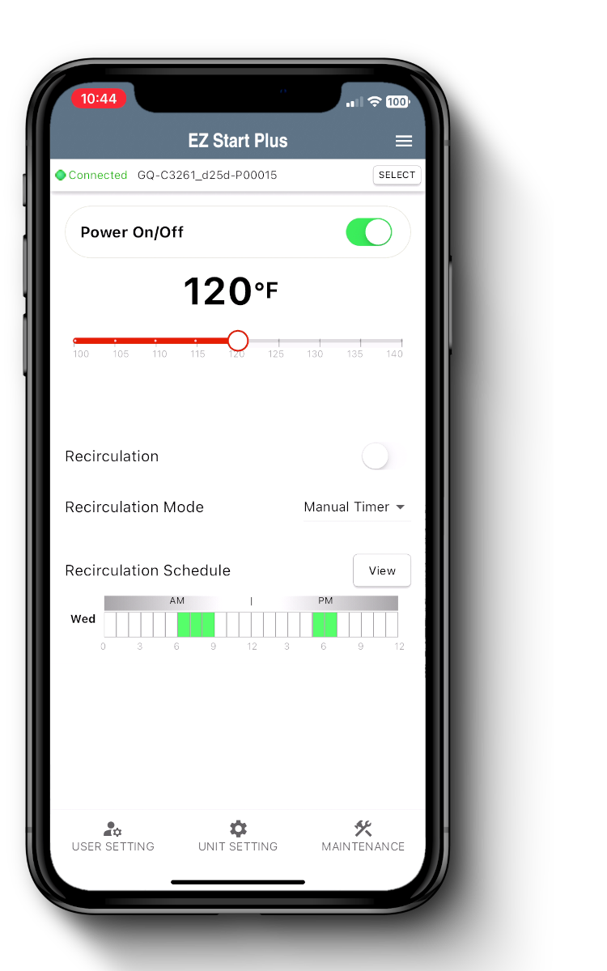
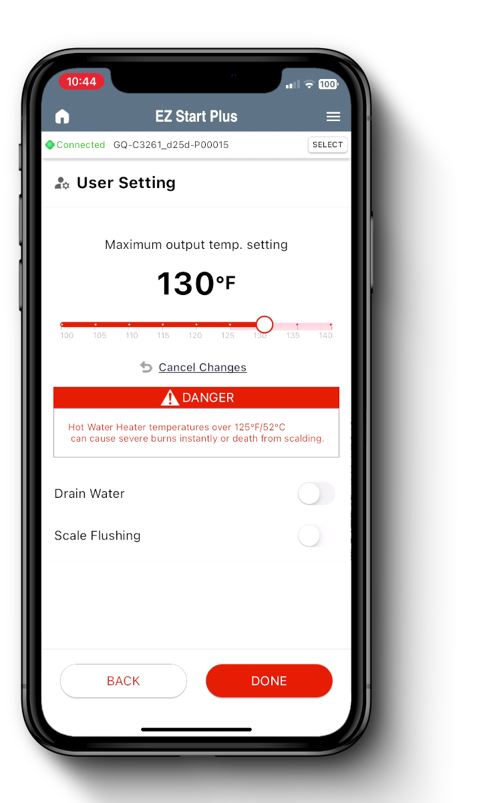
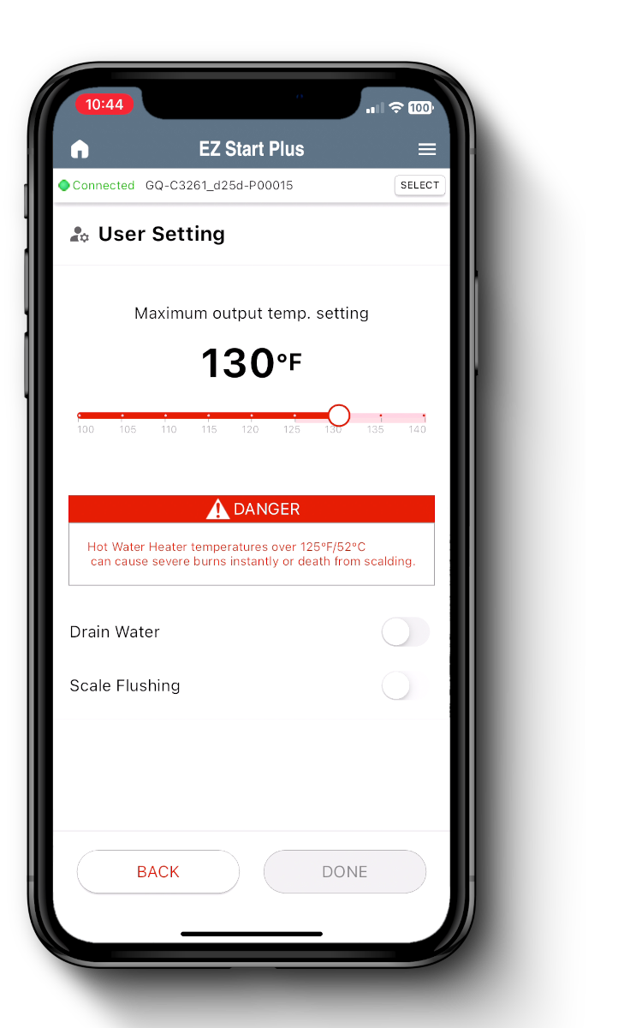
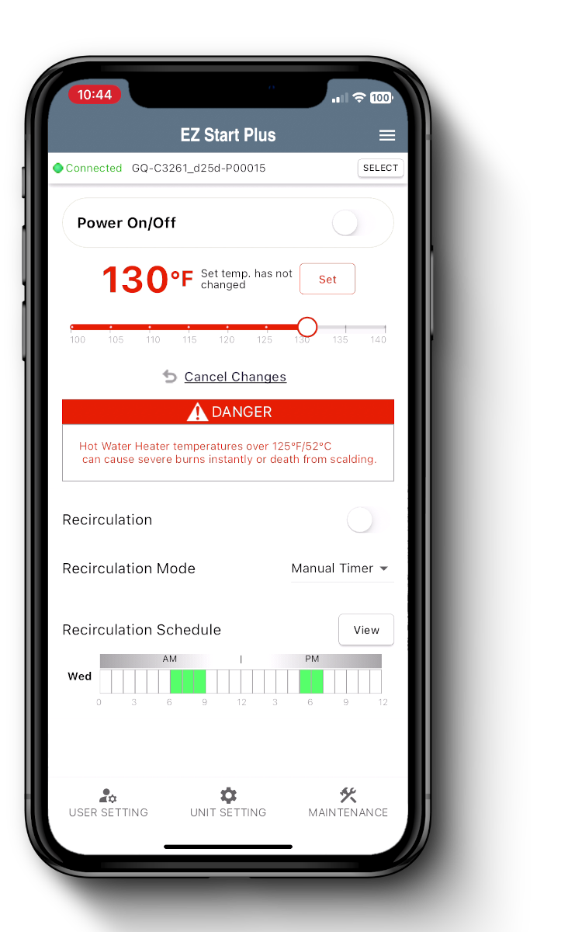
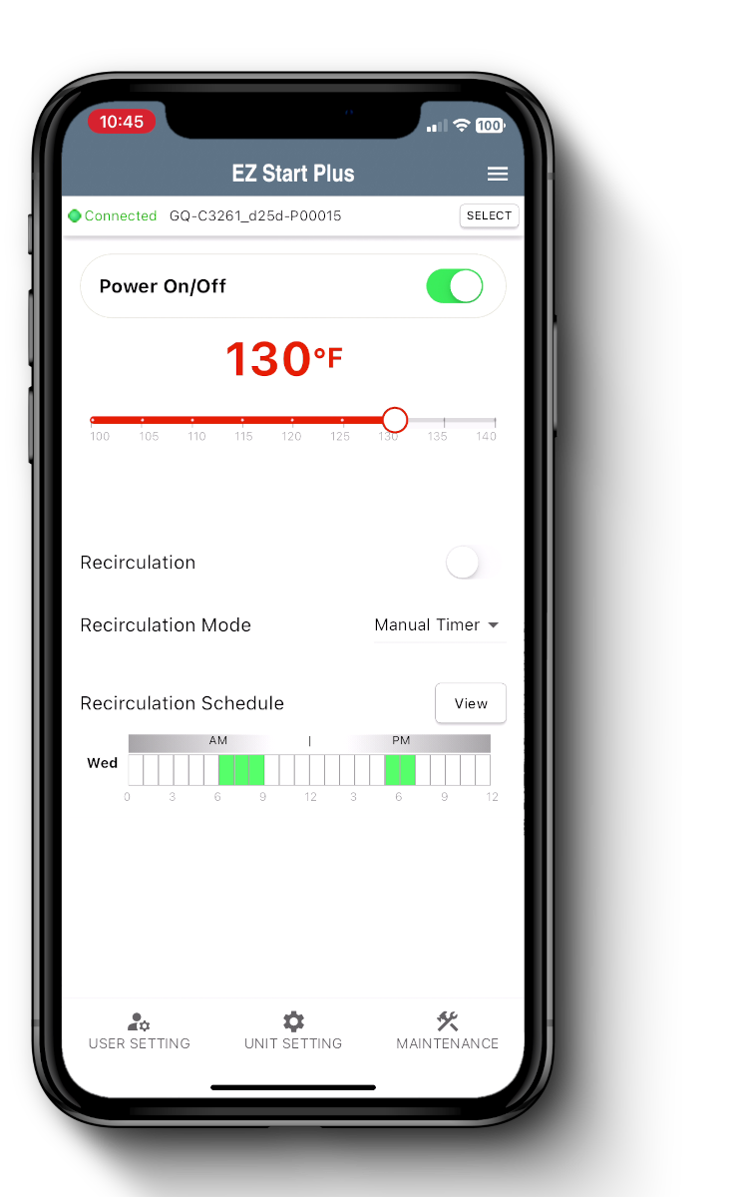

USER SETTINGS
Residential units are limited to 120 by default but they can be bypassed following these steps.
Adjusting the maximum output temperature settings
Power OFF then tap User Settings
Adjust Max Temp then tap Done
Tap Home icon to go back to home page
Adjust Temp then tap Set
Tap the power button to turn back ON
User Setting have a Drain Water and Scale Flushing Feature

Slide 16
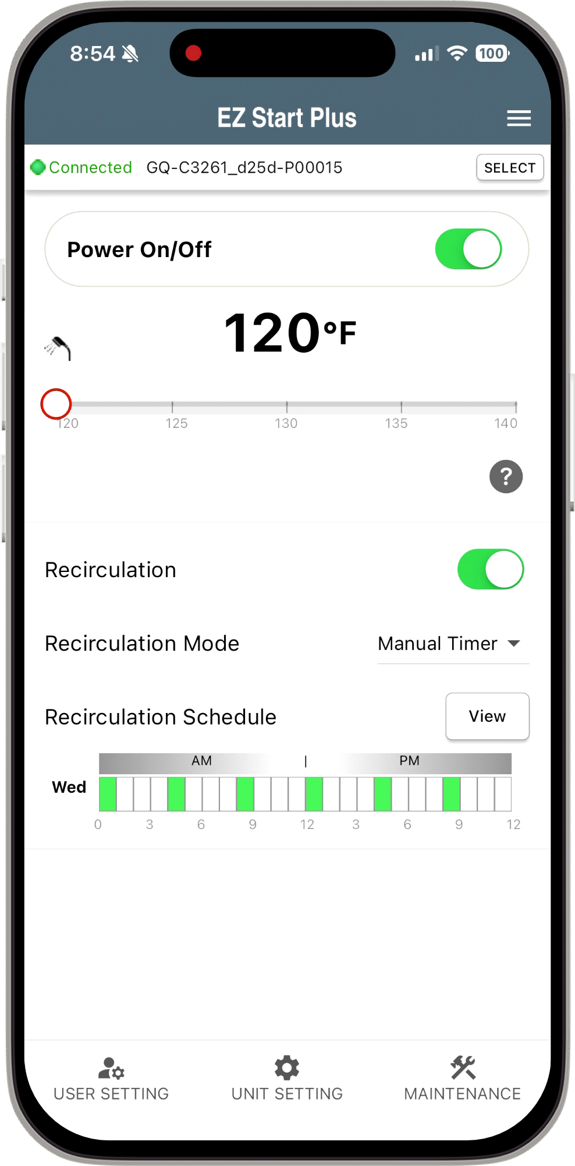
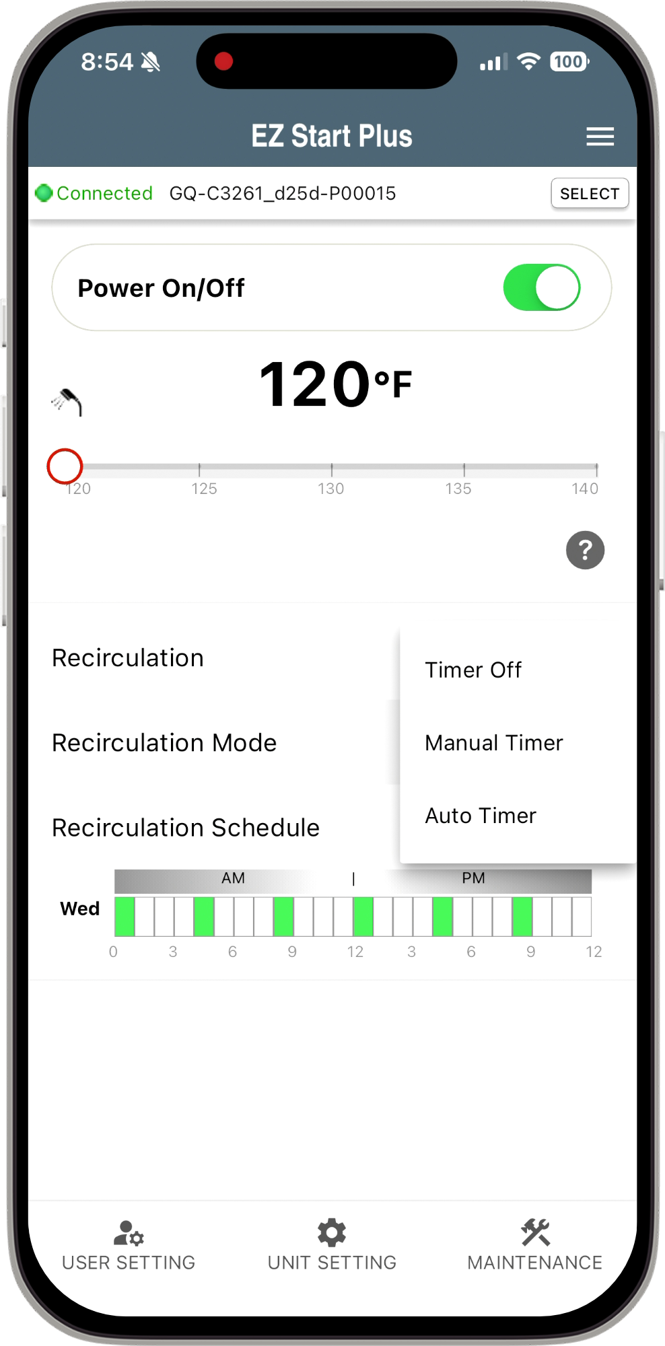



RECIRC TIMER SETTINGS
Select Type of Recirculation Mode*
The “View” button shows the schedule
Highlight the times you want recirculation running in RED
Each day can be different, or you can copy from another day Tap “Copy”
On Home page Tap “Recirculation Mode”
Tap “DONE” to save
*Only NRCR will list Auto Timer

Slide 17





ERROR CODE HISTORY
Shows the number of days elapsed since the error was reported.
Error history can be displayed, and content can be emailed to Noritz Customer Care.
Tap on the error code to link to the Noritz web site. Detailed error code info displayed.
Tap the email icon to launch the email app to send data to Noritz Customer Care.
📨
To
Customer Care
Tap the phone # to launch the phone app and call Noritz.
Tap Maintenance Button
Tap Error History Button

Slide 18




MAINTENANCE MONITORS
You can check and record up to 2 minutes of Maintenance Monitor data
and send to Noritz Customer Care.
Tap Maintenance Button
Tap MM# Info Button
Tap REC Button
Tap STOP Button or 2 minutes passed
Auto launches email after recording ended

Slide 19




TRIAL OPERATION
Depending on the unit you can do a trial operation on:
Fan Motor, Igniter, Water Servo, Pump (NRCR only), or Bypass Servo (CDV only)
Tap Maintenance Button
Tap Trial Operation Button
Select Part for Trial Operation
Tap Toggle Button to turn ON
Tap Toggle Button to turn OFF

Slide 20
HELPFUL LINKS
SUPPORT.NORITZ.COM
NORITZ.COM/TECHTIPS
HELP.NORITZ.COM
TRAINING.NORITZ.COM
YOUTUBE.COM/NORITZAMERICA
Customer Care: 866-766-7489

Slide 21

THANK YOU

