Slide 1
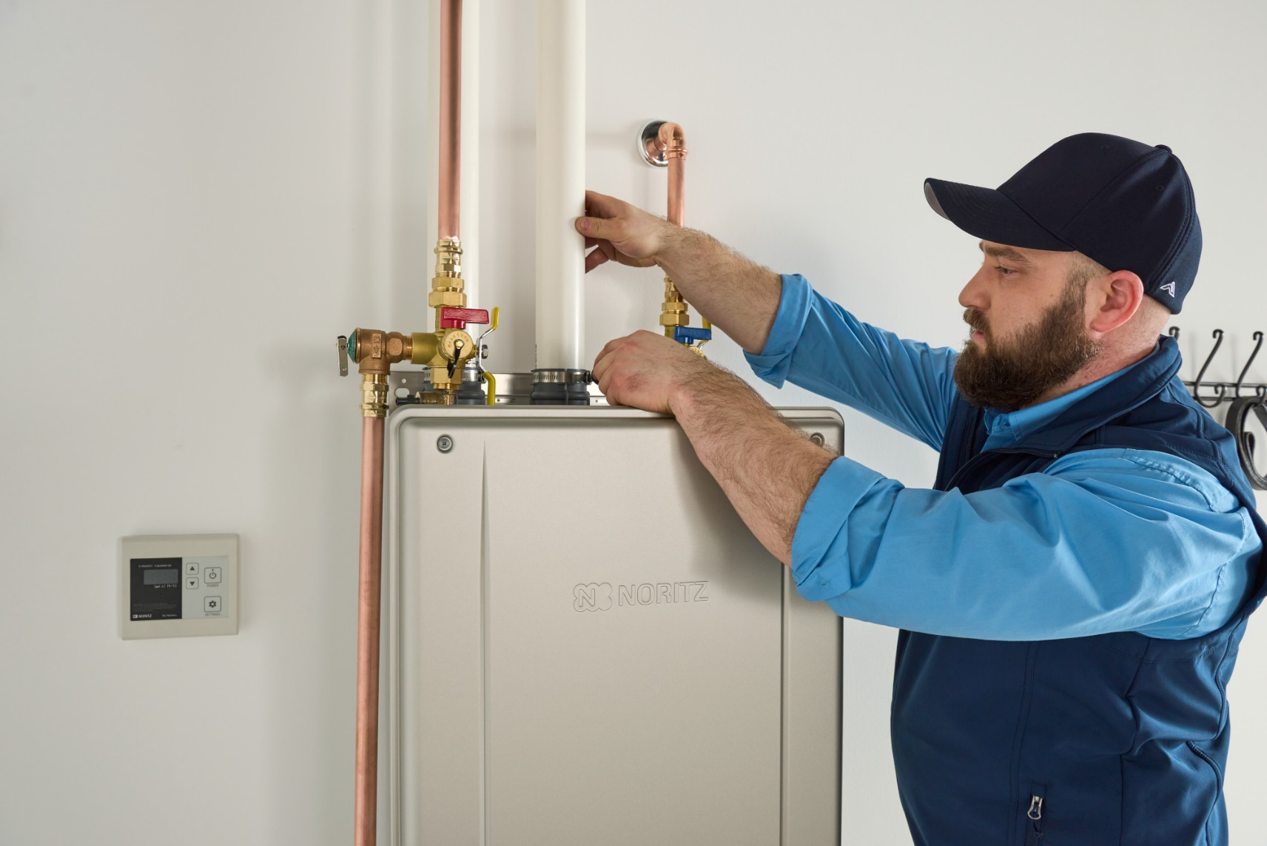

RESIDENTIAL
LEVEL 1
Product Line, Accessories and Installation Basics

Slide 2
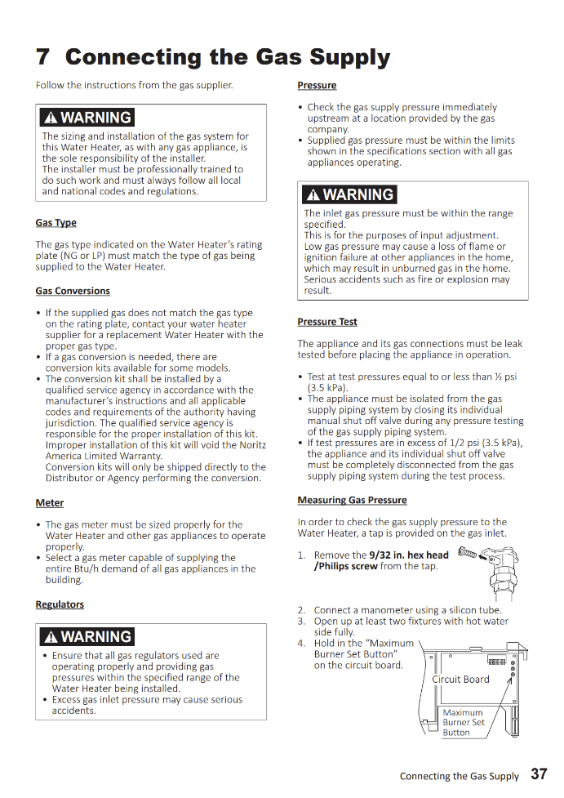
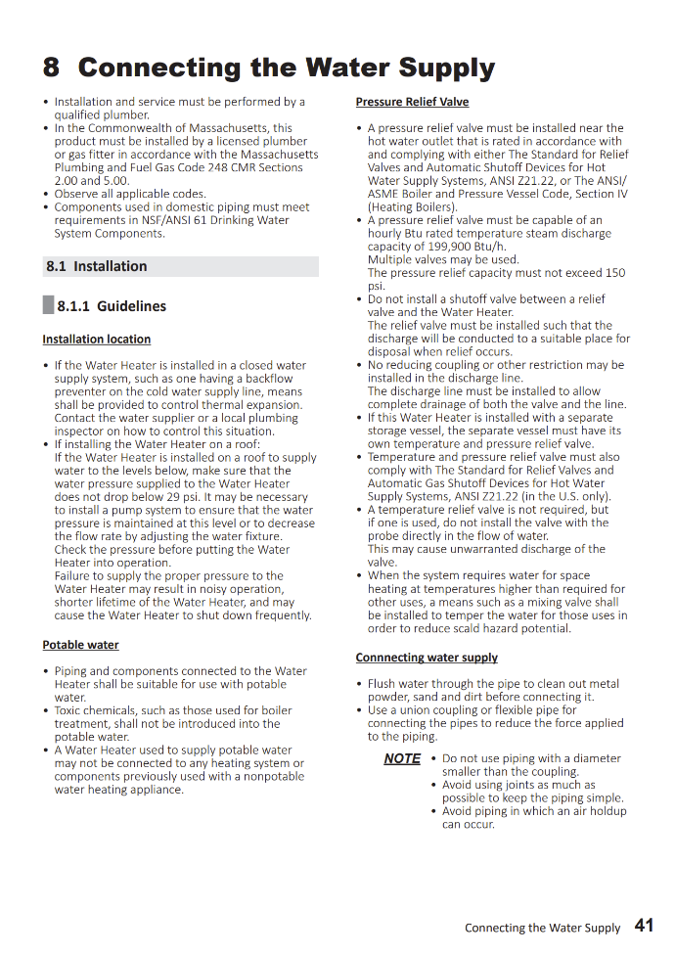
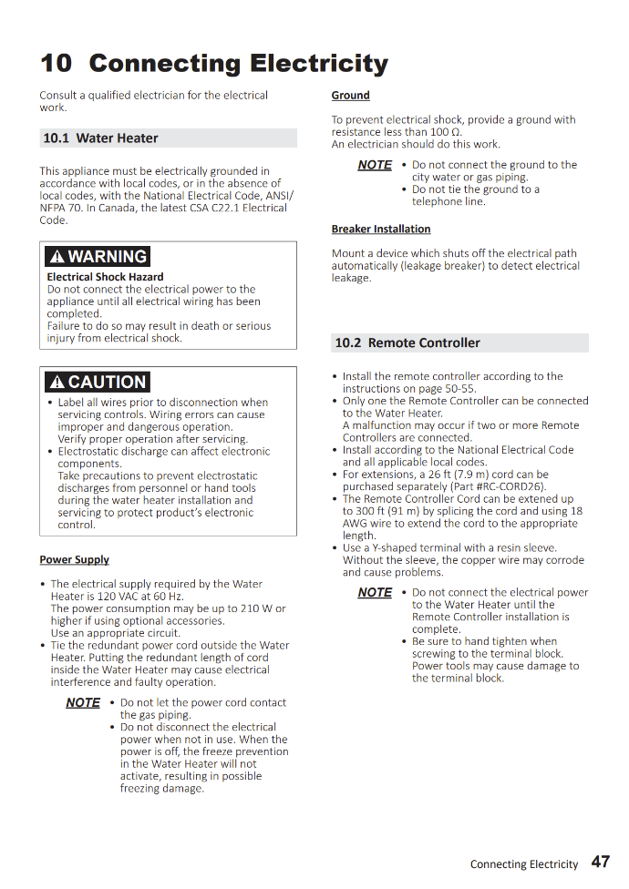

READ THE MANUAL
Tankless units are combustion appliances that contain gas, water and electricity in a unit the size of a suitcase.
The proper, safe and reliable operation of our units is 100% contingent on a correct installation and proper maintenance throughout its life.

Slide 3
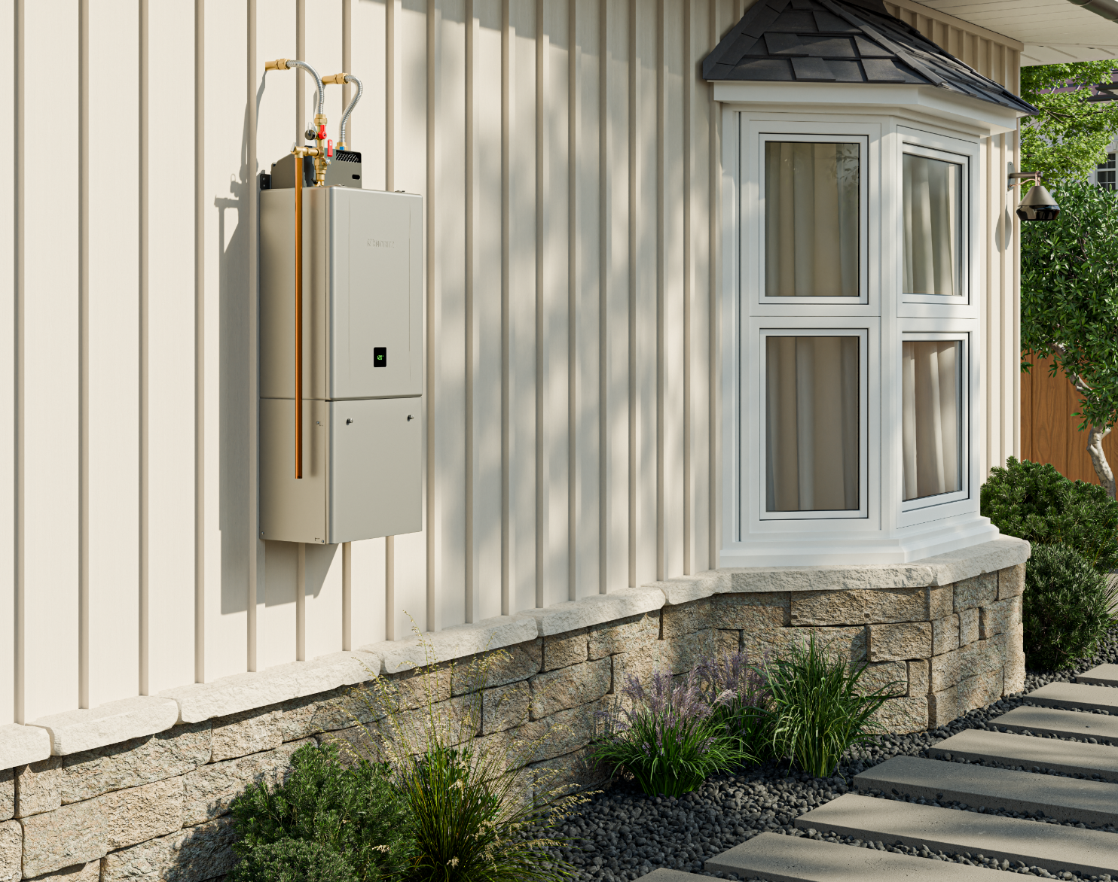
TRAINING SECTIONS
Residential Product Line:
Standard Efficiency
High Efficiency
Pre-mix Units
EZTR Packages
Installation:
Unit Sizing
Gas Line
Choosing Location
Venting
Condensate Line
Circuit Board Dipswitches
Install Checklist
Maintenance:
Water Quality
Water Treatment
Cleaning Unit

Slide 4



WHAT IS A TANKLESS WATER HEATER?
A tankless water heater uses a burner and heat exchanger to produce an endless supply of hot water on-demand.
About
400F
About
120F
Water is heated using the hot exhaust gas.
Tankless Operation:
Hot water fixture is opened
Tankless detects flow
Burner ignites
Water is heated in the Heat Exchanger
Hot water exits the tankless to the fixture
Fixture is closed and tankless shuts off
Standard Efficiency Unit
High Efficiency Unit
Secondary Heat Exchanger
About
400F
Primary Heat Exchanger
About
400F
Primary Heat Exchanger
Condensate
Collector
Fan
Fan
Hot Out
Gas In
Cold In
Hot Out
Gas In
Cold In

Slide 5
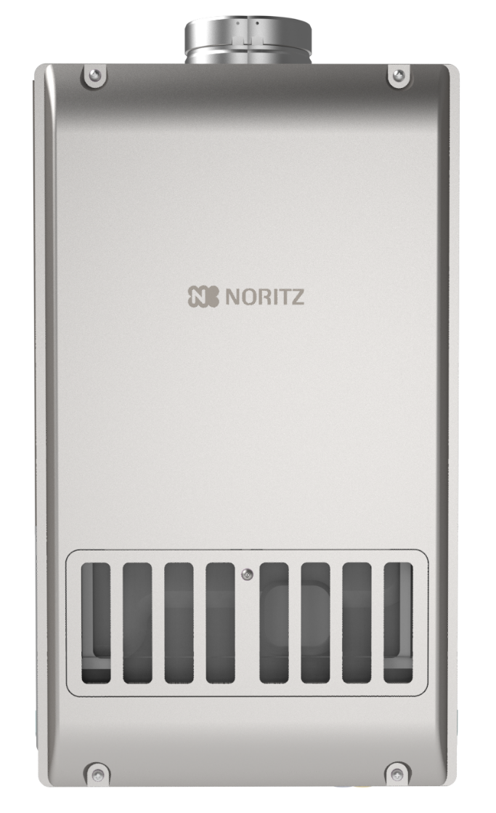
STANDARD EFFICIENCY UNITS
Non-Condensing Units
120k to 199k btu
UEF = 0.82
Indoor and Outdoor Units Available (7 units total)
Indoor Units Require Cat III Stainless Steel Venting
All Units Satisfy 20ppm Low NOx Requirements
Copper Heat Exchanger
12 Years Heat Exchanger
5 Years All Other Parts
1 Year Reasonable Labor
NR98SV
Max 199k btu

Slide 6
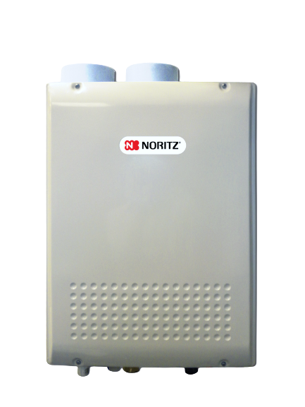
HIGH EFFICIENCY UNITS
Condensing Units
120k to 199k btu
UEF = 0.87 to 0.92 (depending on the unit)
Indoor and Outdoor Units Available (8 units total)
Indoor Units Use 3” or 4” PVC/CPVC/PP
All Units Satisfy 20ppm Low NOx Requirements
Copper Primary Heat Exchanger
Stainless Steel Secondary Heat Exchanger
12 Years Heat Exchanger
5 Years All Other Parts
1 Year Reasonable Labor
NRC98DV
Max 180k btu

Slide 7
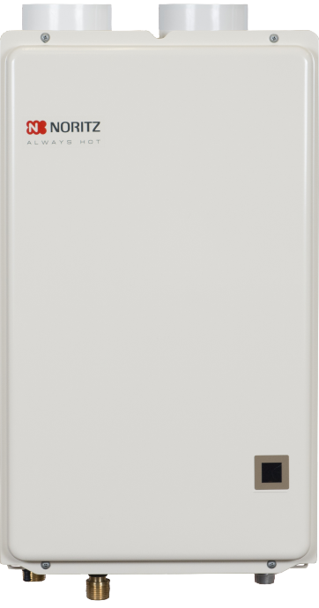
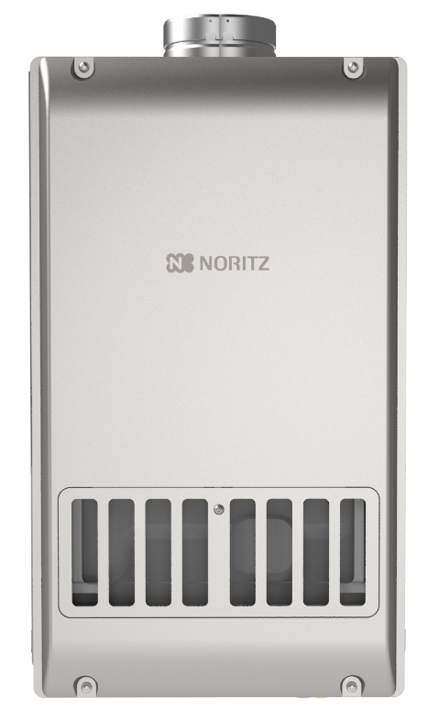
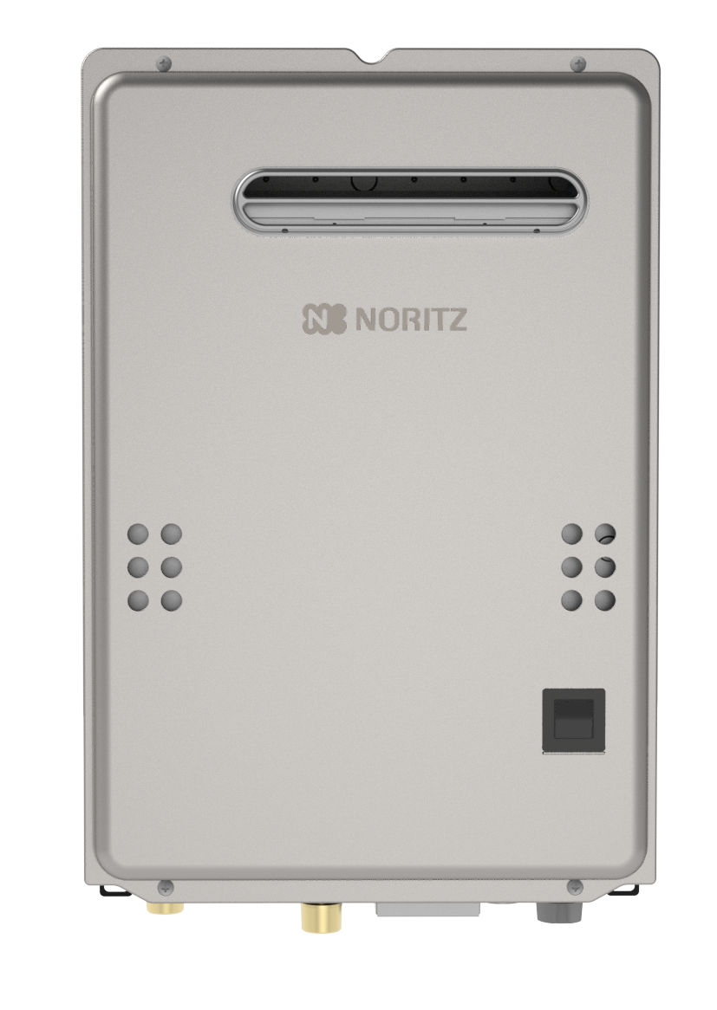
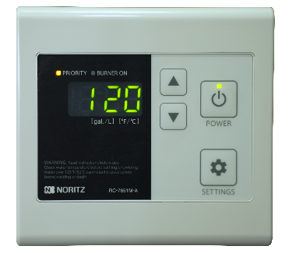
STANDARD & HIGH EFFICIENCY UNITS
All units include either an external remote control or built in display window for easy indication of set temperature along with monitoring and diagnostics capability.
NRC98DV
Max 180k btu
NRC661DV
Max 120k btu
NR98SV
Max 199k btu
NR66OD
Max 120k btu

Slide 8
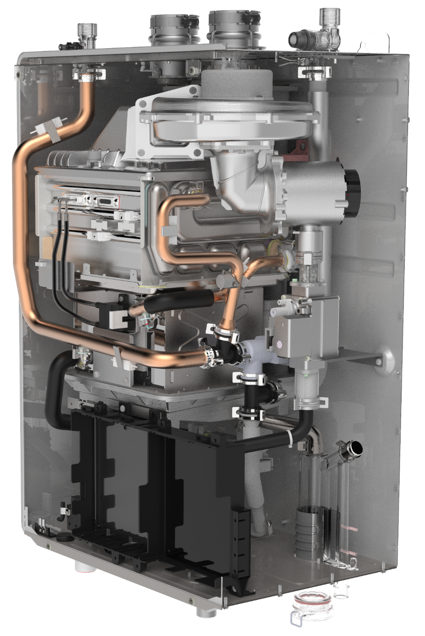
HIGH EFFICIENCY PRE-MIX UNITS
Pre-Mix refers to how the air and gas is pre-mixed in the fan before entering the burner
Pre-Mix units have Dual Stainless Steel Heat Exchangers
The Noritz Pre-mix Lineup:
EZ PRO Series
NRCR PRO Series
NRCB Boiler
NCC199CDV PRO (commercial unit)

Slide 9

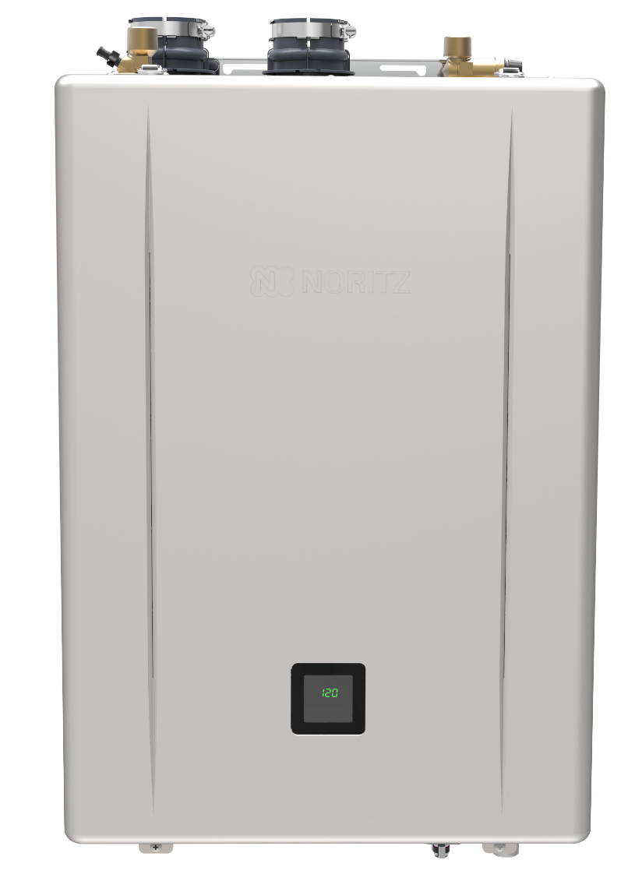

OVERVIEW
Available Models:
EZ71DV: 12,800 – 160,000 BTUh / 0.4 - 9.0 gpm
EZ98DV: 12,800 – 180,000 BTUh / 0.4 - 9.8 gpm
EZ111DV: 12,800 – 199,900 BTUh / 0.4 – 11.1 gpm
Key Features:
Top Mounted Water Connections
UEF = 0.98
EZ Start Plus Bluetooth® App
Built-in Display
Field Gas Conversion (included in the box)
Versatile Venting (one model for Indoor and Outdoor installations)
2”, 3” or 4” PVC/CPVC/PP
  2” Max length: 75’
  3” Max length: 150’
  4” Max length: 65’
Flexible 2” SV up to 35’
25 Year Heat Exchanger Warranty

Slide 10
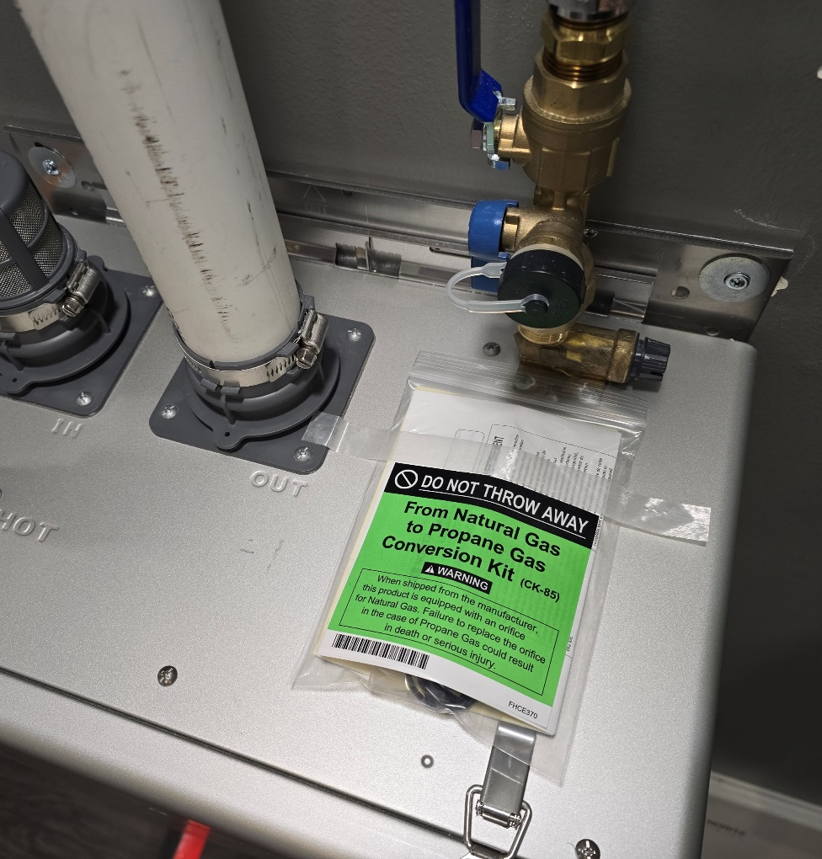
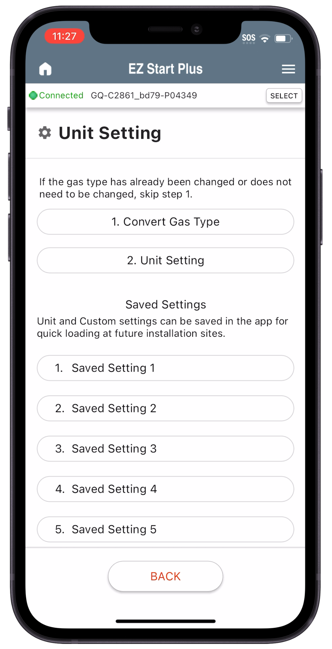

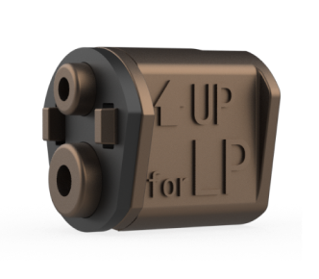
GAS CONVERSION
All PRO Series models are ready for use with NG and include a simple field gas conversion to LP.

Slide 11


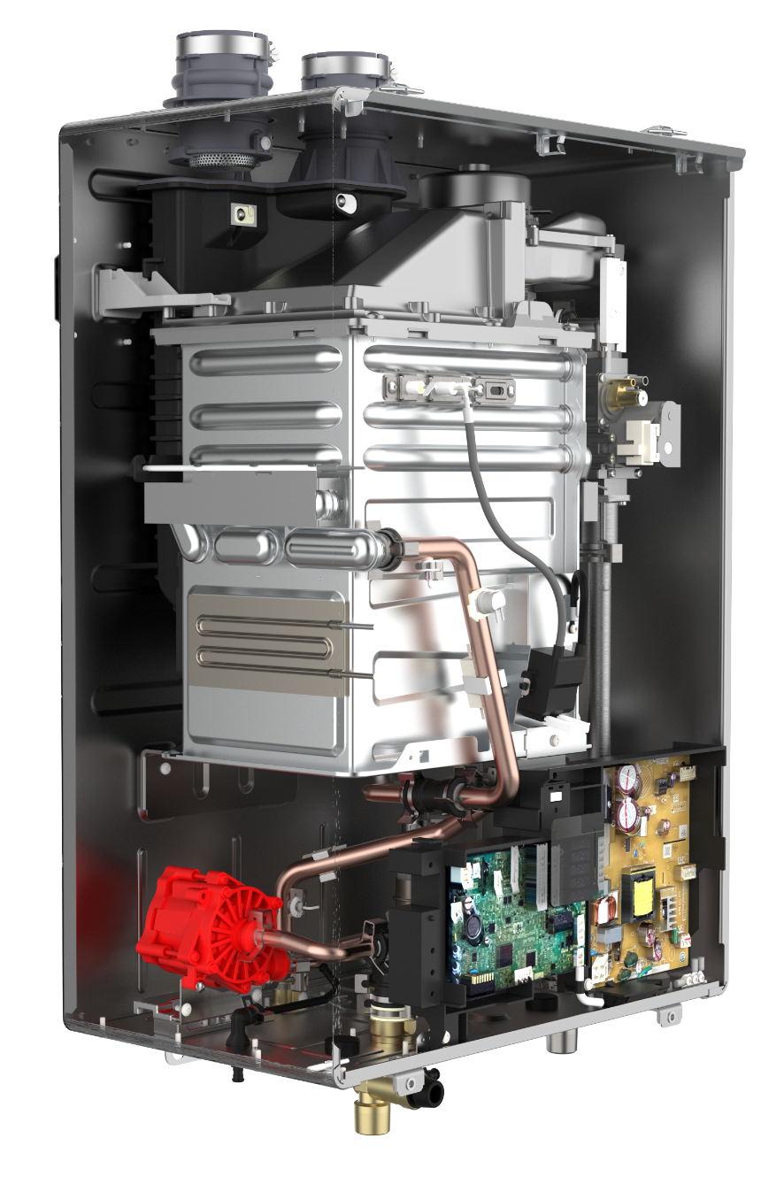

OVERVIEW
Available Models:
NRCR92DV: 12,800 – 165,000 BTUh / 0.4 - 9.2 gpm
NRCR111DV: 12,800 – 199,900 BTUh / 0.4 – 11.1 gpm
Key Features:
Built-In Recirculation Pump
UEF = 0.98
EZ Start Plus Bluetooth® App
Versatile Venting (Just like EZ Pro Series)
Steady BTU Control
15 Year Heat Exchanger Warranty
Recirc Setting:
Auto Learning (Default)
Manual Timer (Using EZ Start Plus Bluetooth app)
Title 24 (On Demand)
Recirc Types:
Dedicated Recirculation
Crossover (up to 2)

Slide 12
VENTING
The NRCR PRO is a pre-mix style unit and thus has the same venting options as the EZ PRO Series:
DV Direct Vent
SV Single Vent
OD Outdoor
No Roof Kit
FSV Flexible Single Vent
Common Vent Capable (2 Units Quick Connected)

Slide 13
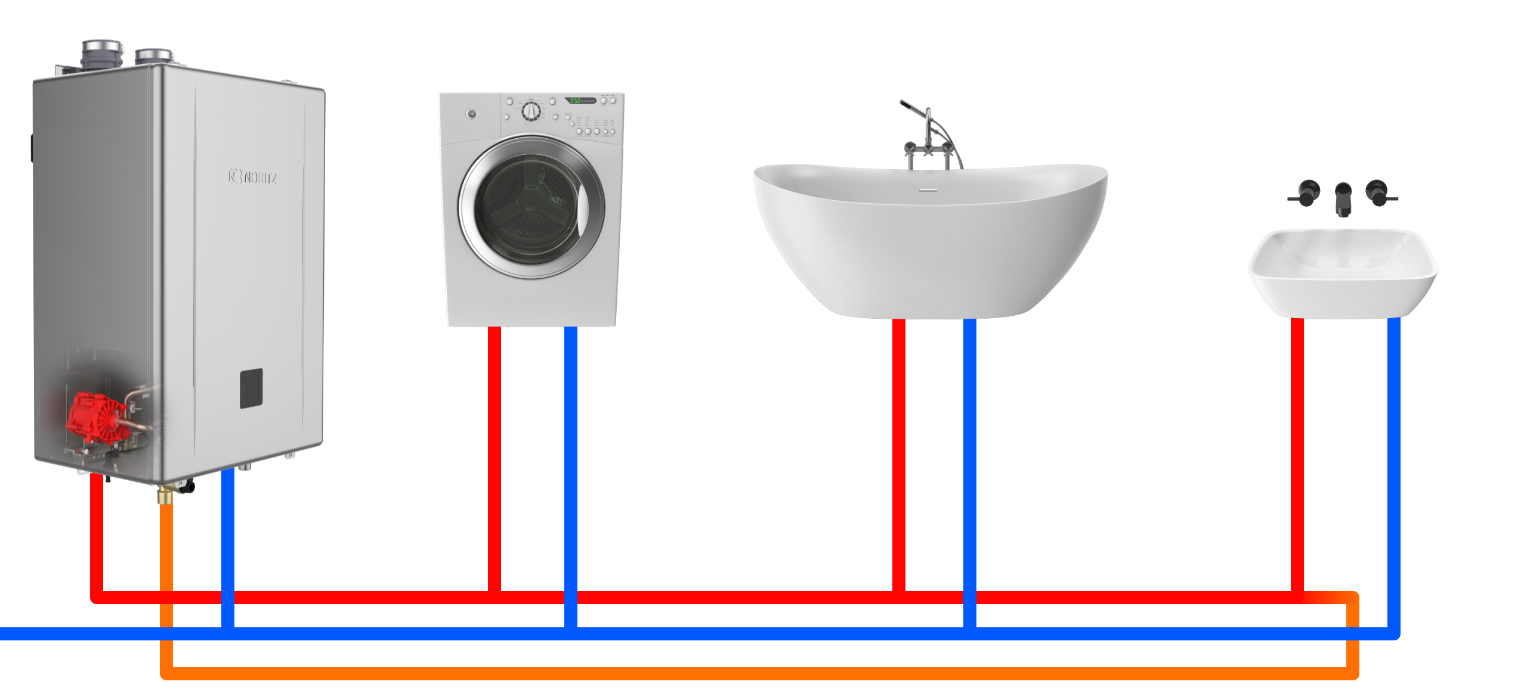
DEDICATED
Return Line should have a shut off valve, hose bibb and expansion tank

Slide 14
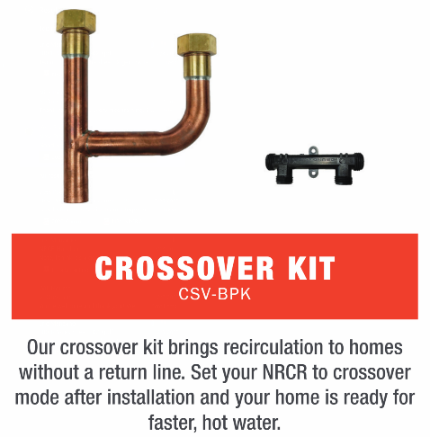
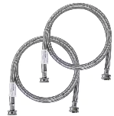
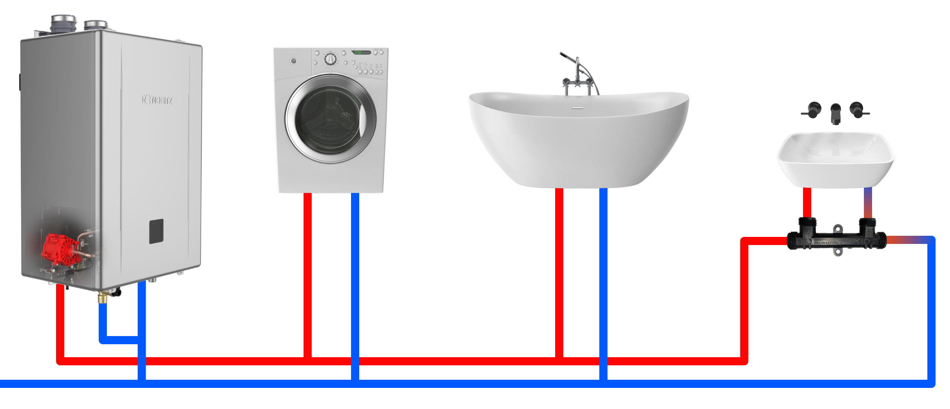
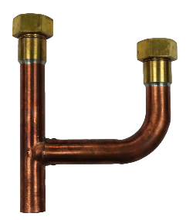
CROSSOVER
When using a crossover valve, the minimum set temperature is 120 F

Slide 15
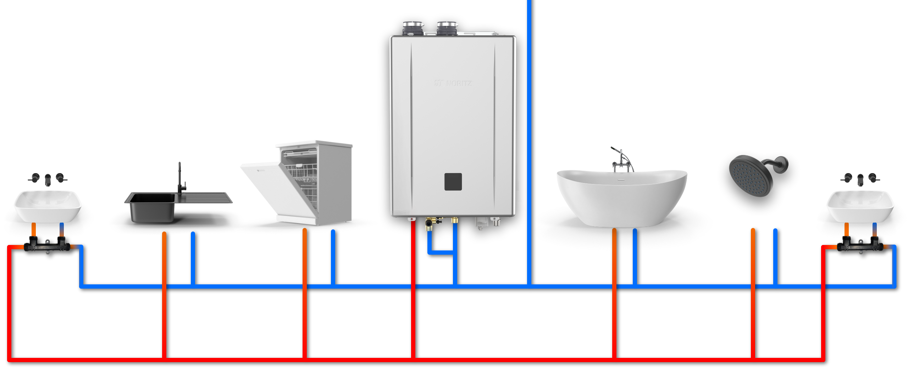
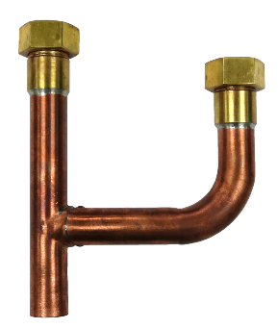
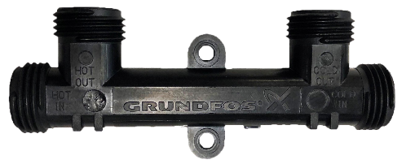
2 CROSSOVER
Crossover Valve: cCS-V
Crossover Kit: CSV-BPK
Return Water
Cold Water
Cold Water
Return Water
Hot Water
Hot Water

Slide 16
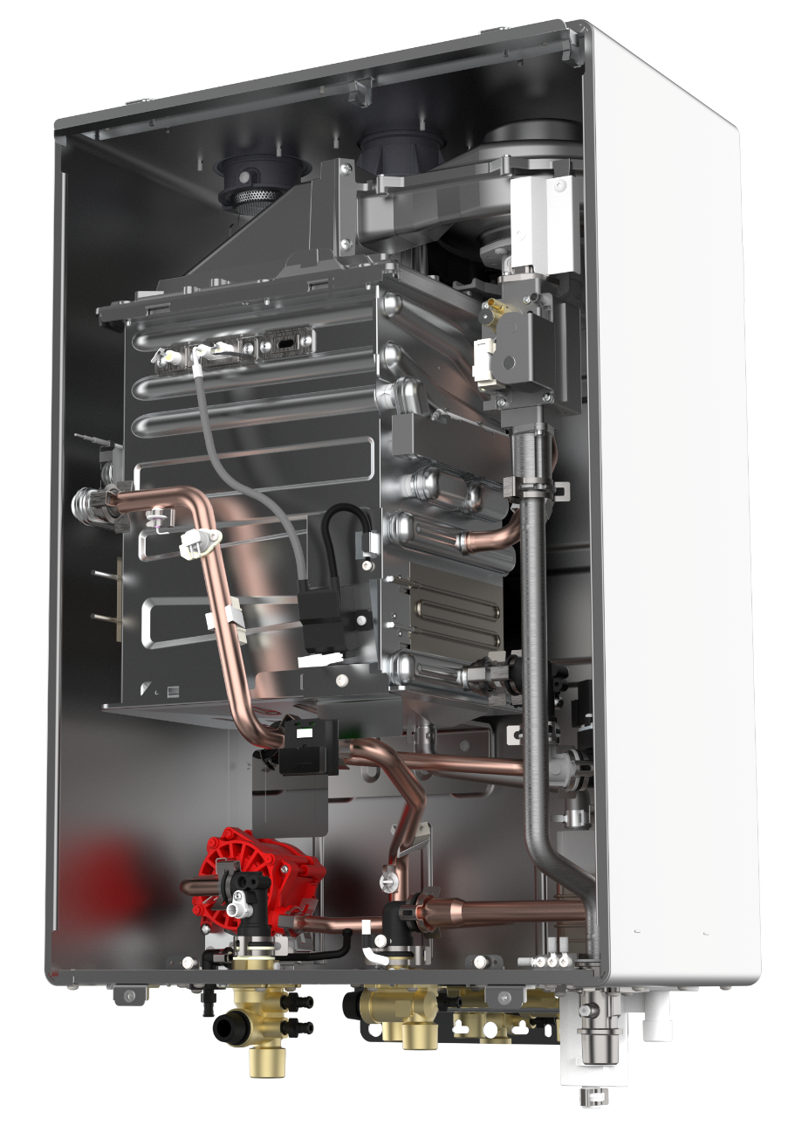
AUTO LEARNING
Auto Learning mode memorizes the customers usage patterns and automatically runs the pump during the hours hot water is needed. If the customers patterns change, the unit will adapt and remove times when it appears the customer no longer uses hot water.

Slide 17
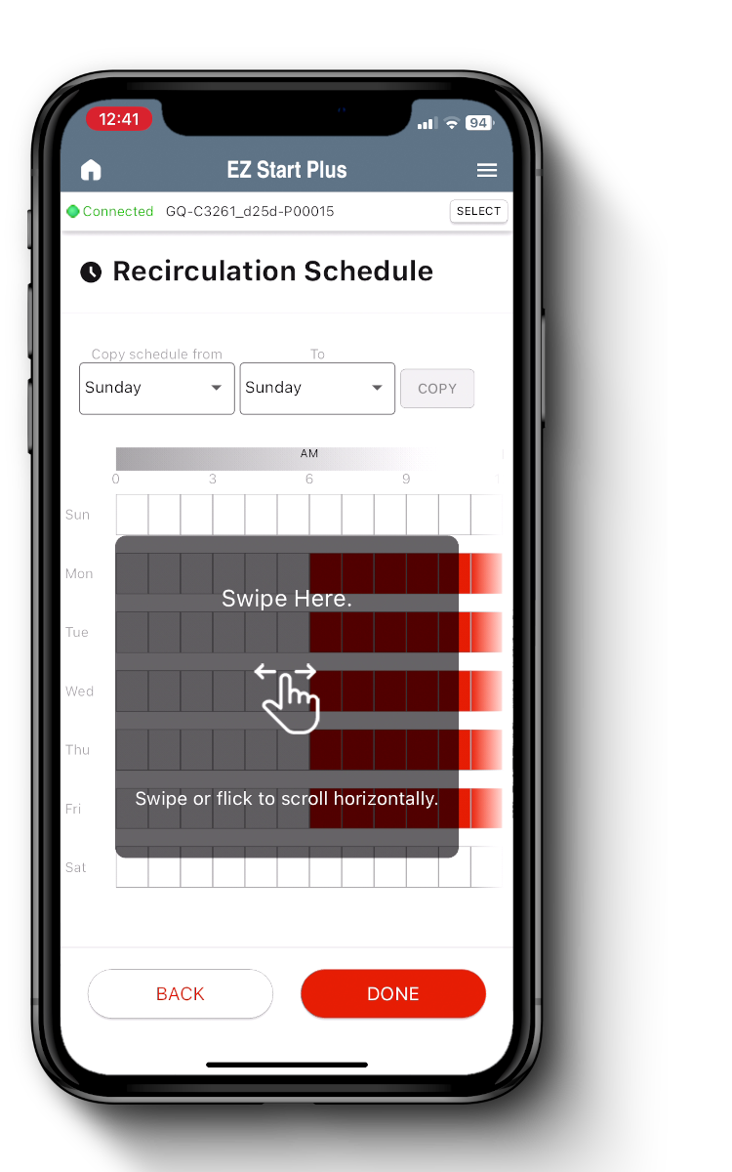
MANUAL SCHEDULE
Schedule the NRCR PRO recirc times manually with the EZ Start Plus App. Simply tap the hours you want the pump to run.
Want the same schedule every weekday? Adjust the schedule for one day then copy to all weekdays.
No longer requires extra purchase!

Slide 18
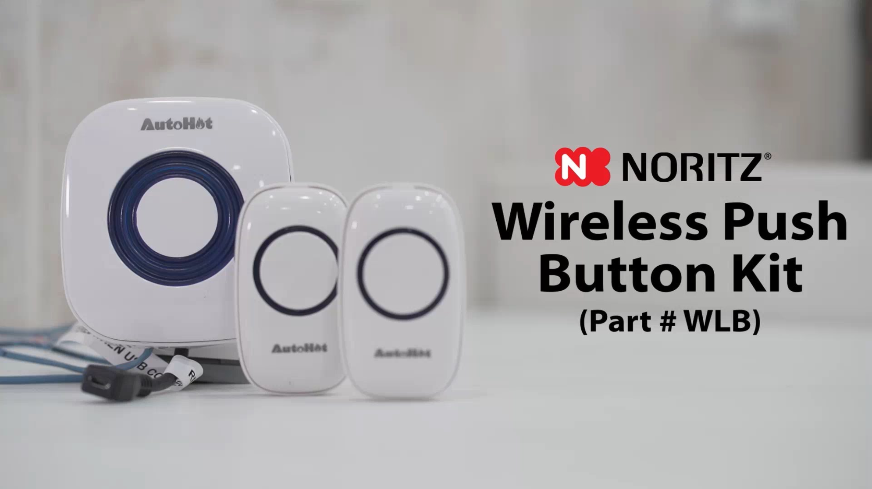
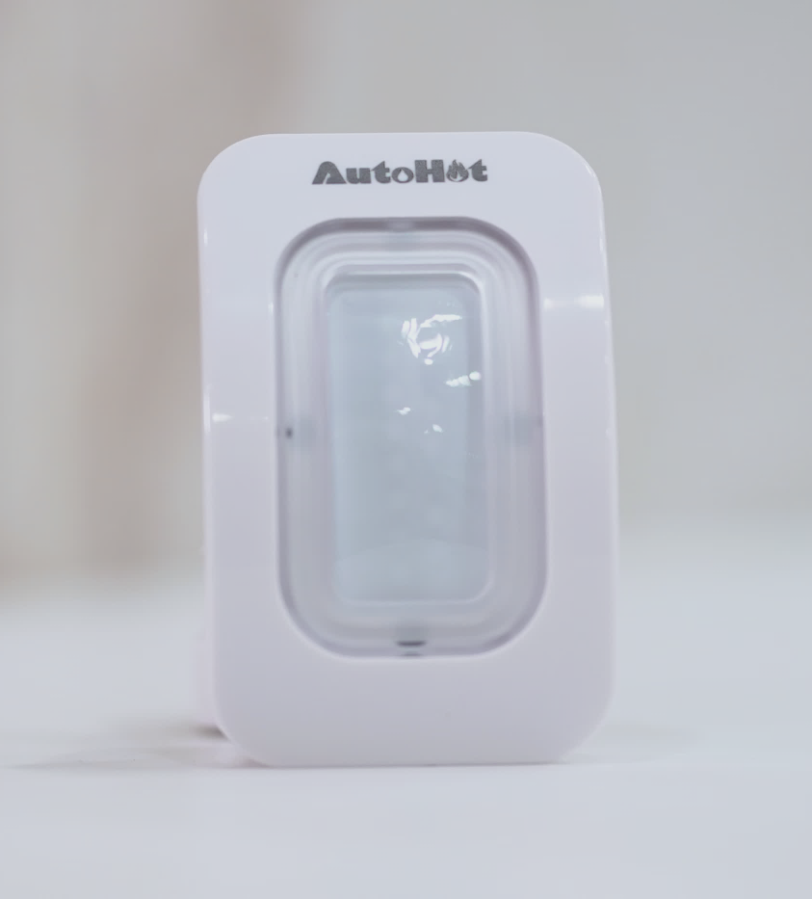
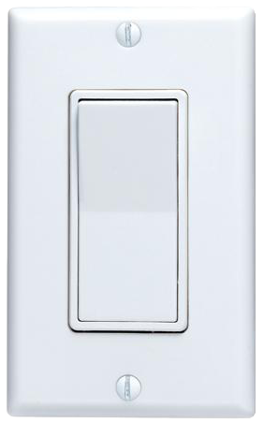
TITLE 24 ON DEMAND
On Demand mode only runs the pump when the customer presses a button or activates a motion sensor.
Wireless Push Button Kit (WLB)
Optional Motion Sensor (WLB-MS)
Rocker Switch (IHK-RS)

Slide 19
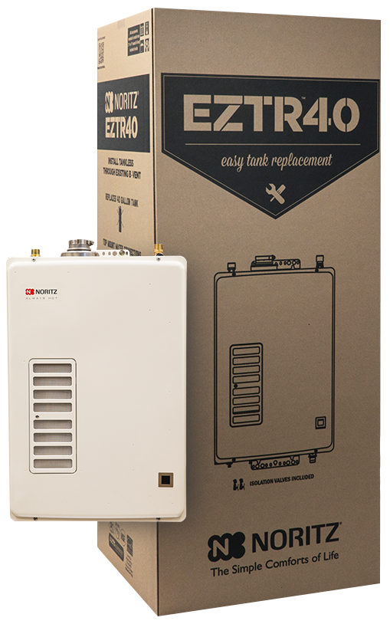
EZTR40 PACKAGE
EZ Tank Replacement of a 40 Gallon Tank
Bundle kits include Unit, Isolation Valves and 25’ Flex Vent Kit (35’ Optional, sold separately)
Top Mounted Water Connections
120k Max btu High Efficiency Unit
6.6 gpm Max
UEF = 0.87
Copper Primary HEX and SS Secondary HEX
12 Year Heat Exchanger Warranty
The EZTR40 can only be used when replacing a tank and using the flexible venting, it cannot be adapted to vent with PVC or other rigid plastic venting.

Slide 20
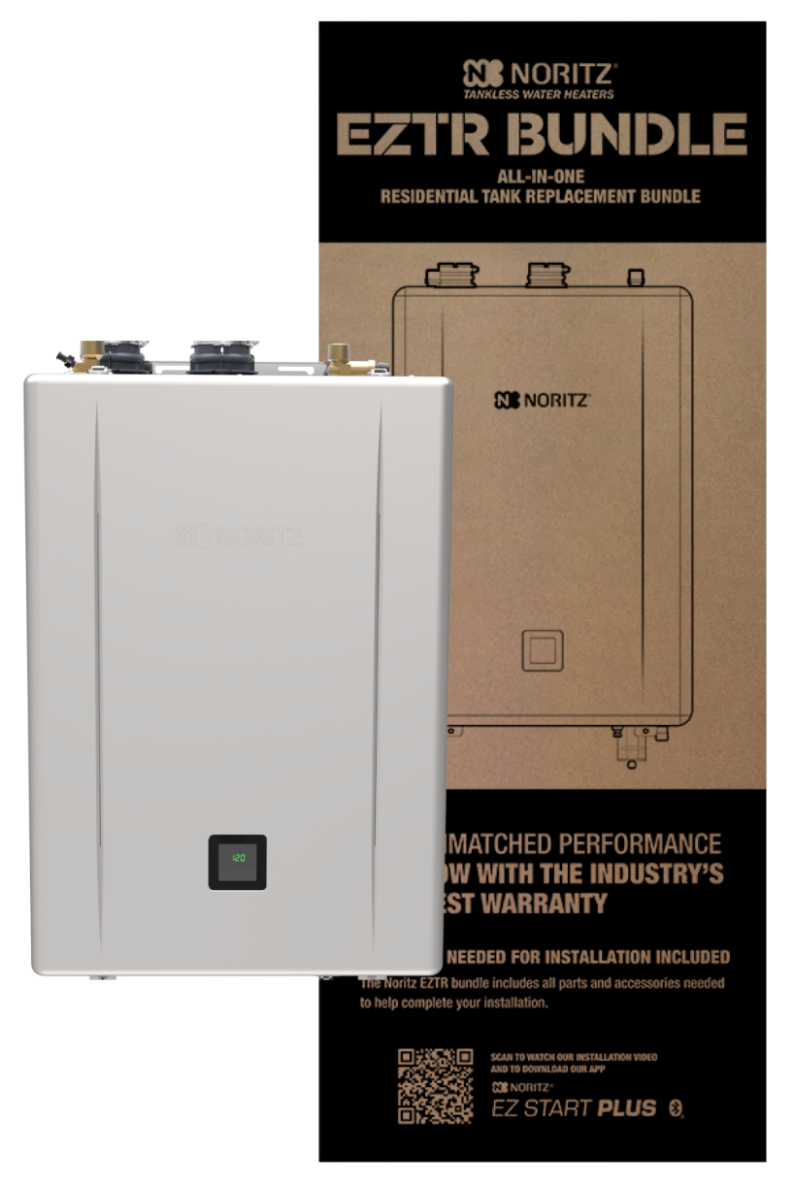

EZTR50 & EZTR75 PACKAGES
EZ Tank Replacement of a 50 or 75 Gallon Tank
Bundle kits include Unit, Isolation Valves and 25’ Flex Vent Kit (35’ Optional, sold separately)
Top Mounted Water Connections
EZTR50 includes EZ98 PRO Unit (180k btu/9.8 gpm)
EZTR75 includes EZ111 PRO Unit (199k btu/11.1 gpm)
Dual Stainless Steel Heat Exchangers
UEF = 0.98
EZ Start Plus Bluetooth® App
Field Gas Conversion
25 Year Heat Exchanger Warranty

Slide 21
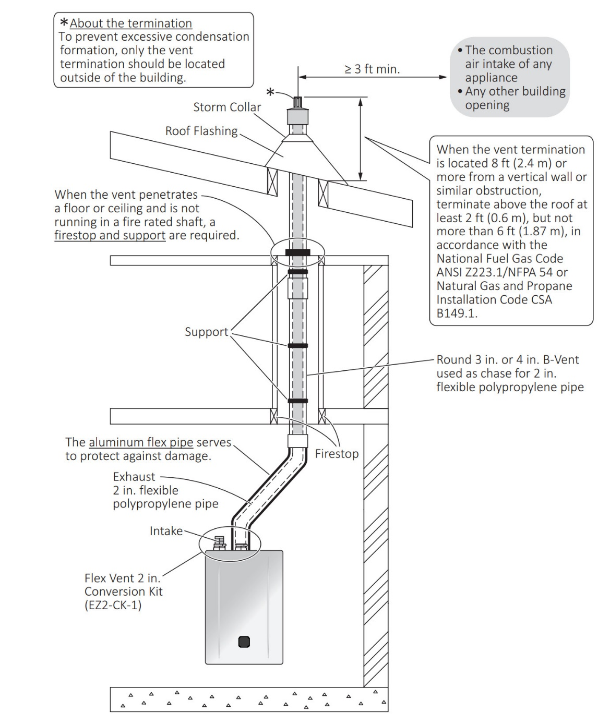
EZTR PACKAGES
Use existing 3” or 4” round b-vent
(no oval vent or common venting with other appliance)
25’ included with EZTR package.
35’ vent kit optional, part # EZ2FVK-2
NOTE: Flexible vent can be shortened but you cannot join 2 pieces of flexible vent to extend the length.
Example: If you need 30’, you would buy the 35’ kit and cut off 5’. You would not attach an extra 5’ to the included 25’ kit.

Slide 22
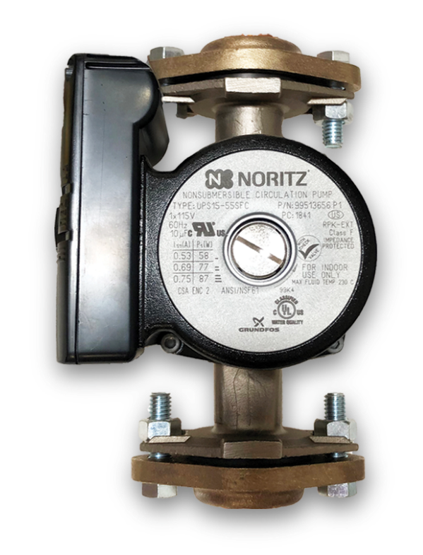
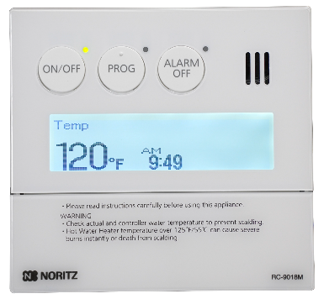
EXTERNAL RECIRCULATION
Many Noritz units are compatible with external recirculation pumps such as the Noritz RPK-EXT pump kit.
Important Notes:
Display Window Units are not compatible with the RPK-EXT pump kit as they do not have a pump control connection. An externally controlled pump may still be used though
Single unit installations only (Will not work with Quick Connected Systems)
Remote included with RPK-EXT kit is optional on EZ PRO and CDV PRO units that use the EZ Start Plus App
RPK-EXT
Pump Kit

Slide 23
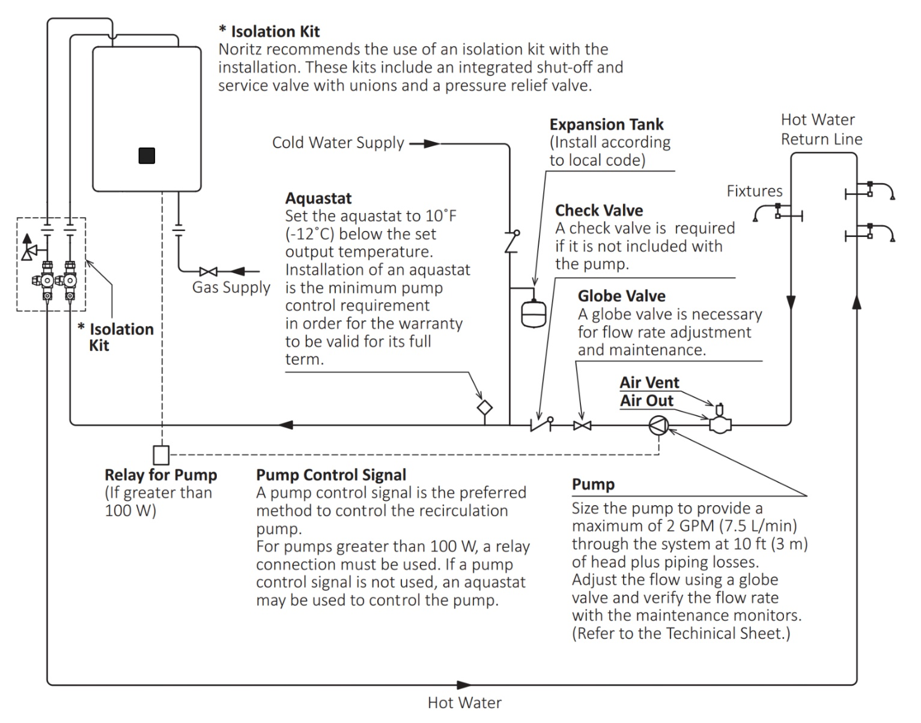
EXTERNAL RECIRCULATION
Typical Recirc Diagram
Size pump for 2 gpm max flow
Control pump with timer or aquastat or use pump connection wires inside unit
Set aquastat 10 degrees below unit set temperature

Slide 24
HOW TO SIZE A TANKLESS
Proper sizing is a key aspect of the customers experience and satisfaction with their tankless.
An undersized tankless will provide the proper temperature but the customer will not be able to run as many hot water fixtures at the same time as they want.
This problem will be more apparent in the wintertime as the cold-water temperatures are even colder.

Slide 25
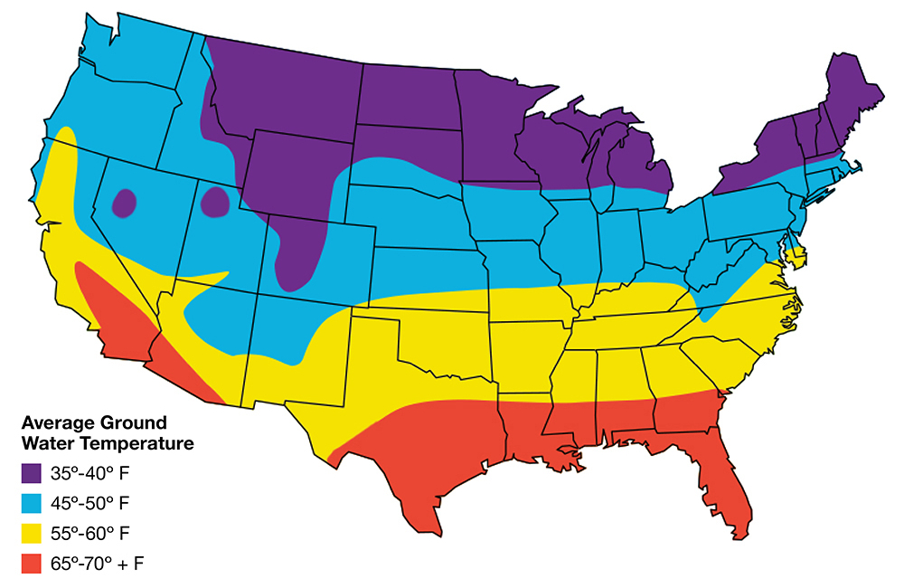

HOW TO SIZE A TANKLESS: STEP 1
Step 1: Determine your maximum temperature rise. This is the difference between the tankless set temp and the wintertime ground water temp (aka Delta T)
For the purpose of this example let’s say the home is on the central coast of California.
Based on the map, we’ll say the winter ground water temp is 55 F.
Now you can determine the wintertime temperature rise:
120 Set Temp – 55 Ground Water Temp = 65 Delta T

Slide 26
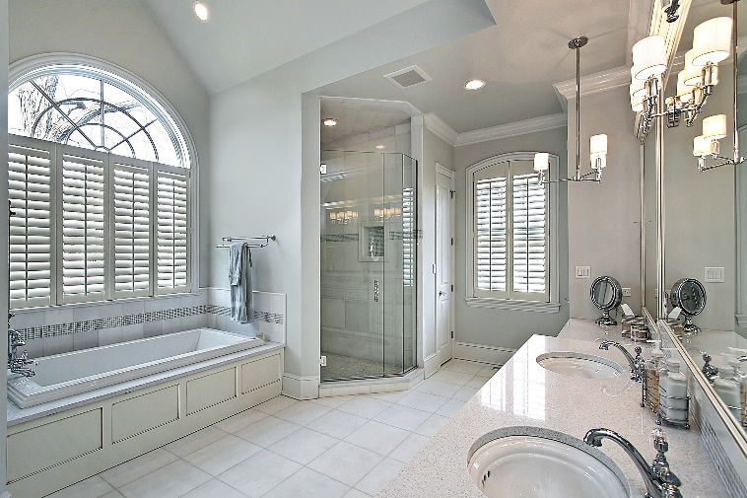
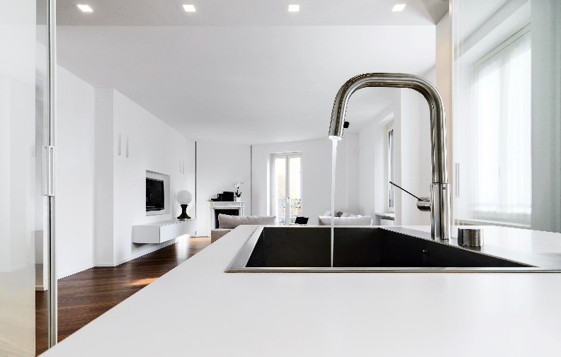
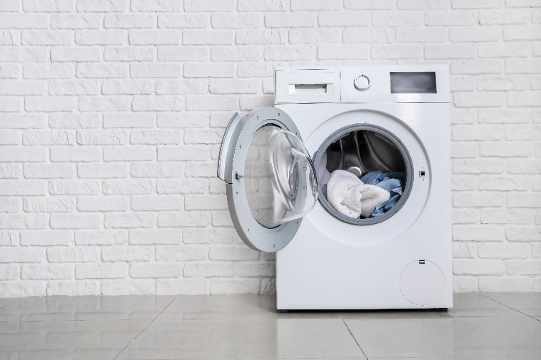
HOW TO SIZE A TANKLESS: STEP 2
Step 2: Determine the peak hot water demand of the home. If possible, ask the homeowner.
Fixtures and appliances all have different flow rates depending on manufacturer however you can use an average amount to get a ballpark figure:
Shower: 2 gpm
Lav Sink: 1 gpm
Kitchen Sink: 1.5 gpm
Dishwasher: 2 gpm
Washing Machine: 2 gpm
Example 1:
Peak usage: 2 Showers & Washing Machine = 6 gpm
Example 2:
Peak usage: 4 Showers & Dishwasher = 10 gpm

Slide 27
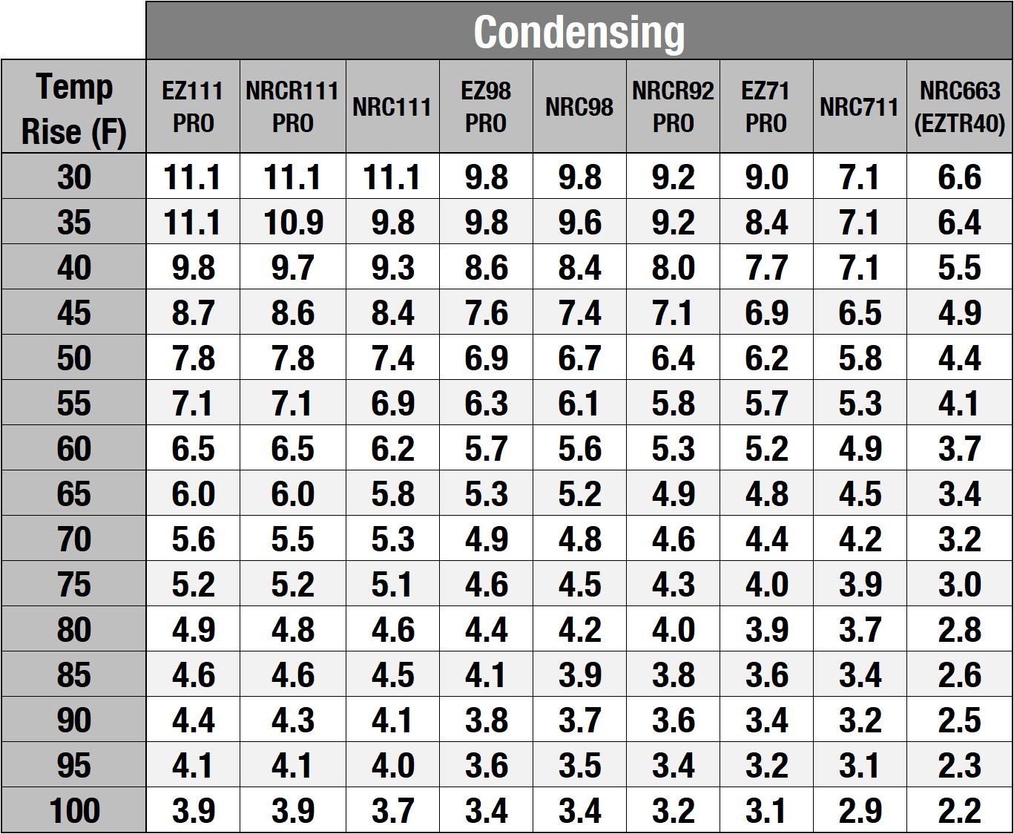
HOW TO SIZE A TANKLESS: STEP 3
Step 3: Select the proper unit or pair of units using the sizing chart found online or in the product catalog.
Simply find the Temperature Rise on the left then match up a unit or pair of units that provides the approximate flow rate needed.
Temp Rise: 65
Example 1:
Peak usage: 2 Showers & Washing Machine = 6 gpm
Ideal Models:
EZ111, NRCR111 or NRC111
Example 1
Example 2
Example 2:
Peak usage: 4 Showers & Dish Washer = 10 gpm
Ideal Models:
Pair of EZ98, NRC98 or NRCR92

Slide 28

HOW TO SIZE A TANKLESS: FINAL TIP
Final Sizing Tip:
It’s always better to slightly oversize a tankless system than to undersize it.
There’s virtually no downside to an oversized system for the home however and undersized system will not provide enough hot water for the home during all times of the year.

Slide 29
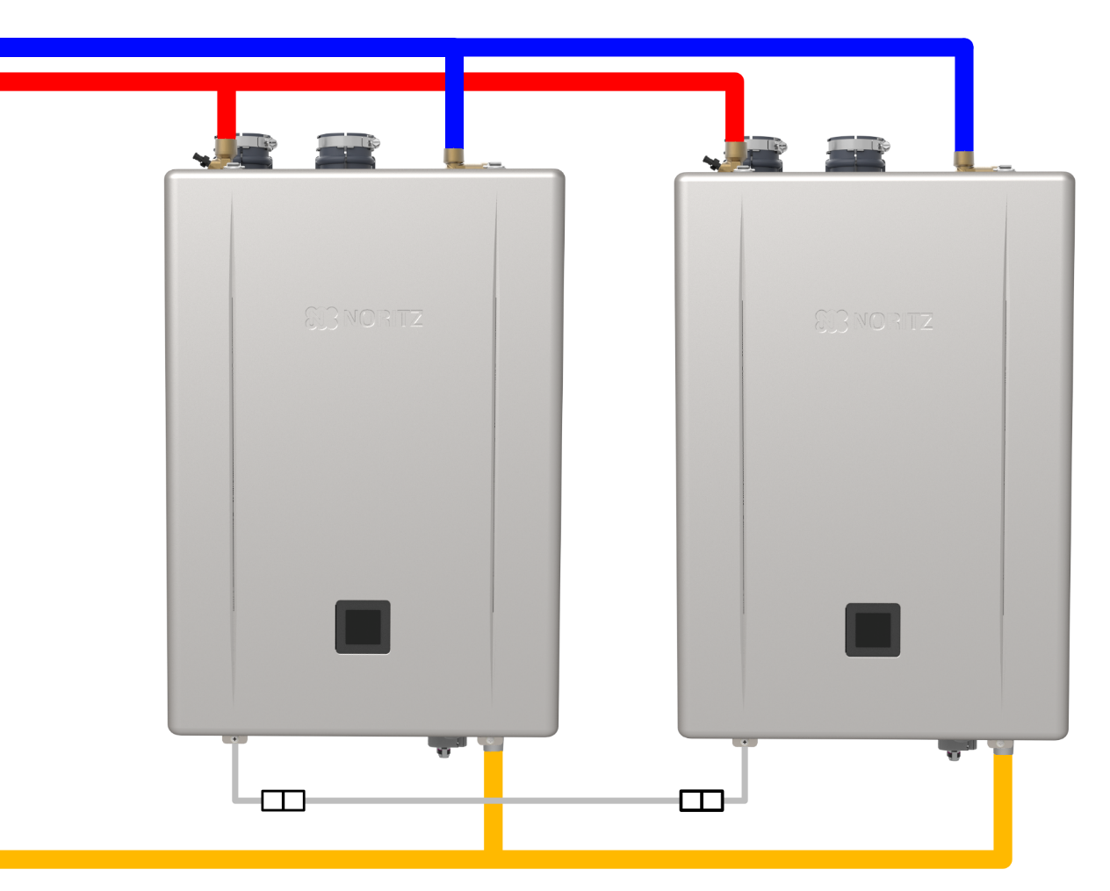
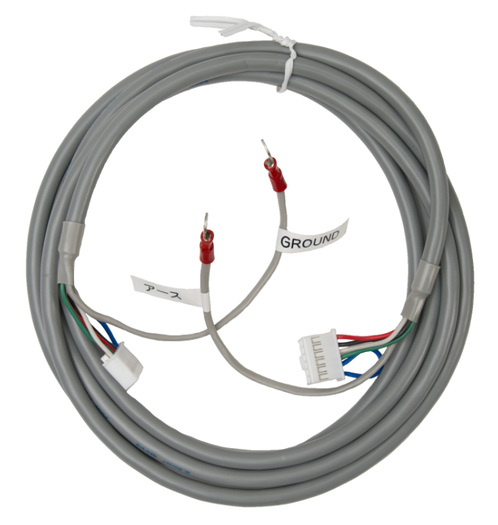
QUICK CONNECT SYSTEMS
For large residential applications
2 compatible Noritz units may be
quick connected to double the
hot water output.
Part #: QC-2

Slide 30
QUICK CONNECT SYSTEMS
The system will automatically
rotate primary and secondary
roles to ensure even use of
both units.
Primary
Secondary
Part #: QC-2

Slide 31

QUICK CONNECT SYSTEMS
When there's a small demand, only the primary heater will fire up to meet the demand.
Primary
Secondary
Part #: QC-2

Slide 32
QUICK CONNECT SYSTEMS
If the demand increases the primary unit will activate the secondary unit to help meet the demand.
Primary
Secondary
Part #: QC-2

Slide 33
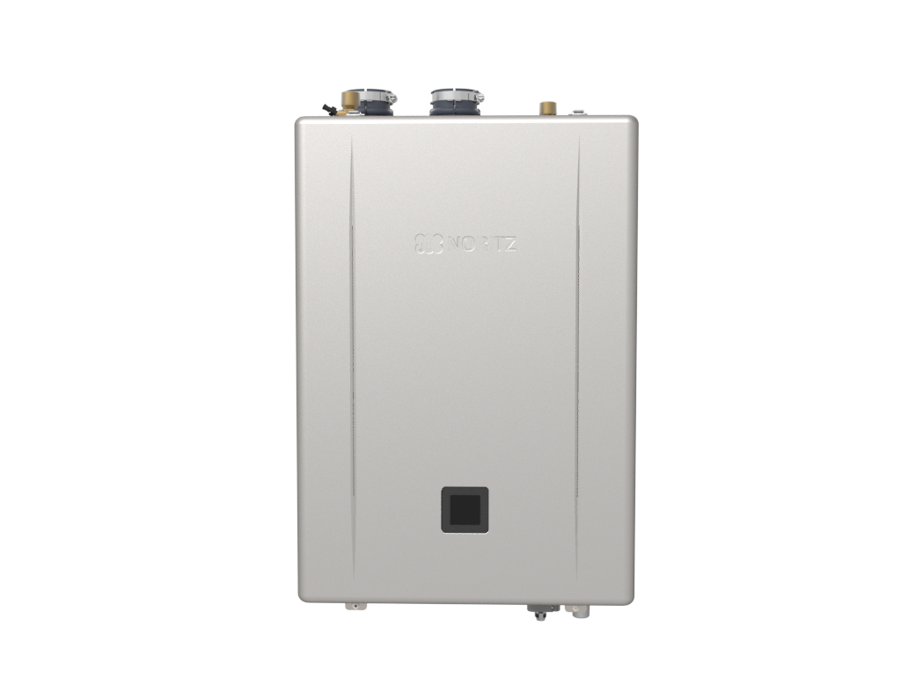
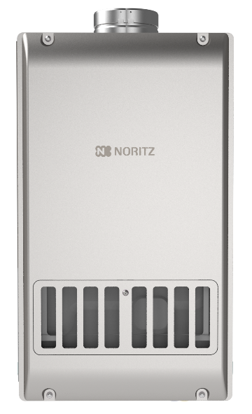
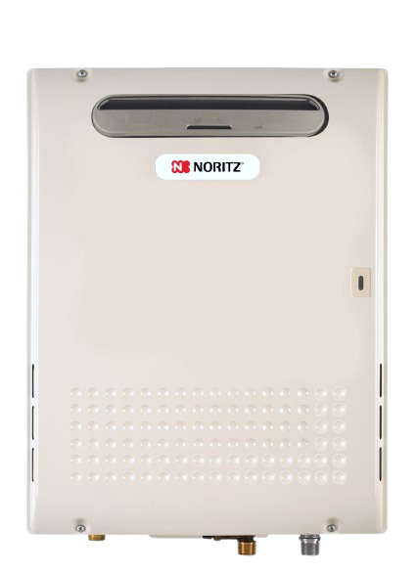
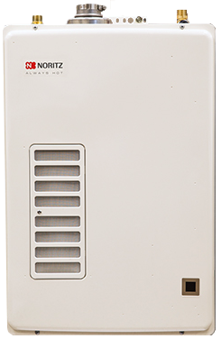
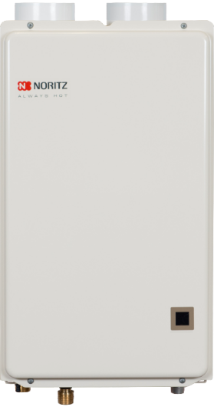
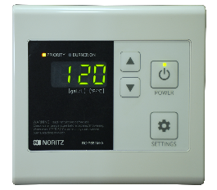
QUICK CONNECT SYSTEMS
Only the PRO Series and larger residential units with an external remote are compatible with the quick connect cable, smaller display window units are designed for single unit installations.
Quick Connect
Compatible
Not Quick Connect
Compatible

Slide 34
GAS LINE SIZING
Of equal importance to a proper sized unit, is a properly sized and installed gas line to ensure adequate gas pressure.
Afterall, what good is selecting the perfect tankless if the gas system can’t support it’s needs?
Required Gas Supply Pressure
NATURAL GAS
3.5 TO 10.5 INCHES
PROPANE GAS
8.0 TO 14.0 INCHES
* Supply pressures may vary unit to unit, refer to rating plate for exact pressure range

Slide 35
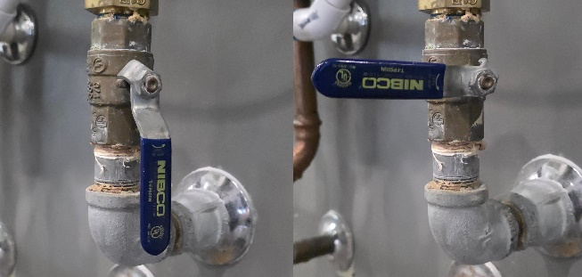




GAS PRESSURE CHECK
1) Locate and shut off gas valve
Check the pressure when the unit is sitting idle (Static Pressure)
Check the pressure when the unit is in high fire (Dynamic Pressure)
2) Zero manometer then connect to inlet port
Check the pressure on the gas connection or the bottom port of gas valve using T15 torx.
3) Open gas valve and note static pressure
4) Create a high flow to ensure unit is in high fire and note dynamic pressure

Slide 36

GAS LINE SIZING
PRO Series installation manuals contains 5 sizing tables for hard pipe gas lines, 4 for NG and 1 for LP.
To pick what NG chart you use, you will need to know the static supply pressure.

Slide 37
½” GAS LINE CONSIDERATIONS
After determining the initial supply pressure, you can use the charts to determine the maximum equivalent length of ½” hard pipe you may use based on the max btu of the unit.

Slide 38
½” GAS LINE CONSIDERATIONS
The higher the initial supply pressure, the longer the ½” gas line can be.
Highlighted areas indicate max equivalent length for an EZ71DV (160k btu max). Equivalent length factors in elbows and fittings, not just straight pipe.

Slide 39

DEDICATED OR BRANCH GAS LINE?
Both Dedicated and Branching from an existing gas line are acceptable choices.

Slide 40

DEDICATED OR BRANCH GAS LINE?
However, if you branch off the existing gas line, you need to make sure all sections of the line can support the btu demand.
60k btu
40k btu
200k btu
Section 1
(300k btu)
Section 2
(240k btu)
Section 3
(200k btu)

Slide 41


DEDICATED OR BRANCH GAS LINE?
Also make sure the gas meter can supply the total btu demand of the home.
Check Rating Plate on Meter
60k btu
40k btu
200k btu
250 CFH
300k btu = total of all gas appliances

Slide 42

DEDICATED OR BRANCH GAS LINE?
In some cases, it may need to be upsized to handle the added demand of the tankless unit.
60k btu
40k btu
200k btu
425 CFH

Slide 43


PROPANE TANK & ORIFICE
PROPANE GAS
8.0 TO 13.0 INCHES
If using the PRO Series units only an Orifice Change and programing with EZ Start Plus App is needed. LP Orifice is included with the unit.

Slide 44

CHOOSING INSTALLATION LOCATION
Now that you’ve sized out the perfect unit for the job and made sure the gas system can support the new tankless, it’s time to pick the perfect installation location.

Slide 45

CHOOSING INSTALLATION LOCATION
For cold climates where snow is a regular or even occasional occurrence, you’ll want to install the unit indoors.

Slide 46

CHOOSING INSTALLATION LOCATION
For warm climates that never see freezing weather, installing the unit outdoors is a great way to free up space inside the home.

Slide 47

CHOOSING INSTALLATION LOCATION
Keep in mind all tankless water heaters have motorized parts. When in operation they are fairly quiet, but the noises may bother some customers so keep that in mind when scouting a location to install the unit.

Slide 48

CHOOSING INSTALLATION LOCATION
If possible, avoid installing the unit on a bedroom wall or other areas where customers might expect a quiet space.

Slide 49
INDOOR VENTING OPTIONS
When installing the unit indoors, you have a few different venting options available to you although they will generally fall into 1 of 2 categories:
DV Direct Vent
SV Single Vent

Slide 50





INDOOR VENTING OPTIONS
Direct Vent Examples:
Two Pipes
To Outside
Concentric
Terminations
DVC Style
Unit

Slide 51



INDOOR VENTING OPTIONS
Single Vent Examples:
DV to SV
Conversion
Flex Vent
Kit
SV Style
Unit

Slide 52

HORIZONTAL OR VERTICAL VENTING
All Noritz indoor units may be vented either horizontally or vertically regardless of SV or DV vent type, with the only exception being the EZTR packages that use the 2” flexible vent.

Slide 53





VENTING MATERIAL
Standard efficiency non-condensing units must be vented with category III stainless steel venting and high efficiency condensing models may use plastic venting such as PVC, CPVC or PP depending on code requirements.
Non-Condensing
Model
Condensing
Model

Slide 54



PVC VENTING
Long Sweep Turns vs Short Radius Turns
Horizontal Exhaust runs should pitch towards the unit to allow condensation to drain in the unit and out the trap.
Long sweep 90° creates a smooth transition of the exhaust gases from one direction to another
Long sweep 90° causes the least amount of turbulence.

Slide 55






VENTING OPTIONS
One SKU, All Venting Options.
Direct Vent
Single Vent
Outdoor
No Roof Kit
Flex Vent Kit

Slide 56
VENTING OPTIONS
DV – Direct Vent
Ideal For:
Areas with dirty combustion air
Tight locations without combustion air
When unit is installed in a conditioned space (Why draw conditioned air through the unit?)

Slide 57
VENTING OPTIONS
SV – Single Vent
Ideal For:
Areas with clean combustion air
Areas with plenty of combustion air

Slide 58
VENTING OPTIONS
OD – Outdoor
Ideal For:
Warm climates without snow
Reclaiming space in the home

Slide 59
VENTING OPTIONS
NRK – No Roof Kit
Ideal For:
Straight up b-vent runs 8.5’ or under
Tank Retrofits
Saving time by not replacing venting or getting on the roof

Slide 60
VENTING OPTIONS
FSV – Flexible Single Vent
Ideal For:
B-vent runs with 45 degree turns
B-vent runs 5’ to 35’
Tank Retrofits
Saving time by not replacing venting

Slide 61

EZTR FLEX VENTING
EZTR installations must be run vertically through the existing round b-vent and cannot be run horizontally.

Slide 62



WHEN TO DIRECT VENT
When combustion air is likely to be contaminated, such as in:
Attics
Laundry Rooms
Commercial Kitchens
It’s best to install a Direct Vent unit.

Slide 63

WHEN TO DIRECT VENT
Pulling in dirty combustion air with an SV unit will require quite a bit of preventative maintenance and likely shorten the overall lifespan of the unit.

Slide 64




2 PIPE TERMINATION OPTIONS
Direct Vent Horizontal
Direct Vent Vertical
Using PVT-HL terminations the distance between the intake and exhaust is 3 ft
Using 90 PVC elbows the distance between the intake and exhaust is 1 ft

Slide 65

CONCENTRIC HORIZONTAL TERMINATION
PVC-2CT: 2" Connections
PVC-3CT: 3" Connections

Slide 66


CONCENTRIC HORIZONTAL TERMINATION
PVC-UCVK: For easy up and out venting

Slide 67



CONCENTRIC HORIZONTAL TERMINATION
PVC-2LPT: 2" Connections
PVC-3LPT: 3" Connections

Slide 68


CONCENTRIC VERTICAL TERMINATION
PVC-2CT: 2" Connections
PVC-3CT: 3" Connections
PRC-1: Plastic Rain Cap

Slide 69





SV TERMINATION OPTIONS
If the installation location meet the combustion air requirements in the manual, you have the option to install a Single Vent unit or use the SV conversion kit on a compatible DV unit and run a single exhaust vent to the outside.

Slide 70



OUTDOOR INSTALL CONSIDERATIONS
Outdoor installations are probably one of the easiest options if the climate allows. However, there are still things to consider such as clearances to building openings and how close the unit is to a neighboring building. The last thing you want is for the exhaust or operational noises to affect the neighbors.

Slide 71


COMMON VENTING 2 PRO SERIES UNITS
The EZ PRO and NRCR PRO units can be common vented
*The Btu/h input of the unit will be reduced by up to 9%.

Slide 72

INSTALLATION CLEARANCE REQUIREMENTS
The terminations of all gas burning appliances are subject to National Fuel Gas Codes clearance requirements to building openings. The installation manual provides these diagrams and many clearance requirements directly from the national fuel gas code for both US and Canada.

Slide 73
INSTALLATION CLEARANCE REQUIREMENTS
It’s important to note that Noritz does not make these clearance requirements and thus cannot overrule any local, state, provincial or national code. When there is no national code clearance listed, local code or the requirements of the gas supplier must be followed.

Slide 74
INSTALLATION CLEARANCE REQUIREMENTS
These codes are designed to prevent the exhaust from a gas burning appliance from entering the home and putting the occupants at risk.

Slide 75

CONDENSATE DRAIN CONNECTION
Condensing heaters will have a ½” condensate drain connection on the bottom of the unit.

Slide 76



CONDENSATE DRAIN CONNECTION
The condensate drain line should be as short and direct as possible and you do not need to create a trap as that’s what the collector inside the unit does.
Adding an air vent on the condensate line will help with draining the condensate and not backing up into the unit.

Slide 77


CONDENSATE DRAIN CONNECTION
If the desired drain location is a long distance from or above the heater, a condensate pump should be used. The pump should be sized to handle 2 gallons per hour.

Slide 78

CONDENSATE DRAIN CONNECTION
In cold climates with freezing weather, the condensate should not be drained to the outside as the condensate line could freeze and the heater will stop operating.

Slide 79



CONDENSATE DRAIN CONNECTION
The drain line should be plastic as the acidic condensate will corrode metal pipes and the line should be no smaller than ½”.
Horizontal runs should be sloped downward a ¼” for every 1 foot of piping.
Make sure you leave an air gap at the end of the drain line.

Slide 80



FILLING CONDENSATE TRAP
The condensate collector inside the unit that should be pre-charged with water to prevent carbon monoxide leakage during initial operation of the unit. Pre-mix models such as the EZ series need about 10 oz of water while traditional condensing units like the NRC111 need about 30 oz.

Slide 81

FILLING CONDENSATE TRAP
If you forget to pre-charge the condensate collector, make sure the installation area is well ventilated for the first 15-20 minutes of operation as the unit creates condensate and fills the collector.

Slide 82

NEUTRALIZING THE CONDENSATE
Treating the acidic condensate created by high efficiency units may be required by local code and is a good practice even if code doesn’t require it.

Slide 83



NEUTRALIZING THE CONDENSATE
Noritz offers external neutralizers to raise the pH level of the acidic condensate to that of water so it can be drained safely.
The residential neutralizer is recommended to be installed 1 per unit.

Slide 84


EZ START PLUS APP
Pro Series models no longer have physical dipswitches on the circuit board. All programming of the unit is done with the new EZ Start Plus App or the built in display window.
Directions can be found in the manual

Slide 85




EZ START PLUS APP
Open EZ Start Plus App and select Contractor
Make sure Bluetooth is ON
Select Unit then tap OK
Enter Passcode and tap “NEXT”

Slide 86




EZ START PLUS APP
Register Warranty or skip
Tap “Unit Setting”
Tap “Unit Setting”
Select Options Based on Installation then tap NEXT

Slide 87




EZ START PLUS APP
Upon completion, email app will open to allow emailing the installation settings to Noritz. This is not required, but very helpful for Customer Care.
Review your selections then tap DONE
App programs unit
Tap OK when complete
Please fill out these items if you opt in to send.

Slide 88

SETTING THE DIPSWITCHES
Non-PRO units will have 8 dipswitches located on the circuit board for adjusting the unit based on vent type, elevation, vent length and size.

Slide 89

SETTING THE DIPSWITCHES
On smaller units that don’t include a remote control, the dipswitches will also allow you to set the output temperature above the default 120 degrees F.

Slide 90

SETTING THE DIPSWITCHES
Be sure to make dipswitch changes with the power off otherwise an error code 73 will occur.

Slide 91
SETTING THE DIPSWITCHES
To Clear EC73:
Disconnect Power
Make Dipswitch Changes
Reconnect Power

Slide 92





SETTING DIPSWITCHES WITH PROCARD
Use the PROCard App to make dipswitch settings simple!

Slide 93

WATER QUALITY CONSIDERATIONS
Water quality, and specifically hard water, is the #1 factor that affects the lifespan of any water heating appliance.

Slide 94

WATER QUALITY CONSIDERATIONS
When installing a Noritz Tankless in an area with hard water, it’s important to follow the water quality and treatment guidelines in the installation manual.

Slide 95

WATER QUALITY CONSIDERATIONS
A Scale Shield is highly recommended for hard water areas. It’s always better to prevent scale build up rather than cleaning it up afterwards.

Slide 96

WATER QUALITY CONSIDERATIONS
As a last resort if there’s no softener or scale shield, descales should be completed on a yearly basis. This involves circulating a calcium lime rust remover or food grade white vinegar through the unit for 1 hour.

Slide 97



WATER QUALITY CONSIDERATIONS
All* units since 2016 have a “Flush Mode” used when descaling the unit.
PRO Series Models
2016+ Models
*NC380-SV Does not have a flush connector.

Slide 98
WATER QUALITY CONSIDERATIONS
Descale procedures can be found:
In the Manual
In the PROCard App
SUPPORT.NORITZ.COM
YOUTUBE.COM/NORITZAMERICA

Slide 99

INSTALLATION CHECKLIST
Before leaving the jobsite and calling the installation complete, it’s a good practice to verify everything is working properly.

Slide 100
INSTALLATION CHECKLIST
This includes, but is not limited to:
Double check unit settings
  EZ Start Plus App for PRO Series
  Dipswitches for other models
Checking inlet water filter
Testing the heater at low, moderate and high flow rates for a few minutes
Registering the warranty

Slide 101



REGULAR MAINTENANCE ITEMS
To keep the tankless running at peak performance and efficiency throughout its life, here are a few other regular maintenance items to keep in mind.
Cleaning the unit and combustion chamber if excessive build up is noticed.
Cleaning the ignition and flame rods.
Checking and cleaning the cold water inlet filter.

Slide 102
REGULAR MAINTENANCE ITEMS
Encourage your customers to visually check the unit once in awhile.
Tankless heaters, like any other gas appliance, are not meant to be installed and forgotten about.

Slide 103

REGULAR MAINTENANCE ITEMS
Periodically inspecting the unit for any minor issues will help prevent it from becoming a bigger problem.

Slide 104
HELPFUL CONTACT INFO
SUPPORT.NORITZ.COM
NORITZ.COM/TECHTIPS
HELP.NORITZ.COM
TRAINING.NORITZ.COM
YOUTUBE.COM/NORITZAMERICA
Customer Care: 866-766-7489

Slide 105

THANK YOU

