Slide 1
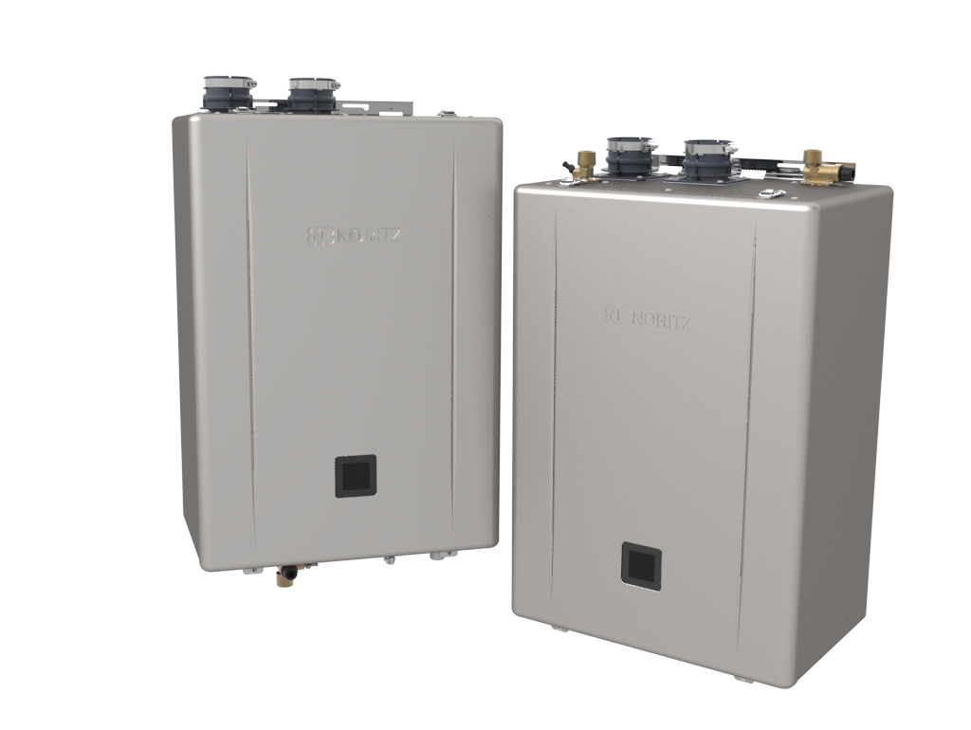


Overview, Features and Changes

Slide 2
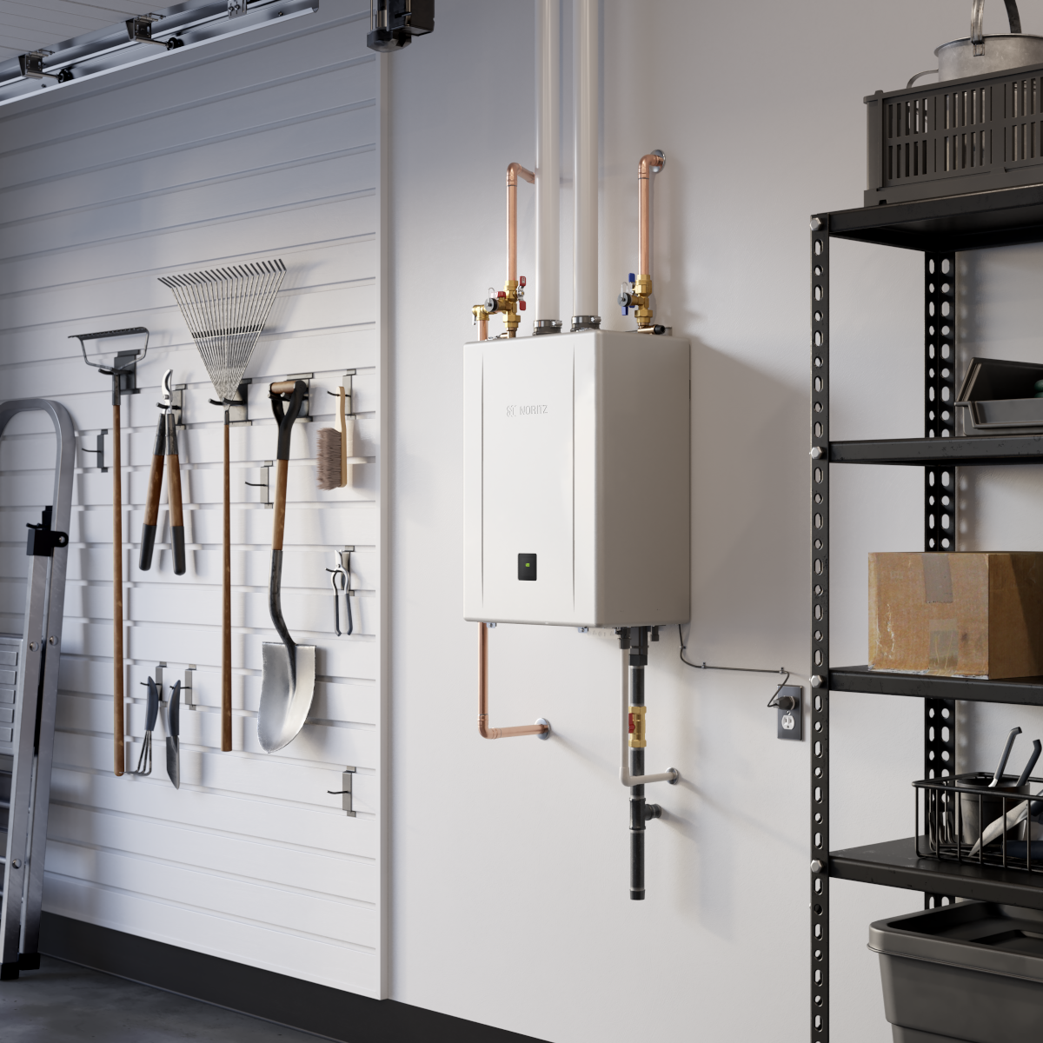

OUTLINE
What’s New
New EZ Model
Field Gas Conversion
EZ Start Plus Bluetooth App
Built in Display Window
Front Cover Latches
Model Specifications
Installation
Venting
Gas
Condensate
Unit Settings
Basic Maintenance

Slide 3
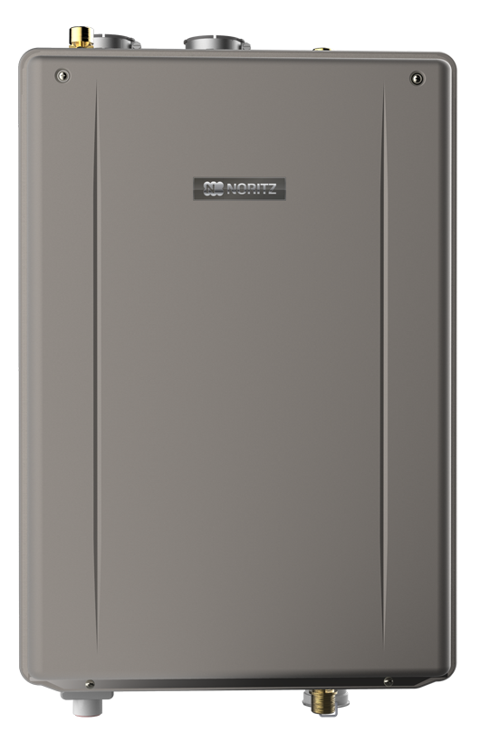
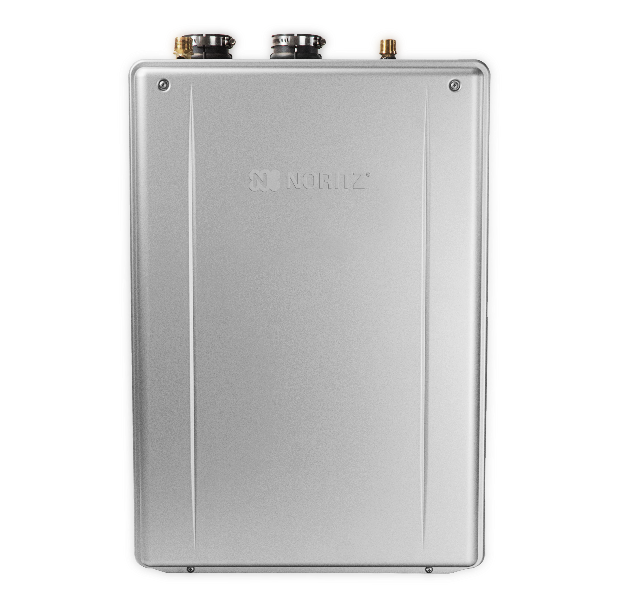
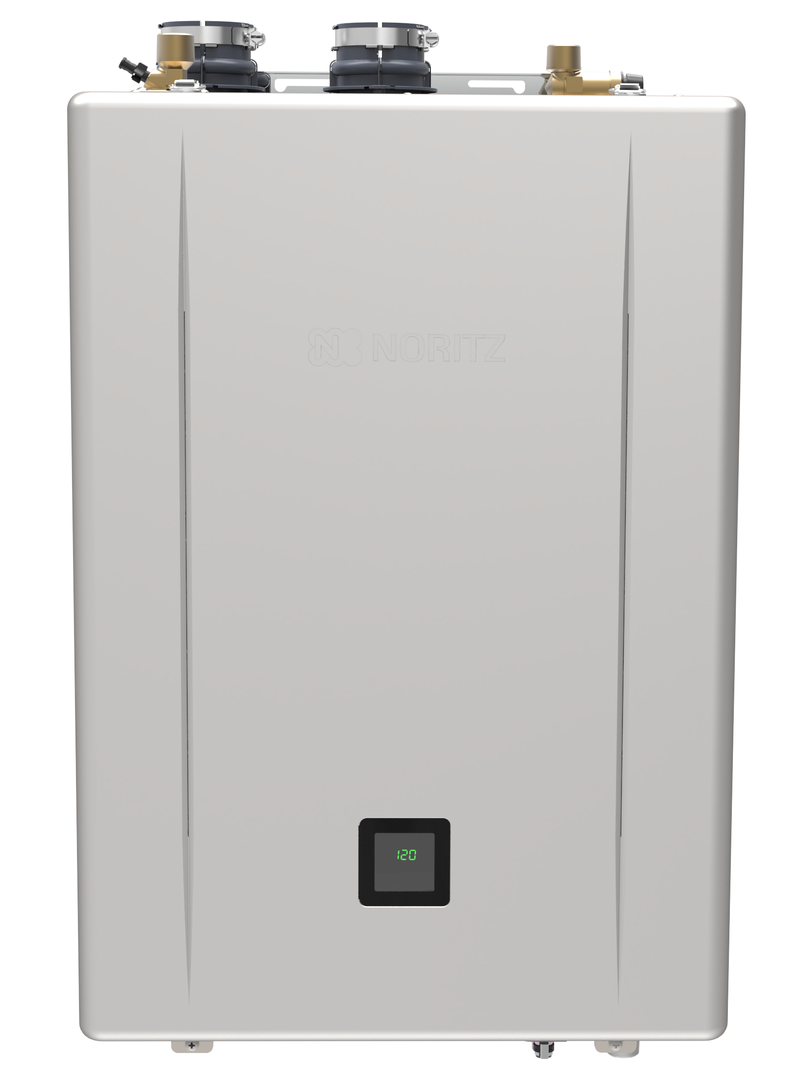
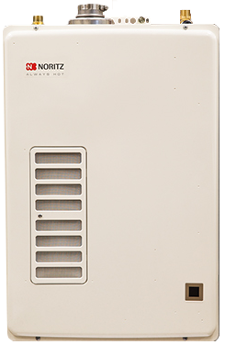
10+ YEARS OF EZTR INNOVATION
It all started in 2014 with the EZTR40 package, offering installers a time saving and EZ way to replace a tank with a tankless utilizing top mounted water connections. In 2017 the Pre-Mix EZ and EZTR models were introduced offering higher efficiency and capacities. In 2020 the EZ/EZTR Pre-Mix lineup was expanded to include the NRCR along with new features like Steady BTU. Now, the latest EZ and EZTR models offer even higher efficiency and more features including a new EZ71 model!
2014
2017
2020
2024

Slide 4
WHAT’S NEW?

Slide 5
WHAT’S NEW
.98 UEF for all models
Highest UEF for complete BTU range in the industry
New EZ Model
160kbtu EZ71 Model Added
Field Gas Conversion
Default setup for NG, conversion included to change to LP without the need to order a gas conversion kit.
EZ Start Plus Bluetooth App
Physical dipswitches are gone! Unit setup is done entirely through Bluetooth app.
Built in Display Window
Remote control is optional. Maintenance Monitors and Unit Settings can be accessed through the Display Window.

Slide 6
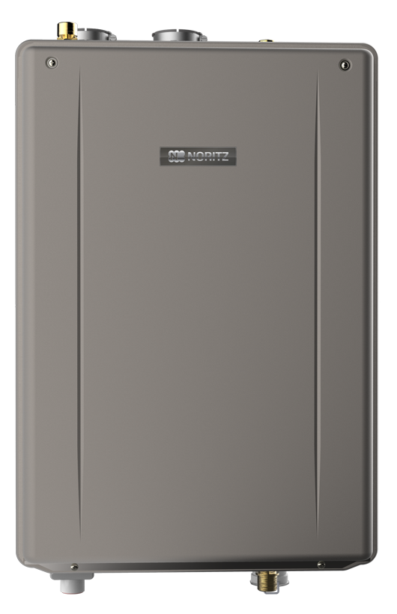
NEW LEVEL OF EFFICIENCY
The new EZ Series Pro and the entire new Pre-Mix line up all achieve a .98 UEF making them among the most efficient tankless models on the market.
.87 UEF
.96 UEF
.96 UEF
.98 UEF
2014
2017
2020
2024

Slide 7
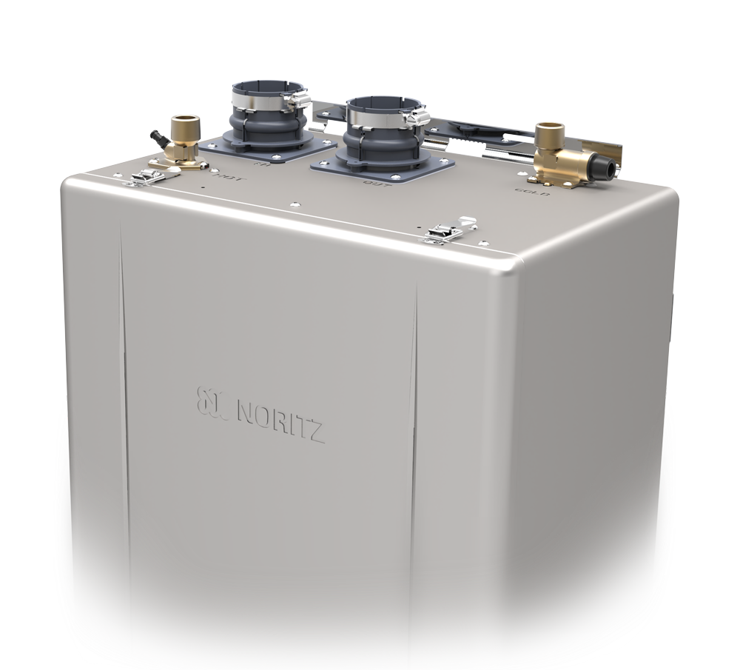
NEW EZ71 MODEL
With the addition of the EZ71, there is now an EZ unit for those smaller applications where a larger unit doesn’t make much sense.
The EZ71 will be available as an individual unit and not part of an EZTR package, however you may still use the flex vent conversion and flex vent kit like any other EZ unit.

Slide 8
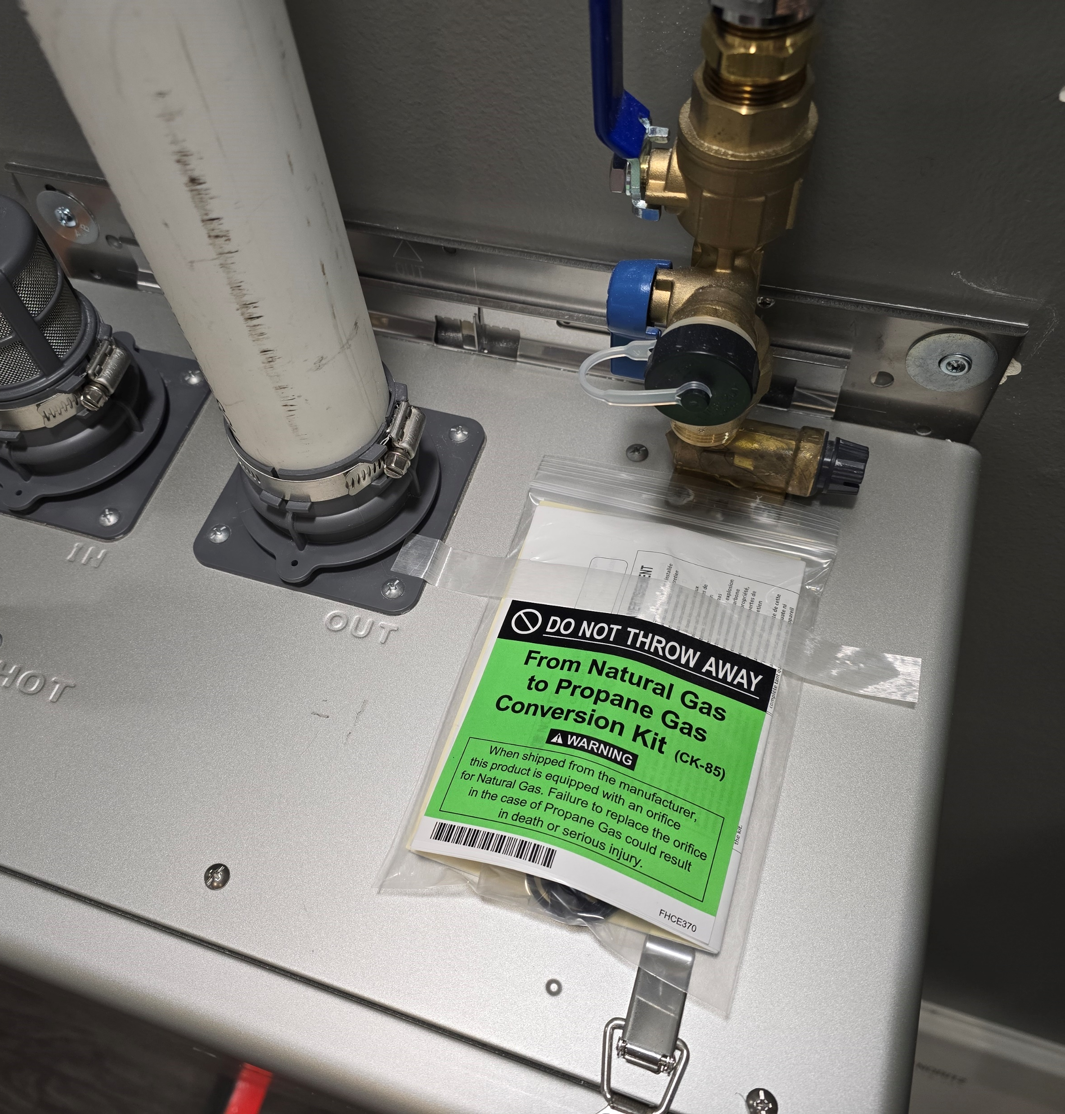
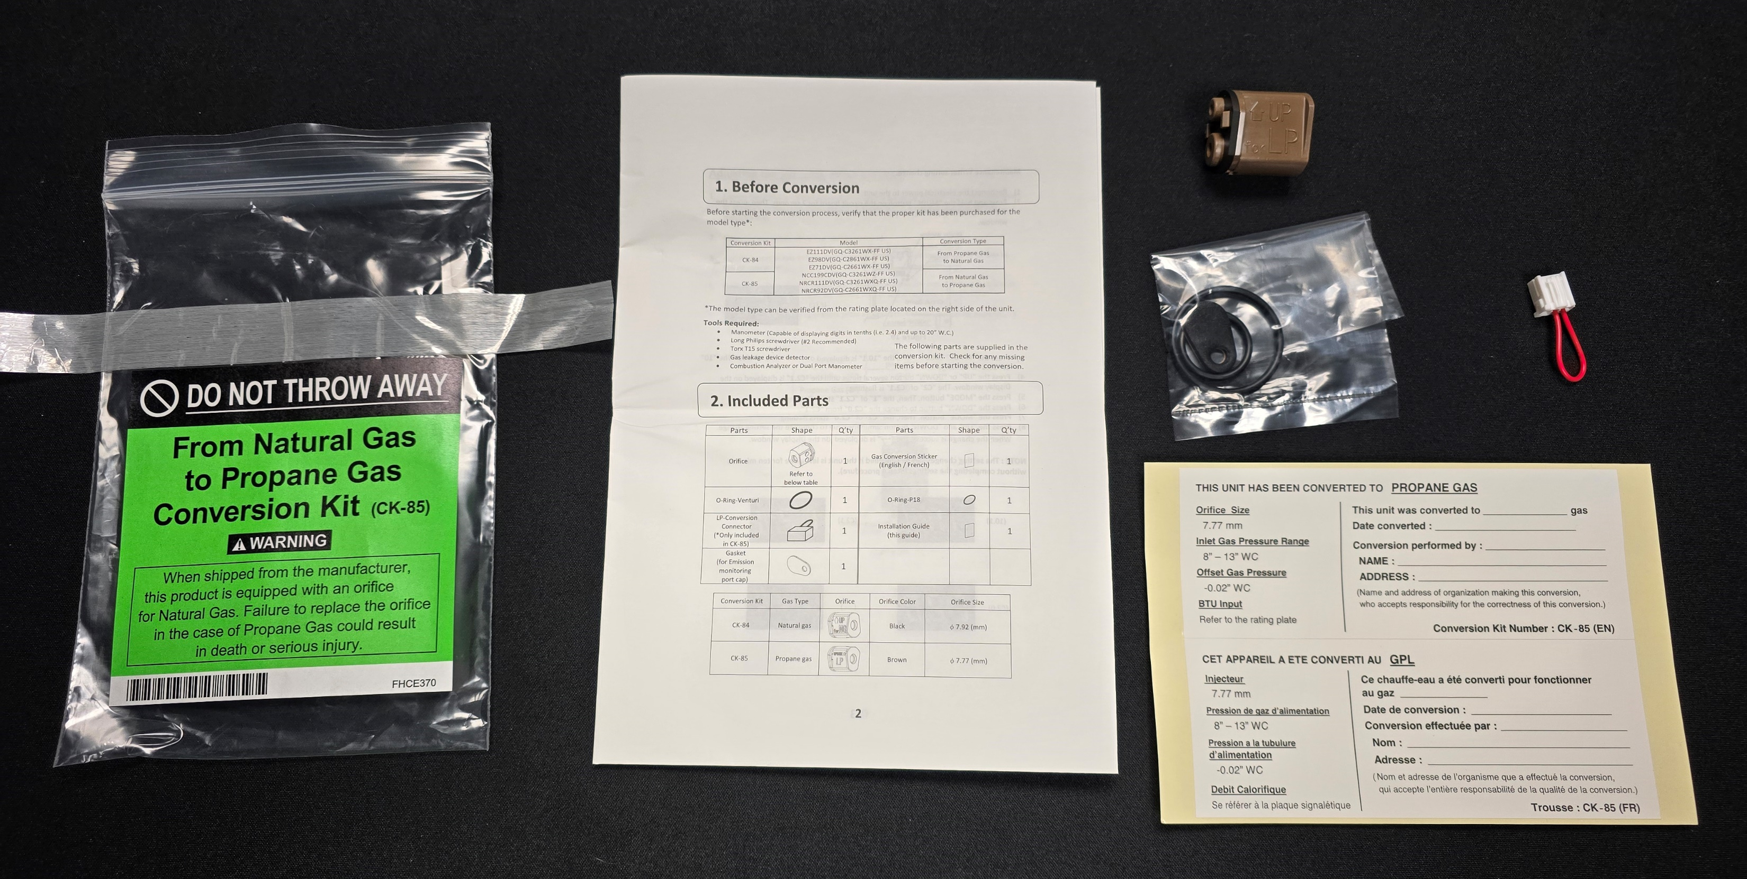
FIELD GAS CONVERSION
All EZ Series Pro and future Pre-Mix models are ready to be used with NG. If the jobsite has LP, a simple field gas conversion can be performed without the need to purchase any additional parts. Conversion is EZ and can be done in about 5 minutes.
Conversion Kit taped to top of unit
Contents of LP Conversion Kit

Slide 9
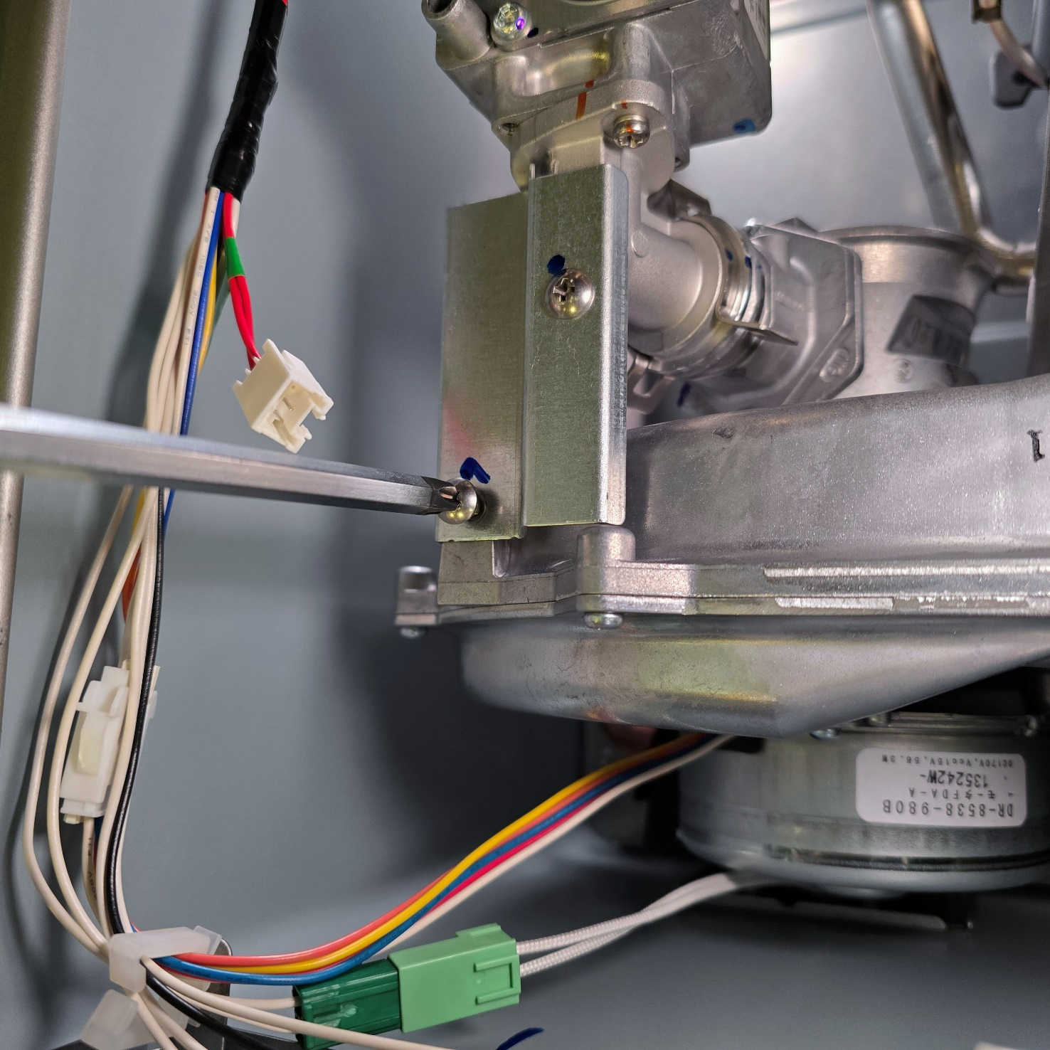
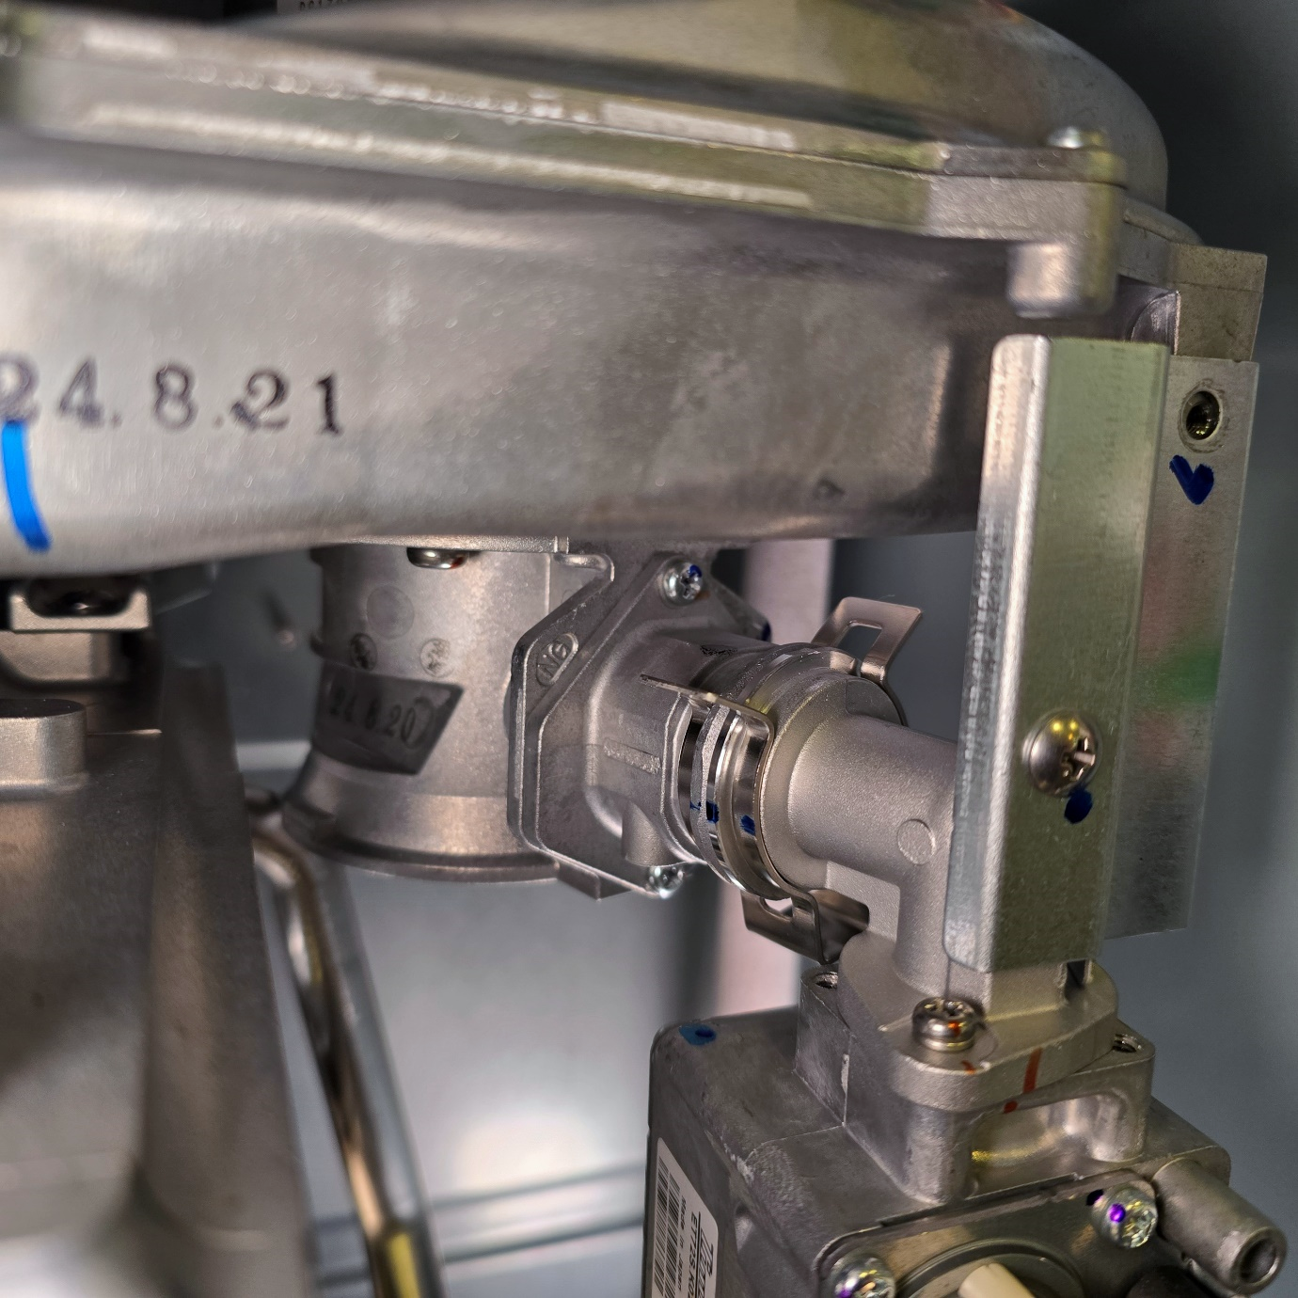
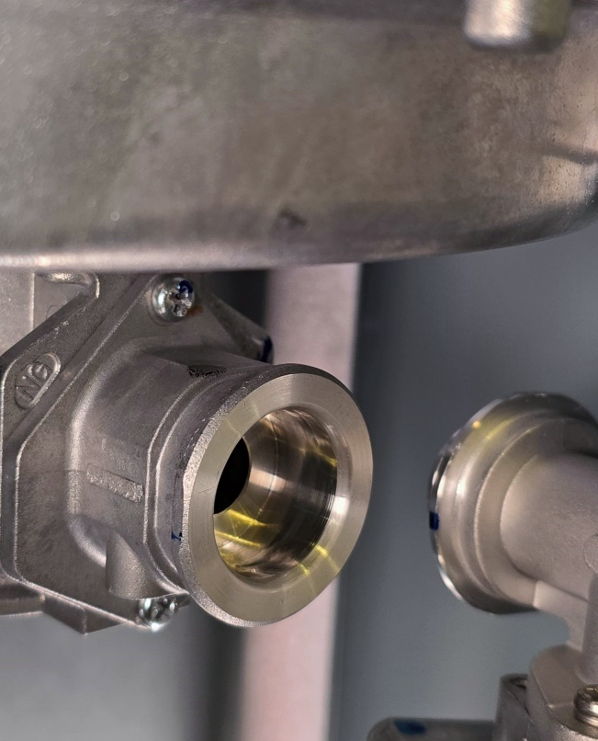
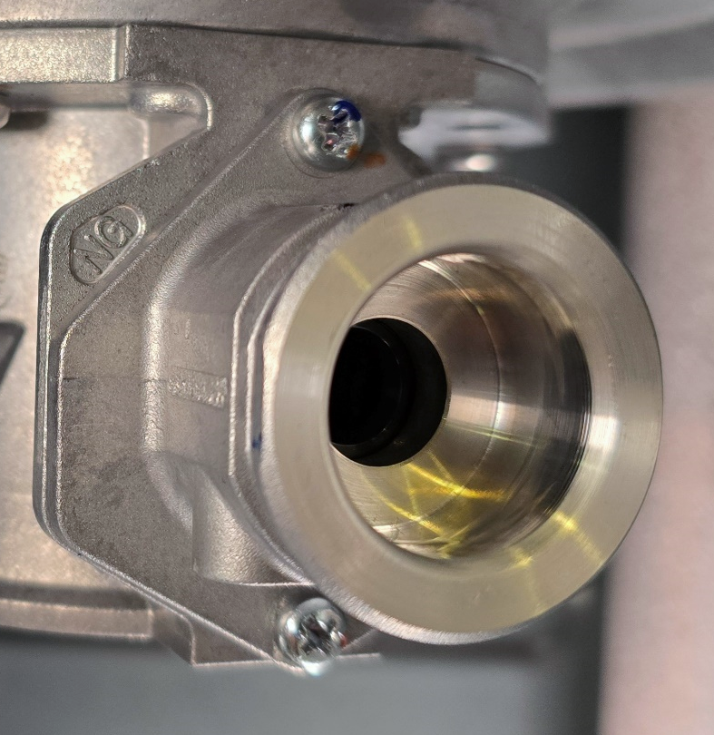
FIELD GAS CONVERSION
Step 1
Step 2
Step 3
Step 4
Remove screw
Remove the c-clip
Carefully remove gas fitting
Remove 2 screws securing venturi fitting

Slide 10
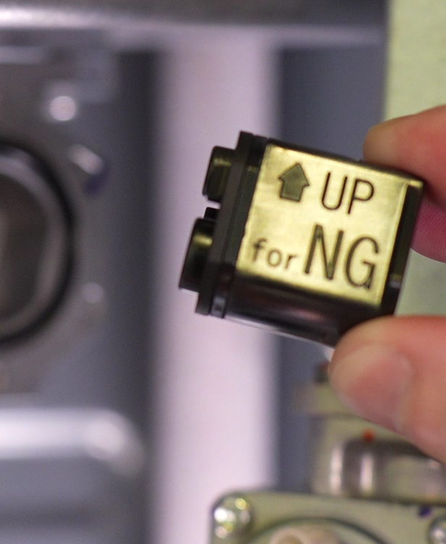
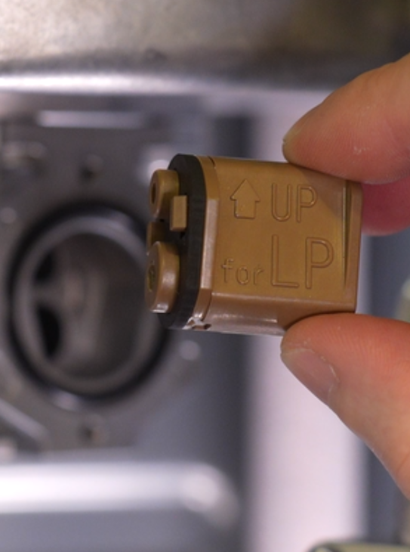
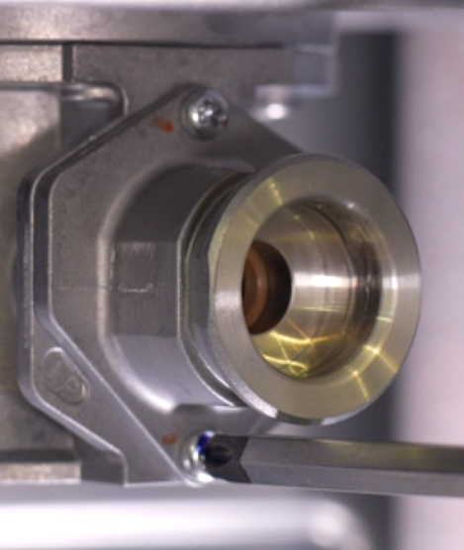
FIELD GAS CONVERSION
Step 5
Step 6
Step 7
Step 8
GASKET
O-RING
Remove NG orifice
Insert LP orifice
(make sure o-ring and gasket aren’t lost or damaged)
Secure venturi fitting
Insert gas fitting, secure c-clip and screw

Slide 11
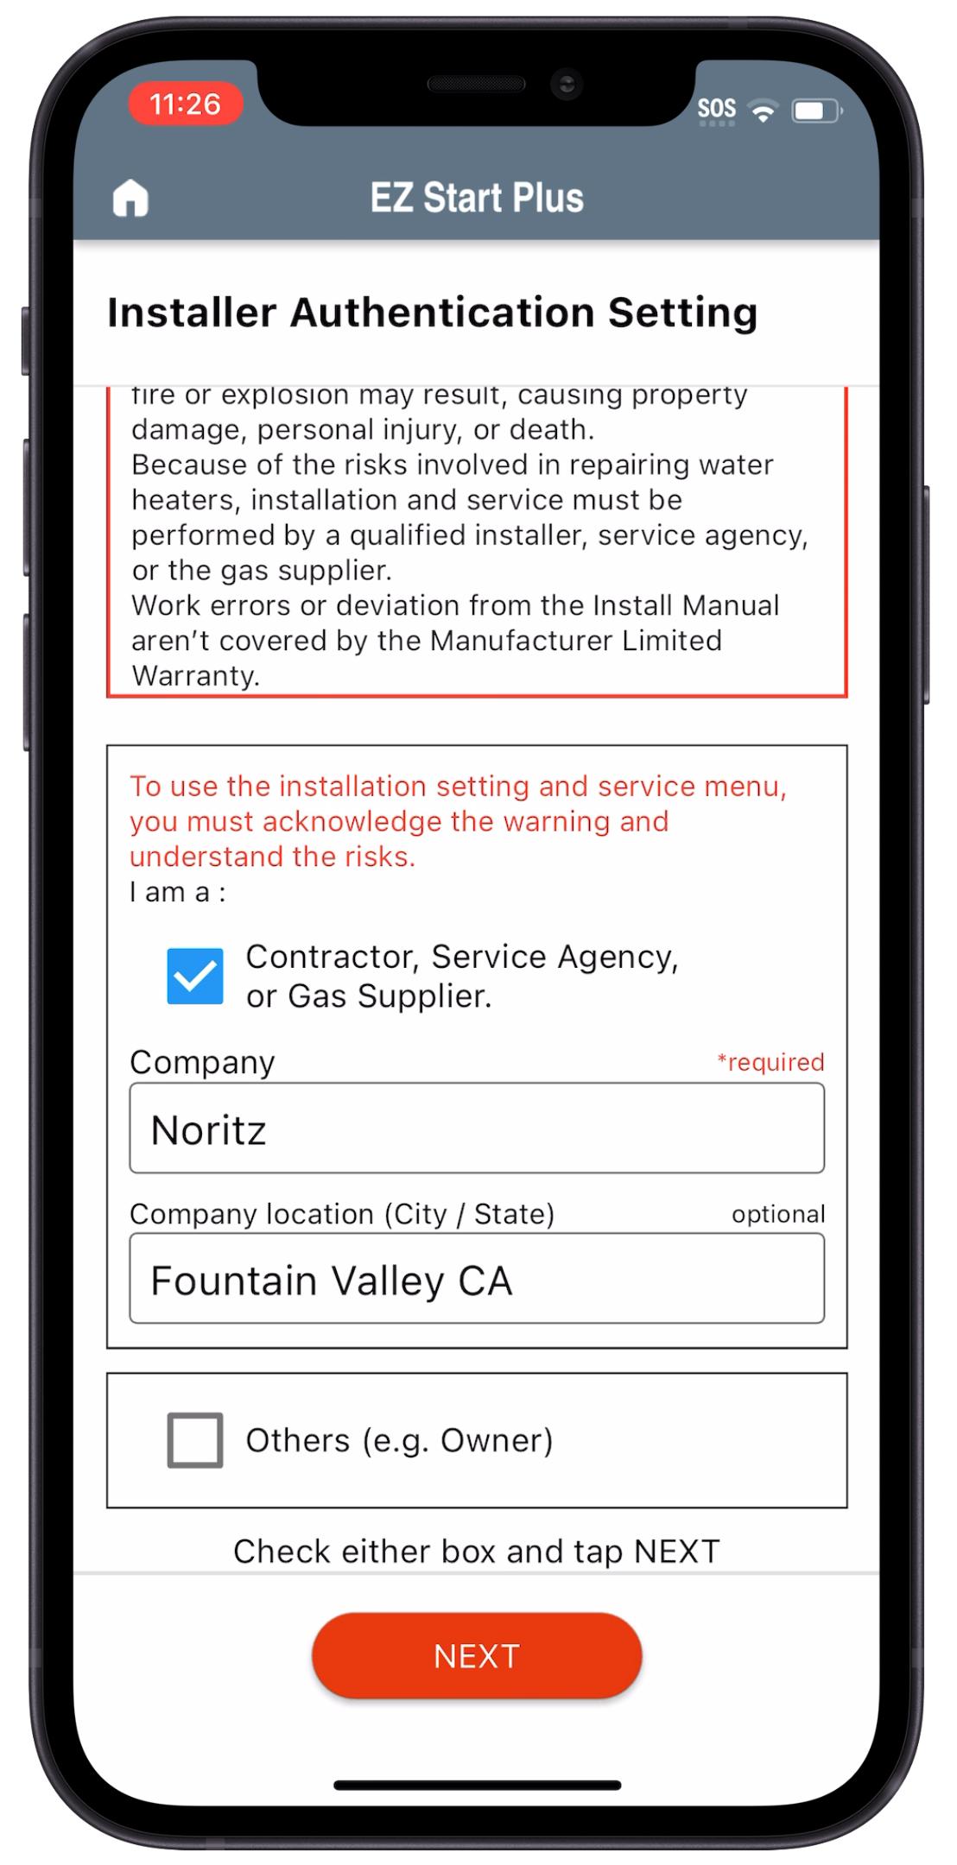
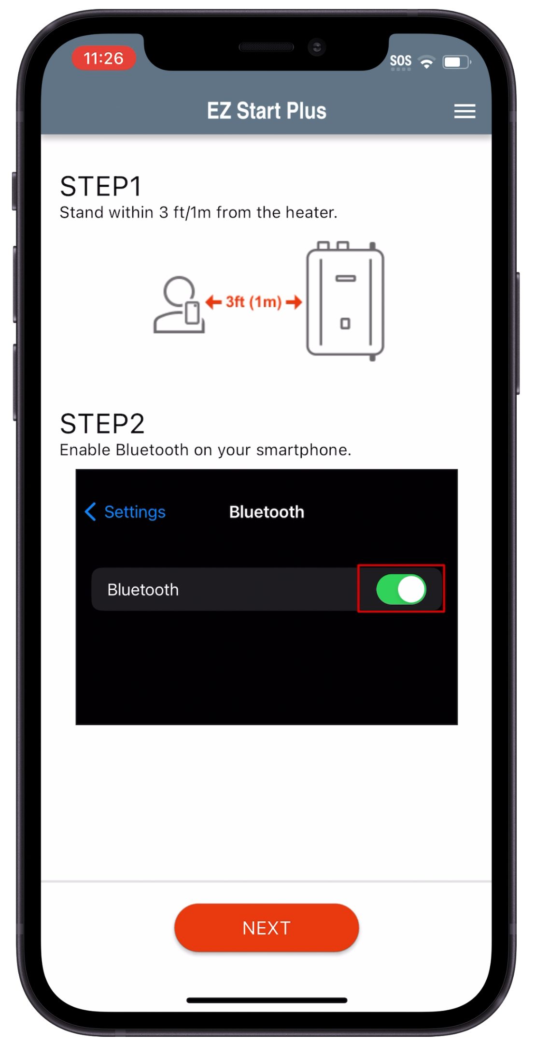
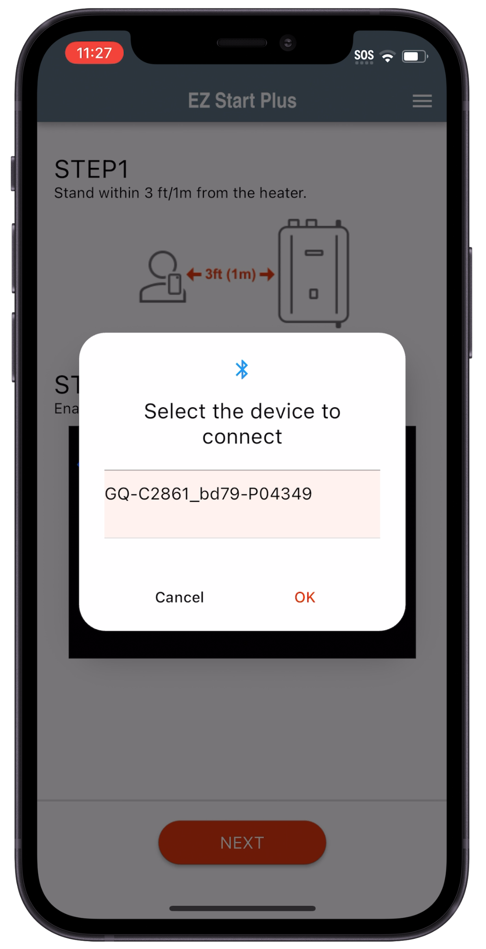
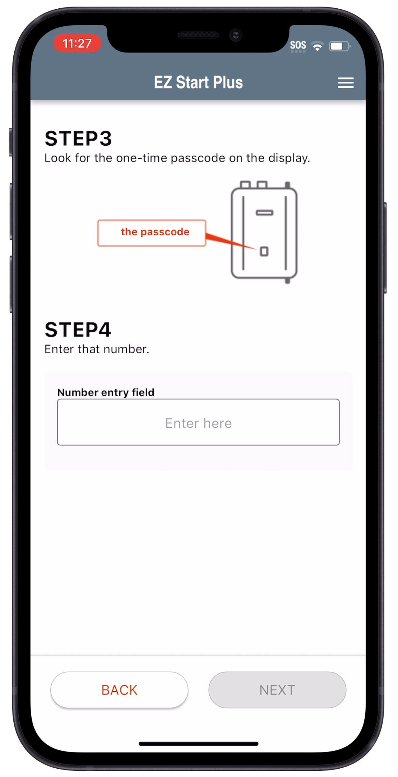
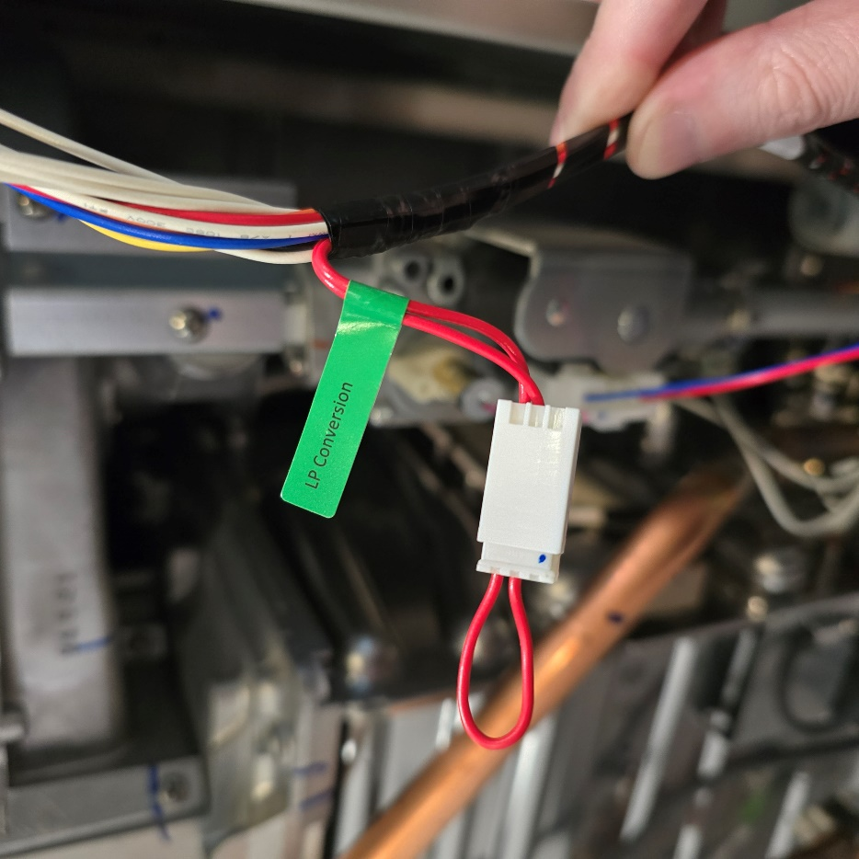

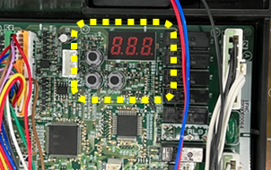
FIELD GAS CONVERSION
Step 9
Step 10: Changing gas type to LP with EZ Start Plus App
Plug in LP conversion connector
*Built in display can also be used to convert gas type, see gas conversion directions included with unit
Open EZ Start Plus App and select Contractor
Make sure Bluetooth is ON
Select Unit then tap OK
Enter Passcode and tap “NEXT”

Slide 12
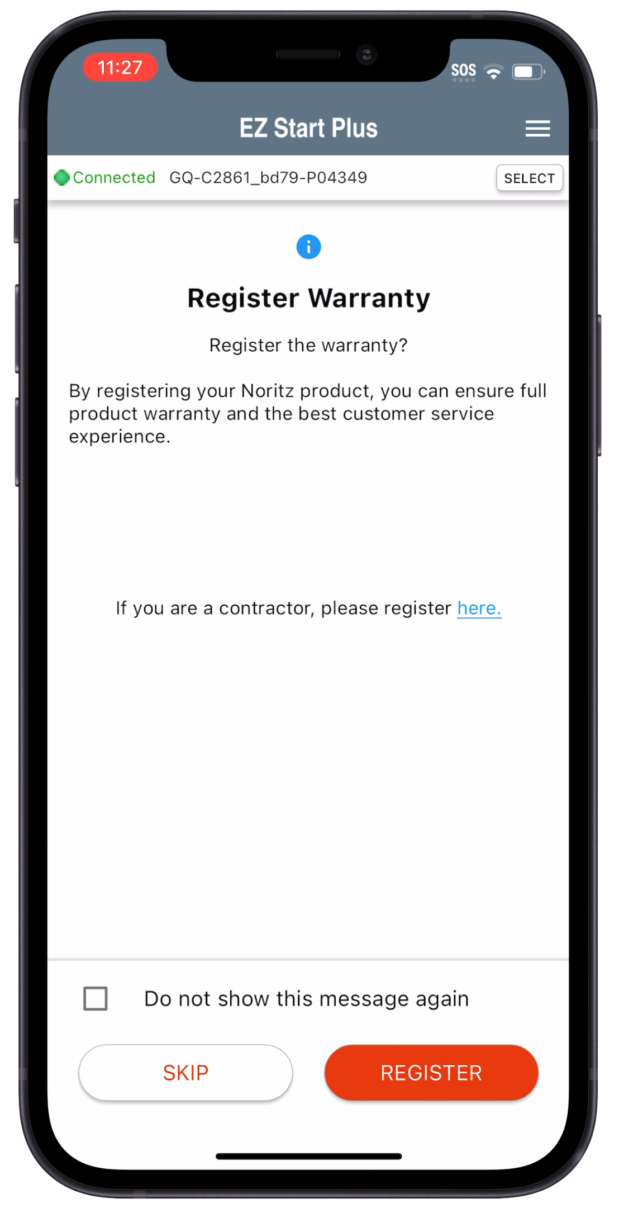
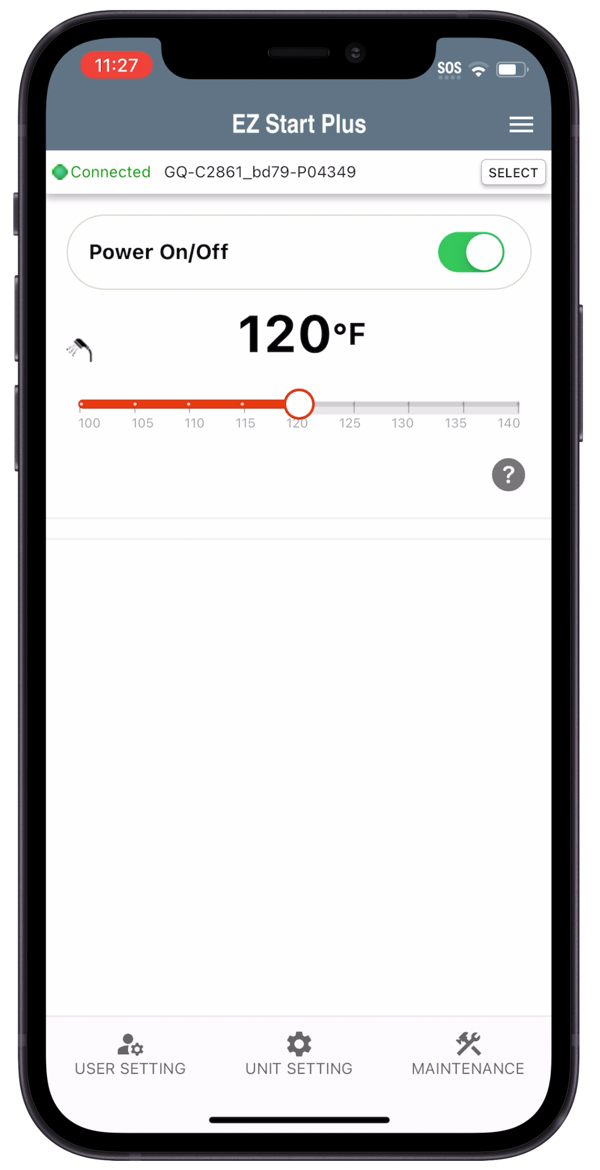
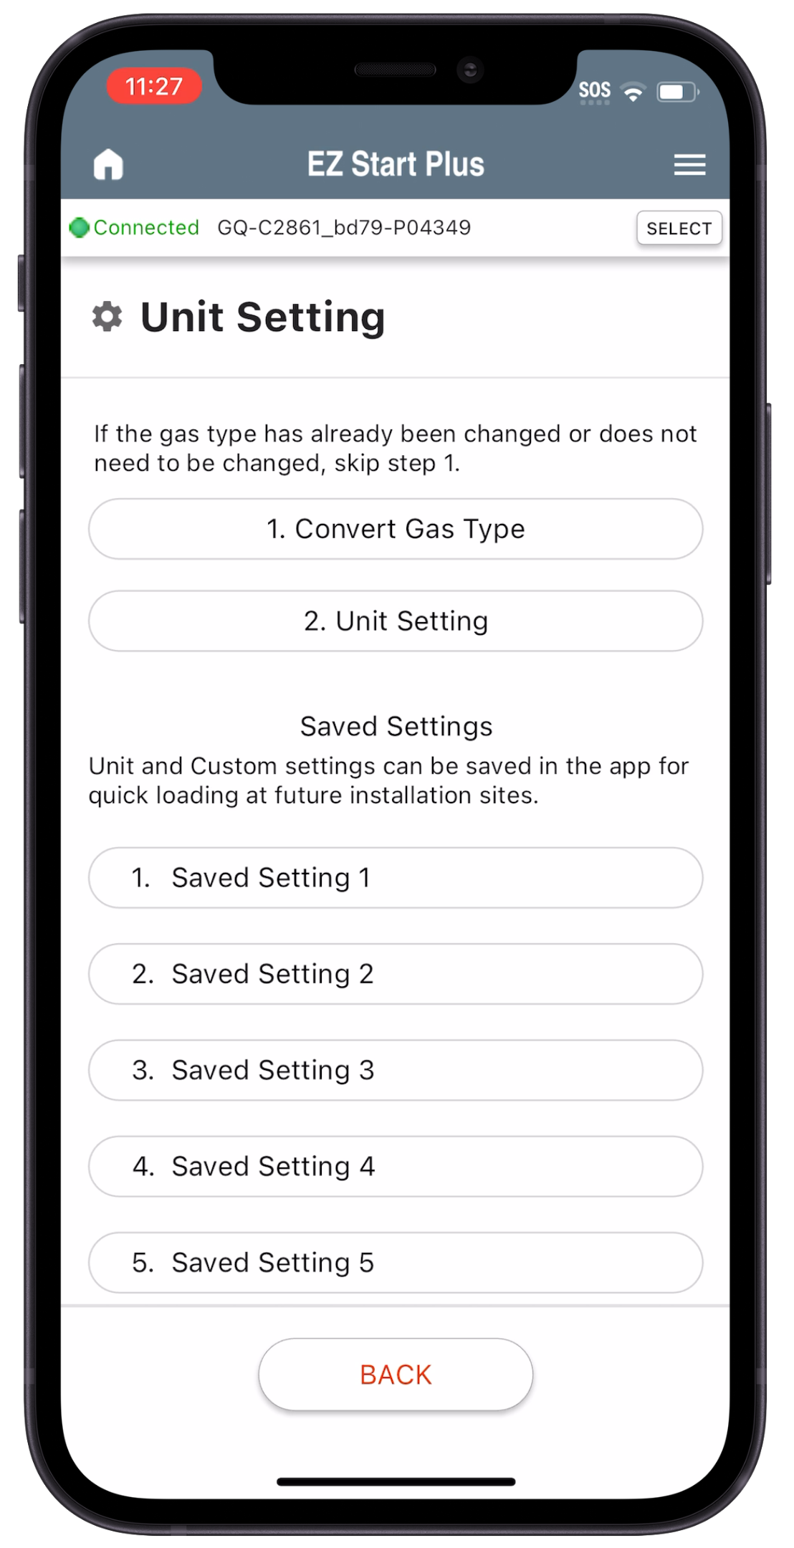
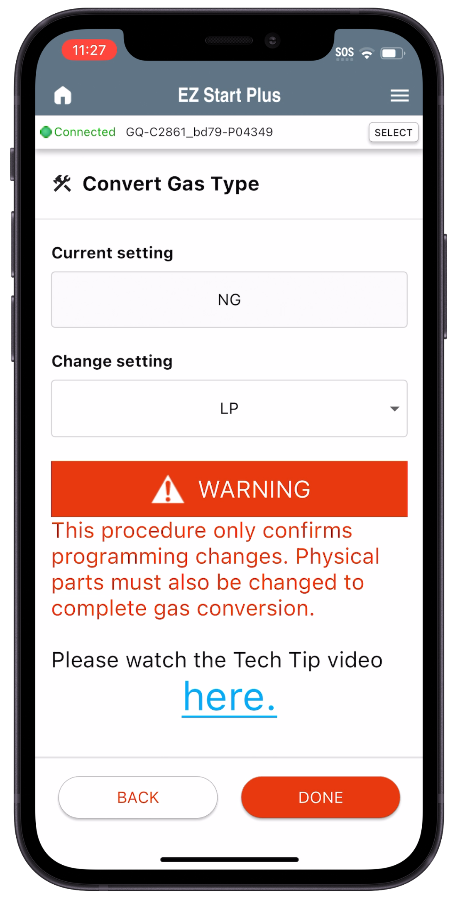
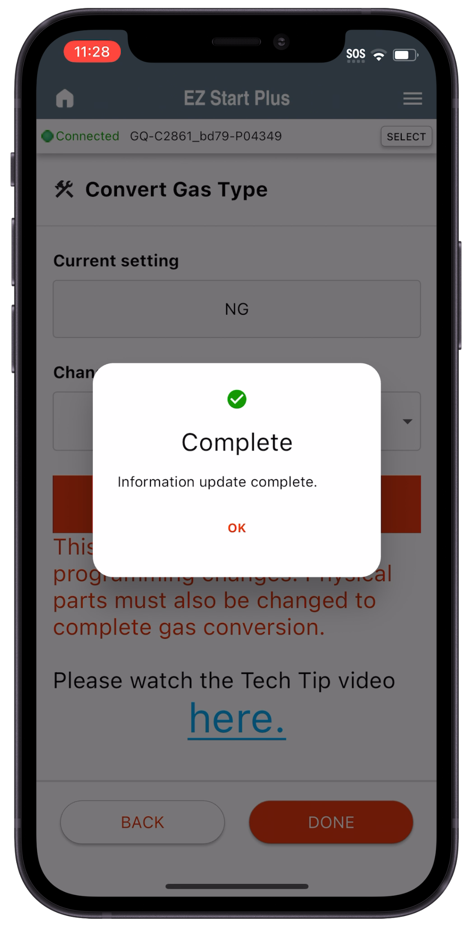
FIELD GAS CONVERSION
Step 10 (continued): Changing gas type to LP with EZ Start Plus App
Register Warranty or skip
Tap “Unit Setting”
Tap “Convert Gas Type”
Tap Change Setting, Tap LP then tap “DONE”
After a few seconds it should show complete

Slide 13
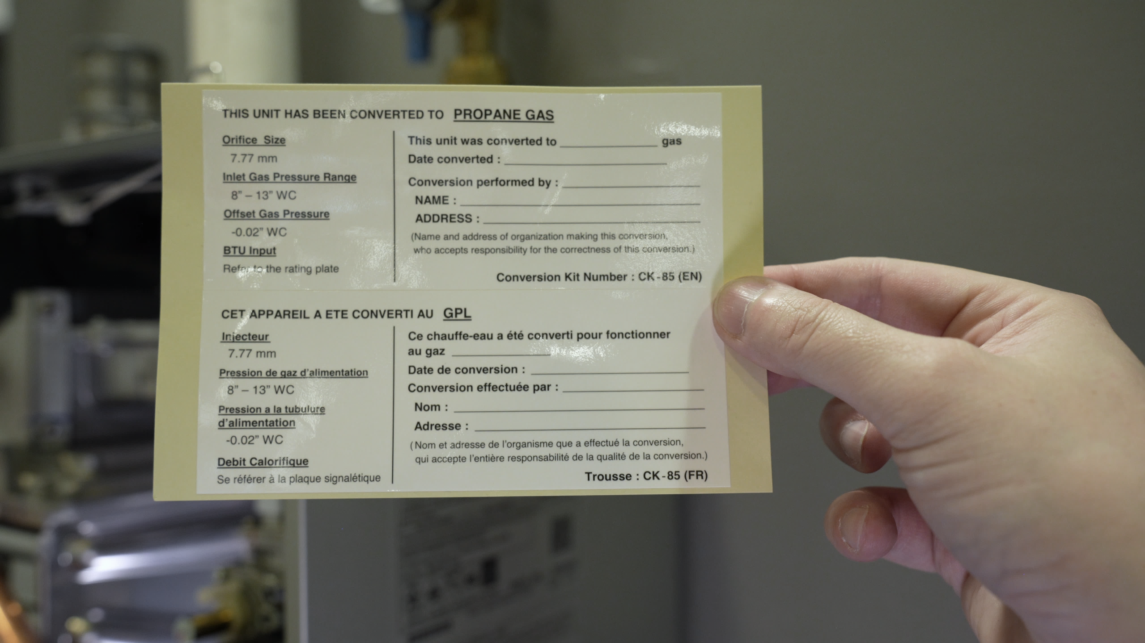
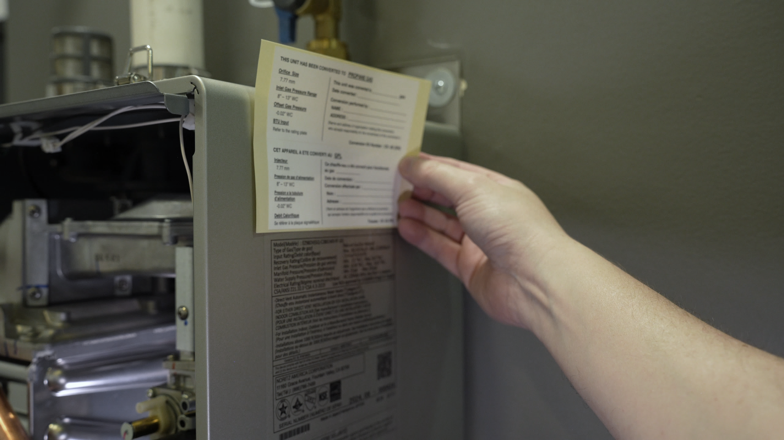
FIELD GAS CONVERSION
MAKE SURE TO FILL OUT AND ATTATCH GAS CONVERSION STICKER TO UNIT

Slide 14
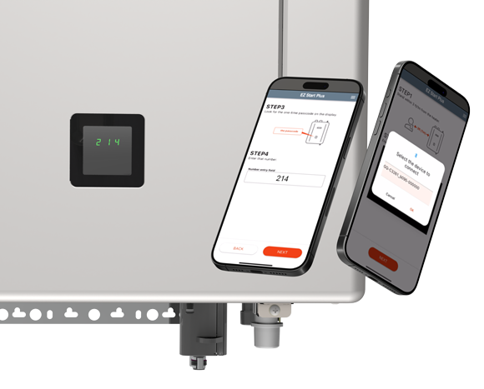
EZ START PLUS APP
Initial unit setup, temperature adjustment and maintenance can all be handled through the new EZ Start Plus Bluetooth App!
The App will walk you through setting up the unit upon completing installation and provides an easy way to register the unit for your customers.
Error Code History can be accessed and will link you directly to help articles related to any error codes stored.

Slide 15
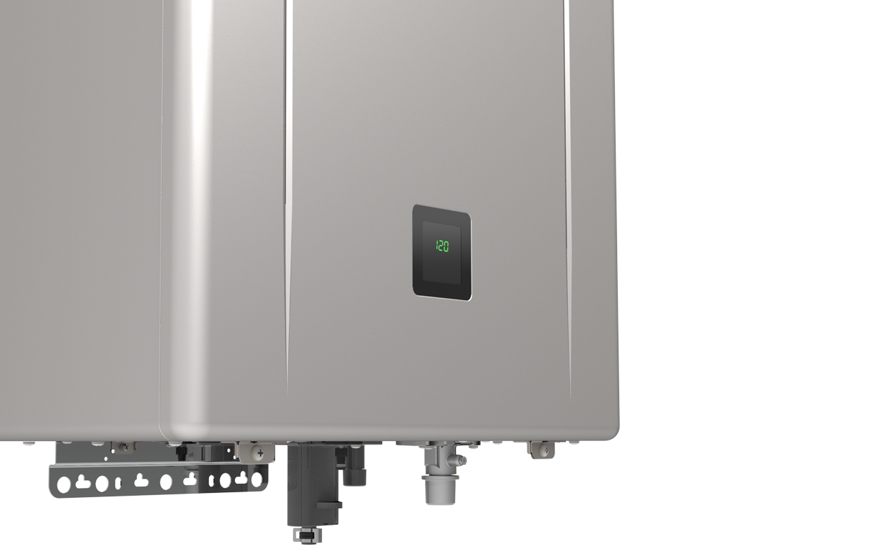
BUILT IN DISPLAY WINDOW
Displays temperature setting, service reminders and error codes. Also allows you to view maintenance monitors, error code history and change installation settings. The new display window makes the remote control a truly optional item.

Slide 16
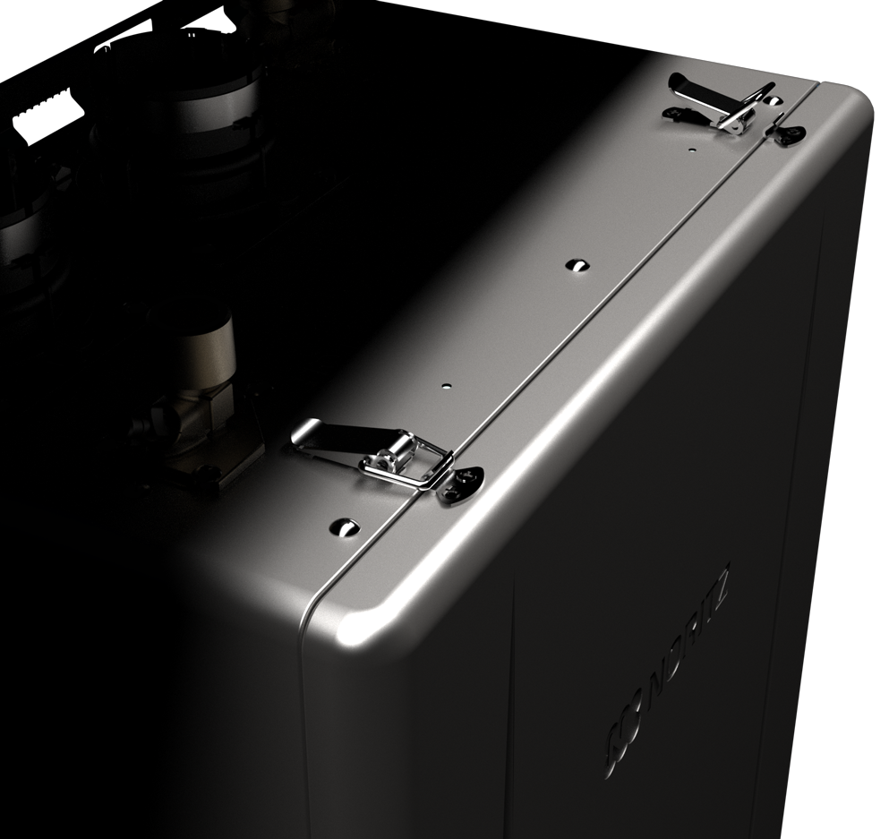
NEW LATCHED FRONT COVER
Easier access when performing preventative maintenance, service or operating the built in display window. Remove 2 screws at the bottom of the front cover and the latches hold the cover in place until you’re ready to remove it.

Slide 17
MODEL SPECIFICATIONS

Slide 18
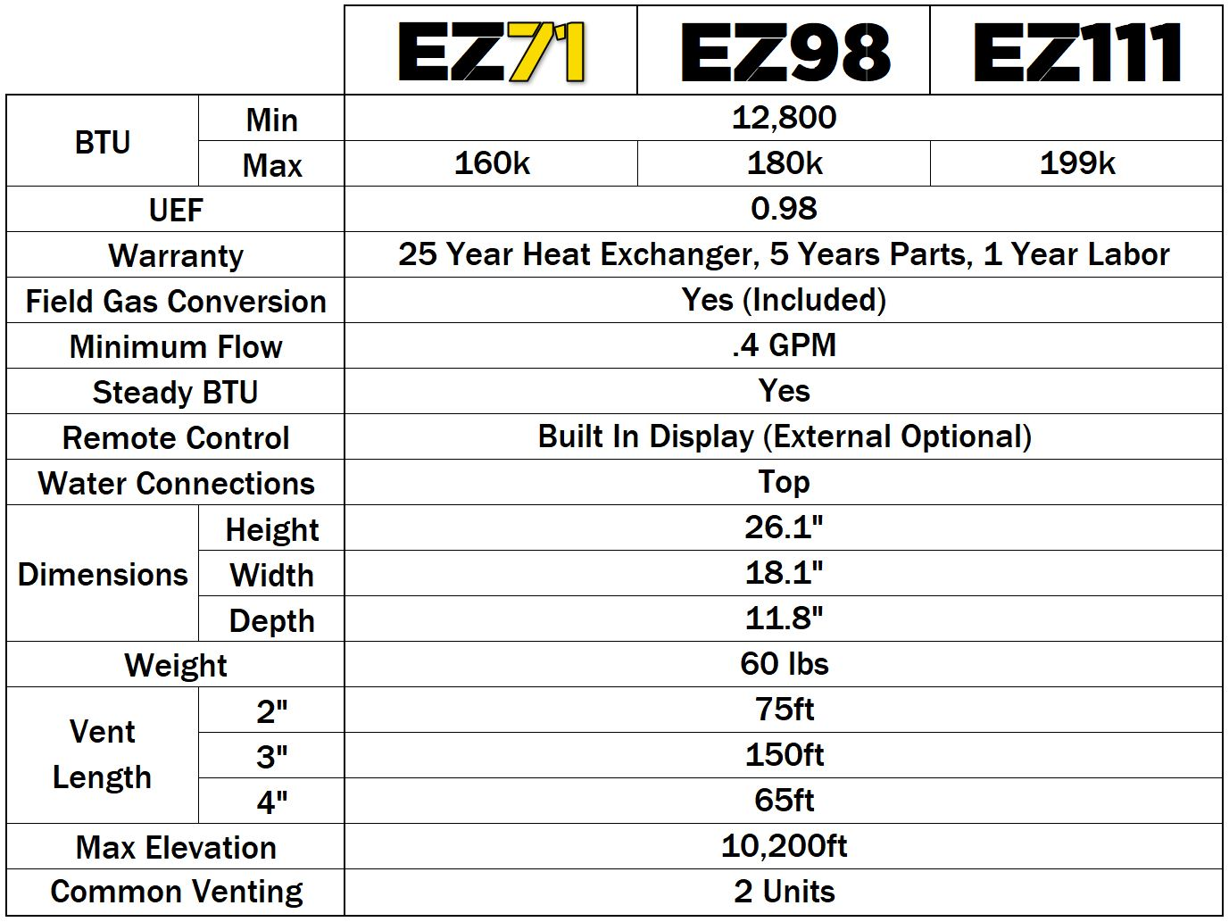
EZ SERIES SPECIFICATIONS
NEW

Slide 19
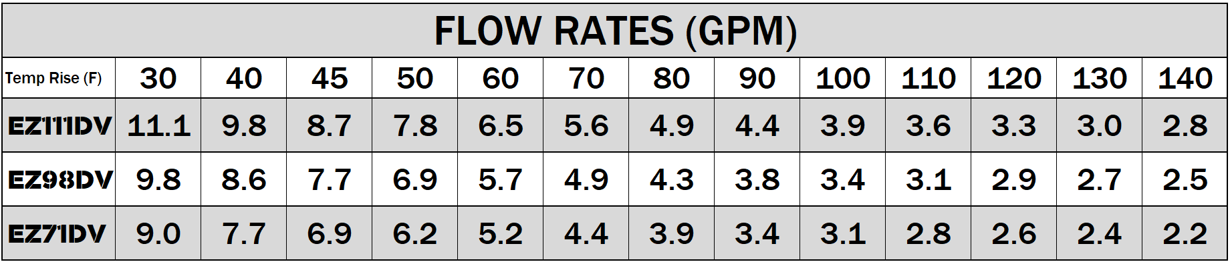

EZ PERFORMANCE
Need more flow? Quick Connect two identical EZ units and double the flow!

Slide 20
INSTALLATION

Slide 21
PRE-INSTALLATION CHECKS
Verify the following before installation and read the manual:
Check the gas:
EZ71 Max btu is 160k
EZ98 Max btu is 180k.
EZ111 Max btu is 199k.
Ensure the existing gas system can support that demand + other existing gas demands.
Check the power:
EZ Series and all Noritz units operate on 120 VAC at 60Hz.
Check the vent:
EZ Series uses plastic venting (PVC, CPVC and PP).
Existing venting will likely have to be replaced unless you are replacing a similar type unit.
Exhaust leaks into the home may lead to injury or death. Do not take shortcuts here.

Slide 22
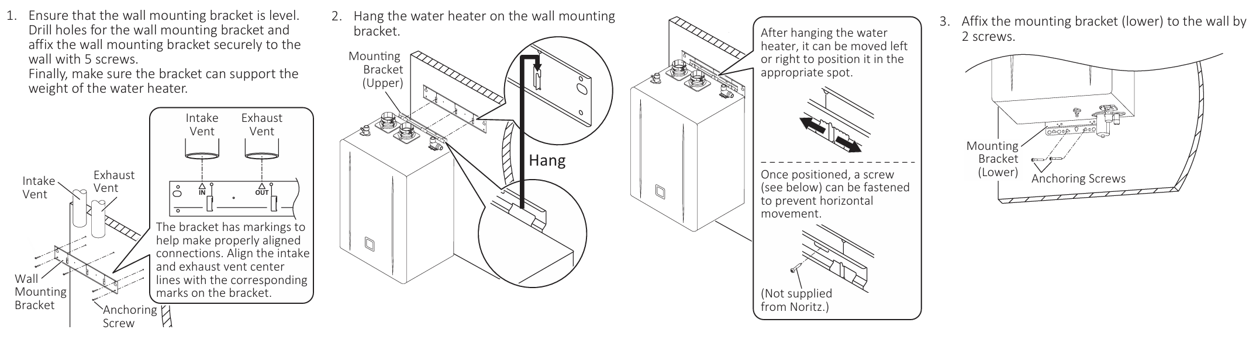
EZ UNIT MOUNTING
Mount bracket, hang heater and shift side to side for precise alignment, secure heater.

Slide 23
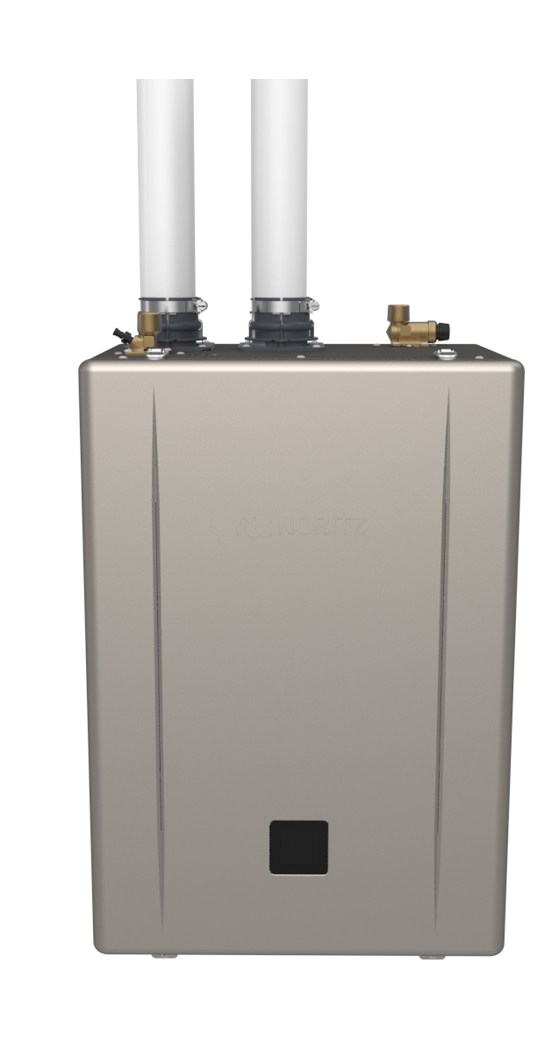
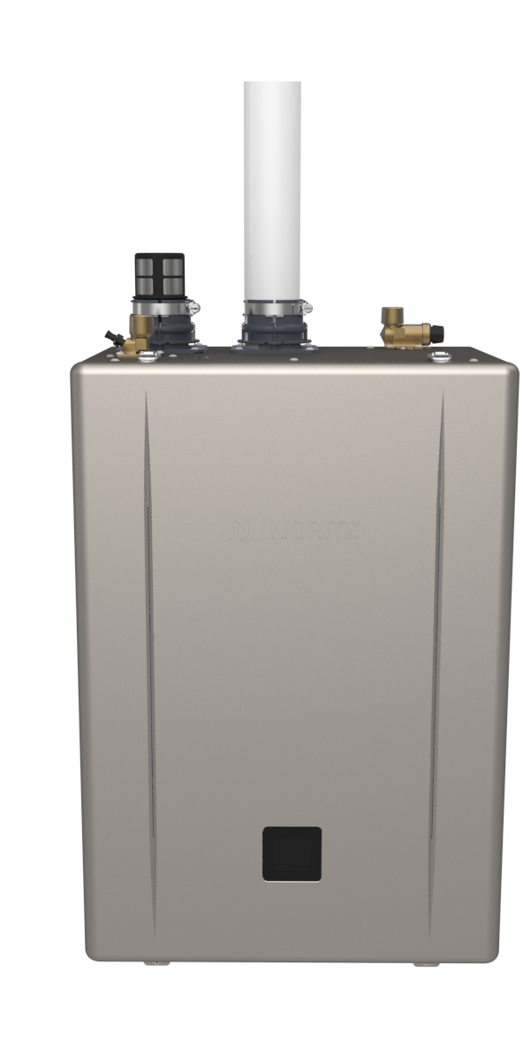
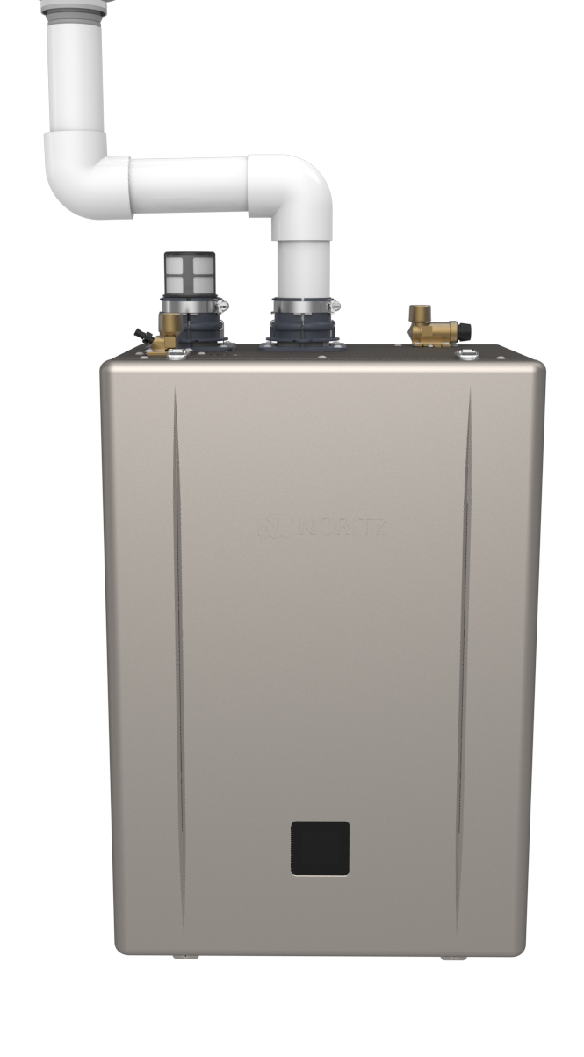
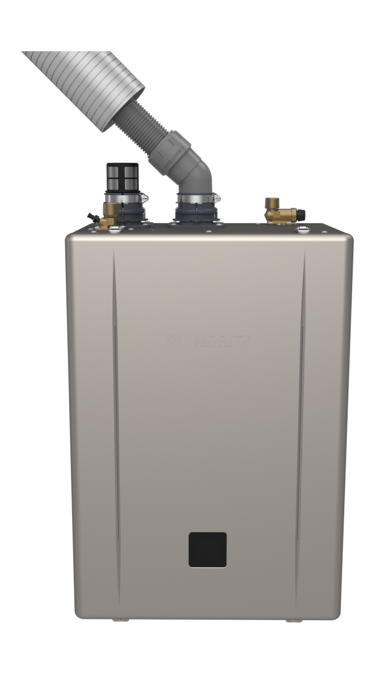
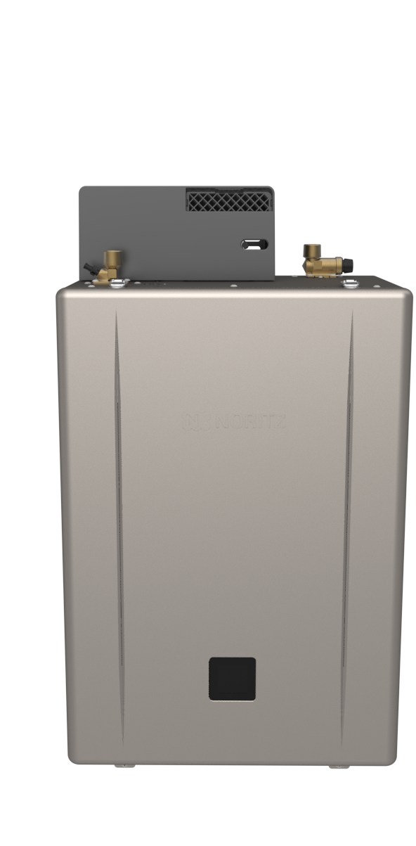
EZ VENTING OPTIONS
As with previous models, you have the ability to install the unit indoors or outdoors with a variety of venting options.
Indoor DV
Indoor SV
Indoor NRK
Indoor FSV
Outdoor
Max Vent Lengths DV or SV:
2”: 75 Feet, 3”: 150 Feet, 4”: 65 Feet

Slide 24
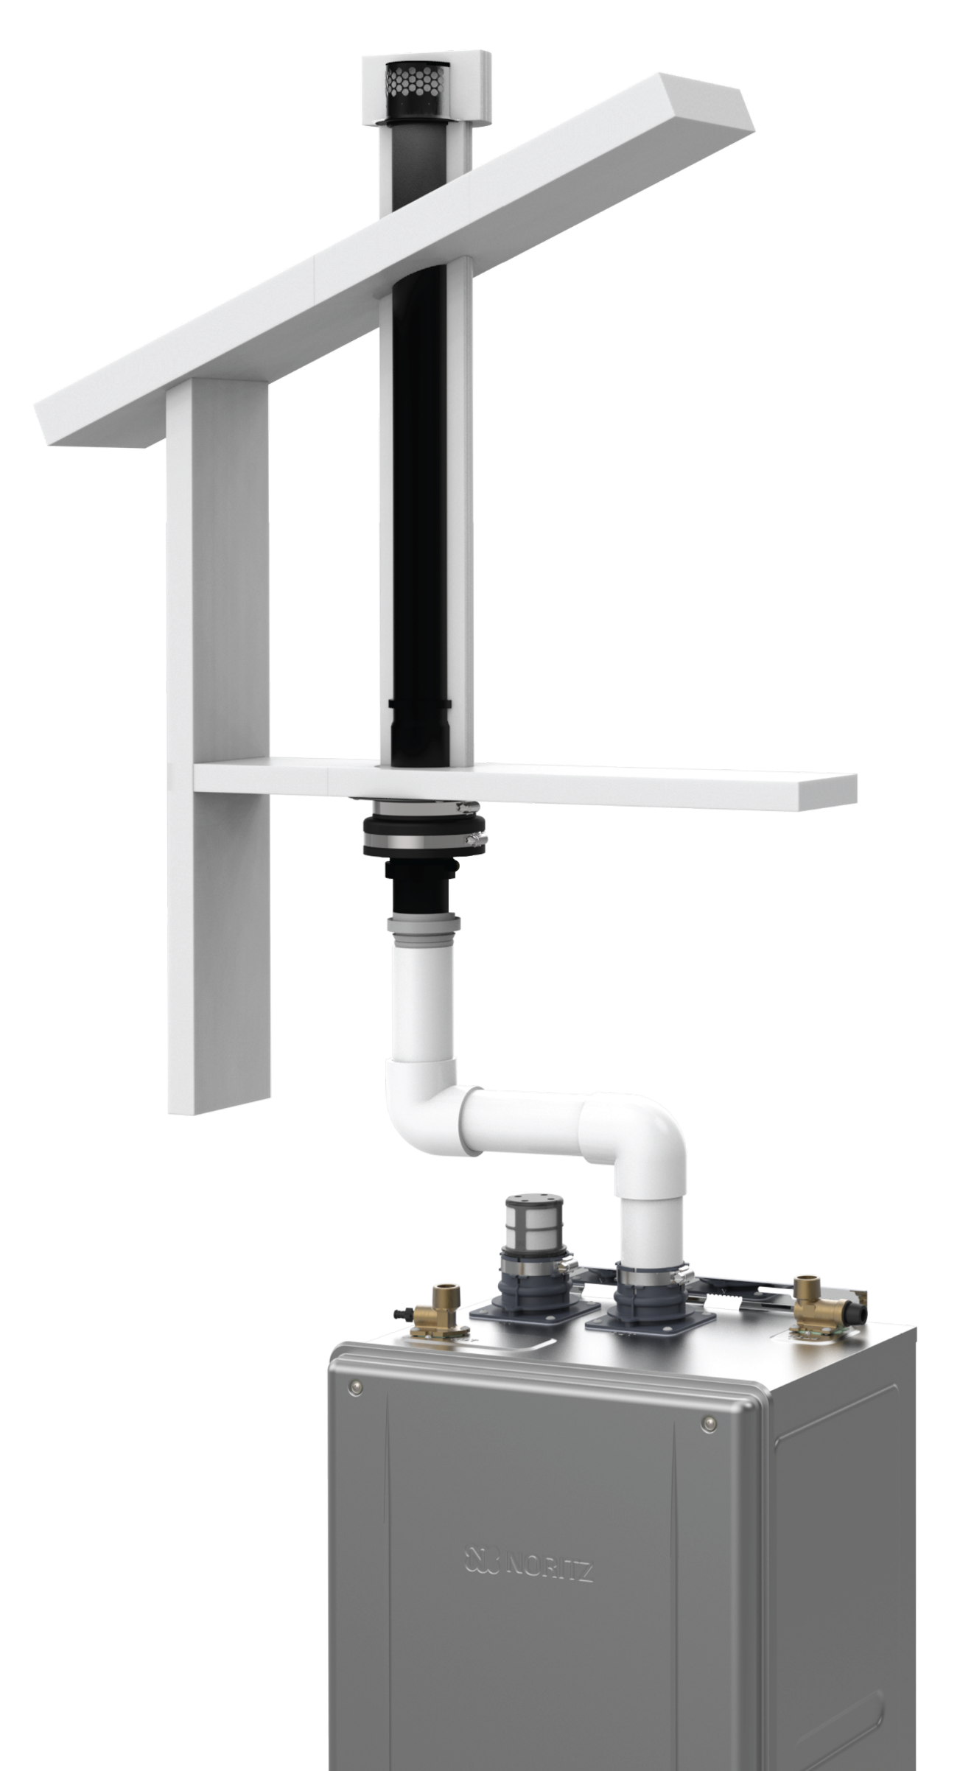
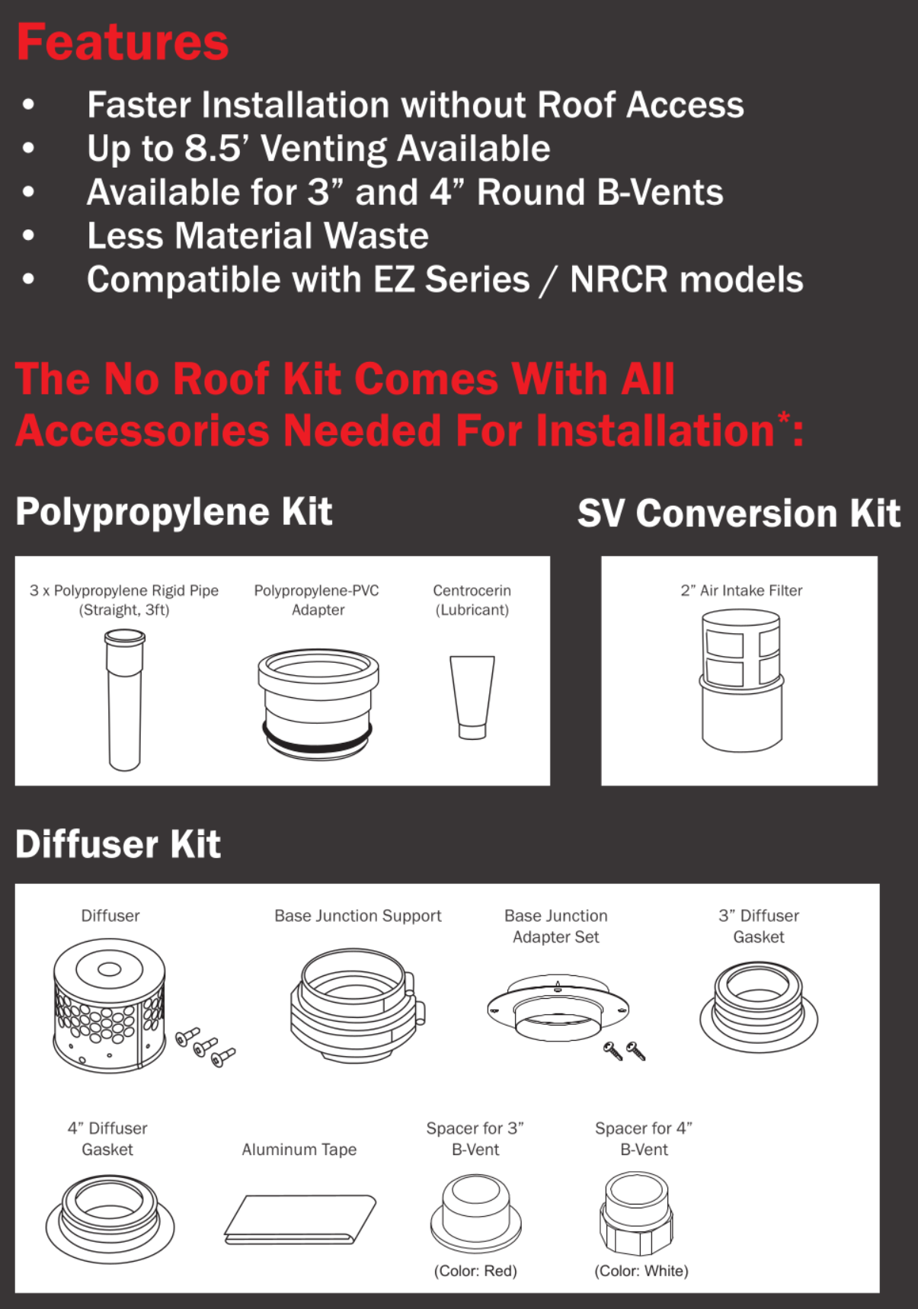
EZ NO ROOF KIT
Have a straight run of b-vent? The No Roof Kit makes it even EZ’er to replace a tank!
Features:
Faster Installation without roof access
Up to 8.5’ venting available
Available for 3” and 4” round b-vent
Less material waste
The No Roof Kit comes with all accessories needed for installation*:
Polypropylene Kit
SV Conversion Kit
Diffuser Kit
Item #: NRK-1
*PVC Parts must be field supplied

Slide 25
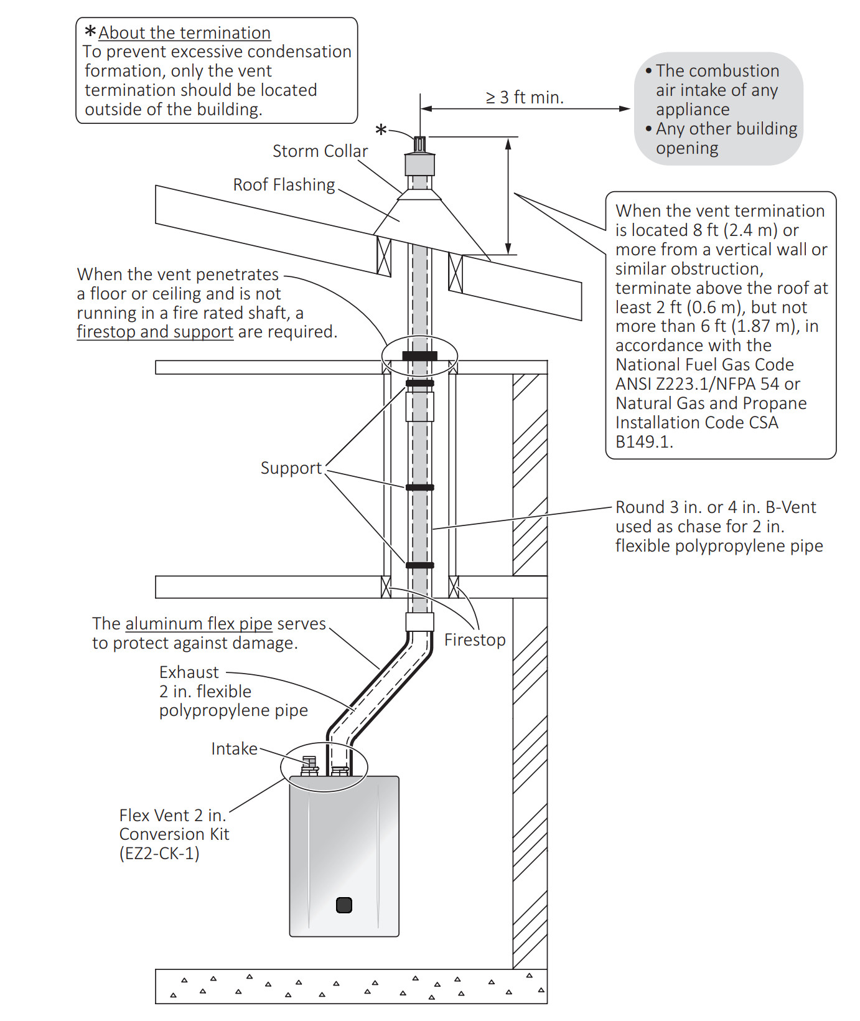
EZ 2 INCH FLEX VENT
Use existing 3” or 4” round b-vent.
2 additional parts numbers required*:
⚫ EZ2-CK or EZ2-CK-1: Conversion kit to adapt unit to accept flex vent.
⚫ EZ2FVK-1 (25 ft.) or EZ2FVK-2 (35 ft.): Select either 25 ft. or 35 ft. depending on length of existing b-vent.
NOTE: Flexible vent can be shortened but you cannot join 2 pieces of flexible vent to extend the length.
*NOT Required if an EZTR package is purchased.

Slide 26
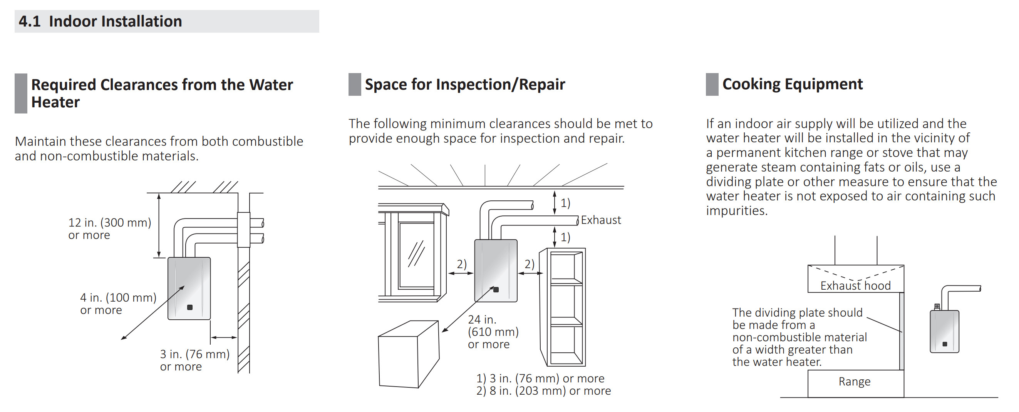
INSTALLATION CLEARANCES
Verify the following before installation and read the manual
Select a proper installation location:
Maintain minimum required clearances and if possible, recommended clearances.
Required
Recommended
Cooking Equipment

Slide 27
INSTALLATION CLEARANCES
Verify the following before installation and read the manual
Select a proper installation location:
Maintain minimum required clearances and if possible, recommended clearances.
Recommended clearances are not only there to provide enough space for inspection, maintenance and repair but also to make sure the homeowner has quick and unimpeded access to gas and water shut off in the unlikely event of an emergency.
Required
Recommended
Cooking Equipment

Slide 28
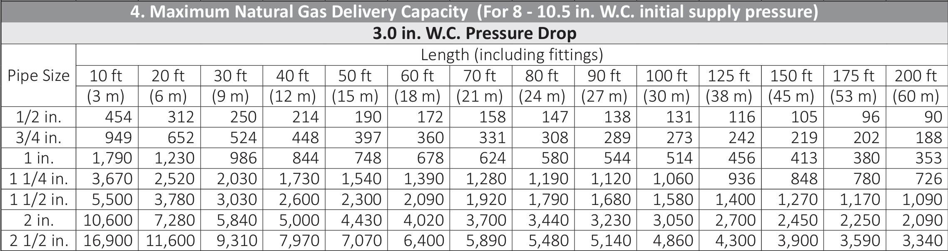
EZ ½” GAS LINE CONDITIONS
½” Gas line is still an option with the new EZ Series Pro assuming an 8” WC or higher initial starting pressure. As always, make sure to follow the gas sizing tables in the installation manual.

Slide 29
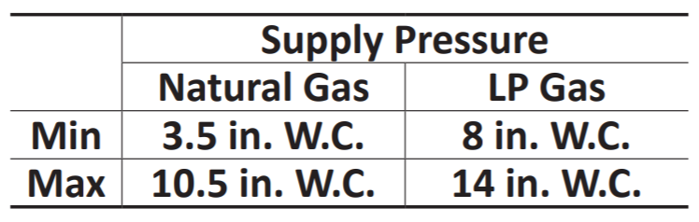
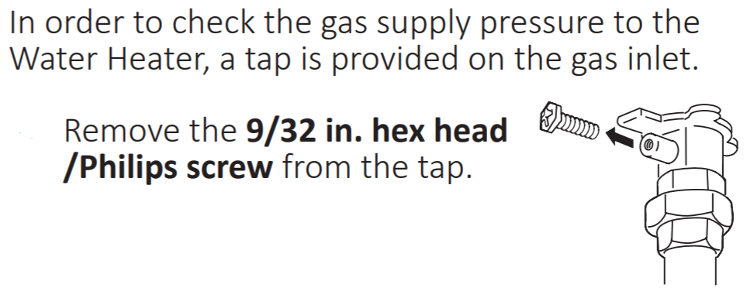
EZ GAS LINE CONDITIONS
General gas guidelines.
Test inlet pressure after installation:
Low demand (1 or 2 fixtures)
Moderate demand (3 or 4 fixtures)
High demand (5+ fixtures)
Worst case scenario, 5+ fixtures + all other gas appliances.

Slide 30
EZ GAS LINE CONDITIONS
An improperly sized gas line generally results in one or more of the following issues:
Ignition Failure (Error Code 11)
Flame Loss (Error Code 12)
Abnormal Combustion (Error Code 10 or 90)
Fluctuating water temperatures
Abnormal noises
Other items in the gas supply system that could cause problems:
Meter size
Water/debris in gas line
Earthquake safety shutoff valve (California specific)

Slide 31
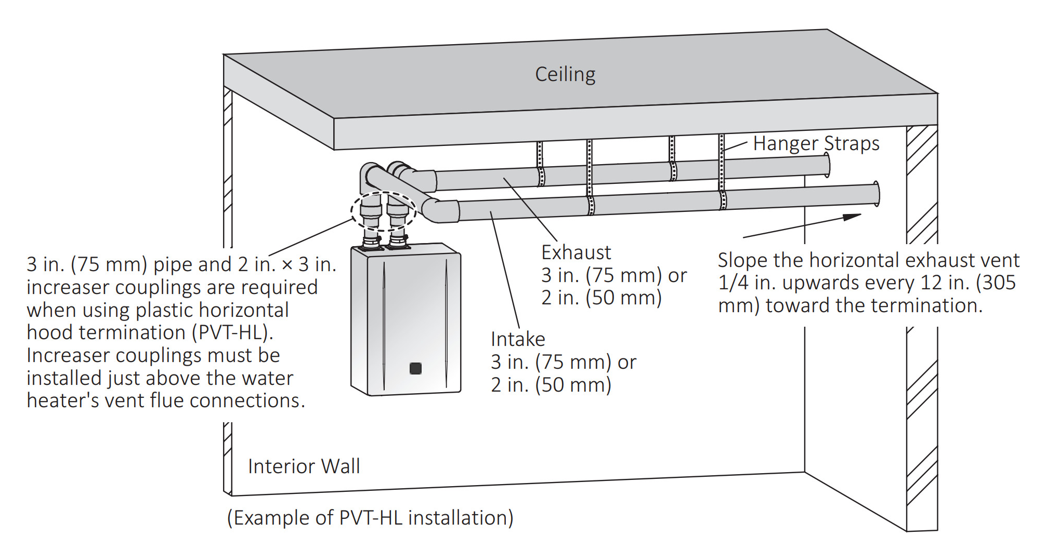
EZ VENTING GUIDELINES
Wide variety of venting options for an EZ install.
Direct Vent Horizontal

Slide 32
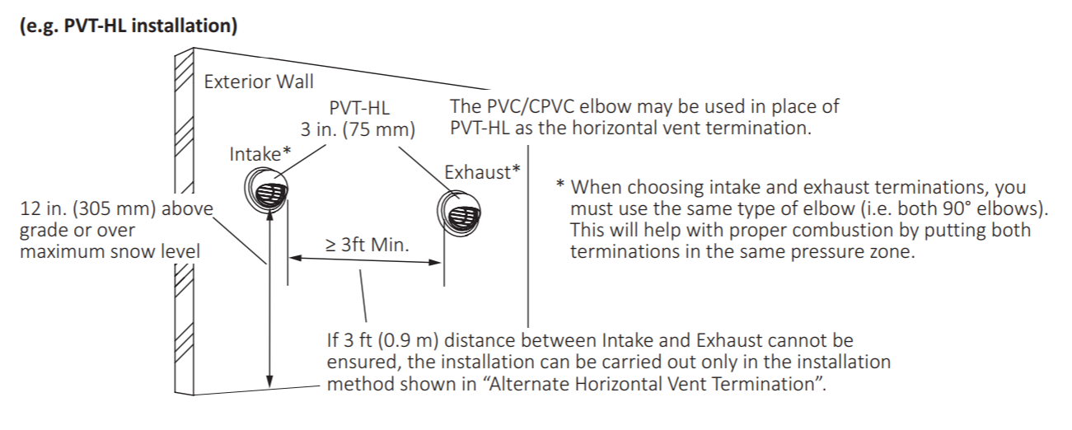
EZ VENTING GUIDELINES
Wide variety of venting options for an EZ install.
Direct Vent Horizontal

Slide 33

EZ VENTING GUIDELINES
Wide variety of venting options for an EZ install.
Direct Vent Horizontal
(Option 1)

Slide 34

EZ VENTING GUIDELINES
Wide variety of venting options for an EZ install.
Direct Vent Horizontal
(Option 2)

Slide 35

EZ VENTING GUIDELINES
Wide variety of venting options for an EZ install.
Direct Vent Horizontal
(Option 3)

Slide 36

EZ VENTING GUIDELINES
Wide variety of venting options for an EZ install.
Direct Vent Horizontal
(Concentric)

Slide 37

EZ VENTING GUIDELINES
Wide variety of venting options for an EZ install.
Direct Vent Vertical

Slide 38

EZ VENTING GUIDELINES
Wide variety of venting options for an EZ install.
Direct Vent Vertical
(Concentric)

Slide 39


EZ VENTING GUIDELINES
Wide variety of venting options for an EZ install.
Single Vent
Horizontal
Vertical

Slide 40

EZ VENTING GUIDELINES
Wide variety of venting options for an EZ install.
Outdoor
Flexible Vent

Slide 41


EZ COMMON VENT
EZ installation of 2 units.

Slide 42


CONDENSATE DRAIN LINE
Guidelines for routing the condensate drain line.

Slide 43


PROGRAMMING THE UNIT
The EZ Series Pro no longer has physical dipswitches on the circuit board. All programming of the unit is done with the new EZ Start Plus App or the built in display window.
Directions can be found in the manual

Slide 44




EZ START PLUS APP
Open EZ Start Plus App and select Contractor
Make sure Bluetooth is ON
Select Unit then tap OK
Enter Passcode and tap “NEXT”

Slide 45




EZ START PLUS APP
Register Warranty or skip
Tap “Unit Setting”
Tap “Unit Setting”
Select Options Based on Installation then tap NEXT

Slide 46




EZ START PLUS APP
Upon completion, email app will open to allow emailing the installation settings to Noritz. This is not required, but very helpful for Customer Care.
Review your selections then tap DONE
App programs unit
Tap OK when complete
Please fill out these items if you opt in to send.

Slide 47
BASIC MAINTENANCE
Keep the unit performing to its potential

Slide 48



WATER QUALITY
Water Quality Guidelines in the Installation Manual should always be followed.

Slide 49





POOR WATER QUALITY ISSUES
Here are some issues related to Hard Water or Poor Water Quality:
Scale Buildup
Overheated Water Temperature
Error Codes: 14, 16, 20, 65
Clogged Inlet Filter Screen

Slide 50

DESCALING/FLUSHING
So, what do you need to perform a proper descale?

Slide 51


DESCALING/FLUSHING
The flush connector is gone and descale mode is started with the EZ Start Plus App or the built in display.
Directions can be found in the manual

Slide 52
HELPFUL LINKS
SUPPORT.NORITZ.COM
NORITZ.COM/TECHTIPS
HELP.NORITZ.COM
TRAINING.NORITZ.COM
YOUTUBE.COM/NORITZAMERICA
Customer Care: 866-766-7489

Slide 53

THANK YOU

