Slide 1
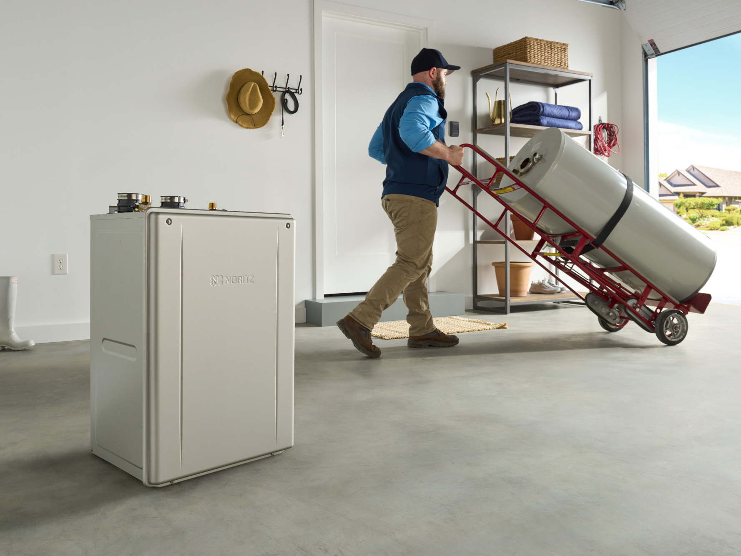

HOW TO SELL
A TANKLESS INSTEAD OF A TANK
It’s easier than you think!

Slide 2
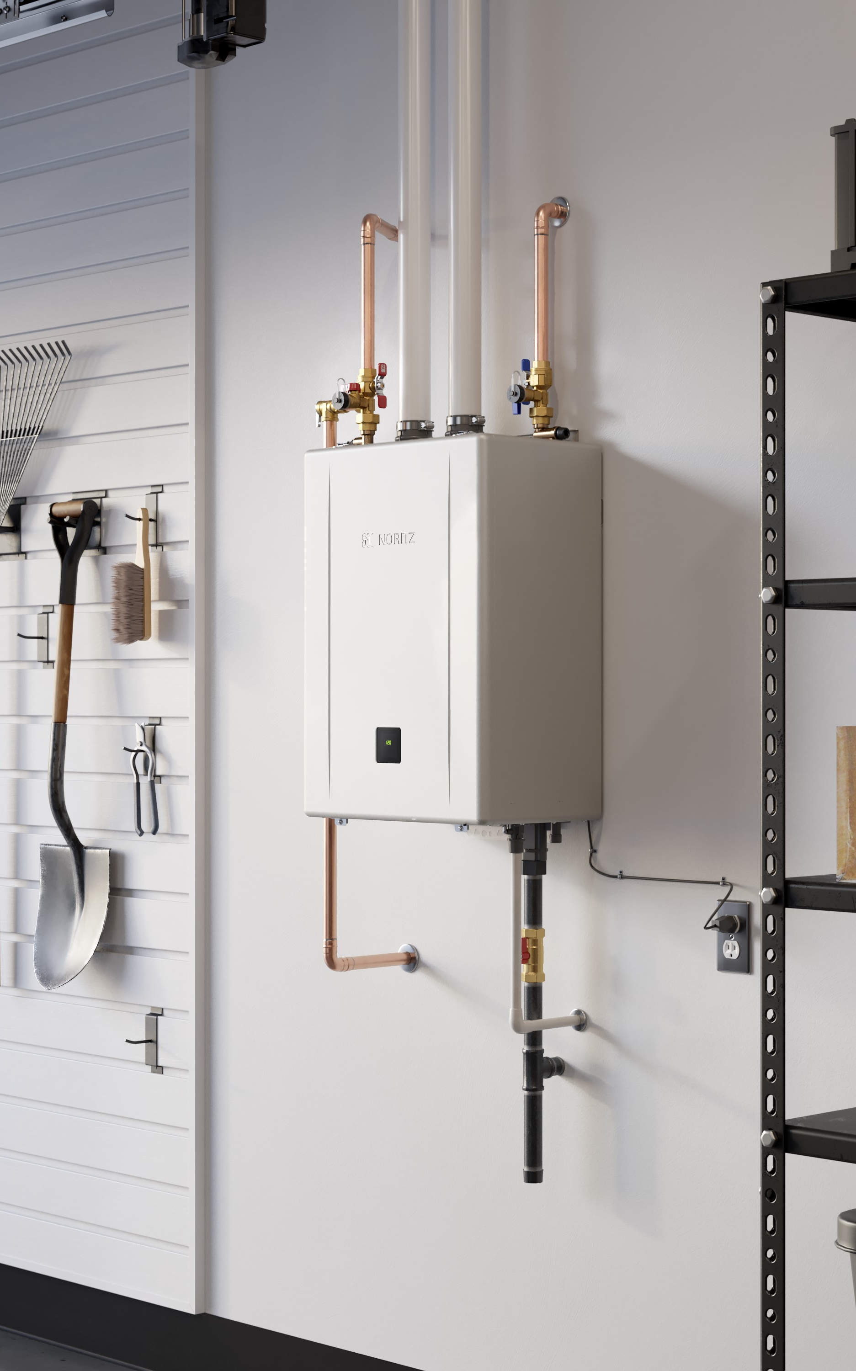
TANKLESS BENEFITS
Never run out of hot water
Reclaim space in the home
Higher efficiency than tanks
Longer life expectancy
Precise temperature control

Slide 3
HOW TO SIZE A TANKLESS
Proper sizing is a key aspect of the customers experience and satisfaction with their tankless.
An undersized tankless will provide the proper temperature but the customer will not be able to run as many hot water fixtures at the same time as they want.
This problem will be more apparent in the wintertime as the cold-water temperatures are even colder.

Slide 4
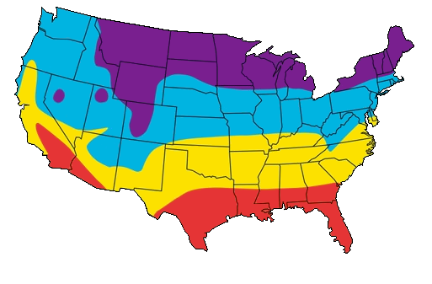

STEP ONE
Determine your maximum temperature rise. This is the difference between the tankless set temp. and the wintertime ground water temp.
For the purpose of this example let’s say the home is in the Bay Area of California.
Based on the map, we’ll say the winter ground water temp is 60 F.
Now you can determine the wintertime temperature rise:
120 Set Temp
– 60 Ground Water Temp
= 60
Average Winter Water Temp:
35° - 40° F
45° - 50° F
55° - 60° F
65° - 70°+ F

Slide 5
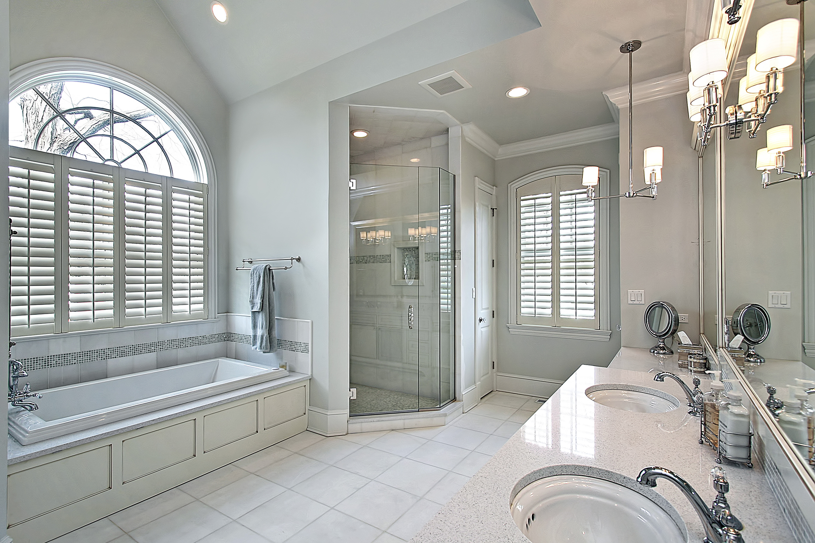
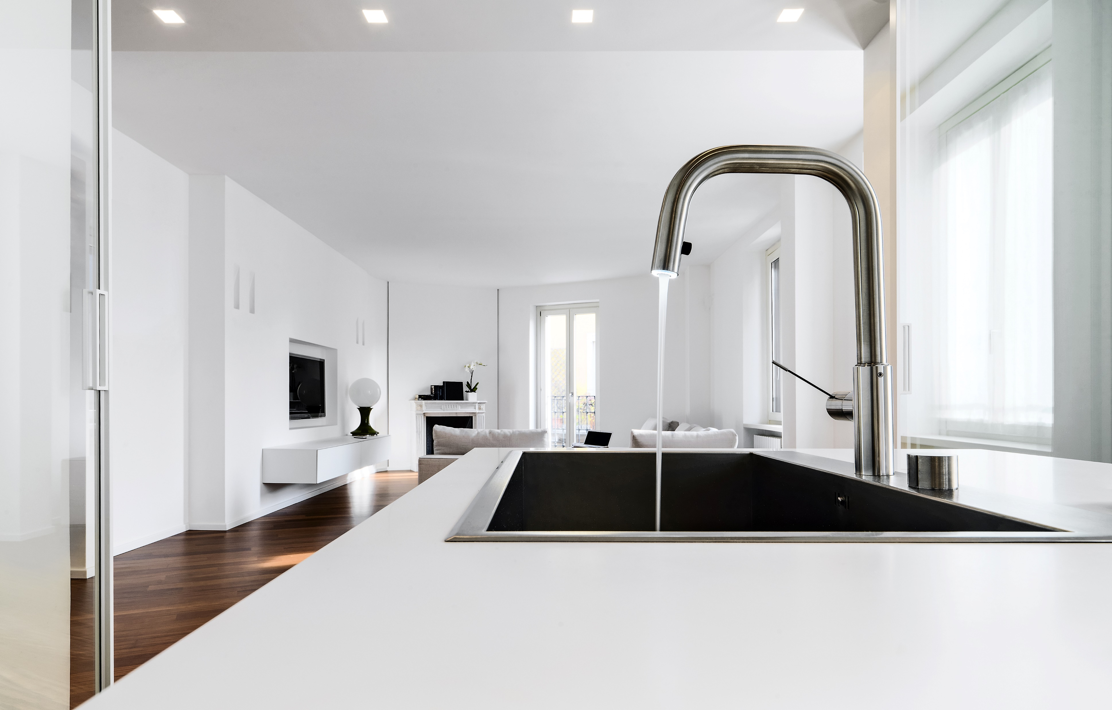
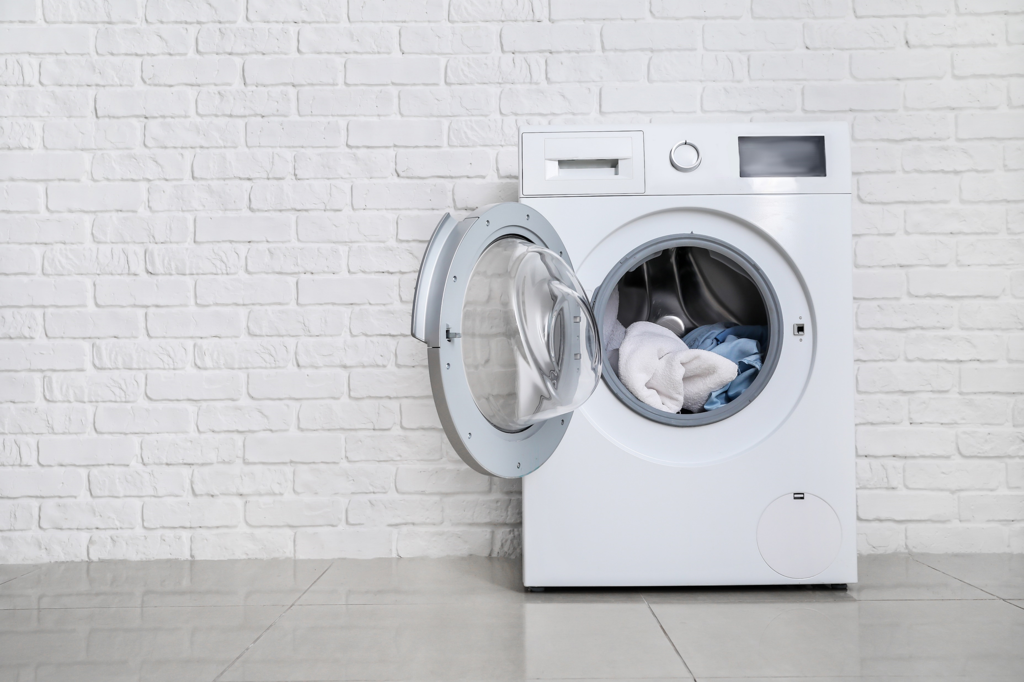
STEP TWO
Determine the peak hot water demand of the home. If possible, ask the homeowner.
Fixtures and appliances all have different flow rates depending on manufacturer however you can use an average amount to get a ballpark figure:
Shower: 2 gpm
Lav Sink: 1 gpm
Kitchen Sink: 1.5 gpm
Dishwasher: 2 gpm
Washing Machine: 2 gpm
Example 1:
Peak usage: 2 Showers & Washing Machine = 6 gpm
Example 2:
Peak usage: 4 Showers & Dishwasher = 10 gpm

Slide 6
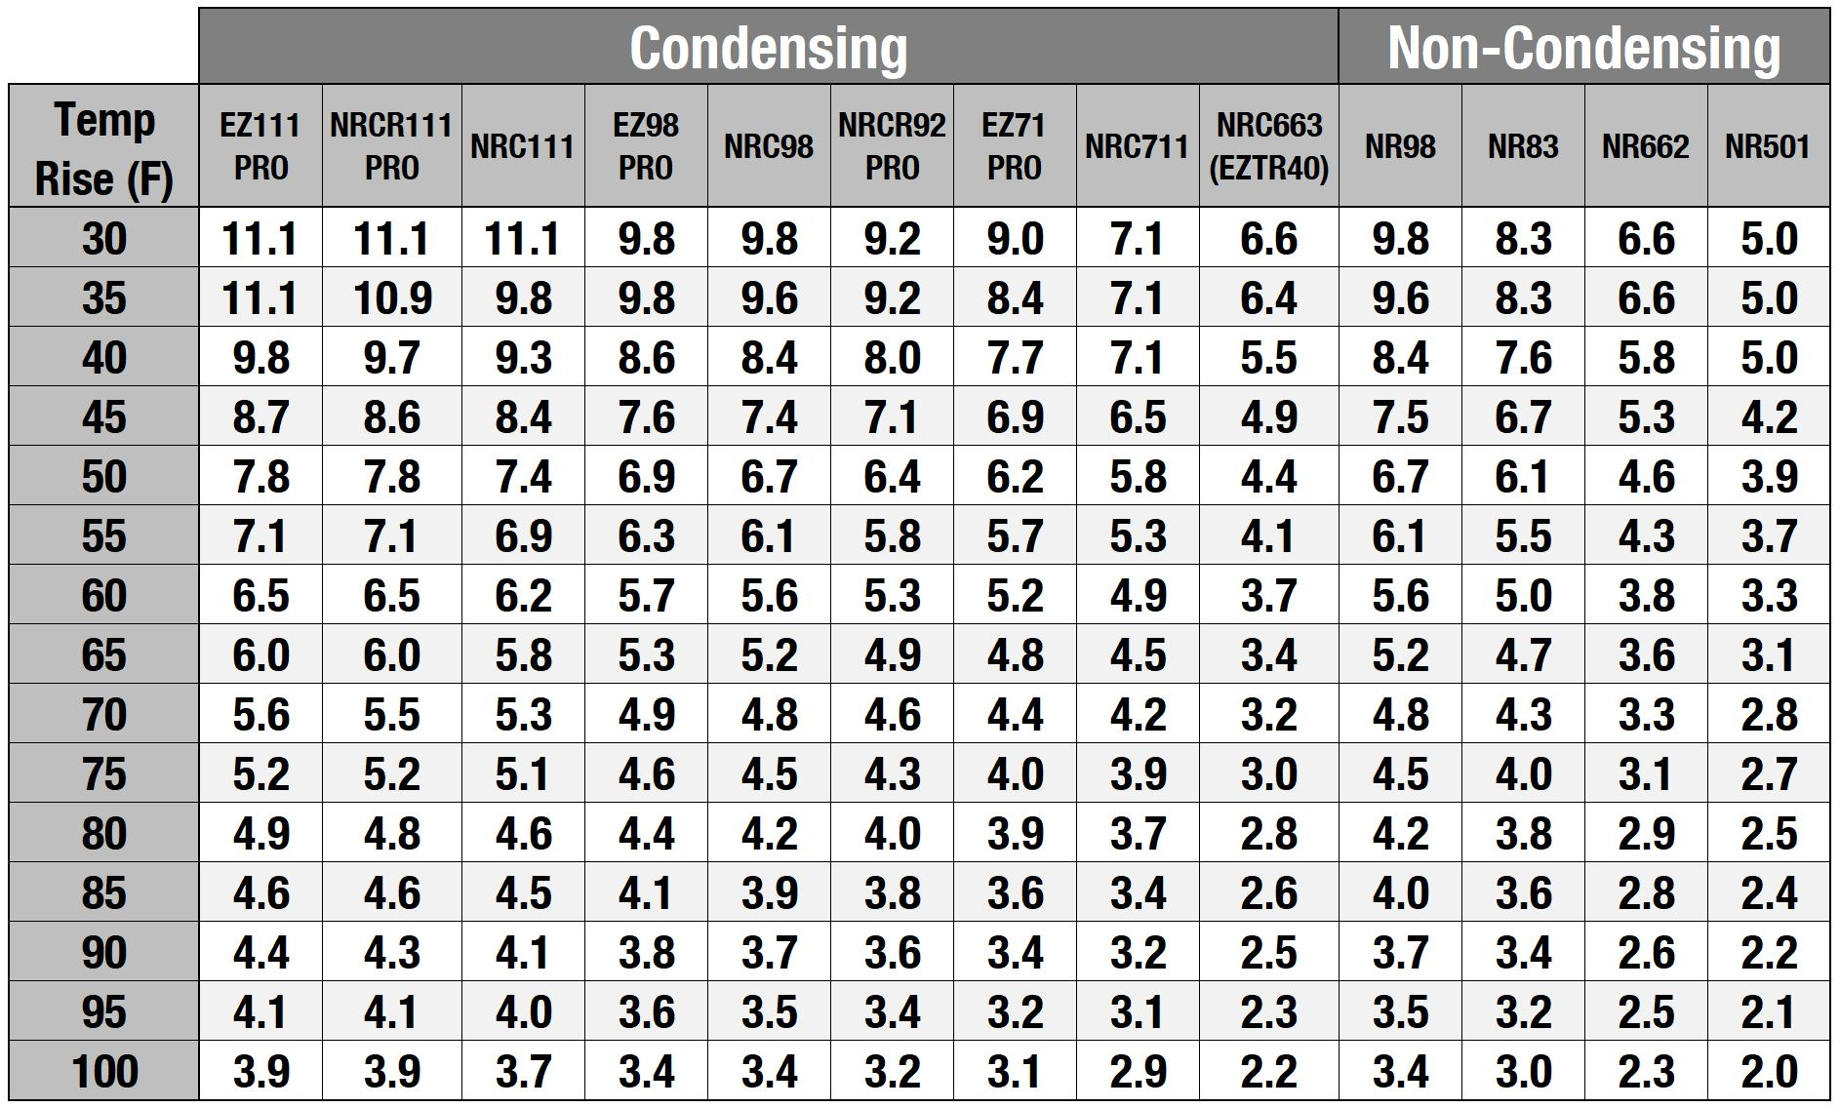
STEP THREE
Select the proper unit or pair of units using the sizing chart found online or in the product catalog.
Simply find the Temperature Rise on the left then match up a unit or pair of units that provides the approximate flow rate needed.
Temp Rise: 60
Example 1:
Peak usage: 2 Showers & Washing Machine = 6 gpm
Ideal Models:
EZ111, NRCR111, NRC111
Example 1
Example 2
Example 2:
Peak usage: 4 Showers & Dish Washer = 10 gpm
Ideal Models:
Pair of EZ71, EZ98, NRCR92, NRC98, NR98 or NR83

Slide 7
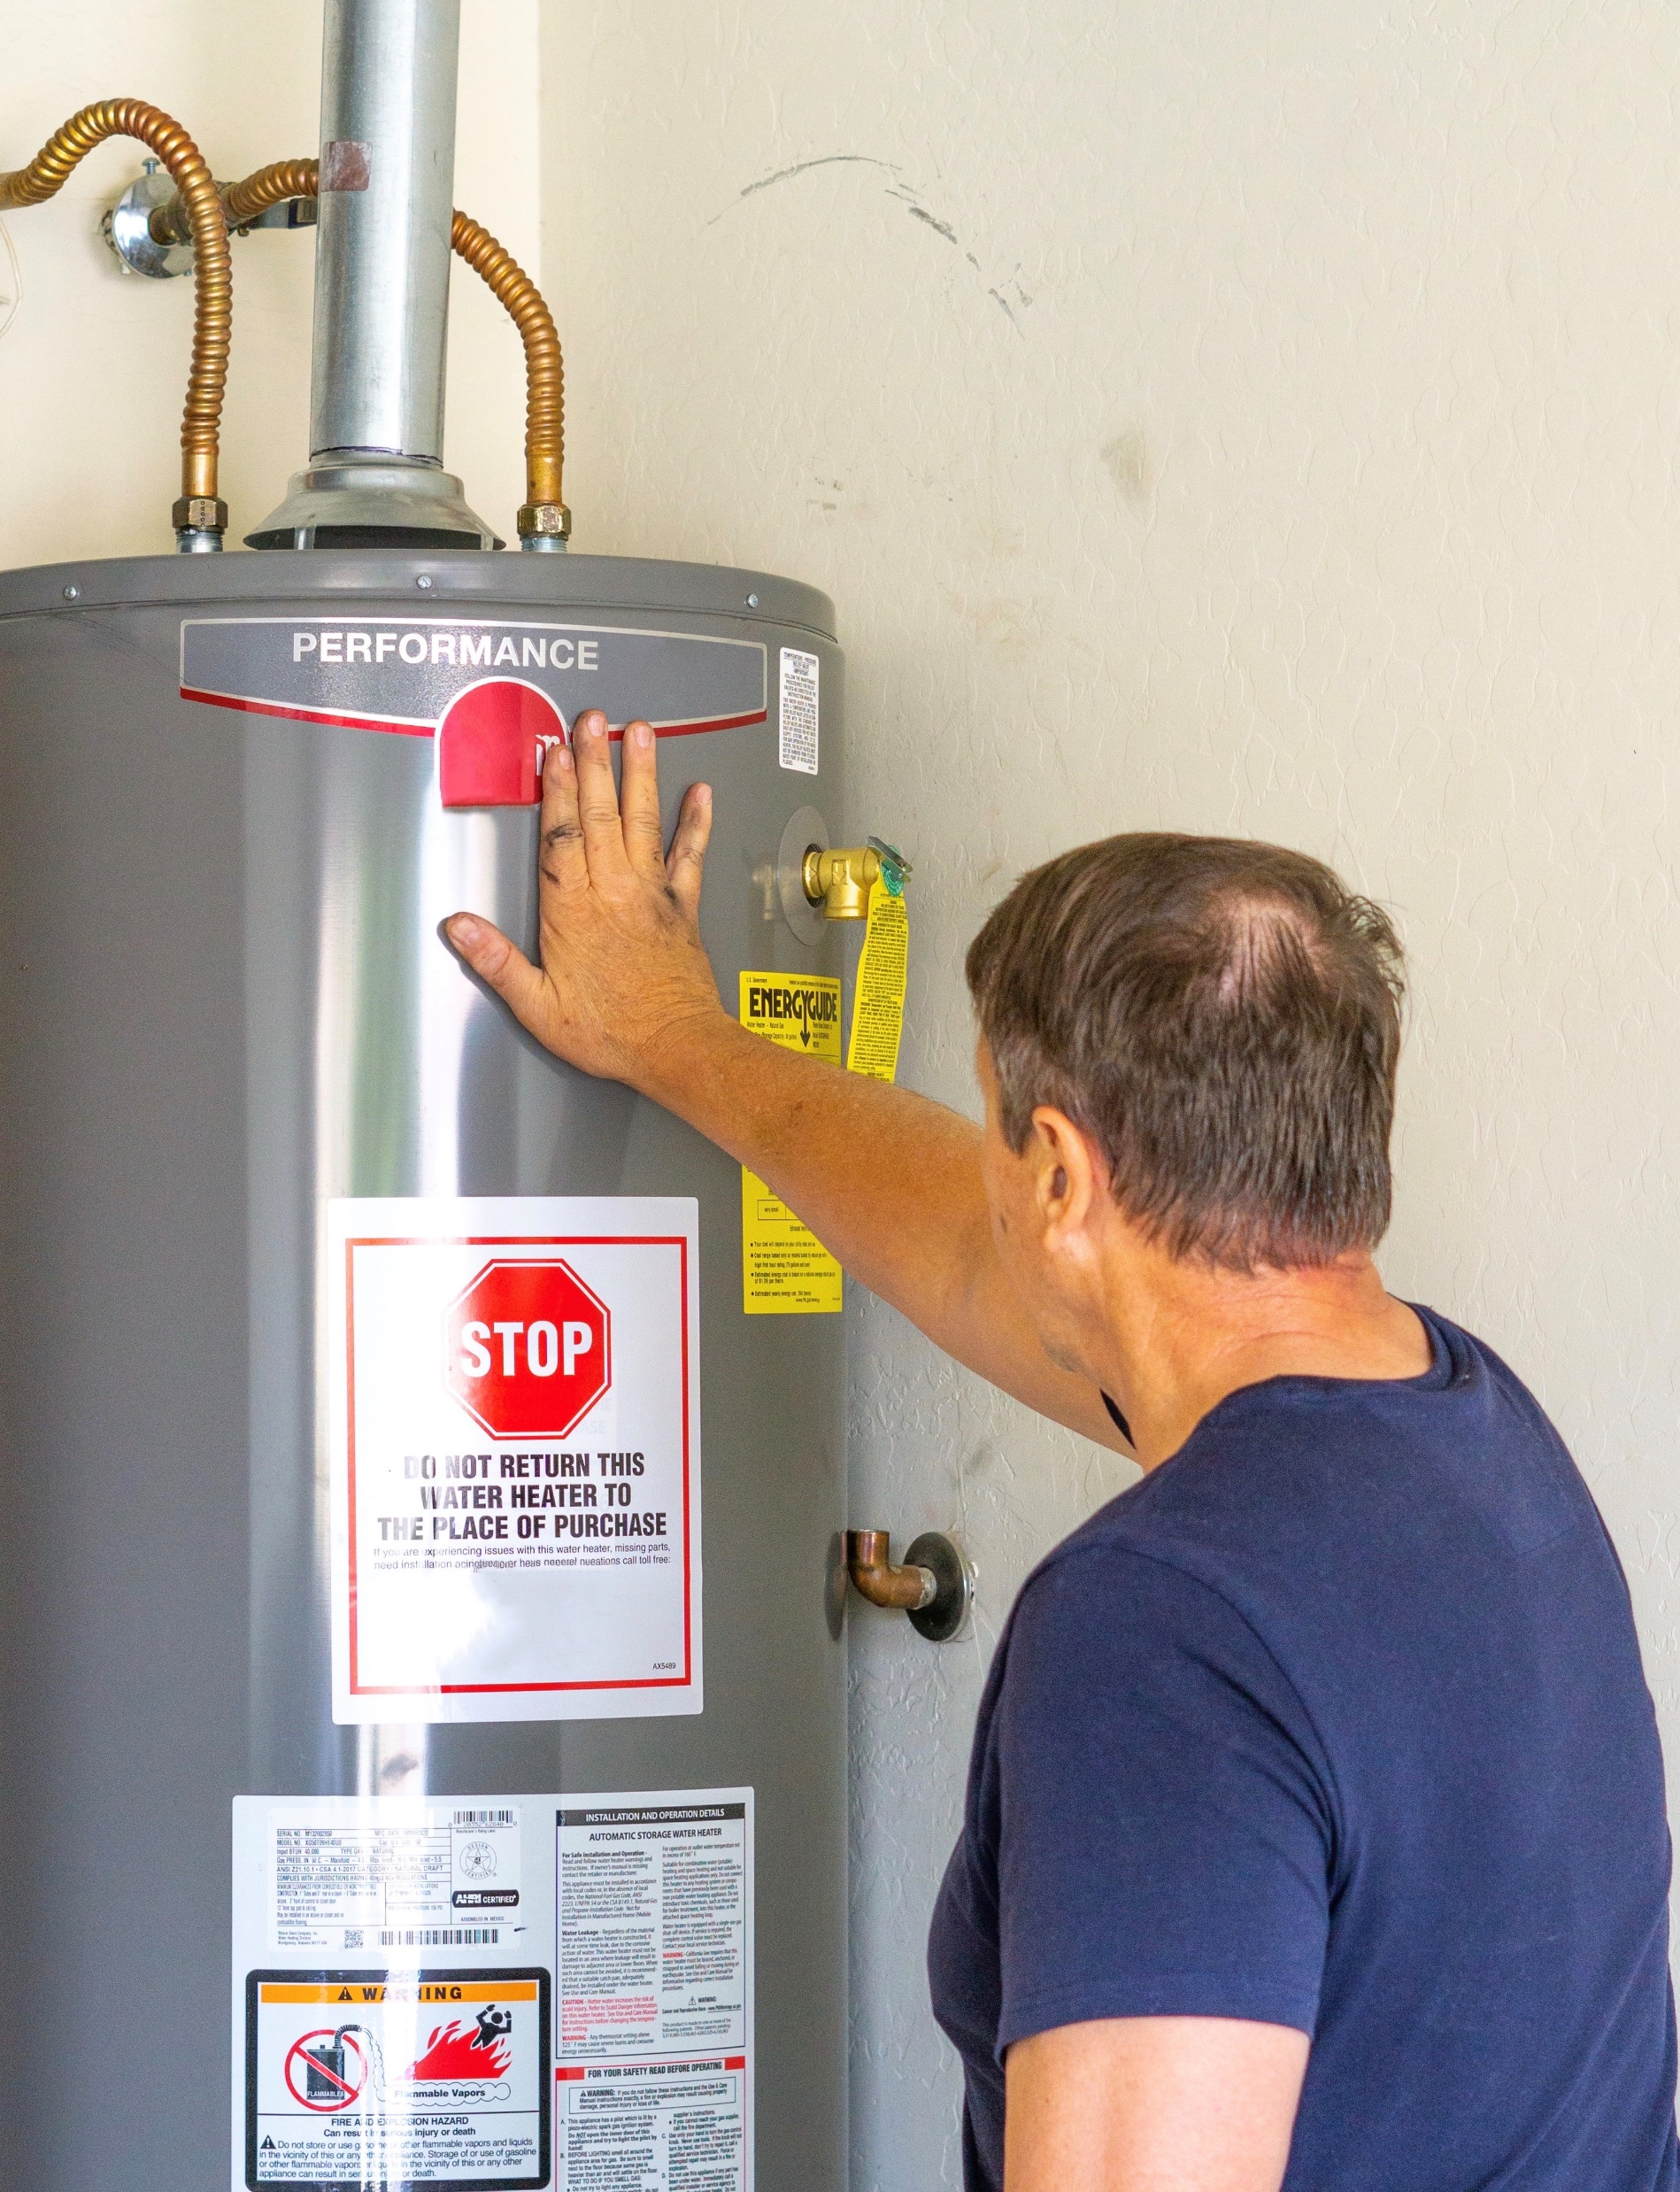
ARE YOU REPLACING A TANK?
Key Questions to ask:
What size is the current tank style water heater?
Is the current vent system 3” or 4” Round B-Vent?
How long is the current vent run?
How many bathrooms?
Do they have a return line? Or want quicker hot water to the fixture?

Slide 8
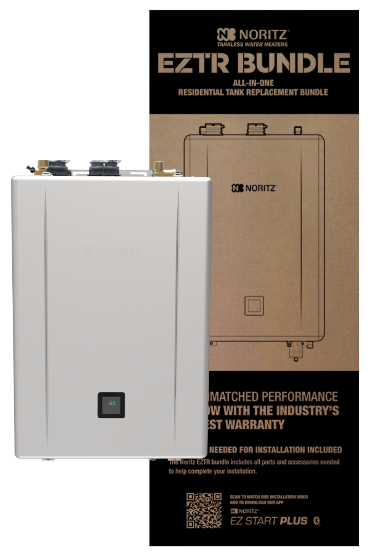

EZTR SERIES
These bundle packages make it easy for the contractor to replace a tank style water heater.
The EZTR package includes tankless water heater, isolation valves and 25’ of flex vent.
Top Mounted Water Connections save time and materials.
Longer Warranty than a tank style water heater.

Slide 9
EZTR SERIES REQUIREMENTS
Current B-Vent must be 3” or 4” round (Oval venting will not work)
The vent run is 25’ or less (Optional 35’ kit sold separately)
Not Common Vented to any other appliance.
If the current installation applies the EZTR Series is a great replacement option.

Slide 10
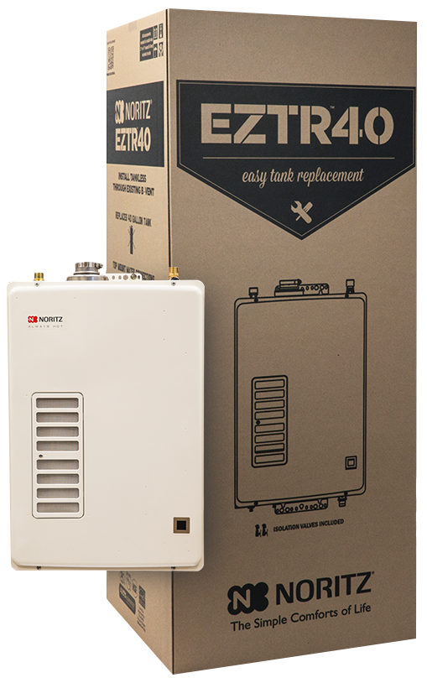
EZTR40 PACKAGE
EZ Tank Replacement of a 40 Gallon Tank
Top Mounted Water Connections
25’ Flex Included, 35’ Optional
120k Max btu High Efficiency Unit
6.6 gpm Max
12 Years Heat Exchanger Warranty
Based on a 60° F rise this unit is good for 2 bath home
The EZTR40 can only be used when replacing a tank and using the flexible venting, it cannot be adapted to vent with PVC or other rigid plastic venting.

Slide 11
EZTR50 & EZTR75 PACKAGES
EZ Tank Replacement of a
50 or 75 Gallon Tank
Top Mounted Water Connections
25’ of 2” Flexible Vent Included, 35’ Optional (sold separately)
Isolation Kit Included
Dual Stainless Steel Heat Exchangers
Based on 60° F rise, EZTR50 is good for 3-3.5 bath home
Based on 60° F rise, EZTR75 is good for 4-4.5 bath home
25 Year Heat Exchanger Warranty
NEW: .98 UEF
NEW: EZ Start Plus Bluetooth® App
NEW: Built-in Display
NEW: Field Gas Conversion
*New for 2024 Pro Series

Slide 12
WHAT IF YOU DON’T HAVE AN EZTR IN STOCK?
Check your inventory for EZ Series
The unit in the EZTR40 is not sold separately but EZ71 would be heater option so you don’t lose the sale
EZTR50 = EZ98 unit
EZTR75 = EZ111 unit
Sell the unit and needed accessories
(see following slides for accessories)

Slide 13
CAN’T USE CURRENT VENT SYSTEM
Oval vent
Common vented to another appliance
Vent run is over 25’
The EZTR Series is not the best option, however the EZ Series Units are still a great option to save time due to top mounted water connections.

Slide 14
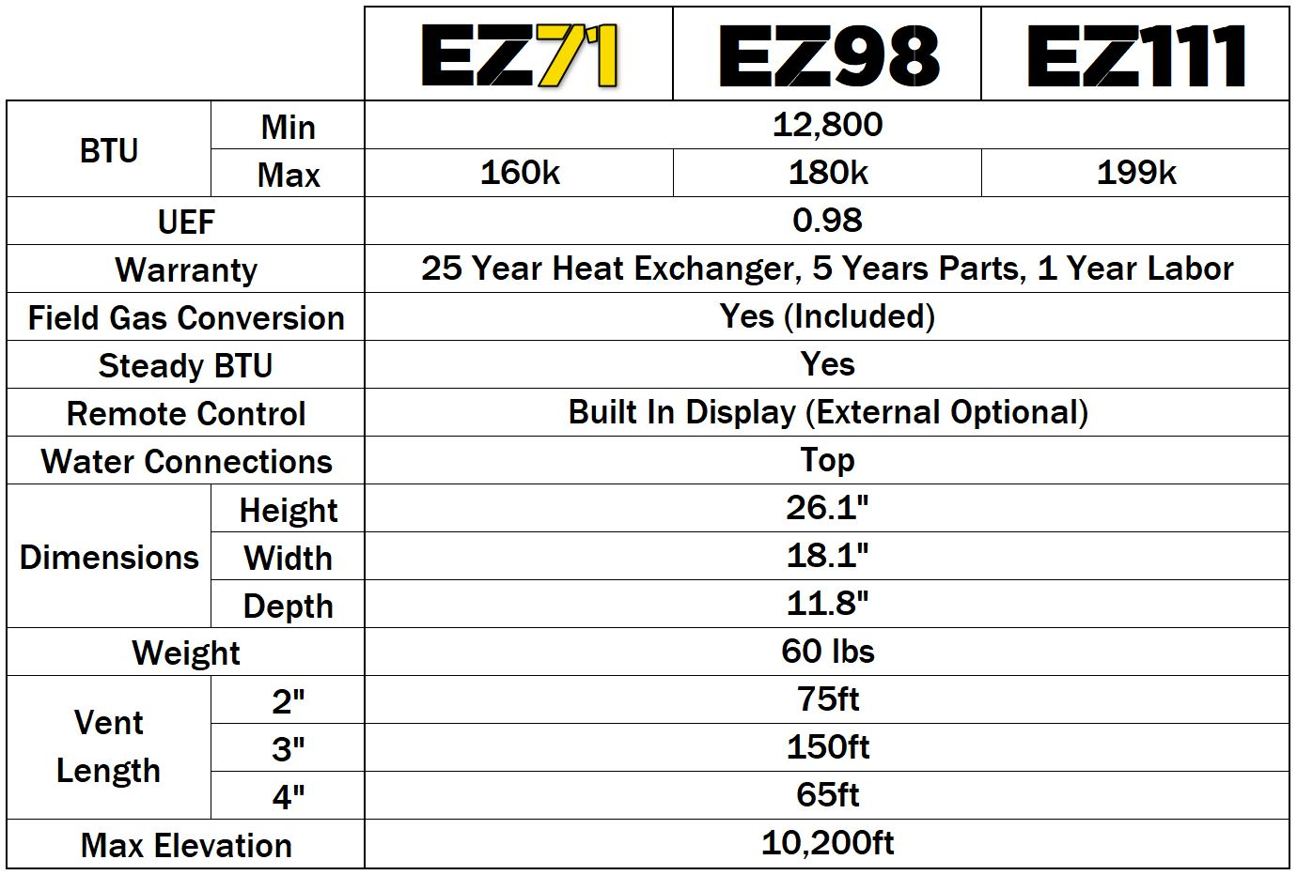

EZ SERIES SPECIFICATIONS
NEW

Slide 15
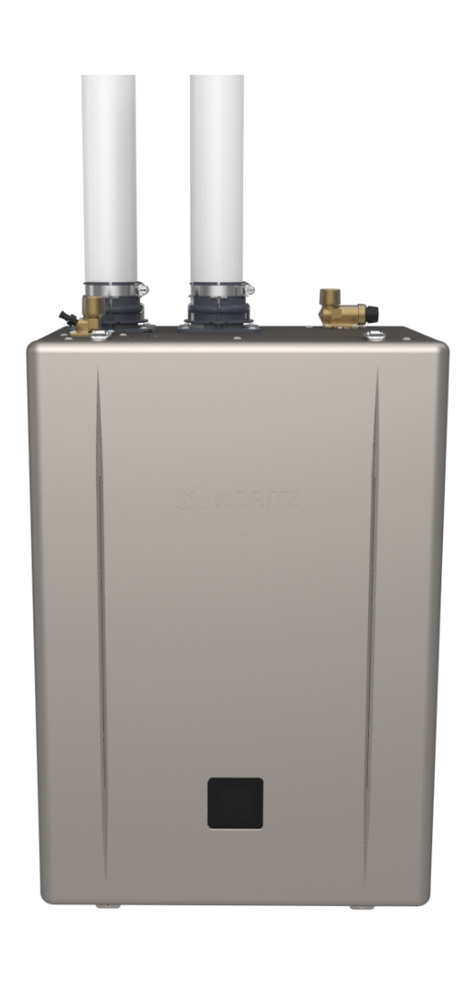
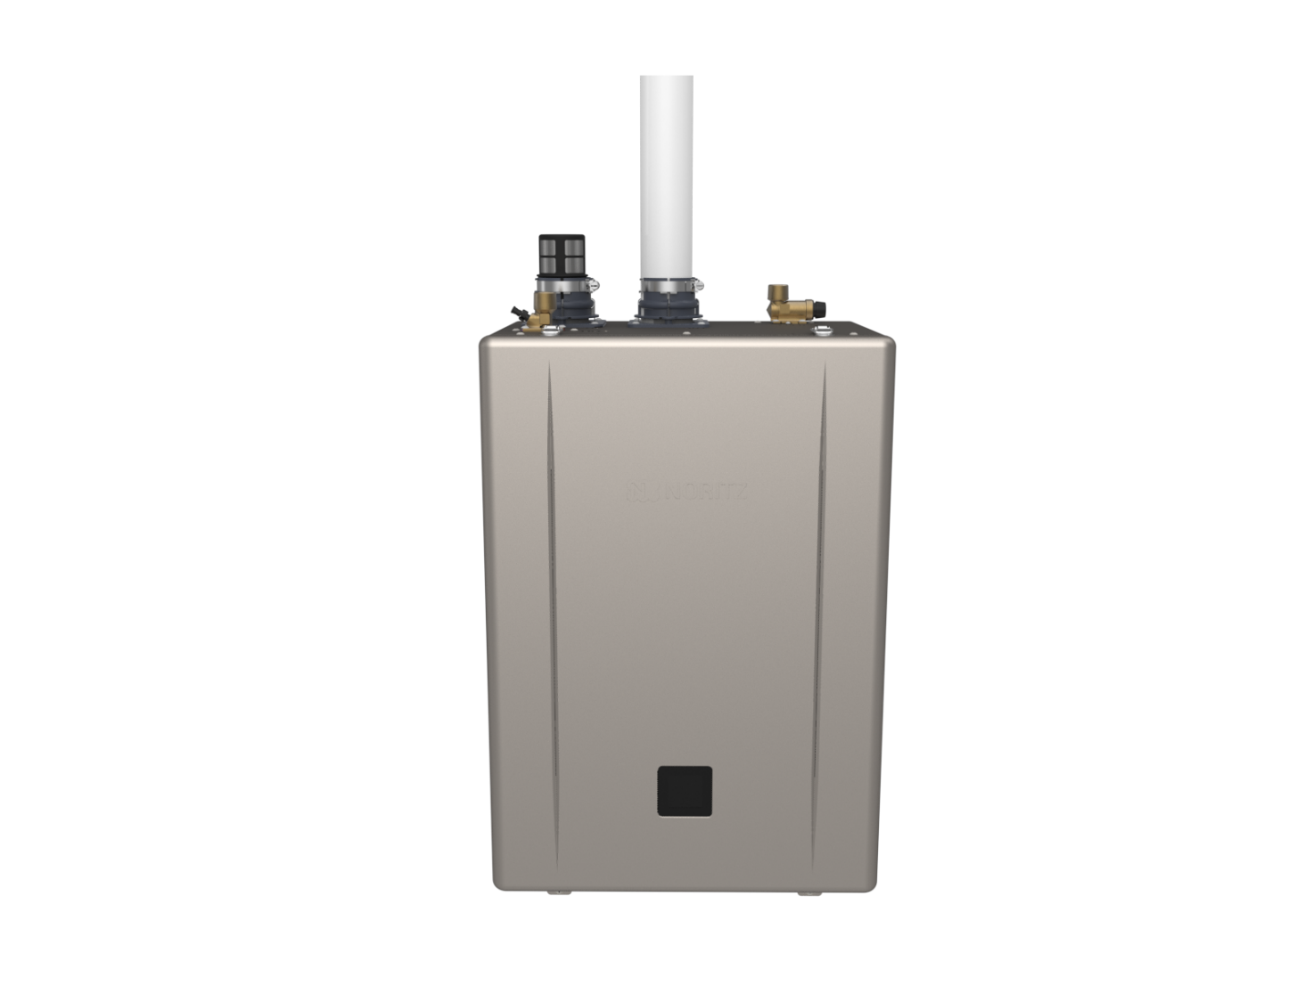
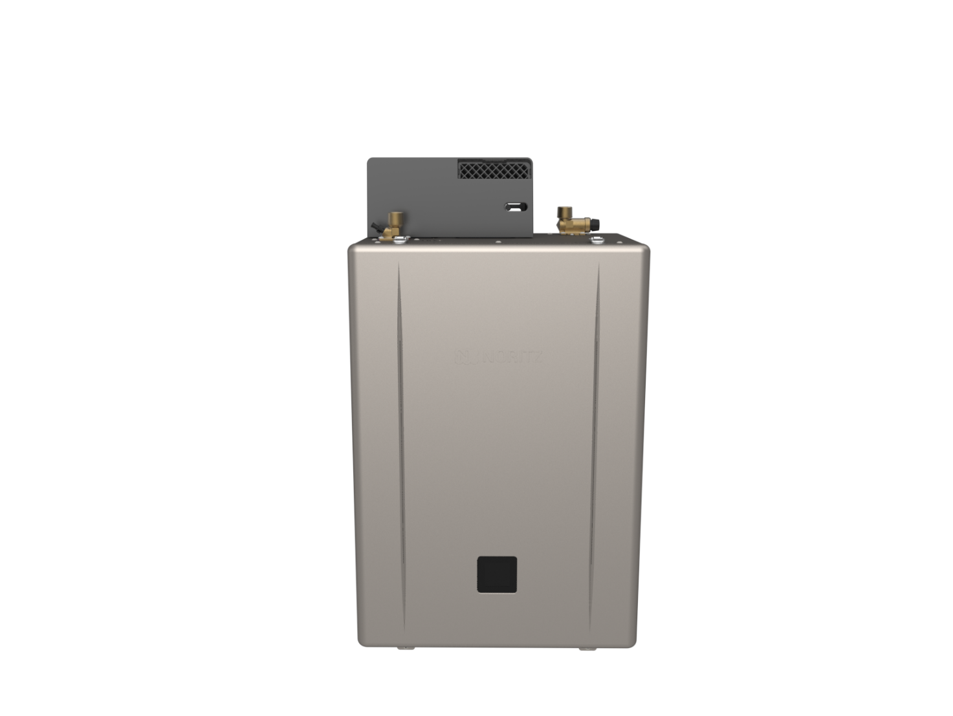
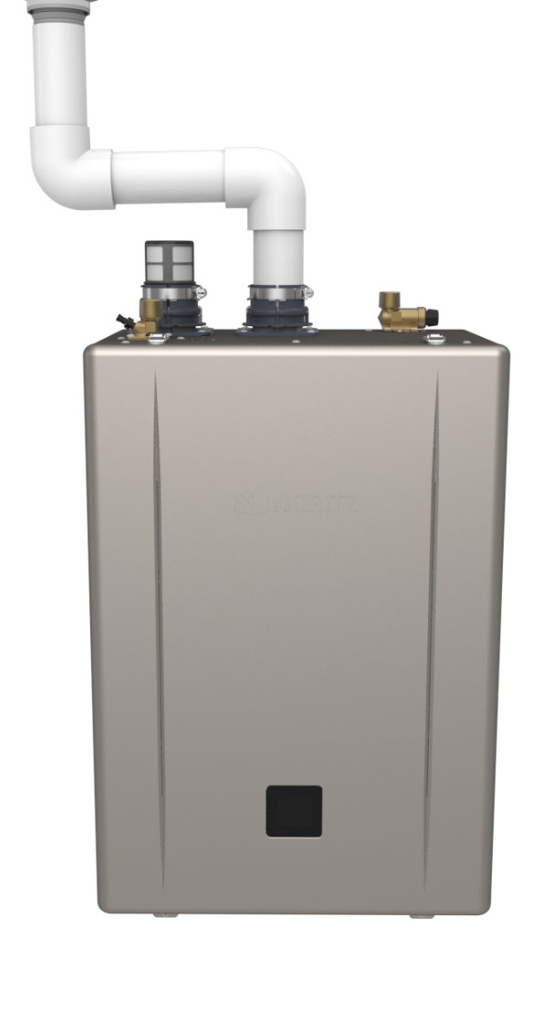
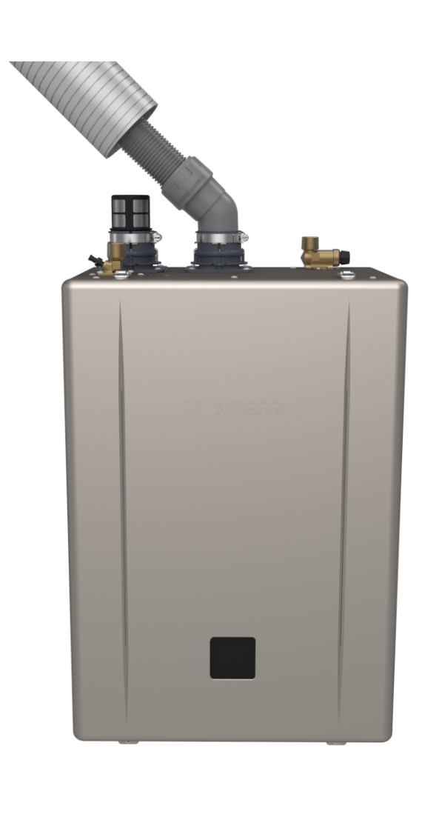
VERSATILE VENT SYSTEM
One SKU, All Venting Options.
Direct Vent
Single Vent
Outdoor
No Roof Kit
Flex Vent Kit

Slide 16
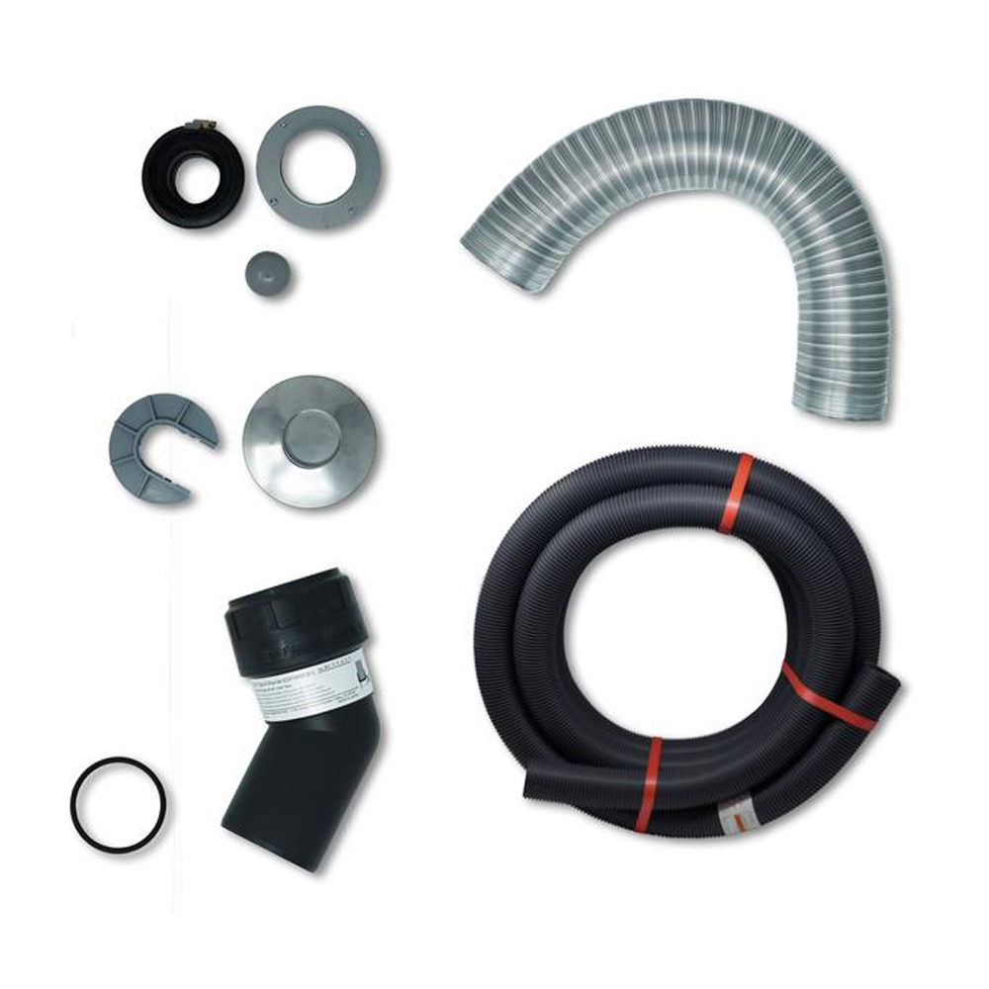
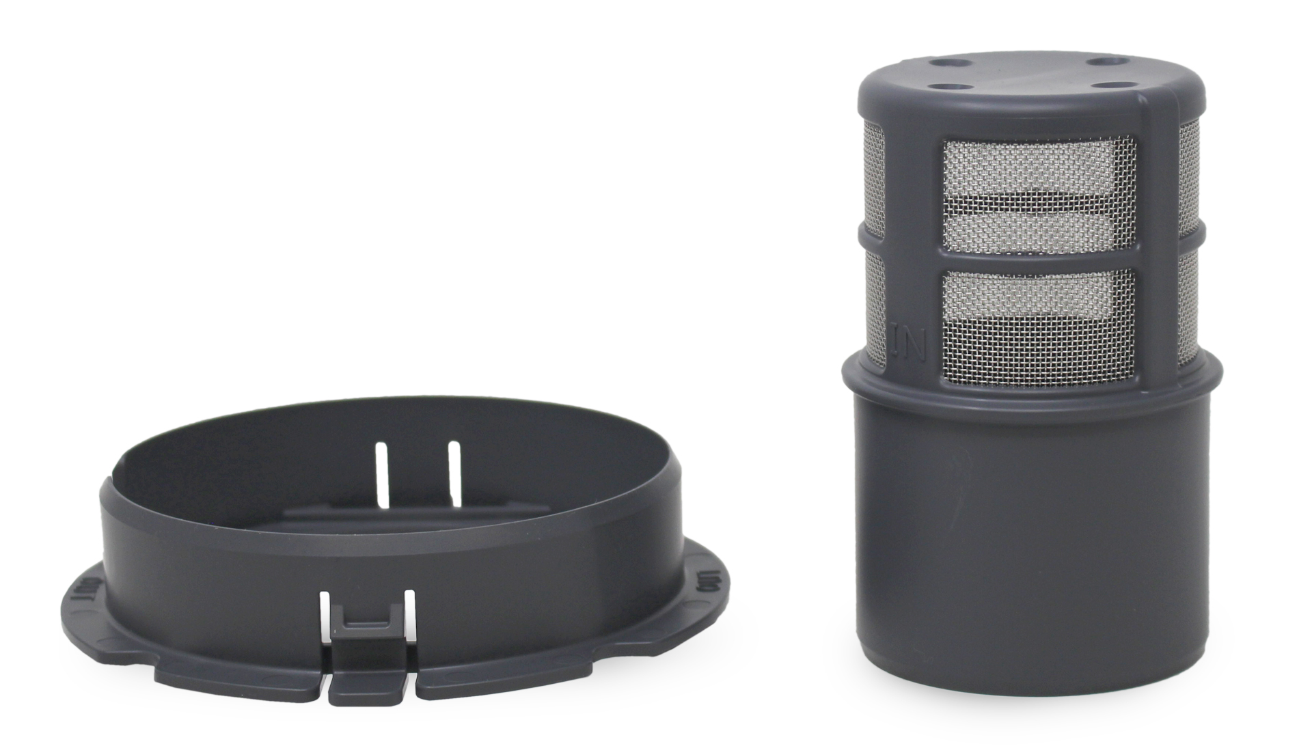
VENT ACCESSORIES FOR EZ SERIES
Flex Feeder w/
Base Junction Support and Base Junction Adapter
Aluminum
Flex
Sleeve
25’ Flex Vent Kit: EZ2FVK-1
or
35’ Flex Vent Kit : EZ2FVK-2-1
and
Flex Vent 2” Conversion Kit:
  EZ2-CK-1
Rain Cap and
Top Flex Support
25 or 35 ft. of 2” Flex Vent
Rigid 45°
Elbow and 2”
Flex Vent Gasket
Flex Vent 2”
Conversion Kit
NOTE: Flexible vent can be shortened but you cannot join 2 pieces of flexible vent to extend the length.
These kits can be used on EZ71, EZ98, EZ111 and NRCR Series

Slide 17
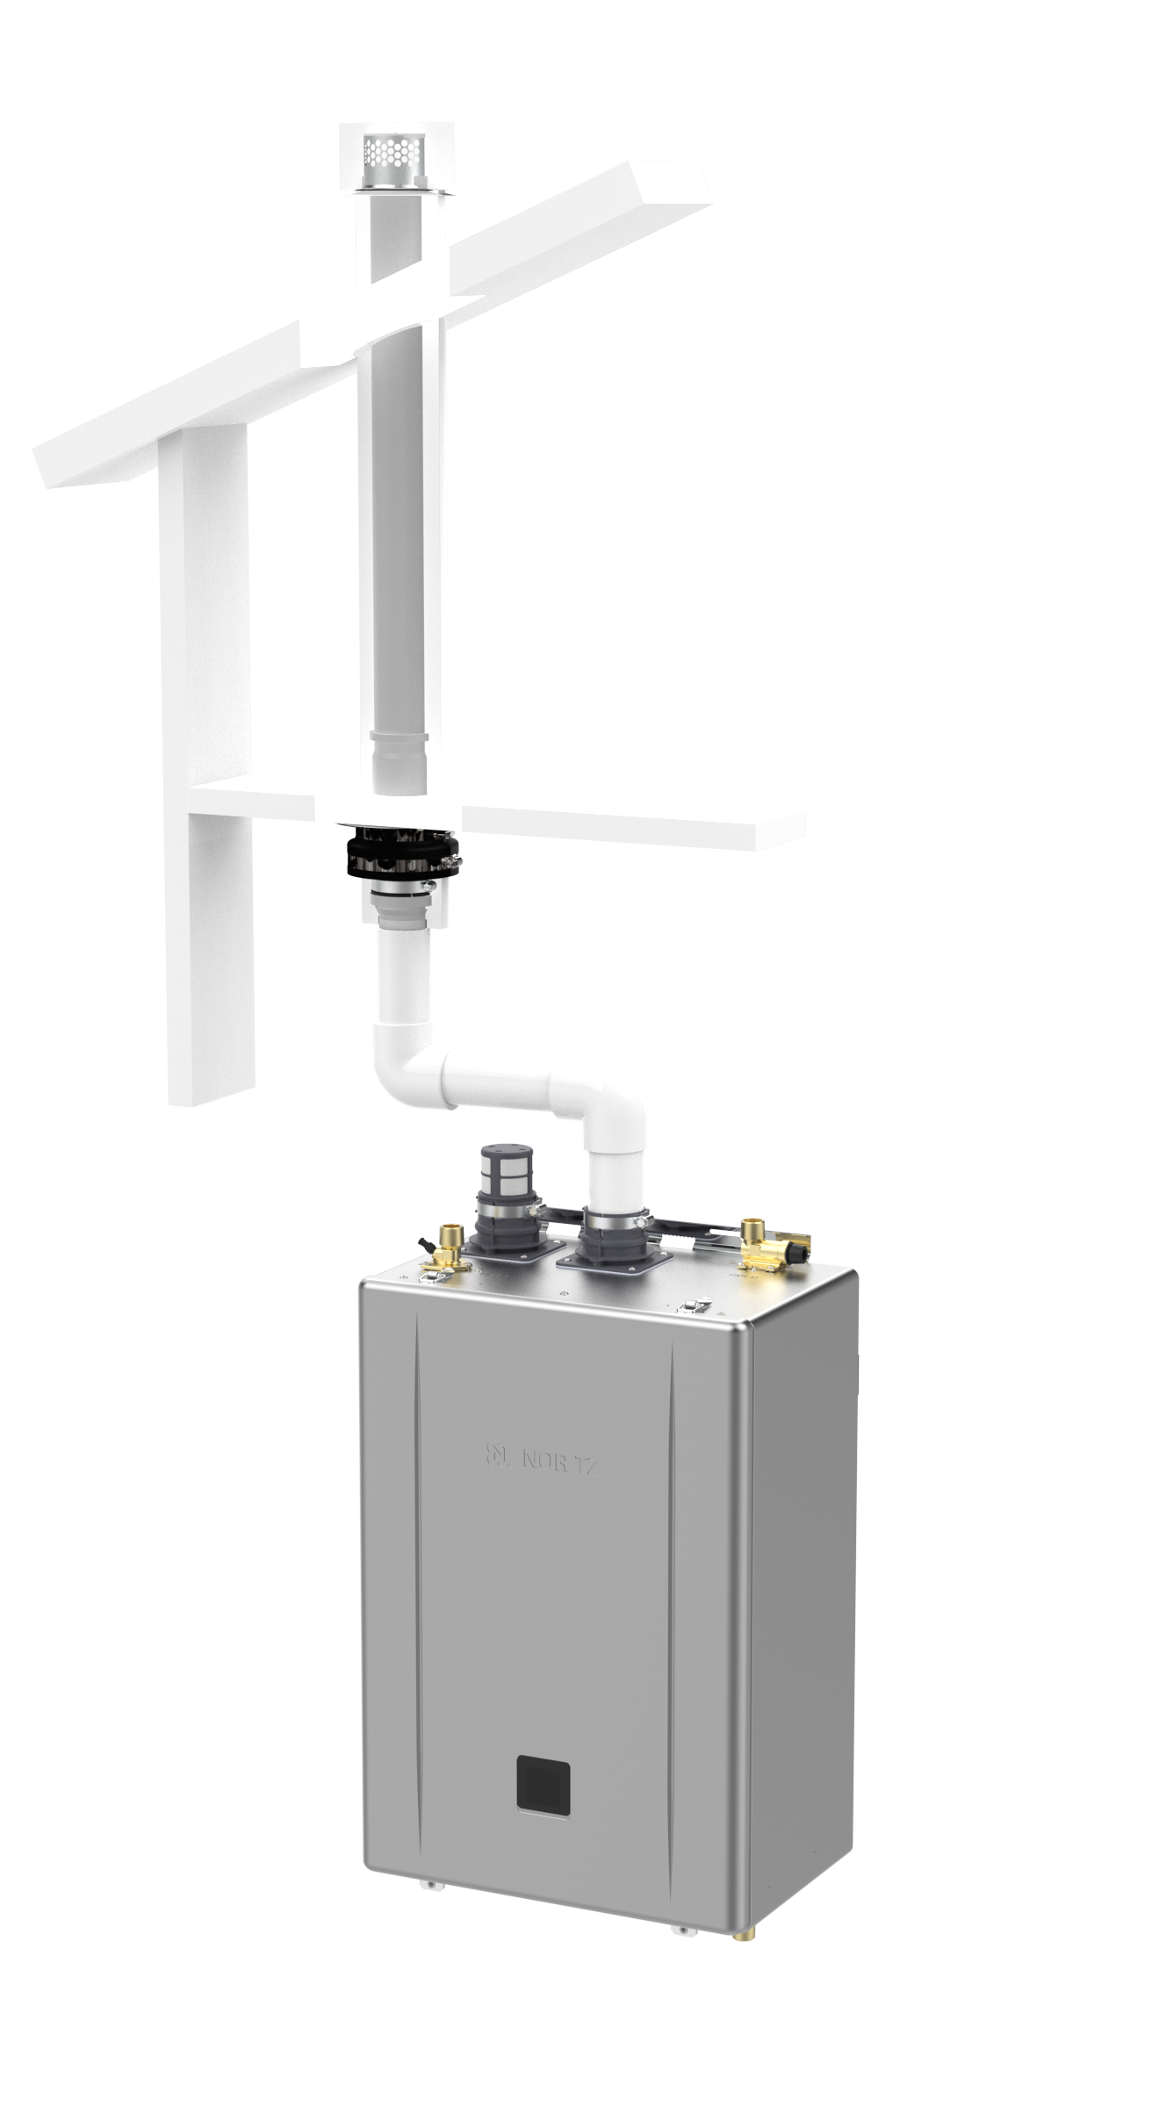
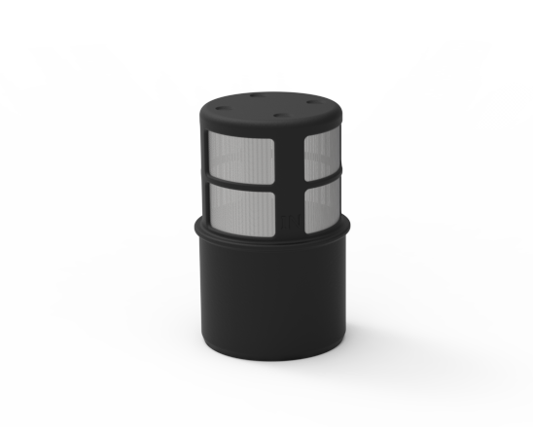
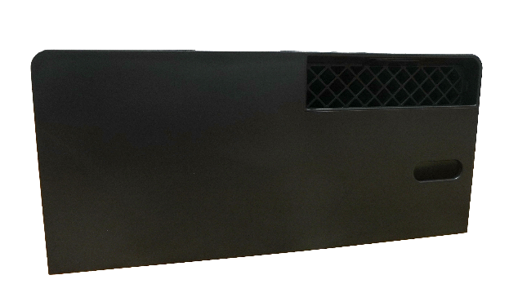
VENT ACCESSORIES FOR EZ SERIES
SV-CK-2-1: SV Conversion Kit
VC-6-1: Outdoor Vent Cap
NRK-1: No Roof Kit
These accessories can be used on EZ71, EZ98, EZ111 and NRCR Series

Slide 18
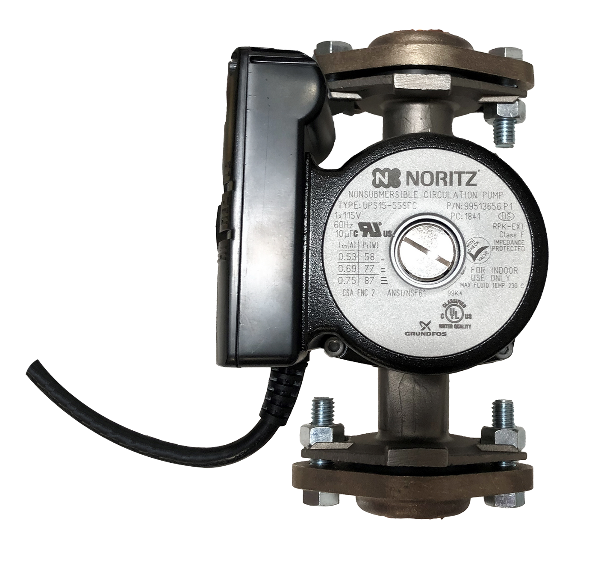
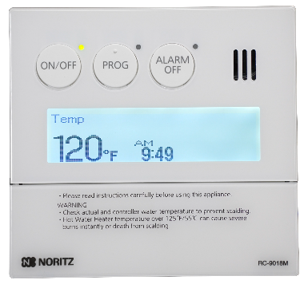
ACCESSORIES FOR EZ SERIES
Does the customer have a return line already?
RPK-EXT is a pump that plugs into the EZ Series units and is programmed by the EZ Start App.
The customer can program every day differently.
Requires a return line.
Commercial remote comes with the RPK-EXT but is optional when used with EZ Series Pro
This accessory can be used on EZ71, EZ98 and EZ111 Series

Slide 19
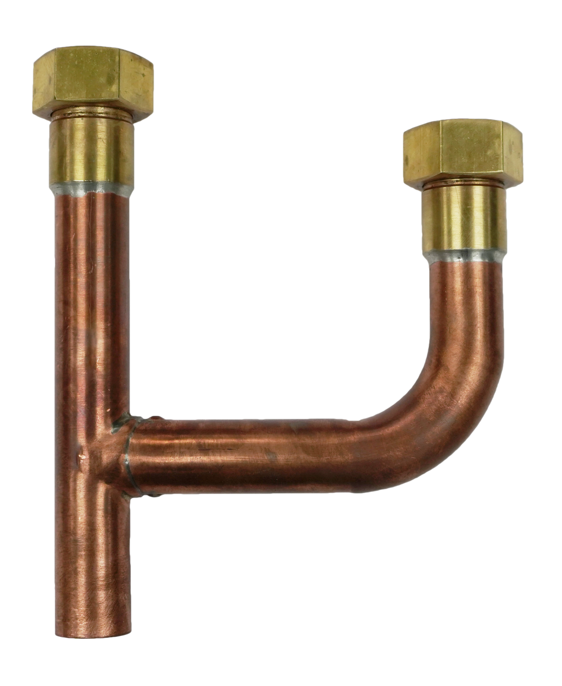
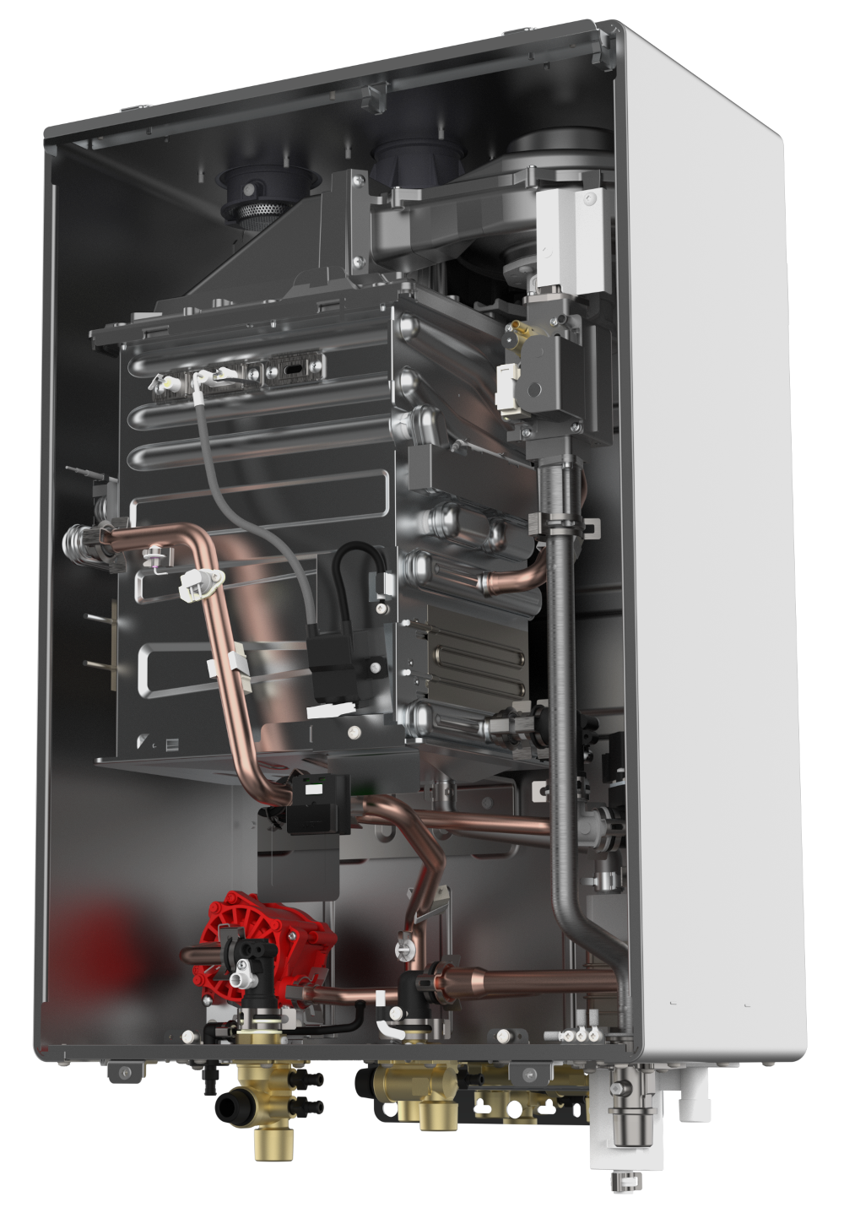
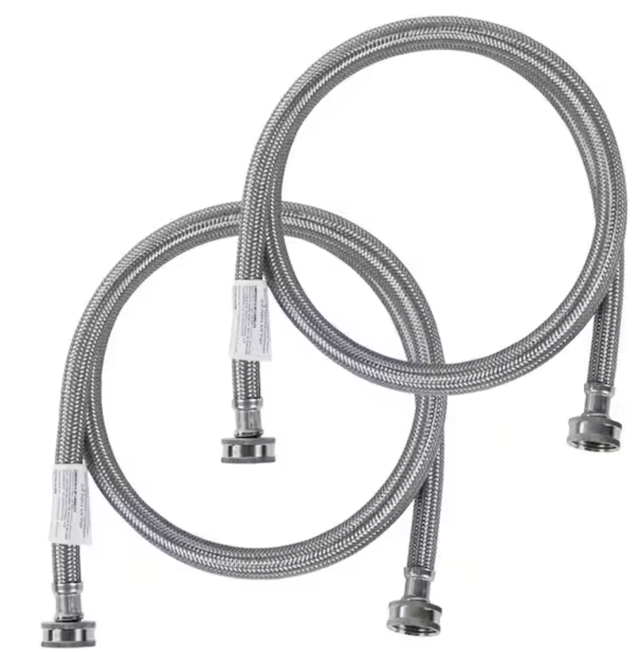
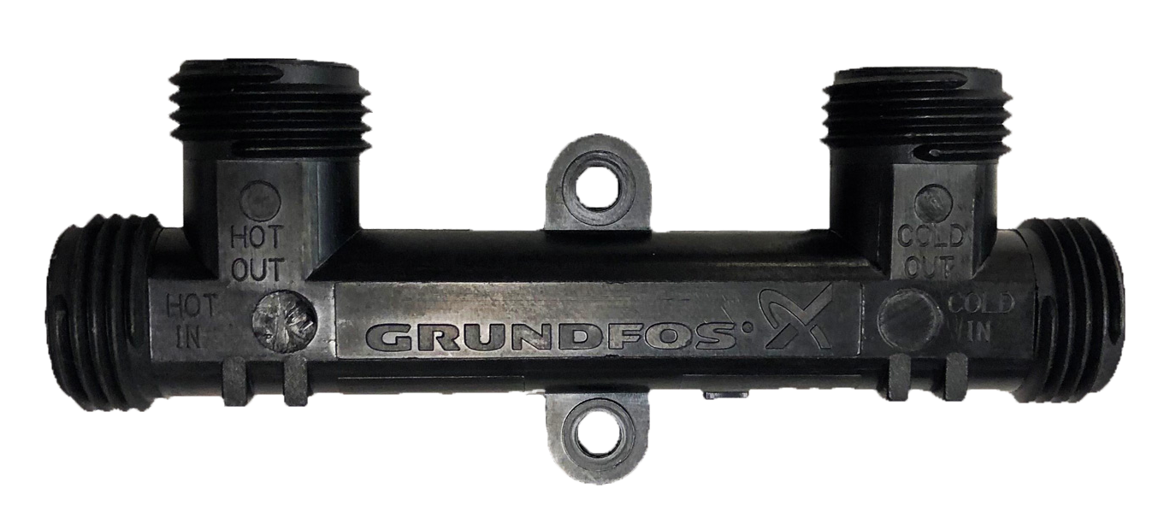

NRCR SERIES
Customer wants quicker hot water without a return line?
Available Models:
NRCR111DV (Max 199k btu, 0.98 UEF)
NRCR92DV (Max 165k btu, 0.98 UEF)
Key Features:
15 Year Heat Exchanger Warranty
Simple Auto Recirc Mode
Crossover Valve Compatible (CSV-BPK)
Flex Vent Capable (Just like EZ Series)
Steady BTU Control
Recirc Modes:
Dedicated Recirculation
Crossover (Up to 2)
Crossover Valve Kit
Item: CSV-BPK
This accessory can be used on NRCR Series

Slide 20
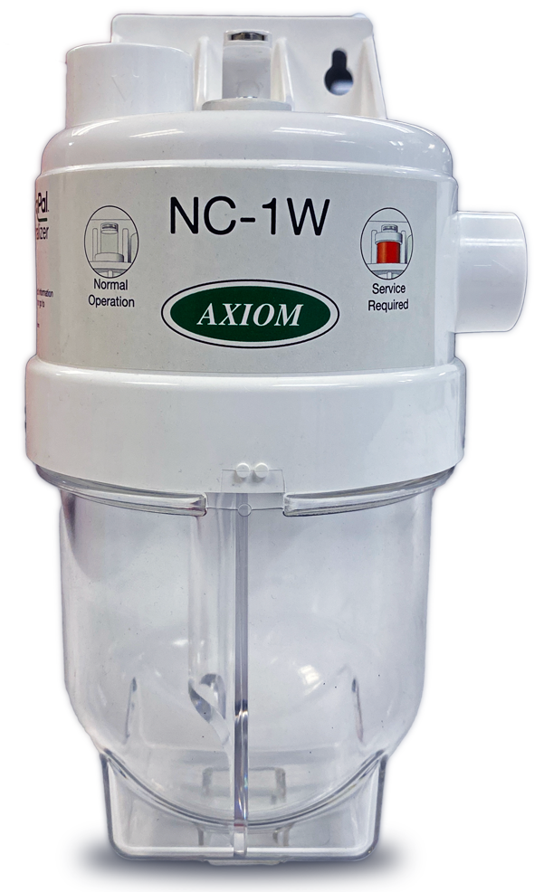
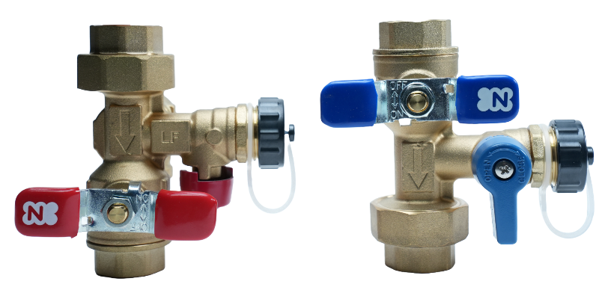
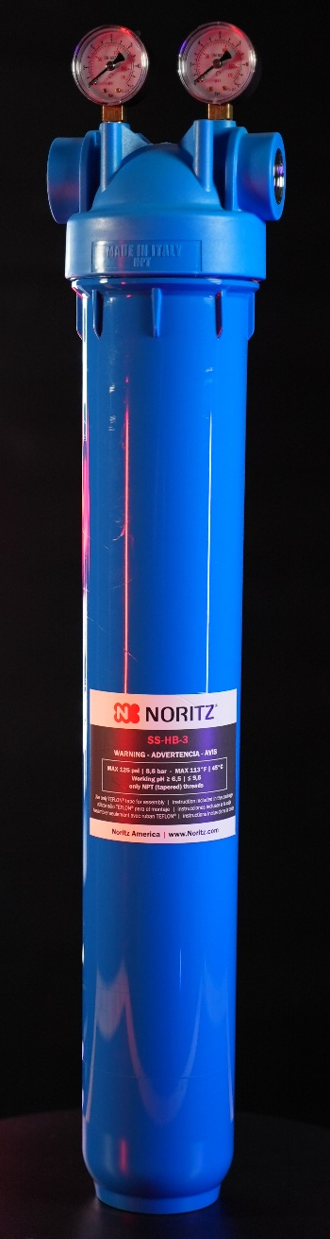
ADDITIONAL ACCESSORIES
Don’t forget the additional accessories!!
Isolation Valves: IK-WV-200-5-S
(not needed with an EZTR Bundle)
Condensate Neutralizer: NC-1W
Scale Shield: SS-HB-3
These accessories can be used on EZTR Series, EZ Series and NRCR Series

Slide 21
HELPFUL CONTACT INFO
SUPPORT.NORITZ.COM
NORITZ.COM/TECHTIPS
HELP.NORITZ.COM
TRAINING.NORITZ.COM
YOUTUBE.COM/NORITZAMERICA
Customer Care: 866-766-7489

Slide 22

THANK YOU
and
Happy Selling!!!

