Slide 1
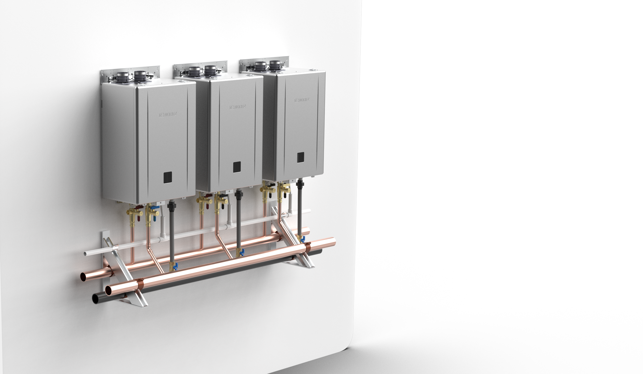

CMK and CRK Commercial Systems
Introducing the new Noritz Complete Commercial System Bundles

Slide 2
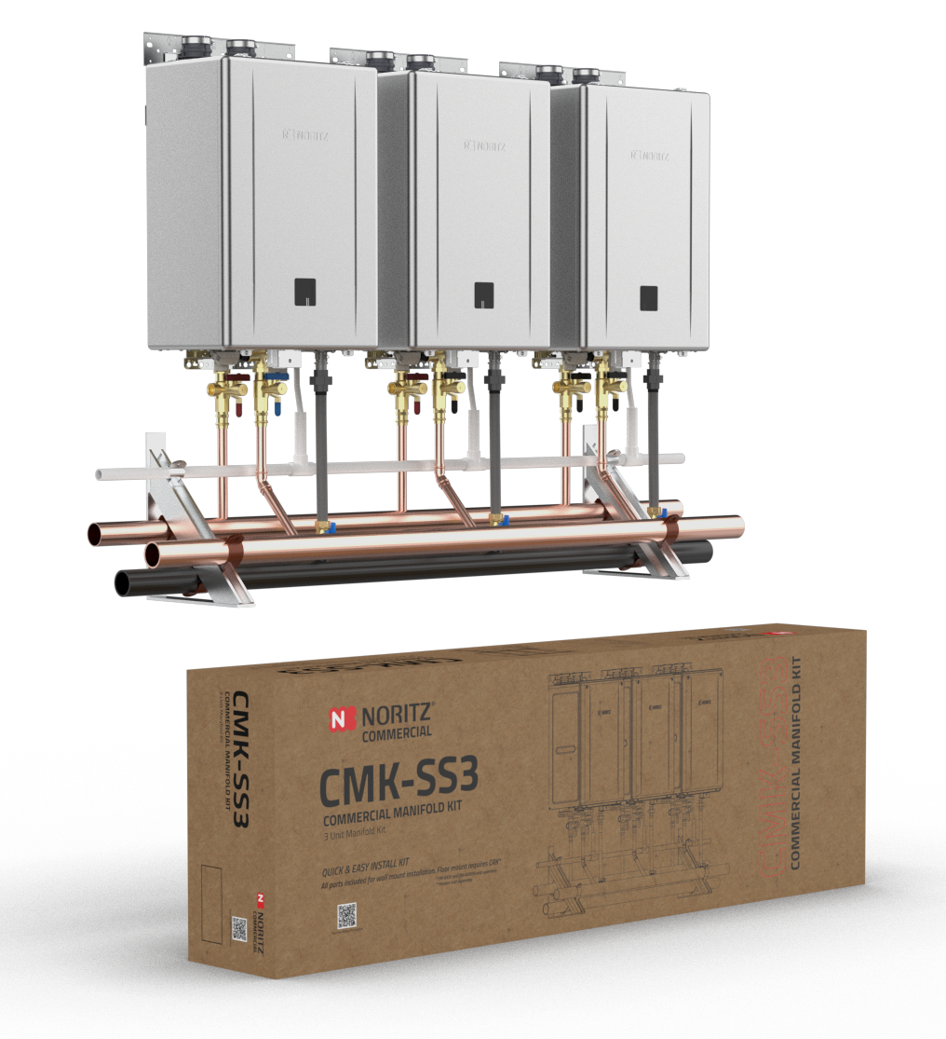
CMK and CRK Training
Overview
Features and Benefits
CMK – CRK System Configurations
Designing Your CMK or CRK System
CMK Wall Mount Installation Overview
CMK-SS3 Shown, NCC199CDV Pro Units Sold Separately.

Slide 3
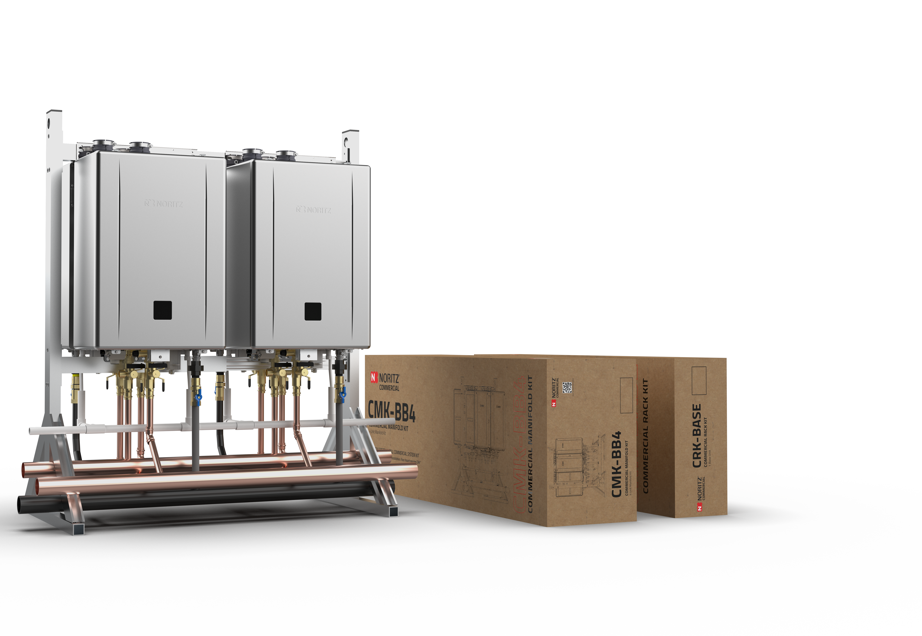
CMK and CRK Systems
Features & Benefits
Easy to Transport
Sturdy Aluminum Frame
Install in Less Than 2 Hours
True Commercial Manifold
Best Value in the Industry
Retrofit Easy Button
CRK-BASE + CMK-BB4 Shown, NCC199CDV Pro Units Sold Separately.

Slide 4
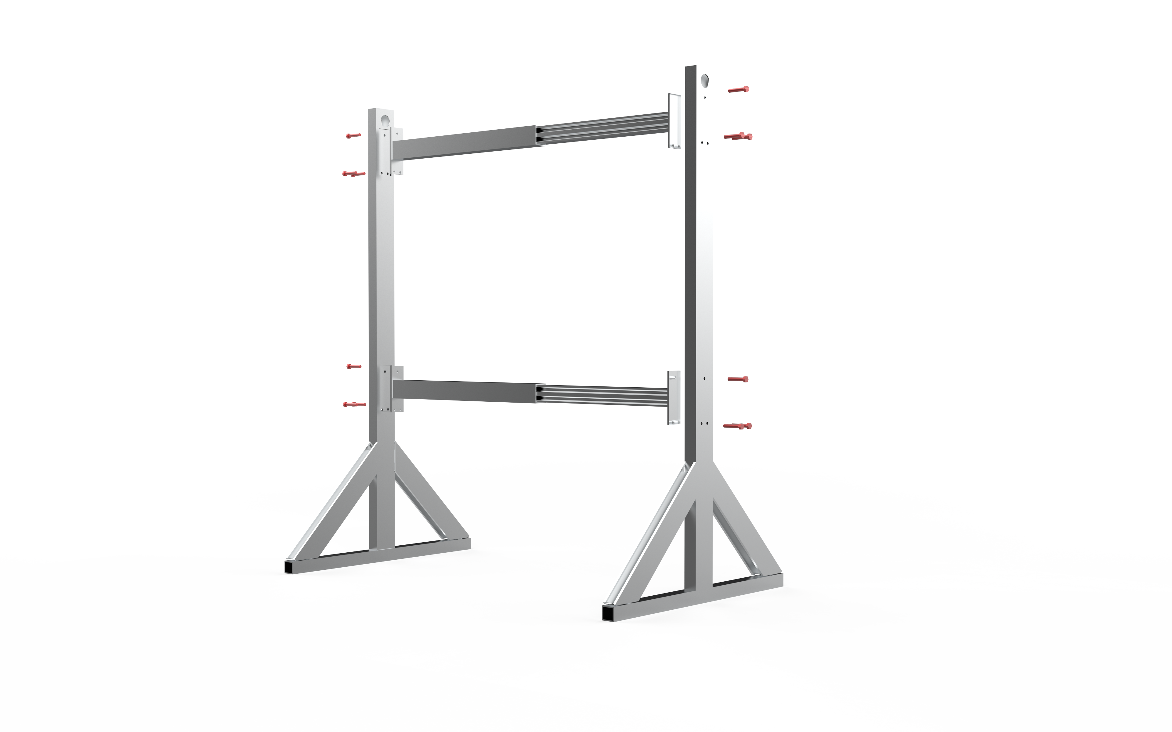
CRK-BASE
Features & Benefits
Assembly uses only 12 Bolts vs 60 Bolts of Competitor Racks!
Single CRK-BASE allows for 1-4 units, competitor requires Base + Extension to install more than 2 units.
Lighter weight corrosion resistant Aluminum frame vs. Heavier Coated Steel frame of competitor.
CRK-BASE Shown expanded to allow up to 4 units in a back to back configuration.
CRK-BASE Shown expanded to allow up to 4 units in a back to back configuration.

Slide 5
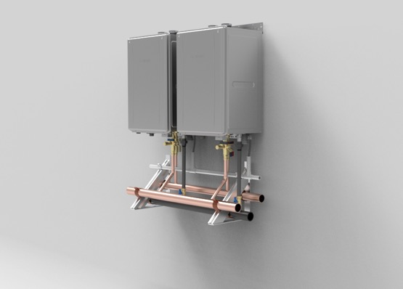
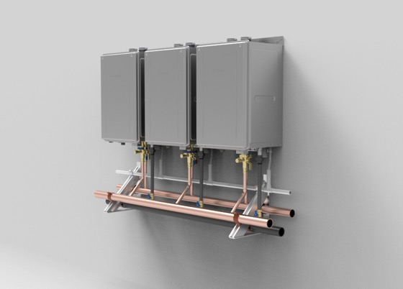
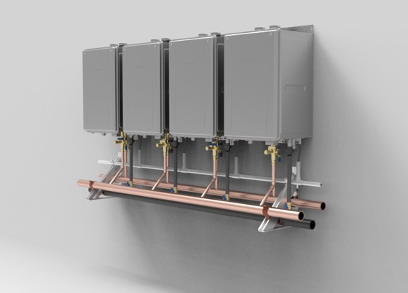
CMK (Commercial Manifold Kit)
System Configurations
Side by Side
CMK-SS2
Wall Hanging Side by Side Commercial Manifold Kit featuring 2 NCC199CDV Tankless Water Heaters (sold separately)
Max BTU/h: 399,800
CMK-SS3
Wall Hanging Side by Side Commercial Manifold Kit featuring 3 NCC199CDV Tankless Water Heaters (sold separately)
Max BTU/h: 599,700
CMK-SS4
Wall Hanging Side by Side Commercial Manifold Kit featuring 4 NCC199CDV Tankless Water Heaters (sold separately)
Max BTU/h: 799,600

Slide 6
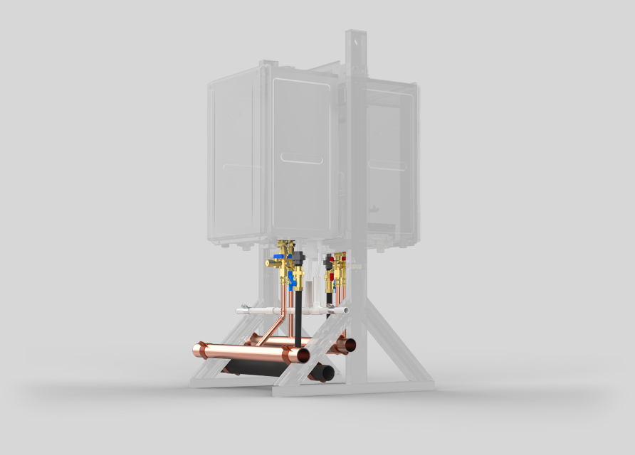
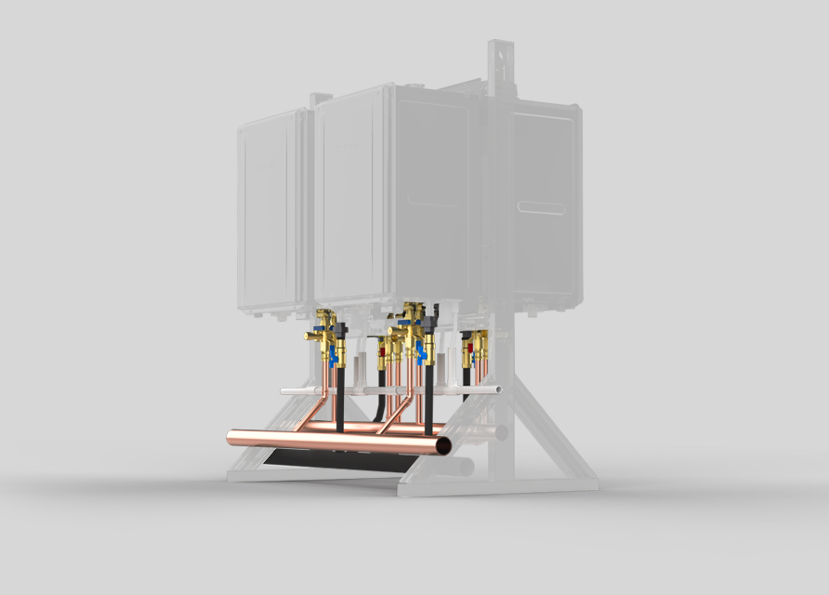
CMK (Commercial Manifold Kit)
System Configurations
Back to Back
CMK-BB2
Commercial Manifold Kit connecting 2 Back to Back NCC199CDV Tankless Water Heaters (sold separately) installed on CRK Base – Floor standing rack (sold separately)
Max BTU/h: 399,800
CMK-BB4
Commercial Manifold Kit connecting 4 Back to Back NCC199CDV Tankless Water Heaters (sold separately) installed on CRK Base – Floor standing rack (sold separately)
Max BTU/h: 799,600

Slide 7
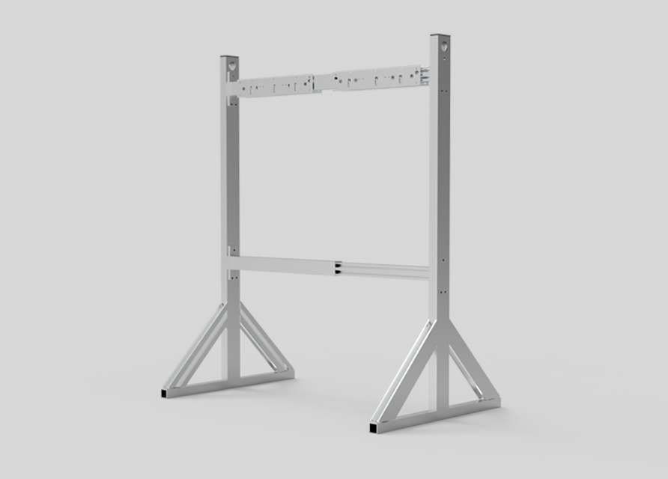
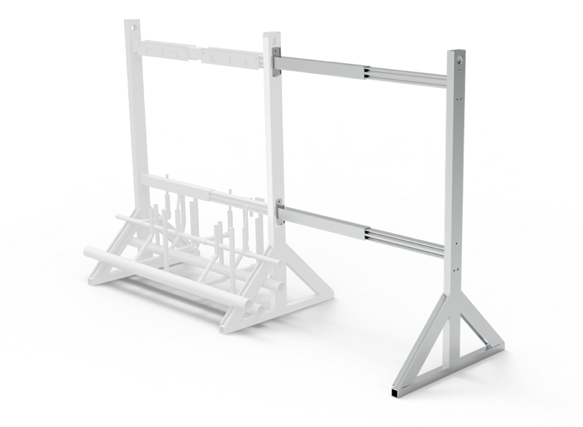
CRK (Commercial Rack Kit)
System Configurations
CRK-BASE
The CRK-BASE commercial rack kit allows for custom floor standing installations of 1 to 4 tankless units.
CRK-ADDON
The CRK-ADDON commercial kit lets you expand your existing system to more than 4 units.

Slide 8
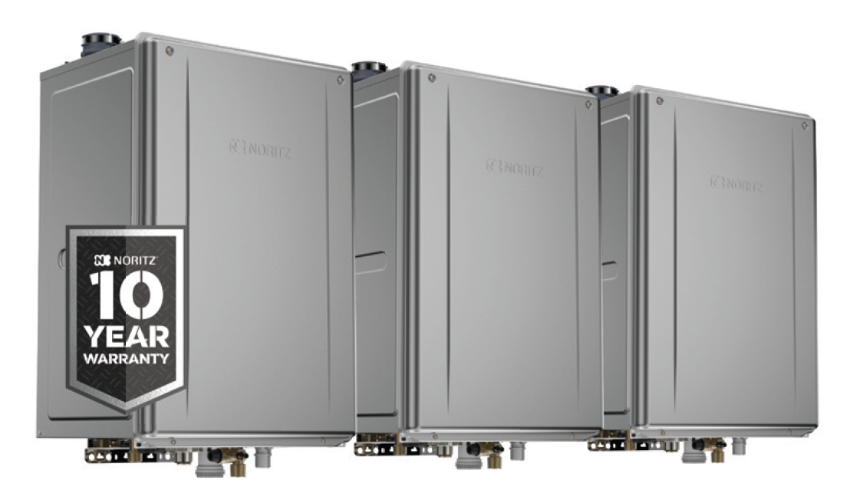
CMK (Commercial Manifold Kit)
Design Your System
Step 1
Select Desired Number of NCC199CDV Tankless Needed for System
Designed for Use With Our Award-Winning NCC199CDV Tankless

Slide 9
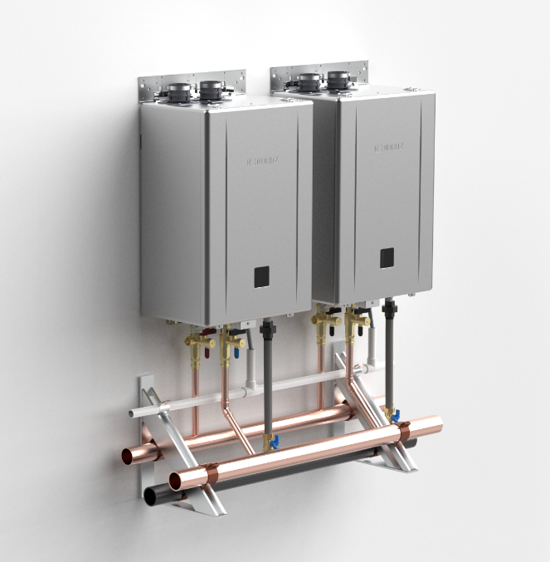
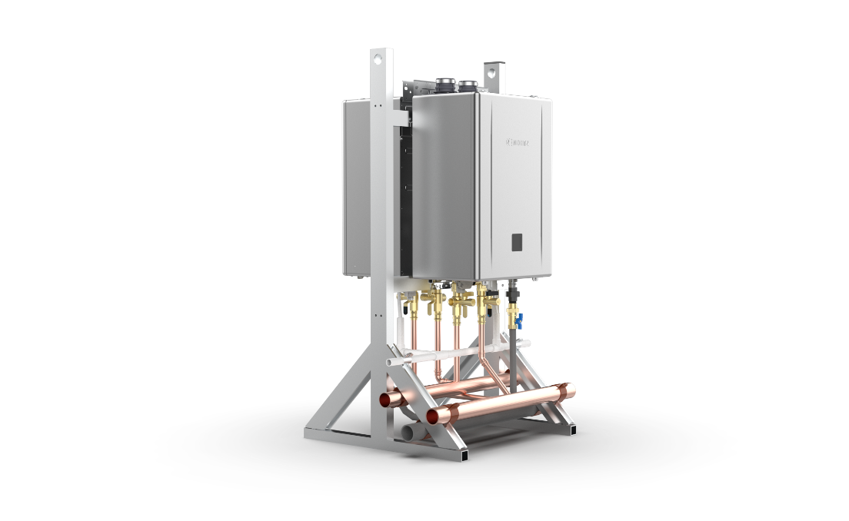
CMK (Commercial Manifold Kit)
Design Your System
Step 2
Choose Between Wall Hanging or Floor Standing System
CMK-SS
Wall Hanging Bundle Kits
CMK-SS2
CMK-SS3
CMK-SS4
CMK-BB
Floor Standing Bundle Kits
CMK-BB2
CMK-BB4

Slide 10

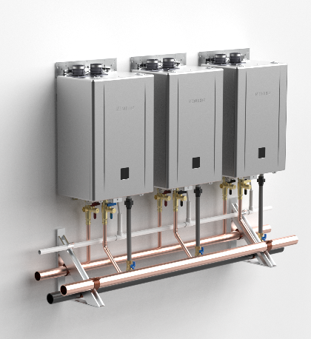
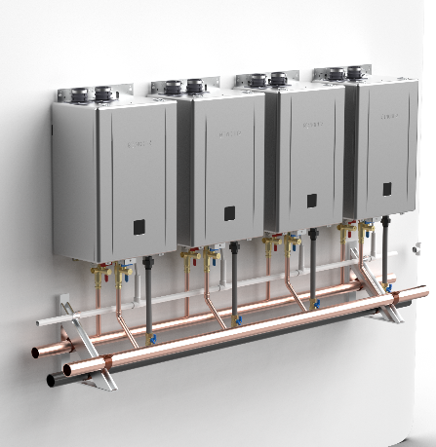

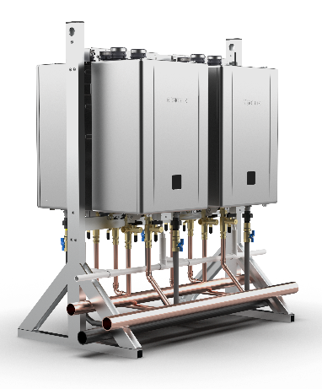
CMK (Commercial Manifold Kit)
Design Your System
Wall
Hanging Configurations
Floor
Standing Configurations
Step 3
Select Your
CMK or CRK Configuration
CMK-SS2
CMK-SS3
CMK-SS4
CMK-BB2
CMK-BB4

Slide 11
CMK (Commercial Manifold Kit)
Design Your System
Step 4
Choose the Floor-Standing Base
(For CRK Only)
The CRK-BASE commercial rack kit allows for custom floor standing installations of 1 to 4 tankless units.
Step 5
Select Optional Extension
(For CRK Only)
The CRK-ADDON commercial kit lets you expand your existing system to more than 4 units.

Slide 12
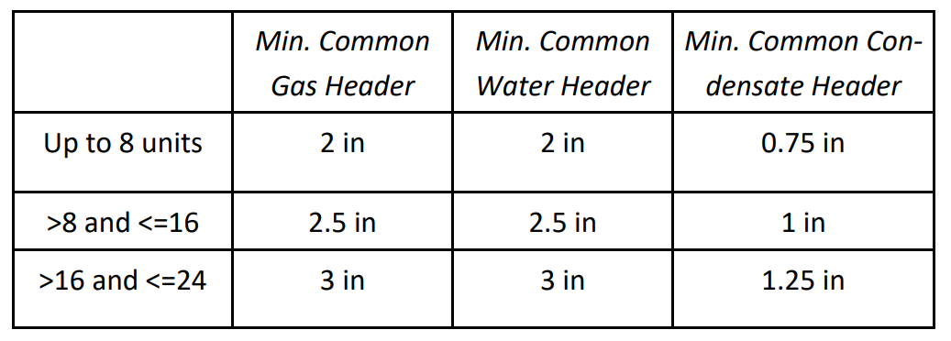
CMK (Commercial Manifold Kit)
Additional Notes
One CRK-ADDON may be used per CRK-BASE. Attempting to use multiple CRK-ADDON may result in misaligned water and gas manifolds.
Up to 24 NCC199CDV Pro heaters can be connected using multiples of the CRK-BASE and CRK-ADDON kits. Quick Connect Pro up to 6 units or use a 6, 12 or 24 unit system controller (sold separately) to ensure system balancing and load management.
NCC199CDV Pro units may be common vented, refer to the common vent manual for full details.
Manifold sizing is designed for a maximum of eight (8) water heaters. In order to connect units in greater number than eight, a common header of a larger diameter may be necessary. Refer to local plumbing and/or building code for minimum pipe sizing requirements.
Common Header Diameter Recommendation

Slide 13
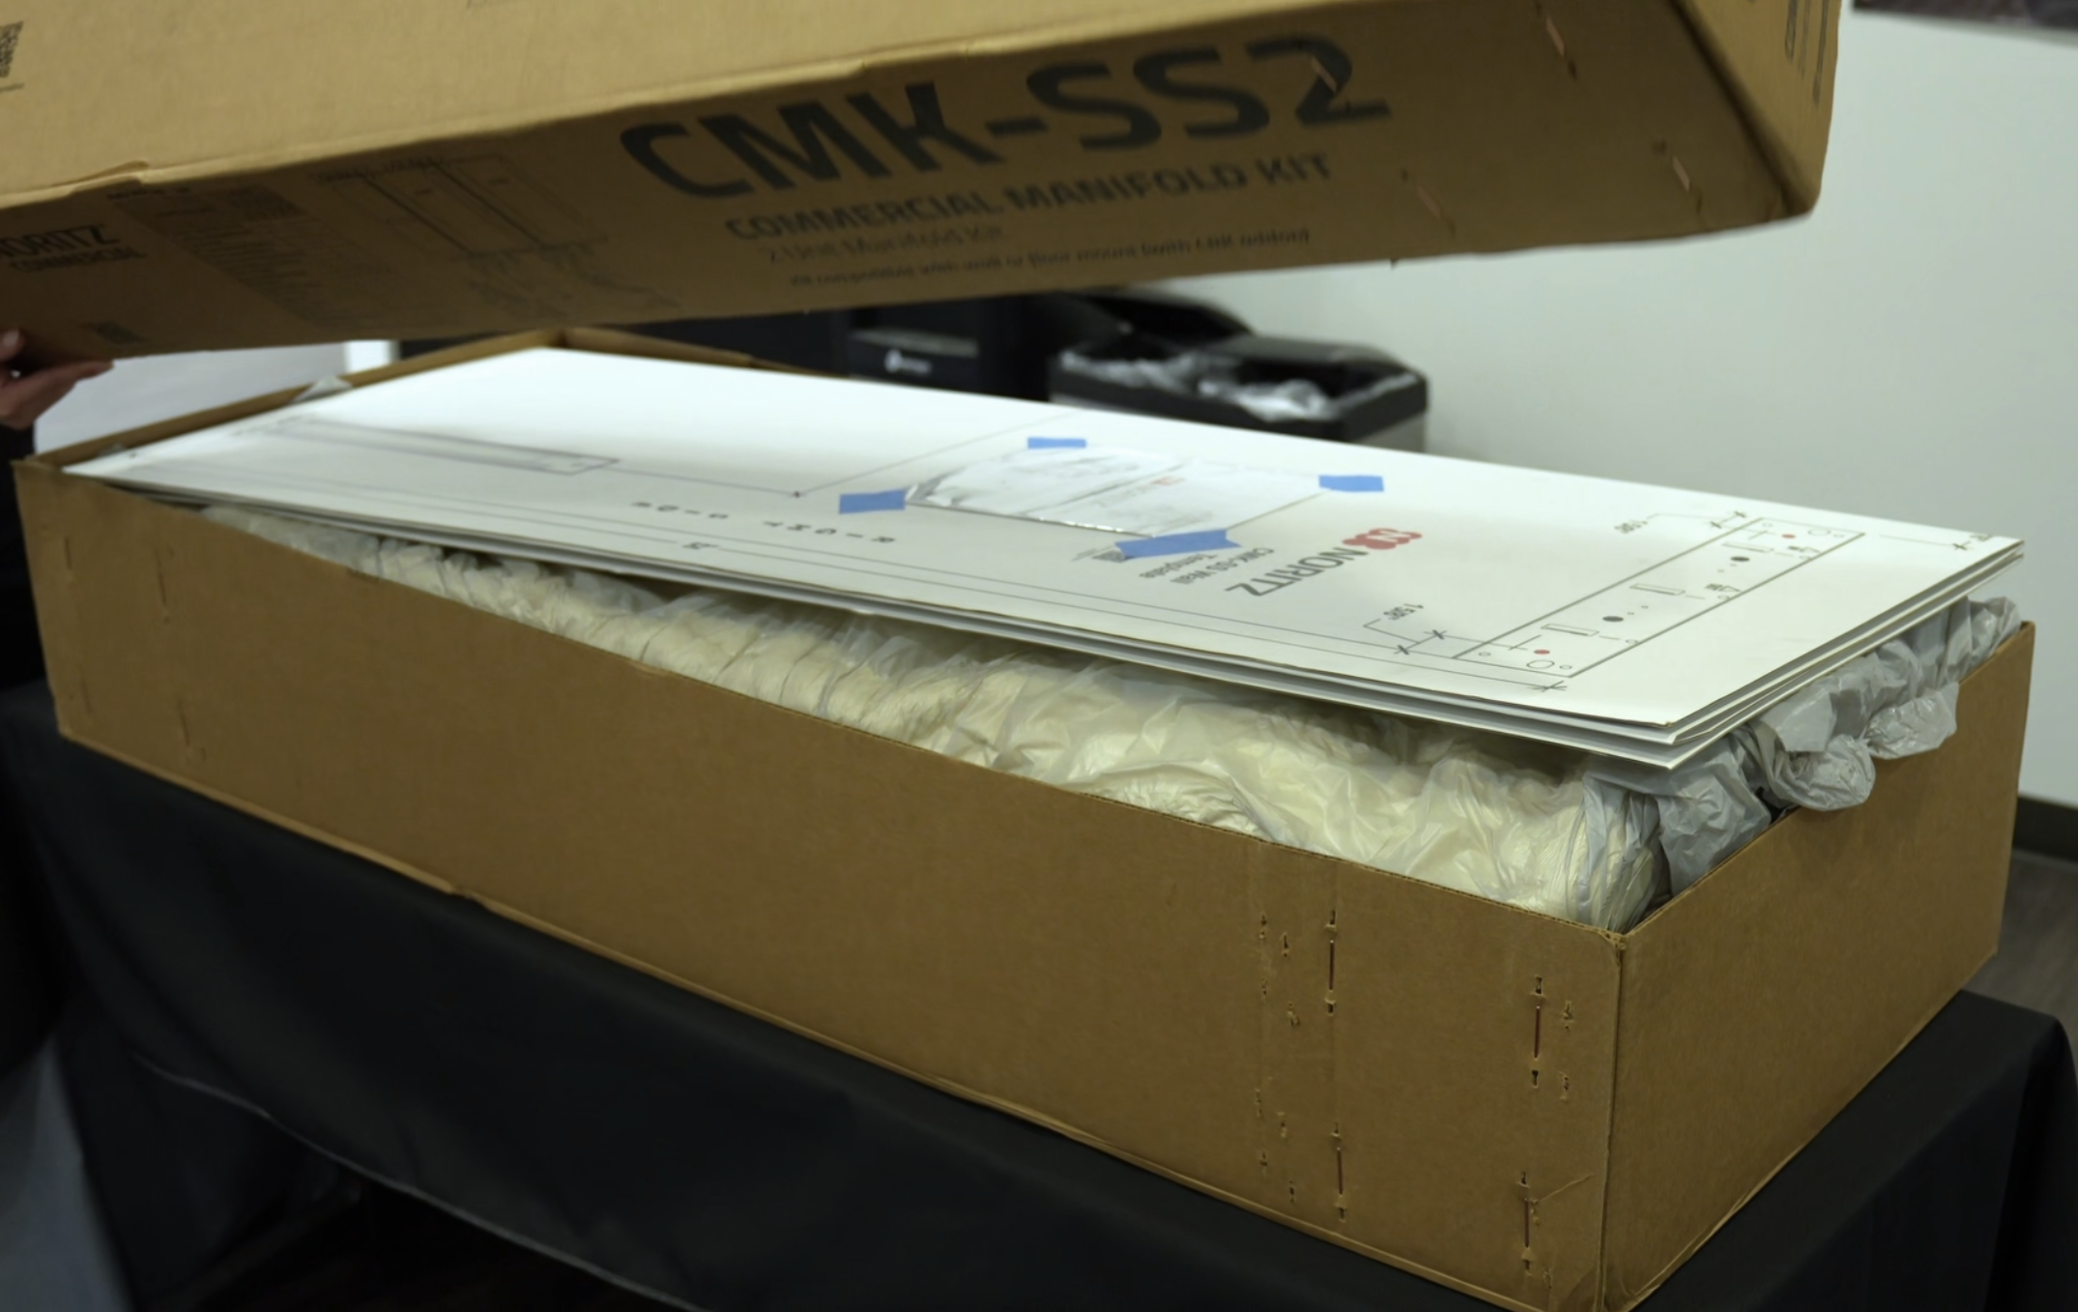
CMK (3 Unit Wall Mount)
Installation Overview
In The Box
CMK (Wall Mount)
In The Box
Cardboard Mounting Template
2” Hot Water Manifold
2” Cold Water Manifold
2” Gas Manifold
¾” Condensate Drain Manifold
2x Manifold Wall Mount Brackets
Clamps, Caps, Etc
See Page 3 of Installation Manual for full details

Slide 14
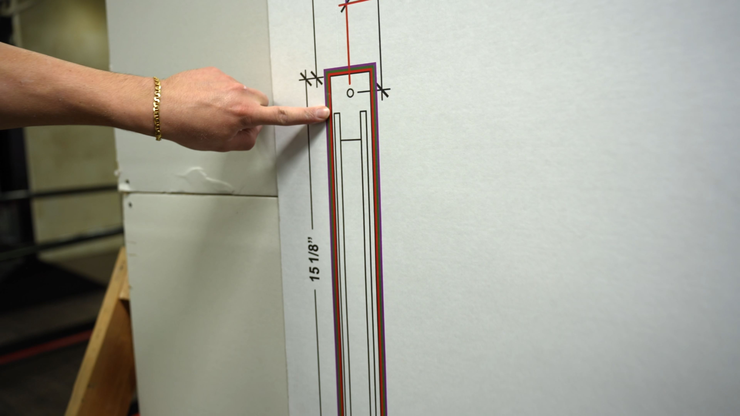
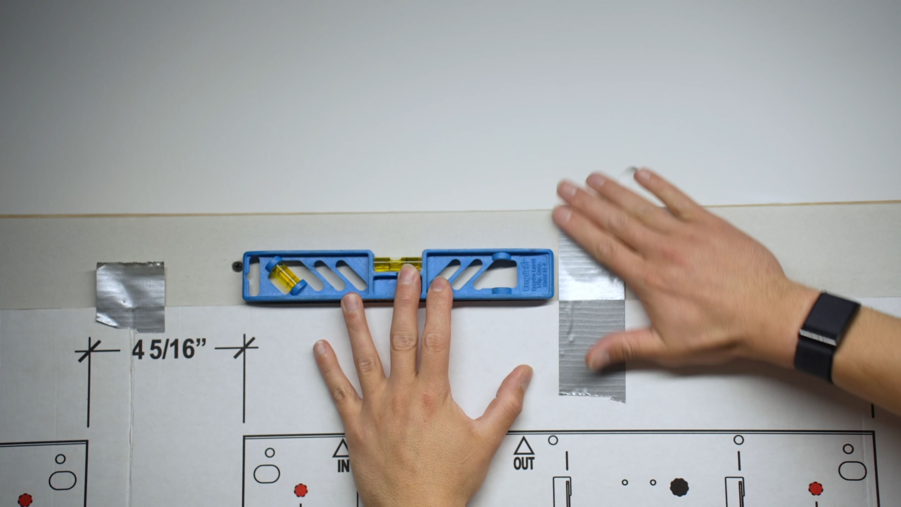
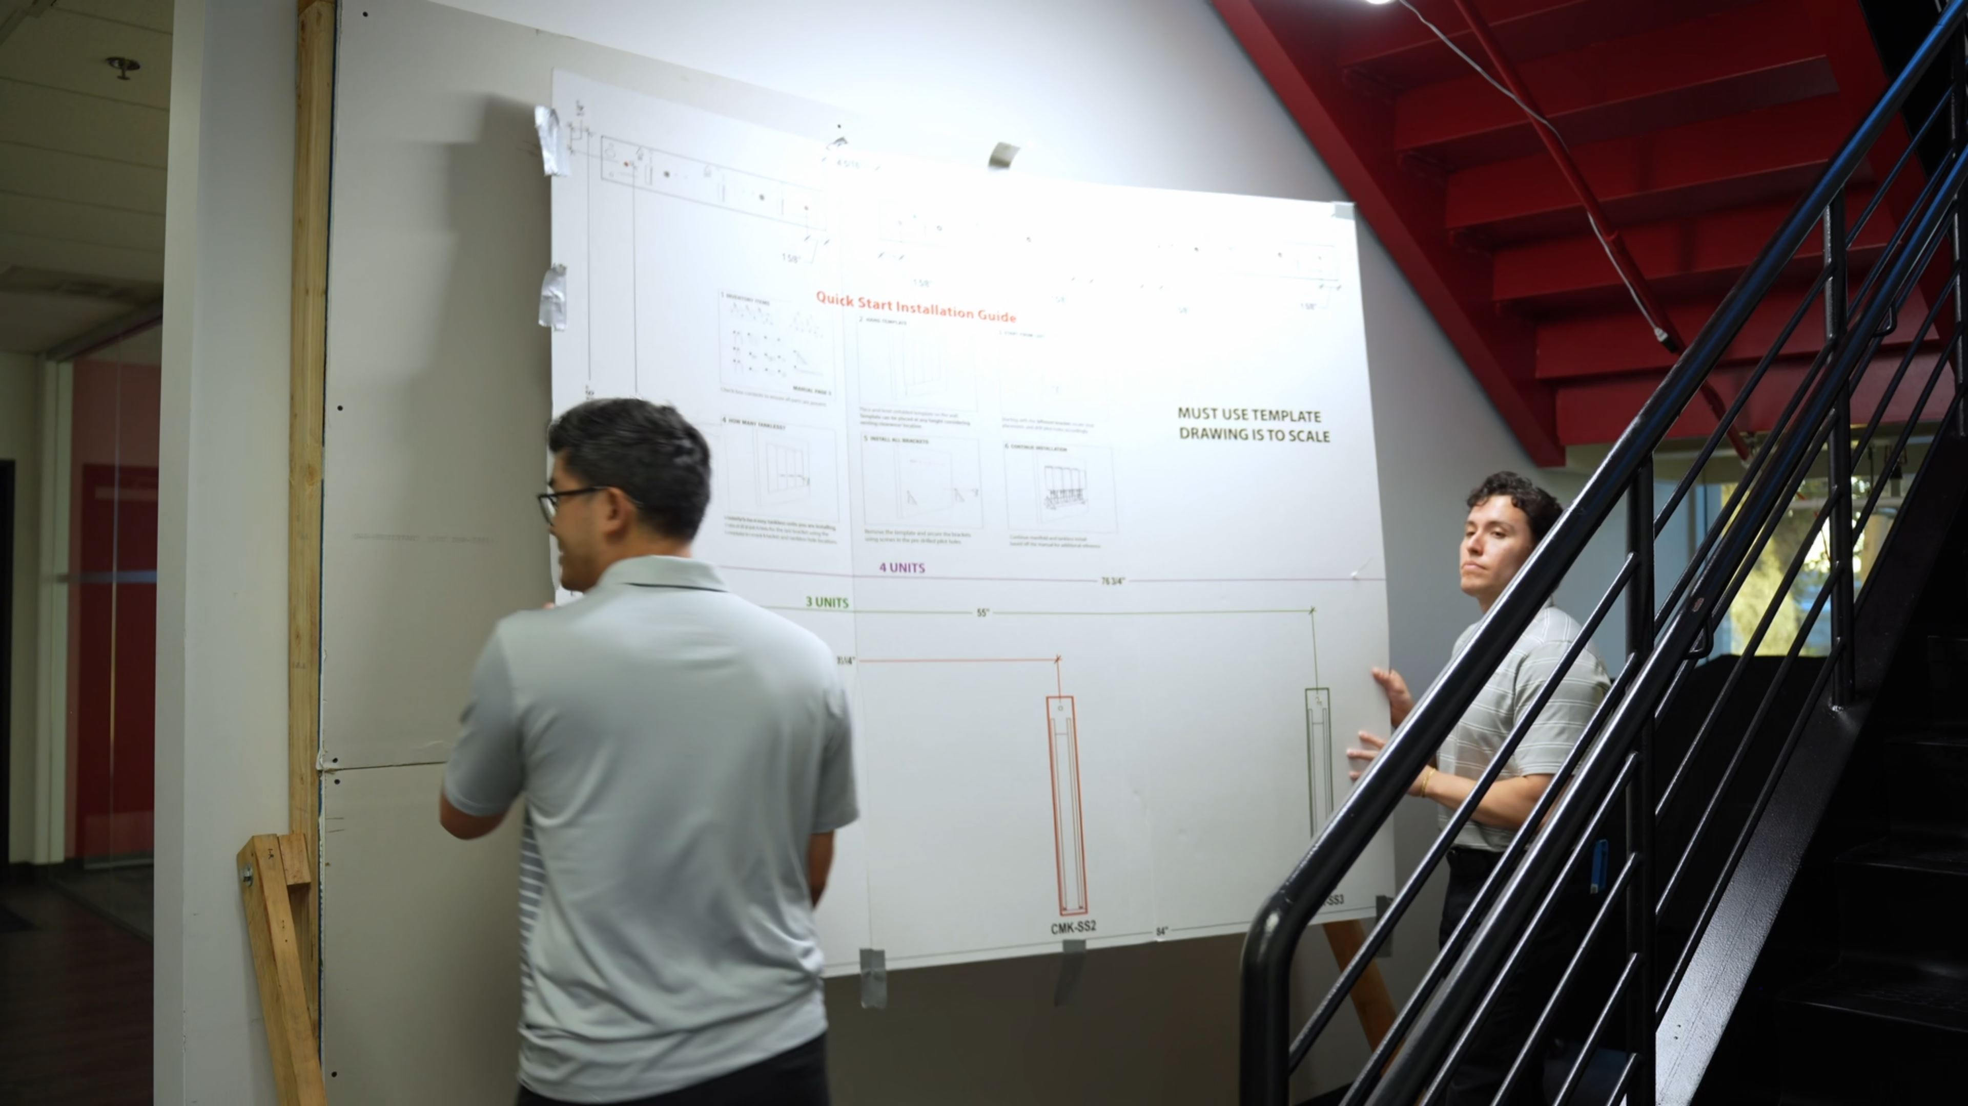
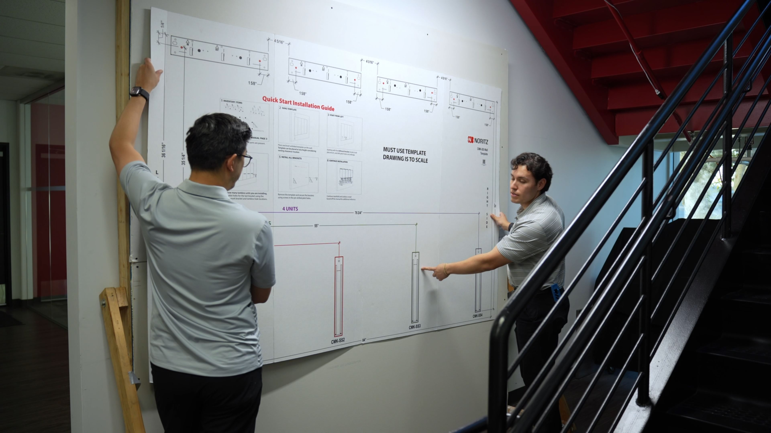
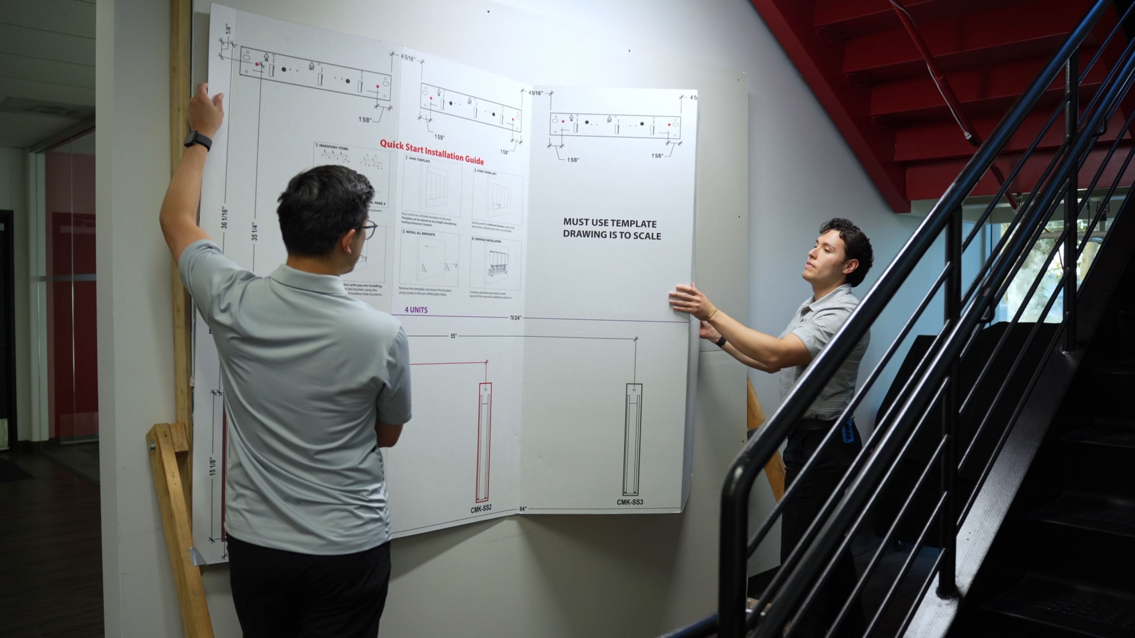
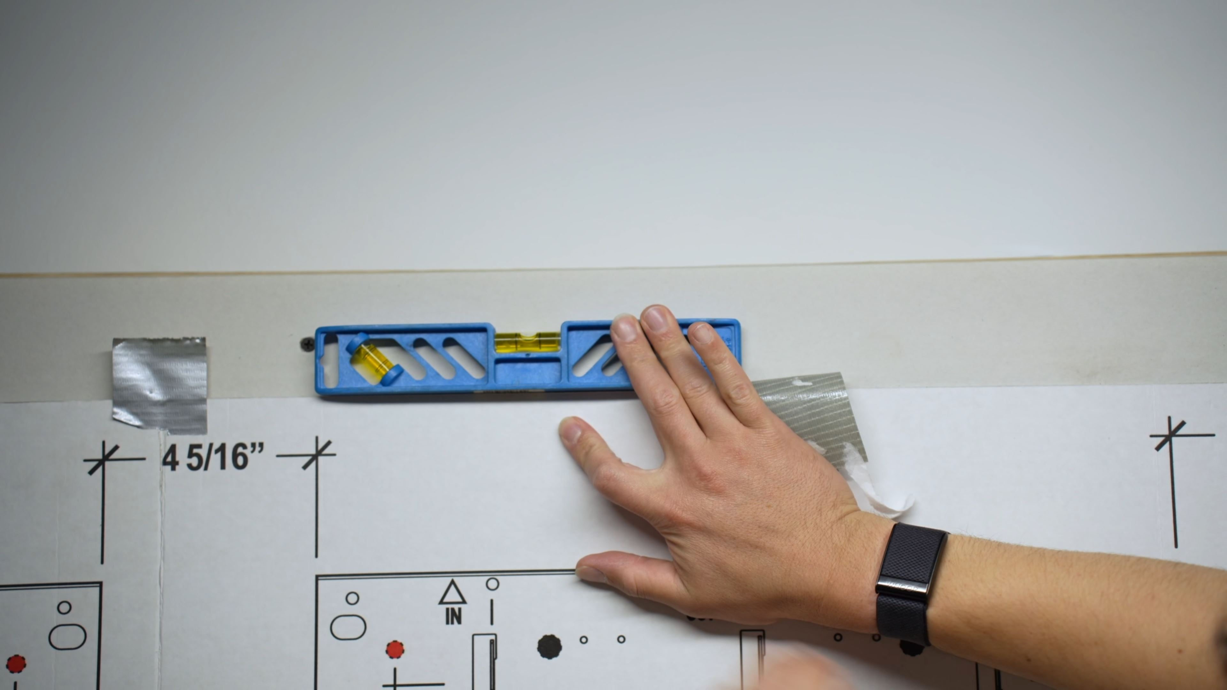
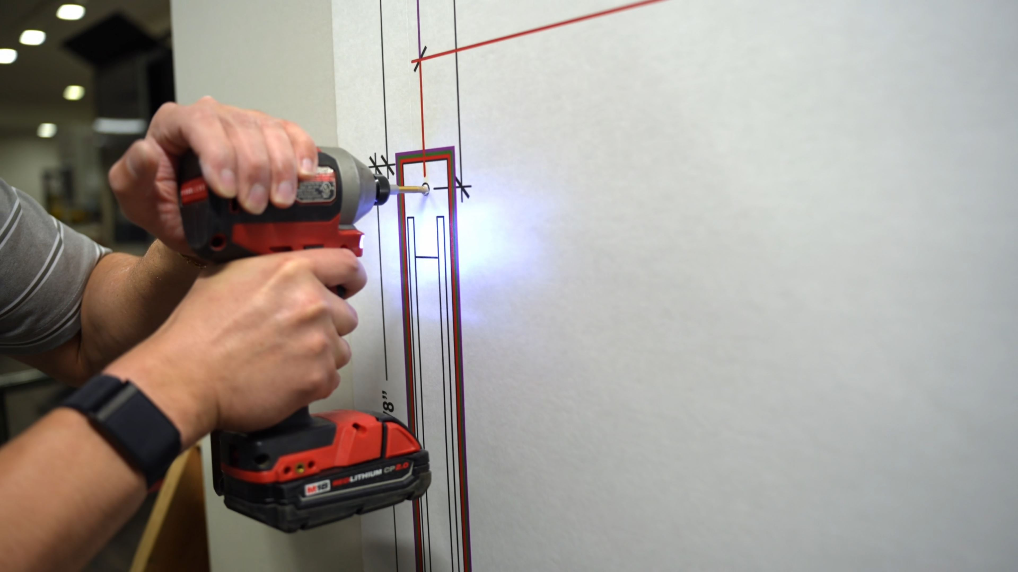
CMK (3 Unit Wall Mount)
Installation Overview
Using Mounting Template
CMK (Wall Mount)
Mounting Template
Determine number of units to be mounted
Template may be folded if less than 4
Align left bracket mount with stud
Level template
Secure template to wall
Drill pilot holes
Remove template

Slide 15
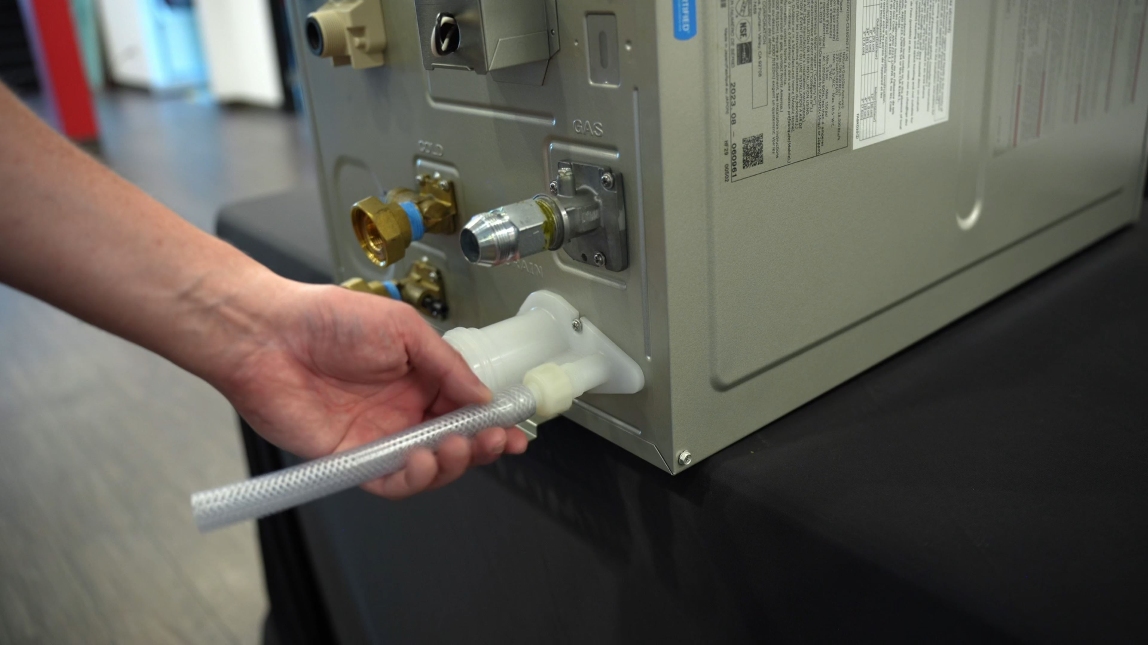
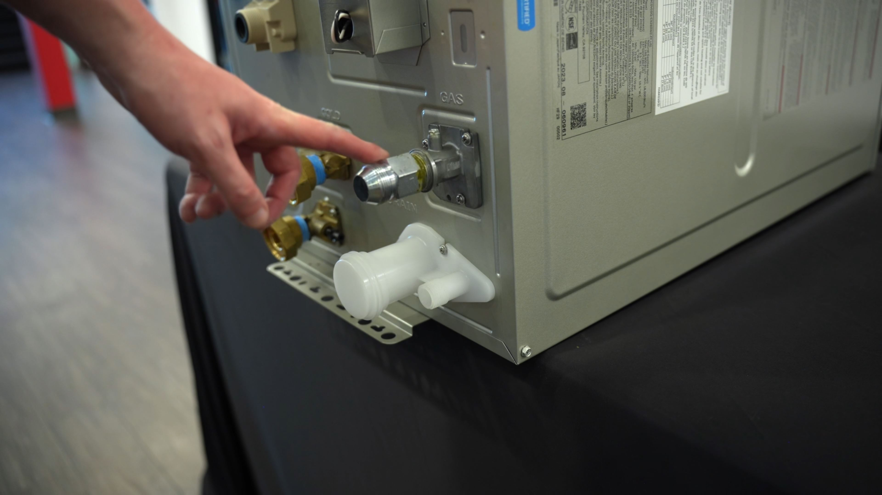
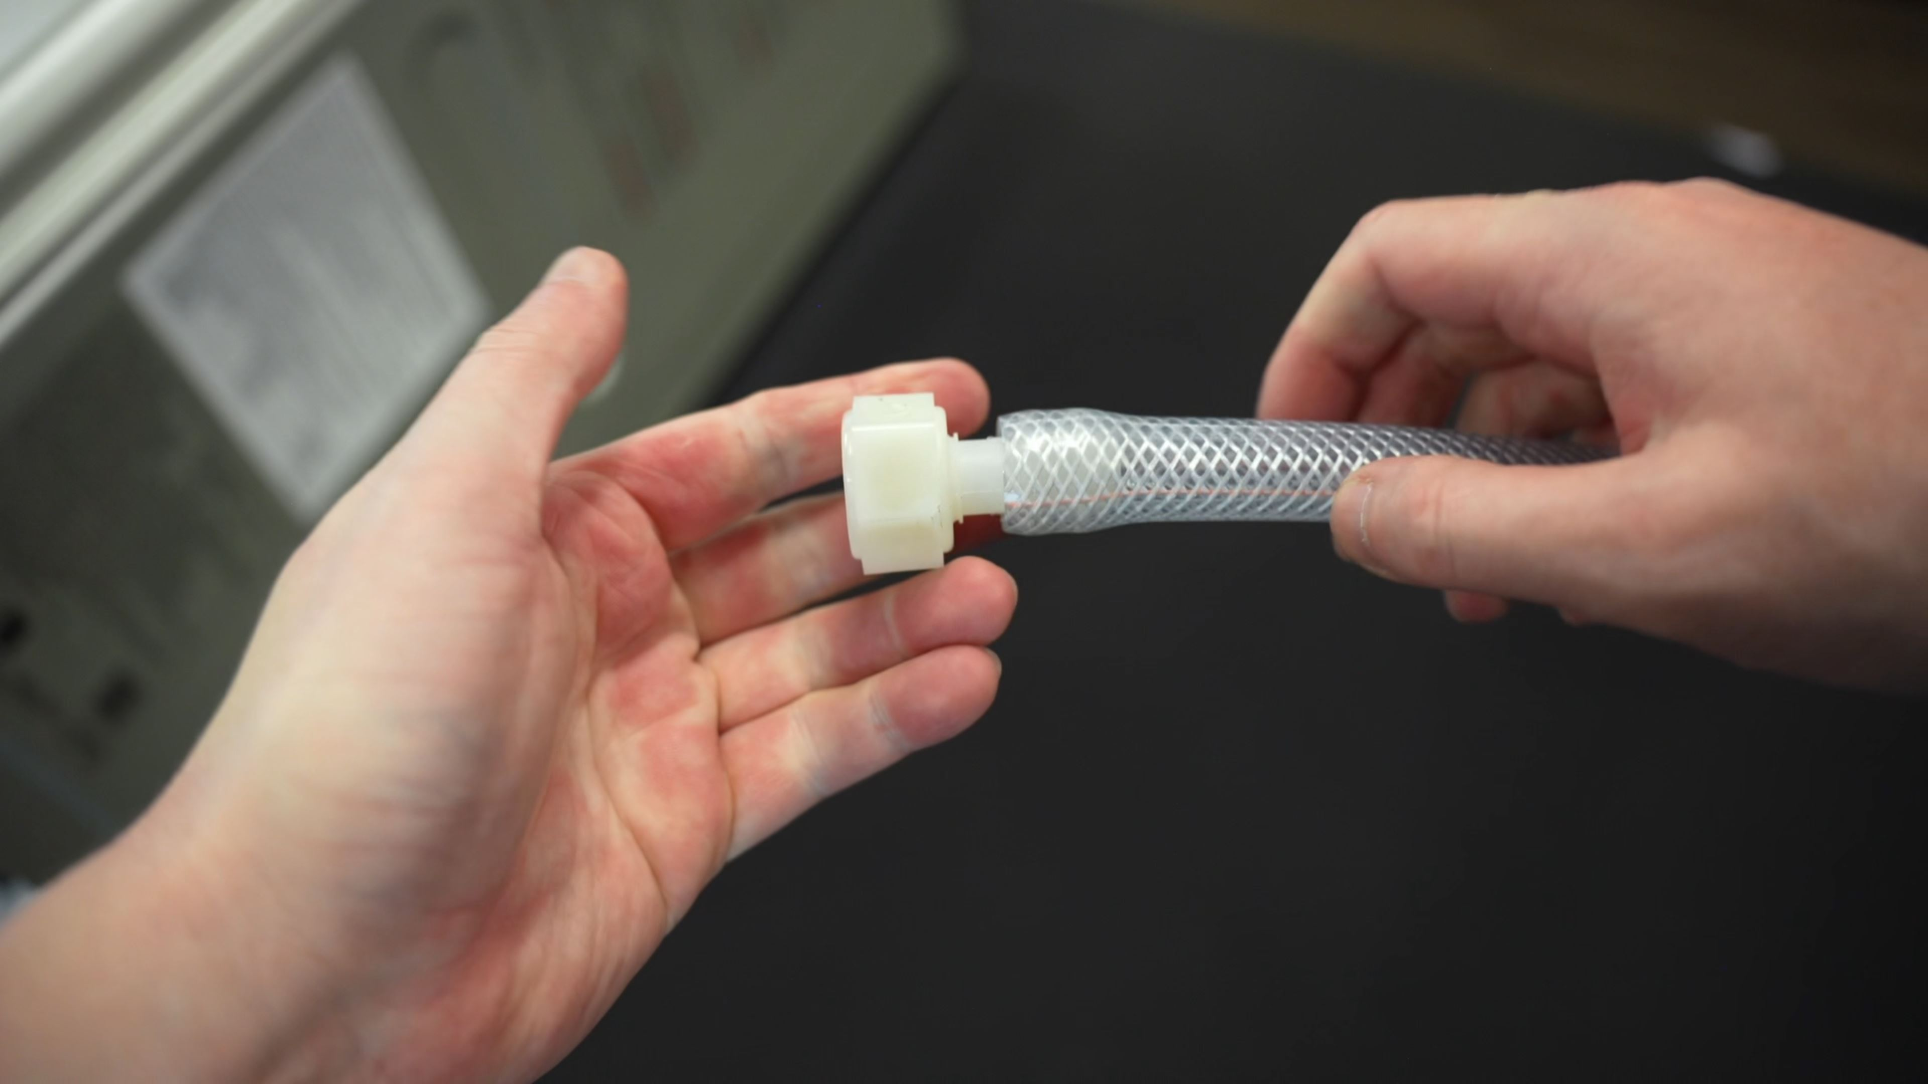
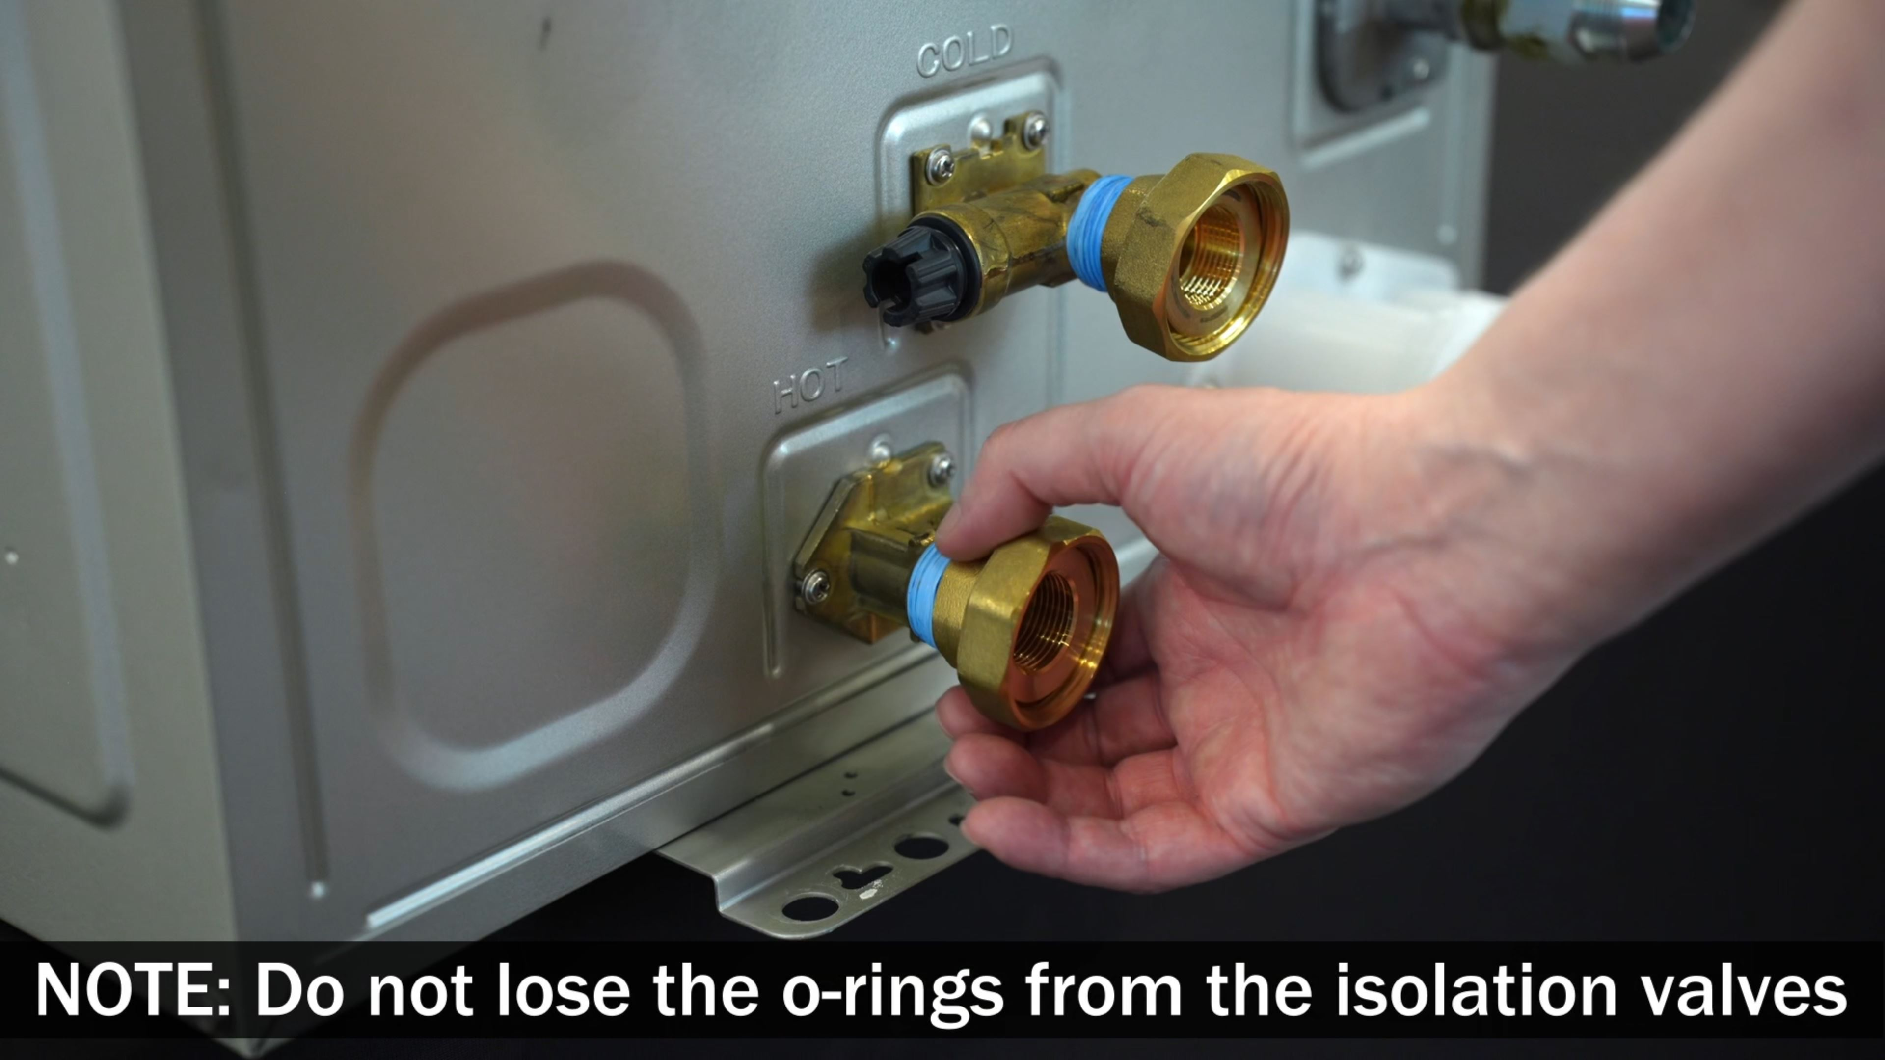
CMK (3 Unit Wall Mount)
Installation Overview
Preparing Heaters
CMK (Wall Mount)
Preparing Heaters
Attach iso kit unions to cold/hot fittings
Attach braided hose to condensate fitting
Attach gas union to unit
Attach condensate fitting to unit

Slide 16
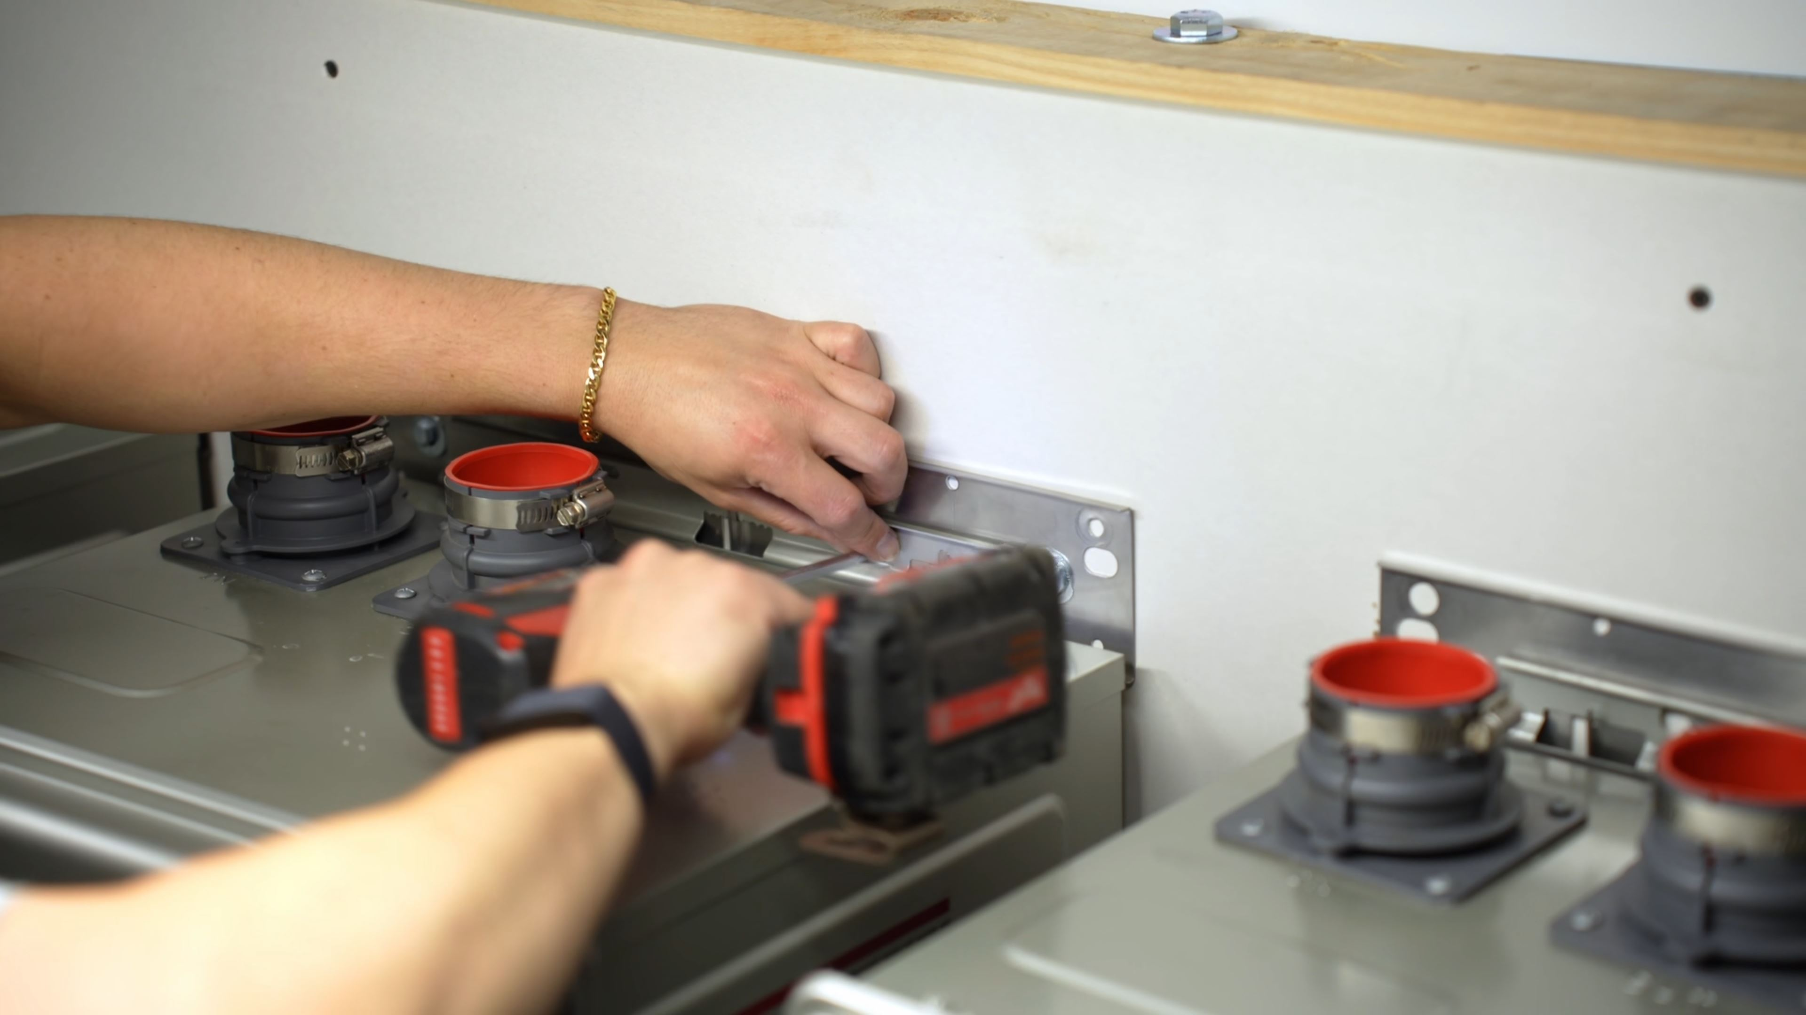
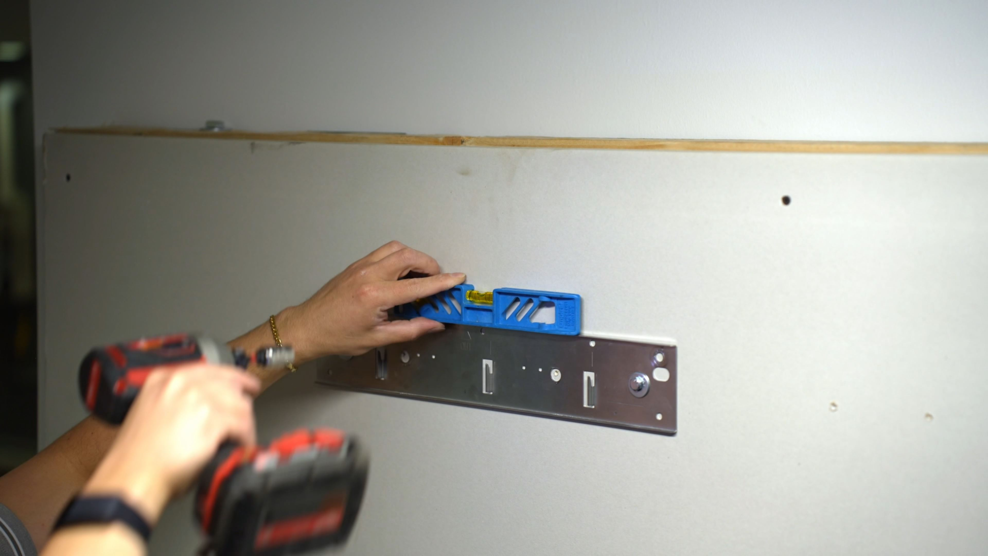
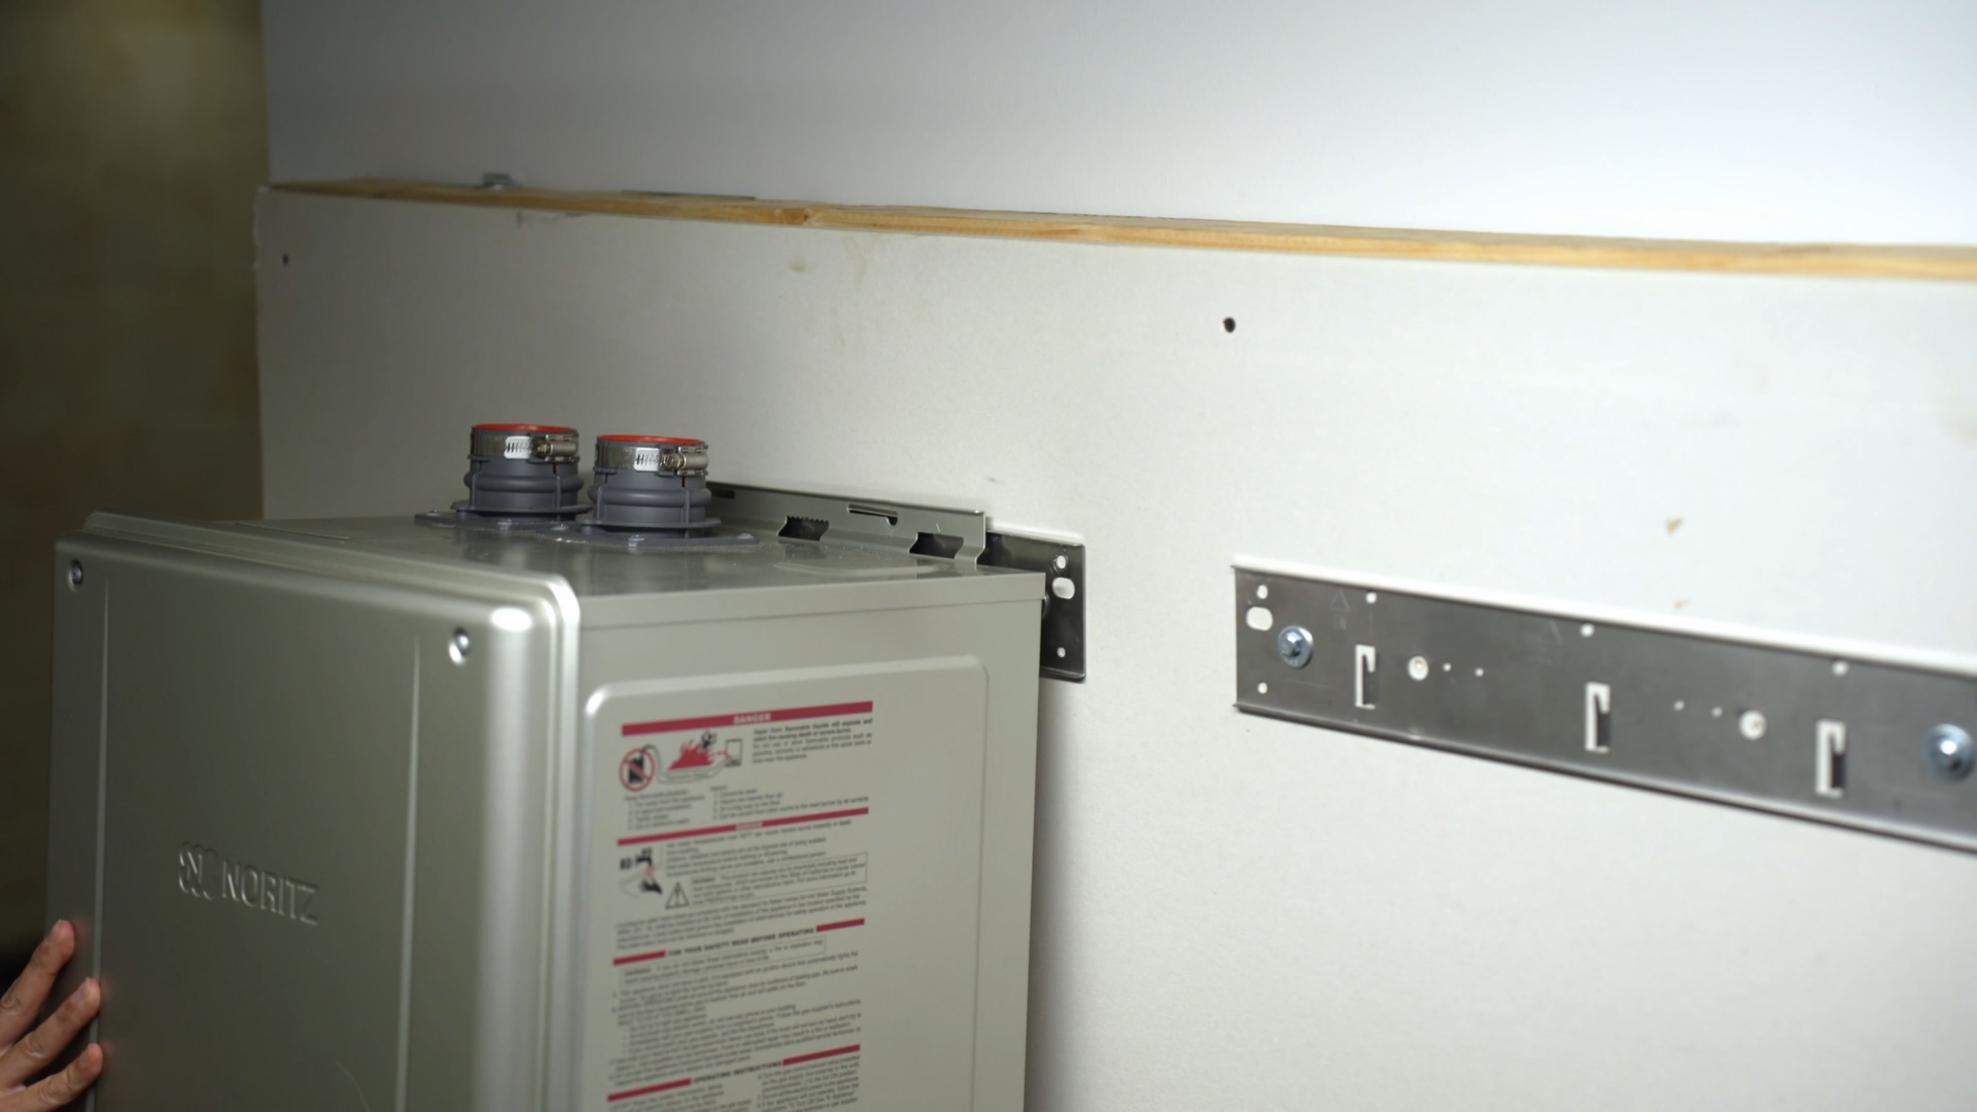
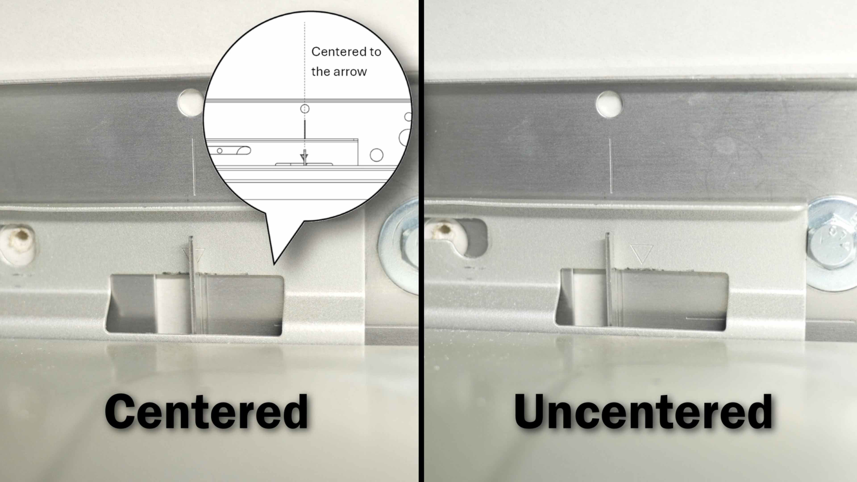
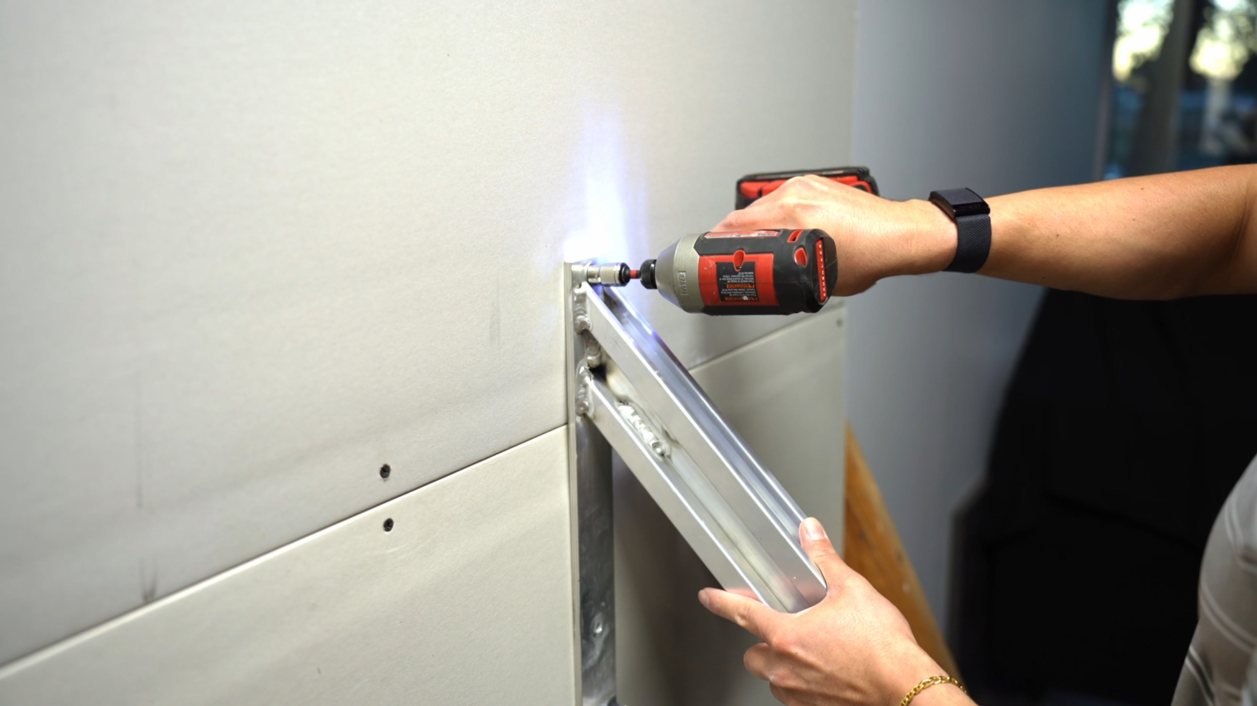
CMK (3 Unit Wall Mount)
Installation Overview
Mounting Brackets
CMK (Wall Mount)
Mounting Brackets
Mount heater brackets
Mount manifold wall brackets
Hang units
Make sure units are centered on bracket
Secure units to top bracket

Slide 17
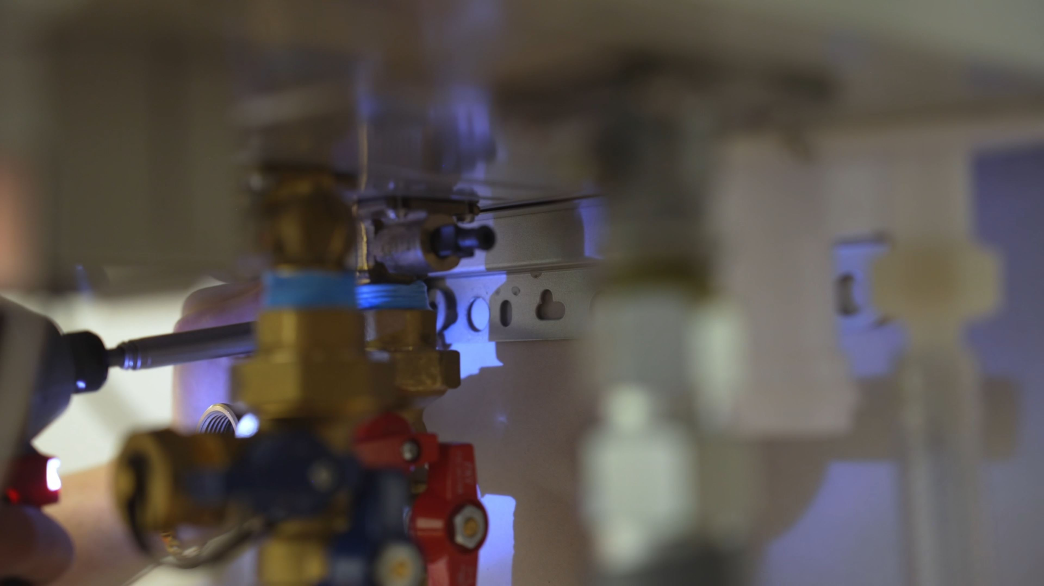
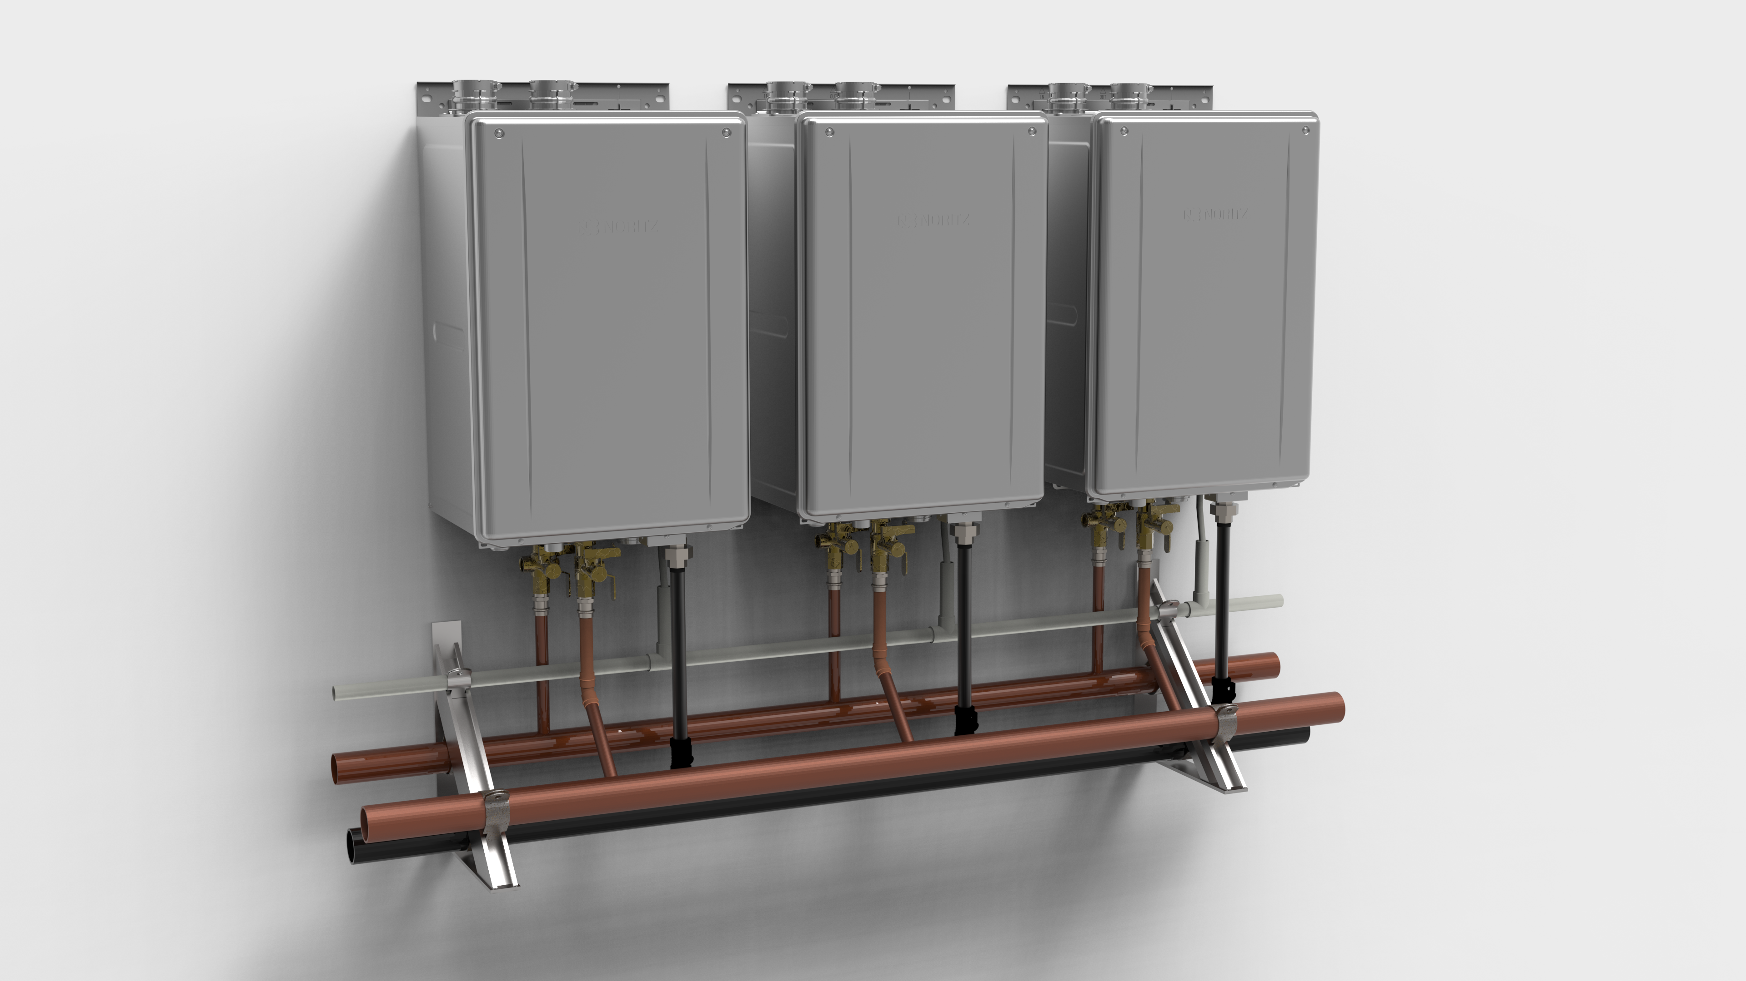
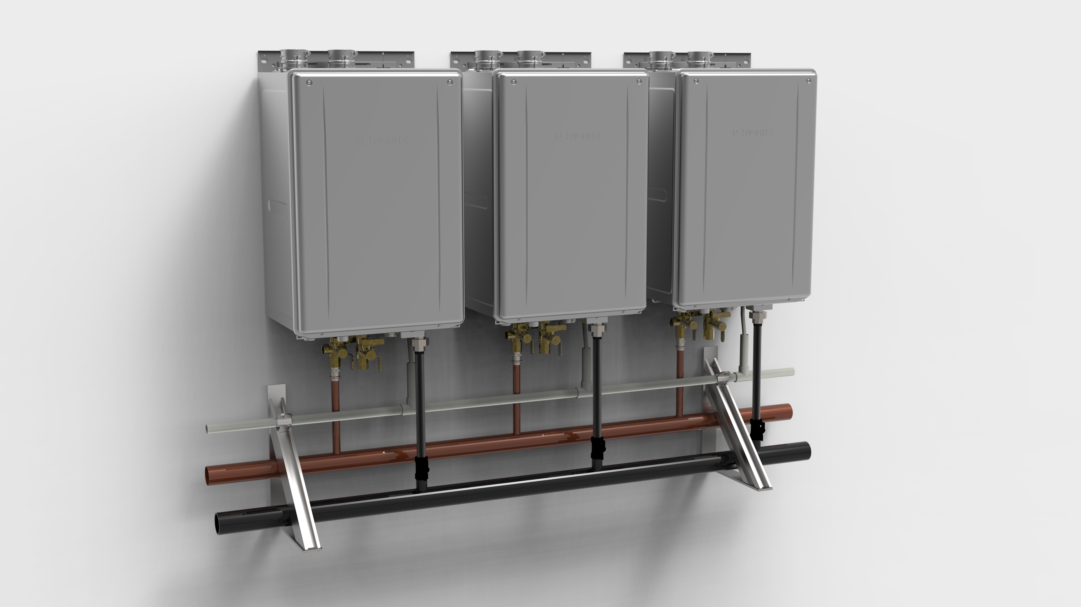
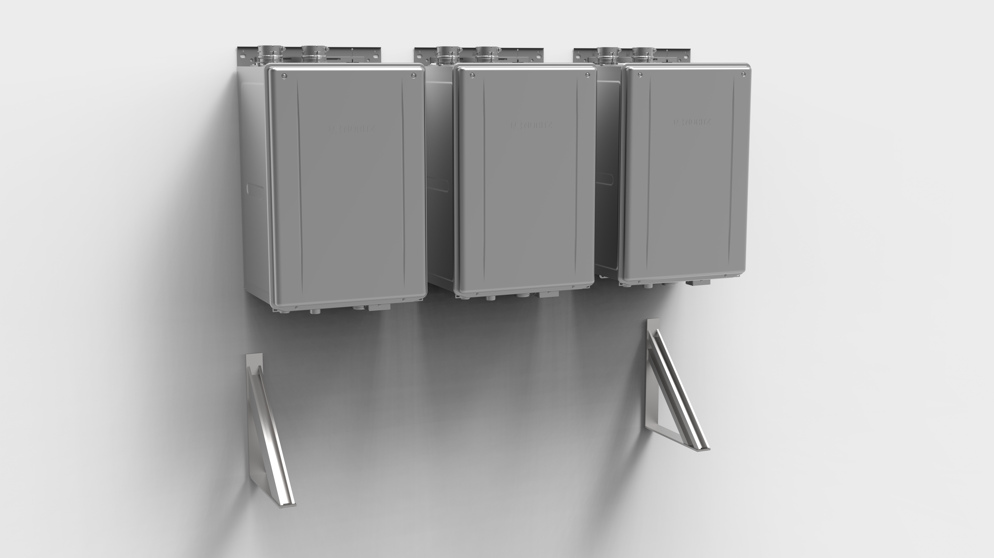
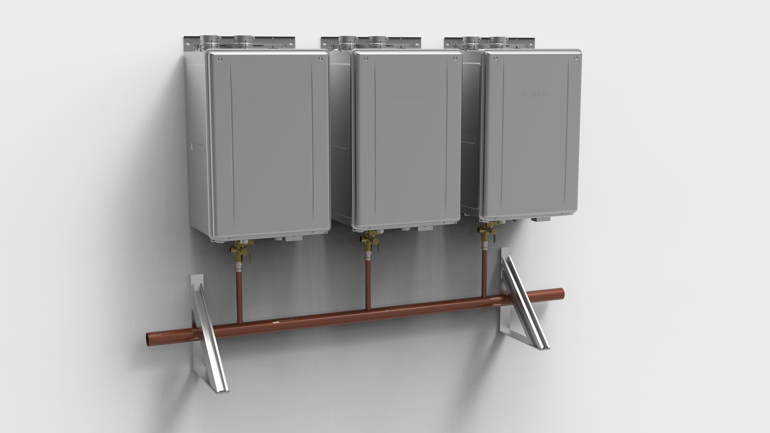
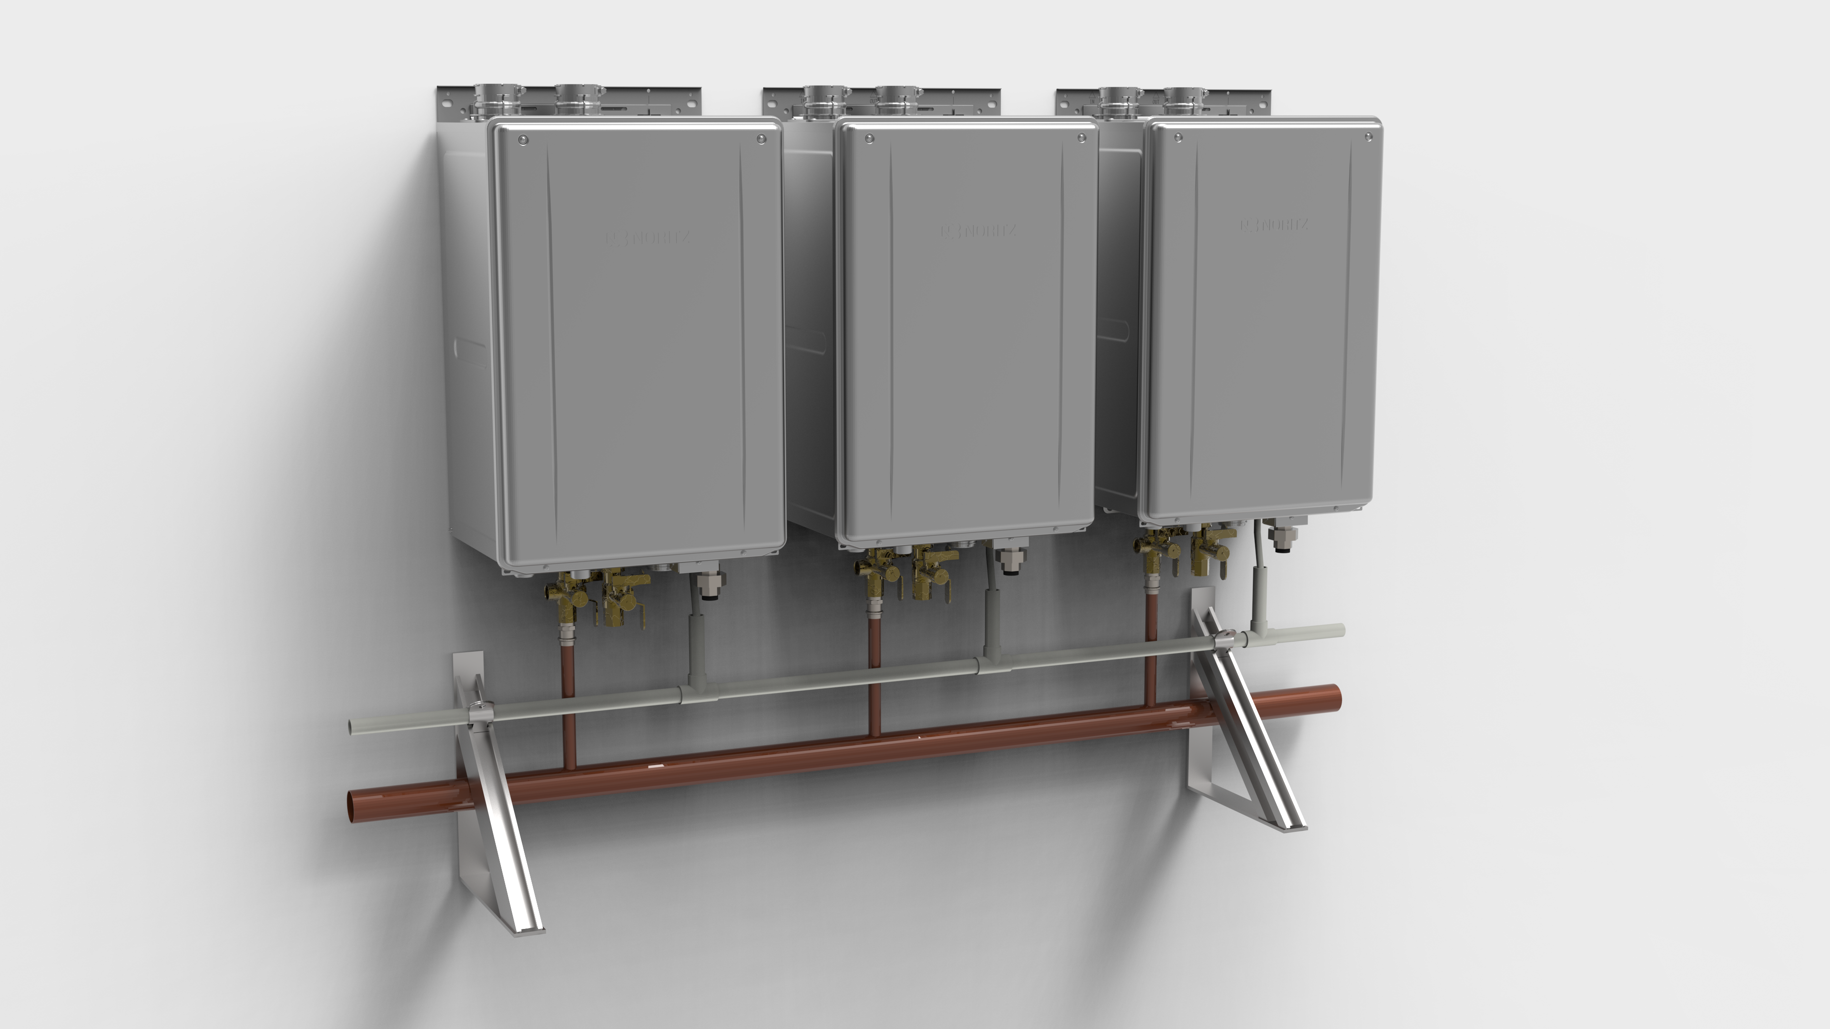
CMK (3 Unit Wall Mount)
Installation Overview
Manifold Installation
CMK (Wall Mount)
Manifold Installation
Units and brackets mounted
Mount hot water manifold
Mount condensate drain manifold
Mount gas manifold
Mount hot water manifold
Secure bottom bracket of units

Slide 18
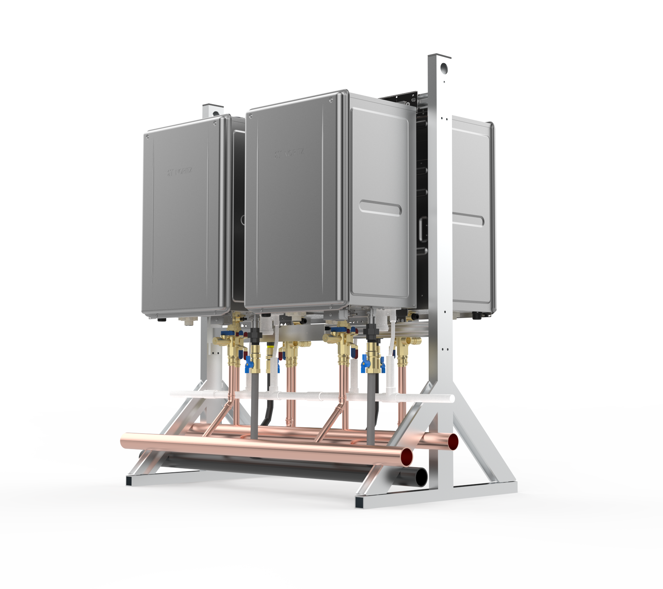
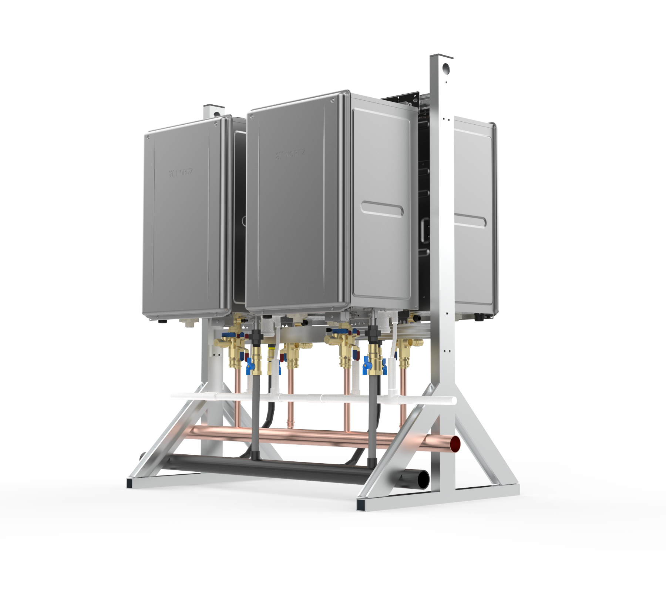
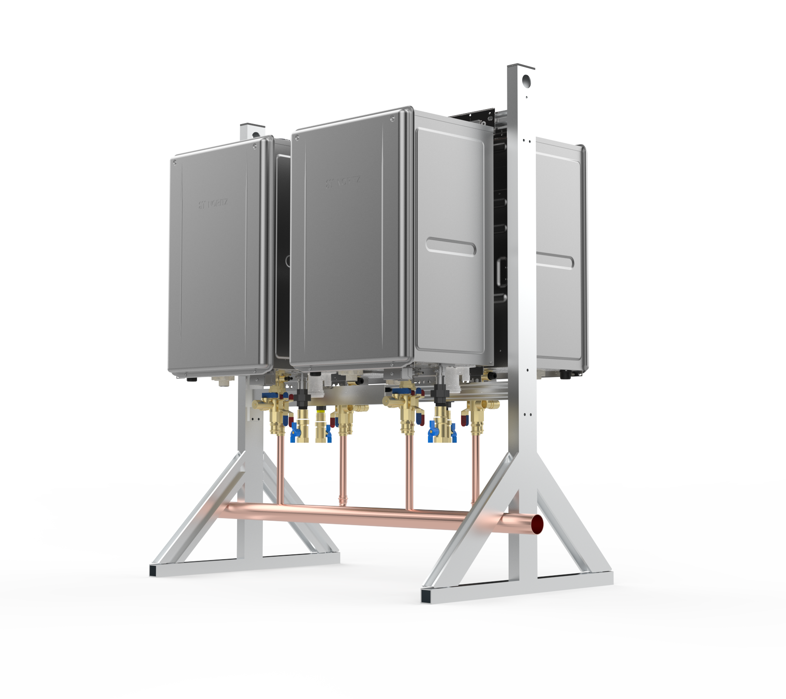
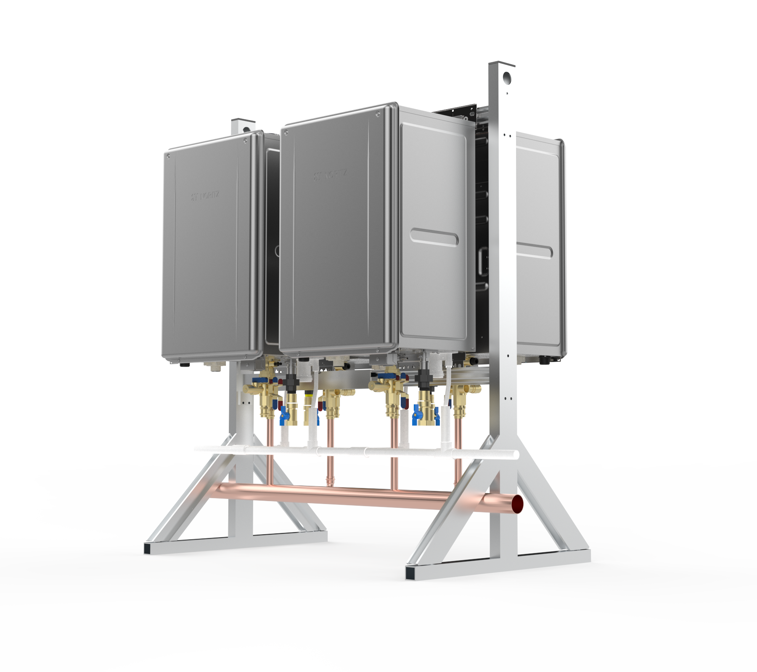
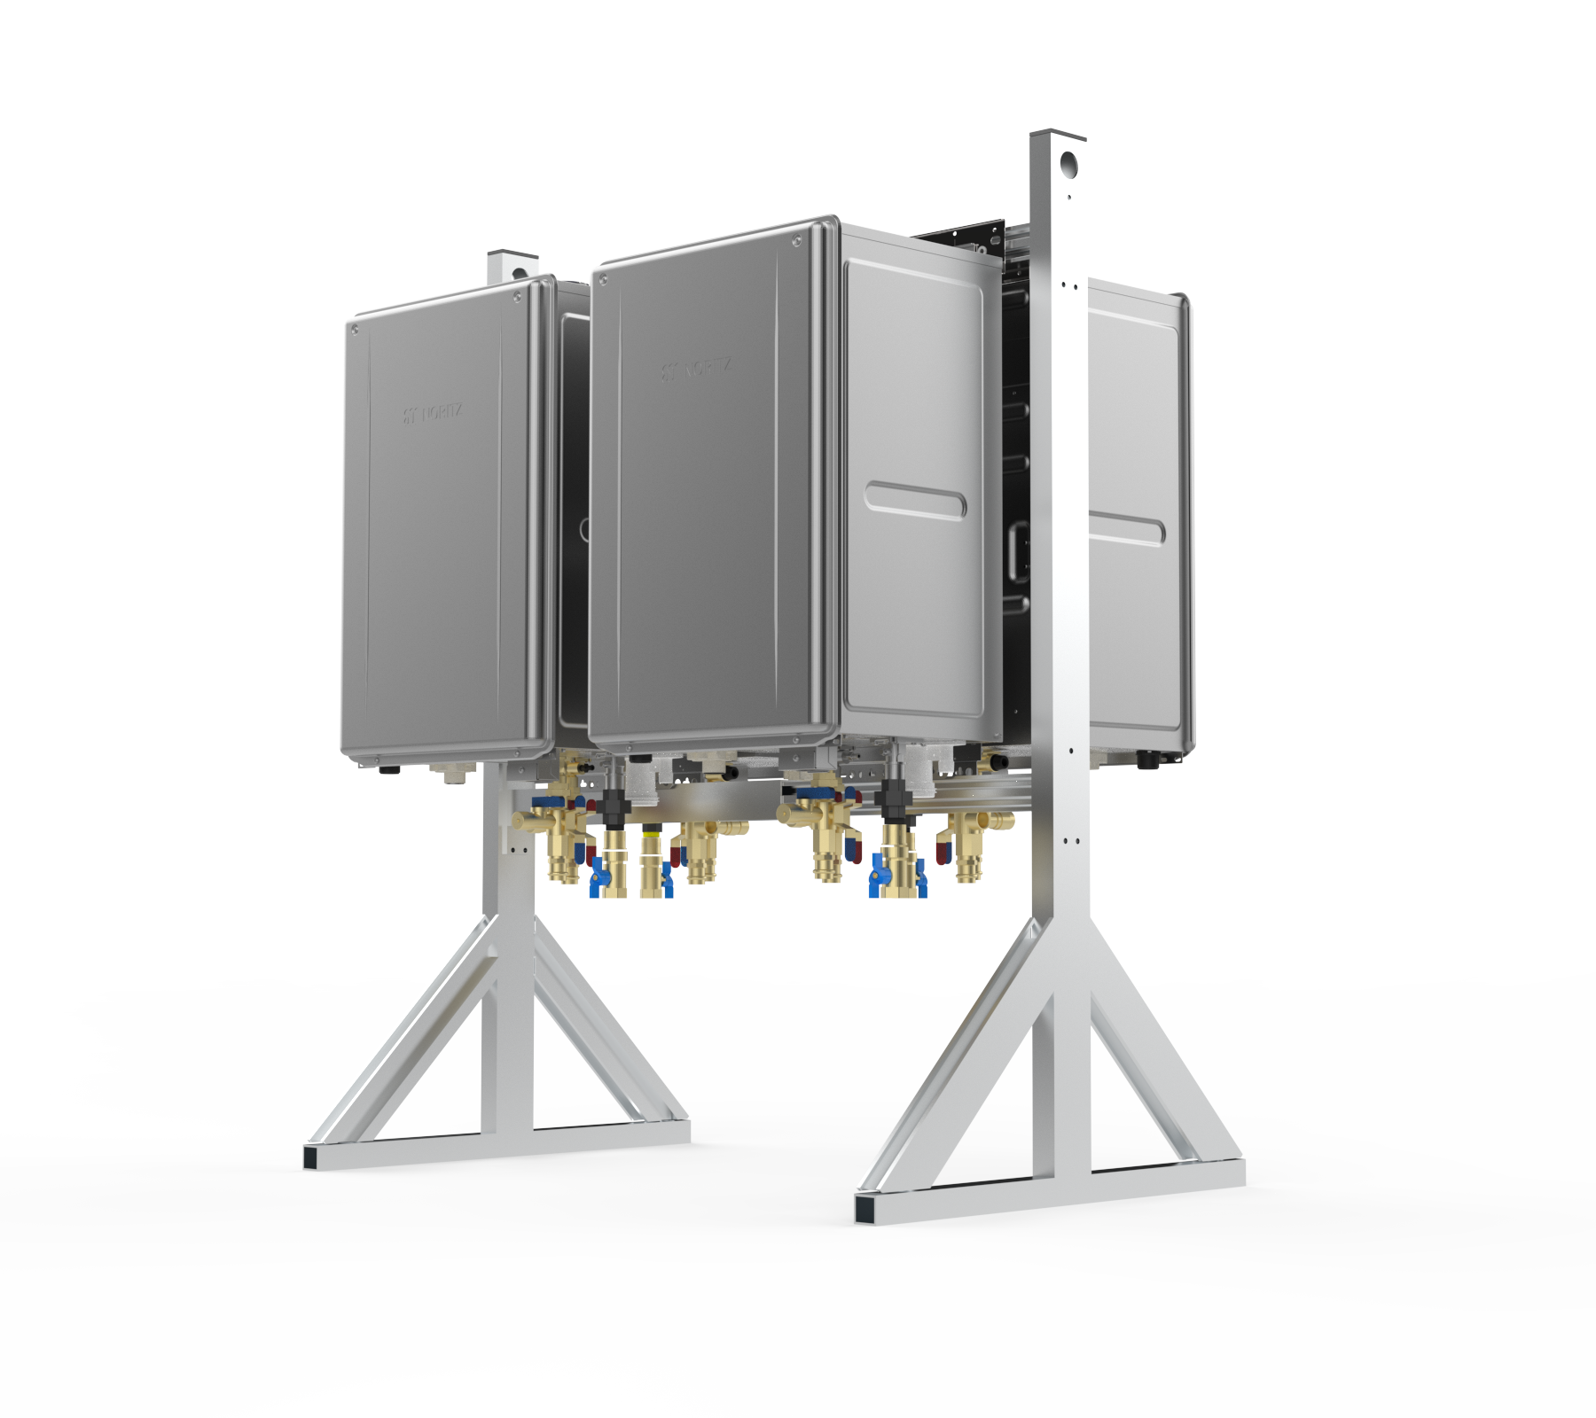
CRK (4 Unit Back to Back)
Installation Overview
CRK (Floor Standing Rack)
Installation Basics
Assemble CRK-BASE
Prepare and Hang Units
Install Hot Water Manifold
Install Condensate Manifold
Install Gas Manifold
Install Cold Water Manifold

Slide 19
THANK YOU

