Slide 1
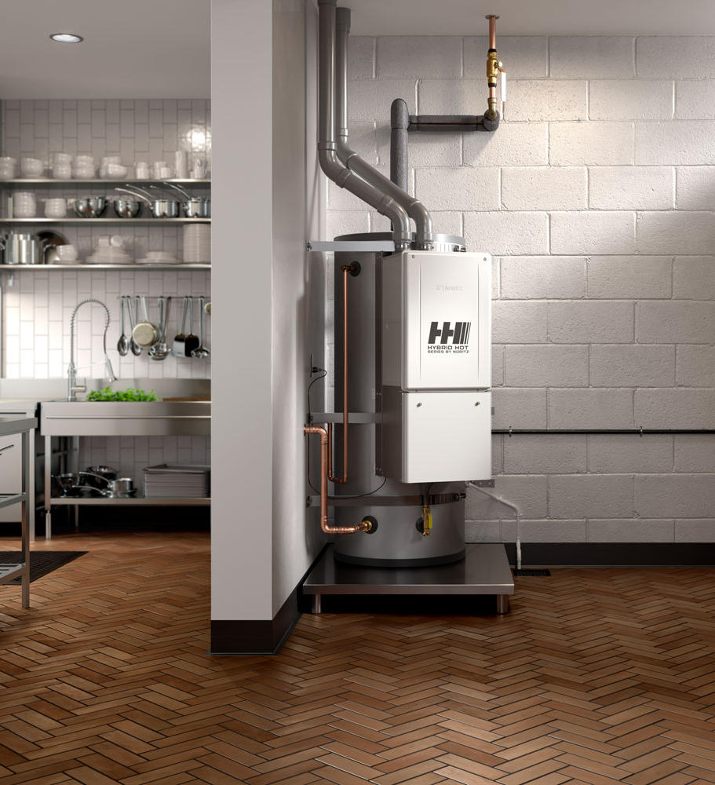

Introduction and Overview

Slide 2
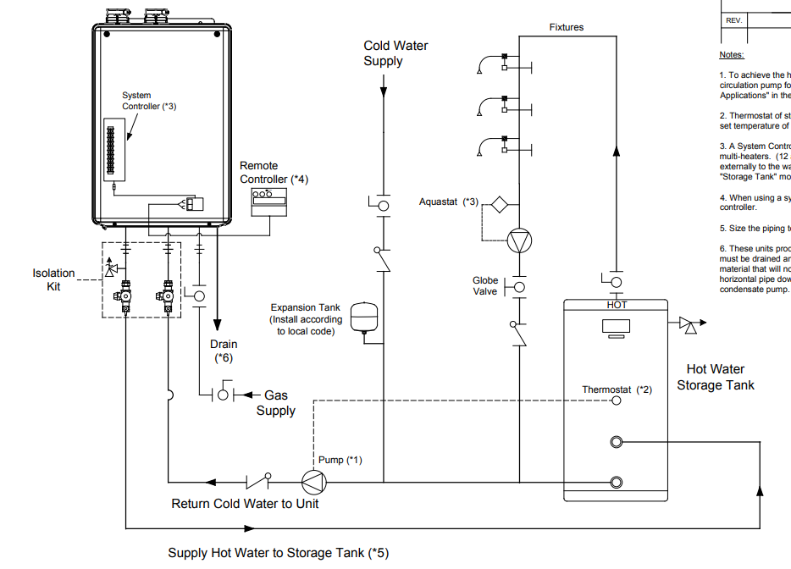

WHY HYBRID HOT?
Noritz has offered plumbing diagrams showing the use of a storage tank and tankless for many years. Now we offer the complete package ready to install.

Slide 3
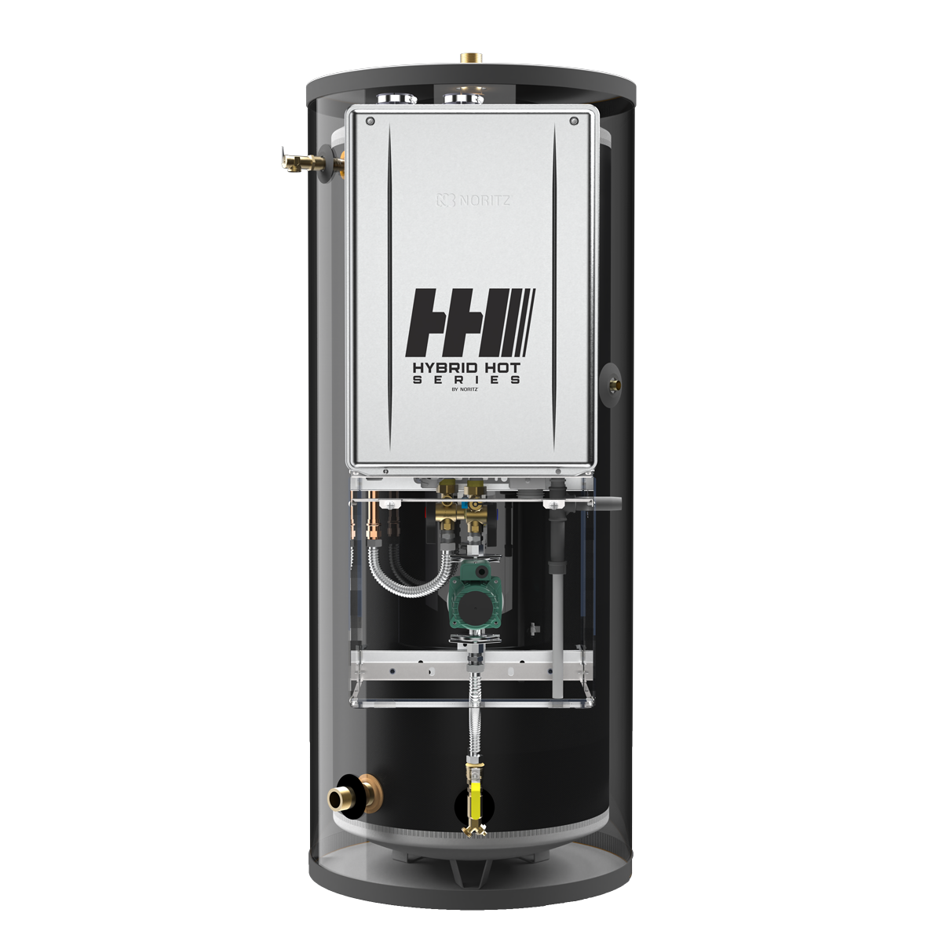

FEATURES & BENEFITS
10 Year Warranty on Tank & Tankless
Storage tank mode without the system controller
All draws from storage tank, flow rates maximized through 1 ½” supply, no low pressure issues
Faster hot water recovery and larger first hour rating because of larger pump and bypass
Removing the heat engine from a storage tank extends the life of both the tank and tankless
  (Can be isolated from each other for service)

Slide 4
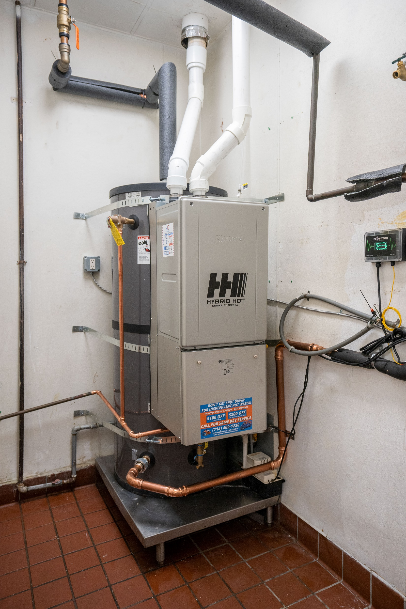
APPLICATIONS
Best used in short periods of high demand applications but applicable in any kind of commercial application.
  Commercial dish machines
  Laundromats
Case studies being conducted in Santa Paula Middle School and Rowland Heights Boiling Crab
Rowland Heights Boiling Crab

Slide 5
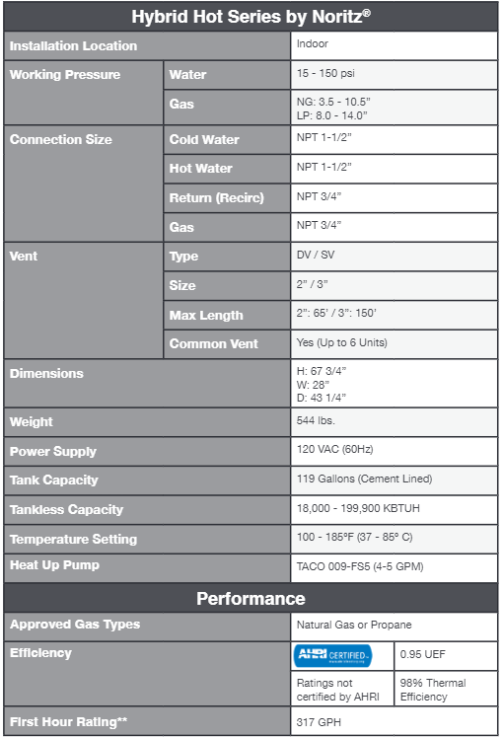
SPECIFICATIONS

Slide 6
RECOVERY RATE
Recovery GPH temperature rise (GPH)
Tank (Gallon) | °F | 30 °F | 40 °F | 50 °F | 60 °F | 70 °F | 80 °F | 90 °F | 100 °F | 110 °F | 120 °F | 130 °F | 140 °F
 | ℃ | 17 ℃ | 22 ℃ | 28 ℃ | 33 ℃ | 39 ℃ | 44 ℃ | 50 ℃ | 56 ℃ | 61 ℃ | 67 ℃ | 72 ℃ | 78 ℃
119 | GPH | 780 | 585 | 468 | 390 | 334 | 292 | 260 | 234 | 213 | 195 | 180 | 168
 | LPH | 2,953 | 2,214 | 1,771 | 1,476 | 1,264 | 1,105 | 984 | 886 | 806 | 738 | 681 | 632

Slide 7
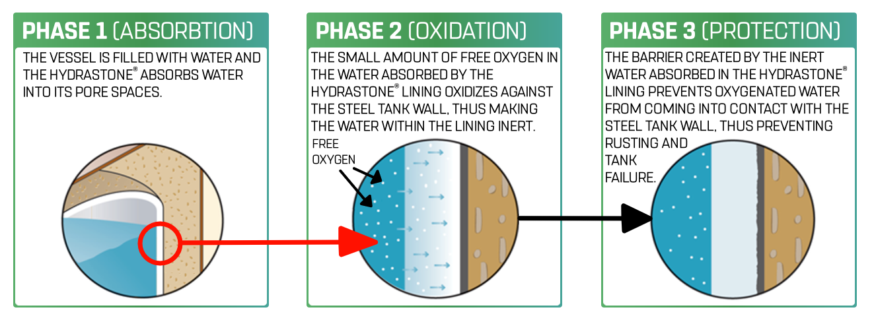
HYDRASTONE® LINING

Slide 8
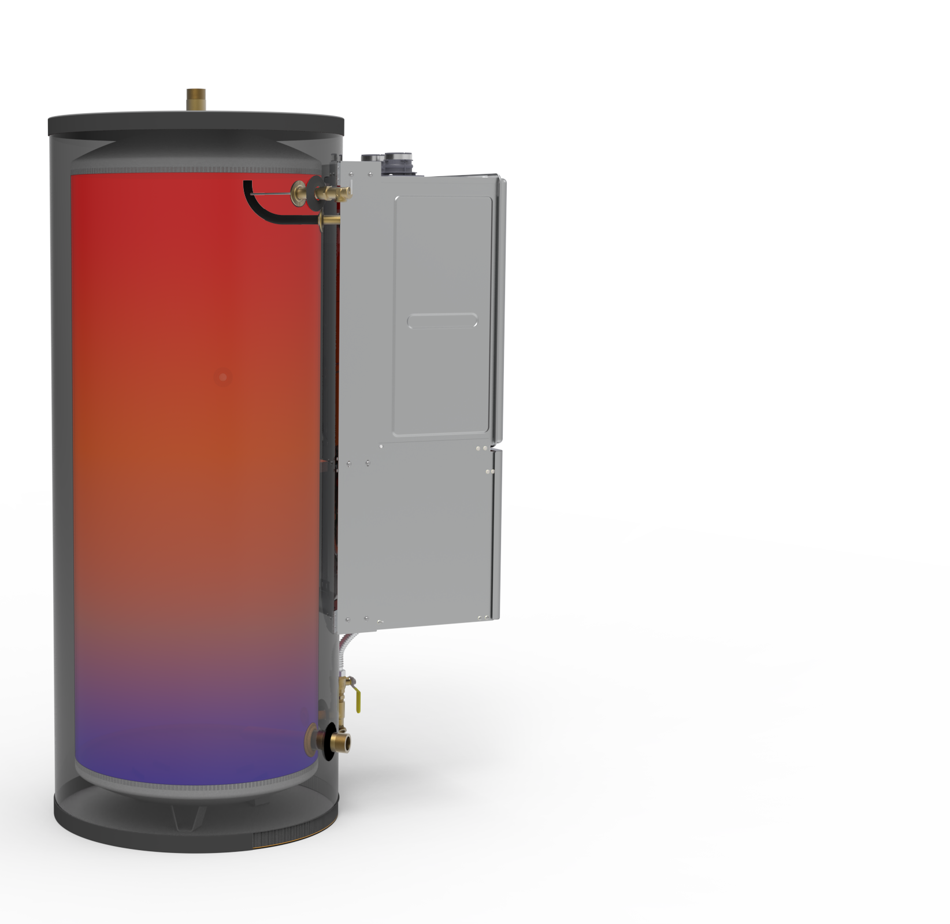
STRATIFICATION OF HEATED WATER
Elephant Nose Pipe
Elephant Nose Pipe
Water connection locations help to stratify the water temperatures in the tank keeping the upper tank full of hot water. Provides the best energy efficient supply of hot water.

Slide 9
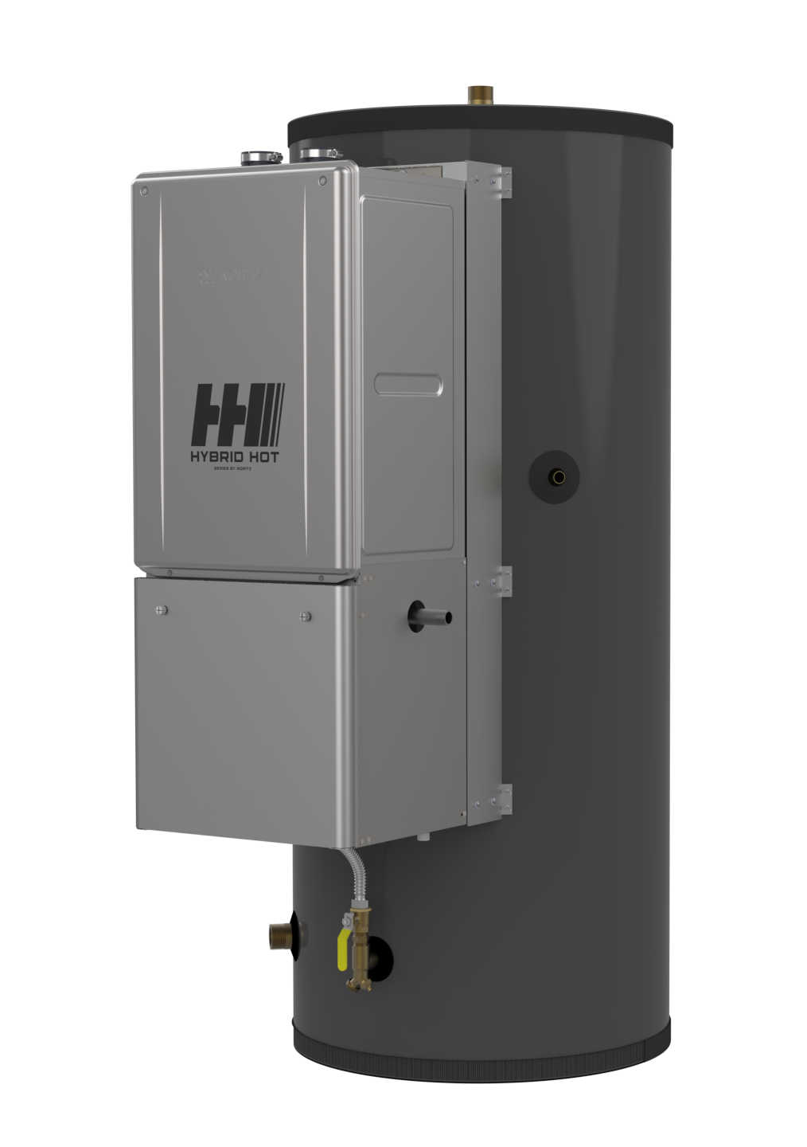
CONNECTIONS OVERVIEW
1 ½” NPT Hot Outlet
1 ½” NPT Hot and Cold Connections
¾” NPT Recirc Return
¾” NPT Gas
¾” NPT Combo Drain and Cold Inlet to Tankless
¾” NPT Recirc Return
¾” NPT Gas
1 ½” NPT Cold Supply
¾” NPT Combo Drain and
Cold Inlet to Tankless

Slide 10
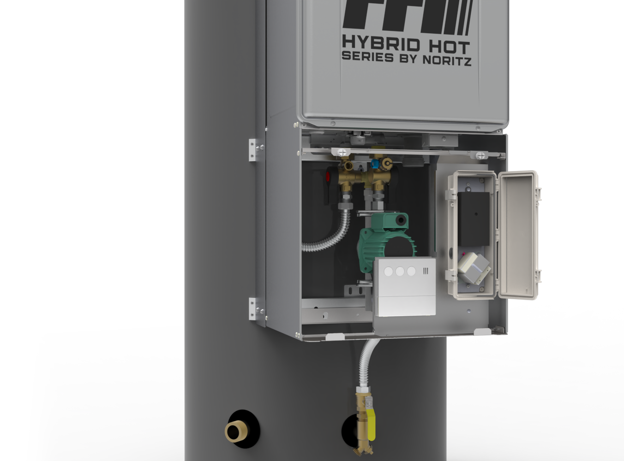
UNDER THE HOOD
Error Indicator Light
Pump Controller
Transformer
Remote Controller

Slide 11
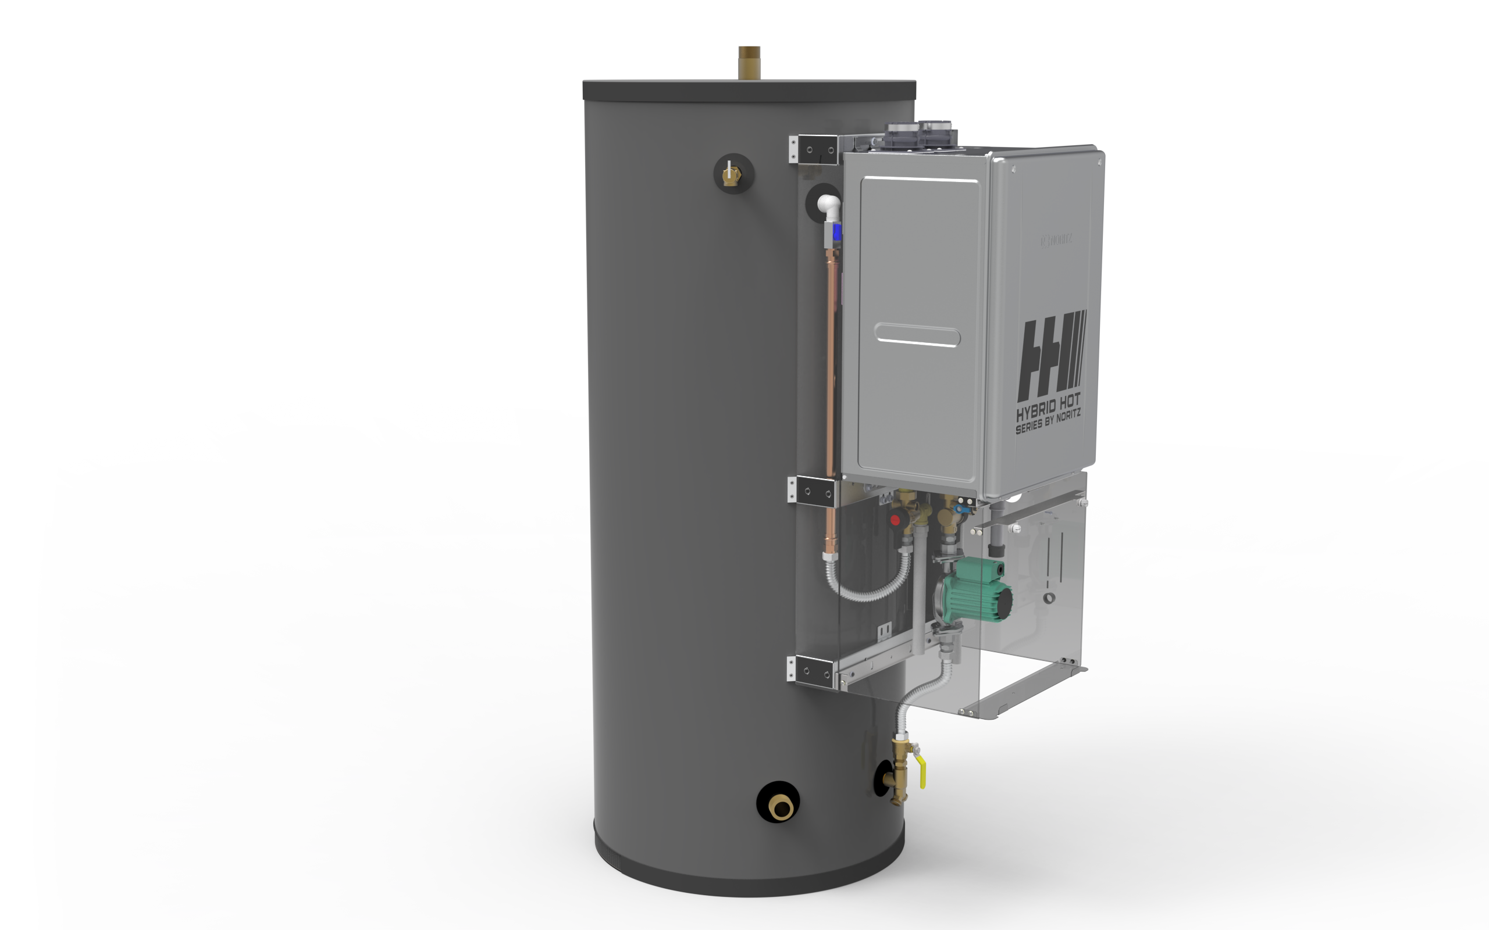
UNDER THE HOOD
Tank Outlet Port
T&P Relief Valve
Hot Water Line
Pump
Cold Water Line
Tank Inlet Port

Slide 12
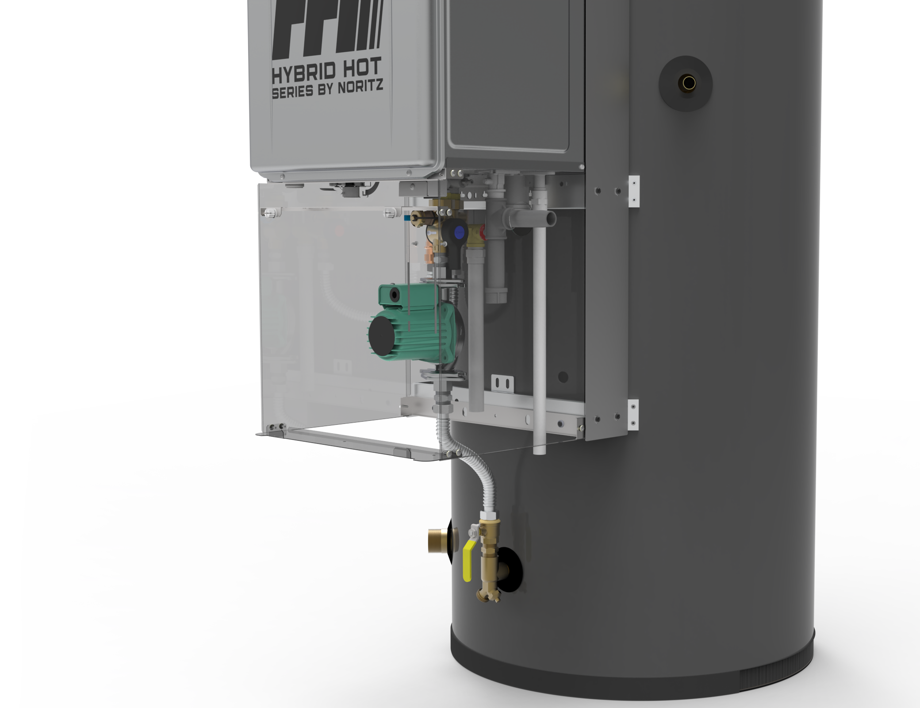
UNDER THE HOOD
Recirc Port
Gas Port
Condensate Drain
Port
Thermistor
(on tank surface)
Drain Port

Slide 13
MULTI UNIT CAPABILITY
Up to 6 units can be common vented together when a system controller is used.

Slide 14
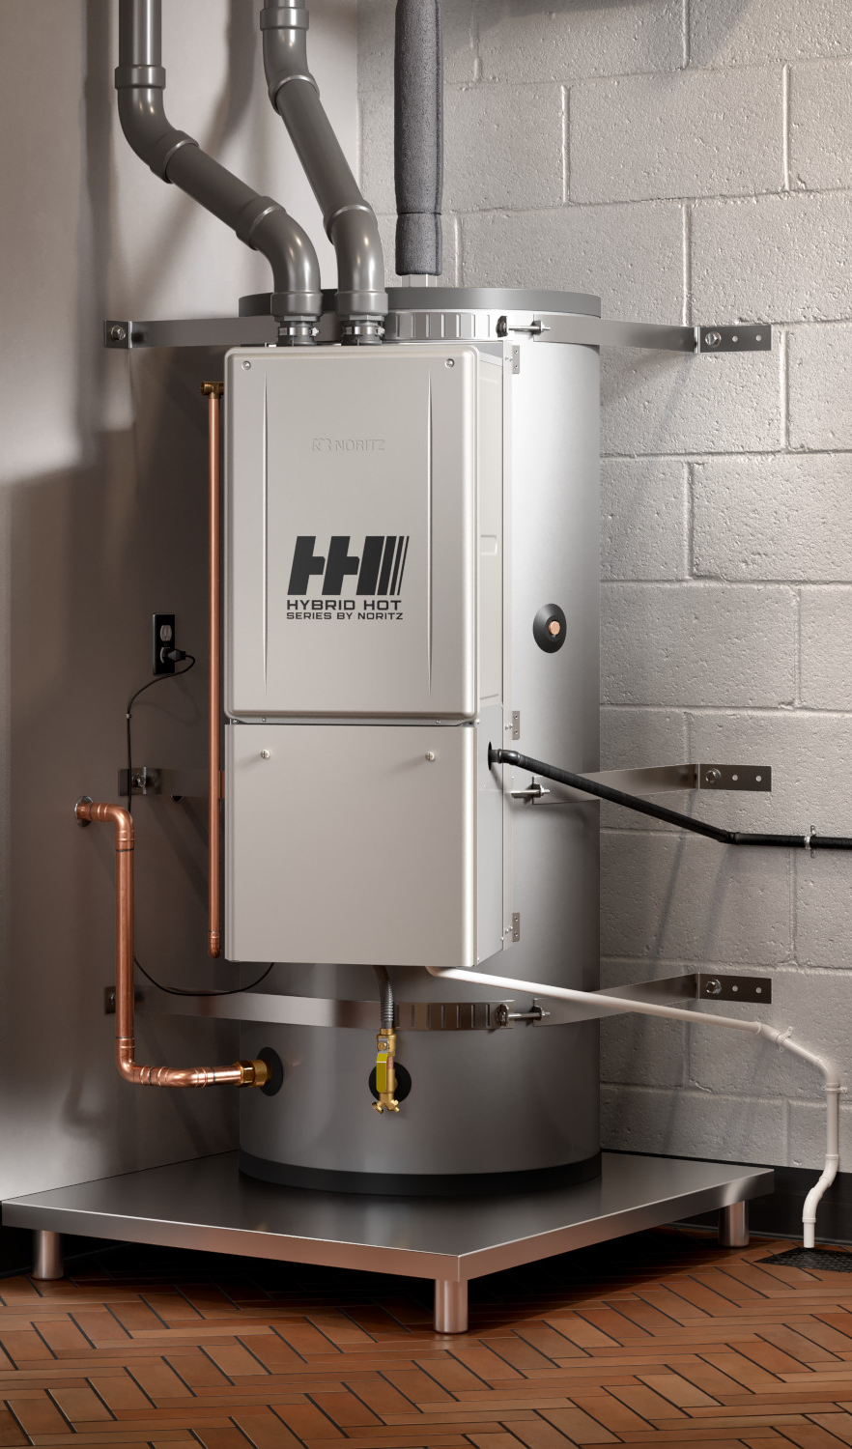
WARRANTY REGISTRATION
Tankless serial number is used for registration
Warranty is registered via PROCard App or Noritz website
Our system recognizes that the NCC199CDV used is part of a Hybrid Hot

Slide 15
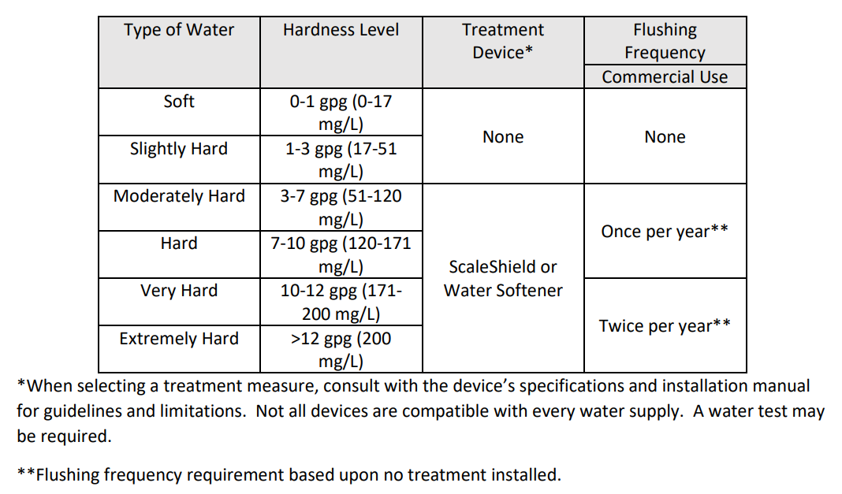
SERVICE & MAINTENANCE
Tankless only cares about refilling the storage tank, that's its primary operation
Tankless can be isolated from the tank to provide hot water while the tankless is serviced
Tankless is taking water from the bottom of the tank so hard water sediment can accumulate at the inlet filter
Tank should be flushed of hard water buildup periodically
Hard water should be treated per guidelines in the manual
Parts Available:
  All NCC199CDV Parts
  Pump
  Controls
  Isolation Valves
  Gaskets

Slide 16

THANK YOU

