Slide 1
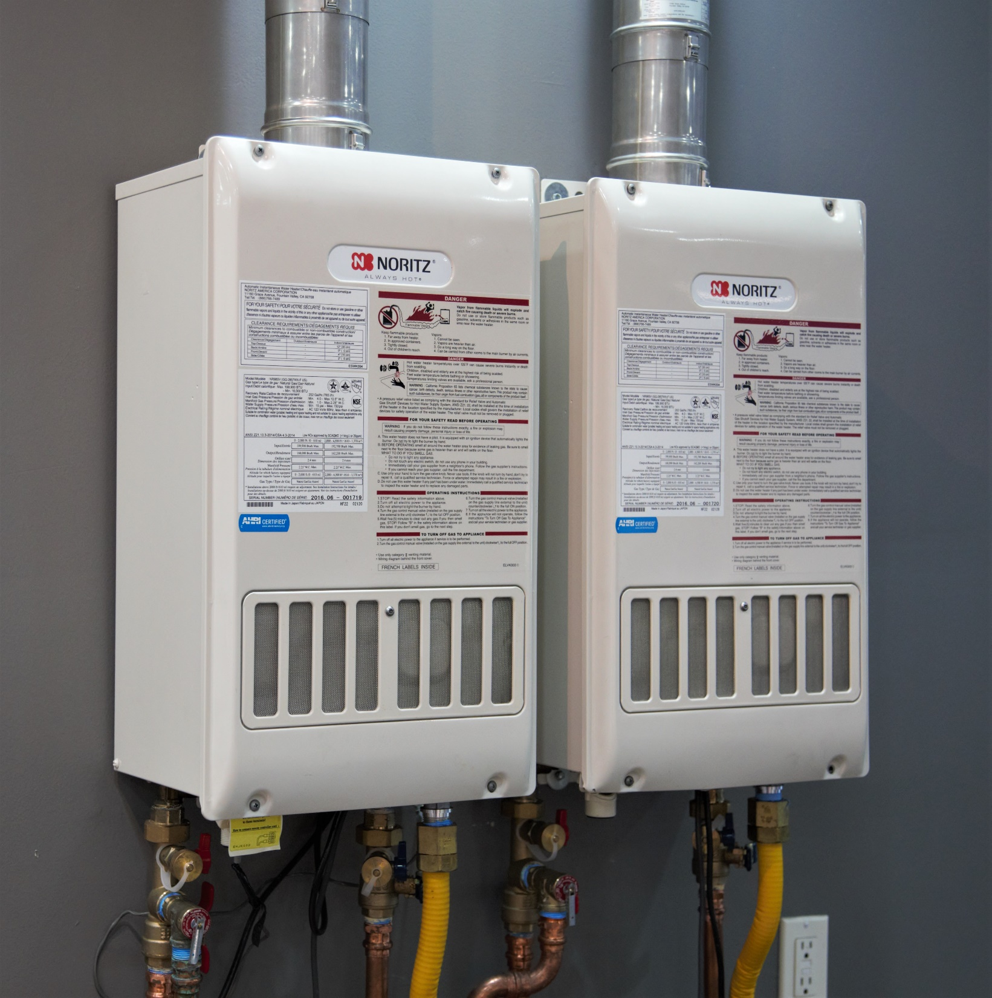

RESIDENTIAL
LEVEL 1
Installation Basics

Slide 2
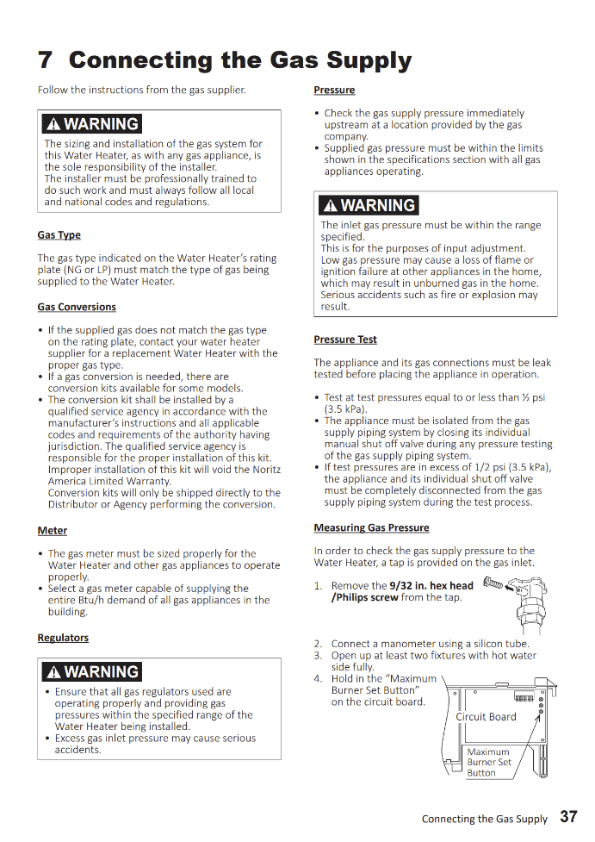
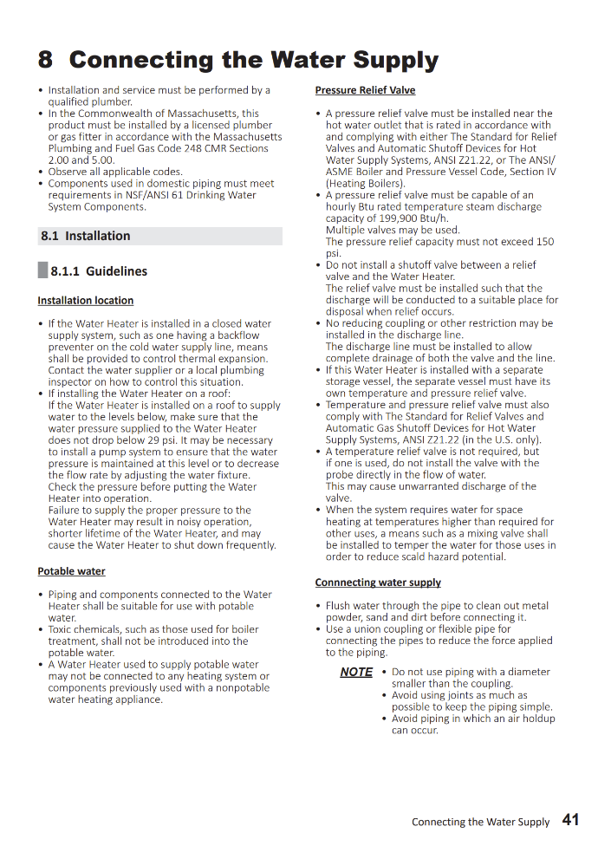
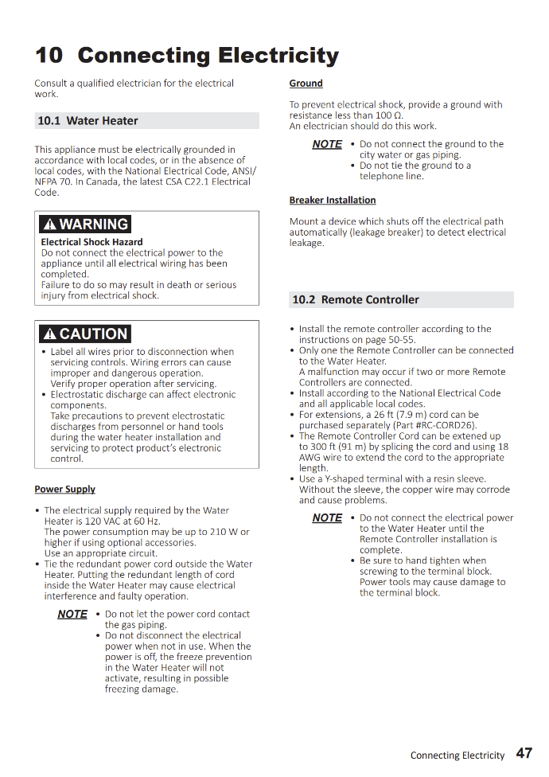
READ THE MANUAL
Tankless units are combustion appliances that contain gas, water and electricity in a unit the size of a suitcase.
The proper, safe and reliable operation of our units is 100% contingent on a correct installation and proper maintenance throughout its life.

Slide 3
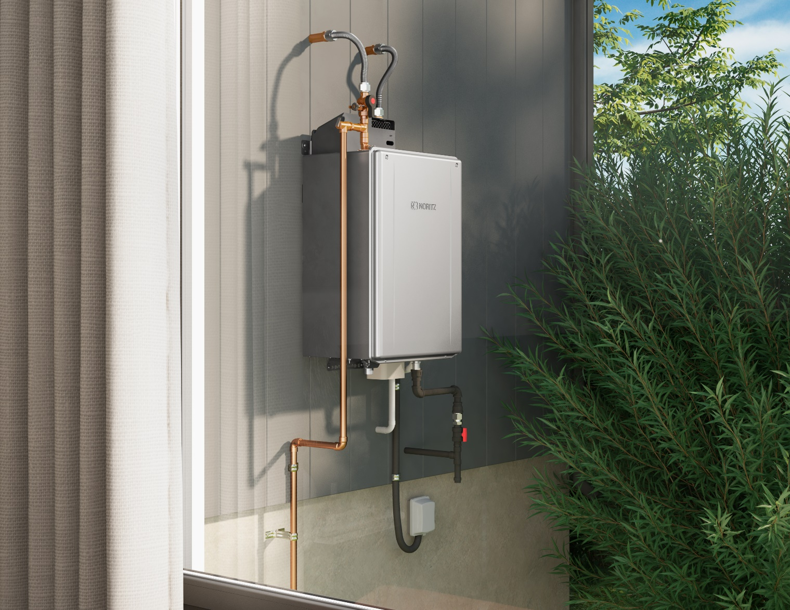
TRAINING SECTIONS
Product Line:
Standard Efficiency
High Efficiency
Pre-mix Units
Installation:
Unit Sizing
Gas Line
Choosing Location
Venting
Condensate Line
Circuit Board Dipswitches
Install Checklist
Maintenance:
Water Quality
Water Treatment
Cleaning Unit

Slide 4



WHAT IS A TANKLESS WATER HEATER?
A tankless water heater uses a burner and heat exchanger to produce an endless supply of hot water on-demand.
About
400F
About
120F
Water is heated using the hot exhaust gas.
Tankless Operation:
Hot water fixture is opened
Tankless detects flow
Burner ignites
Water is heated in the Heat Exchanger
Hot water exits the tankless to the fixture
Fixture is closed and tankless shuts off
Standard Efficiency Unit
High Efficiency Unit
Secondary Heat Exchanger
About
400F
Primary Heat Exchanger
About
400F
Primary Heat Exchanger
Condensate
Collector
Fan
Fan
Hot Out
Gas In
Cold In
Hot Out
Gas In
Cold In

Slide 5
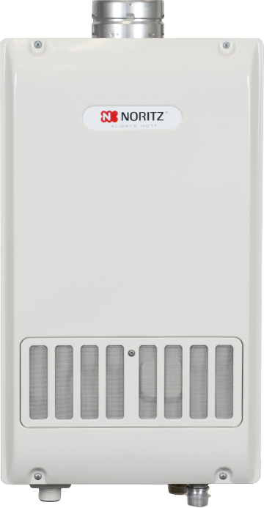
STANDARD EFFICIENCY UNITS
120k to 199k btu
Indoor and Outdoor Units Available
Indoor Units Require Cat III Stainless Steel Venting
All Units Satisfy 20ppm Low NOx Requirements
12 Years Heat Exchanger
5 Years All Other Parts
1 Year Reasonable Labor
NR98SV
Max 199k btu

Slide 6
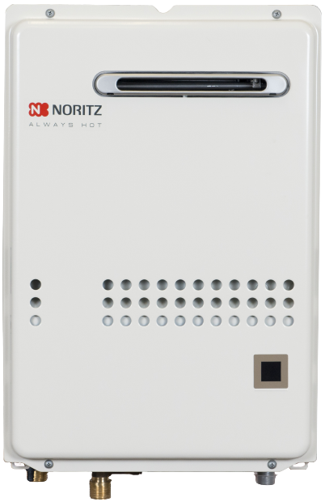
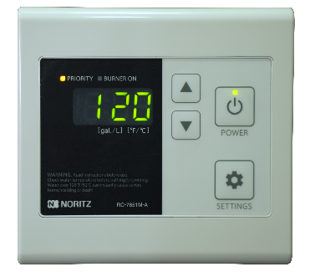
STANDARD EFFICIENCY UNITS
All units include either an external remote control or built in display window for easy indication of set temperature along with monitoring and diagnostics capability.
NR98SV
Max 199k btu
NR66OD
Max 120k btu

Slide 7
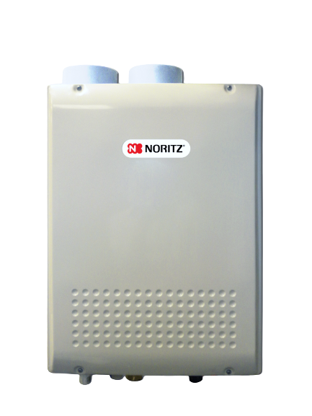
HIGH EFFICIENCY UNITS
120k to 199k btu
Indoor and Outdoor Units Available
Indoor Units Use 3” or 4” PVC/CPVC/PP
All Units Satisfy 20ppm Low NOx Requirements
12 Years Heat Exchanger
5 Years All Other Parts
1 Year Reasonable Labor
NRC98DV
Max 180k btu

Slide 8
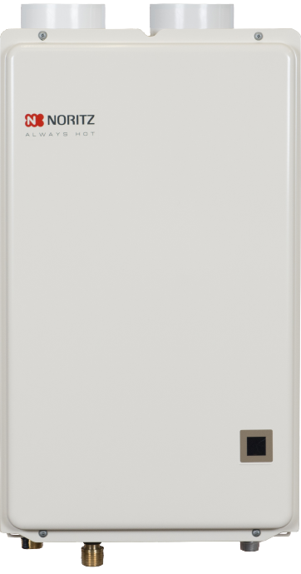
HIGH EFFICIENCY UNITS
All units include either an external remote control or built in display window for easy indication of set temperature along with monitoring and diagnostics capability.
NRC98DV
Max 180k btu
NRC661DV
Max 120k btu

Slide 9
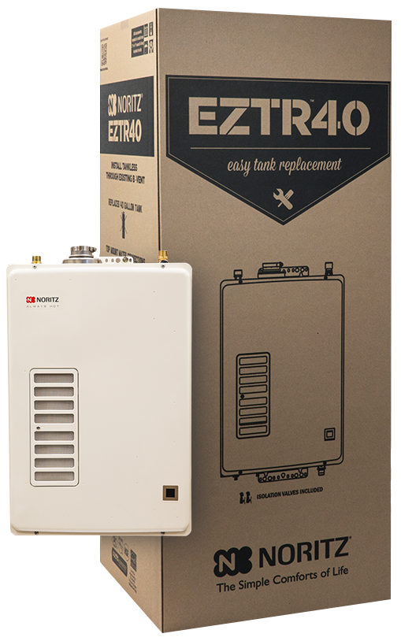
EZTR40 PACKAGE
EZ Tank Replacement of a 40 Gallon Tank
Top Mounted Water Connections
120k Max btu High Efficiency Unit
6.6 gpm Max
12 Years Heat Exchanger
5 Years All Other Parts
1 Year Reasonable Labor
The EZTR40 can only be used when replacing a tank and using the flexible venting, it cannot be adapted to vent with PVC or other rigid plastic venting.

Slide 10
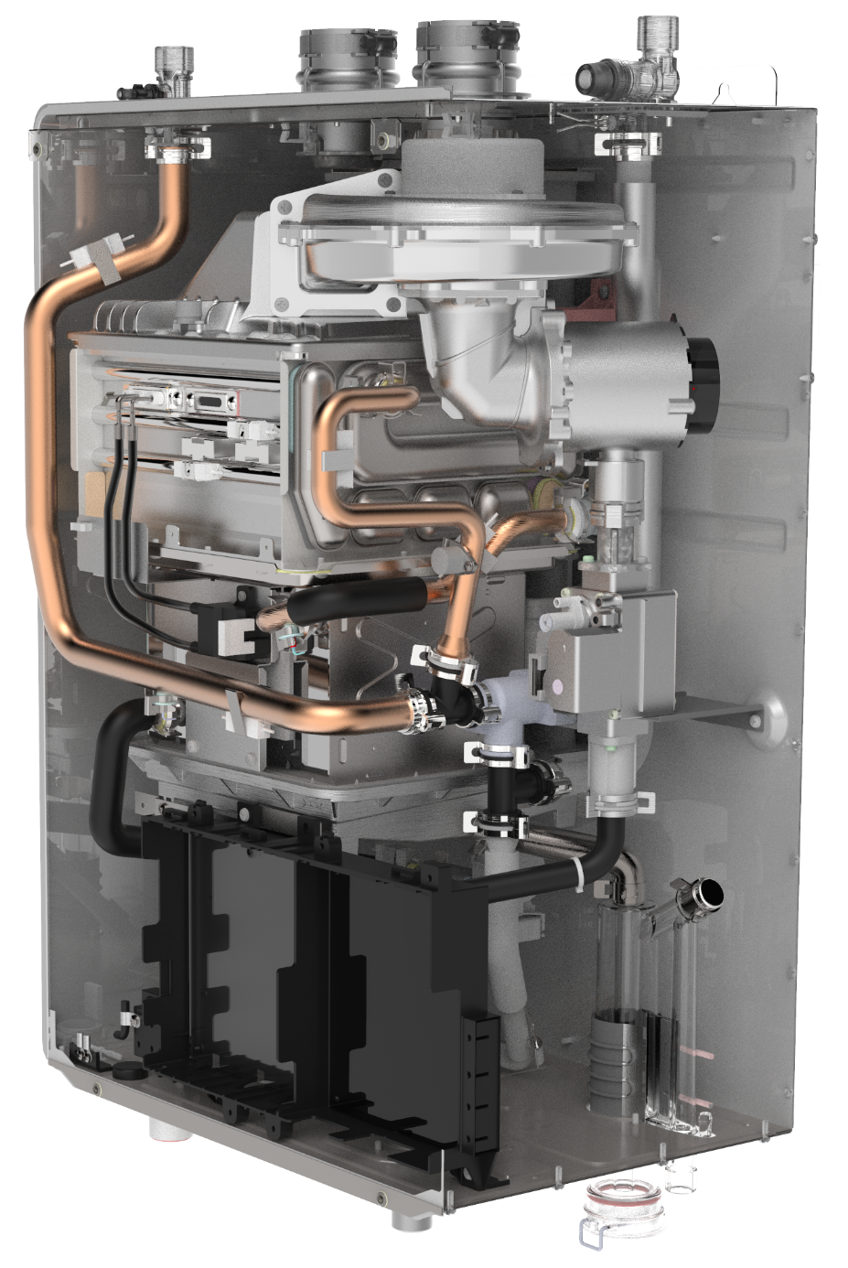
HIGH EFFICIENCY PRE-MIX UNITS
Introduced in 2017, Pre-Mix refers to how the air and gas is pre-mixed in the fan before entering the burner.

Slide 11
HIGH EFFICIENCY PRE-MIX UNITS
The Noritz Pre-mix Lineup:
EZ Series
NRCR Series
NRCB Boiler
NCC199CDV

Slide 12
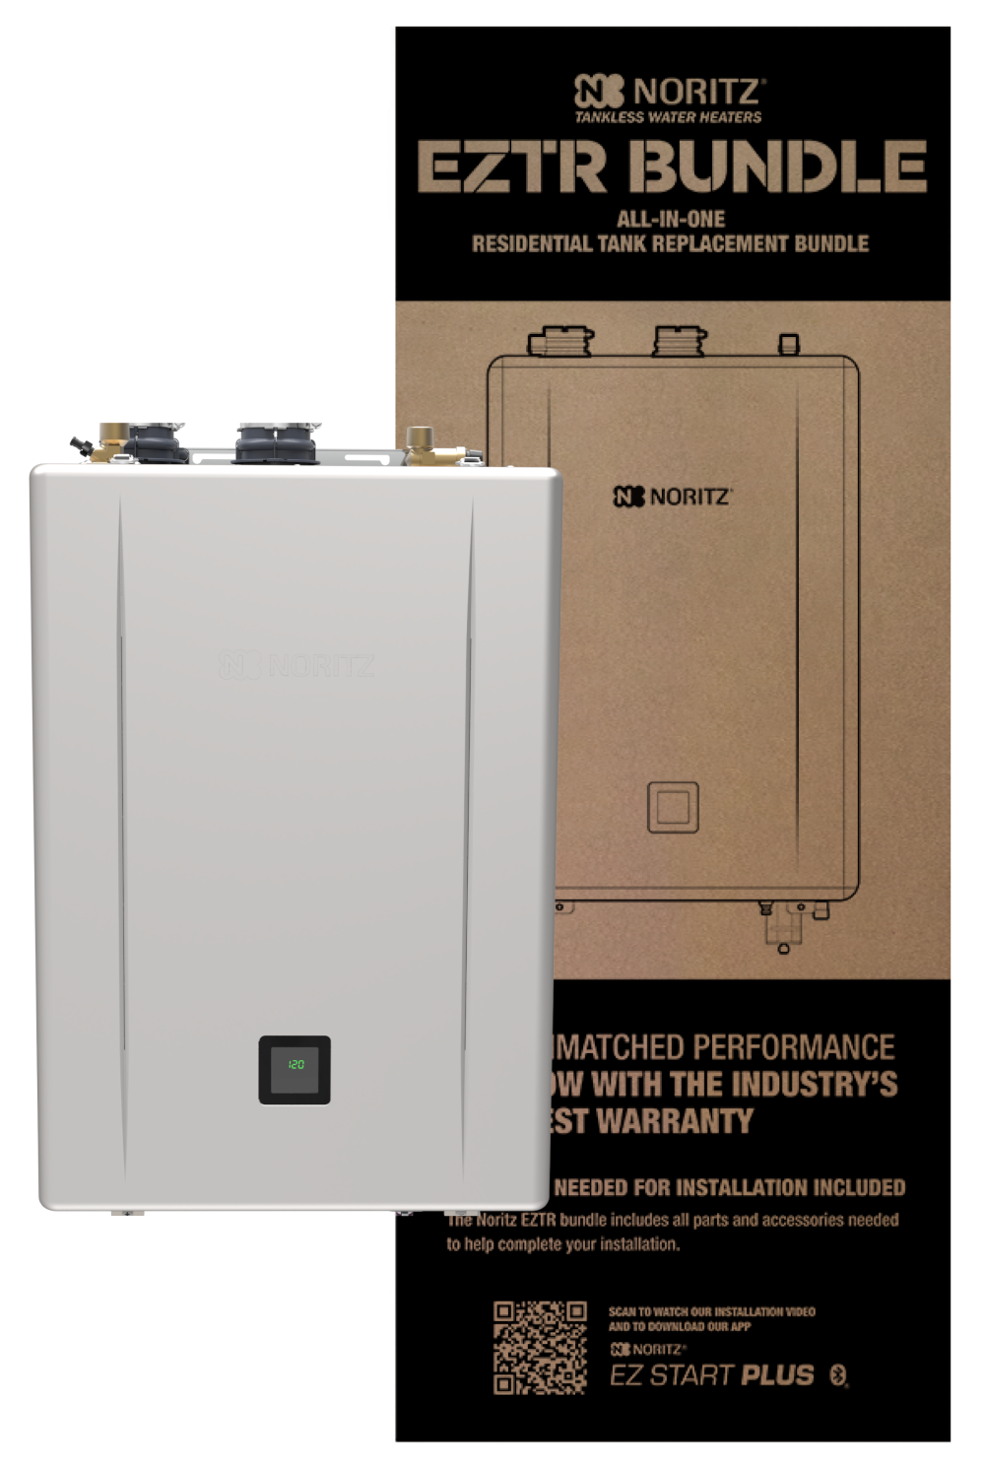

EZTR50 & EZTR75 PACKAGES
EZ Tank Replacement of a
50 or 75 Gallon Tank
Top Mounted Water Connections
2” Flexible Vent
25’ Flex Included, 35’ Optional
Isolation Kit Included
Dual Stainless Steel Heat Exchangers
NEW: .98 UEF
NEW: EZ Start Plus Bluetooth® App
NEW: Built-in Display
NEW: Field Gas Conversion
*New for 2024 GQ-C61 Series

Slide 13
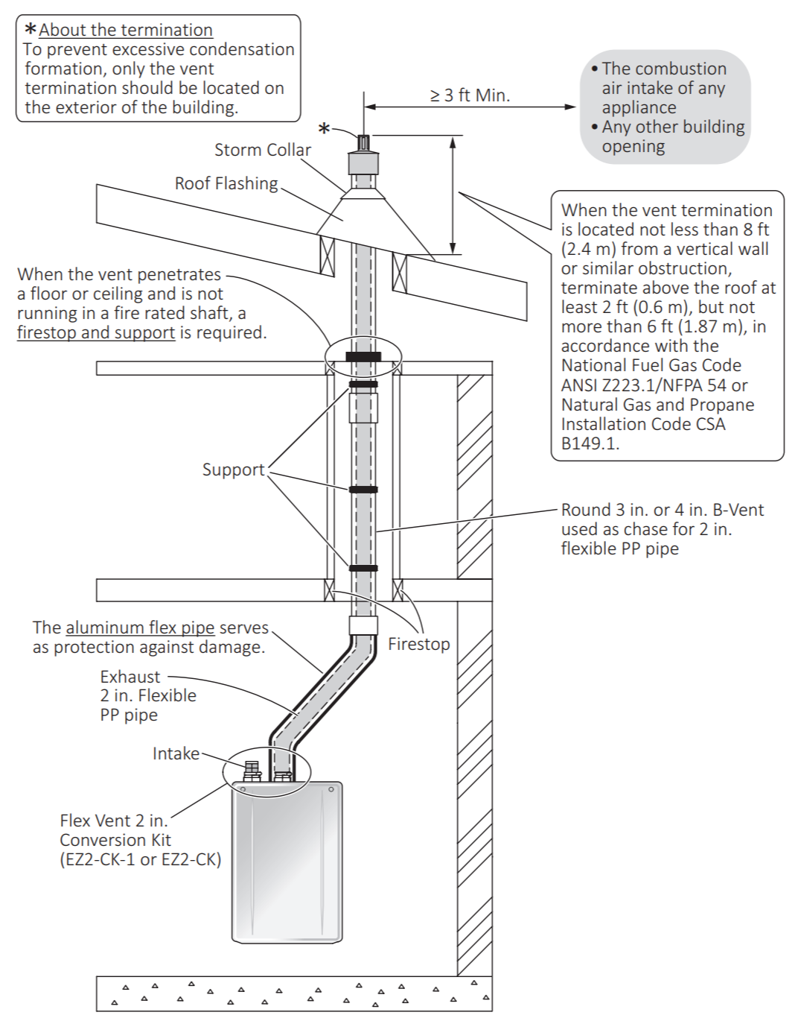
EZTR50 & EZTR75 PACKAGES
Use existing 3” or 4” round b-vent.
25’ included with EZTR package.
35’ vent kit optional, part # EZ2FVK-2
NOTE: Flexible vent can be shortened but you cannot join 2 pieces of flexible vent to extend the length.
Example: If you need 30’, you would buy the 35’ kit and cut off 5’. You would not attach an extra 5’ to the included 25’ kit.

Slide 14
EZTR50 & EZTR75 PACKAGES
EZ111DV Unit
199k btu Max
11.1 gpm Max
EZ98DV Unit
180k btu Max
9.8 gpm Max

Slide 15
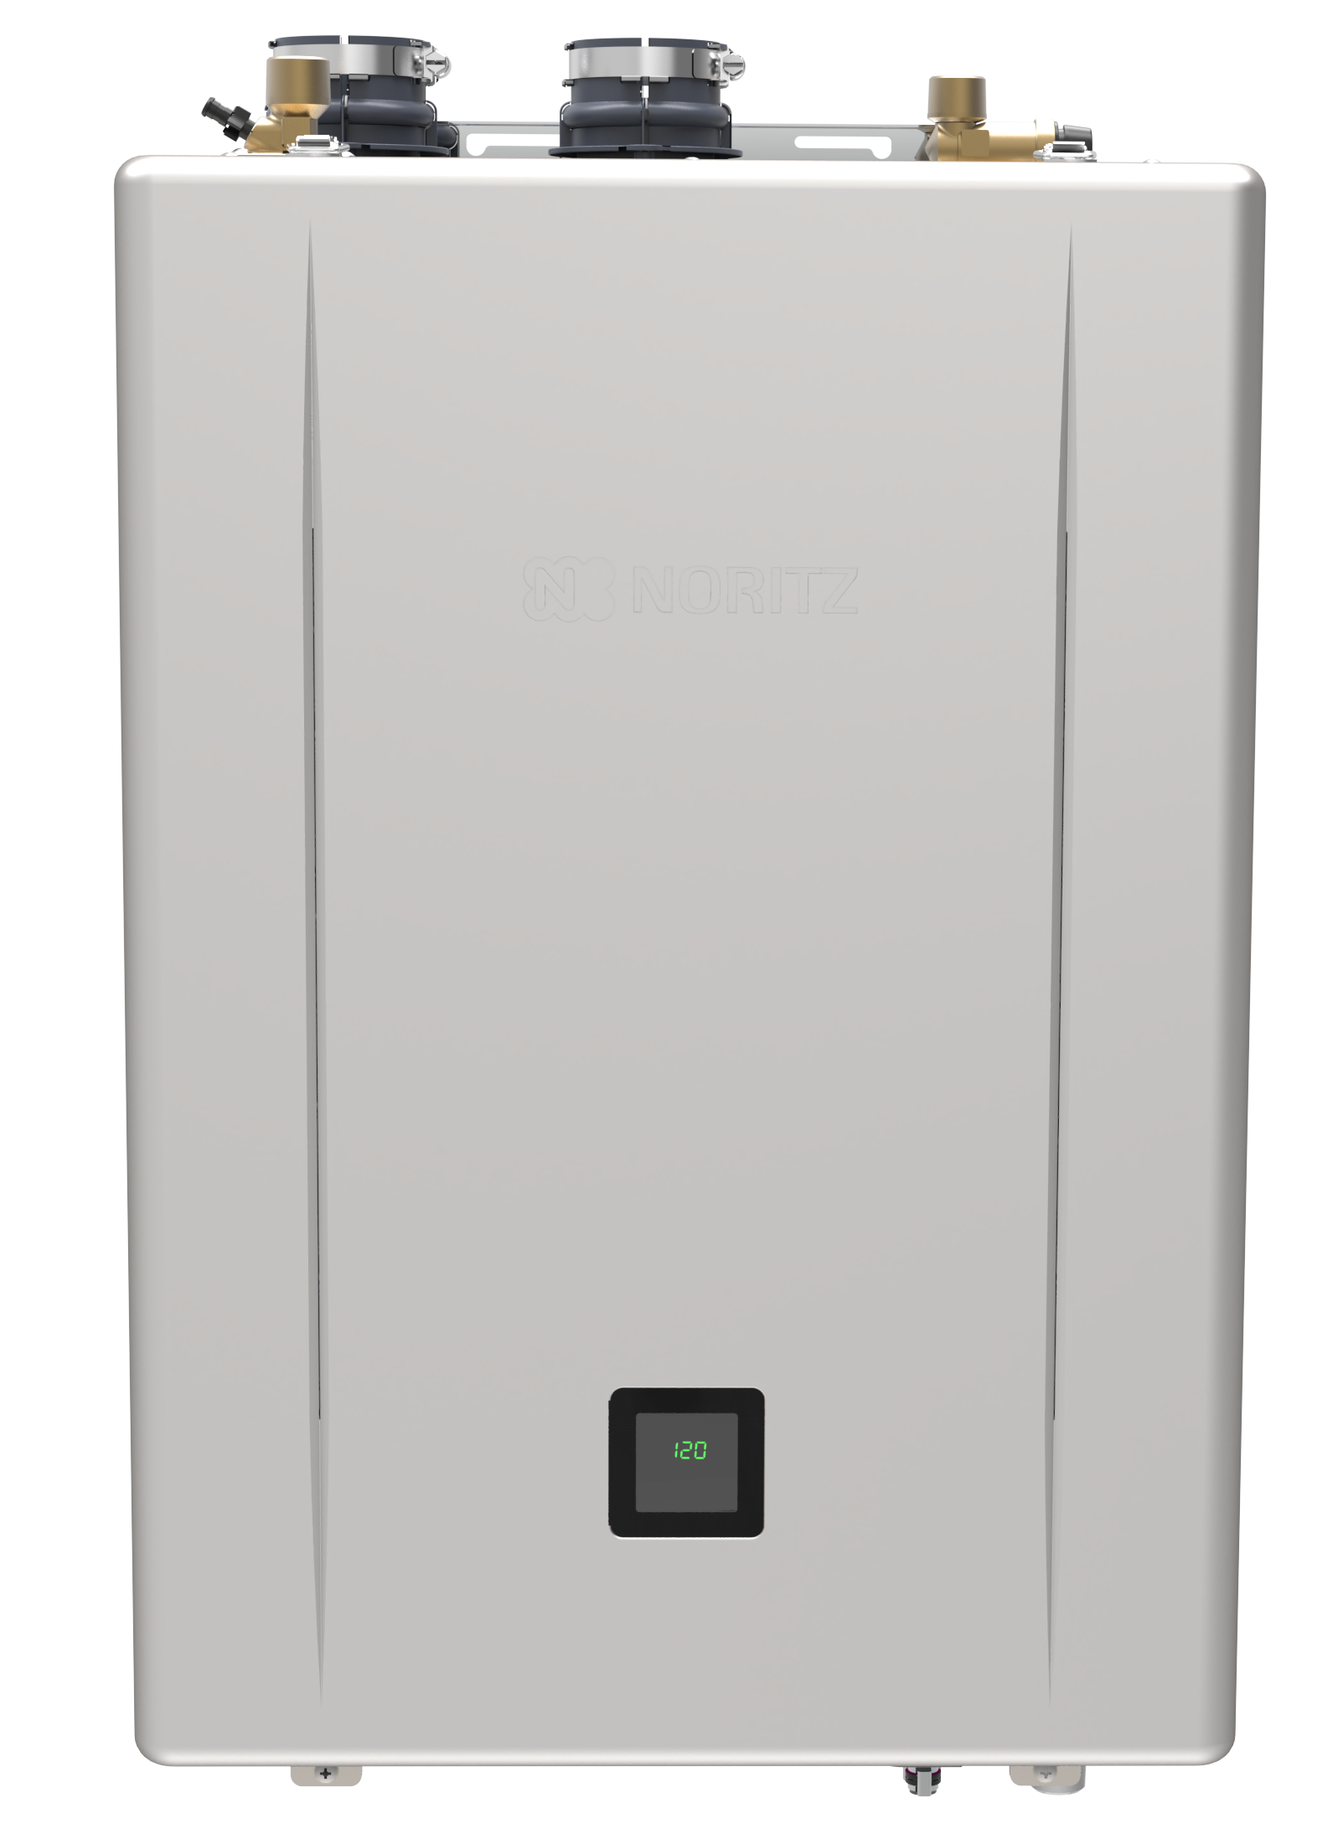
EZ SERIES PRO INDIVIDUAL UNITS
Not replacing a tank?
Installing in a different area?
NEW: .98 UEF
NEW: EZ Start Plus Bluetooth® App
NEW: Built-in Display
NEW: Field Gas Conversion
Top Mounted Water Connections
2” or 3” PVC/CPVC/PP
  2” Max length: 75’
  3” Max length: 150’
Flexible 2” SV up to 35’
NEW: EZ71DV: 160k btu / 9.0 gpm max
EZ98DV: 180k btu / 9.8 gpm max
EZ111DV: 199k btu / 11.1 gpm max
*New for 2024 GQ-C61 Series

Slide 16
EZ SERIES PRO INDIVIDUAL UNITS
EZ Series Warranty:
25 Years Heat Exchanger
5 Years Other Parts
1 Year Reasonable Labor
EZ Series Individual Units can be vented as:
DV (Default out of box)
SV
OD
No Roof Kit
Flexible SV
Common Vent Capable (2 Units Quick Connected)

Slide 17
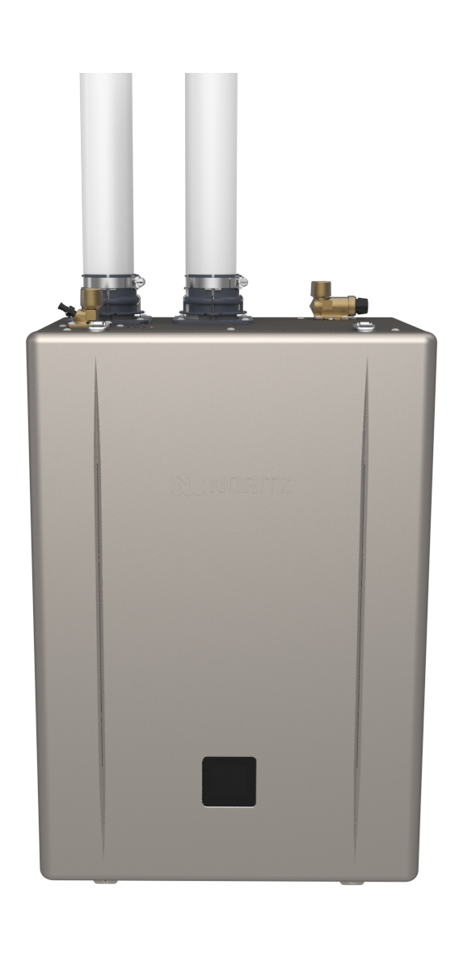
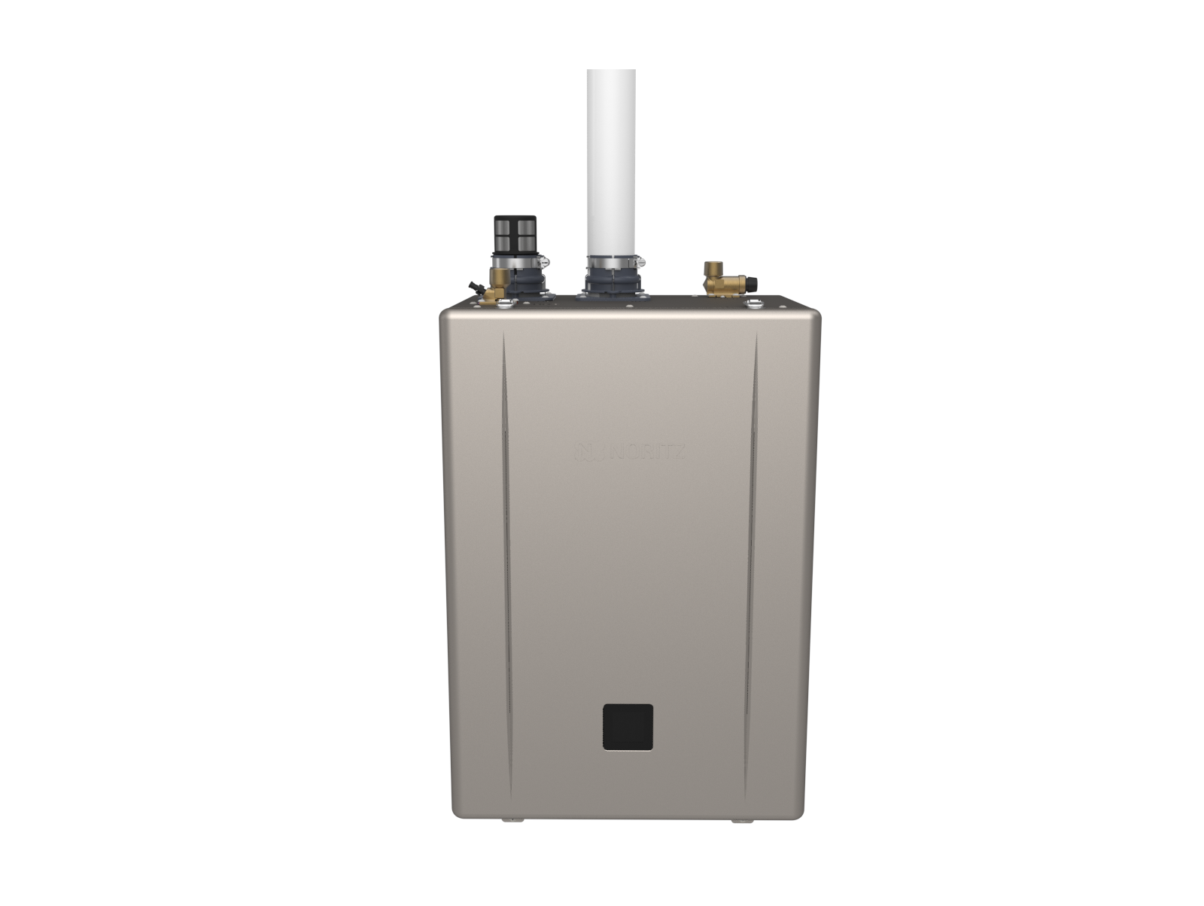
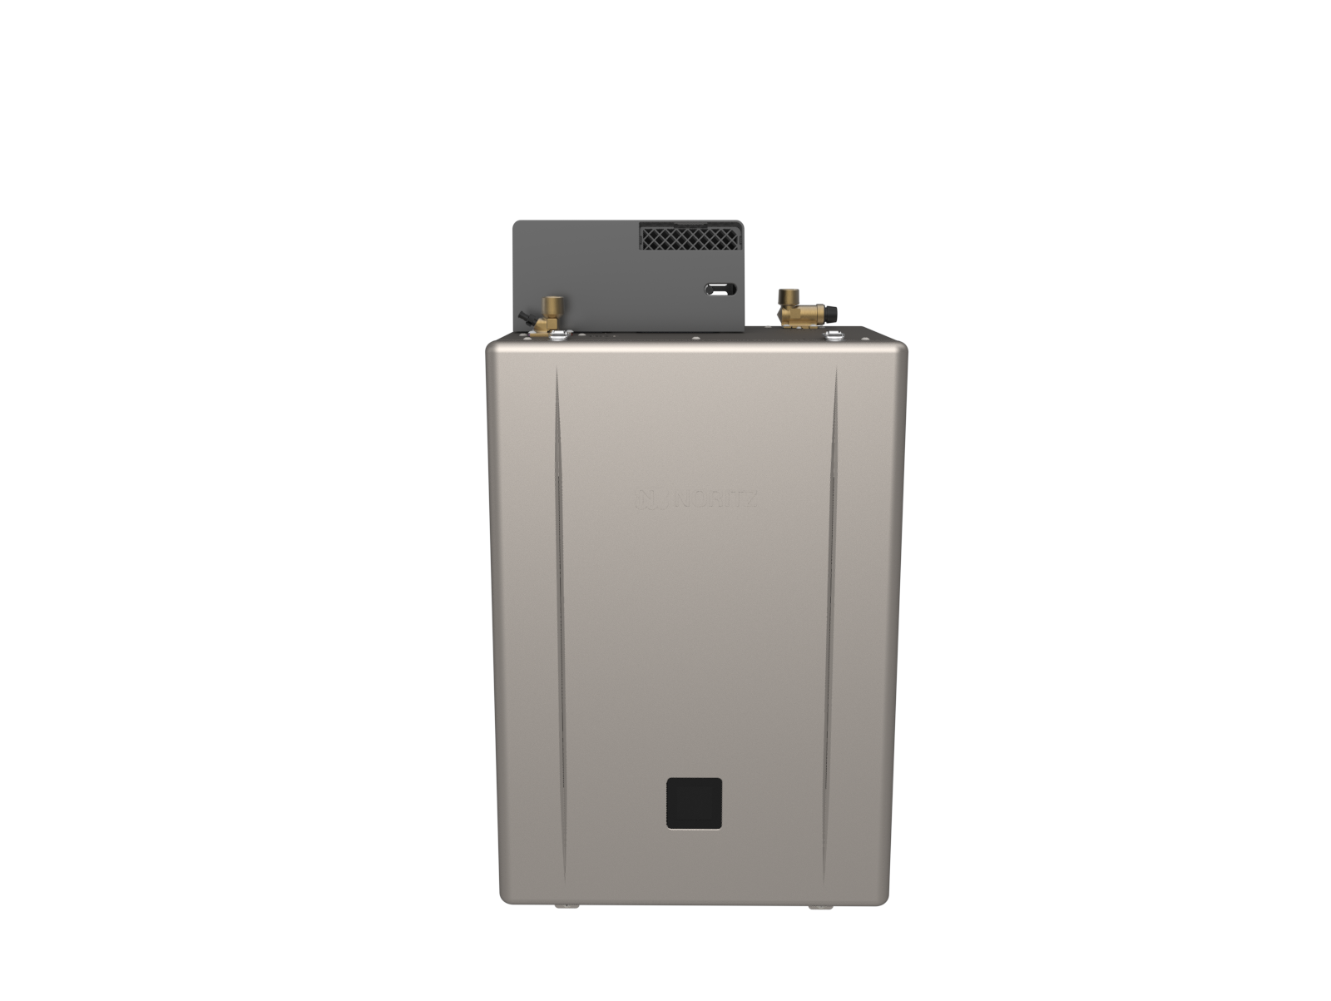
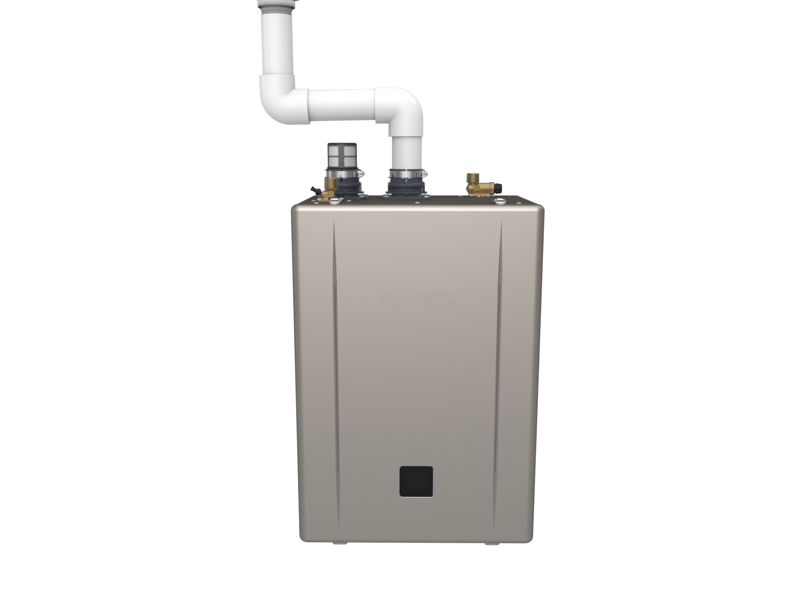
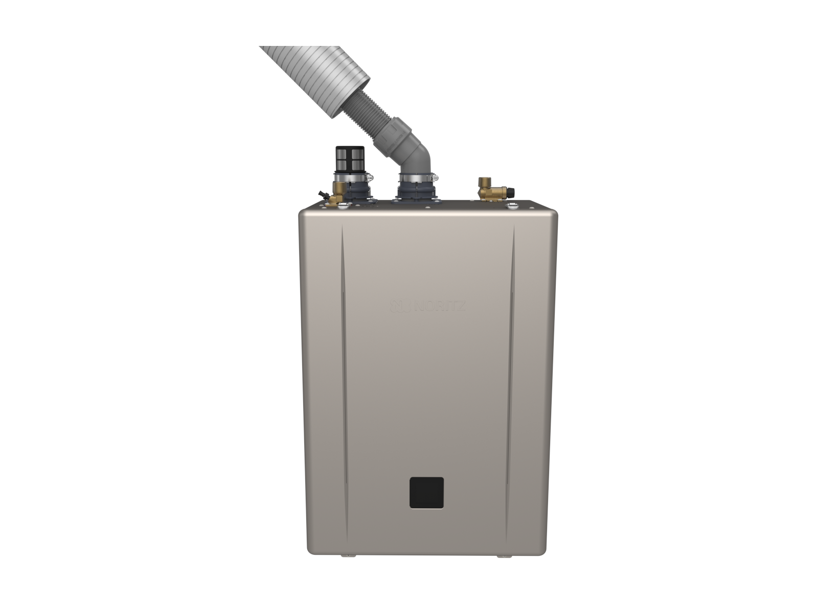
EZ SERIES PRO INDIVIDUAL UNITS
One SKU, All Venting Options.
Direct Vent
Single Vent
Outdoor
No Roof Kit
Flex Vent Kit

Slide 18
EZ SERIES PRO INDIVIDUAL UNITS
DV – Direct Vent
Ideal For:
Areas with dirty combustion air
Tight locations without combustion air
When unit is installed in a conditioned space (Why draw conditioned air through the unit?)

Slide 19
EZ SERIES PRO INDIVIDUAL UNITS
SV – Single Vent
Ideal For:
Areas with clean combustion air
Areas with plenty of combustion air

Slide 20
EZ SERIES PRO INDIVIDUAL UNITS
OD – Outdoor
Ideal For:
Warm climates without snow
Reclaiming space in the home

Slide 21
EZ SERIES PRO INDIVIDUAL UNITS
NRK – No Roof Kit
Ideal For:
Straight up b-vent runs under 9’
Tank Retrofits
Saving time by not replacing venting

Slide 22
EZ SERIES PRO INDIVIDUAL UNITS
FSV – Flexible Single Vent
Ideal For:
B-vent runs with 45 degree turns
B-vent runs longer than 9’
Tank Retrofits
Saving time by not replacing venting

Slide 23
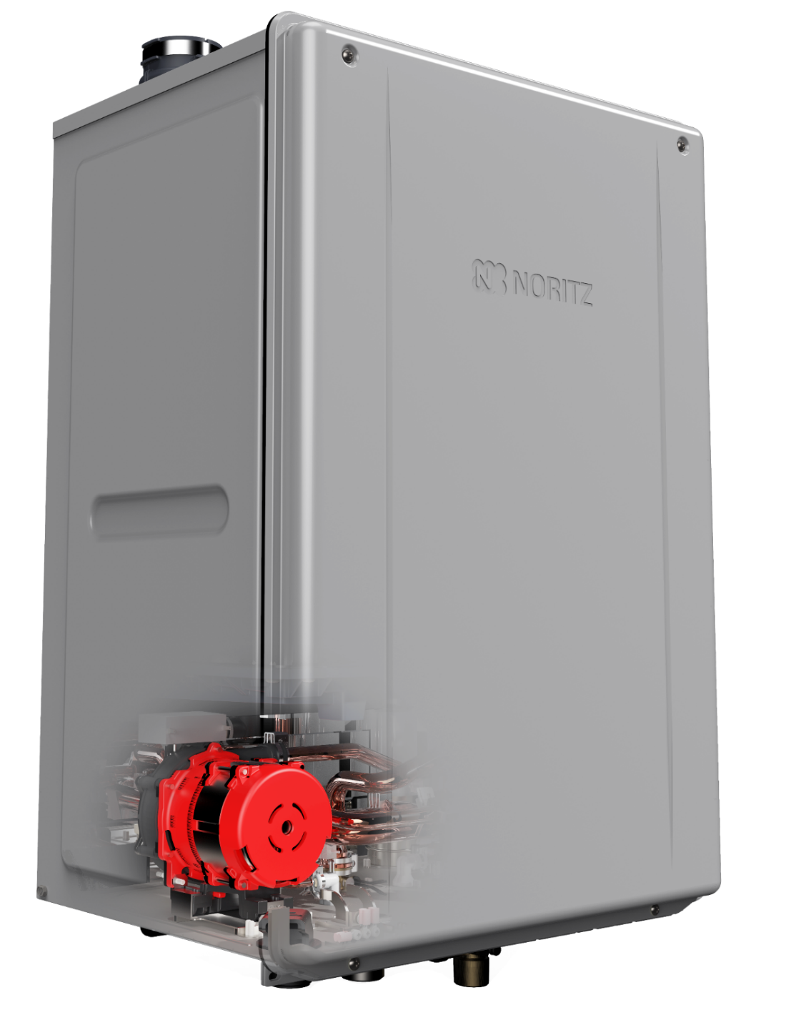

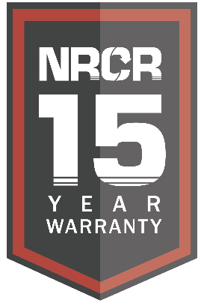
NRCR SERIES
Noritz Residential
Condensing w/ Recirculation

Slide 24
NRCR SERIES
Available Models:
NRCR111DV (Max 199k btu, 0.96 UEF)
NRCR92DV (Max 165k btu, 0.95 UEF)
Key Features:
15 Year Heat Exchanger Warranty
Simple Auto Recirc Mode
Crossover Valve Compatible
Flex Vent Capable (Just like EZ Series)
Steady BTU Control
Recirc Setting:
Auto Learning (Default)
Manual Timer (RC-9018M or Wifi Adapter needed)
Title 24 (On Demand)
Recirc Modes:
Dedicated Recirculation
Crossover

Slide 25
NRCR SERIES
The NRCR is a pre-mix style unit and thus has the same venting options as the EZ Series:
DV Direct Vent
SV Single Vent
OD Outdoor
FSV Flexible Single Vent
Common Vent Capable (2 Units Quick Connected)

Slide 26
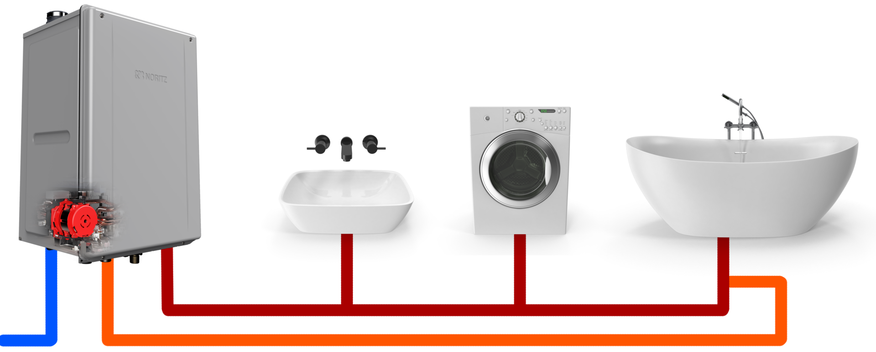
NRCR SERIES
Dedicated Return Line

Slide 27
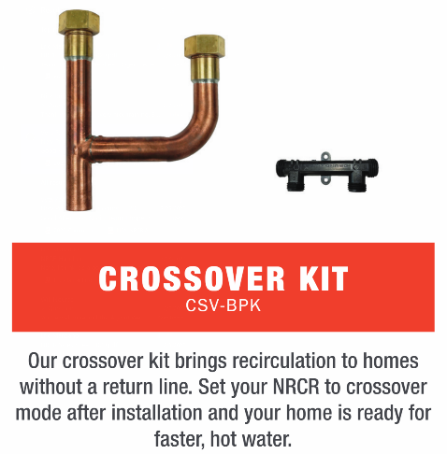
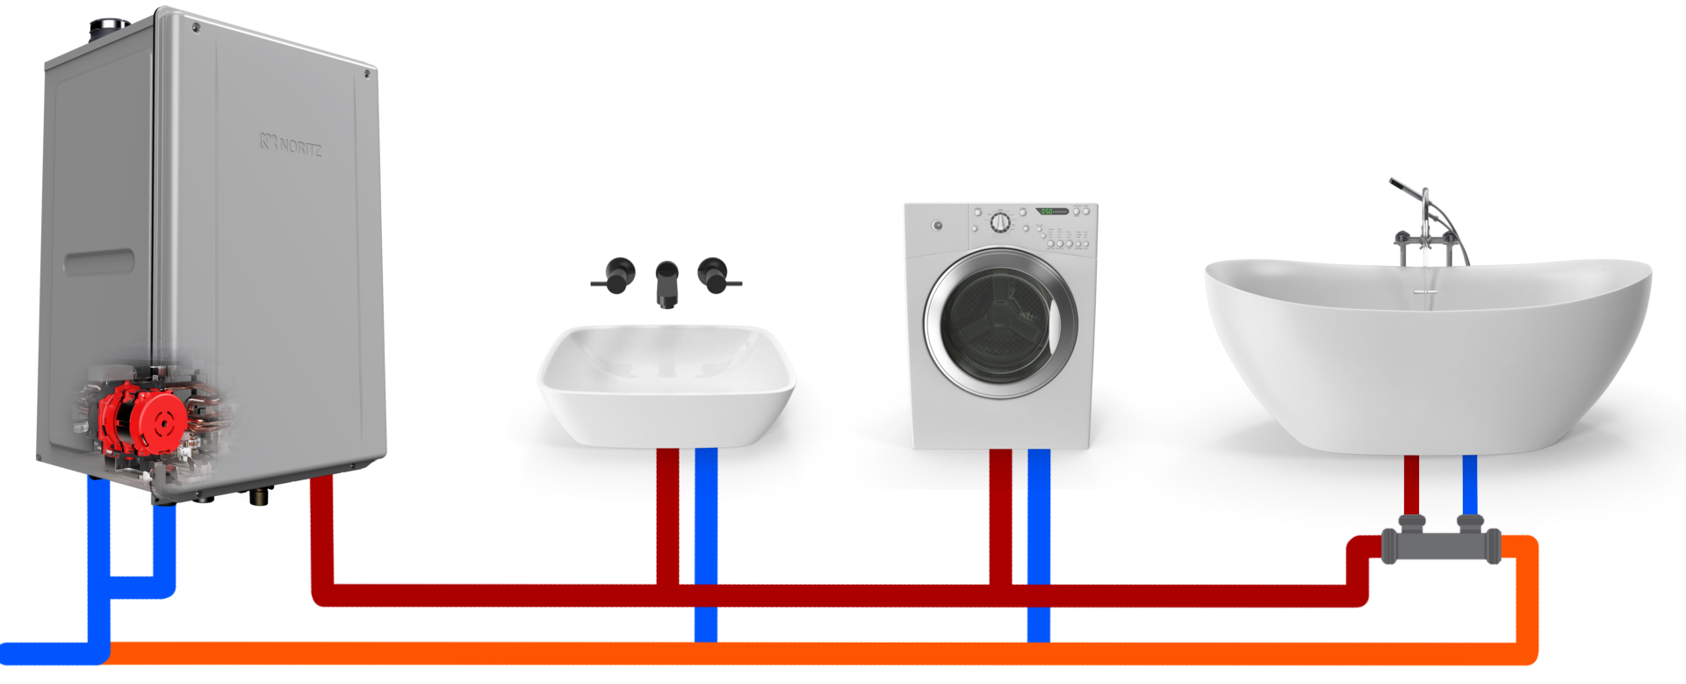
NRCR SERIES
Crossover Return Line

Slide 28
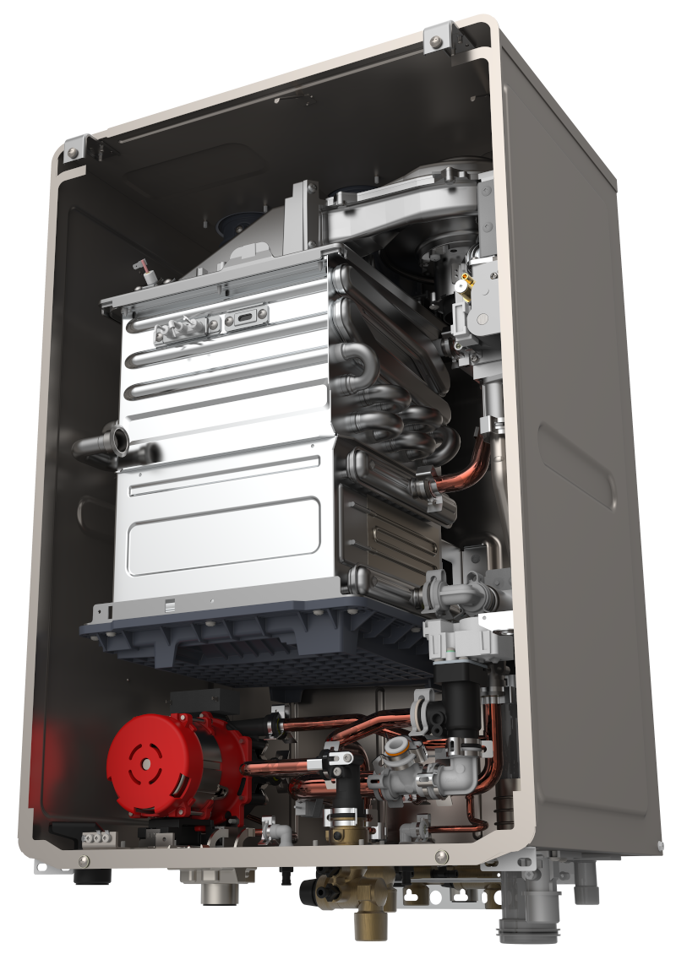
NRCR SERIES: AUTO LEARNING MODE
Auto Learning mode memorizes the customers usage patterns and automatically runs the pump during the hours hot water is needed. If the customers patterns change, the unit will adapt and remove times when it appears the customer no longer uses hot water.

Slide 29
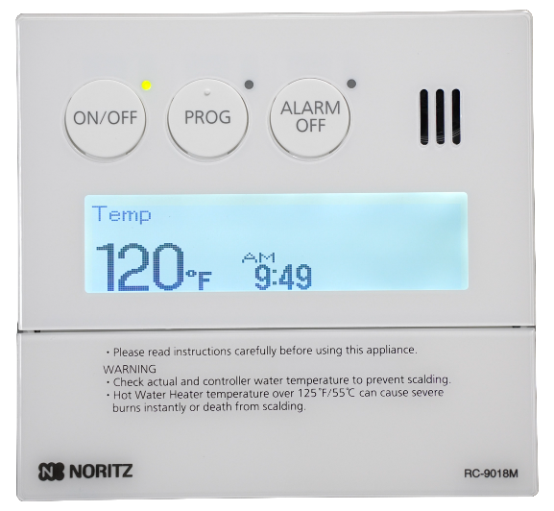
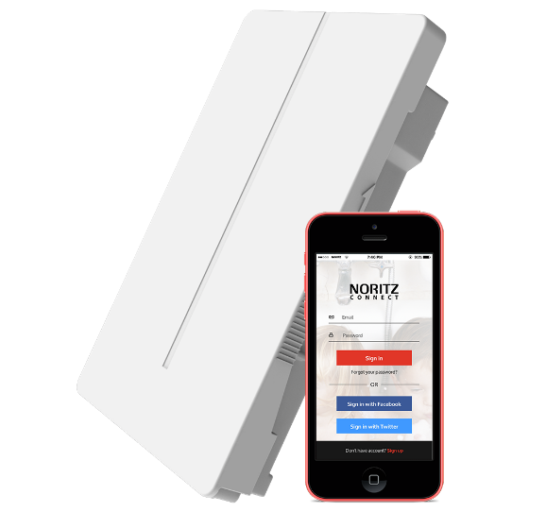
NRCR SERIES: MANUAL SCHEDULE MODE
Manual schedule mode requires the commercial remote or wifi adapter and allows the customer to set their own recirc schedule in 1 hour time blocks.

Slide 30
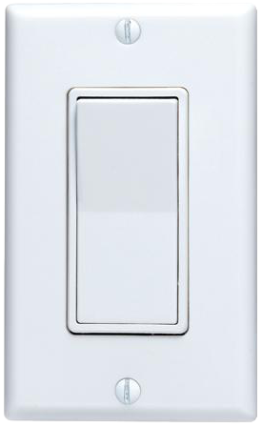
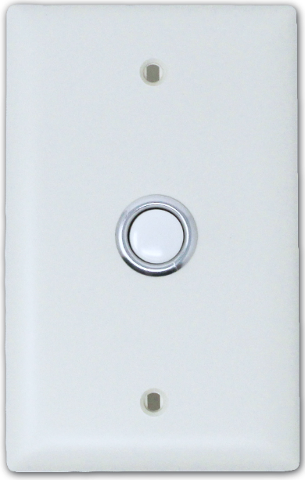
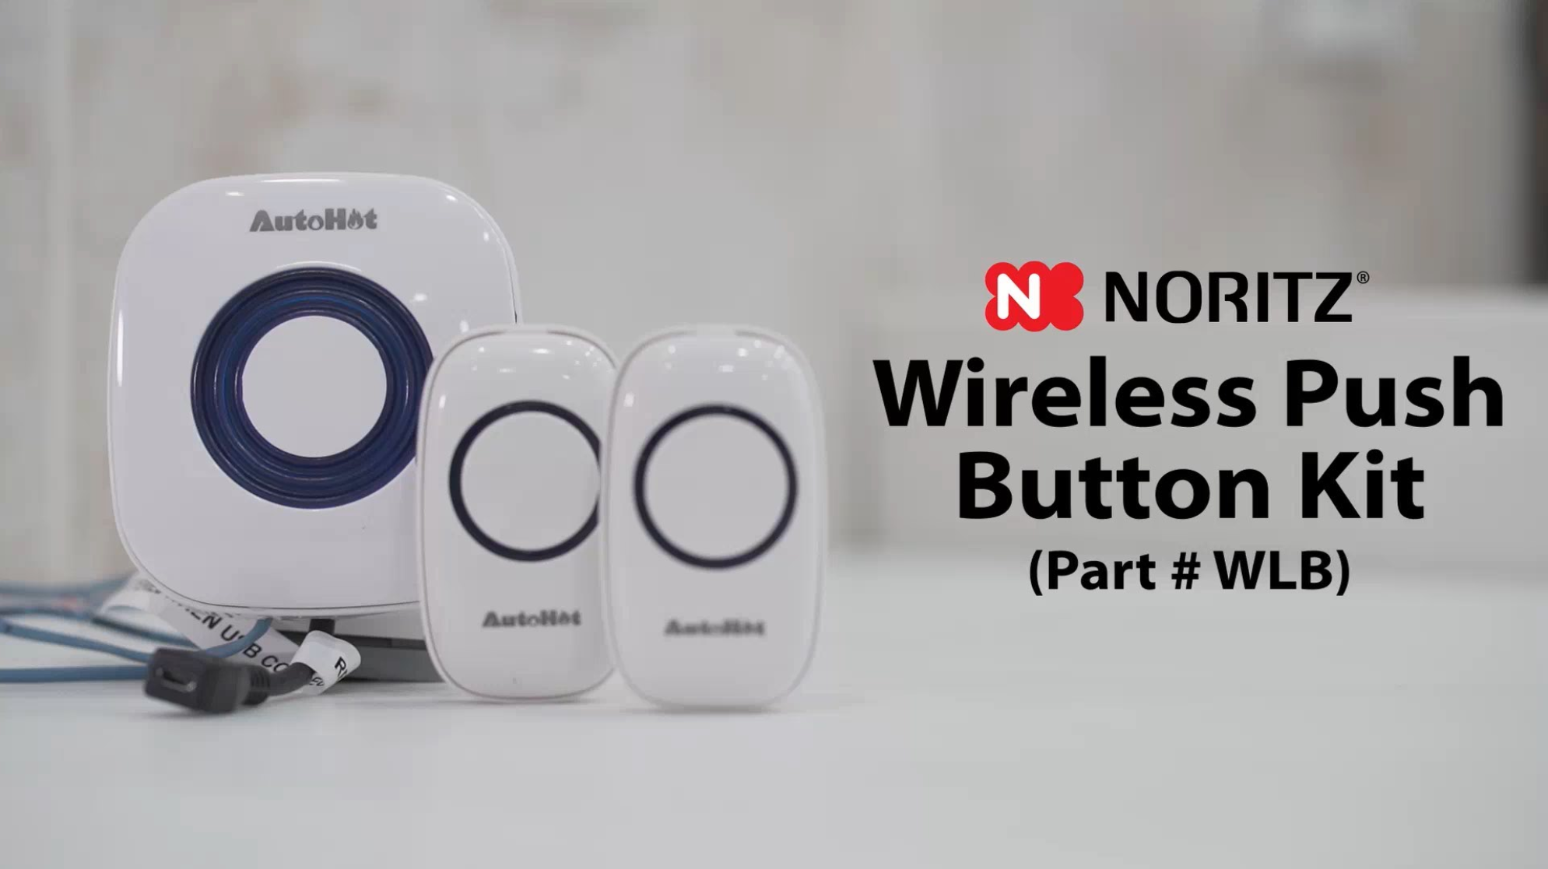
NRCR SERIES: TITLE 24 (ON DEMAND)
On Demand mode only runs the pump when the customer presses a button or activates a motion sensor.

Slide 31
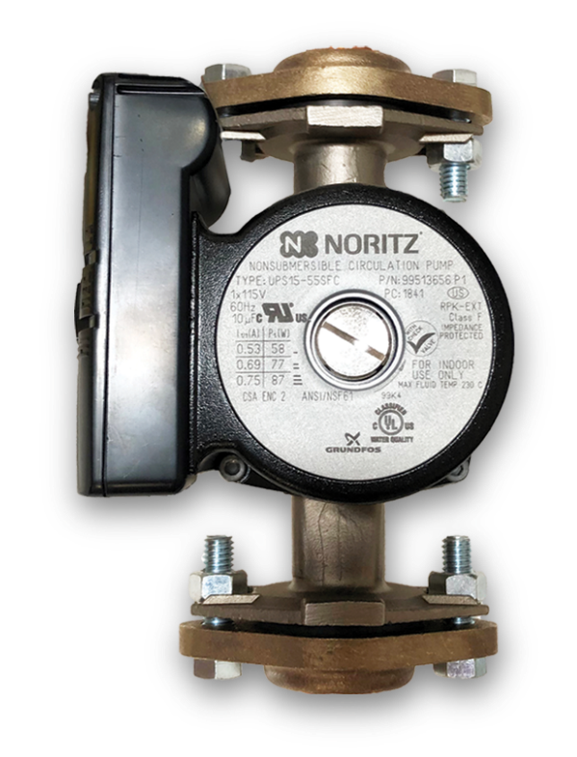
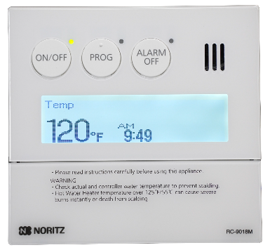
OPTIONAL RECIRCULATION
Many Noritz units are compatible with external recirculation pumps such as the Noritz RPK-EXT pump kit.
(Display Window Units are not compatible with the RPK-EXT pump kit as they do not have a pump control connection. An externally controlled pump may still be used though)
RPK-EXT
Pump Kit

Slide 32
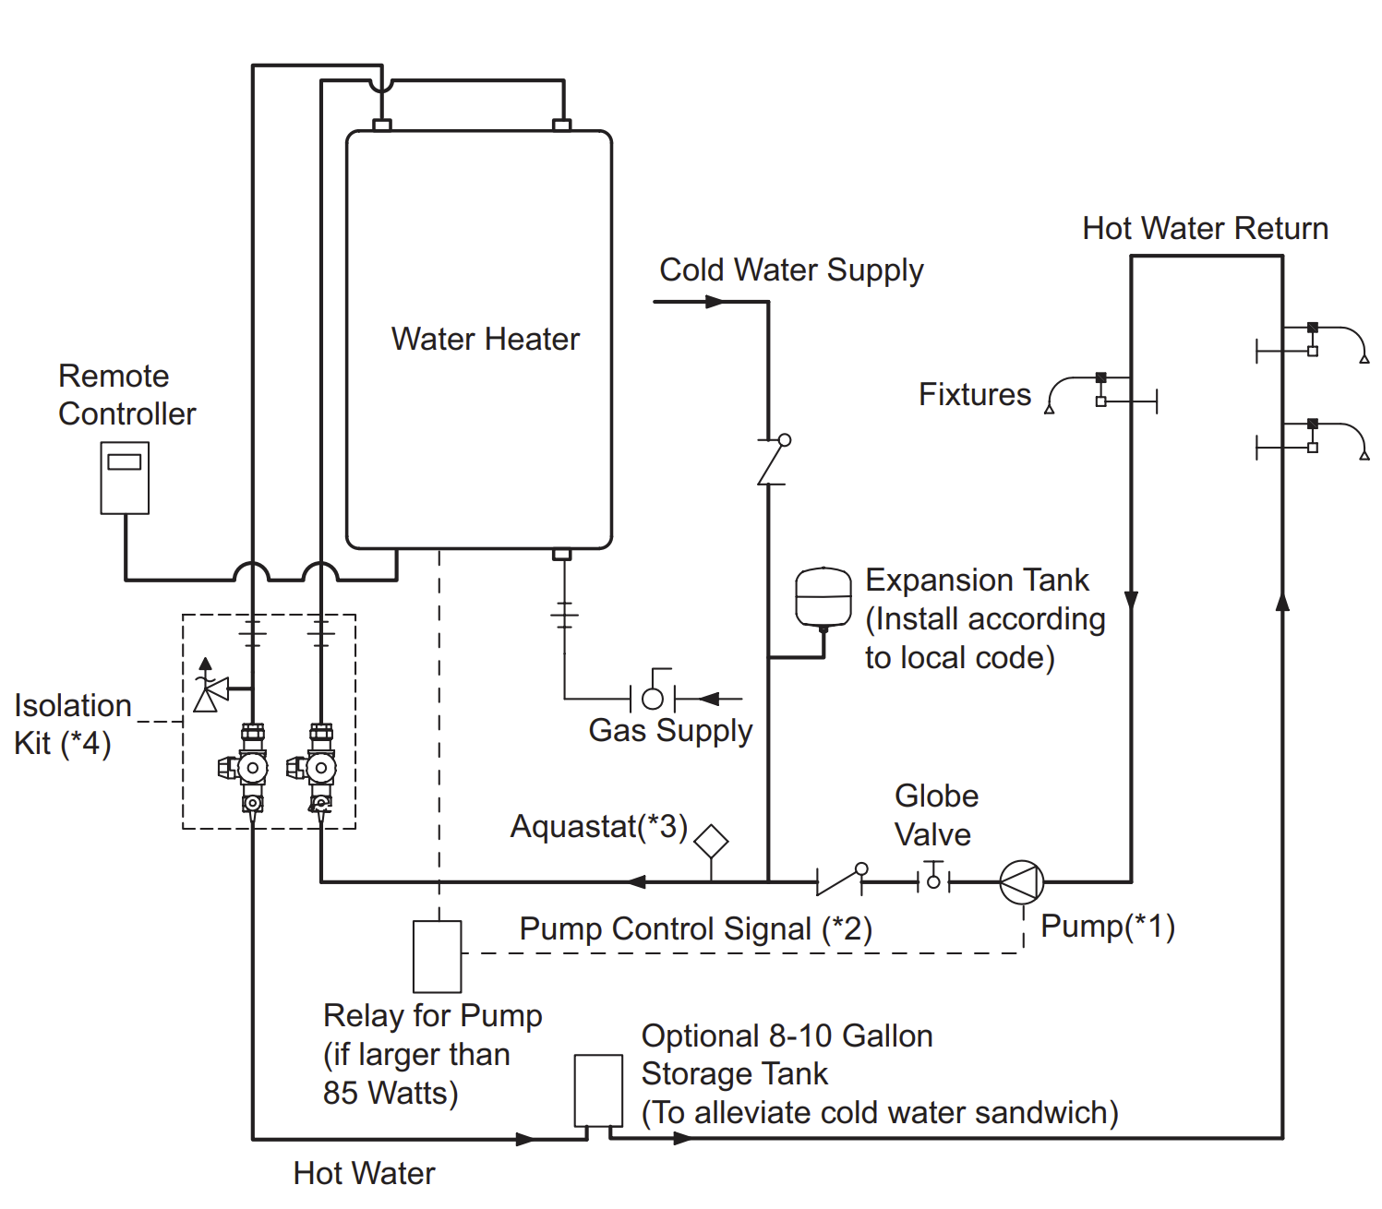
OPTIONAL RECIRCULATION
Typical Recirc Diagram
Size pump for 2 gpm max flow
Control pump with timer or aquastat or use pump connection wires inside unit
Set aquastat 10 degrees below unit set temperature

Slide 33
HOW TO SIZE A TANKLESS
Proper sizing is a key aspect of the customers experience and satisfaction with their tankless.
An undersized tankless will provide the proper temperature but the customer will not be able to run as many hot water fixtures at the same time as they want.
This problem will be more apparent in the winter time as the cold water temperatures are even colder.

Slide 34
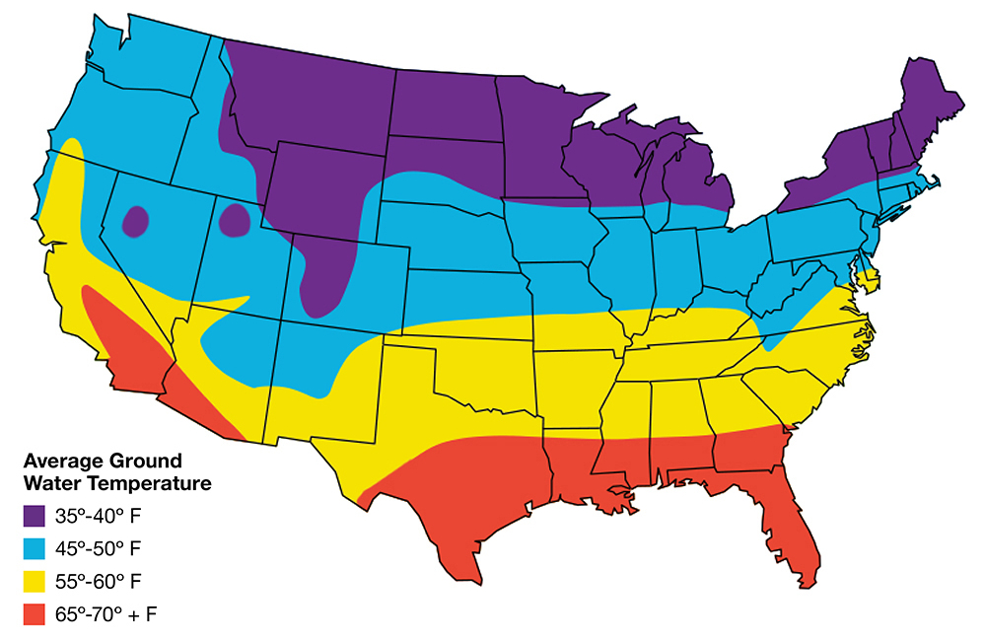

HOW TO SIZE A TANKLESS: STEP 1
Step 1: Determine your maximum temperature rise. This is the difference between the tankless set temp. and the winter time ground water temp.
For the purpose of this example let’s say the home is on the central coast of California.
Based on the map, we’ll say the winter ground water temp is 55 F.
Now you can determine the winter time temperature rise:
120 Set Temp – 55 Ground Water Temp = 65

Slide 35
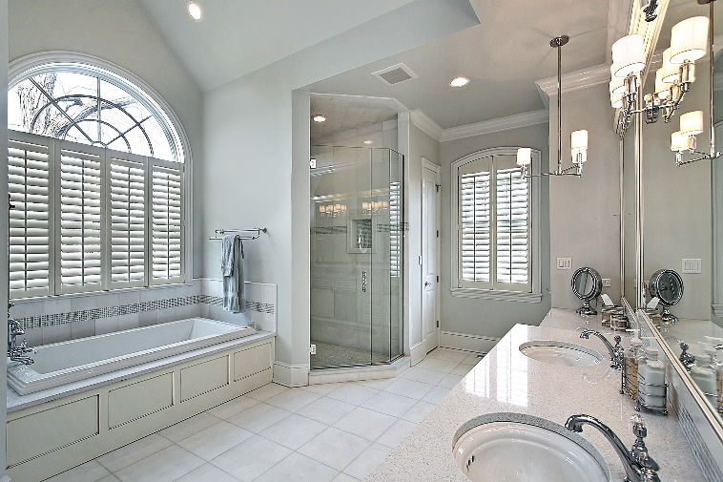
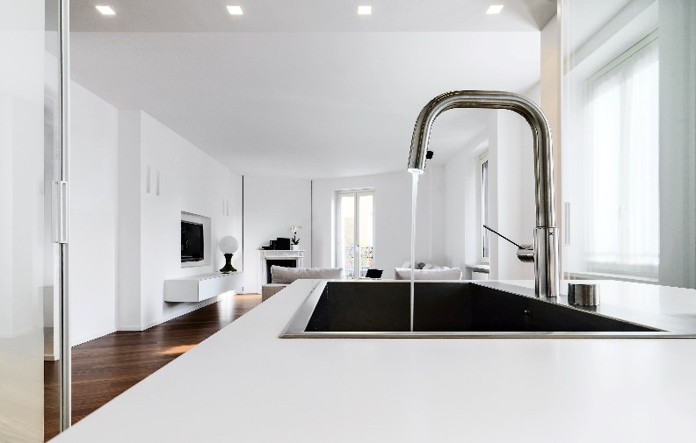
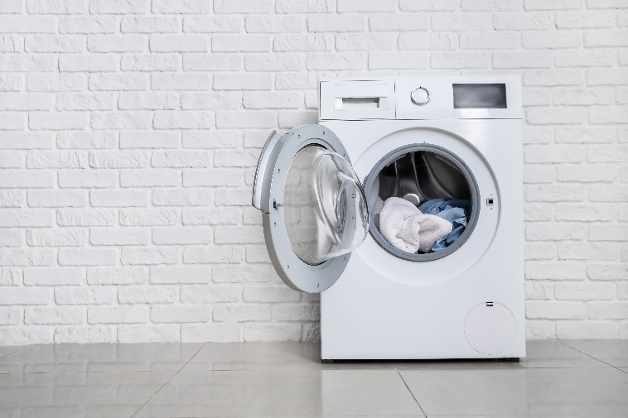
HOW TO SIZE A TANKLESS: STEP 2
Step 2: Determine the peak hot water demand of the home. If possible, ask the homeowner.
Fixtures and appliances all have different flow rates depending on manufacturer however you can use an average amount to get a ballpark figure:
Shower: 2 gpm
Lav Sink: 1 gpm
Kitchen Sink: 1.5 gpm
Dishwasher: 2 gpm
Washing Machine: 2 gpm
Example 1:
Peak usage: 2 Showers & Washing Machine = 6 gpm
Example 2:
Peak usage: 4 Showers & Dish Washer = 10 gpm

Slide 36
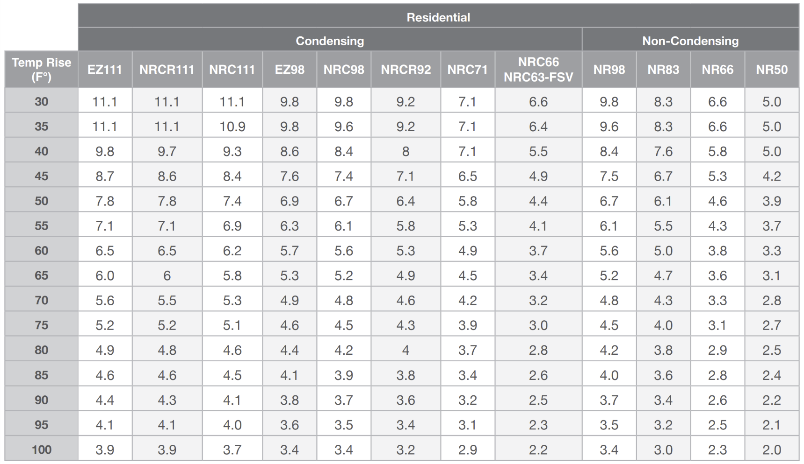
HOW TO SIZE A TANKLESS: STEP 3
Step 3: Select the proper unit or pair of units using the sizing chart found online or in the product catalog.
Simply find the Temperature Rise on the left then match up a unit or pair of units that provides the approximate flow rate needed.
Temp Rise: 65
Example 1:
Peak usage: 2 Showers & Washing Machine = 6 gpm
Ideal Models:
EZ111, NRCR111, NRC111
Example 2:
Peak usage: 4 Showers & Dish Washer = 10 gpm
Example 1
Example 2
Ideal Models:
Pair of EZ98, NRC98, NRCR92, NR98

Slide 37

HOW TO SIZE A TANKLESS: FINAL TIP
Final Sizing Tip:
It’s always better to slightly oversize a tankless system than to undersize it.
There’s virtually no downside to an oversized system for the home however and undersized system will not provide enough hot water for the home during all times of the year.

Slide 38
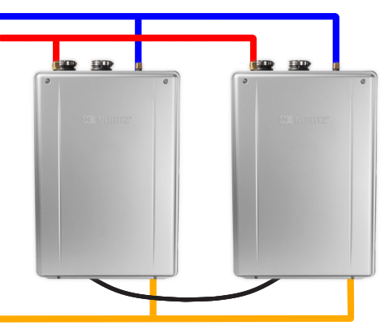
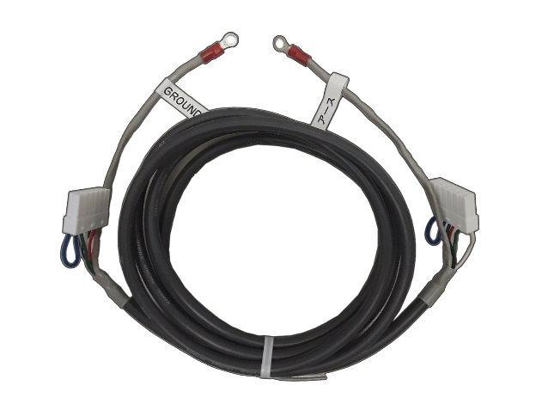
QUICK CONNECT SYSTEMS
For large residential applications
2 compatible Noritz units may be
quick connected to double the
hot water output.
Part #: QC-2

Slide 39
QUICK CONNECT SYSTEMS
The system will automatically
rotate primary and secondary
roles to ensure even use of
both units.
Primary
Secondary
Part #: QC-2

Slide 40

QUICK CONNECT SYSTEMS
When there's a small demand, only the primary heater will fire up to meet the demand.
Primary
Secondary
Part #: QC-2

Slide 41
QUICK CONNECT SYSTEMS
If the demand increases the primary
unit will activate the secondary unit
to help meet the demand.
Primary
Secondary
Part #: QC-2

Slide 42
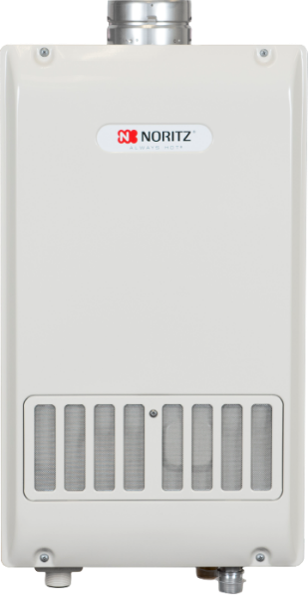
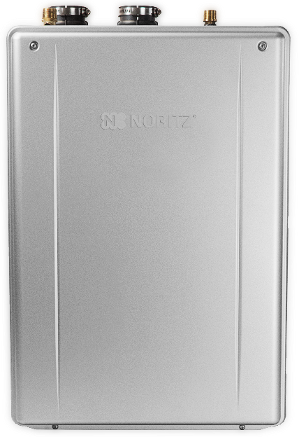
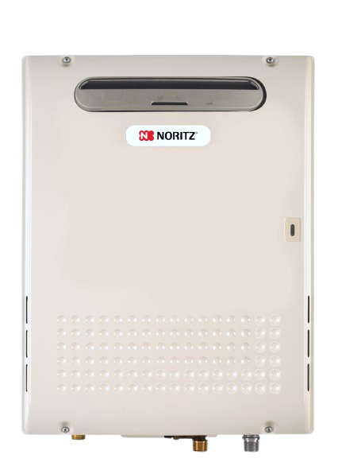
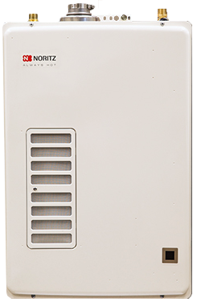
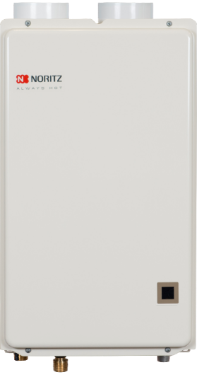
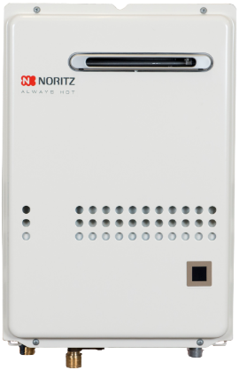
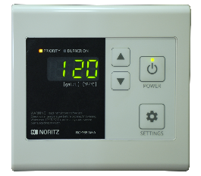
QUICK CONNECT SYSTEMS
Only the larger residential units with an external remote are compatible with the quick connect cable, smaller display window units are designed for single unit installations.
Quick Connect
Compatible
Not Quick Connect
Compatible

Slide 43
GAS LINE CONSIDERATIONS
Of equal importance to proper sizing of the unit is the proper sizing and installation of the gas line.
Afterall, what good is selecting the perfect tankless if the gas system can’t support it’s needs?

Slide 44
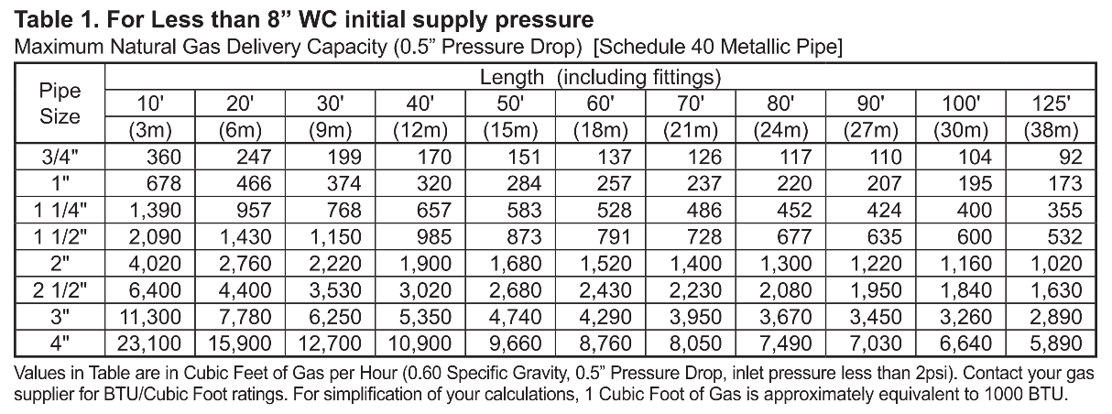
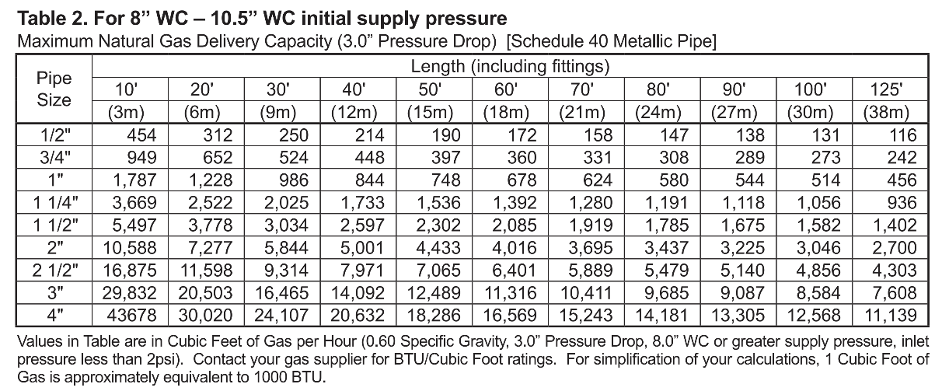

GAS LINE CONSIDERATIONS
The installation manual contains 3 sizing tables for hard pipe gas lines, 1 for propane and 2 for natural gas.

Slide 45

½” GAS LINE CONSIDERATIONS
The second natural gas table addresses gas line sizing when the initial supply pressure is above 8 inches water column. With a higher supply pressure, this opens up the option to use ½” gas lines where local code allows. This may be helpful in certain retrofit application that have existing ½” gas line.

Slide 46
½” GAS LINE CONSIDERATIONS
NOTE: The lengths listed are equivalent lengths for hard pipe and factor in any fittings as well.

Slide 47

DEDICATED OR BRANCH GAS LINE?
Both Dedicated and Branching from an existing gas line are acceptable choices.

Slide 48

DEDICATED OR BRANCH GAS LINE?
However, if you branch off the existing gas line, you need to make sure all sections of the line can support the btu demand.
60k btu
40k btu
200k btu
Section 1
(300k btu)
Section 2
(240k btu)
Section 3
(200k btu)

Slide 49

DEDICATED OR BRANCH GAS LINE?
Also make sure the gas meter is capable of supplying the total btu demand of the home.
60k btu
40k btu
200k btu
250 CFM

Slide 50

DEDICATED OR BRANCH GAS LINE?
In some cases it may need to be upsized to handle the added demand of the tankless unit.
60k btu
40k btu
200k btu
425 CFM

Slide 51


CHOOSING INSTALLATION LOCATION
Now that you’ve sized out the perfect unit for the job and made sure the gas system can support the new tankless, it’s time to pick the perfect installation location.

Slide 52

CHOOSING INSTALLATION LOCATION
For cold climates where snow is a regular or even occasional occurrence, you’ll want to install the unit indoors.

Slide 53

CHOOSING INSTALLATION LOCATION
For warm climates that never see freezing weather, installing the unit outdoors is a great way to free up space inside the home.

Slide 54

CHOOSING INSTALLATION LOCATION
Keep in mind all tankless water heaters have motorized parts. When in operation they are fairly quiet but the noises may bother some customers so keep that in mind when scouting a location to install the unit.

Slide 55

CHOOSING INSTALLATION LOCATION
If possible, avoid installing the unit on a bedroom wall or other areas where customers might expect a quiet space.

Slide 56
INDOOR VENTING OPTIONS
When installing the unit indoors, you have a few different venting options available to you although they will generally fall into 1 of 2 categories:
DV Direct Vent
SV Single Vent

Slide 57





INDOOR VENTING OPTIONS
Direct Vent Examples:
Two Pipes
To Outside
Concentric
Terminations
DVC Style
Unit

Slide 58



INDOOR VENTING OPTIONS
Single Vent Examples:
DV to SV
Conversion
Flex Vent
Kit
SV Style
Unit

Slide 59

HORIZONTAL OR VERTICAL VENTING
All Noritz indoor units may be vented either horizontally or vertically regardless of SV or DV vent type, with the only exception being the EZTR packages that use the 2” flexible vent.

Slide 60

HORIZONTAL OR VERTICAL VENTING
EZTR installations must be run vertically through the existing round b-vent and cannot be run horizontally.

Slide 61




HORIZONTAL OR VERTICAL VENTING
Standard efficiency non-condensing units must be vented with category III stainless steel venting and high efficiency condensing models may us plastic venting such as PVC, CPVC or PP depending on code requirements.

Slide 62



WHEN TO DIRECT VENT
When combustion air is likely to be contaminated, such as in:
Attics
Laundry Rooms
Commercial Kitchens
It’s best to install a Direct Vent unit.

Slide 63

WHEN TO DIRECT VENT
Pulling in dirty combustion air with an SV unit will require quite a bit of preventative maintenance and likely shorten the overall lifespan of the unit.

Slide 64

DV TERMINATION OPTIONS
PVC-2CT: 2" Connections
PVC-3CT: 3" Connections

Slide 65


DV TERMINATION OPTIONS
PVC-2CT: 2" Connections
PVC-3CT: 3" Connections
PRC-1: Plastic Rain Cap

Slide 66


DV TERMINATION OPTIONS
PVC-UCVK: For easy up and out venting

Slide 67



DV TERMINATION OPTIONS
PVC-2LPT: 2" Connections
PVC-3LPT: 3" Connections

Slide 68





SV TERMINATION OPTIONS
If the installation location meet the combustion air requirements in the manual, you have the option to install a Single Vent unit or use the SV conversion kit on a compatible DV unit and run a single exhaust vent to the outside.

Slide 69



OUTDOOR INSTALL CONSIDERATIONS
Outdoor installations are probably one of the easiest options if the climate allows. However, there are still things to consider such as clearances to building openings and how close the unit is to a neighboring building. The last thing you want is for the exhaust or operational noises to affect the neighbors.

Slide 70

INSTALLATION CLEARANCE REQUIREMENTS
The terminations of all gas burning appliances are subject to National Fuel Gas Codes clearance requirements to building openings. The installation manual provides these diagrams and many clearance requirements directly from the national fuel gas code for both US and Canada.

Slide 71
INSTALLATION CLEARANCE REQUIREMENTS
It’s important to note that Noritz does not make these clearance requirements and thus cannot overrule any local, state, provincial or national code. When there is no national code clearance listed, local code or the requirements of the gas supplier must be followed.

Slide 72
INSTALLATION CLEARANCE REQUIREMENTS
These codes are designed to prevent the exhaust from a gas burning appliance from entering the home and putting the occupants at risk.

Slide 73

CONDENSATE DRAIN CONNECTION
Condensing heaters will have a ½” condensate drain connection on the bottom of the unit.

Slide 74

CONDENSATE DRAIN CONNECTION
The condensate drain line should be as short and direct as possible and you do not need to create a trap as that’s what the collector inside the unit does.

Slide 75


CONDENSATE DRAIN CONNECTION
If the desired drain location is a long distance from or above the heater, a condensate pump should be used. The pump should be sized to handle 2 gallons per hour.

Slide 76

CONDENSATE DRAIN CONNECTION
In cold climates with freezing weather, the condensate should not be drained to the outside as the condensate line could freeze and the heater will stop operating.

Slide 77



CONDENSATE DRAIN CONNECTION
The drain line should be plastic as the acidic condensate will corrode metal pipes and the line should be no smaller than ½”.
Horizontal runs should be sloped downward a ¼” for every 1 foot of piping.
Make sure you leave an air gap at the end of the drain line.

Slide 78


FILLING CONDENSATE TRAP
The condensate collector inside the unit that should be pre-charged with water to prevent carbon monoxide leakage during initial operation of the unit. Pre-mix models such as the EZ series need about 10 oz of water while traditional condensing units like the NRC111 need about 30 oz.

Slide 79

FILLING CONDENSATE TRAP
If you forget to pre-charge the condensate collector, make sure the installation area is well ventilated for the first 15-20 minutes of operation as the unit creates condensate and fills the collector.

Slide 80

NEUTRALIZING THE CONDENSATE
Treating the acidic condensate created by high efficiency units may be required by local code and is a good practice even if code doesn’t require it.

Slide 81

NEUTRALIZING THE CONDENSATE
Noritz offers external neutralizers to raise the pH level of the acidic condensate to that of water so it can be drained safely. The residential neutralizer is recommended to be installed 1 per unit.

Slide 82


EZ START PLUS APP
The EZ Series Pro no longer has physical dipswitches on the circuit board. All programming of the unit is done with the new EZ Start Plus App or the built in display window.
Directions can be found in the manual

Slide 83




EZ START PLUS APP
Open EZ Start Plus App and Turn on Bluetooth
Select Unit
Enter Passcode
Register Warranty (or Skip)

Slide 84






EZ START PLUS APP
Tap
“Unit Setting”
Select Options Based on Installation
Tap “NEXT”
Review and Tap “DONE”

Slide 85



EZ START PLUS APP
Upon completion, email app will open to allow emailing the installation settings to Noritz. This is not required, but very helpful for Customer Care.
Please fill out these items if you opt in to send.
App Programs Unit
Tap “OK” When Complete

Slide 86

SETTING THE DIPSWITCHES
Each unit will have 8 dipswitches located on the circuit board for adjusting the unit based on vent type, elevation, vent length and size.

Slide 87

SETTING THE DIPSWITCHES
On smaller units that don’t include a remote control, the dipswitches will also allow you to set the output temperature above the default 120 degrees F.

Slide 88

SETTING THE DIPSWITCHES
Be sure to make dipswitch changes with the power off otherwise an error code 73 will occur.

Slide 89
SETTING THE DIPSWITCHES
To Clear EC73:
Disconnect Power
Make Dipswitch Changes
Reconnect Power

Slide 90





SETTING DIPSWITCHES WITH PROCARD APP
Use the PROCard App to make dipswitch settings simple!

Slide 91

WATER QUALITY CONSIDERATIONS
Water quality, and specifically hard water, is the #1 factor that affects the lifespan of any water heating appliance.

Slide 92

WATER QUALITY CONSIDERATIONS
When installing a Noritz Tankless in an area with hard water, it’s important to follow the water quality and treatment guidelines in the installation manual.

Slide 93

WATER QUALITY CONSIDERATIONS
A Scale Shield is highly recommended for hard water areas. It’s always better to prevent scale build up rather than cleaning it up afterwards.

Slide 94

WATER QUALITY CONSIDERATIONS
As a last resort if there’s no softener or scale shield, descales should be completed on a yearly basis. This involves circulating a calcium lime rust remover or food grade white vinegar through the unit for 1 hour.

Slide 95
WATER QUALITY CONSIDERATIONS
Descale procedures can be found:
In the Manual
In the PROCard App
SUPPORT.NORITZ.COM
YOUTUBE.COM/NORITZAMERICA

Slide 96

INSTALLATION CHECKLIST
Before leaving the jobsite and calling the installation complete, it’s a good practice to verify everything is working properly.

Slide 97
INSTALLATION CHECKLIST
This includes, but is not limited to:
Double checking dipswitches
Checking inlet water filter
Testing the heater at low, moderate and high flow rates for a few minutes
Registering the warranty

Slide 98



REGULAR MAINTENANCE ITEMS
To keep the tankless running at peak performance and efficiency throughout its life, here are a few other regular maintenance items to keep in mind.
Cleaning the unit and combustion chamber if excessive build up is noticed.
Cleaning the ignition and flame rods.
Checking and cleaning the cold water inlet filter.

Slide 99
REGULAR MAINTENANCE ITEMS
Encourage your customers to visually check the unit once in awhile.
Tankless heaters, like any other gas appliance, are not meant to be installed and forgotten about.

Slide 100

REGULAR MAINTENANCE ITEMS
Periodically inspecting the unit for any minor issues will help prevent it from becoming a bigger problem.

Slide 101
HELPFUL CONTACT INFO
SUPPORT.NORITZ.COM
NORITZ.COM/TECHTIPS
HELP.NORITZ.COM
TRAINING.NORITZ.COM
YOUTUBE.COM/NORITZAMERICA
Customer Care: 866-766-7489

Slide 102

THANK YOU

