Slide 1
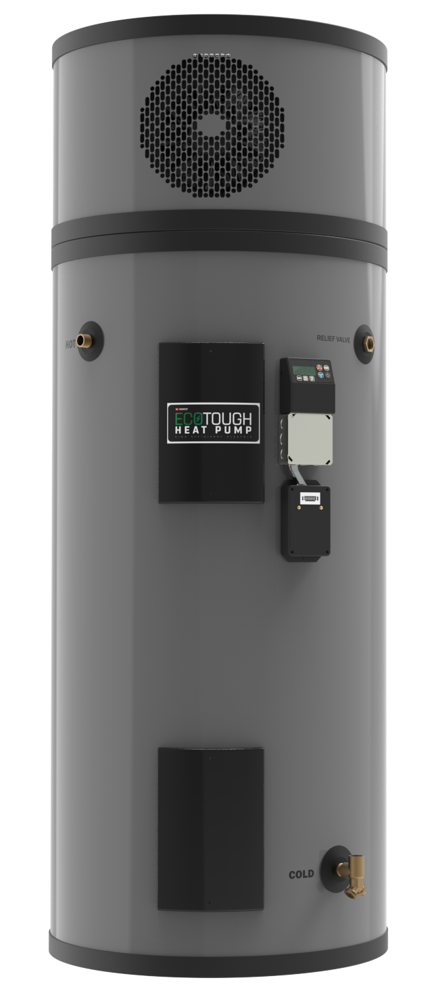


Slide 2

TRAINING OVERVIEW
Heat Pump Information
Heat Pump Installation
Why a Heat Pump?
What is a Heat Pump?
When to use a Heat Pump?
Sizing a Tank
Specification
Features
Main Components
General Info
Clearances
Plumbing Connections
Electrical Connections
Filling the Tank
Setting the Temperature
Setting the Mode

Slide 3
WHY A HEAT PUMP?
Why is Noritz, a gas tankless manufacturer, now offering an electric heat pump tank?
To offer customers seeking to reduce or even eliminate their reliance on fossil fuels in the home a super efficient way to heat their water.
To adapt to future regulations regarding the use of natural gas.
To continue offering our customers efficient and environmentally friendly options to heat their water.

Slide 4
WHAT IS A HEAT PUMP?
A heat pump works like a refrigerator in reverse. A refrigerator moves heat from inside the refrigerator and transfers it to the surrounding room whereas a heat pump water heater captures heat from the ambient air and transfers it to the water stored in the tank.
This is much more efficient than an electric tank and doesn’t produce any emissions as it’s not gas fired.

Slide 5
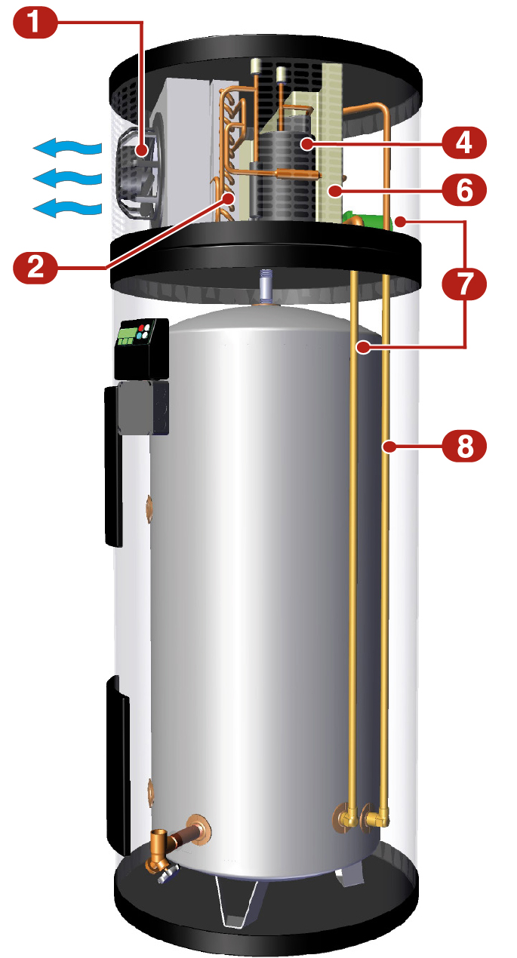
HEAT PUMP OPERATING PRINCIPLE
Fan draws air from the room and into the heat pump compartment.
Evaporator captures heat and transfers that energy to the refrigerant.
The refrigerant changes from a liquid to a gas as it gets warmer.
The vapor refrigerant then flows into the compressor.
The refrigerant then is compressed causing it to become superheated.
The heat exchanger transfers refrigerant heat to water from the tank.
Pump circulates water from the tank through the heat exchanger.
Hot water is returned to the tank.
The superheated gas condenses back to a liquid and the process is repeated.

Slide 6
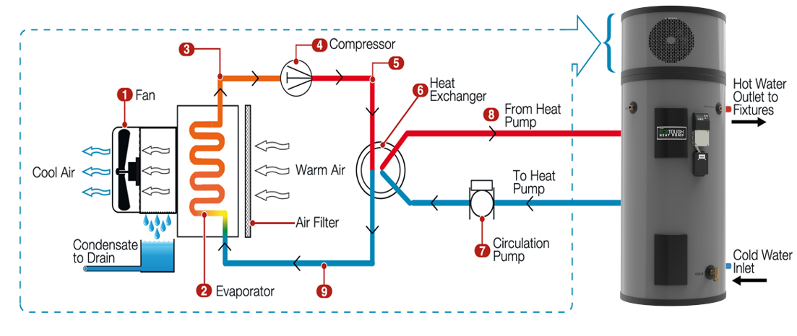
OPERATIONAL DIAGRAM

Slide 7
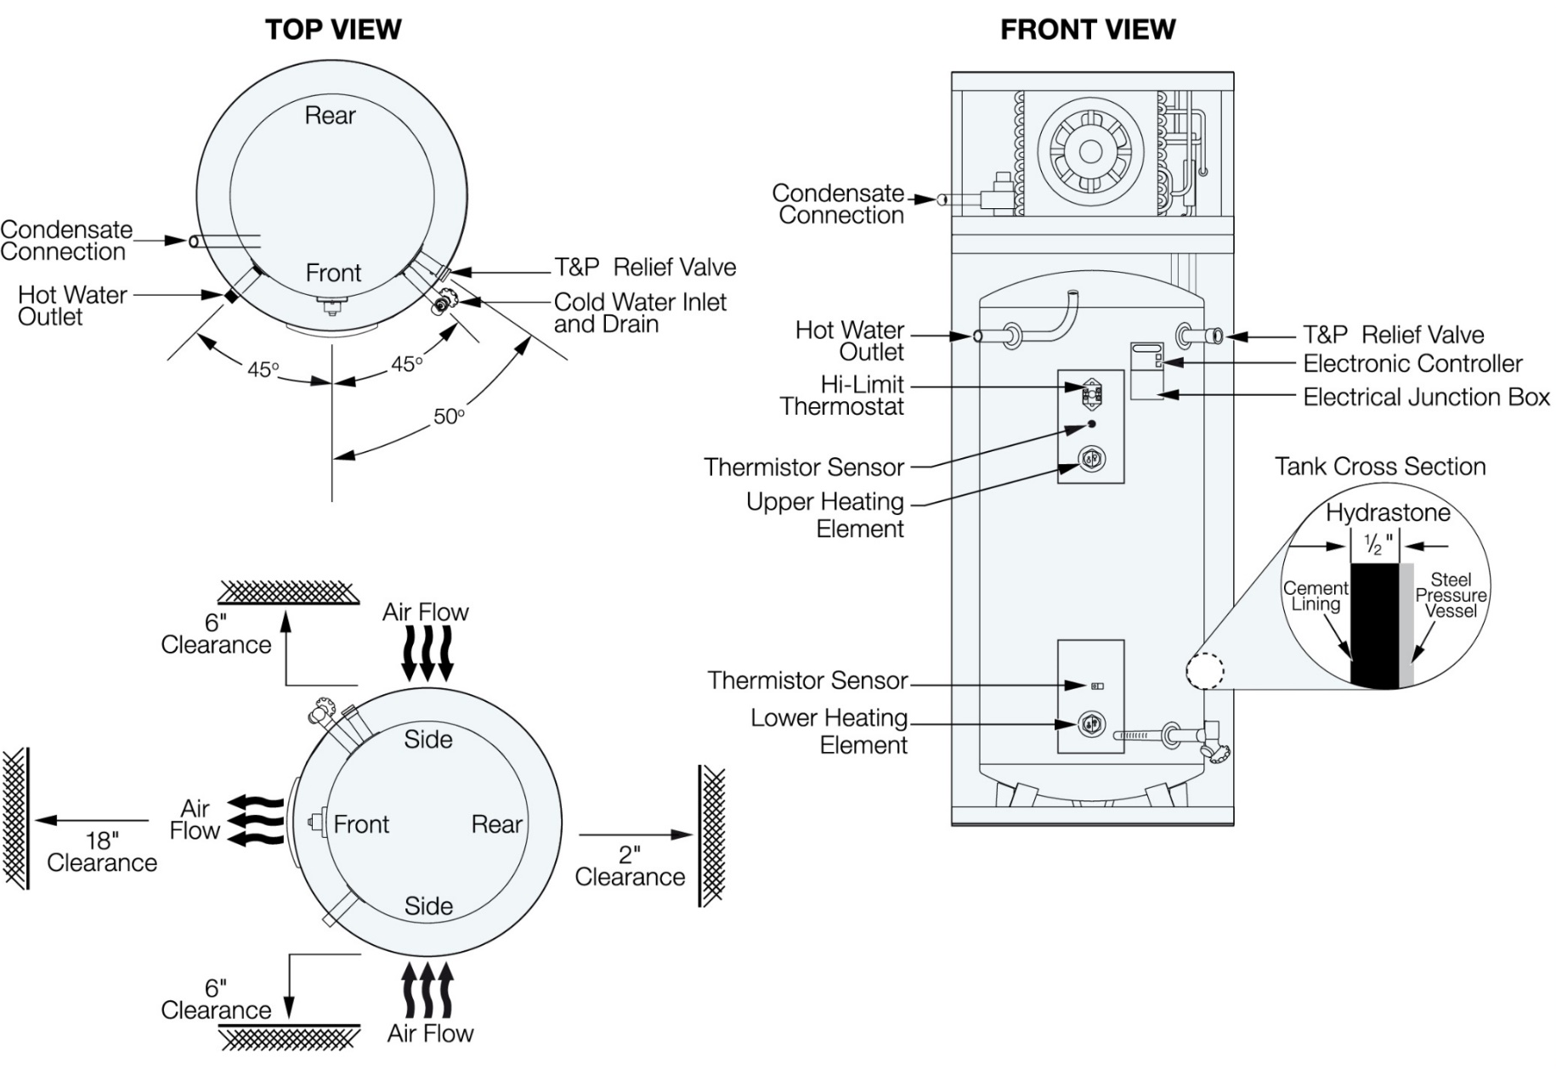
HEAT PUMP OVERVIEW
HEAT PUMP DESIGN

Slide 8
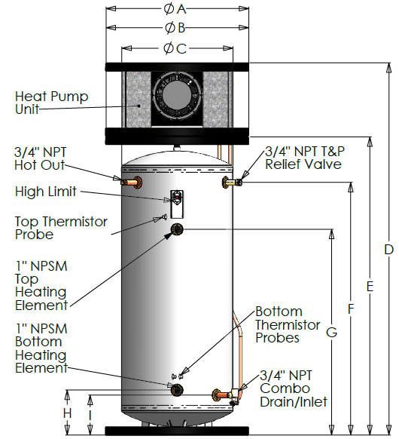
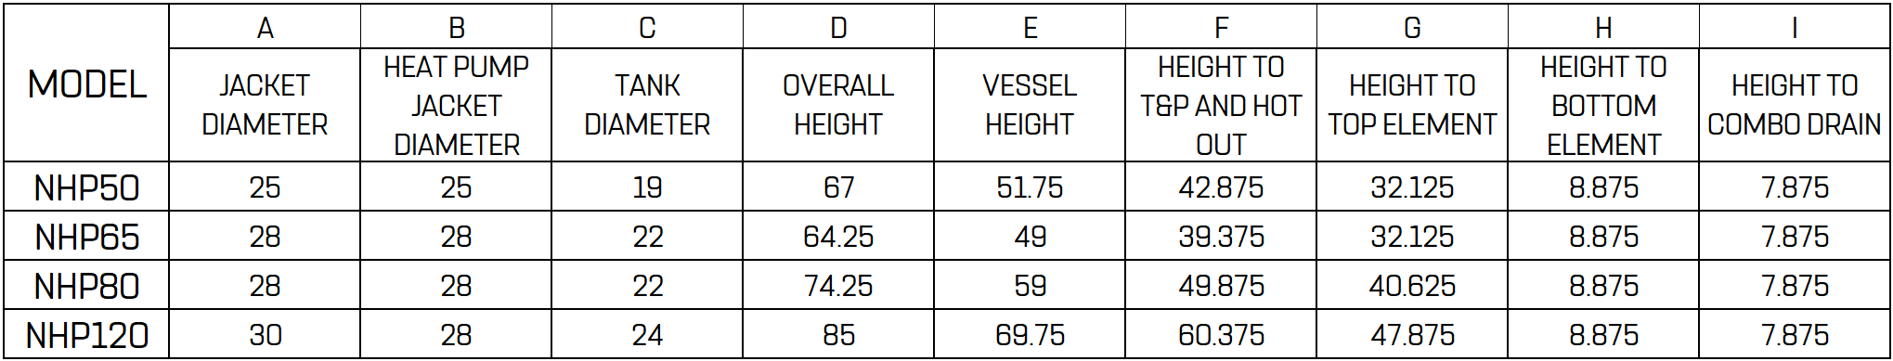
50 Gallon:
  25” Diameter x 67” Tall
65 Gallon:
  28” Diameter x 64.25” Tall
80 Gallon:
  28” Diameter x 74.25” Tall
120 Gallon:
  30” Diameter x 85” Tall
HEAT PUMP DESIGN

Slide 9
WHEN TO USE A HEAT PUMP
New Construction?
No Gas Available?
Replacing an electric tank?
Eco conscious customers?

Slide 10
GENERAL SIZING CONSIDERATIONS
Heat pump water heaters don’t recover as quickly as their gas fired or electric counterparts, but they do heat the water much more efficiently.
When sizing a tank water heater, the first hour rating is the important bit of info to look for. This is how many gallons of hot water the tank can provide in an hour, starting with a full tank of hot water.
Noritz Heat Pump First Hour Ratings:
NHP50: 58 Gallons
NHP65: 70 Gallons
NHP80: 86 Gallons
NHP120: 105 Gallons

Slide 11
GENERAL SIZING CONSIDERATIONS
To select the correct size tank, first determine when the peak hour of hot water is used. Is it a morning rush as they get ready for work and/or school? Is it in the evening when they return from work/school?
Estimate the maximum hot water usage during this one hour period of the day. Some example hot water uses are:
  Shower (2gpm x 10 minutes): 20 Gallons
  Shaving (.5gpm x 4 minutes): 2 Gallons
  Hand Washing or Food Prep: (2gpm): 3 Gallons
  Dishwasher: 7 Gallons
  Washer – Top Loader: 25 Gallons
  Washer – Front Loader: 15 Gallons
  Estimates from Energy.gov

Slide 12
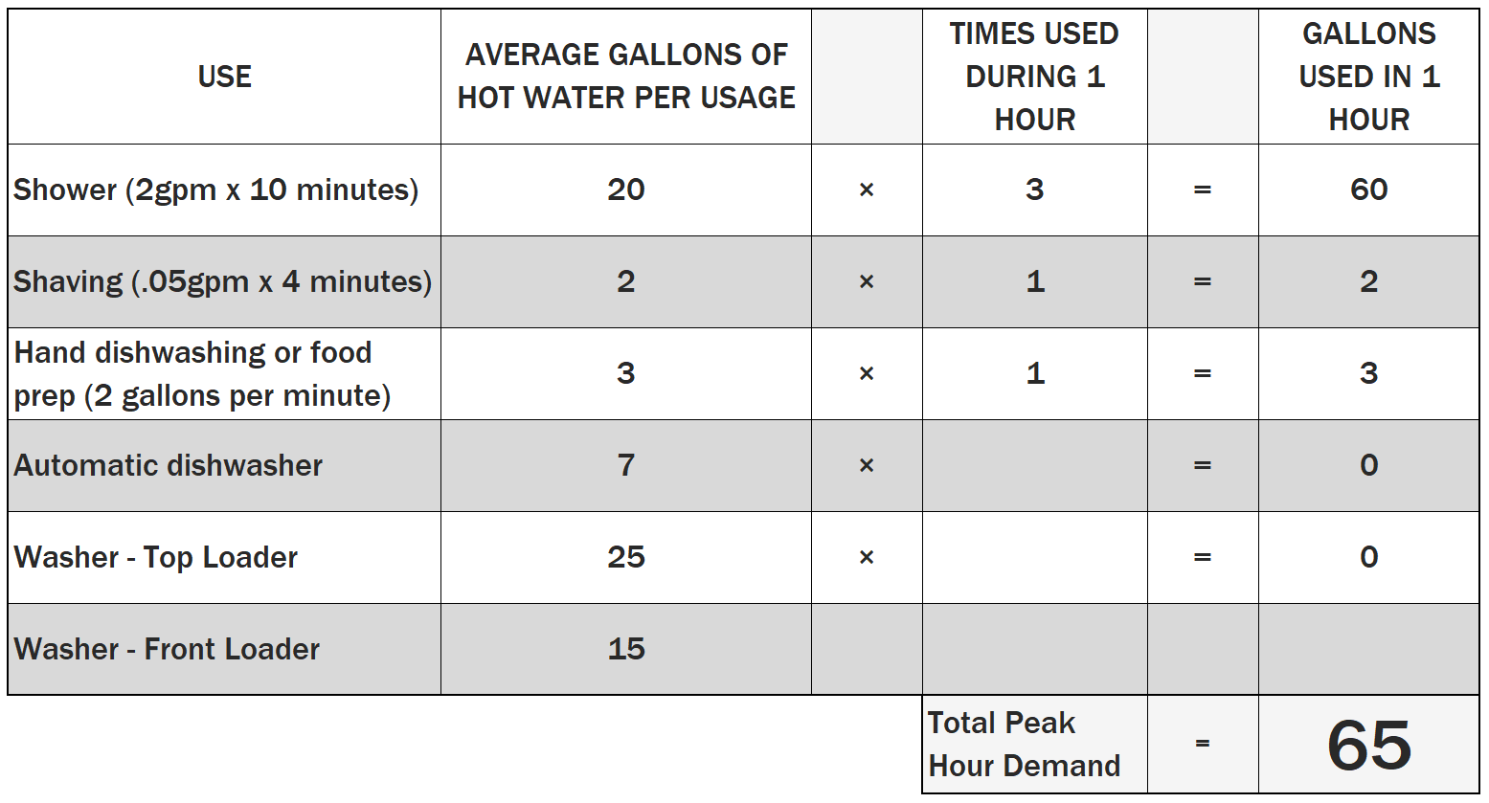
SIZING A TANK
Sizing Example:
Estimates from Energy.gov

Slide 13
SIZING A TANK
Based on the peak demand of 65 gallons, the NHP65 with a first hour rating of 70 gallons would meet the needs of that home. They could go up another size to the 80 gallon which has a first hour rating of 86 gallons if they want to account for having guests over and a higher than normal peak usage.
Another benefit of going a bit larger than you might need is it’s less likely the electric elements will be used to heat the water. If you’re not using up nearly all the hot water available in the hour, the tank will most likely only use the efficient heat pump to recover the tank.

Slide 14
HEAT PUMP SPECIFICATIONS
Tank
Vessel: Hydrastone ® Lined Steel
Pressure Rating: 150 psi Working Pressure, 300 psi Test Pressure
Inlet Size: 3/4” Female NPT
Outlet Size: 3/4” Male NPT
Drain Size: 3/4” GHT
Condensate Size: 3/8” Tube
Relief Valve Size: 3/4” Female NPT
Relief Valve Type: T&P, 210°F, 150 psi
Electrical
Voltages: 208-240 Volt AC
Phase: Single
Frequency: 60 Hz
High Fan Power: 680 Watts
Low Fan Power: 614 Watts
Elements: 4500 Watt at 240 Volt
Hi-Limit: 190°F Manual Reset
Thermostat Range: 50-160°F
Error Indication: Visual and Audible
Demand Response Capable: Yes
Child Lock Capable: Yes
Heat Pump
Refrigerant: R134A
Ozone Depleting Potential: 0
Global Warming Potential: 1415
Over Pressure Safety: Manual Reset
Field Chargeable: No
Air Flow (High Fan): 450 CFM
Air Flow (Low Fan): 250 CFM
Air Filtration: Washable / Removable
Temperature Range: 35-110°F
Sound Level: 54db Average @ 3 Feet

Slide 15
HEAT PUMP OVERVIEW
Low maintenance design
  Two control boards
  Hydrastone® lined tank
  Detachable heat pump unit
Simple installation
User friendly electronic controller
Built-in controller logic
Upgradable remote software

Slide 16
TANK
CONSTRUCTION

Slide 17
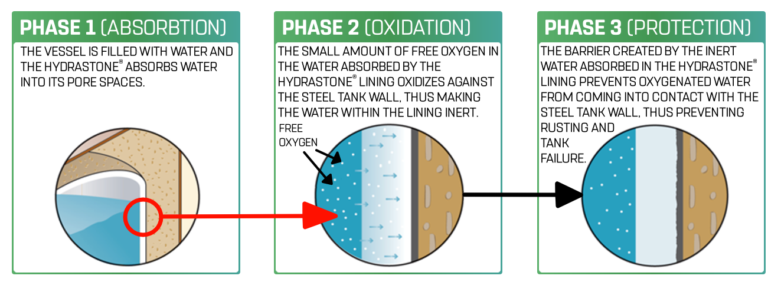
HYDRASTONE® LINING

Slide 18
BENEFITS OF HYDRASTONE® LINING
No water condition limitation
No temperature limitation
No dissimilar metals
No sacrificial anode rod required
Minimal maintenance needed
Allows for greater pressure tolerance and higher operating temperatures than glass lined tanks
28 years mean time before failures

Slide 19
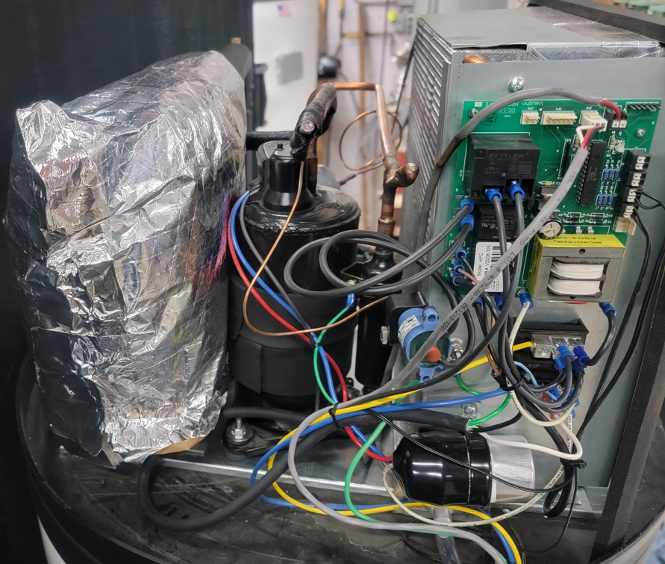
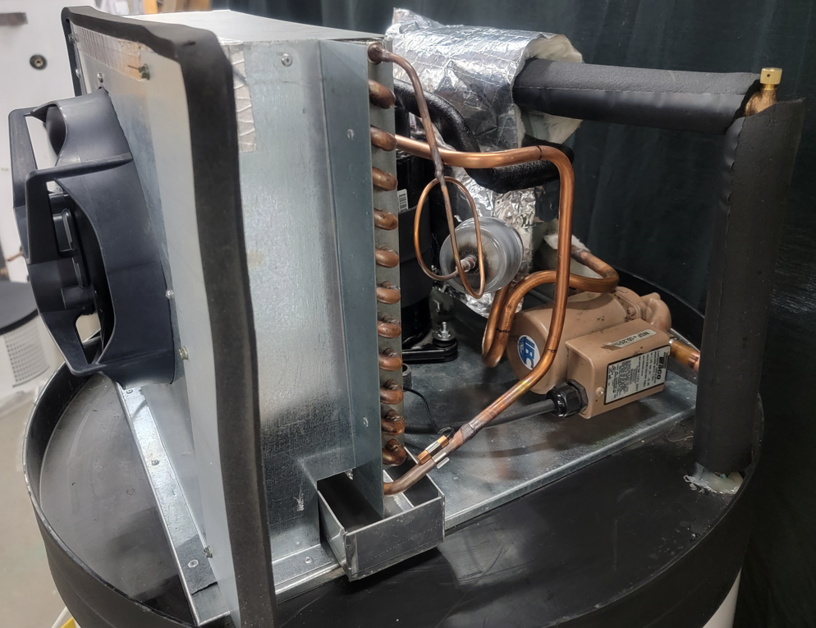
HEAT PUMP MAIN COMPONENTS
Heat Exchanger
Compressor
HPC
Fan
Evaporator
Air Bleeder Valve
Condensate
Sensor
High Limit
Reset
Condensate
Tube
Condensate
Collector
Defrost Sensor
Water Pump

Slide 20
INSTALLATION

Slide 21
GENERAL INSTALLATION INFO
Install location must have minimum dimension of 10' x 10' x 7' room (700 cubic feet of air space). If smaller, there must be a louver installed to provide sufficient airflow.
Make sure there is clearance above the unit to remove the top cover so the air can be bled from the bleeder valve.
Make sure there is clearance around the unit to allow for proper connection of the water lines and for ease of inspection/service in the future.

Slide 22
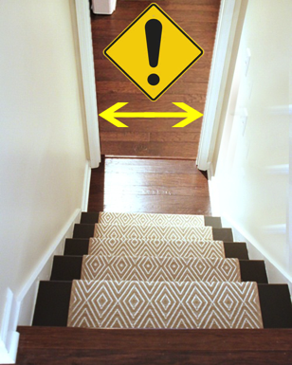
CLEARANCES
Measure ALL doorways to ensure the water heater will be able to fit through properly.
The door frame should NOT be included in these measurements.
Clearances:
50 gallon requires 26” minimum.
65 / 80 gallon requires 29” minimum.
120 gallon requires 31” minimum.

Slide 23
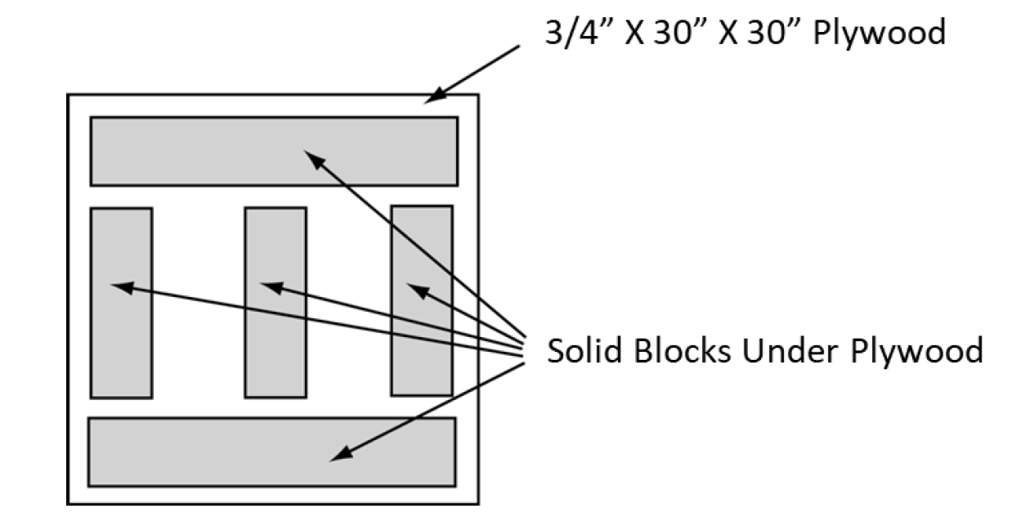
LOCATION
Do not place the heater where there is a risk of property damage in the event of a leak.
The heater should be protected from high temperature and from freezing.
If heater is placed on blocks to raise it from the floor, be sure to support the entire bottom with at least ¾" plywood on the top of the blocks.

Slide 24
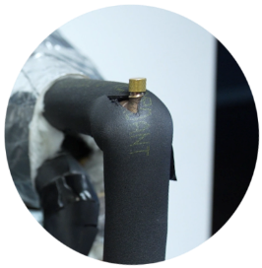
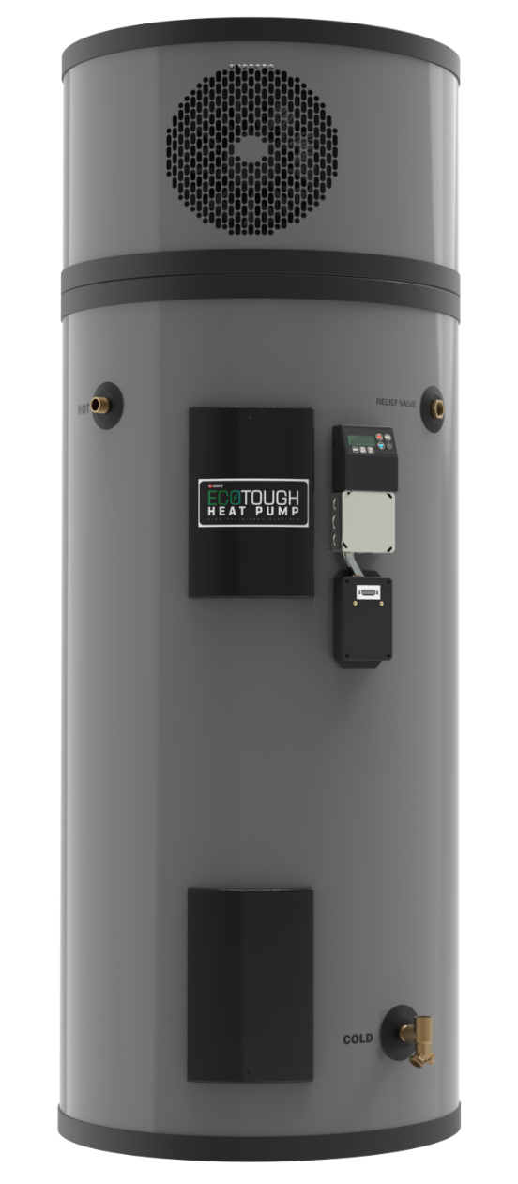
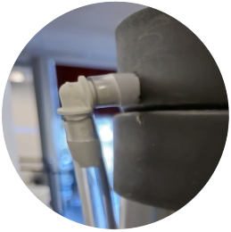
PLUMBING CONNECTIONS
Air Bleeder Valve
(Not Shown)
Condensate Removal Tube
(Not Shown)
Temperature and Pressure Relief Valve
Hot Water Outlet
Cold Water Inlet with Diffuser and Combination Drain

Slide 25
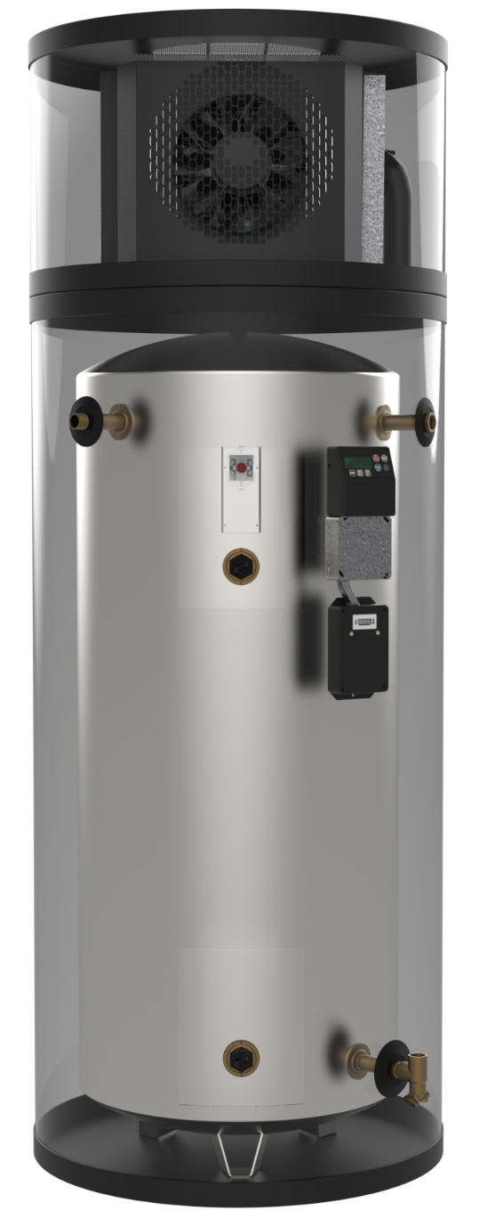
FILLING THE WATER HEATER
Completely close the drain valve.
Open the highest hot water faucet to allow all air to escape from piping.
Open the valve to the cold-water inlet and allow the heater and piping system to completely fill, as indicated by a steady flow of water from the open faucet.
Close the faucets.
Lift the top cover of the heat pump unit.
Carefully open the Air Purge Valve at the top of the heat pump unit to let air escape.
Fully tighten Air Purge Valve.

Slide 26
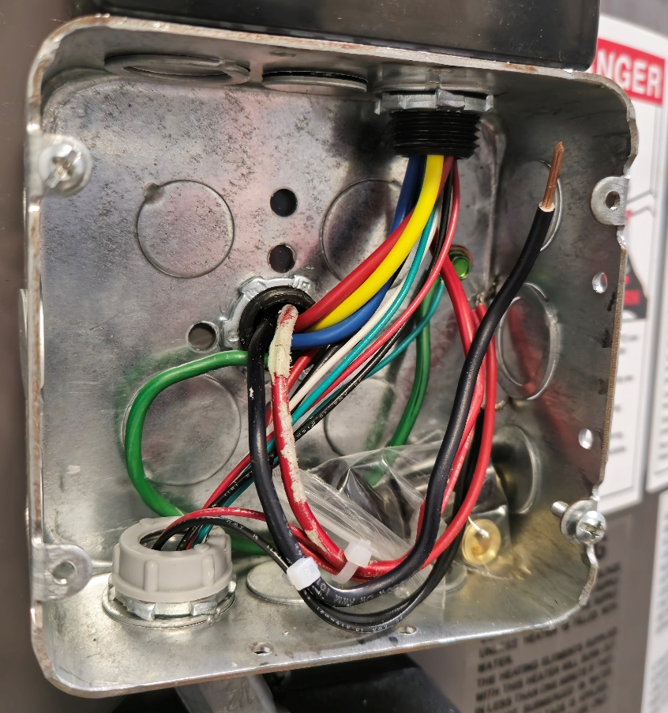
ELECTRICAL INSTALLATION
Use properly sized wire leads.
Connect the power leads to wires enclosed in junction box with the supplied wire nuts.
Connect the ground wire to the installed ground nut.
All other electrical connections are made at the factory; therefore, no other electrical connections are necessary.
*Note that overcurrent circuit protection is required. For the standard model, the overcurrent protection must be rated 25 amp minimum.

Slide 27
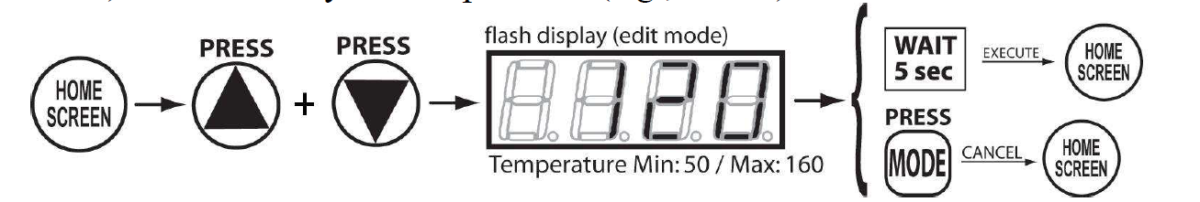
SETTING TEMPERATURE
From the home screen, press the ↑ AND ↓ buttons on the controller.
The setpoint temperature will flash quickly on the display.
The temperature is adjusted up or down as the ↑ or ↓ buttons are pressed.
Pressing and holding the ↑ or ↓ will allow fast scrolling through the temperatures.
Once the desired temperature setting has been reached, press the ↑ AND ↓ buttons to save the new setpoint. The setpoint will also be saved about 5 seconds after single button presses (not after fast scrolling).
Fully adjustable from 50° to 160°F

Slide 28
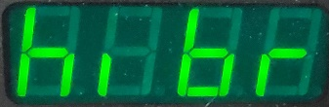
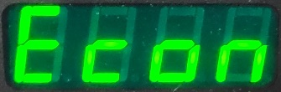
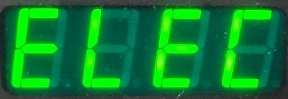
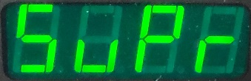
HPCM OPERATING MODES
HYBRID:
In Hybrid mode, the heat pump provides most of the heating capacity. The top electric element will be automatically switched on only when necessary to meet high demand situations. This is the default mode.
ECONOMY:
Economy mode allows only the heat pump portion of the unit to operate; the electric heating elements will not operate in this mode. This is the most efficient mode but may not meet high demand situations.
ELECTRIC:
Electric Mode disables the heat pump unit, allowing only the electric heating elements to heat the water in the tank.
SUPER:
Super mode allows either of the electric elements as well as the heat pump to function simultaneously, providing the fastest recovery option for the unit. This is the least efficient mode but provides the fastest heating rate high demand situations.

Slide 29

THANK YOU

