Slide 1
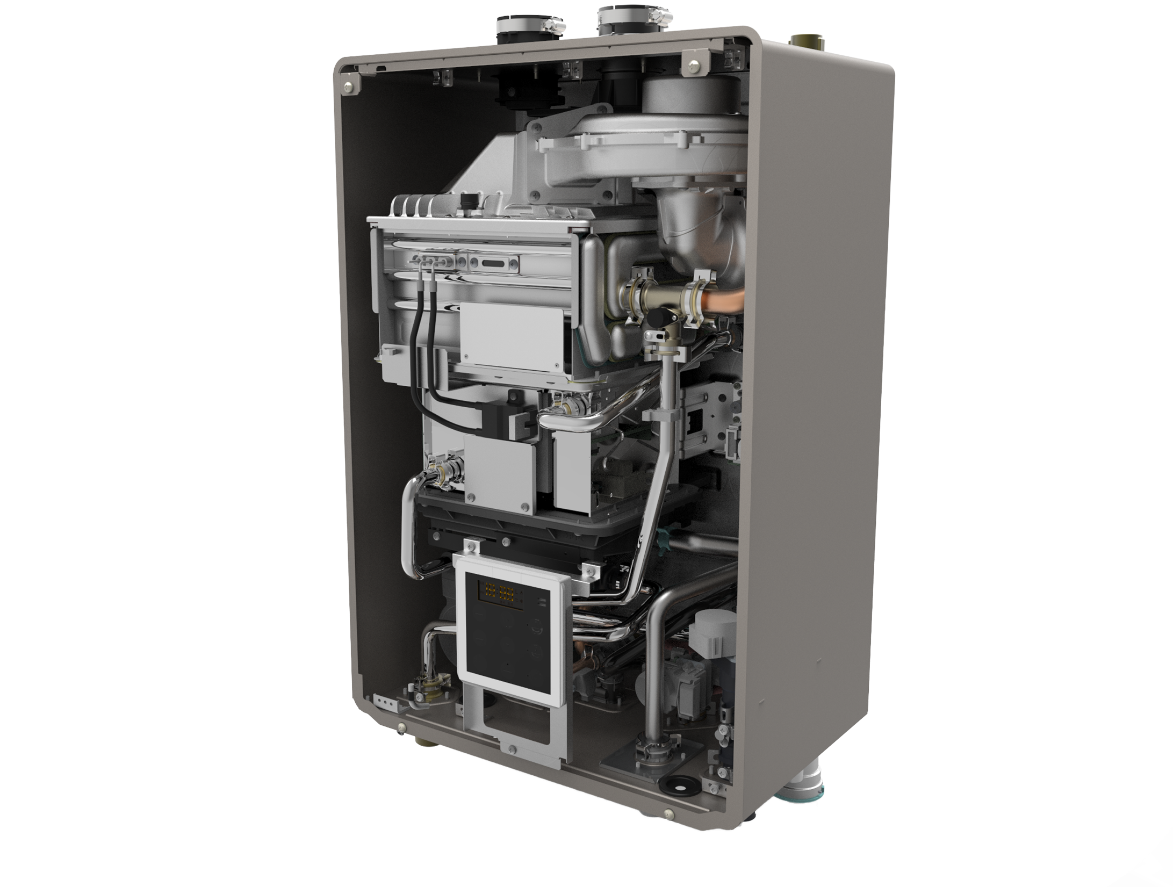
NRCB OVERVIEW
Introduction to the NRCB

Slide 2
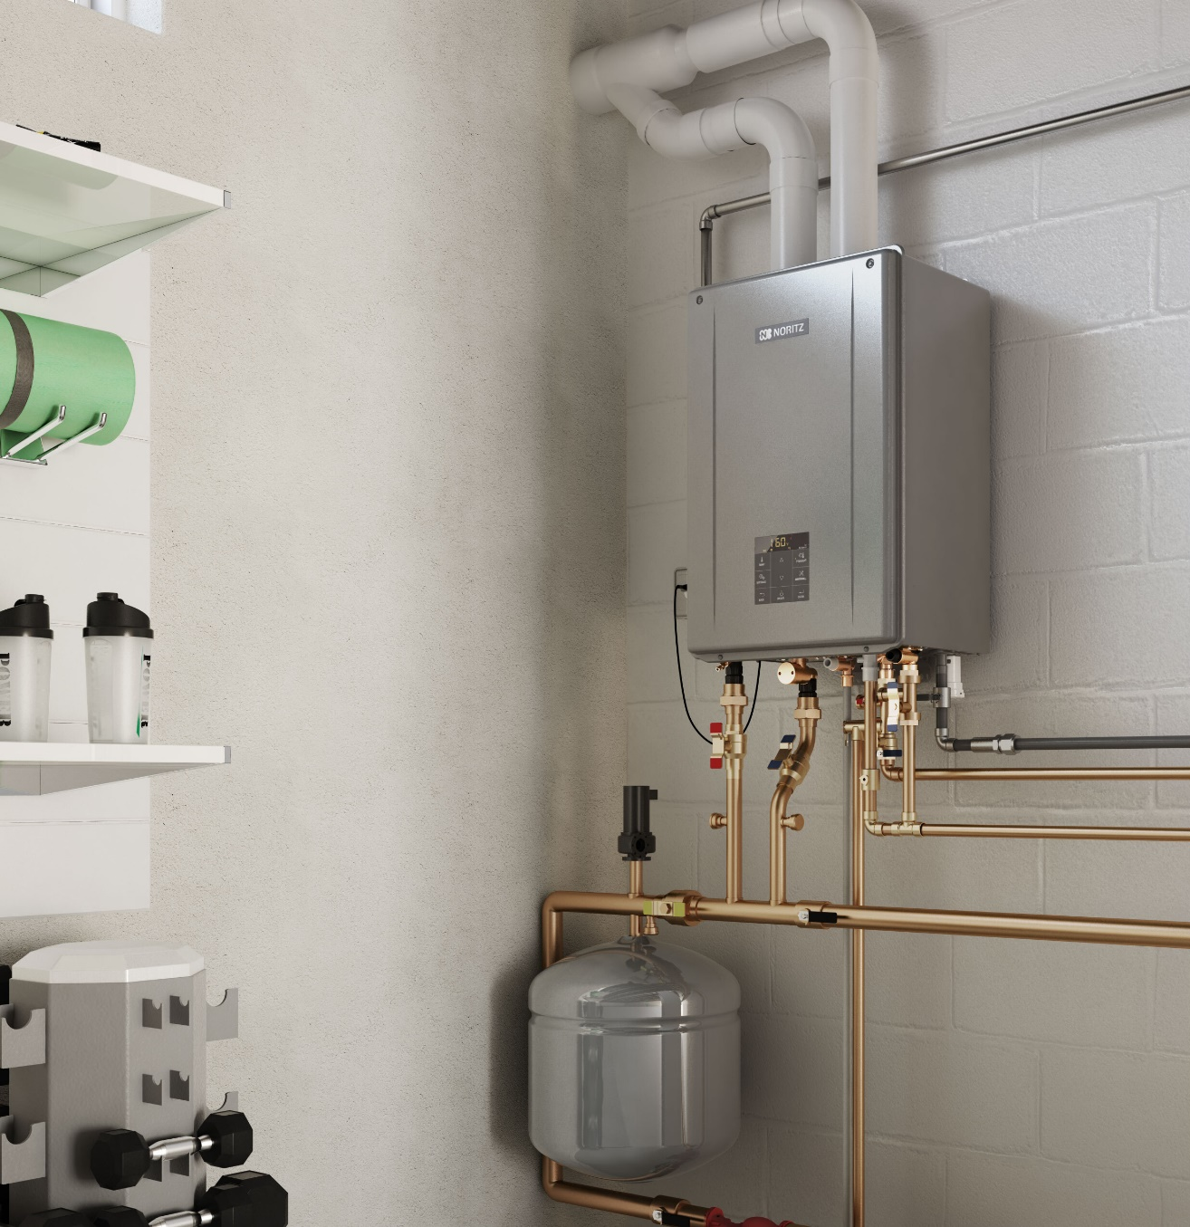
INTRODUCTION
Specifications
Key Features
Installation
Mounting Bracket
Venting
Water Connections
Water Treatment
Dip Switch Settings
Electrical Wiring

Slide 3
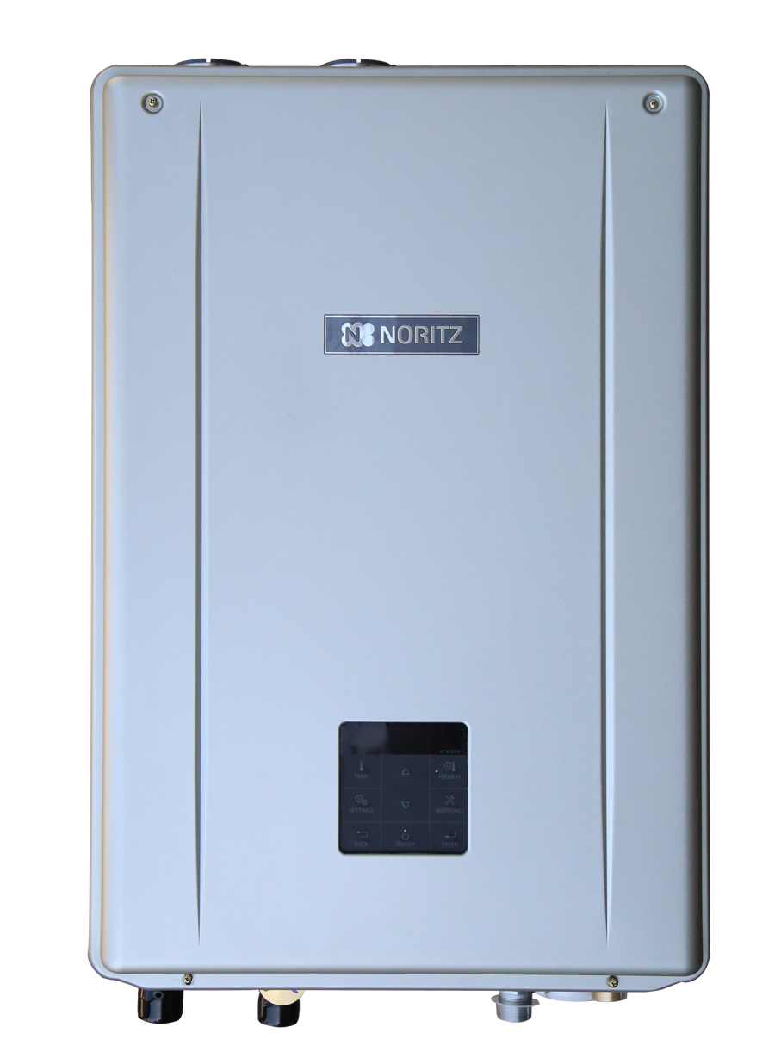
SPECIFICATIONS
Models | NRCB180DV / NRCB199DV
Standard Gas Input | Min: 18k Max: 180k / Min: 18k Max: 199k
Heating Gas Input | Min: 18k Max: 100k / Min: 18k Max: 120k
DHW Flow Range | 0.4 – 9.8 GPM / 0.4 – 11.1 GPM
AFUE | 95%
DHW Burner Off Flow | 0.29 GPM
Heating Temp Range | 100F – 180F (As low as 80F with setting)
DHW Temp Range | 90F – 140F
Simultaneous Heating & DHW | YES
Max Elevation | 10,000 feet
Wifi Compatible | YES
Quick Connect Capable | YES (With same BTU EZ Unit)
Outdoor Temp Sensor | INCLUDED
Warranty | 10 Year HEX, 5 Year Parts, 1 Year Labor

Slide 4
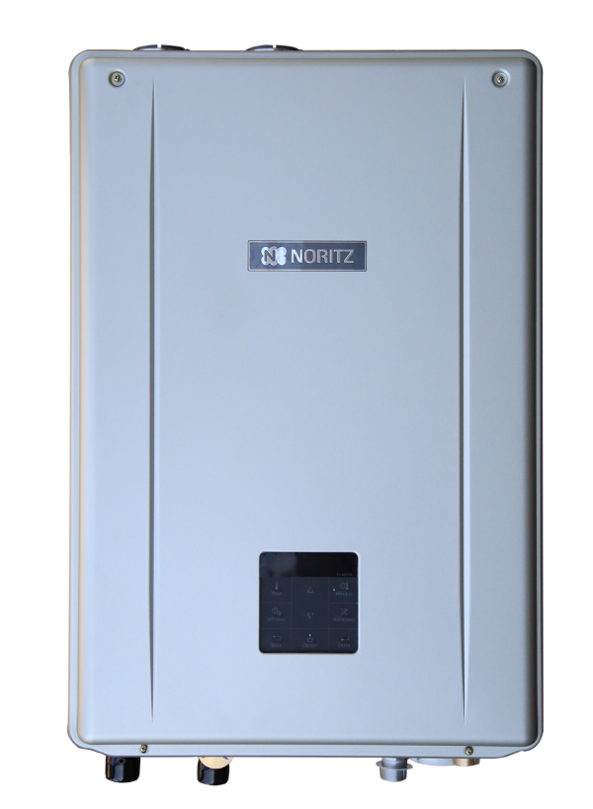
KEY FEATURES
Simultaneous Operation of DHW & Heating
Quick Temperature Control and Stability
High DHW Flow Rates
Notes:
Since Noritz started out as a water heating company our focus has always been providing the best, most comfortable and reliable DHW products on the market. We have taken all of that technology and experience and put it into our combi boiler to provide the best of both worlds in one product: the NRCB. It features Simultaneous operation of heating & DHW: no other product offers that. Because we were a water heating company first, the NRCB has the same level of temp control and stability you’re used to with our DHW tankless products. Finally, the NRCB offers the same DHW flow rate capability as a similar btu tankless water heater: something our competition can’t do.

Slide 5
SIMULTANEOUS OPERATION
Most Competitor’s 3-way Valve:
Either heating or DHW.
Hot Water
Hot Water
Heating
DHW
Heating Position
DHW Position
Notes:
Here we see a simple representation of the 3-way valve in competitors' products. Note that it can only move between heating and DHW positions meaning you can only have one or the other operating at a time.

Slide 6
SIMULTANEOUS OPERATION
NRCB 3-way Valve:
BOTH heating and DHW!
Hot Water
Hot Water
Hot Water
Heating
Heating
DHW
DHW
Heating
DHW
Heating
DHW
Heating Position
Simultaneous Position
DHW Position
Notes:
Now take a look at the VARIABLE 3-way valve in the NRCB. No longer does the customer have to make the sacrifice of having either heating or DHW, they can have both at the same time! Now, keep in mind the heating set temp does need to be at least 30 degrees above the DHW set temp for simultaneous operation to work. You couldn’t have a DHW temp of 120 and a heating temp of 110 and have simultaneous work. Luckily we have a feature that’s called expanding simultaneous operation that will allow the unit to raise the heating set temp up to 30 degrees above it’s normal set temp to allow for simultaneous to work. This is done by turning on dipswitch #2 on the circuit board. However you the installer needs to be aware of the heating systems temperature limitations and make sure it can handle a 30 increase in temp without damaging anything.

Slide 7
QUICK TEMP CONTROL & STABILITY
Overshoots OVER 10°F
ONLY 1°F Overshoot
 | Hot Water Speed |  | Overshooting Temperature
 | 110°F | 120°F
NRCB | 19 sec | 23 sec | 1°F
Competitor | 32 sec | 35 sec | 10°F
Notes:
Here we can see how quickly the NRCB gets to temp as compared to a competitor's product. In this example the heating side is not in operation and a DHW faucet of 2gpm is opened with a set temp of 120.

Slide 8
QUICK TEMP CONTROL & STABILITY
OVER 140°F for MORE than 30 sec.
Overshoots OVER 30°F
NO Temp Spike
NO RISK of ever reaching dangerous scalding temperatures while heating
 | Overshooting
 | Temp
NRCB | 0°F
Competitor | Over 30°F
Competitor REQUIRES an additional external thermostatic mixing valve for improved temperature stability
Notes:
Now let’s take this a step further. In this example the heating system is running and set to 180 F, the highest temp possible. While the unit’s are running a DHW demand of 2gpm is created and once again the temp is set to 120. When the fixture is opened the competitor races to 120…. And well beyond!! It reaches 150 F before it realizes that it’s way too hot and starts to lower the output temp.. But it still maintains over 140 F for more than 30 seconds! That’s why the competitor requires an additional external mixing valve.

Slide 9
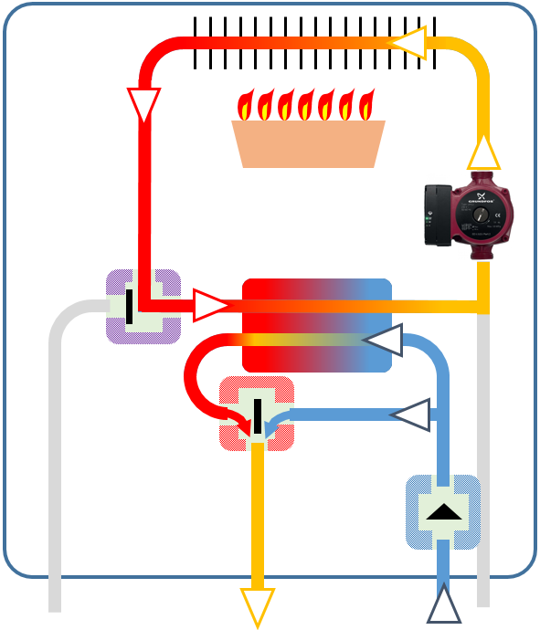
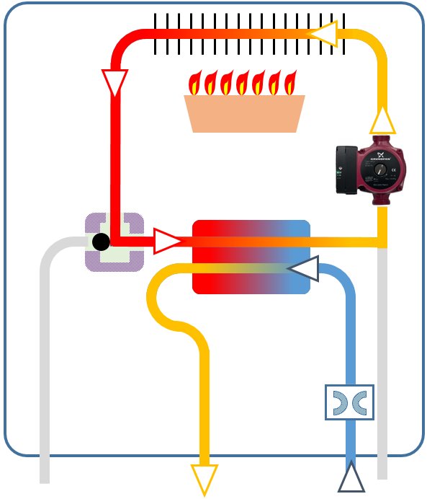
HIGH DHW FLOW RATES
 | NRCB | Competitor
Water Pathway
Flow Control | Variable | Fixed
Max GPM (199k btu Model) | 11.1 GPM | 5.6 GPM
Min Activation | 0.4 GPM | 0.5 GPM
Min Operation | 0.29 GPM | Not Mentioned
Bypass Control
Valve
Flow Control
(Variable)
Flow Restriction
(Fixed)
HOT
COLD
HOT
COLD

Slide 10
INSTALLATION

Slide 11
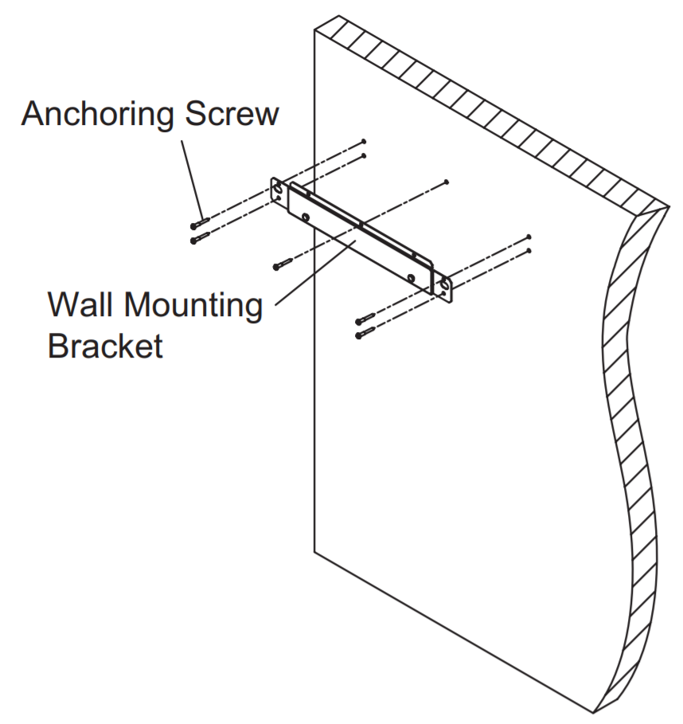
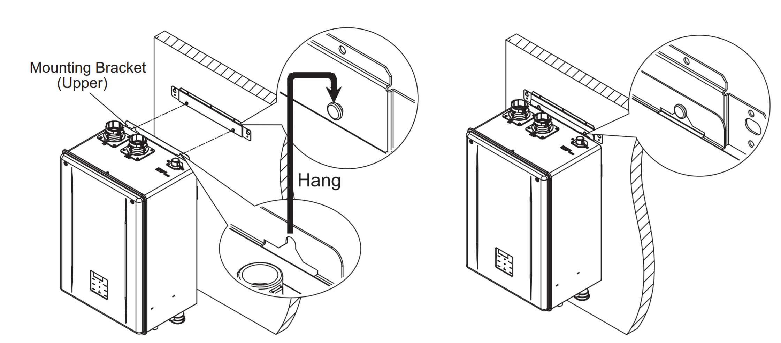
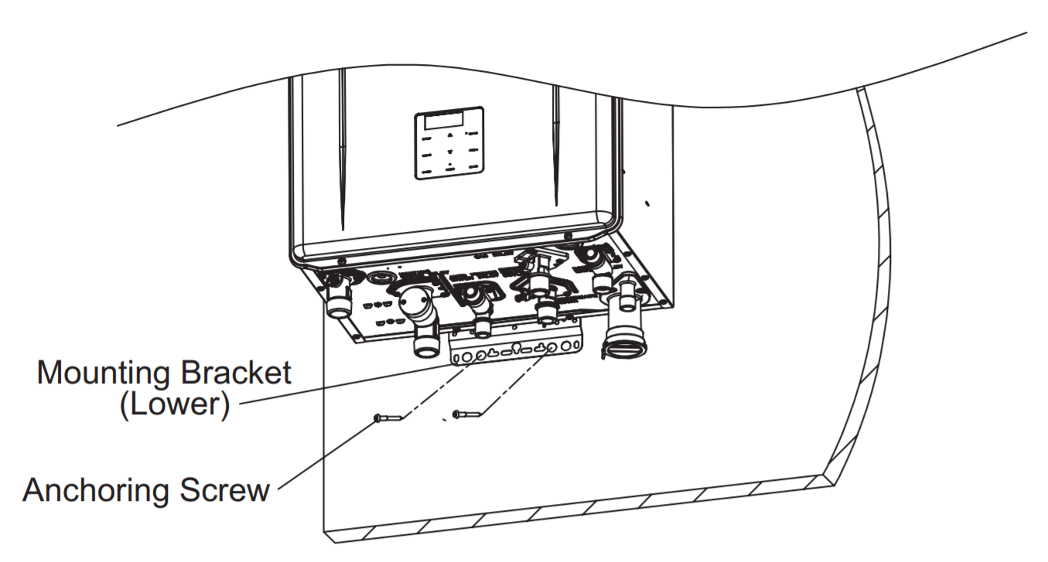
MOUNTING BRACKET
1. Mount the Bracket
2. Hang the Heater
3. Secure the Heater

Slide 12
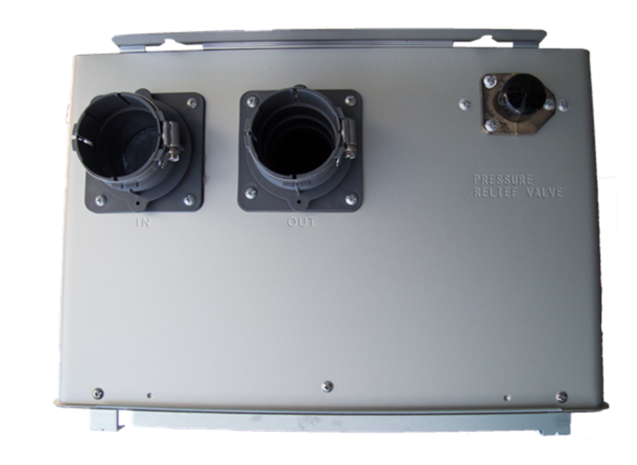
VENTING
Intake
Exhaust
Pressure Relief Valve
DV or SV capable.
2” or 3” PVC/CPVC or PP
Up to 60ft w/ 2” or 100ft w/ 3”

Slide 13
BOTTOM CONNECTIONS
Heating Water Outlet (Supply)
Auto Feeder Water Inlet
Cold Water Inlet
(DHW)
Heating Water Inlet (Return)
Hot Water Outlet
(DHW)
Condensate Drain
Gas Inlet

Slide 14
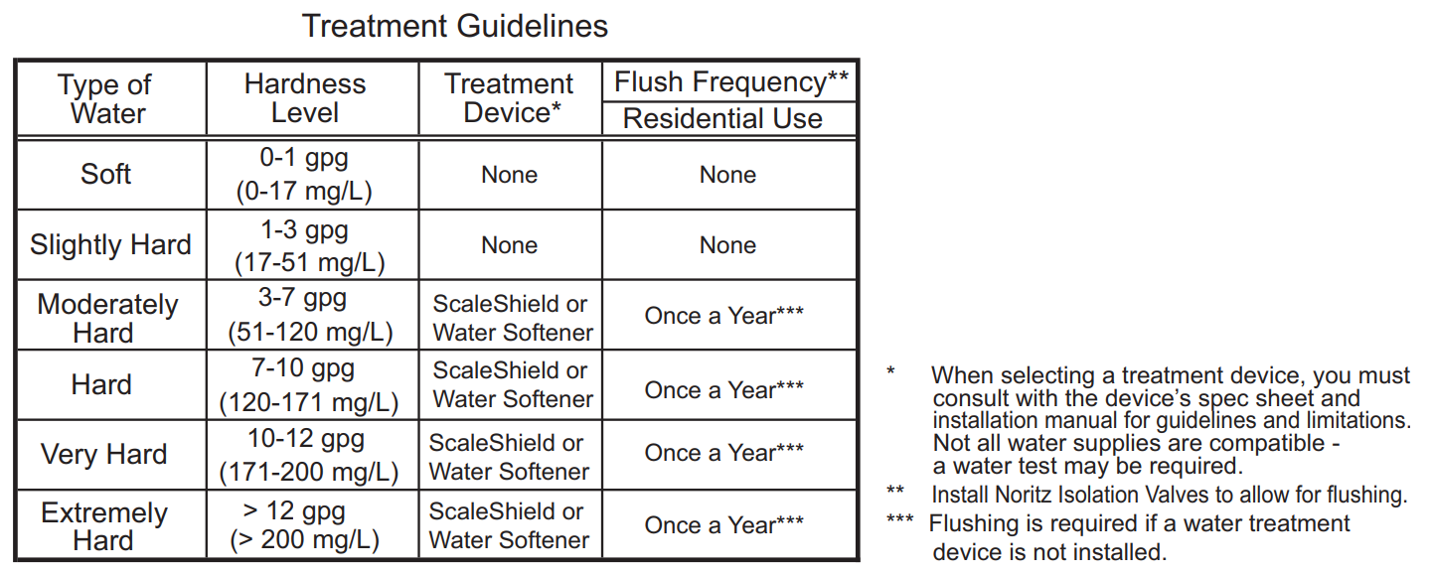
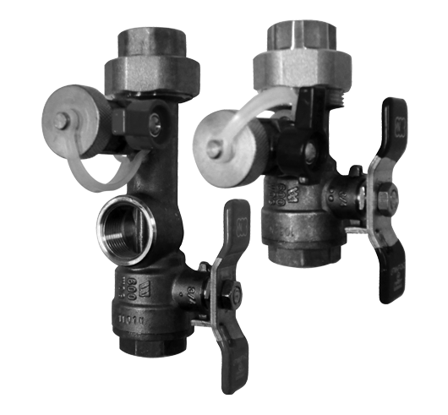
WATER TREATMENT
Water Quality Guidelines in the Installation Manual should always be followed.

Slide 15
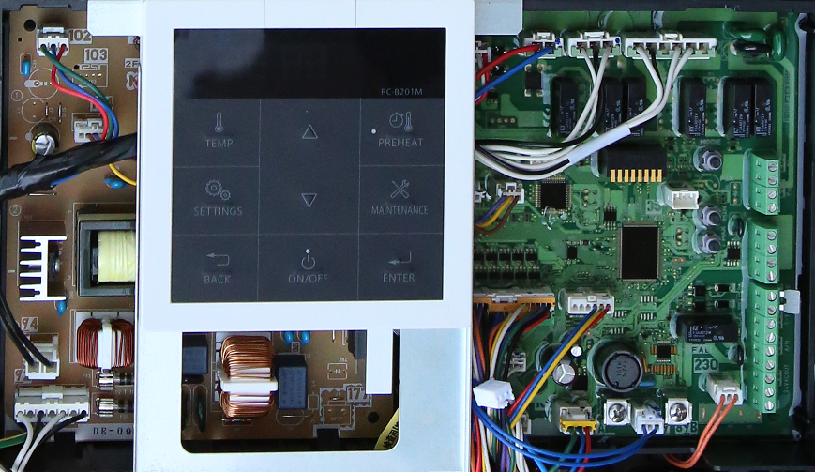
DIPSWITCH SETTINGS
Set up the unit for expanding simultaneous, vent type, elevation, vent length and size.
SW1 | SW2 | SW3 | SW4 | SW5 | SW6 | SW7 | SW8
DO NOT USE | Simultaneous Use | Vent Type | DO NOT USE | Elevation Adjustment |  | Vent Length Adjustment and Vent Size
 | Normal* | DV* |  | 0 - 2,000 Feet* |  | 2” Short Length*
 | Expanding | SV |  | 2,001 – 4,000 Ft. |  | 2” Long Length
 |  |  |  |  | 4,001 – 7,000 Ft. |  | 3” Short Length
 |  |  |  | 7,001 – 10,000 Ft. |  | 3” Long Length
*Default Setting

Slide 16
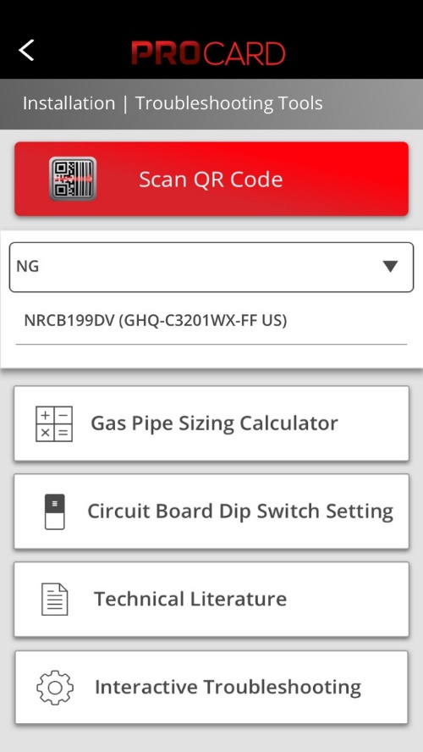
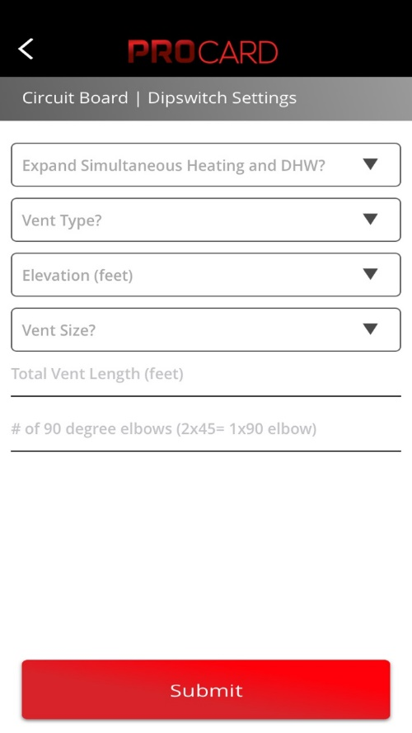
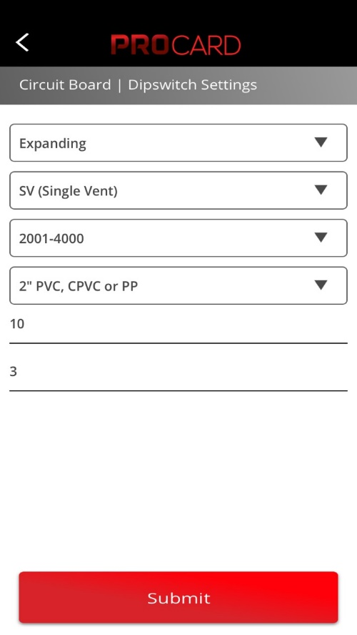
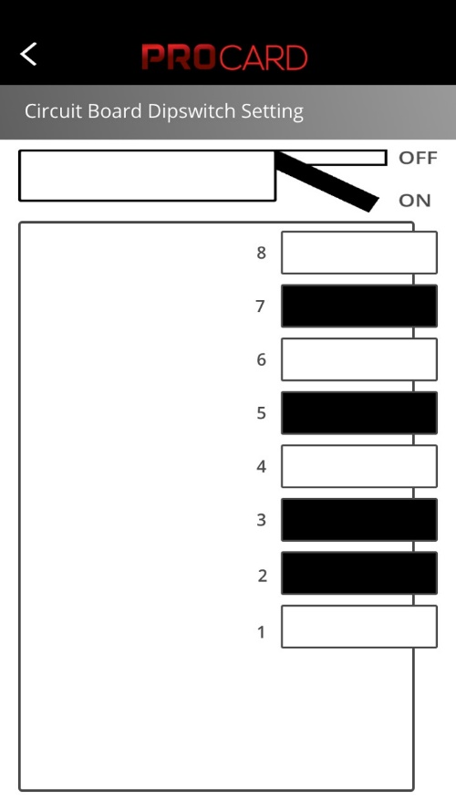
DIPSWITCH SETTINGS WITH PROCARD APP
Made simple using the PROCard APP!

Slide 17
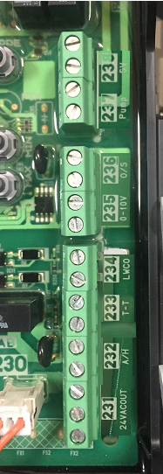
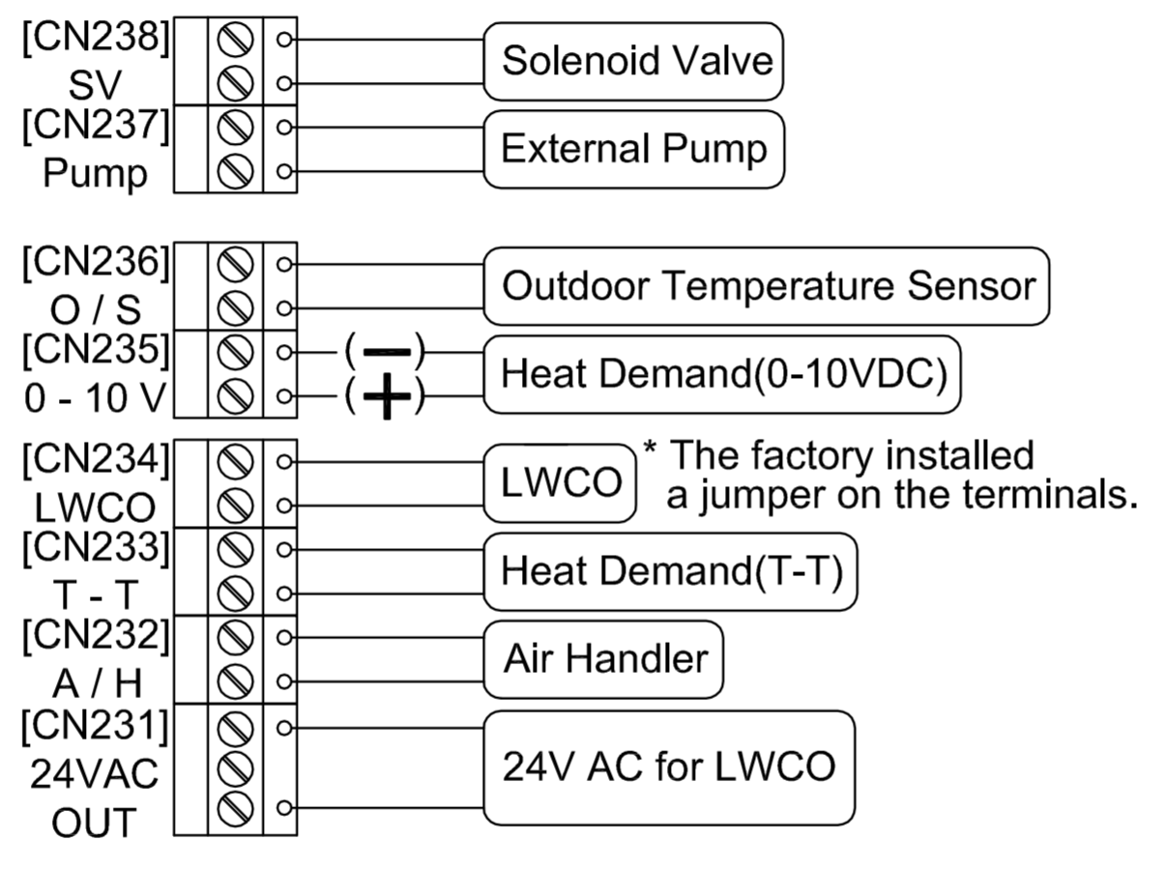
ELECTRICAL WIRING

Slide 18
THANK YOU

