Slide 1
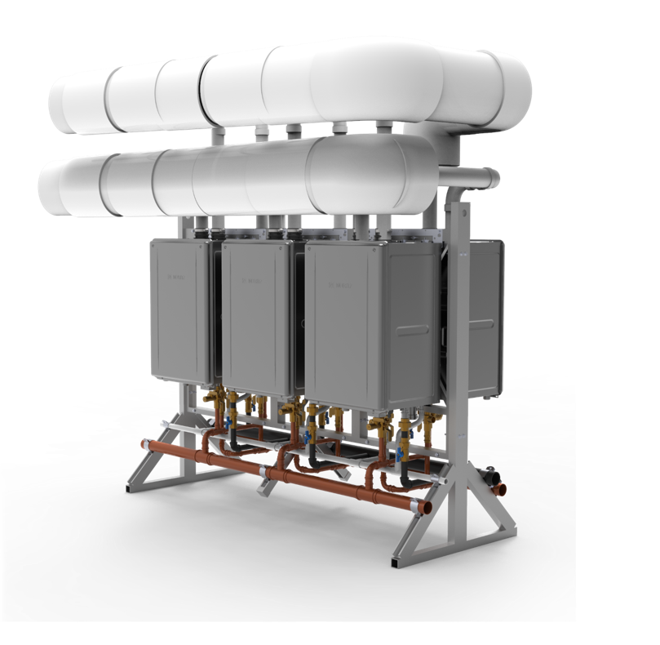

COMMON VENTING
NCC199CDV Next Gen TRUE Commercial Model

Slide 2


TRAINING AGENDA
NCC199CDV Features, Benefits & Vent Versatility
Commercial Rack Features & Benefits
CDV’s Vent Design and Install Practices
Common Vent Install Examples
Case Studies, Technical Docs & Resources
Trusted. Reliable. Unmatched. Efficient.

Slide 3
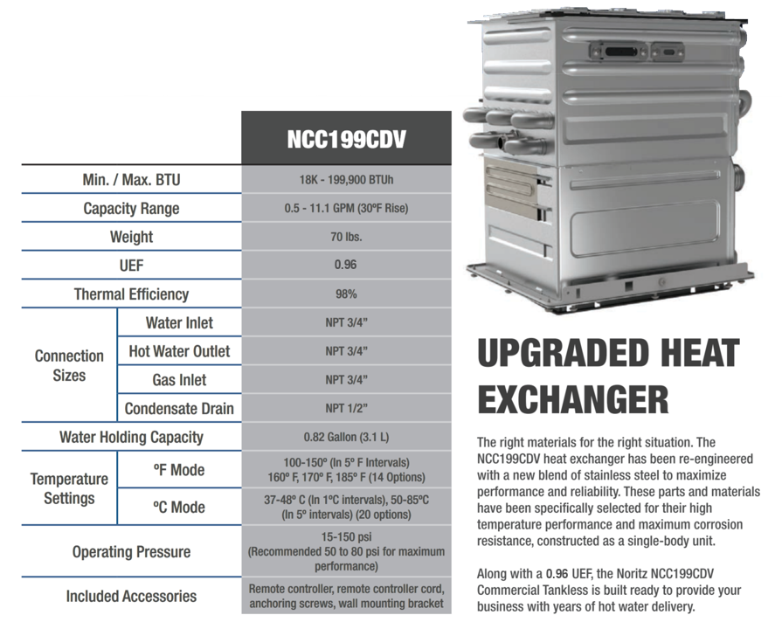
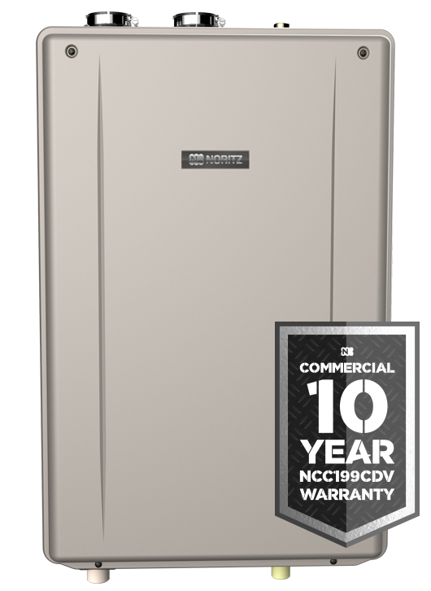
TECHNICAL SPECIFICATIONS

Slide 4
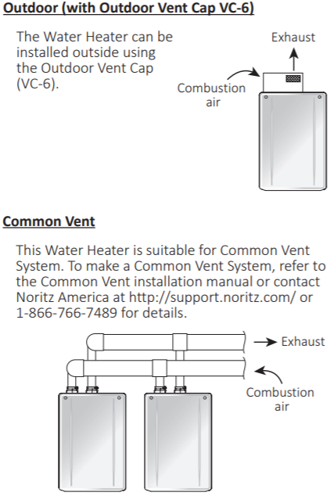
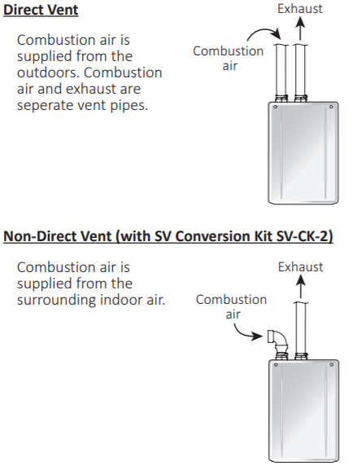

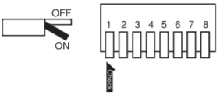
NCC199CDV VENT VERSATILITY

Slide 5
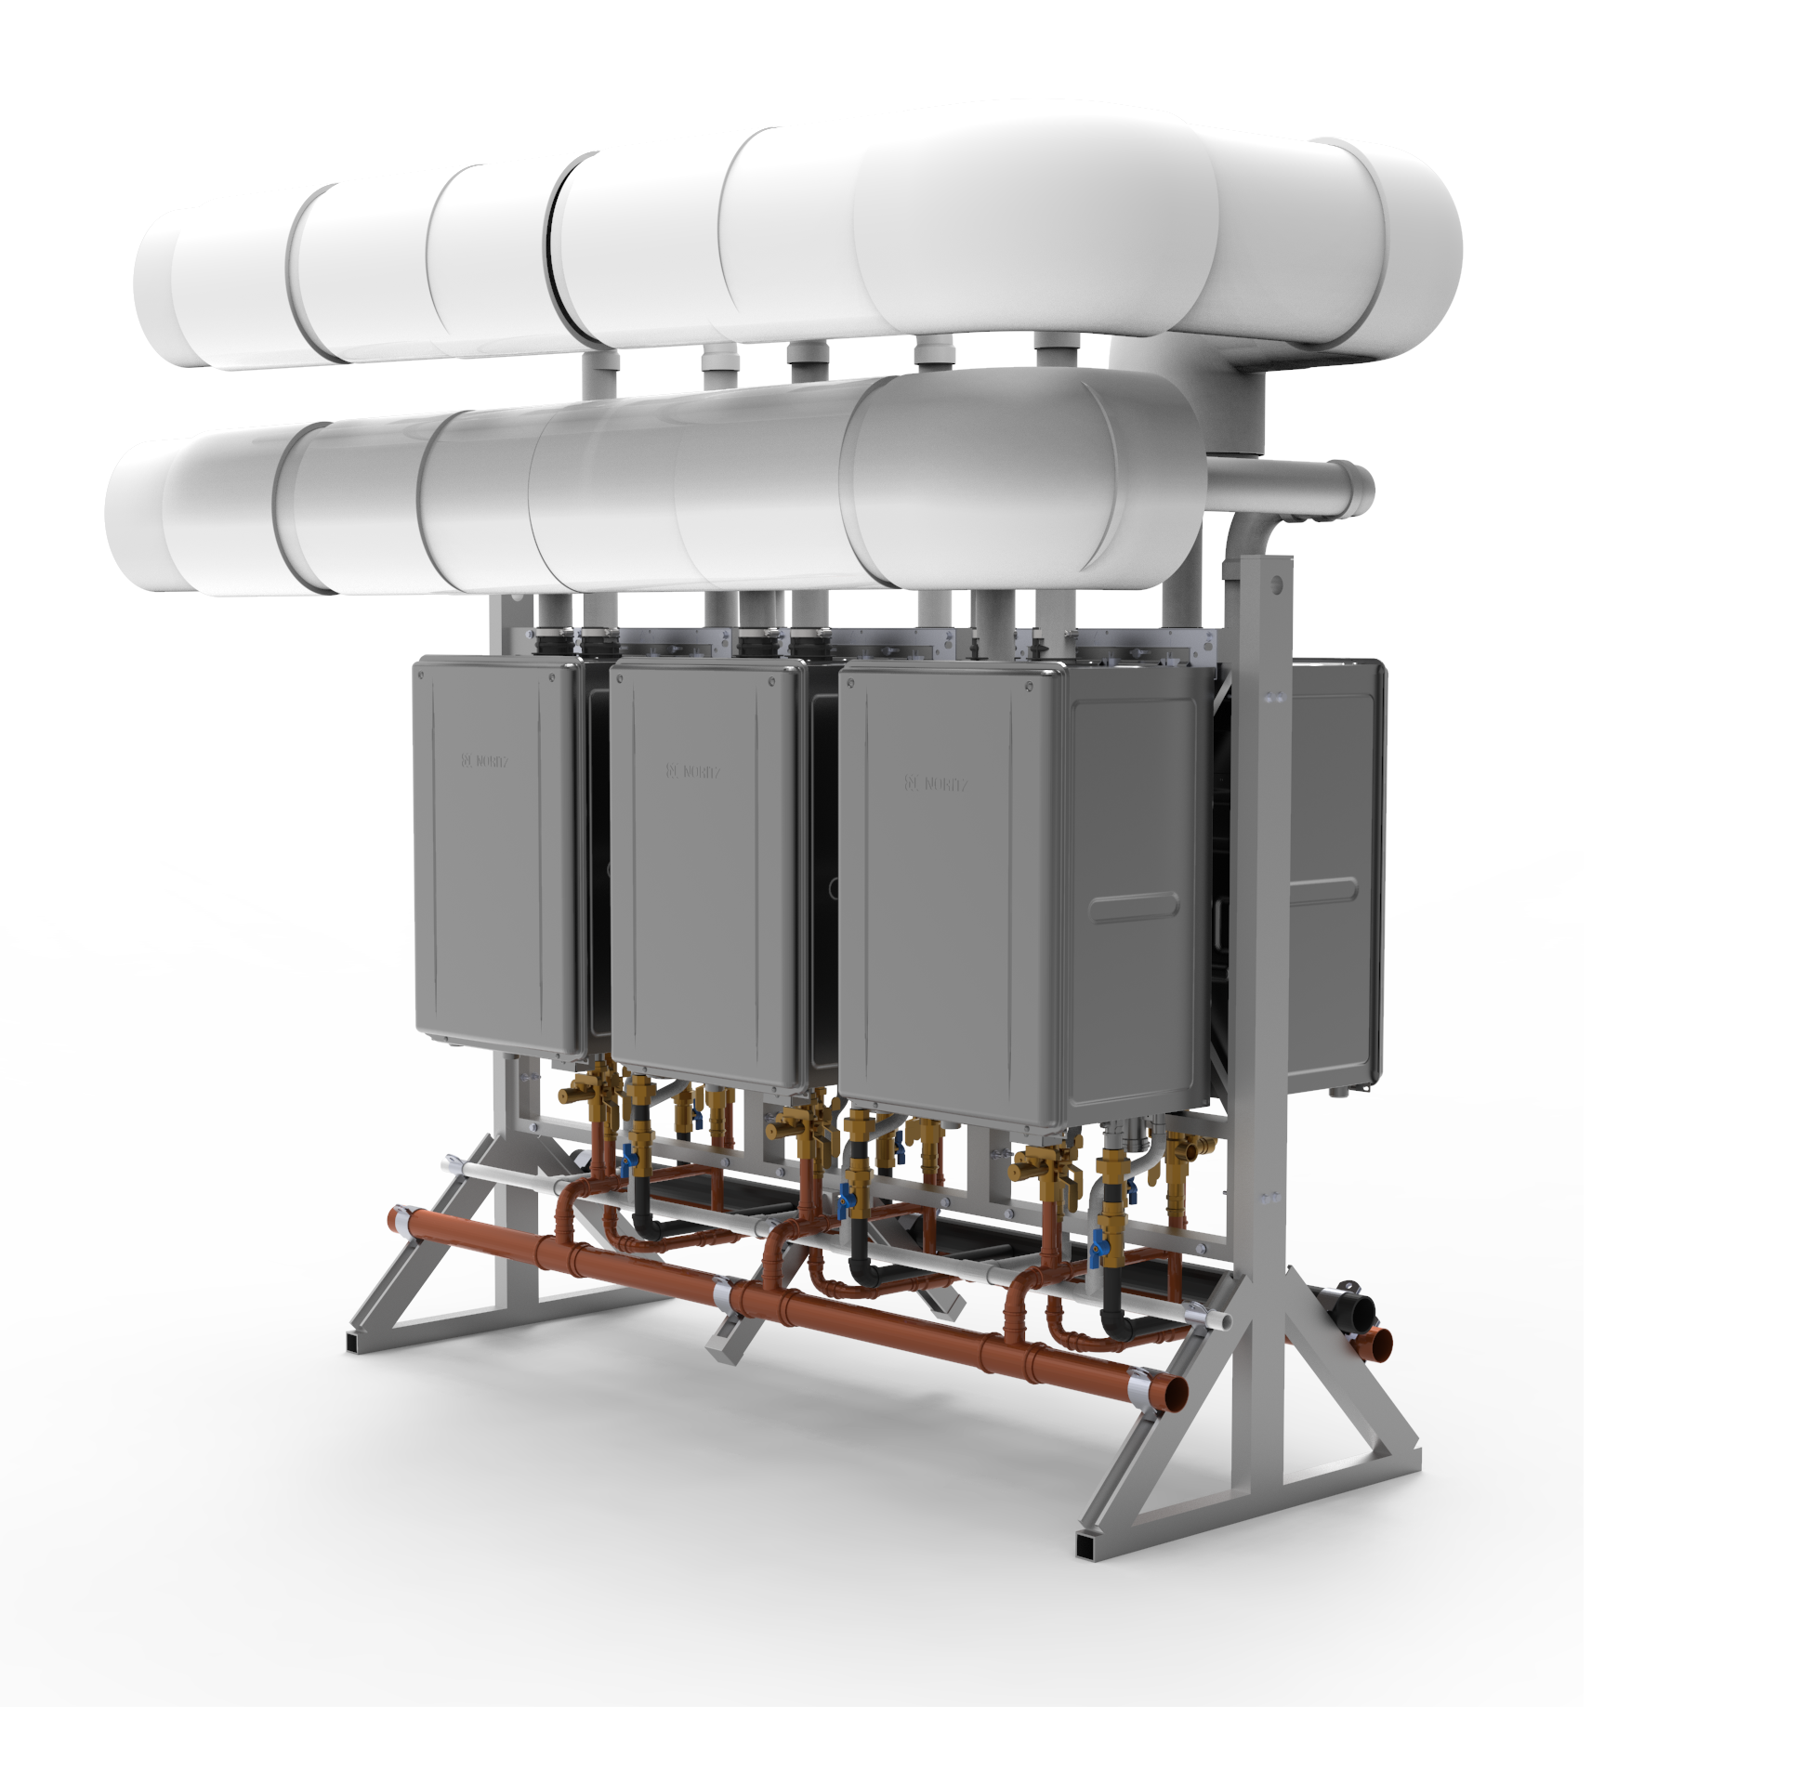
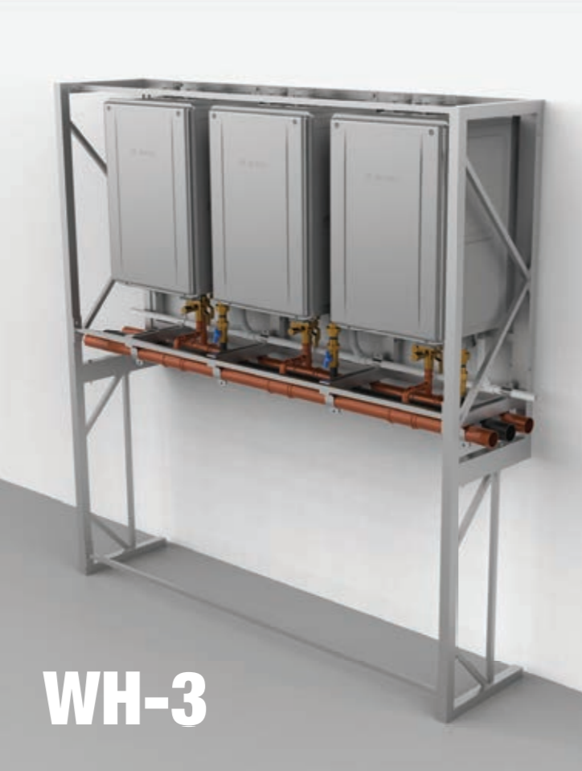

COMMERCIAL RACK SYSTEM
Upgraded for 2020, the Noritz CR Commercial Rack System (formerly CWHS) has been redesigned for maximum performance and ease of installation. A new low profile design and a variety of installation options make this new rack system ideal for business owners looking to replace outdated storage tanks.
NEW LOW PROFILE DESIGN
Lower profile design makes system less top heavy for safer transportation while also minimizing the rack system’s footprint.
REDUCED INSTALL TIME
An added PVC manifold condensate drain cuts installation time for a quicker setup.
NEW WALL MOUNT OPTION
Removable end rail stands for flexible location of rack when faced with existing lines above or below the heaters.
NEW MODULAR OPTION
With 2” manifolds for water and gas, our new design allows for expanding hot water demand with multiple commercial hot water systems.
INSTALLATION VERSATILITY
The new CR is designed for both indoor or outdoor applications. (Requires outdoor vent cap, item# VC-6)

Slide 6
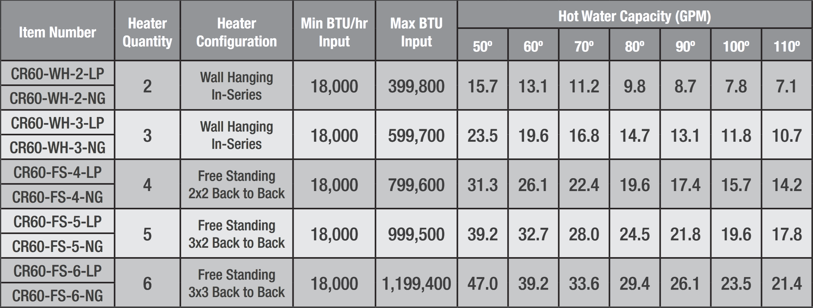
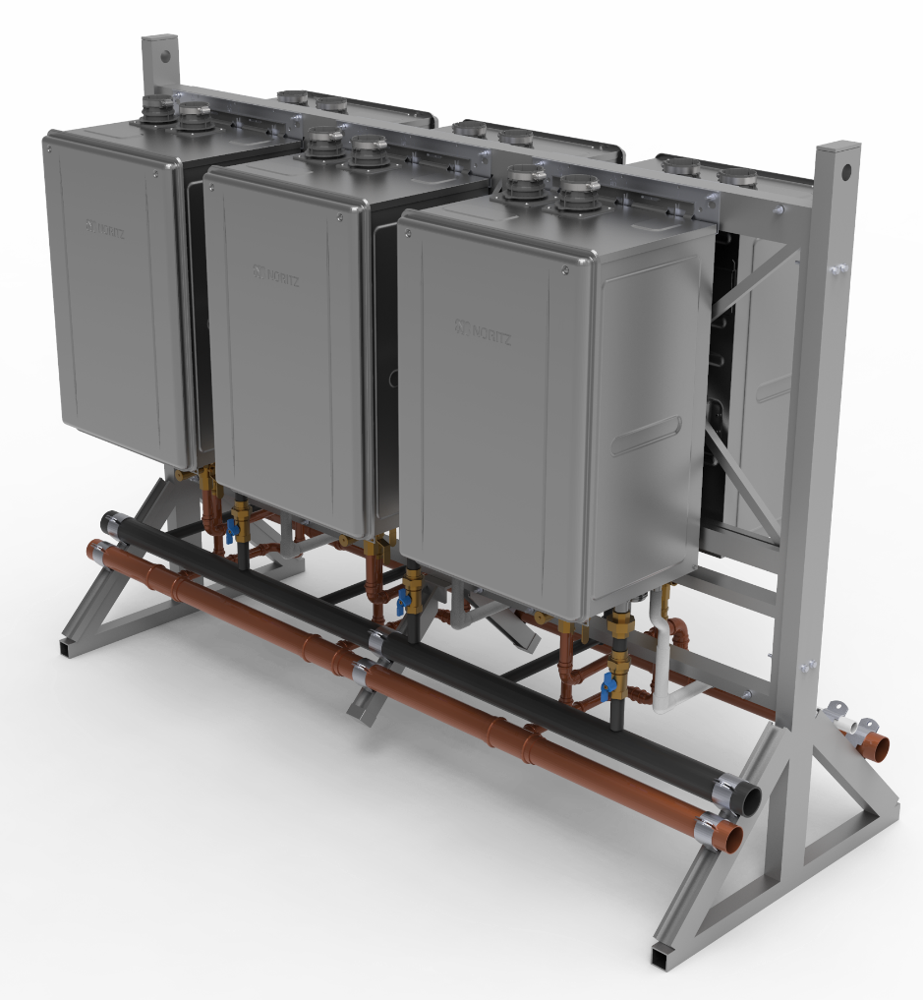
COMMERCIAL RACK SERIES (CR)
HOT WATER SUPPLY CAPACITY
INCLUDES:
NCC199CDV w/ 0.96 UEF (GQ-C3260WZ-FF US)
System Controller (SC-401-6M)
Remote Control Cord (RC-CORD-10)
2” Copper Manifold for Hot & Cold Water
2” Black Iron Manifold for Gas
3/4” PVC Manifold Condensate Drain
Aluminum Frames
Isolation Valves w/ PRV for Water
Gas Shut Offs
Serial Number Barcode tags
Individual Heater Number Label

Slide 7
COMMON VENTING
TRUE INSTALLATION FLEXIBILITY
With Noritz Common Venting, up to 6 Noritz Water Heaters are able to share the same venting system. This means significantly reduced penetrations through the wall or roof resulting in less labor and a cleaner finished look. The use of a larger vent diameter system allows for longer vent runs for larger and taller building – up to 200 ft. of equivalent length. The system is independently tested and approved for use by CSA in both the US and Canada. With the new built-in exhaust non-return valve, scalability of up to 6 heaters in possible now without an external non-return valve.
OFFERS A CLEAN, LABOR SAVING INSTALL WHILE ENSURING THE UTMOST IN SAFETY AND PERFORMANCE
Tested with safety in mind – each water heater uses a built-in non-return valve to prevent flue gas from entering idle units.
Reduces wall or ceiling penetrations.
Utilizes either ULCS-636 approved Polypropylene (PP) venting (capable of handling temperatures up to 230° F) or Schedule 40/80 PVC.

Slide 8
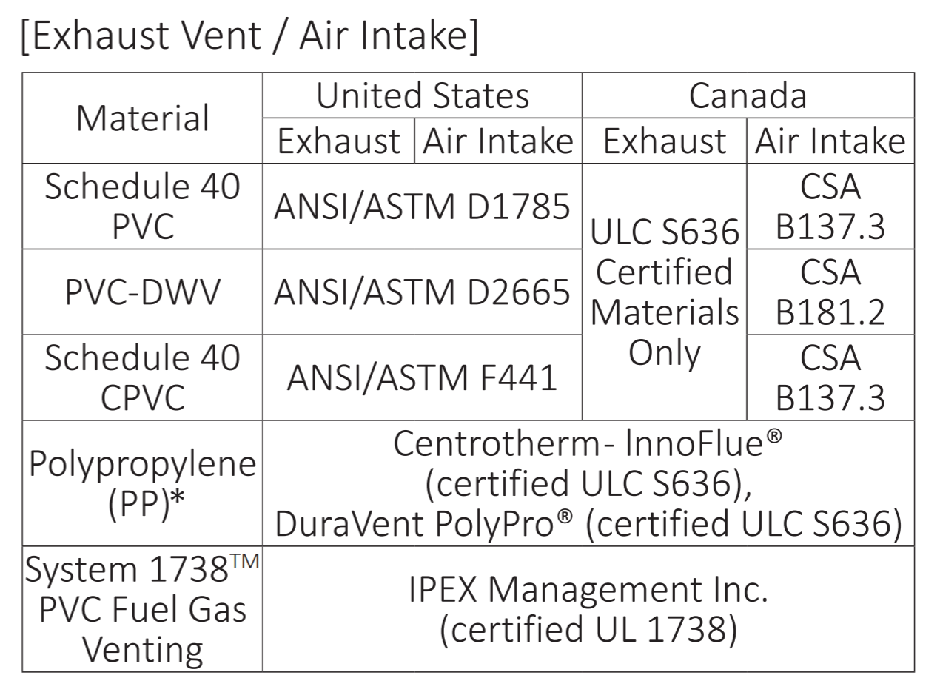
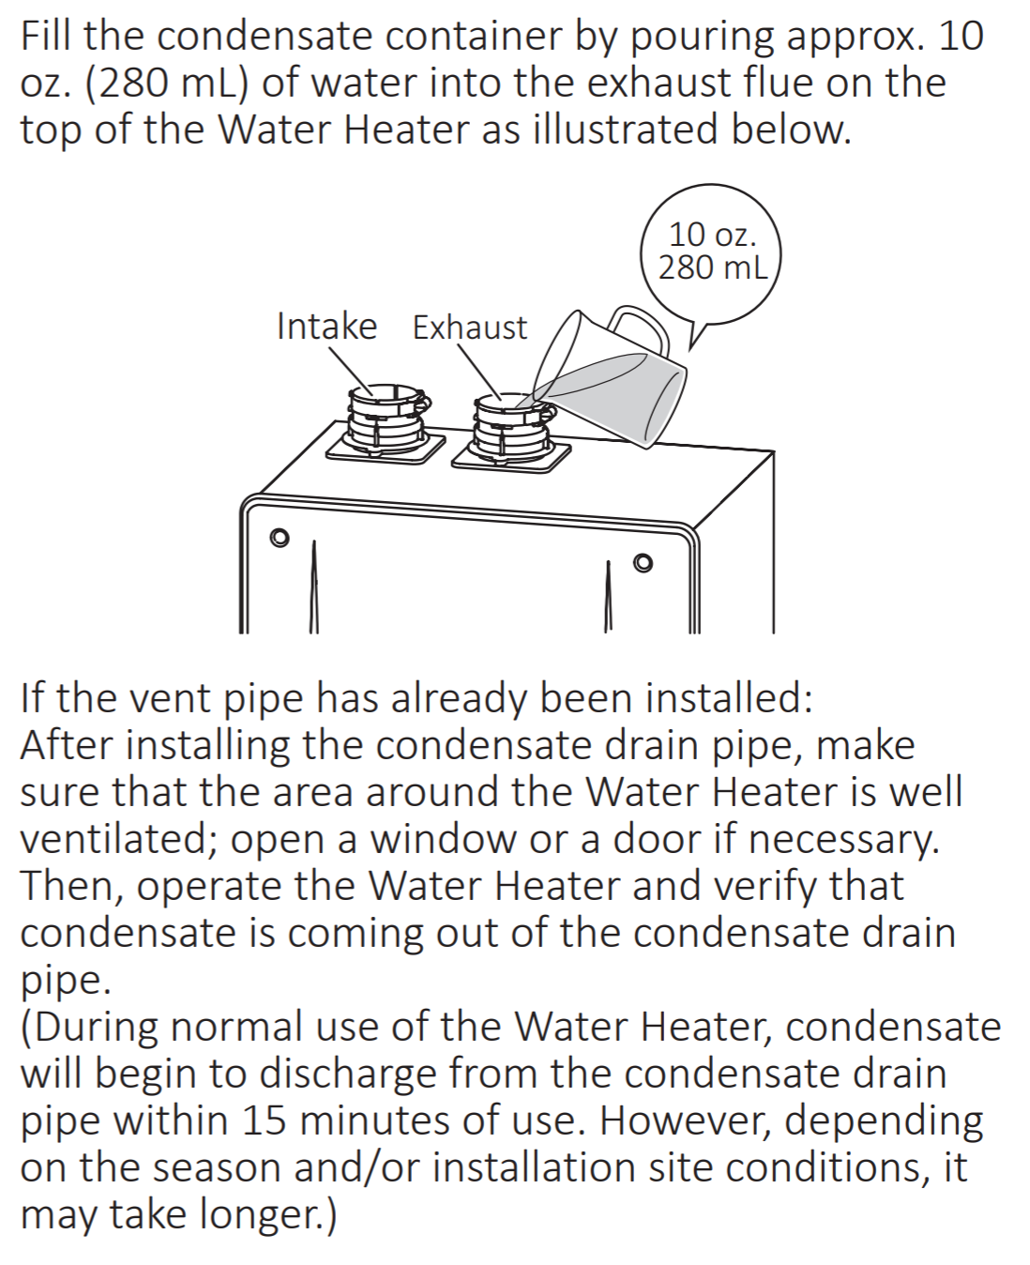
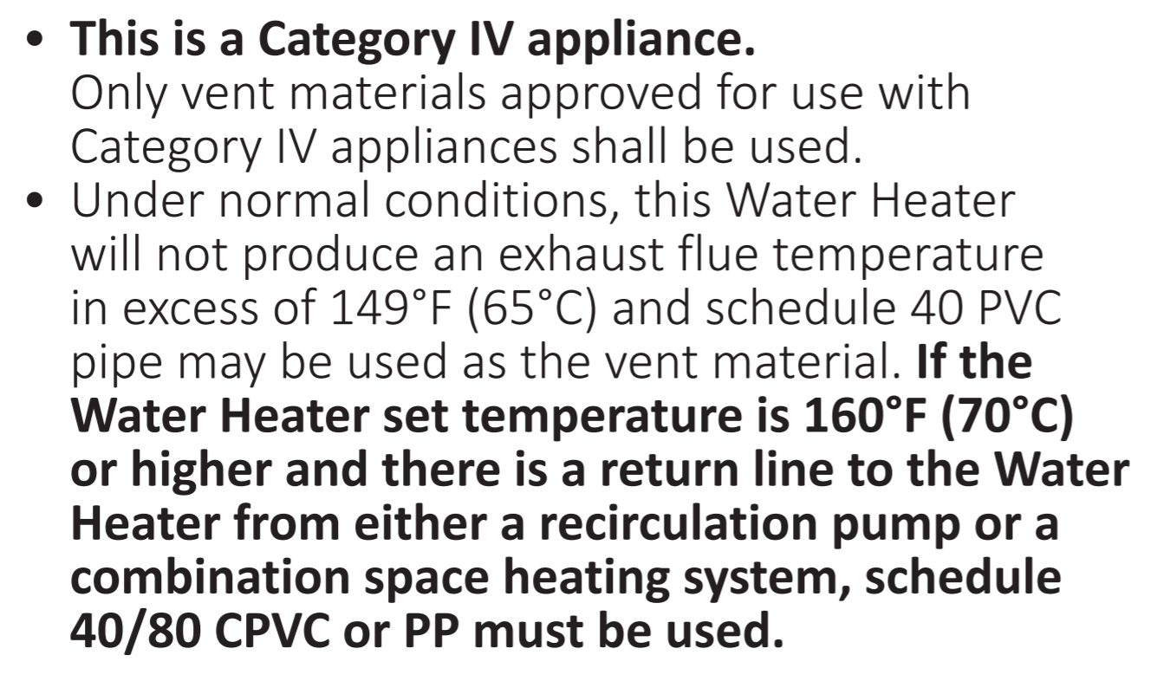
NCC199CDV VENT MATERIALS

Slide 9
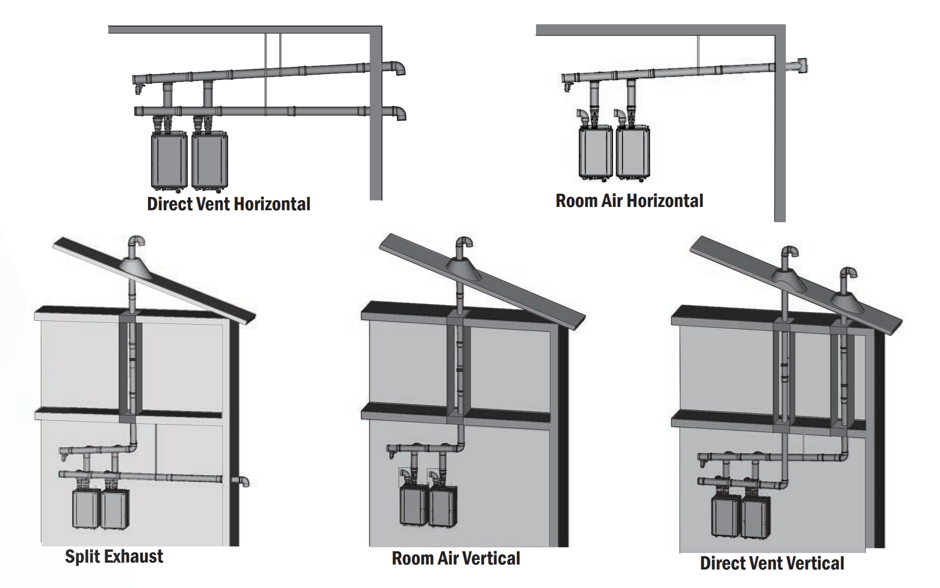
COMMON VENT OPTIONS
ULTIMATE FLEXIBILITY
Figuring out where to safely and efficiently route the exhaust system is one of the biggest hurdles for any HVAC system designer. Noritz Common Venting offers designers the most flexibility to decide how to safely and efficiently route the vent. For room air installations, the combustion air can be drawn from the room environment, further reducing the installation complexity, by requiring only a single penetration for the exhaust.

Slide 10
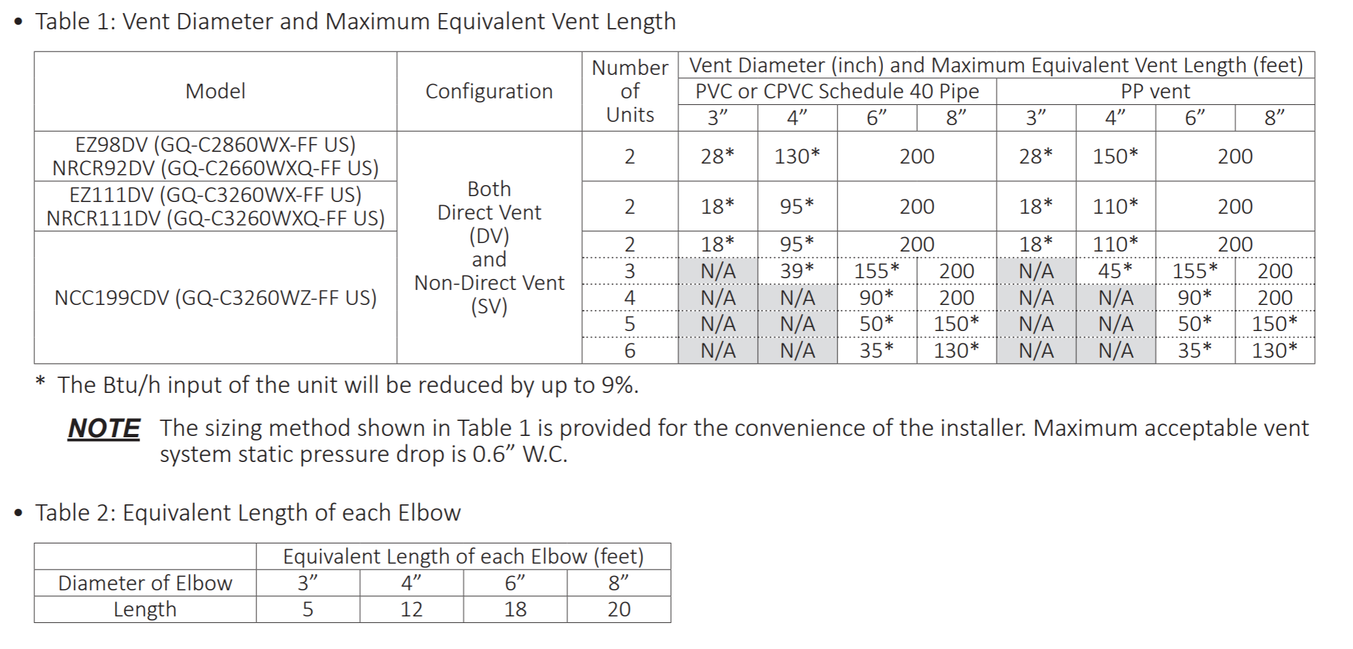
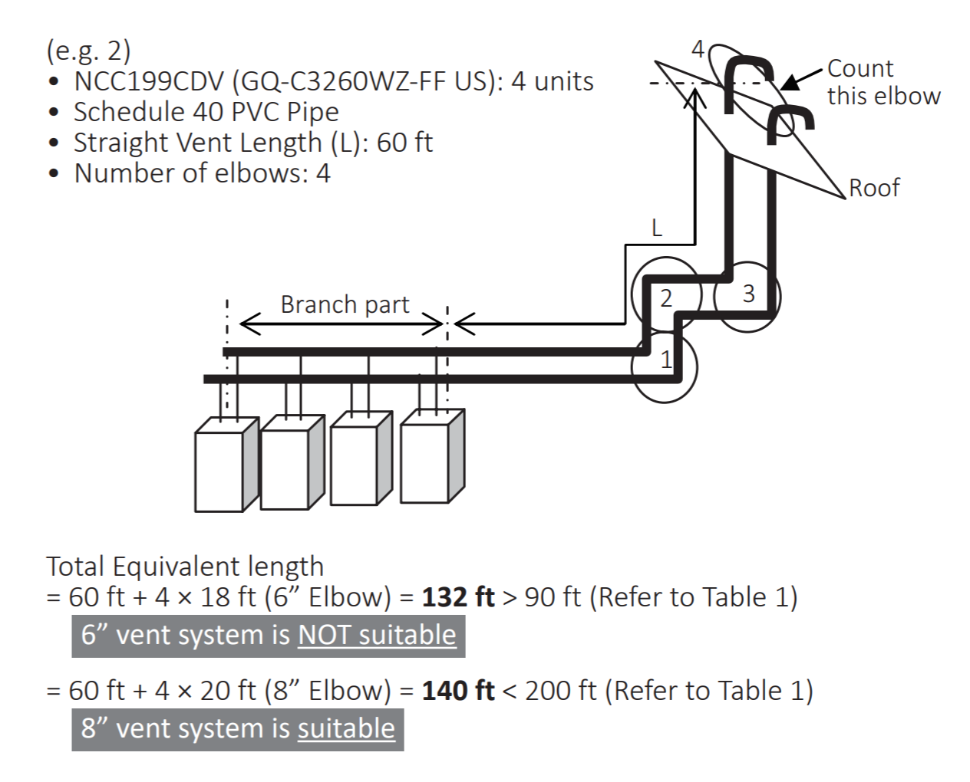
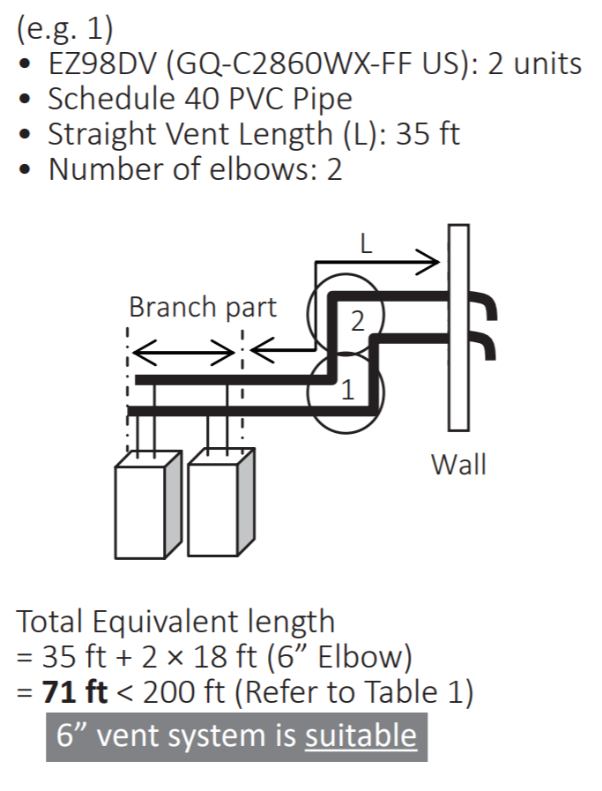
COMMON VENT LENGTHS

Slide 11
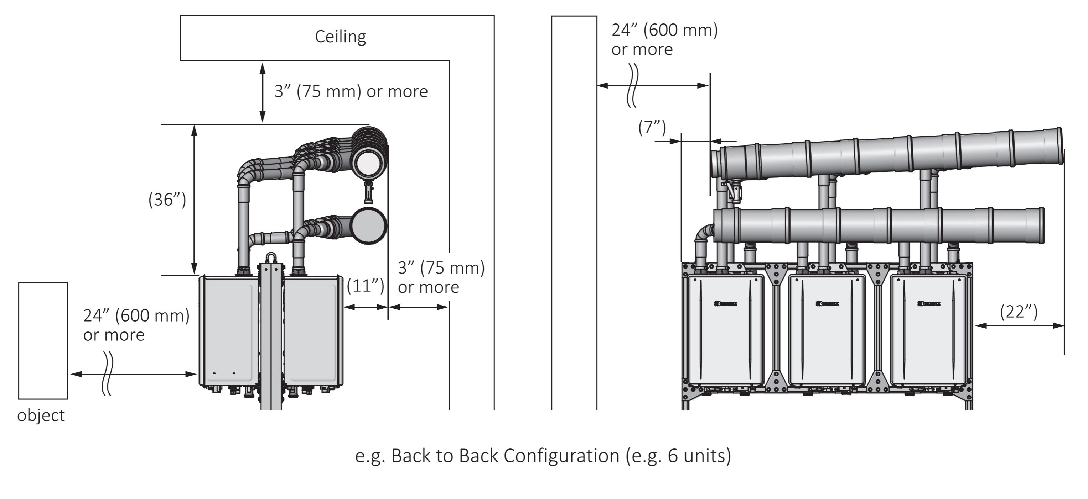
COMMON VENT EXAMPLES
6 Unit back to back PP DV
Allow appropriate space to maintain service clearances for equipment and vent system.

Slide 12
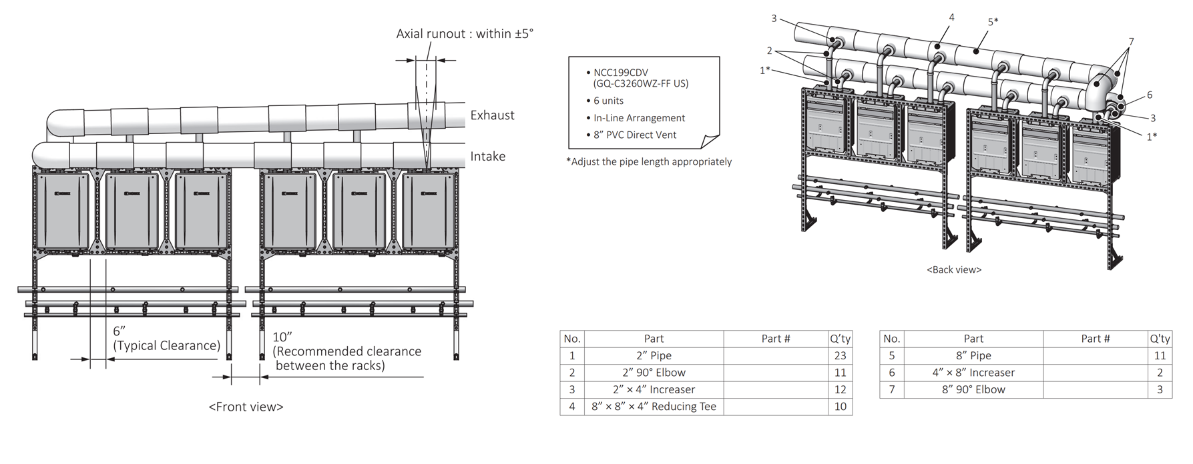
COMMON VENT EXAMPLES
6 Units in a line PVC DV
Exhaust & Intake branch / Manifold vent pieces itemized for easy reference.

Slide 13
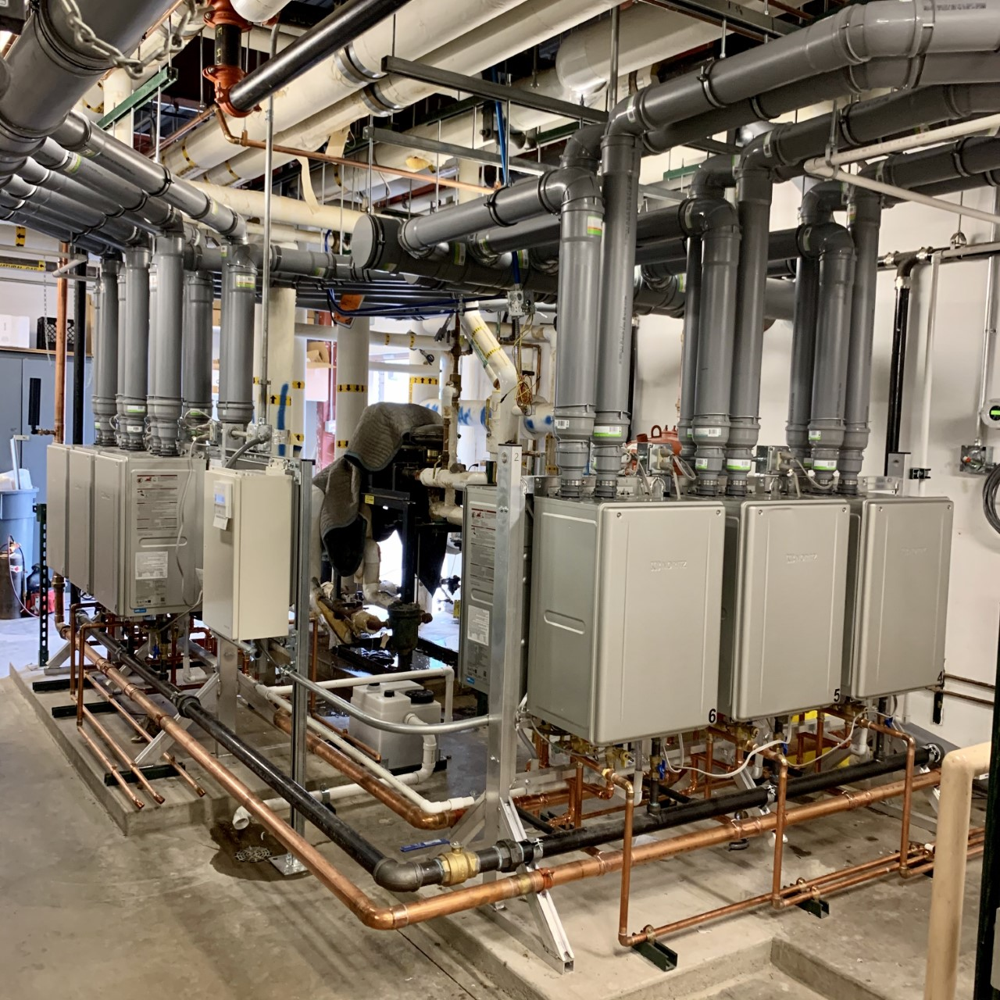
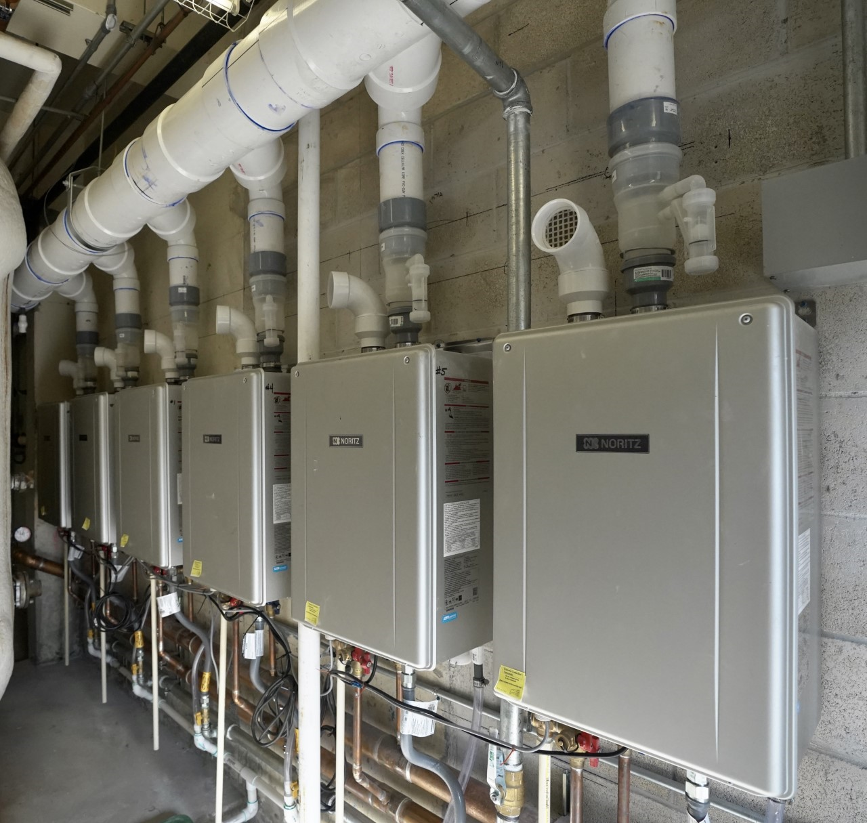
INSTALLATION EXAMPLES
Back to back config. 2x CR60-FS-6-NG
2.4 MBtuh input.
In line config. Field installed 6x NCC199CDV
1.2 MBtuh input.

Slide 14
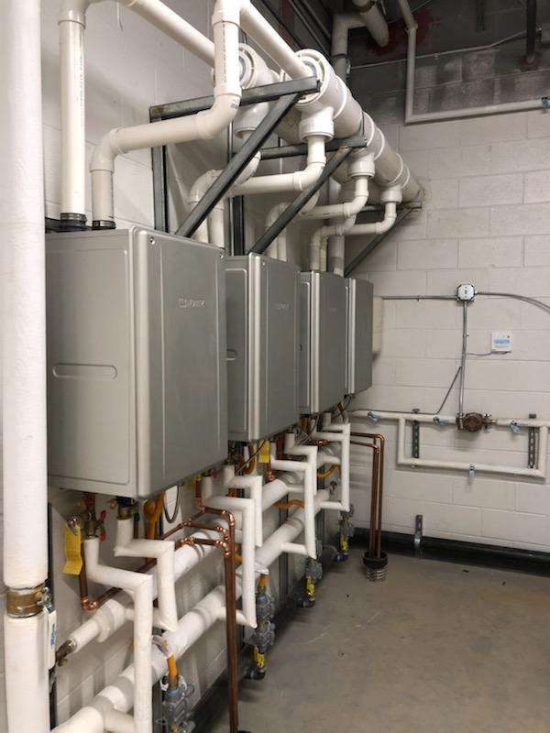
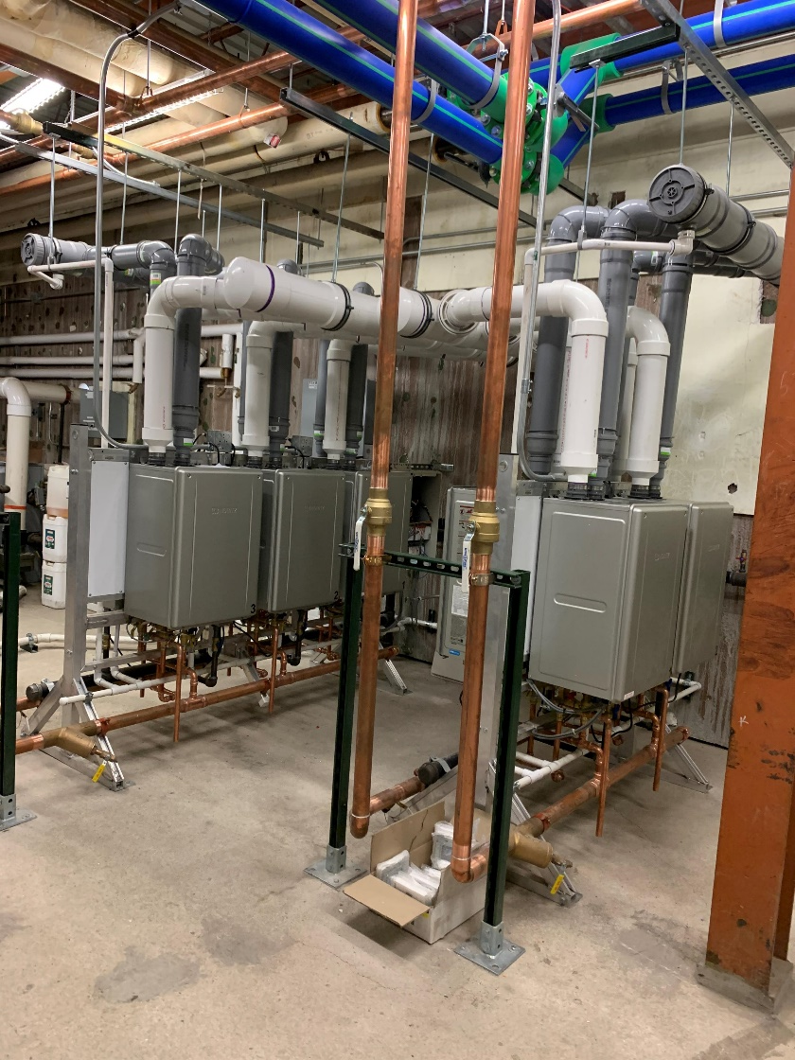
INSTALLATION EXAMPLES

Slide 15
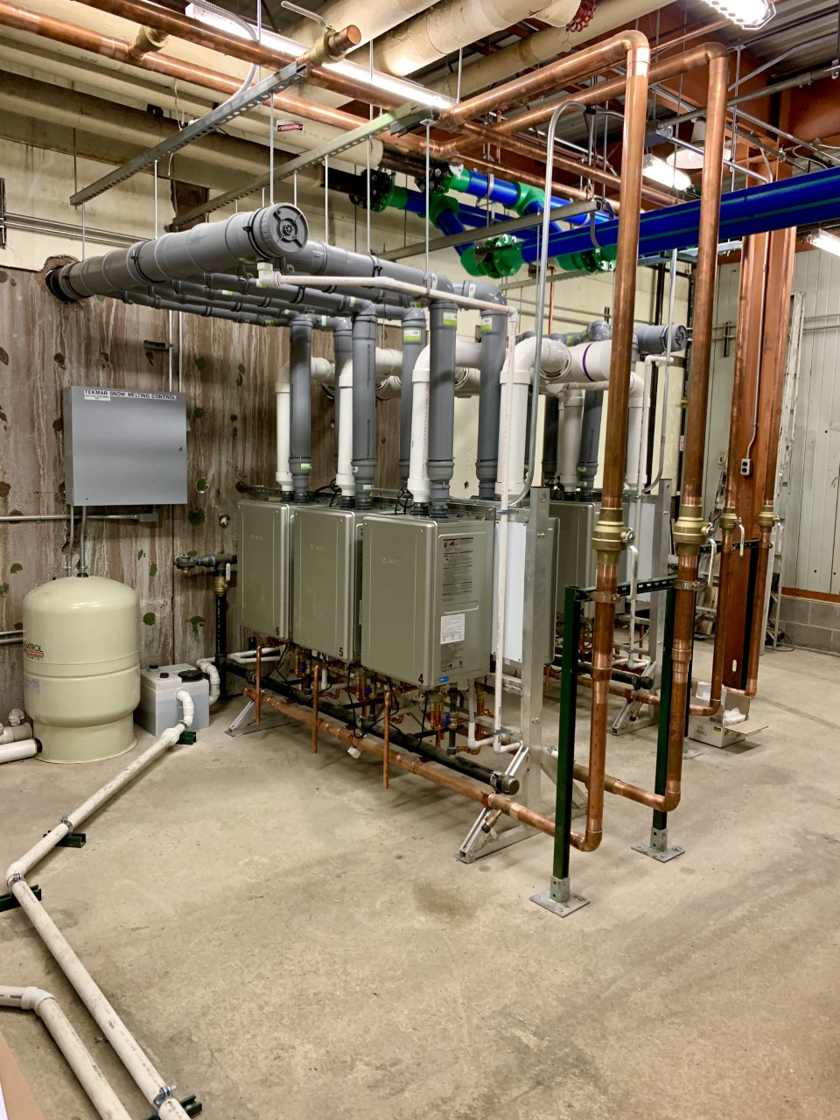
INSTALLATION EXAMPLES
1x CR60-FS-6-NG & 1x CR60-FS-4-NG.
Back to back configuration.
Intake solid core Schedule 40 PVC. Exhaust Centrotherm Polypropylene.

Slide 16

COMMERCIAL CONSULTATION
Have a question on specs, sizing or how you can build Noritz into your next project? Talk to our commercial experts directly.
Commercial@Noritz.com
Case Studies, Resources, Technical Documents, Sizing Calculator:
www.noritz.com/commercial

Slide 17

THANK YOU

