Slide 1
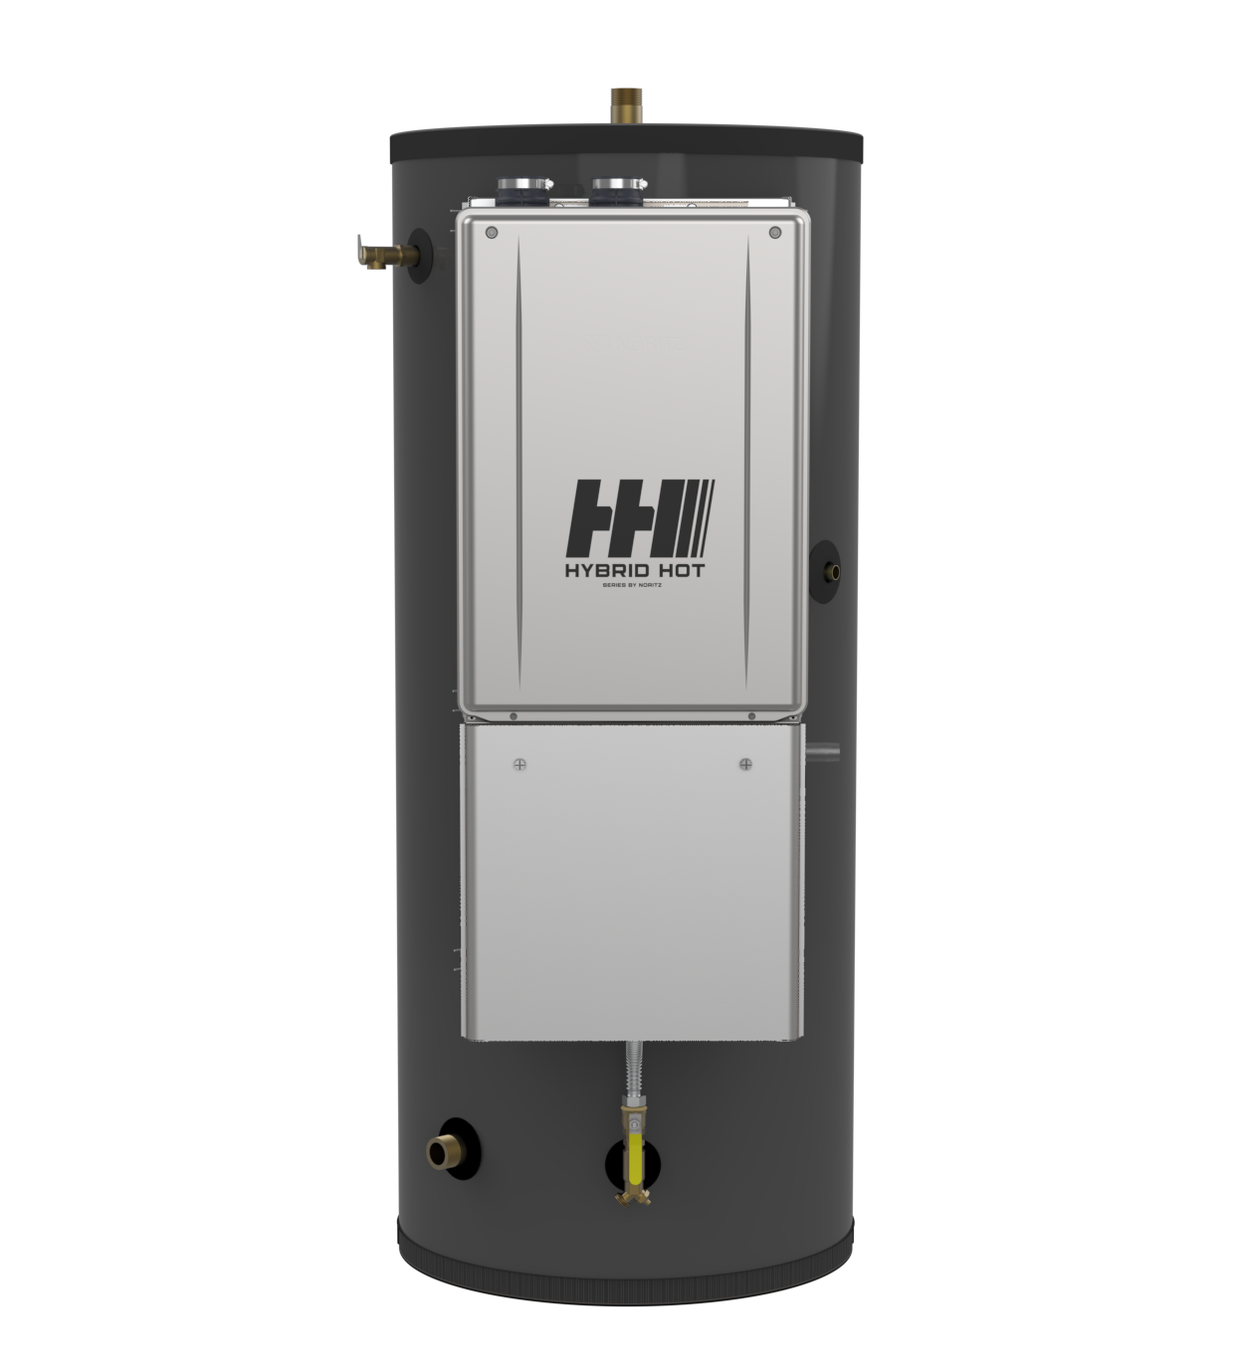

Slide 3
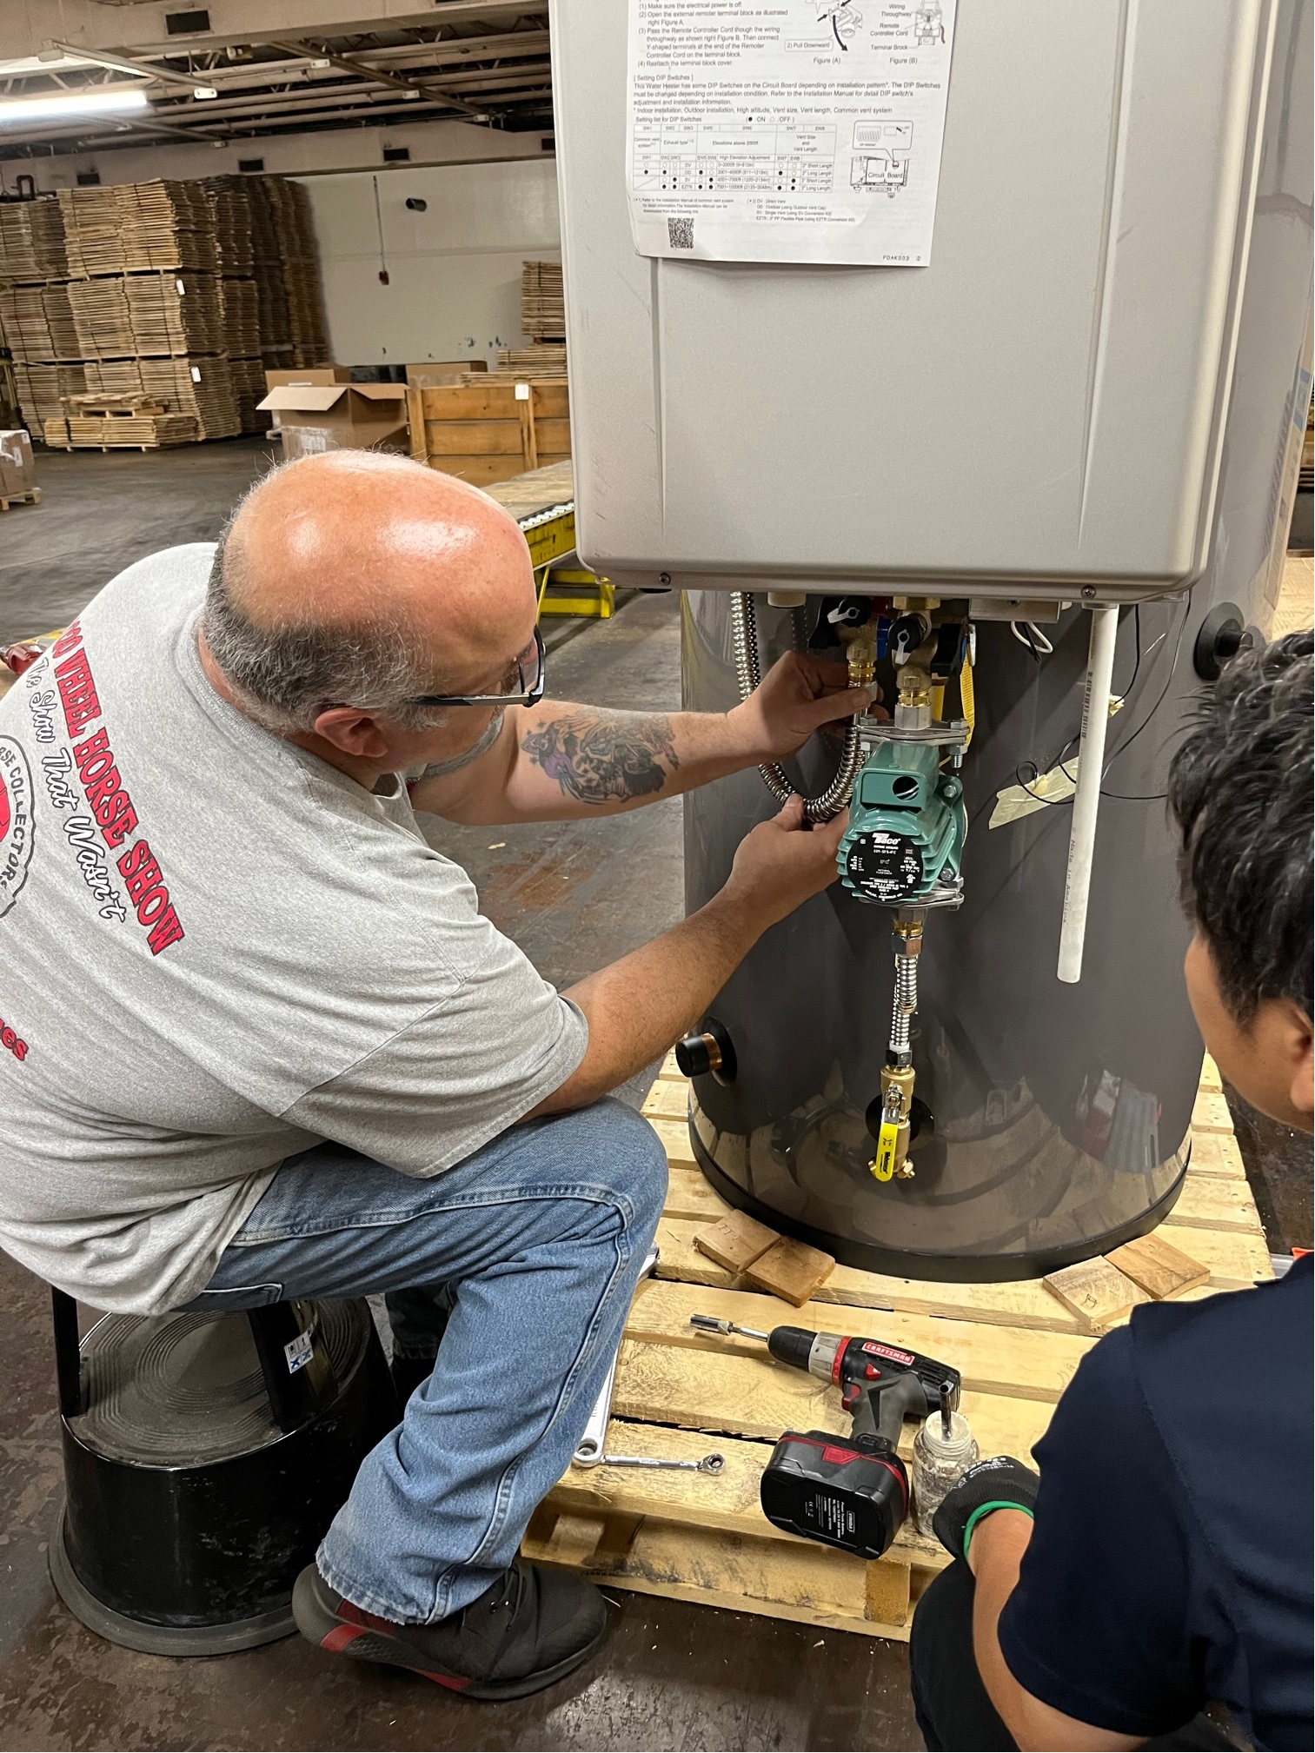
Assembled by PB
Assembled in Pennsylvania by Peerless Boilers

Slide 4
Hybrid Hot
Features and Benefits
Specifications
Applications
Case Studies
Installation
Storage tank requirements
Tankless requirements
Single vs Multi unit installation
Operation
Single and multi unit operation
Vs system controller storage tank setting
Service and Maintenance
Error Codes and Lukewarm water

Slide 5
Tankless & Storage

Slide 6
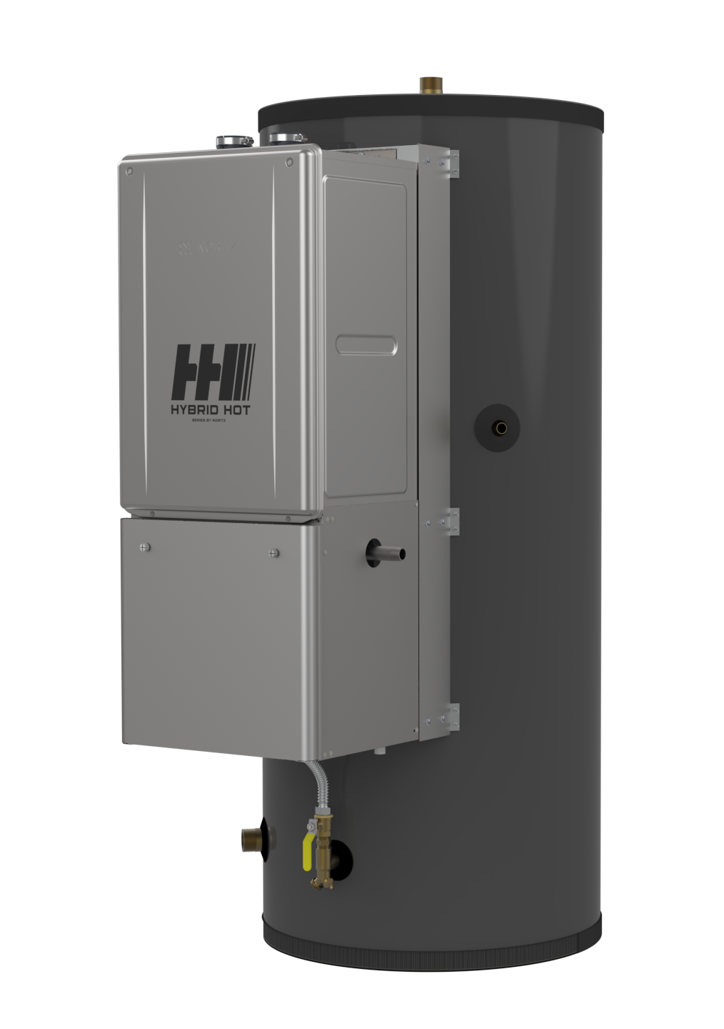
Hybrid Hot
1-½” NPT Hot Outlet
¾” NPT Recirc Return
¾” Gas
1-½” NPT Cold Supply
¾” NPT Combo Drain and
Cold Inlet to Tankless

Slide 7
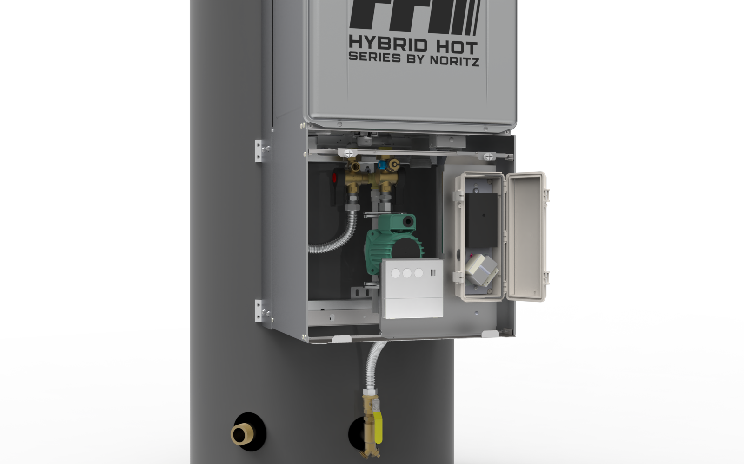
Parts
Error Indicator Light
Pump Controller
Transformer
Remote Controller

Slide 8
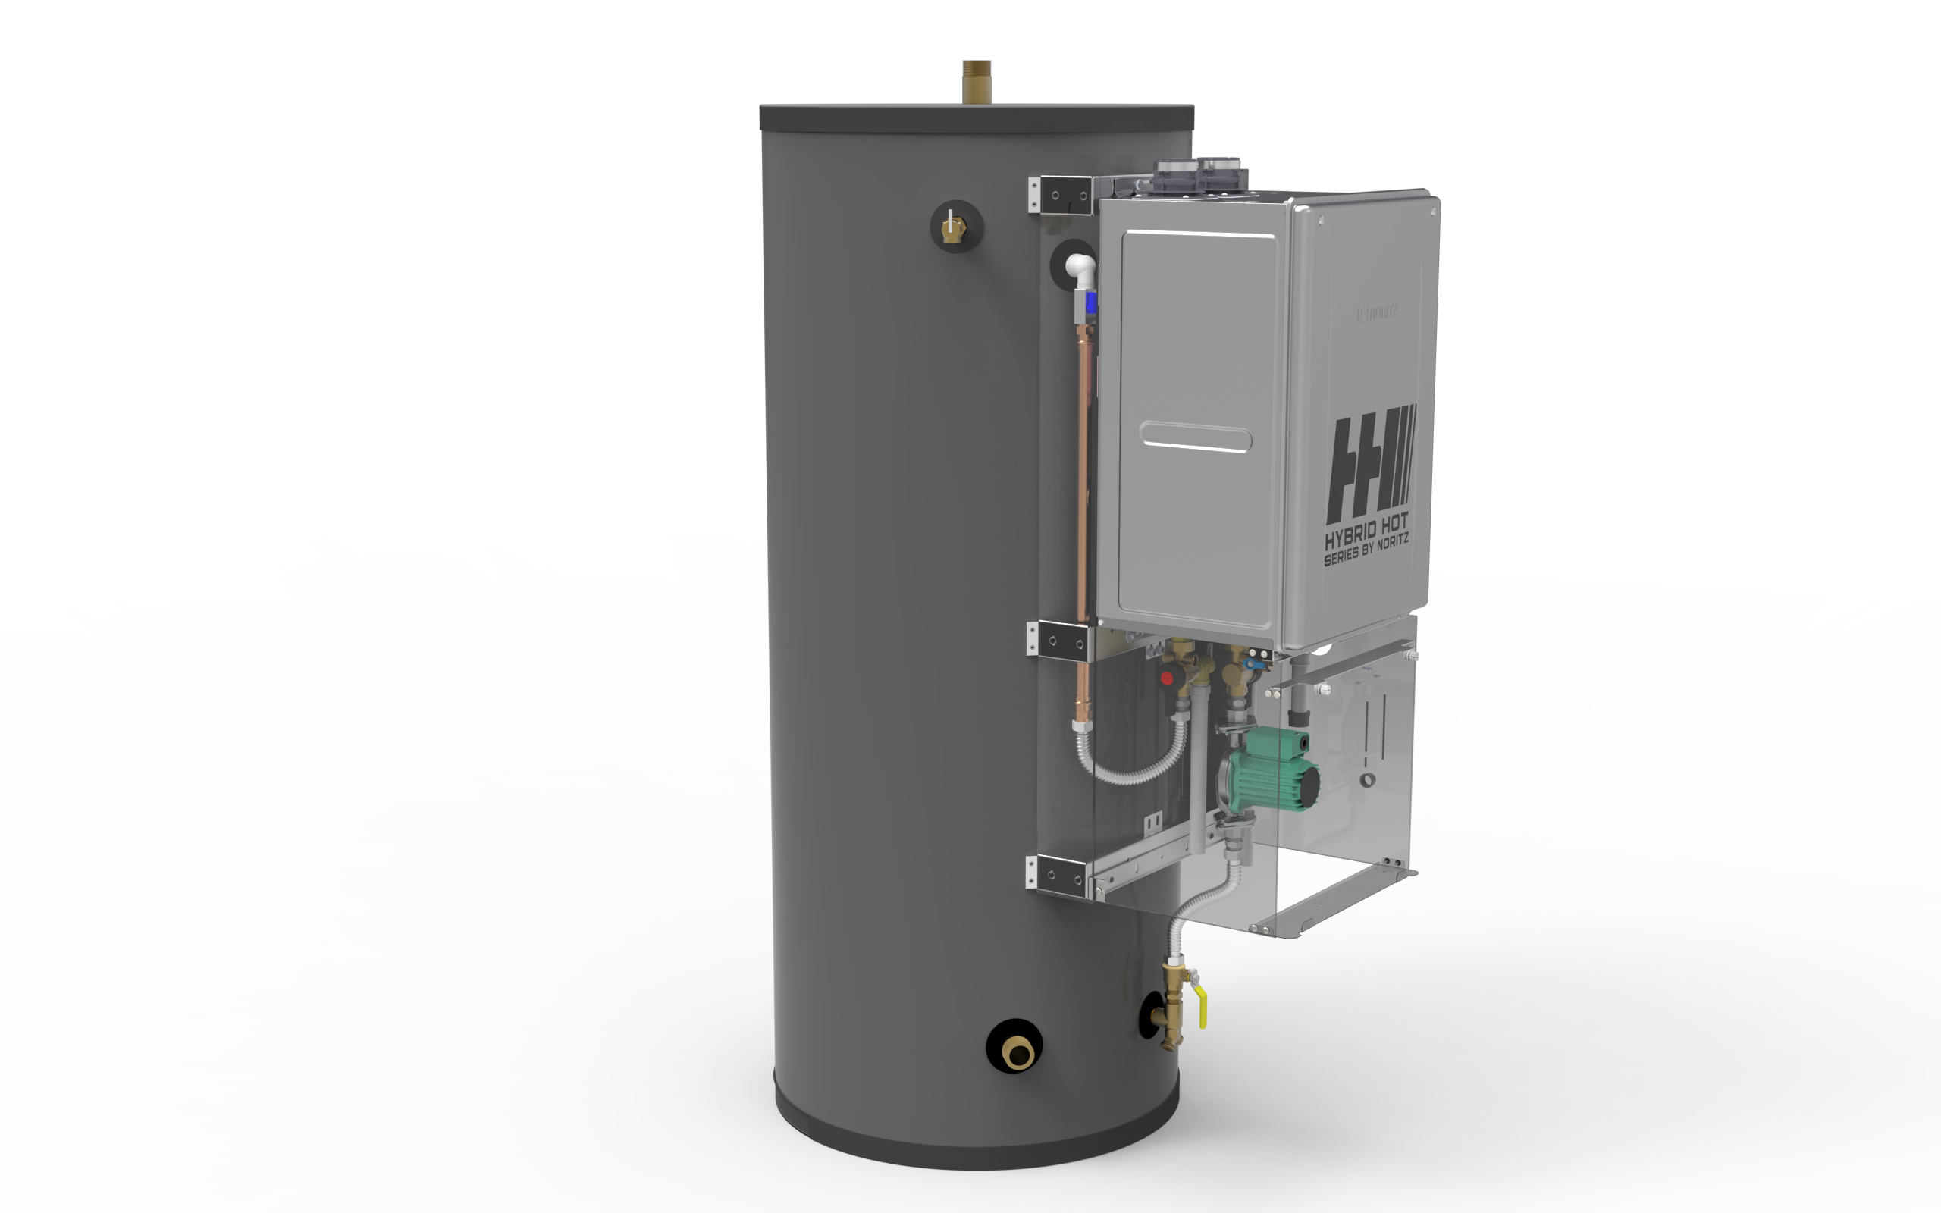
Parts
Tank Outlet Port
T&P Relief Valve
Hot Water Line
Pump
Cold Water Line
Tank Inlet Port

Slide 9
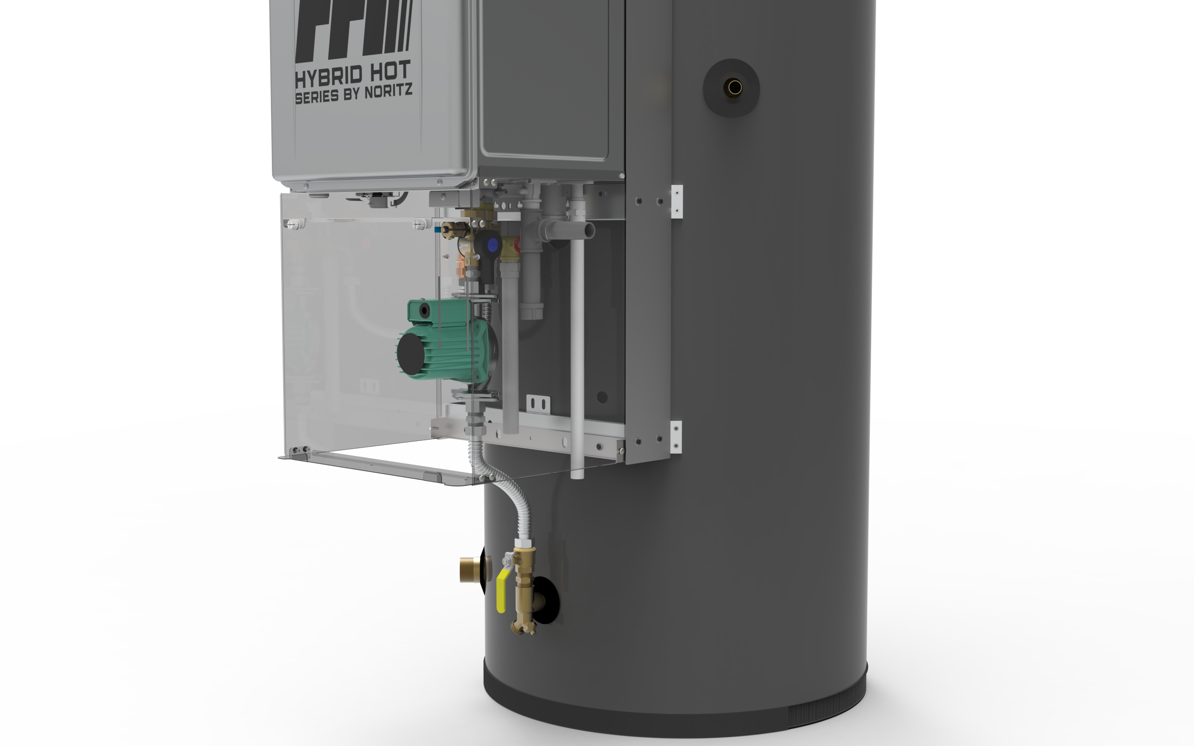
Parts
Recirc Port
Gas Port
Condensate Drain Port
Thermistor
Thermistor is on the tank surface
Drain Port

Slide 10
Features & Benefits
Storage tank mode without the system controller
All draws from storage tank, flow rates maximized through 1 ½” supply, no low pressure issues
Faster Hot water recovery and larger first hour rating because of larger pump and bypass
Warranty 10 Year TANK / 10 Year TANKLESS
Removing the heat engine from a storage tank extends the life of both the tank and tankless
Can be isolated from each other for service

Slide 11
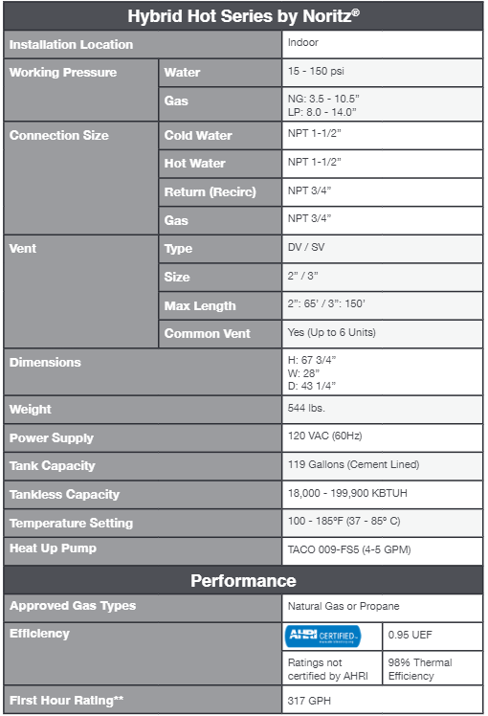
Specifications
10 years or 12000 combustion hours

Slide 12
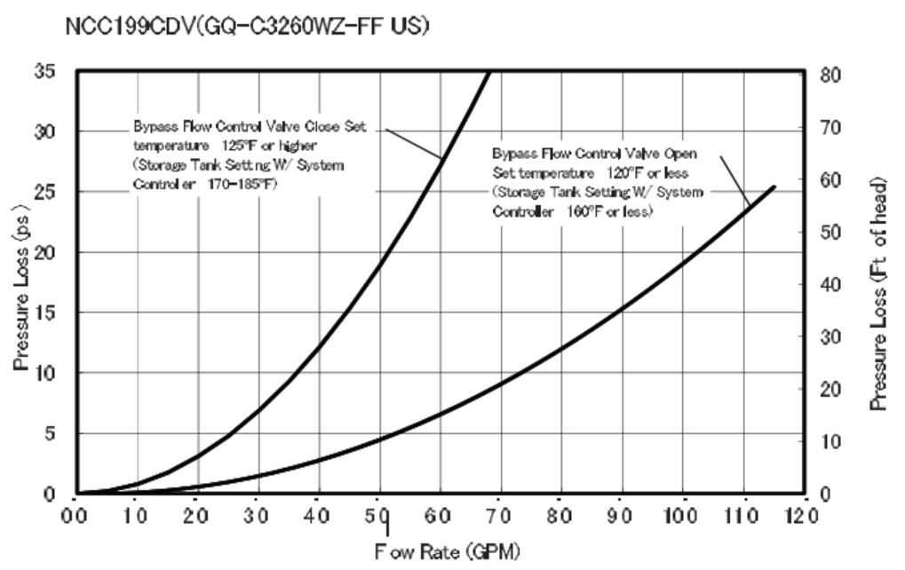
Recovery Rate
Btu/hr = 500 * gpm * (Th-Tc)
Recovery GPH temperature rise (GPH)
Tank (Gallon) | °F | 30 °F | 40 °F | 50 °F | 60 °F | 70 °F | 80 °F | 90 °F | 100 °F | 110 °F | 120 °F | 130 °F | 140 °F
 | ℃ | 17 ℃ | 22 ℃ | 28 ℃ | 33 ℃ | 39 ℃ | 44 ℃ | 50 ℃ | 56 ℃ | 61 ℃ | 67 ℃ | 72 ℃ | 78 ℃
119 | GPH | 784 | 588 | 470 | 392 | 336 | 294 | 261 | 235 | 214 | 196 | 181 | 168
 | LPH | 2,966 | 2,225 | 1,780 | 1,483 | 1,271 | 1,112 | 989 | 890 | 809 | 742 | 685 | 636

Slide 13
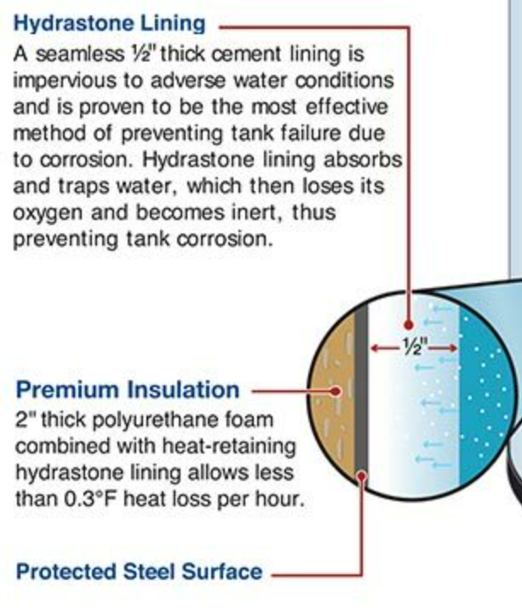
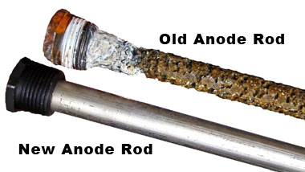
Cement Lined Tank vs Glass Lined Tank
0.005” Glass line storage tanks require an anode rod to attract the corrosive minerals that attack the water heater.
images provided by vaughncorp.com and anyhourservices.com

Slide 14
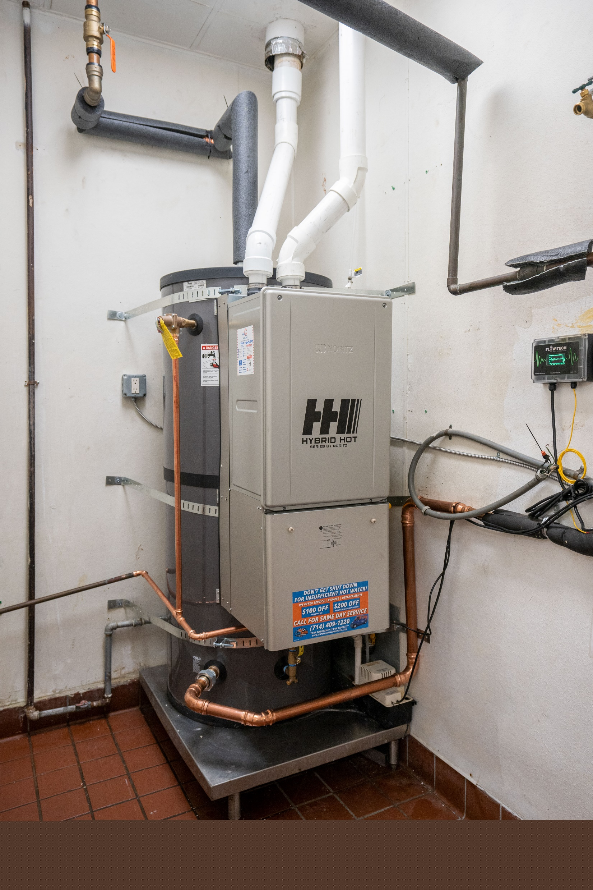
Applications
Best used in short periods of high demand applications but applicable in any kind of commercial application.
Commercial dish machines
Laundromats
Case studies being conducted in Santa Paula Middle School and Rowland Heights Boiling Crab

Slide 15
1-½” NPT Hot Outlet
Installation
¾” NPT Recirc Return
Where does the expansion tank go?
¾” Gas
1-½” NPT Cold Supply
½” Condensate
¾” NPT Combo Drain and
Cold Inlet to Tankless

Slide 16
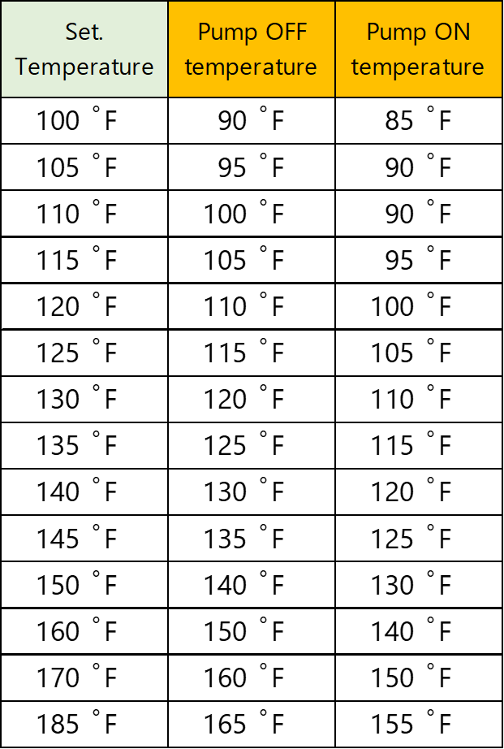
Operation
Notes:
Cold water continually fills until the capacity of the tank is met.
The pump circulates the cold water at the bottom of the tank back through the tankless water heater to its desired temperature
Water gets heated up to desired temperature and ejected through an elephant nose pipe at the top of the tank causes hot water to rain down into the tank; closer to the top of the water level where the hot outlet is.
If recirculation is employed, it is returned to the center of the tank.
Once tank is at temperature and capacity, the tankless will shutdown

Slide 17
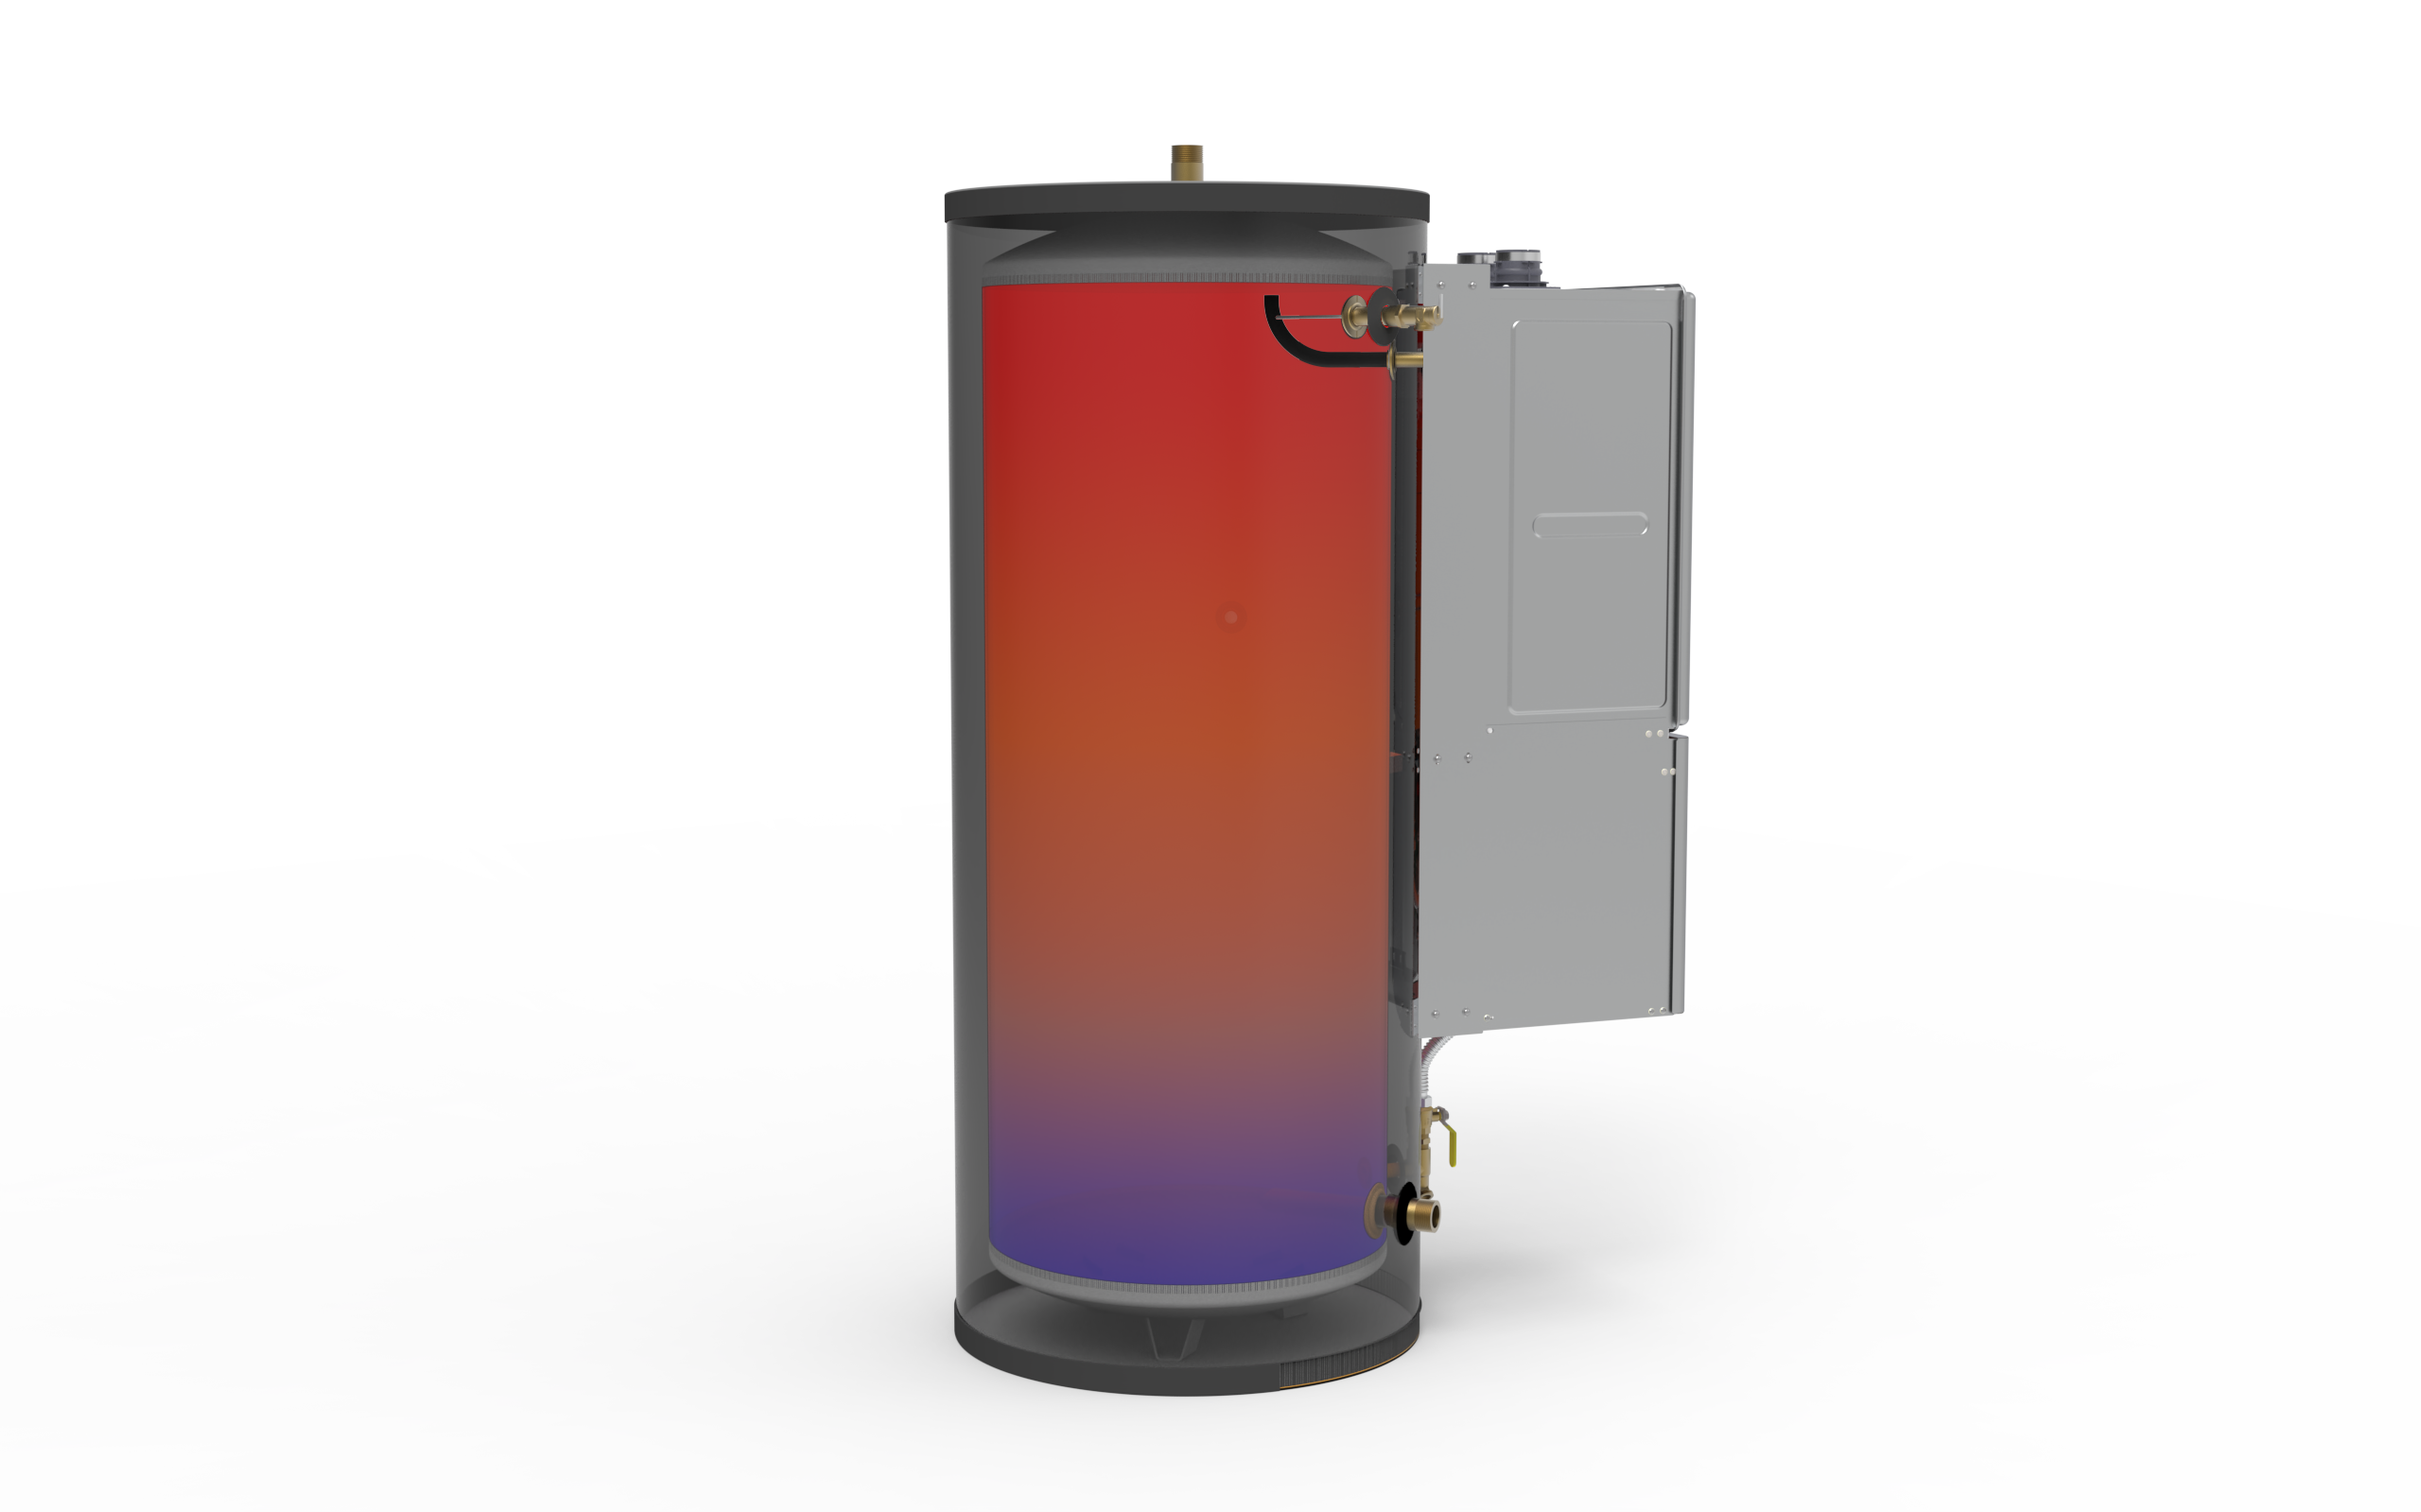
Stratification of heated water
Elephant Nose Pipe
Water connection locations help to stratify the water temperatures in the tank keeping the upper tank full of hot water. Provides the best energy efficient supply of hot water.

Slide 18
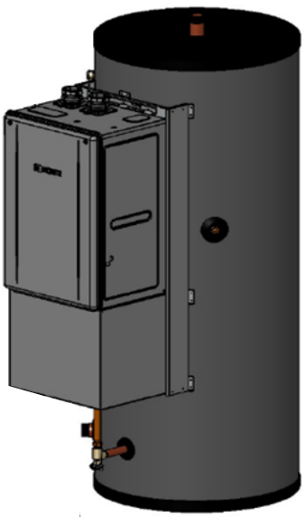
Multiple Hybrid Hot
Common vent up to 6 units with system controller
Which system controller setting?
Multi unit systems require pressure balancing of plumbing
VS storage tank mode setting on system controller, requires one large system pump to push the flow through the heaters to fire all at once

Slide 19
Service and Maintenance
The tankless unit only cares about refilling the storage tank: that is it's primary operation
The tankless can be isolated from the tank to provide hot water while the tankless is serviced.
The tankless is taking the water from the bottom of the tank so hard water sediment can accumulate at the inlet filter screen assembly.
The tank should be flushed of hard water buildup periodically.

Slide 20
Parts
Parts will be available from Noritz
Pump
Controls
Iso valves
Gaskets

Slide 21
Warranty Registration
Tankless serial number is used to registration
Registration is done via PROCard or Noritz Warranty site
The system recognizes the tankless is attached to a Hybrid Hot

Slide 22
QA
Questions?

