Slide 1
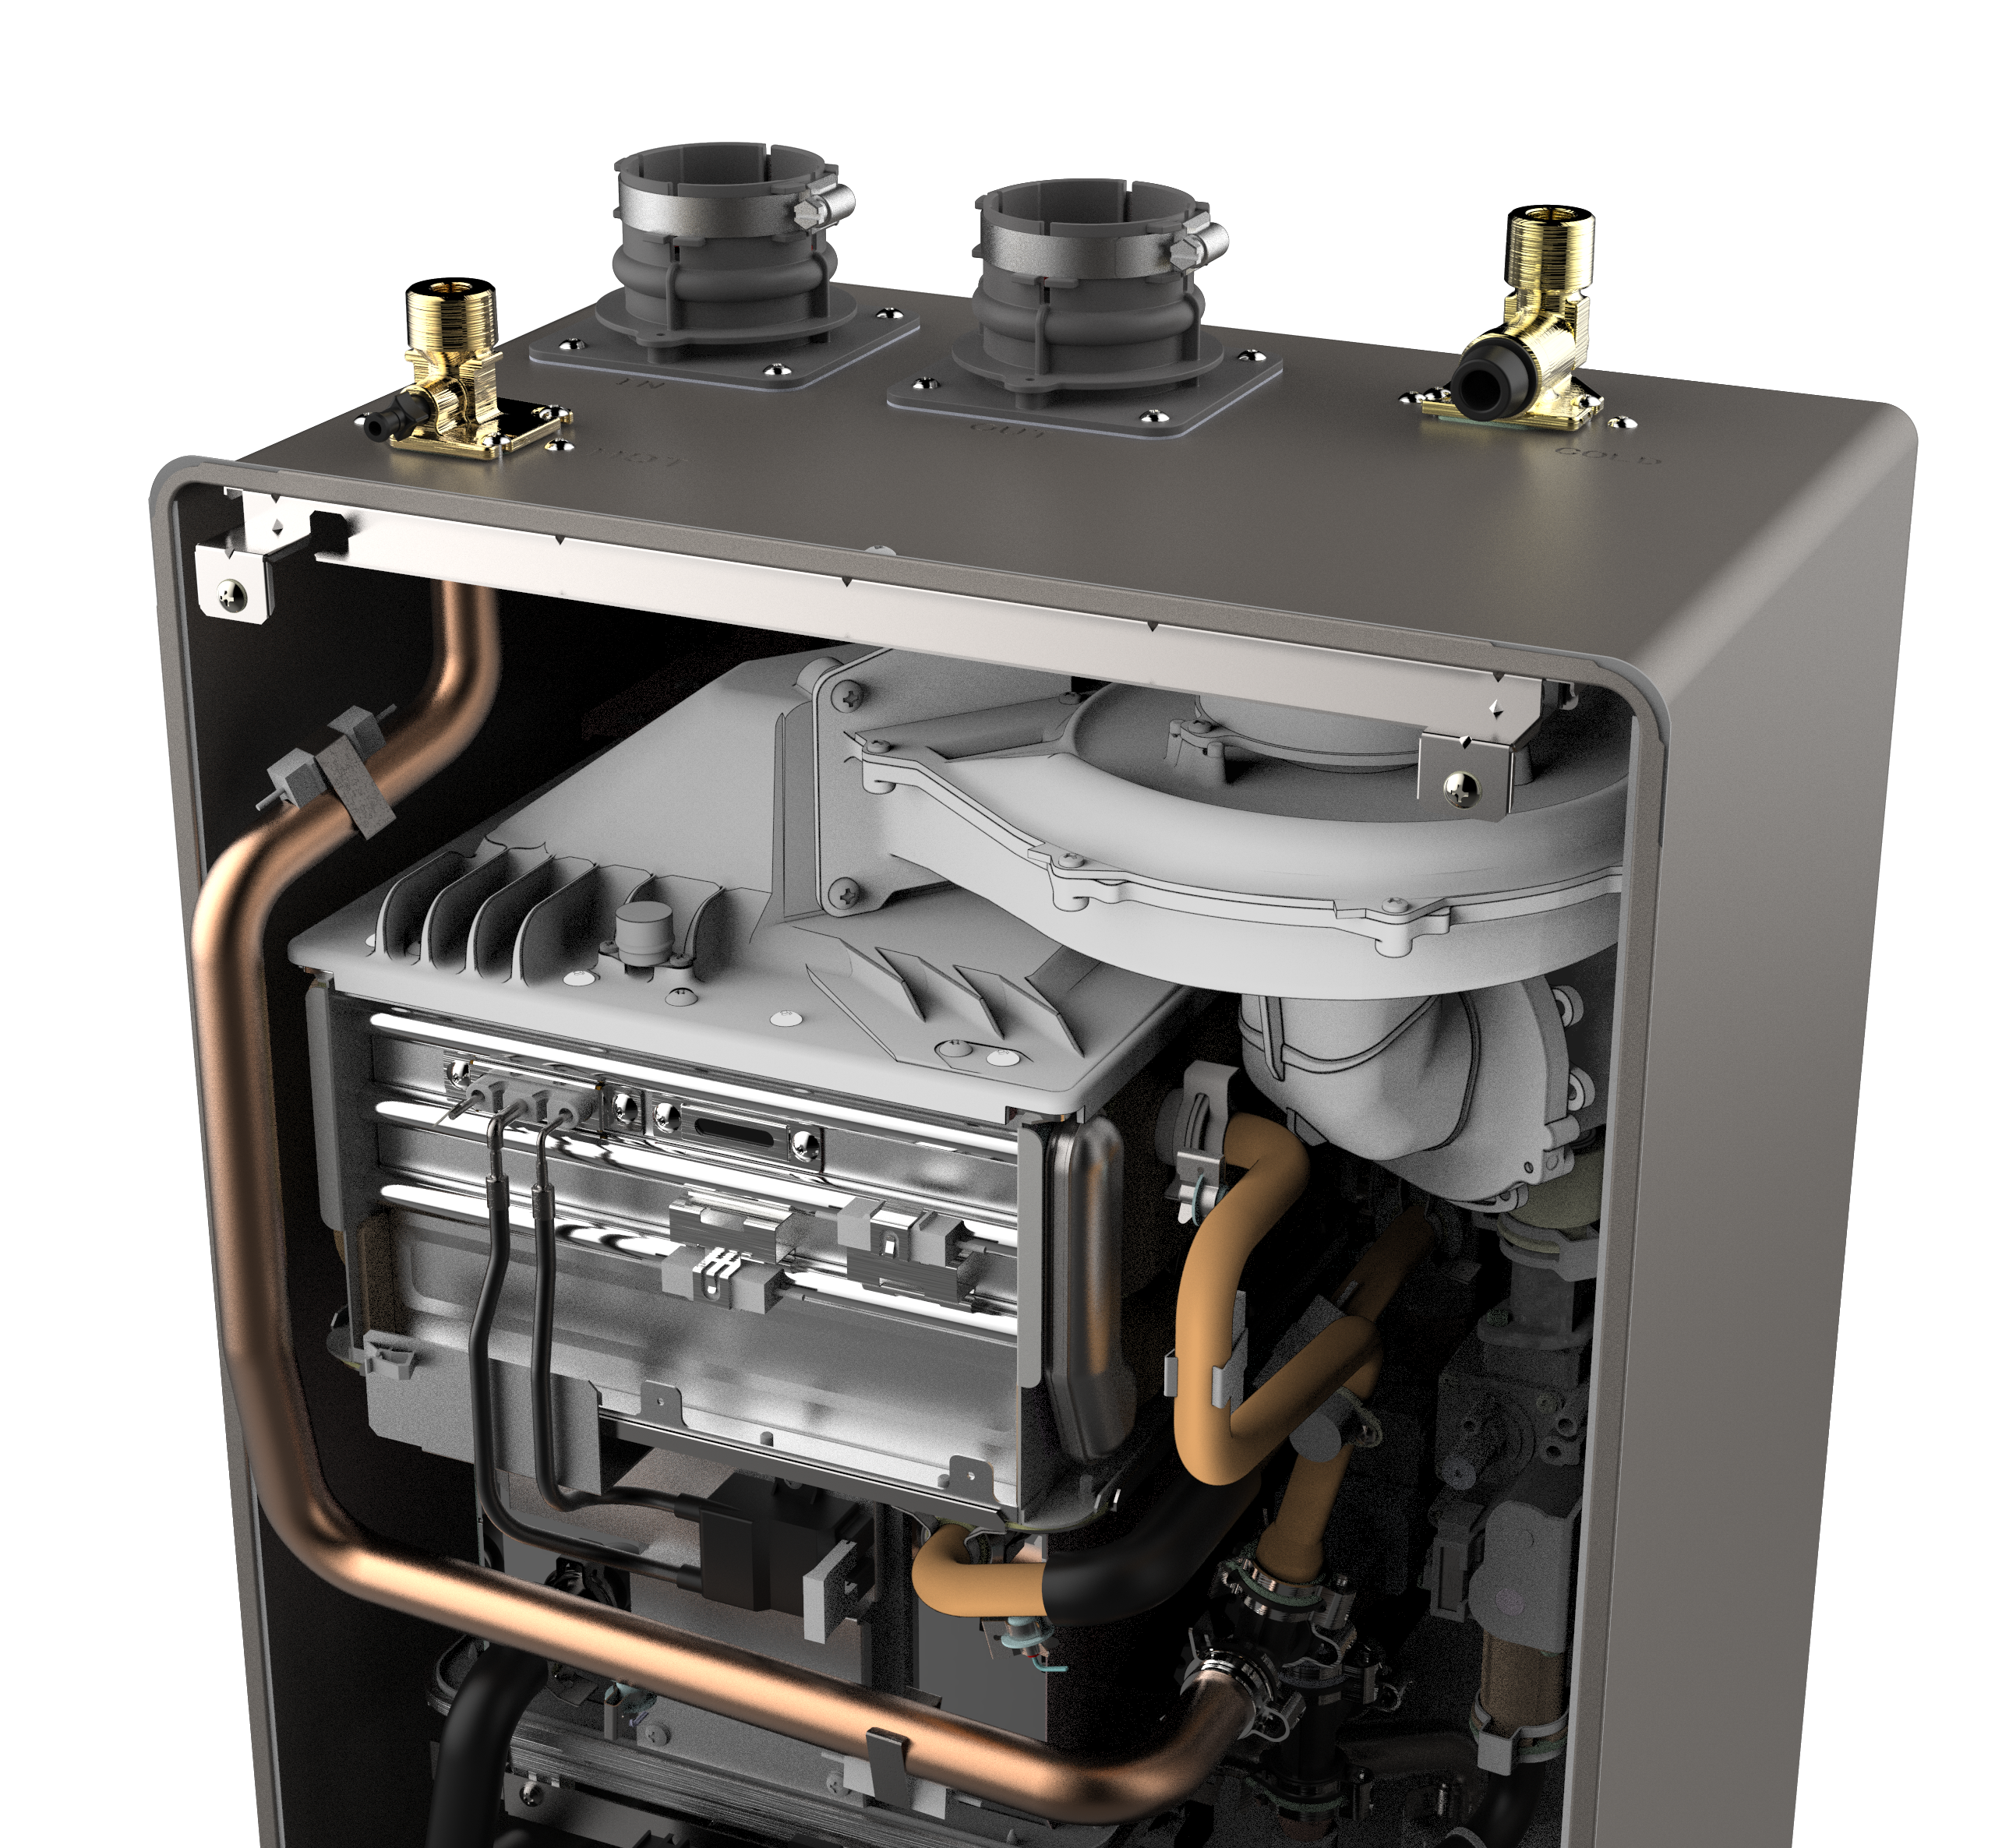
HOW TO SIZE A TANKLESS
(It’s easier than you think!)

Slide 2
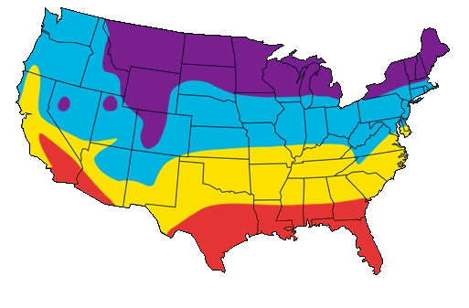
STEP ONE
Determine your maximum temperature rise. This is the difference between the tankless set temp. and the winter time ground water temp.
For the purpose of this example let’s say the home is on the central coast of California.
Based on the map, we’ll say the winter ground water temp is 55 F.
Now you can determine the winter time temperature rise:
120 Set Temp
– 55 Ground Water Temp
= 65
Average Winter Water Temp:
35° - 40° F
45° - 50° F
55° - 60° F
65° - 70°+ F

Slide 3
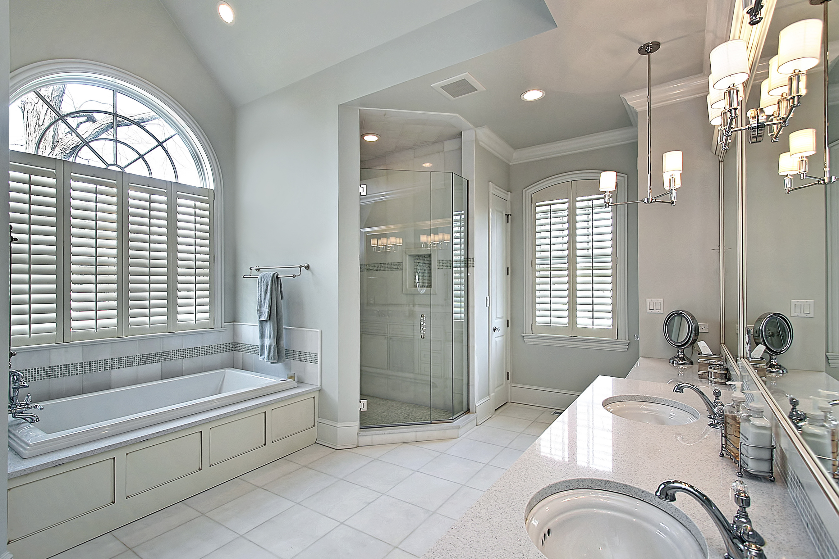
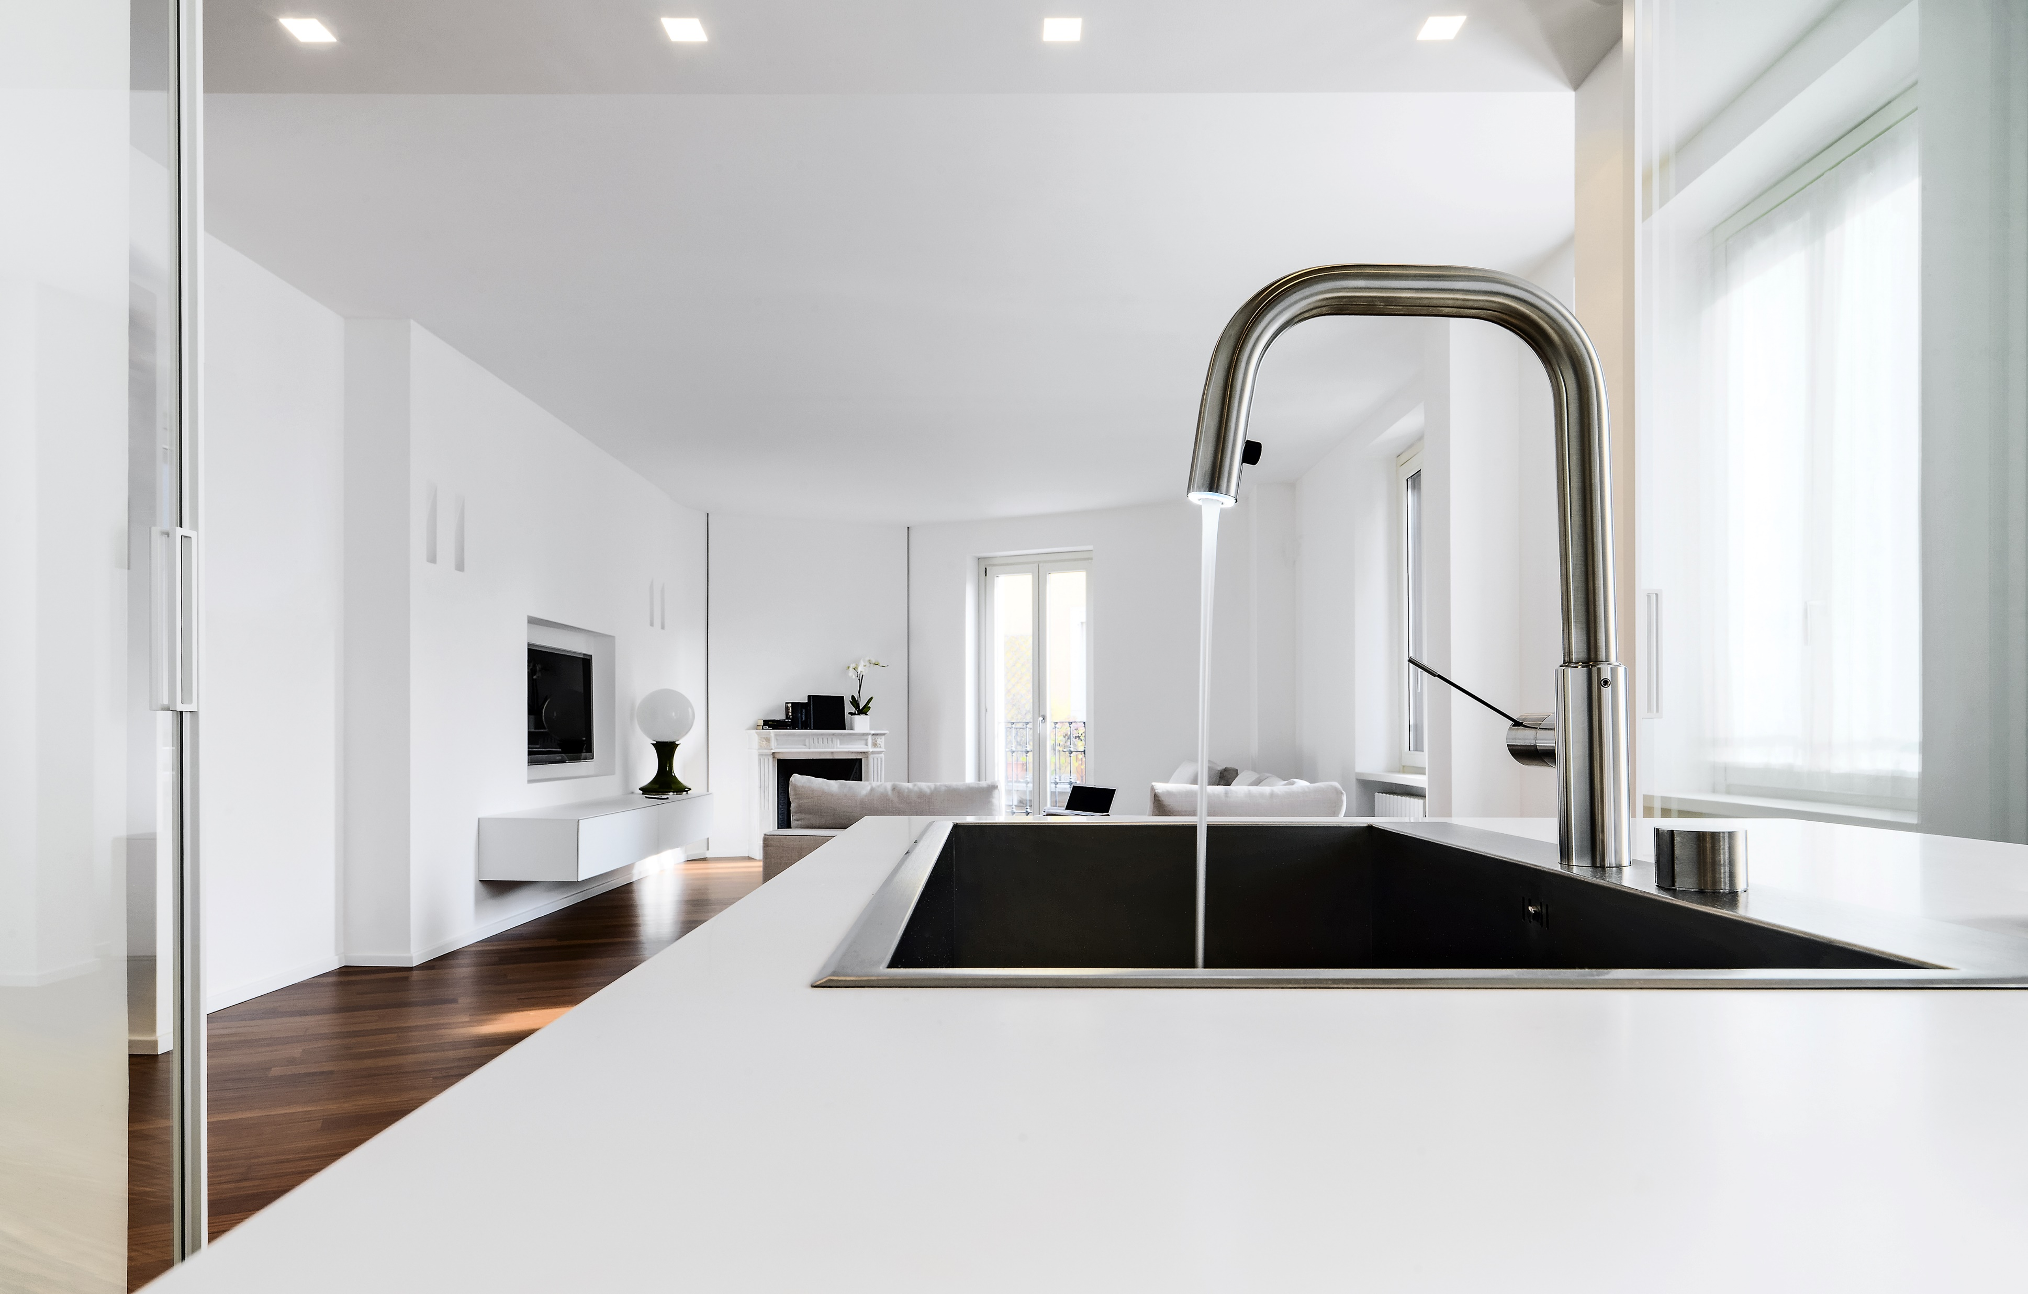
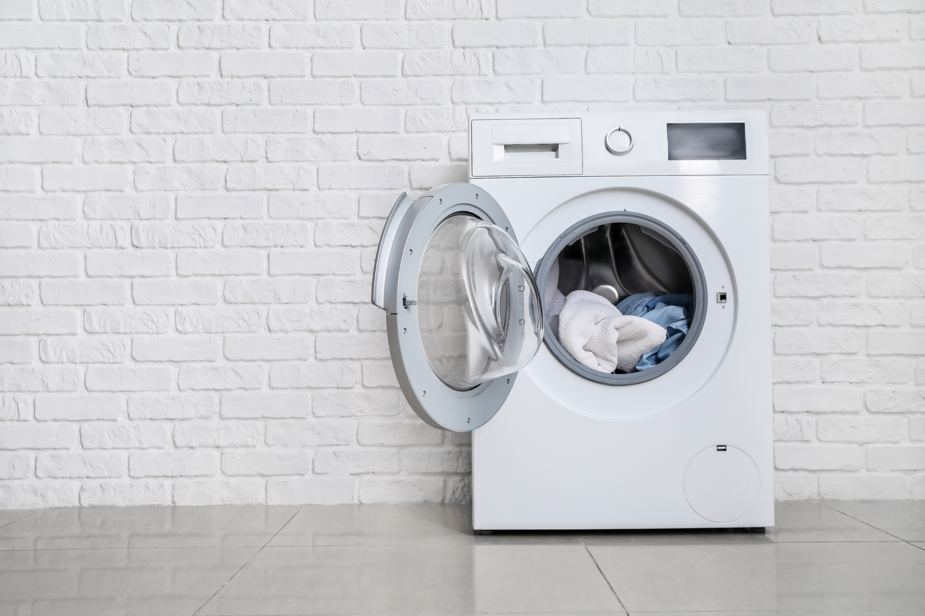
STEP TWO
Determine the peak hot water demand of the home. If possible, ask the homeowner.
Fixtures and appliances all have different flow rates depending on manufacturer however you can use an average amount to get a ballpark figure:
Shower: 2 gpm
Lav Sink: 1 gpm
Kitchen Sink: 1.5 gpm
Dishwasher: 2 gpm
Washing Machine: 2 gpm
Example 1:
Peak usage: 2 Showers & Washing Machine = 6 gpm
Example 2:
Peak usage: 4 Showers & Dish Washer = 10 gpm

Slide 4
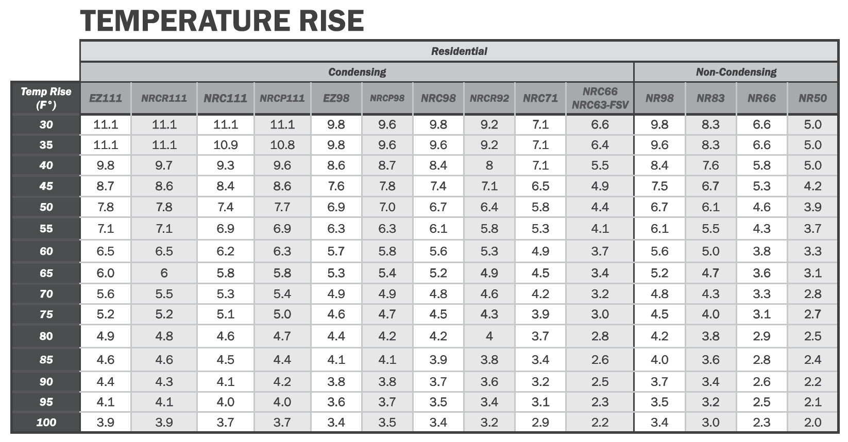
STEP THREE
Select the proper unit or pair of units using the sizing chart found online or in the product catalog.
Simply find the Temperature Rise on the left then match up a unit or pair of units that provides the approximate flow rate needed.
Temp Rise: 65
Example 1:
Peak usage: 2 Showers & Washing Machine = 6 gpm
Ideal Models:
EZ111, NRCR111, NRC111, NRCP111
Example 2:
Peak usage: 4 Showers & Dish Washer = 10 gpm
Ideal Models:
Pair of EZ98, NRC98, NRCR92, NRCP98, NR98

Slide 5
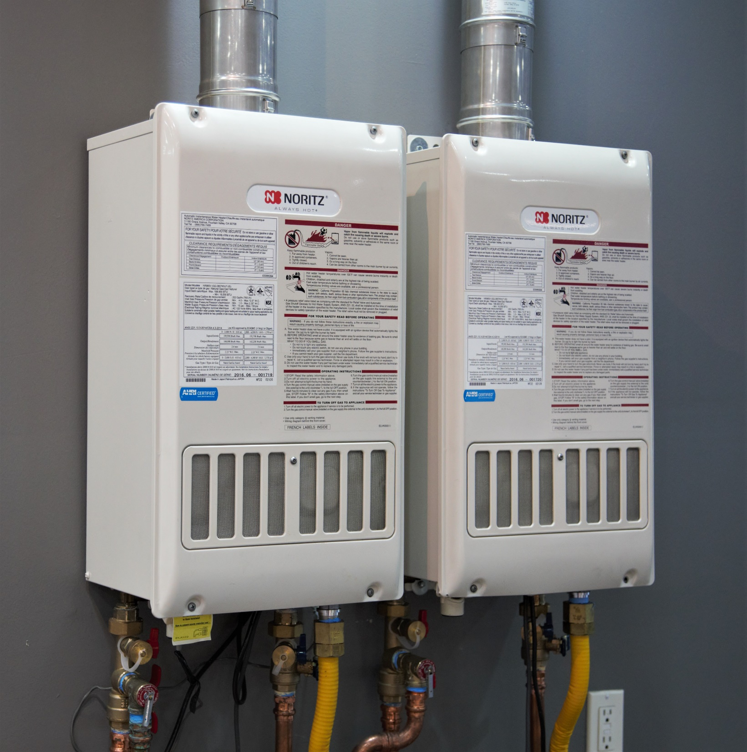
FINAL TIP:
It’s always better to slightly oversize than to undersize.

